Slide 1
Precipitation Evaluation of the North Dakota Cloud Modification Project (NDCMP) using rain gauge and radar observations
Matt Tuftedal
Committee Meeting 10/16/2018

Slide 2
Importance of study
This project is an overall evaluation of the effectiveness of the NDCMP.
Results of this study can help determine the increase in rainfall due to the seeding in Western North Dakota, which in return can help determine the economic cost benefits of running the program.
The most recent similar study was last done in 2005 and found a 6-9% increase in rainfall (Wise 2005).

Slide 3
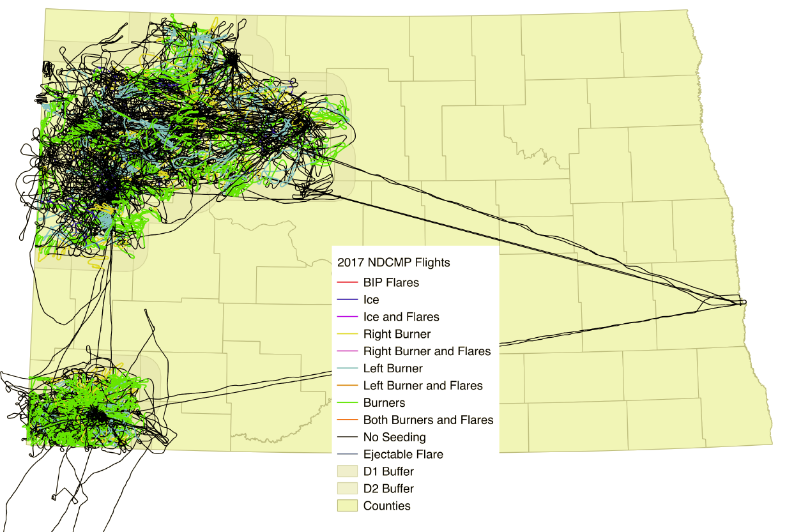
Project Background
NDCMP has ran a seeding operation in North Dakota for 41 years.
C-Band radars are located in Bowman and Stanley, ND.
Eight aircrafts have been used in recent years, with planes located in Bowman, McKenzie, Williams, Mountrail, and Ward County.
NDCMP Flight tracks for the entire length of 2017 field campaign.

Slide 4
Methodology
Weighing rain gauge within radius of influence
Single ratio test
Double ratio test
Radar derived rainfall totals compared to observed
    TITAN (depending on if it works)
    Uncertainty estimates

Slide 5
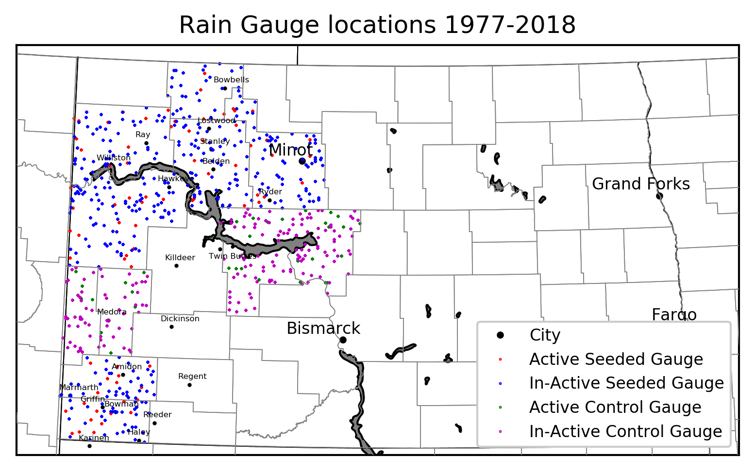

Slide 6
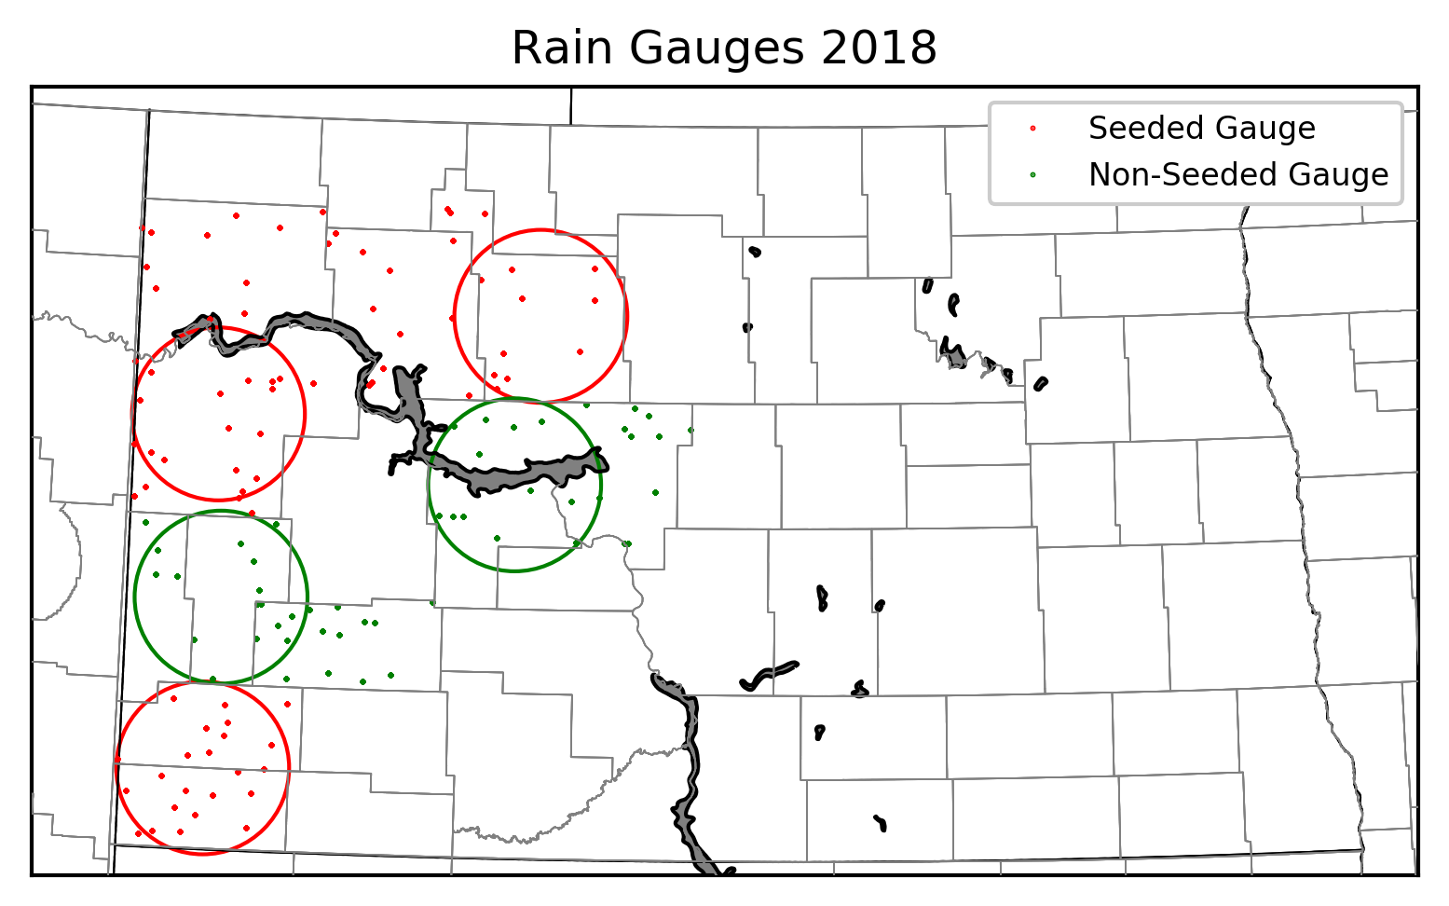
McKenzie Circle
Ward Circle
Mercer Circle
Billings Circle
Bowman Circle

Slide 7
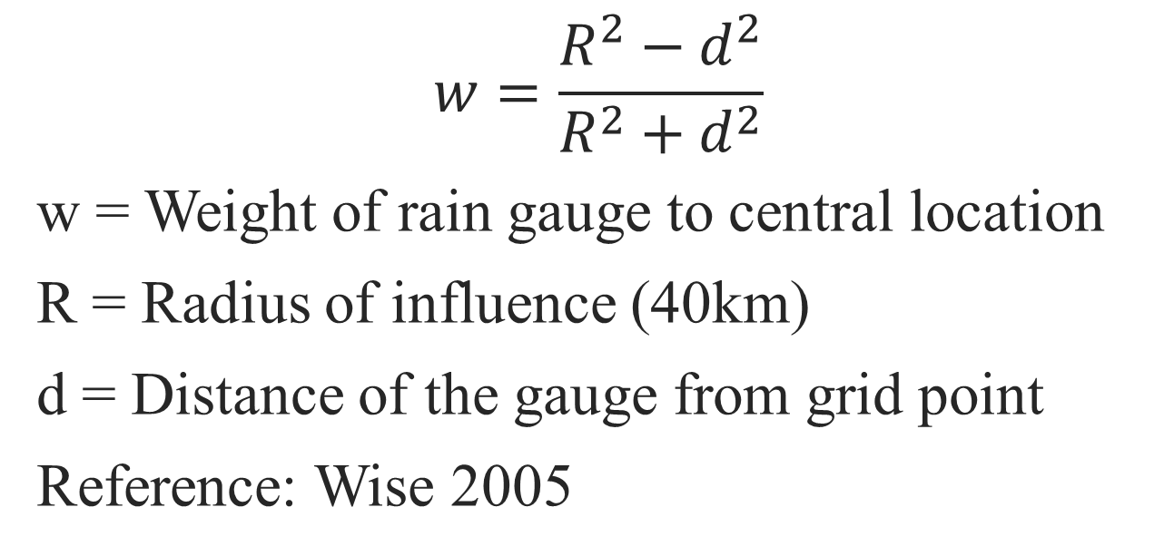
Weighted rain gauges
$$w=\frac{R^{2}−d^{2}}{R^{2}+d^{2}}$$
w = Weight of rain gauge to central location
R = Radius of influence (40km)
d = Distance of the gauge from grid point
Reference: Wise 2005

Slide 8
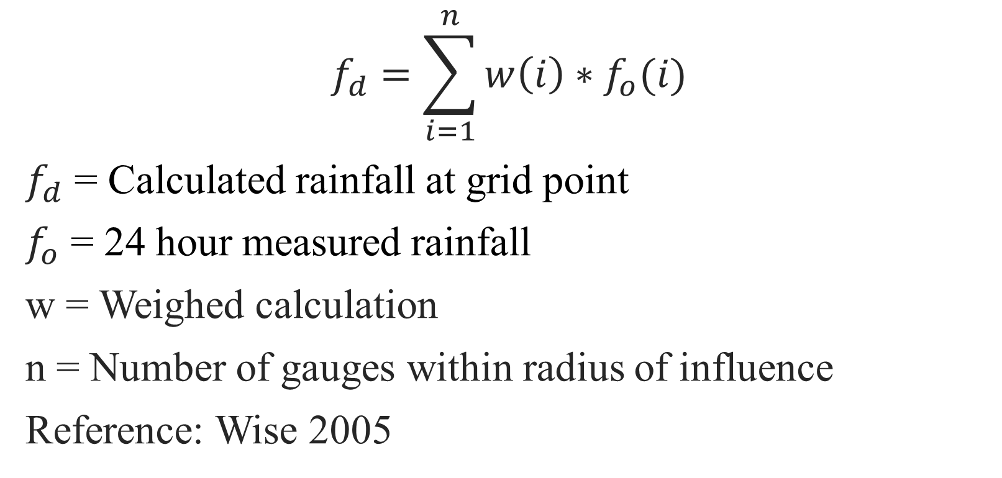
County Circle weighted rainfall amount
$$f_{d}=\sum_{i=1}^{n}{w\left(i\right)∗f_{o}(i)}$$
$f_{d}$ = Calculated rainfall at grid point
$f_{o}$ = 24 hour measured rainfall
w = Weighed calculation
n = Number of gauges within radius of influence
Reference: Wise 2005

Slide 9
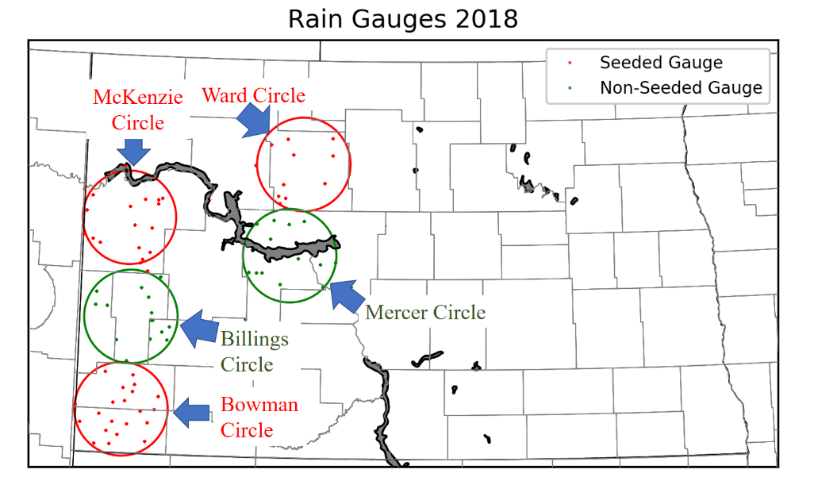
Statistical Tests
For the statistical tests, target and control regions will be used in calculated single and double ratios.
McKenzie and Bowman Circles (target) will be compared to Billings Circle (control).
Ward Circle (target) will be compared to Mercer Circle (control)

Slide 10
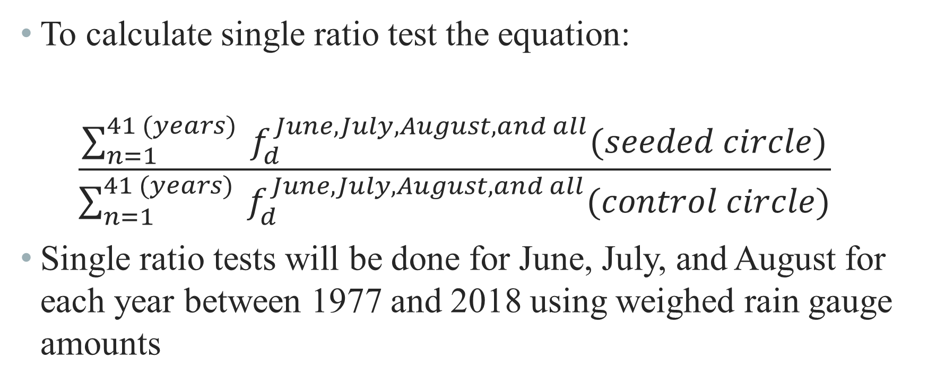
Single Ratio Test
To calculate single ratio test the equation:
    $$\frac{\sum_{n=1}^{41 (years)}{ f_{d}^{June, July, August, and all}(seeded circle)}}{\sum_{n=1}^{41 (years)}{ f_{d}^{June, July, August, and all}(control circle)}}$$
Single ratio tests will be done for June, July, and August for each year between 1977 and 2018 using weighed rain gauge amounts

Slide 11
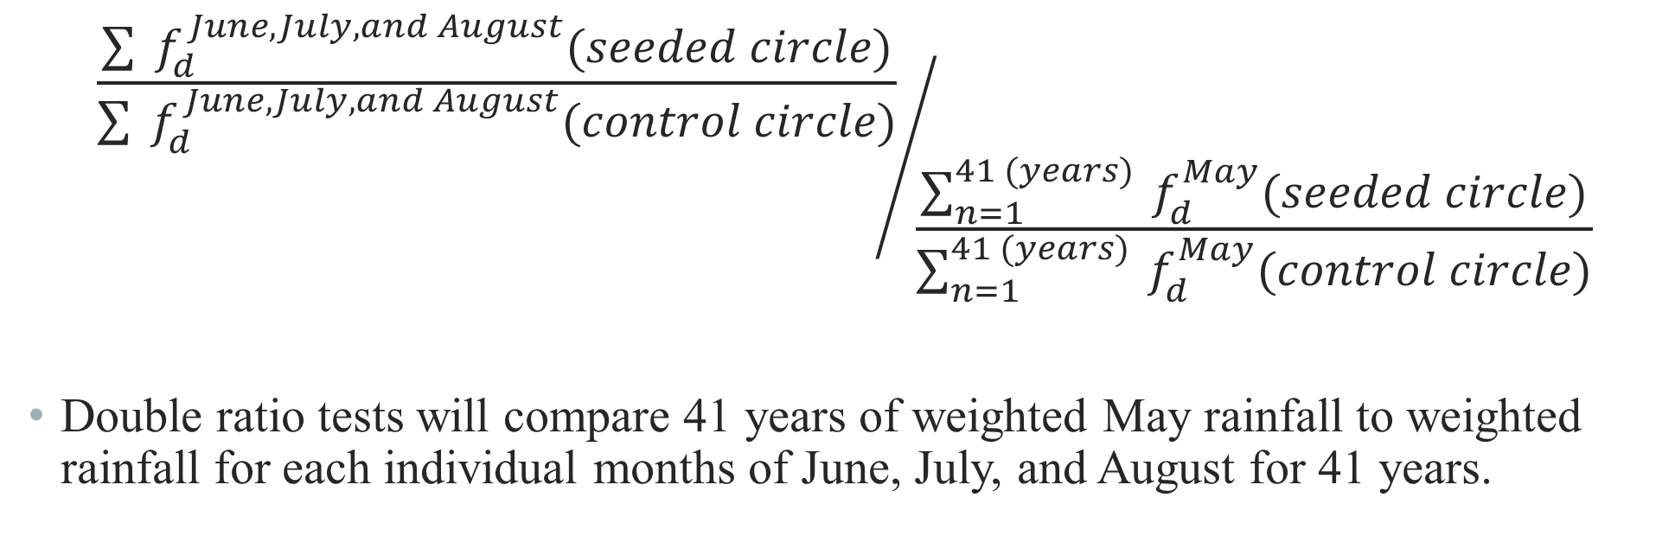
Double Ratio Test
$${\frac{\sum{ f_{d}^{June, July, and August}(seeded circle)}}{\sum{ f_{d}^{June, July, and August}(control circle)}}}/{\frac{\sum_{n=1}^{41 (years)}{ f_{d}^{May}(seeded circle)}}{\sum_{n=1}^{41 (years)}{ f_{d}^{May}(control circle)}}}$$
Double ratio tests will compare 41 years of weighted May rainfall to weighted rainfall for each individual months of June, July, and August for 41 years.

Slide 12
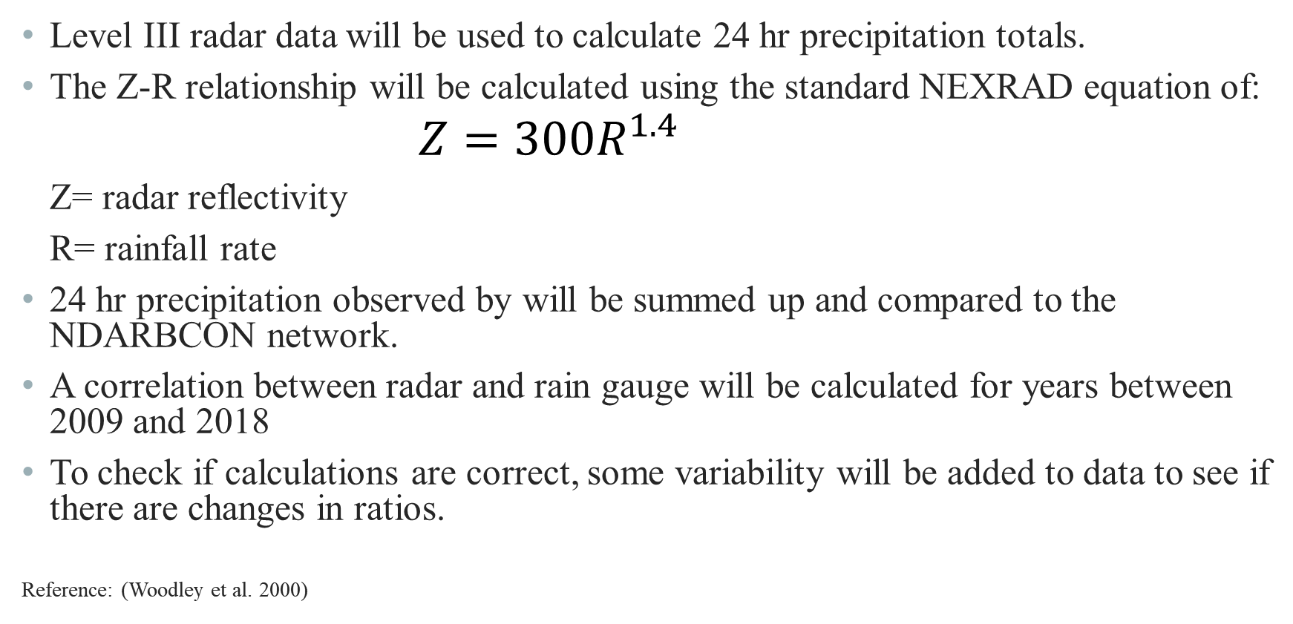
Radar estimated rainfall
Level III radar data will be used to calculate 24 hr precipitation totals.
The Z-R relationship will be calculated using the standard NEXRAD equation of:
                $$Z=300R^{1.4}$$
  Z= radar reflectivity
  R= rainfall rate
24 hr precipitation observed by will be summed up and compared to the NDARBCON network.
A correlation between radar and rain gauge will be calculated for years between 2009 and 2018
To check if calculations are correct, some variability will be added to data to see if there are changes in ratios.
Reference: (Woodley et al. 2000)

Slide 13
References
Wise, E., 2005: PRECIPITATION EVALUATION OF THE NORTH DAKOTA CLOUD MODIFICATION PROJECT (NDCMP). University of North Dakota, 63 pp. http://www.swc.nd.gov/arb/ndcmp/pdfs/PrecipEvalNDCMP_2005.pdf.
Woodley, W. L., R. Drori, D. Rosenfeld, S. Orr, and G. Bomar, 2001: Results of Monthly and Seasonal Gauge vs. Radar Rainfall Comparisons in the Texas Panhandle. Journal of Weather Modification, Volume 33, 46–60.

