Slide 1
Balloon-borne Digital Thermosonde Instrument for Measurements of Atmospheric Optical Turbulence ($C_{n}^{2}$)
David J. Delene, Blake T. Sorenson¹, and James Casler
¹Department Alumni 2018 and 2024
Notes:
https://phys.org/news/2021-03-atmospheric-turbulence-cloud-droplet-formation.html
Atmospheric turbulence may promote cloud droplet formation
by Morgan Rehnberg, American Geophysical Union

Slide 2
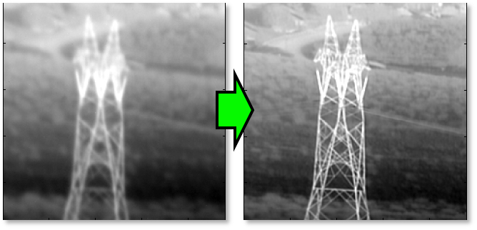
Atmospheric Optical Turbulence
Light waves are impacted by fluctuations in the air’s refractive index, known as optical turbulence.
Optical turbulence causes stars to “twinkle” .
The quality of electromagnetic signals is impacted by optical turbulence, leading to degraded images.
Knowledge of the atmospheric optical turbulence helps to improve high-resolution image quality
Image from University of Dayton Signal & Image Processing Lab (https://tinyurl.com/nhkcbn9k)

Slide 3
Calculations using Thermosonde Temperature Measurements
Optical turbulence is quantified by the refractive index structure parameter $C_{n}^{2}$, given in Bufton (1975) as:
$C_{n}^{2}={\left(76×{10}^{−6}\left(\frac{P}{T^{2}}\right)\right)}^{2}C_{T}^{2}$
P = Pressure (mb)
T = Temperature (K)
$C_{T}^{2}\left(h\right)=\frac{{\left[T\left(r_{1}\right)−T\left(r_{2}\right)\right]}^{2}}{r^{\frac{2}{3}}}$
$C_{T}^{2}$ quantifies the thermal turbulence over a distance (r) resulting from temperature differences between points $r_{1}$ and $r_{2}$.
Methods were developed to estimate $C_{n}^{2}$ from standard meteorological variables.
One method, defined by Dewan et al., (1993)
$C_{n}^{2}=2.8{\left(76×{10}^{−6}\left(\frac{P}{T^{2}}\right)\left(\frac{∂T}{∂Z}+γ\right)\right)}^{2}×{\left(0.1\right)}^{\frac{4}{3}}×{10}^{Y(z)}$
$Y\left(z\right)=\left\{\begin{aligned}1.64+42×S_{raw}, Troposphere \\ 0.506+50×S_{raw}, Stratosphere\end{aligned}\right.$
$S_{raw}=\sqrt{{\left(\frac{∂u}{∂z}\right)}^{2}+{\left(\frac{∂v}{∂z}\right)}^{2}}$
Estimates $C_{n}^{2}$ based on air temperature and pressure, as well as the vertical wind shear and vertical temperature gradient

Slide 4
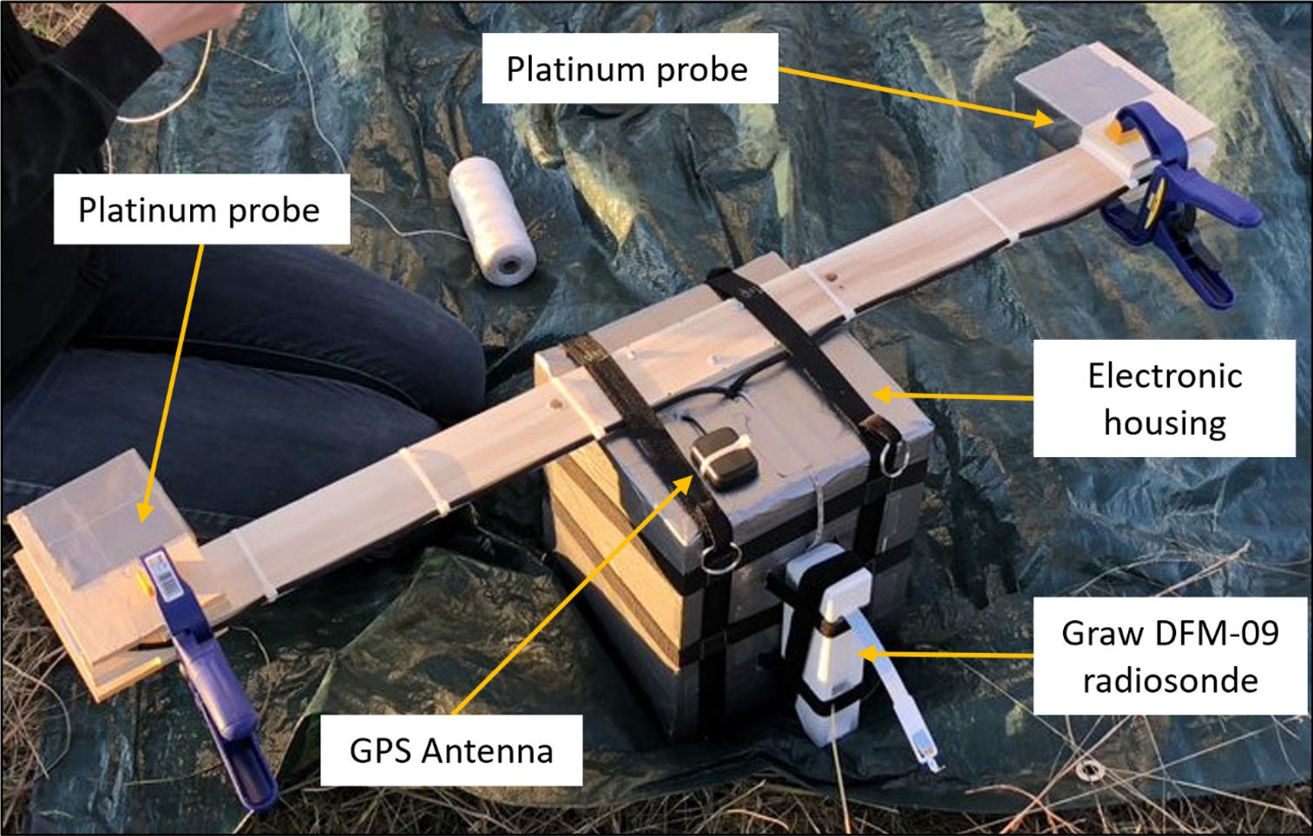
Thermosonde Instrument Design
The thermosonde instrument, based on NASA designs, measures high-resolution temperature differences that can be used to calculate $C_{n}^{2}$.
Major Components
2 $μ$m Diameter Platinum Wires
Graw DFM-09 Radiosonde (XDATA protocol)
Raspberry Pi Signal Processing Components
GPS Receiver
Two thin-wire probes for Wheatstone Bridge legs.
Difference in resistance between the wires creates voltage difference at the bridge.
Voltage difference is a function of the difference in temperature between the probes.

Slide 5
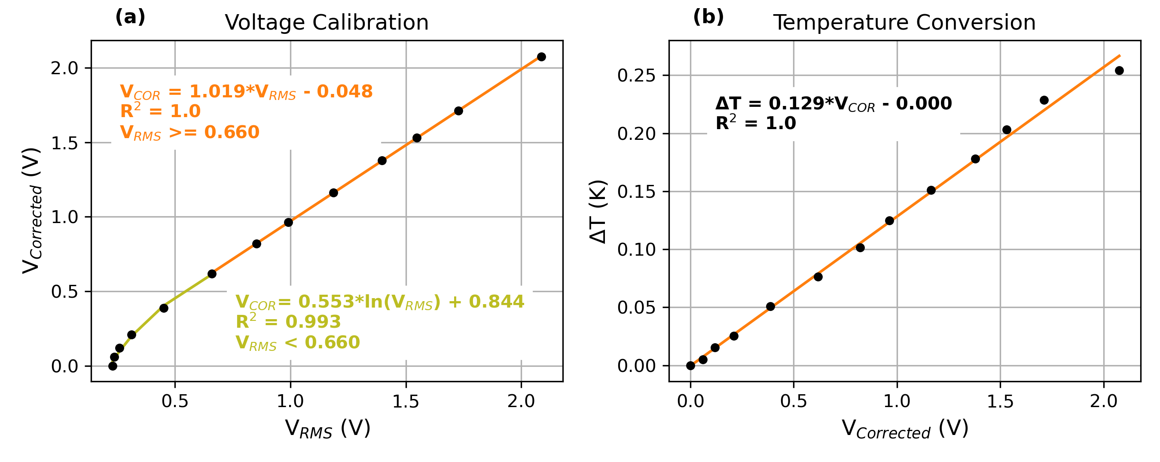
17 November 2017 Instrument Calibration
Calibration conducted based on a November 2017 tethered balloon measurements.
Root-mean-square voltages from instrument corrected to account for noise floor.
Corrected voltages are converted to temperature differences.

Slide 6
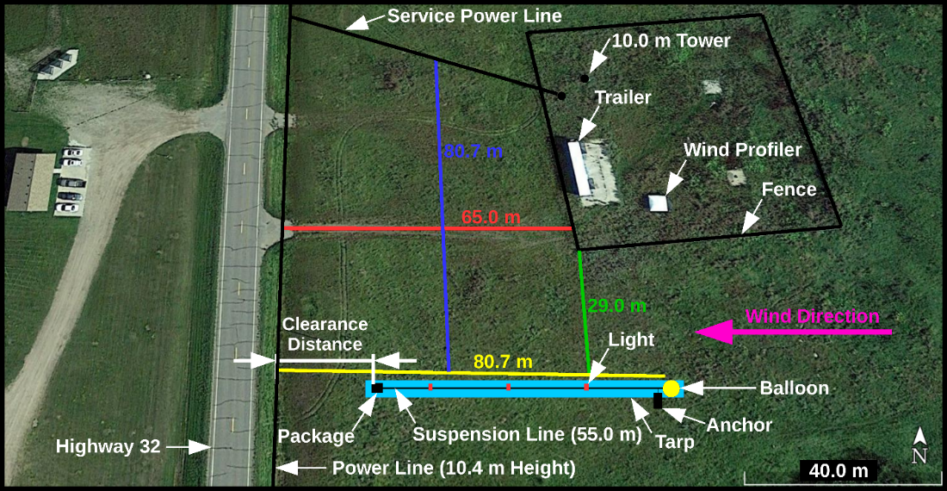
Balloon Flight Operations
Thermosonde package suspended 55 m beneath a balloon.
Long tether used to reduce the effect of thermal balloon wakes on the measurements.
High altitude balloon carries instrument through the atmosphere and descends after balloon burst.
Initial flights testing conducted at the University of North Dakota Glacial Ridge Atmospheric Observatory

Slide 7
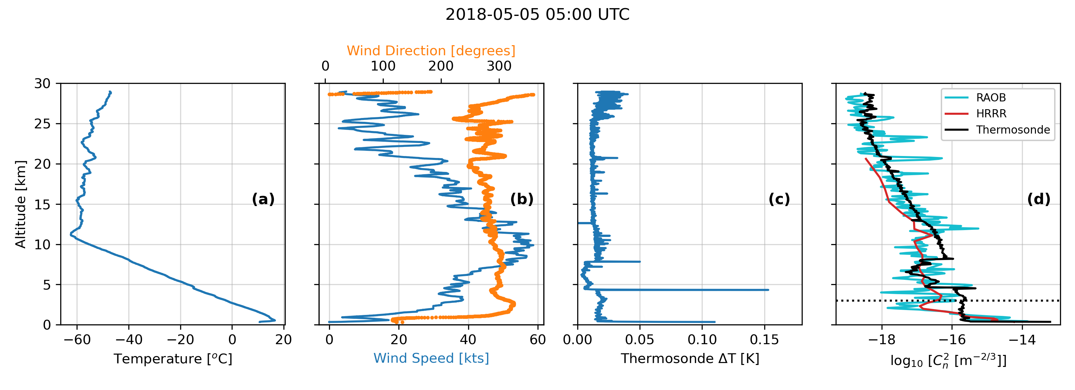
5 May 2018 Thermosonde Balloon Flight
Thermosonde measured temperature differences with resolution of 0.02 K.
Slight increase in temperature differences below the tropopause.
$C_{n}^{2}$ from the thermosonde highest near the surface.
Radiosonde-estimated $C_{n}^{2}$ compares well with thermosonde-observed $C_{n}^{2}$.

Slide 8
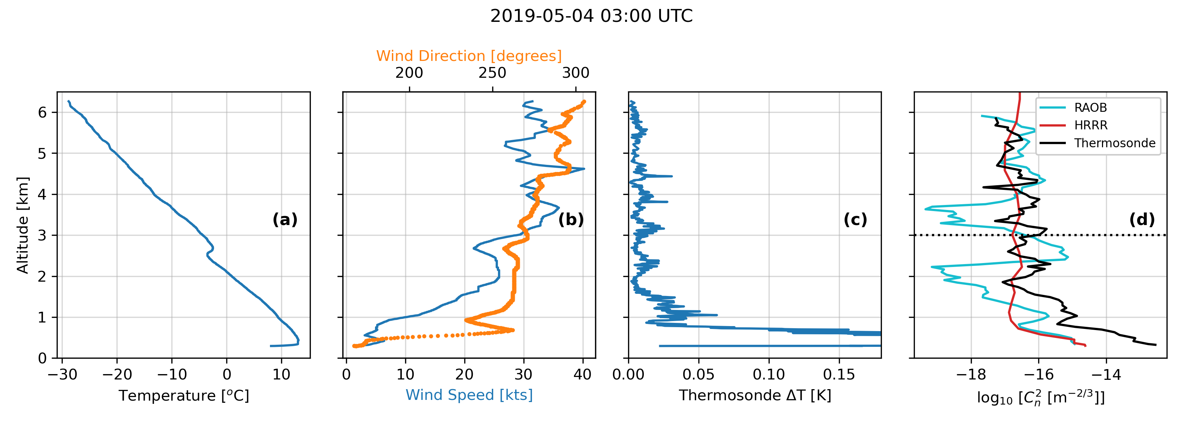
4 May 2019 Thermosonde Balloon Flight (Mayville)
The thermosonde was restructured to increase measurements sensitivity.
Instrument connection was lost at ~6 km.
Larger temperature difference variations were observed compared to previous flight.
Radiosonde-estimated and thermosonde-observed $C_{n}^{2}$ agree; however, radiosonde $C_{n}^{2}$ has higher variations.

Slide 9
Conclusions
A thermosonde instrument was built to study atmospheric optical turbulence
Profiles of the refractive index structure parameter ($C_{n}^{2}$) observed by the thermosonde compare well with radiosonde-based estimates of $C_{n}^{2}$
The instrument designed in this study can serve as a prototype for future systems to routinely observe atmospheric optical turbulence profiles when coupled with radiosondes

Slide 10
References
Future Work
Sorenson, Blake, James Casler, and David Delene, Development at the University of North Dakota of a Digital Thermosonde Instrument for the Study of Atmospheric Optical Turbulence (Cn2), American Journal of Undergraduate Research, in public release review, 2025.
Proposal entitled “Expendable Air-Sea Profiling Observations Supporting Agency” , Department of Deference - ONR STTR; Dollar Value - $95,999; Project Duration 08/01/2025 - 10/31/2026; Support 2026-1.0, 2027-1.0; Proposal Submitted 02/05/2025
Bufton, J., 1975: A Radiosonde Thermal Sensor Technique For Measurement of Atmospheric Turbulence (No. NASA-TN-D-7867). NASA. Retrieved from https://ntrs.nasa.gov/archive/nasa/casi.ntrs.nasa.gov/19750008971.pdf
Dewan, E. M., Good, R. E., Beland, R., and Brown, J., 1993: A Model for Cn2 (Optical Turbulence) Profiles Using Radiosonde Data (Scientific No. ERP, No. 1121) (p. 52). PHILLIPS LAB HANSCOM AFB MA. Retrieved from http://www.dtic.mil/docs/citations/ADA279399

