Slide 1
Improving accuracy of weather Forecast Models
Researcher: Shekinah Bass
Advisors: Dr. David Delene; Dr. Gretchen Mullendore; Andy Detwiler, Mariusz Starzec

Slide 2
Objectives
To understand the influence of Cloud Condensation Nuclei (CCN) on Cloud Droplet Concentrations (CDC)

Slide 3
Importance of Accurate Precipitation Forecast
People are able to prepare for the storms
People are able to prevent property damage

Slide 4
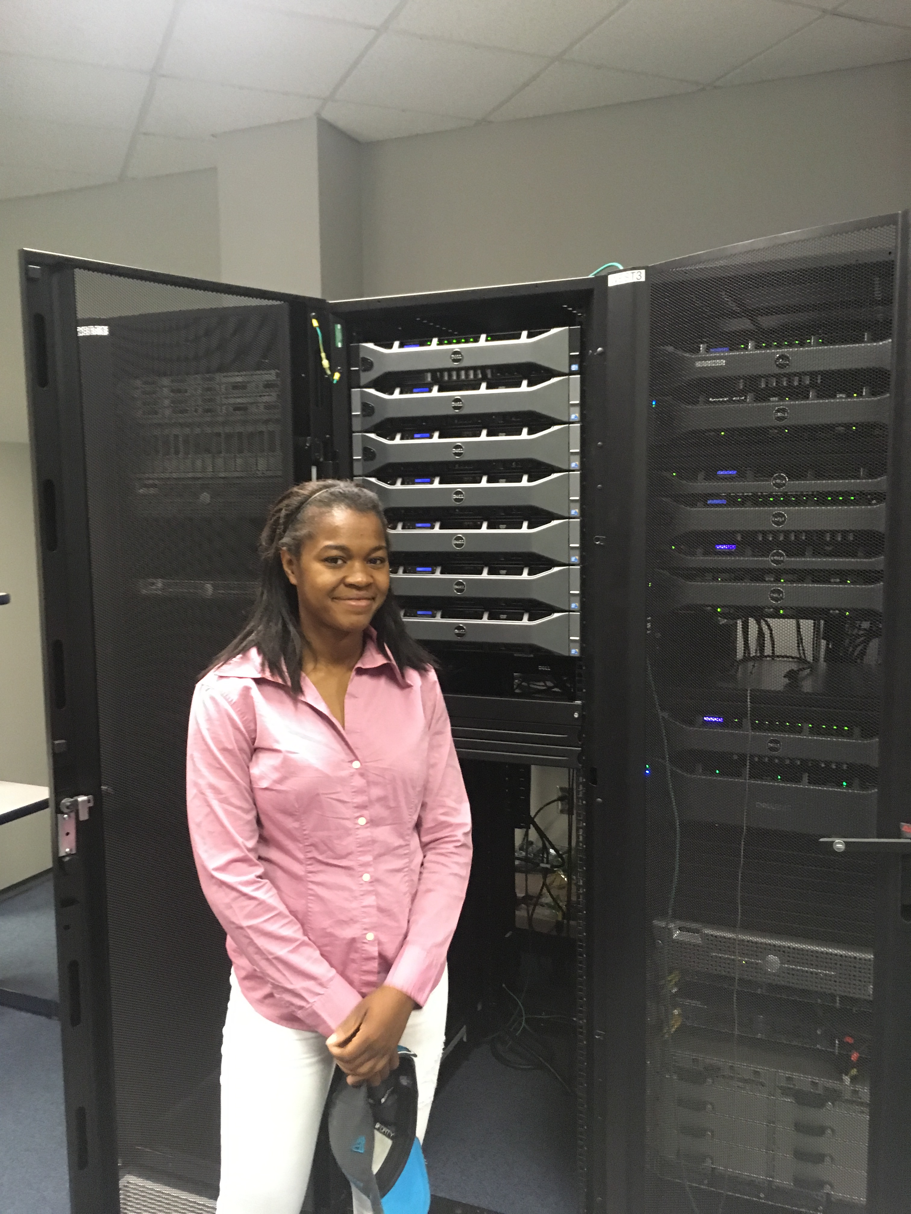
How weather is currently forecast?
Weather is currently forecast using WRF model with a standard value of 300#/cm³
http://gretchen.atmos.und.edu/sbass/CDC300/index.xhtml

Slide 5
Background
Cloud condensation nuclei (CCN) are tiny particles approximately 0.04 um in size
CCN are used to determine CDC
CCN are directly proportionate to cloud droplet concentrations (CDC).
https://www.eol.ucar.edu/content/aerosols-particles-gases
Notes:
10-3,-6,-9

Slide 6
Data Methodology
Data analysis of previously collected CCN measurements are used to analyze a hailstorm forecast in western North Dakota near Bismarck, on 30 September 2015.
From a range of the measurements 3 are chosen (100, 300*, 1000 cm⁻³).
The numbers were input in WRF model to determine and compare the sensitivity of the forecast for the hailstorm.

Slide 7
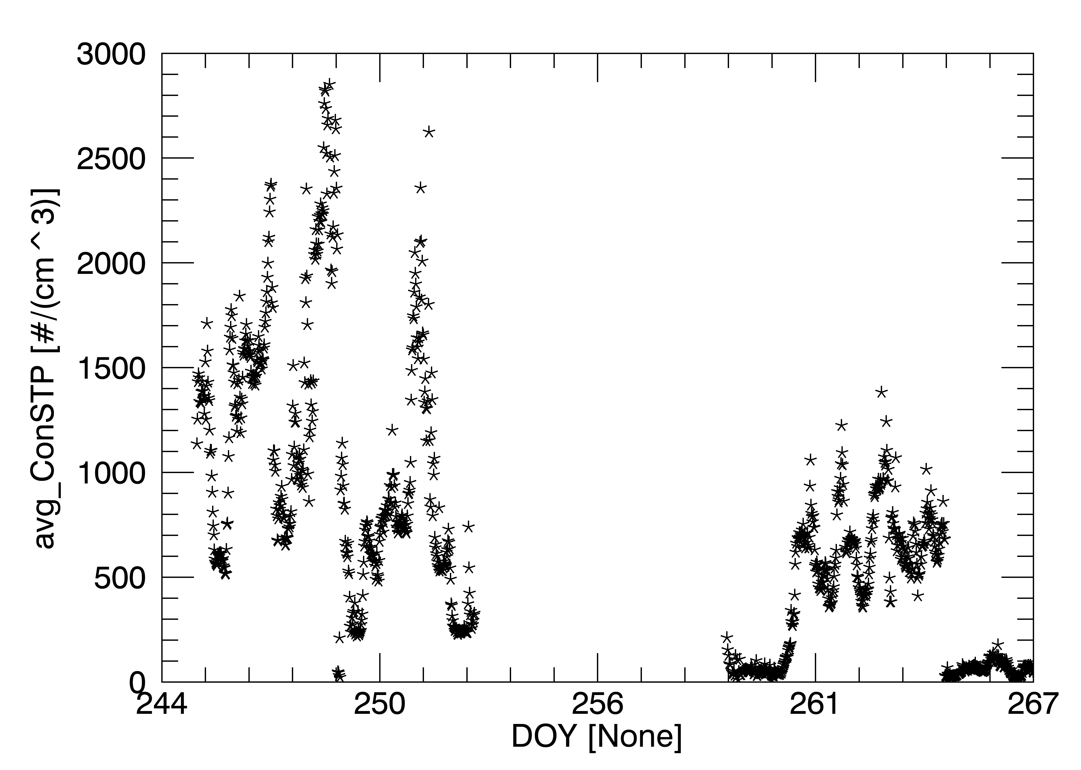
Data: Cloud Condensation Nuclei Measurements of 9/30/2015
1000
300
100

Slide 8
Results
http://gretchen.atmos.und.edu/sbass/CDC300/index.xhtml

Slide 9
Results: Precipitation
Forecast model varies upon change in Cloud droplet concentration
1000 CDC Run
300 CDC Run
100 CDC Run

Slide 10
Results: HailCast Diameter
1000 CDC Run
300 CDC Run
100 CDC Run

Slide 11
Important Things to Remember
CCN measurements are taken form the amount of particles present per volume in the air.
As discussed before CCN measurements influence the sensitivity of precipitate producing weather forecast.

Slide 12
Applications: Weather Modification
With more accurate forecast, there will be more opportunity to perform weather modification technique on harmful precipitate-producing storms.
https://americandigitalnews.com/2017/08/30/adn-compilation-hurricane-harvey-and-weather-modification/#.Wys2iC2ZPsE
http://gretchen.atmos.und.edu/forecast_west/index.xhtml

Slide 13
Acknowledgments
REU Advisor- Dr. Frank Bowman
Research Advisors- Dr. David Delene; Dr. Gretchen Mullendore, Dr. Andy Detwiler, Mariusz Starzec
We would like to acknowledge support from National science Foundation (NSF) REU IREC program in No. CHE-1757922. Any opinions, findings, and conclusions or recommendations expressed in this material are those of the author(s) and do not necessarily reflect views of the NSF.

