Slide 1


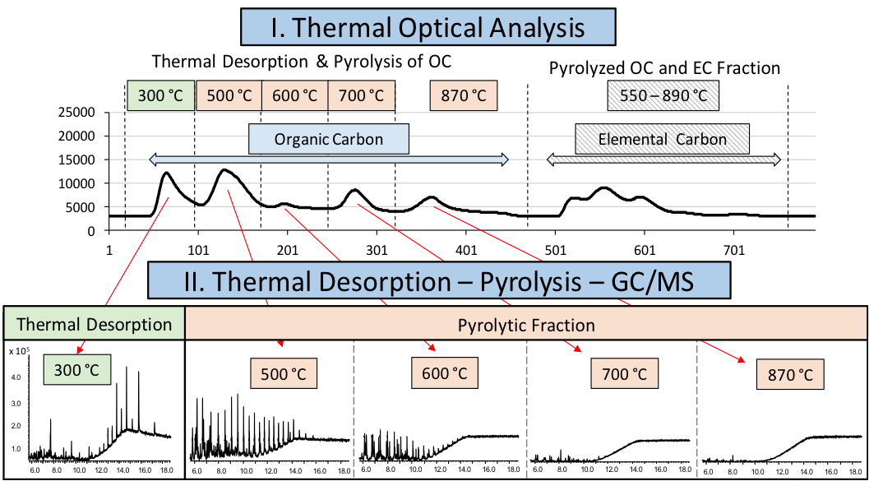
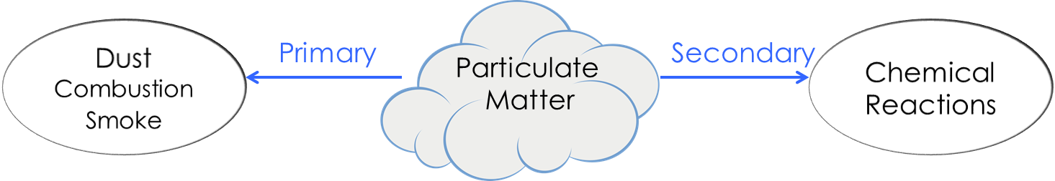
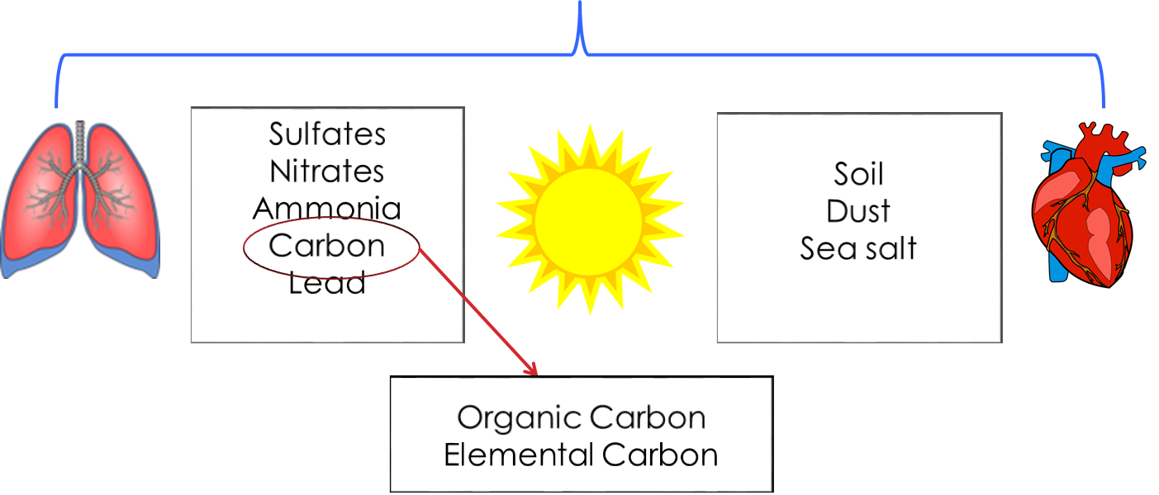
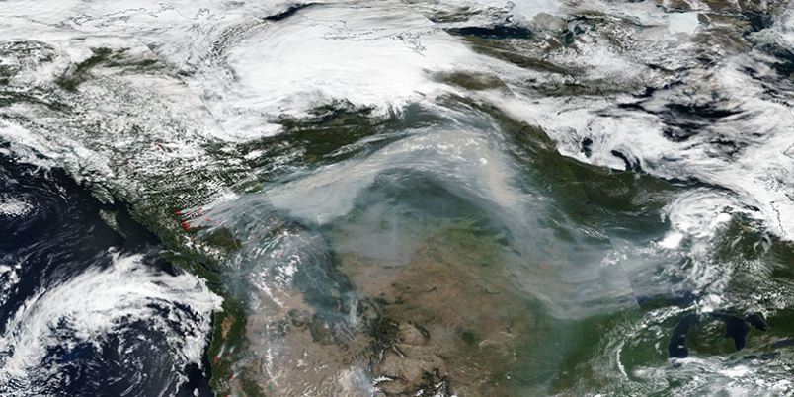
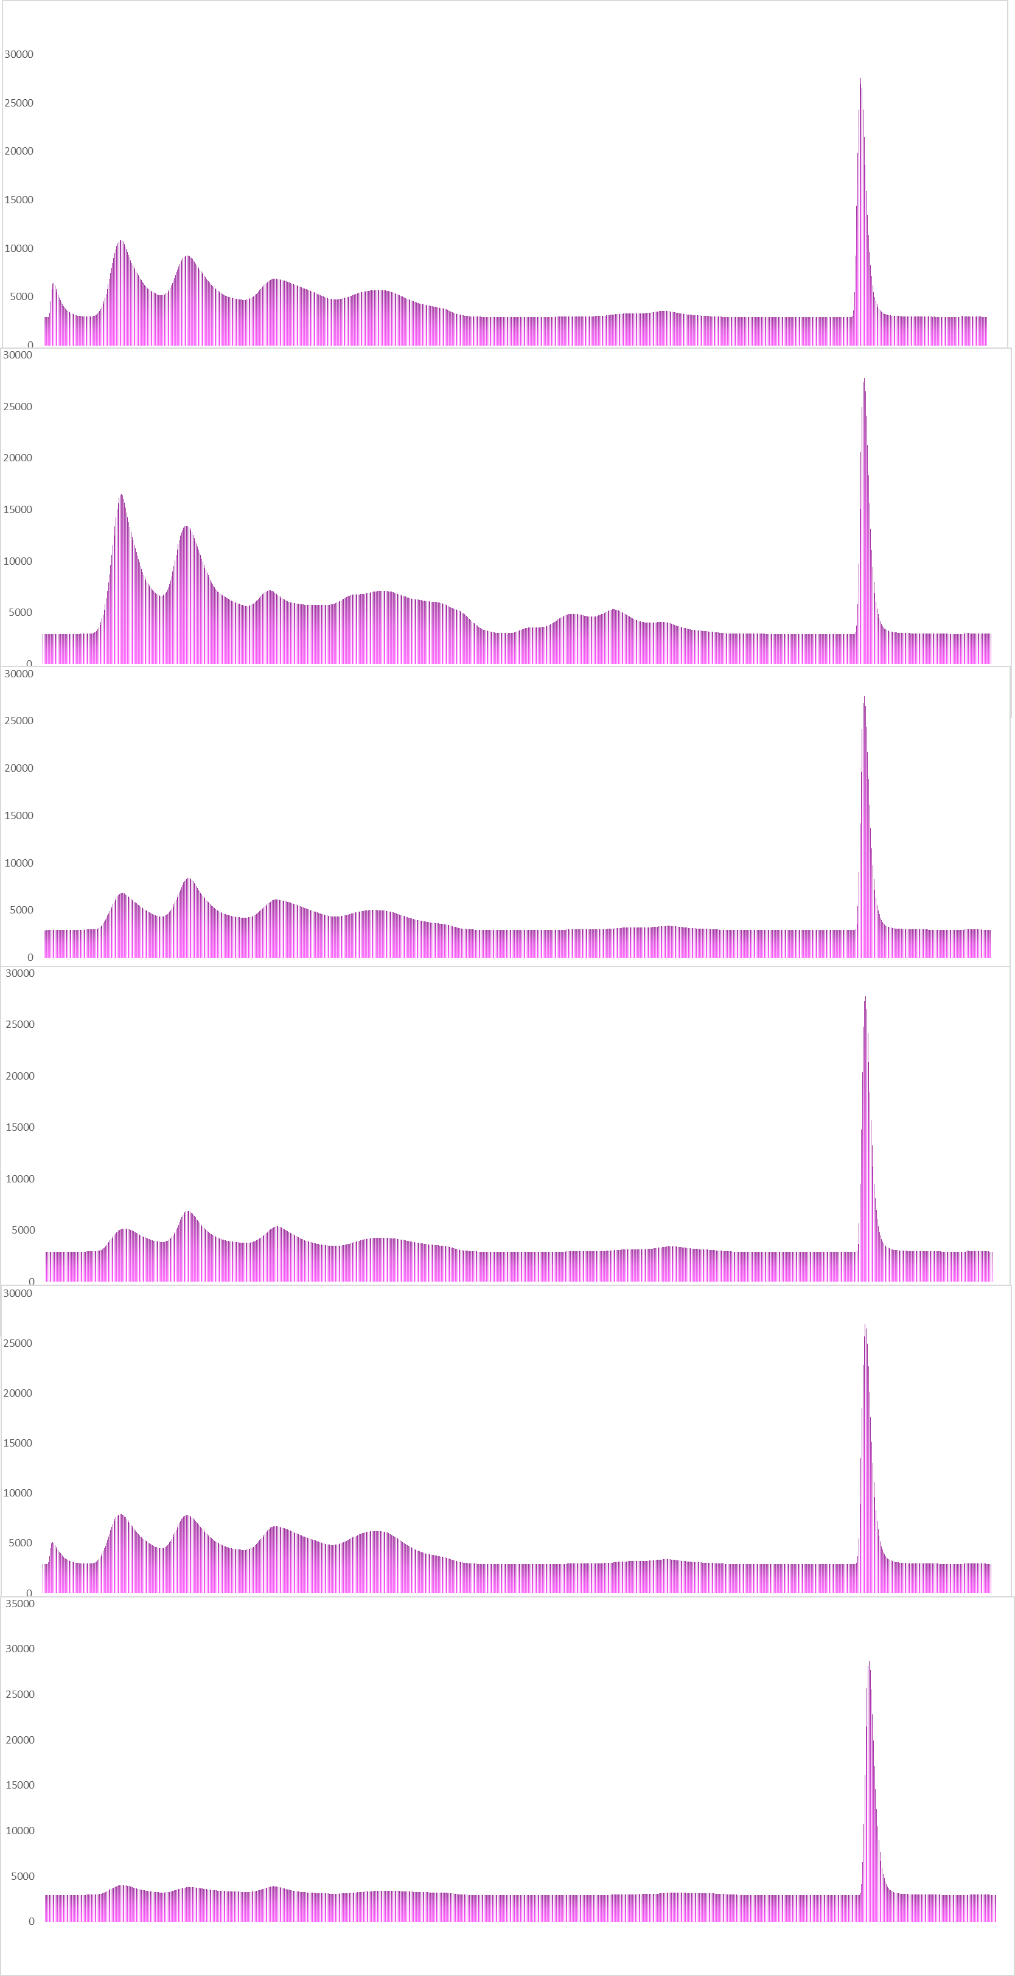
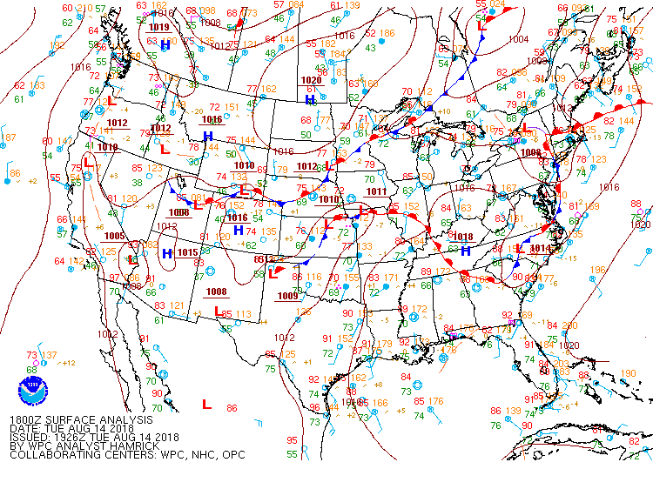
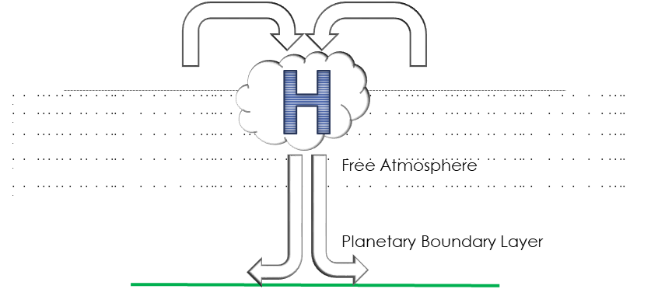
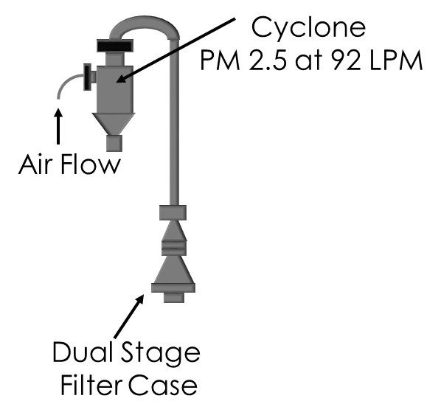
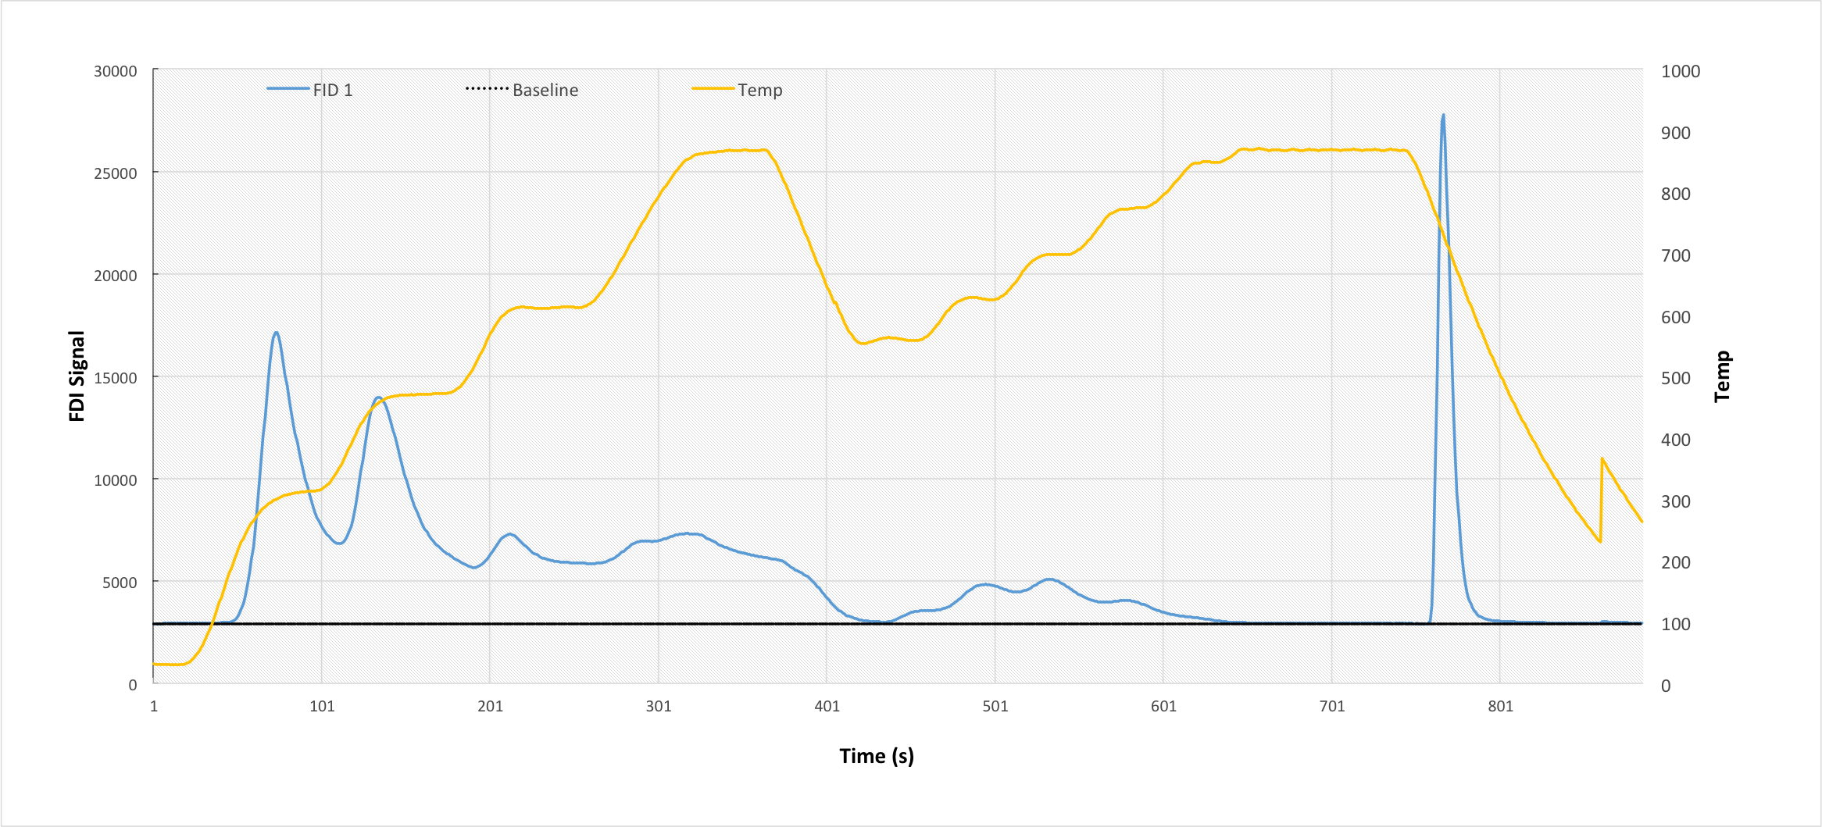
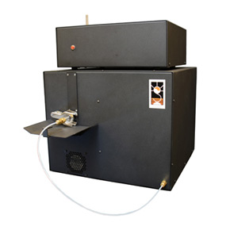
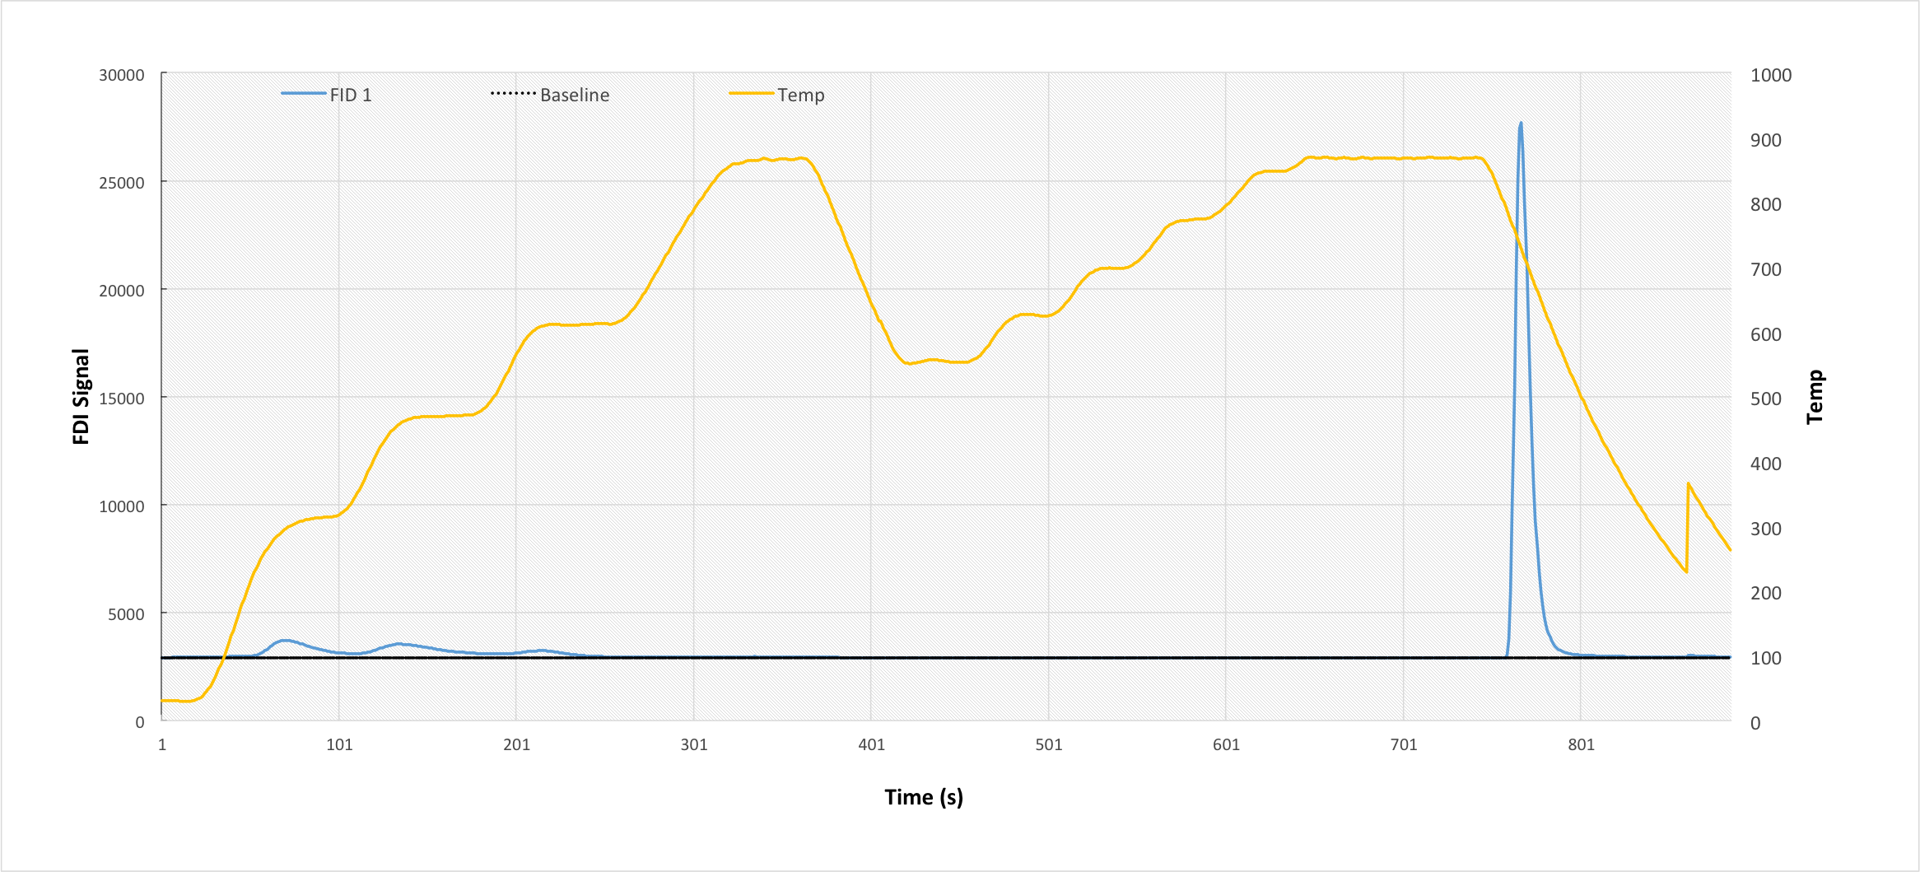
Interdisciplinary
Renewable & Environmental
Collaborative REU
Characteristics of Carbonaceous Fractions in Atmospheric Particulate Matter for Grand Forks, North Dakota
Victoria Lang¹, Jessica Emond², Dr. David Delene¹, Dr. Alena Kubatova²
¹Department of Atmospheric Science, University of North Dakota, Grand Forks, ND
²Department of Chemistry, University of North Dakota, Grand Forks, ND
Objectives
Thermal Carbon OC/EC Analyzer: Carbon Speciation
Conclusions
Investigate carbonaceous atmospheric particulate matter of 2.5 µm (PM_{2.5}) in Grand Forks, ND in the months of July through November in 2018
Measure organic carbon (OC) and elemental carbon (EC) concentrations within PM using a thermal optical OC/EC analyzer
Carbonaceous fractions of atmospheric PM made up 10-36% of total PM_{2.5} in Grand Forks, ND during the months of July through November
Elemental carbon made up 1.5-12% of total carbonaceous PM_{2.5} using TOT method and 2-12% using TOR method
Agriculture, Canadian forest fires and meteorological perturbations can impact the total PM2.5 and characteristics of carbonaceous fractions
Background
Atmospheric PM is any particle suspended in the atmosphere in either a solid or liquid state
Both OC and EC have been associated with impacting the Earth’s energy budget and the public’s health, making knowledge on the composition and transport of OC/EC in atmospheric models vital
Results: Carbonaceous Fractions
Of the total PM 2.5 collected, carbonaceous species makes up 10-36%
Results: Carbonaceous Concentrations
NOAA
Thermal Desorption & Pyrolysis of OC
Oxidation of EC and Pyrolyzed OC
Mid-August through early September is the peak of harvest season for barley, wheat, and oats in North Dakota.
310°
475°
615 °
870°
8/14-8/17/2018
*
Smoke
August 10,2018
Volatile and
semi-volatile organics
Pyrolyzed fractions of heavy organic species
8/17-8/21/2018
British Columbia fires in late July through August may have contributed to EC levels.
96 hrs
96 hrs
Total carbonaceous concentrations are not strongly linked to longer temporal sampling
Sample Collection and Analysis
72 hrs
72 hrs
96 hrs
8/21-8/24/2018
Prebaked quartz filters were used in a high volume semi-volatile organic aerosol sampler to collect PM_{2.5} from the roof of Clifford Hall in Grand Forks
Samples were collected for 72, 96,120,168 and 192 hours then processed in a thermal optical OC/EC analyzer
96 hrs
96 hrs
72 hrs
96 hrs
72 hrs
96 hrs
72 hrs
96 hrs
72 hrs
Future Work
*
96 hrs
72 hrs
96 hrs
72 hrs
96 hrs
168 hrs
192 hrs
192 hrs
FID Signal
8/28-8/31/2018
Continue to collect longer temporal range of samples
Characterize non-volatile organic carbon species using Thermal Desorption-Pyrolysis-Gas Chromatography-Mass Spectrometry (TD-Pyr-GC-MS)
Collect detailed meteorological data in Grand Forks, ND to correlate atmospheric sinks with carbonaceous fractions
Top filter
High pressure systems present over Grand Forks, ND during peak PM_{2.5} high concentration weeks (*)
9/4-9/07/2018
High pressure systems can act as mechanism for subsidence of PM in the free atmosphere
Acknowledgements
Bottom filter representing gas phase and subtracted from top filter
As precipitation increases, total PM _{2.5} concentrations decrease.
I would like to thank Dr. Bin Yao, Dr. Frank Bowman, and Matt Tuftedal for assisting me throughout the program.
This material is based upon work supported by the National Science Foundation (NSF) REU IREC program under Grant No. CHE-175 922. Any opinions, findings, and conclusions or recommendations expressed in this material are those of the authors and do not necessarily reflect the views of the NSF.
Thermal Optical OC/EC Analyzer
9/21-9/25/2018
Top Filter
Bottom Filter
1
10
90
170
250
405
Time (seconds)

