Slide 1
Development of a Weather Balloon Package for Atmospheric Carbon Dioxide Measurements
Michael Witherspoon, Vanderbilt University, Nashville, TN
Advisors: Dr. David Delene and Dr. Ron Fevig
Graduate Mentor: Shawn Wagner
Research Experience for Undergraduates, University of North Dakota

Slide 2
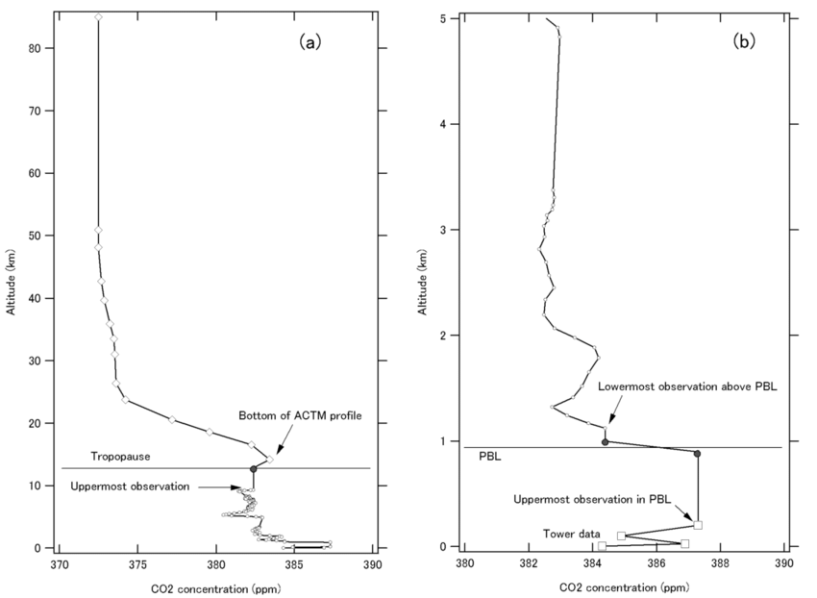
Background Information
Carbon Dioxide:
Carbon dioxide is a potent greenhouse gas that traps heat and contributes to global warming in excess, and it is also essential for plant growth and photosynthesis
Why measure carbon dioxide?
Filling Research gaps of carbon dioxide (Vertical Profiling)
Improve climate models
Climate Mitigation Policy Advocacy: Direct Air Capture Technology
Vertical profile of the atmospheric carbon dioxide.
Miyamoto, Y. et. al
The Conversation Article, Dr. David Delene & Elizabeth Cardoza
Miyamoto, Y. et al. (2013) Corrigendum to ‘Atmospheric column-averaged mole fractions of carbon dioxide at 53 aircraft measurement sites’ published in Atmos. Chem. Phys. 13, 5265–5275, 2013. Atmospheric chemistry and physics. [Online] 13 (18), 9213–9216.

Slide 3
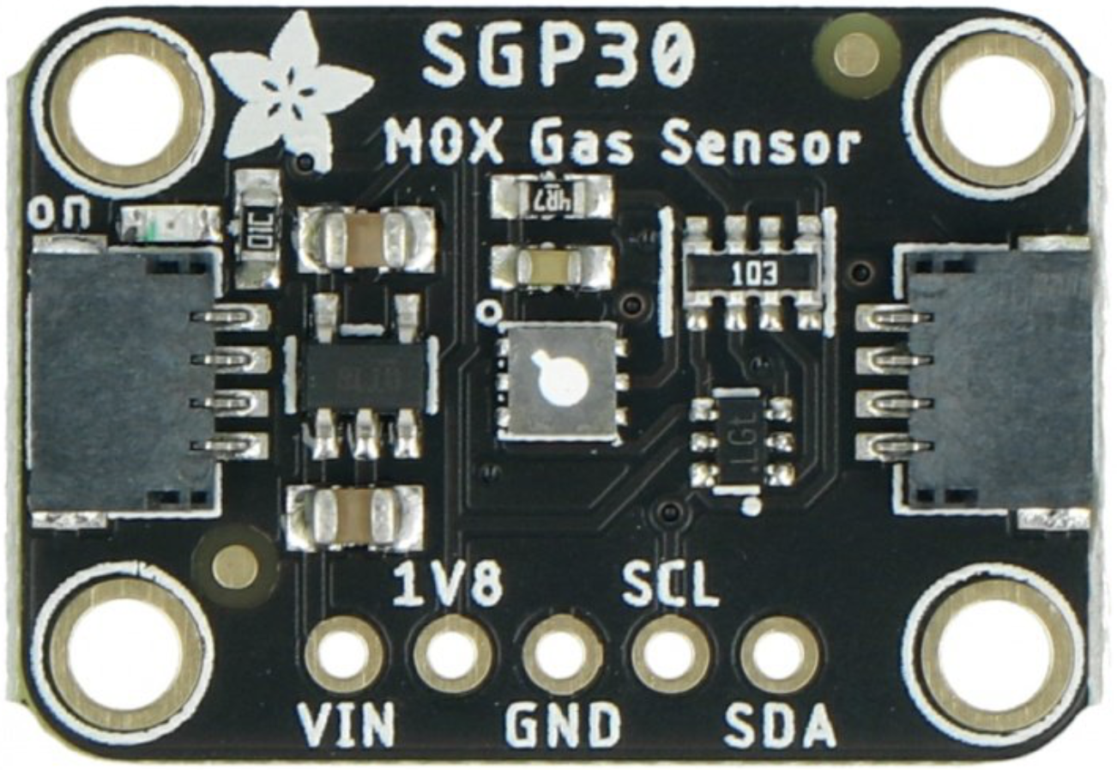
Research Problem
Past REU projects, included sensors for temperature, atmospheric pressure, and humidity. Last year REU, included computer modeling of projections of carbon dioxide impacts on agriculture as carbon dioxide concentration is removed from the atmosphere. A carbon dioxide sensor researched last year for testing was Equivalent carbon dioxide (eCO2); however, this sensor provided an indirect estimate of atmospheric carbon dioxide based on related gases .
Research Problem: How to development an open hardware and accessible weather ballon to accurately collect carbon dioxide measurements?
This year’s approach:
Utilize a more accurate carbon dioxide sensor
Build upon previous designs of weather ballons
Equivalent Carbon Dioxide Sensor

Slide 4
Goals & Objectives
Goals:
To successfully launch the project’s weather ballon this summer and accurately collect measurements from its sensors.
Objectives:
Compare carbon dioxide measurements from this project’s weather ballon launch with data from Young-Suk Oh’s ballon, which uses a different technique to collect carbon dioxide.

Slide 5
Project Overview
1
2
3
Product Research Phase:
Research effective carbon dioxide sensors (PAS, NDIR, and eCO2)
Literature Review
Review past REU projects of development of weather ballons and analyze how I can improve on typical design
Design Phase:
Develop the design concept for the weather ballon
Take into consideration atmospheric conditions that might interfere with the parts
Test individual sensors and parts before official launch
Test Phase:
Conduct Weather ballon launch
Compare measurements with Young-Suk Oh’s ballon measurements

Slide 6
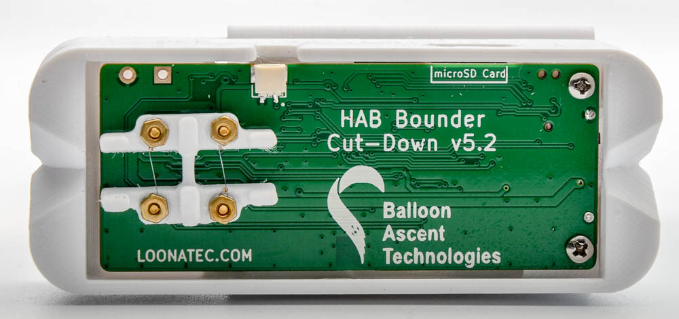
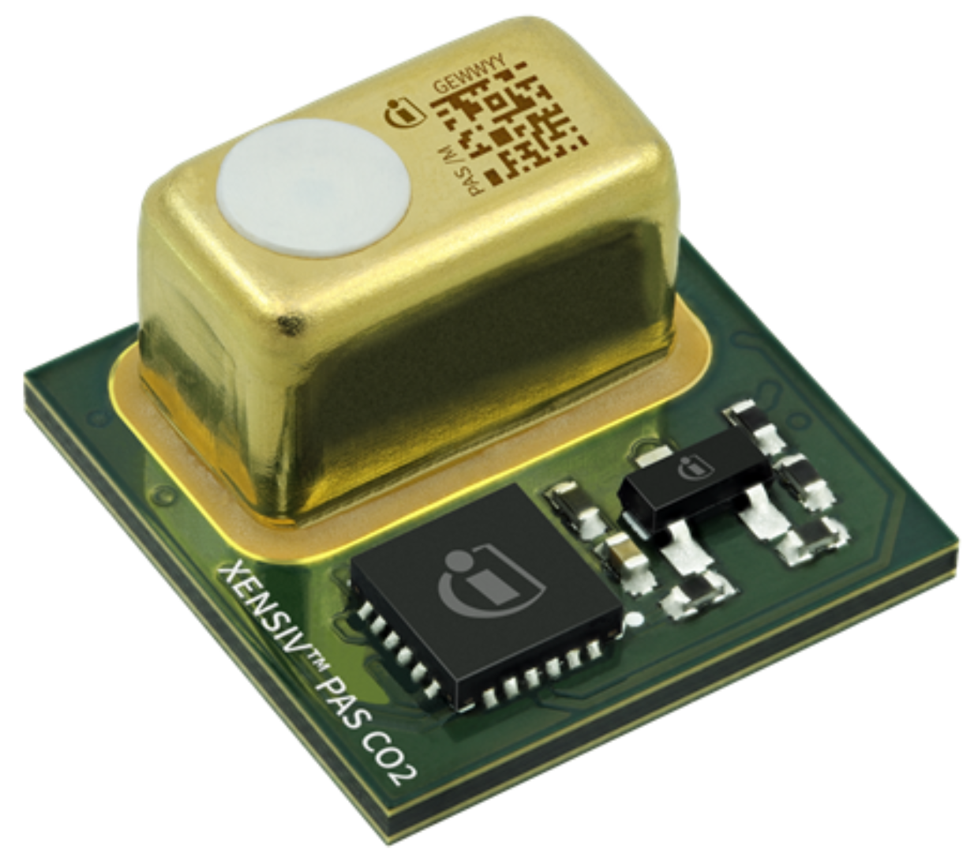
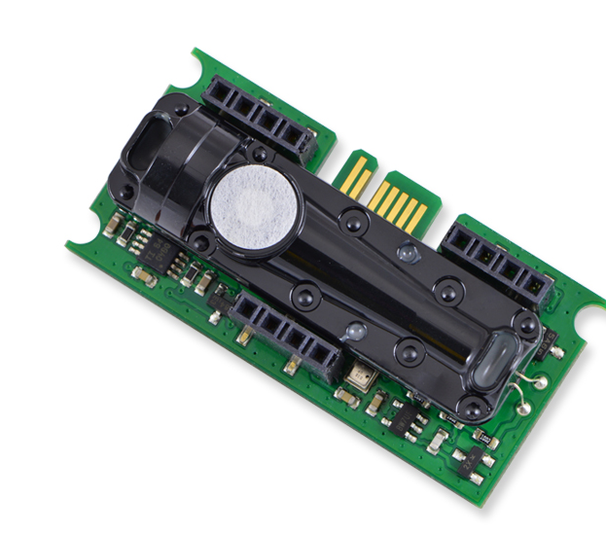
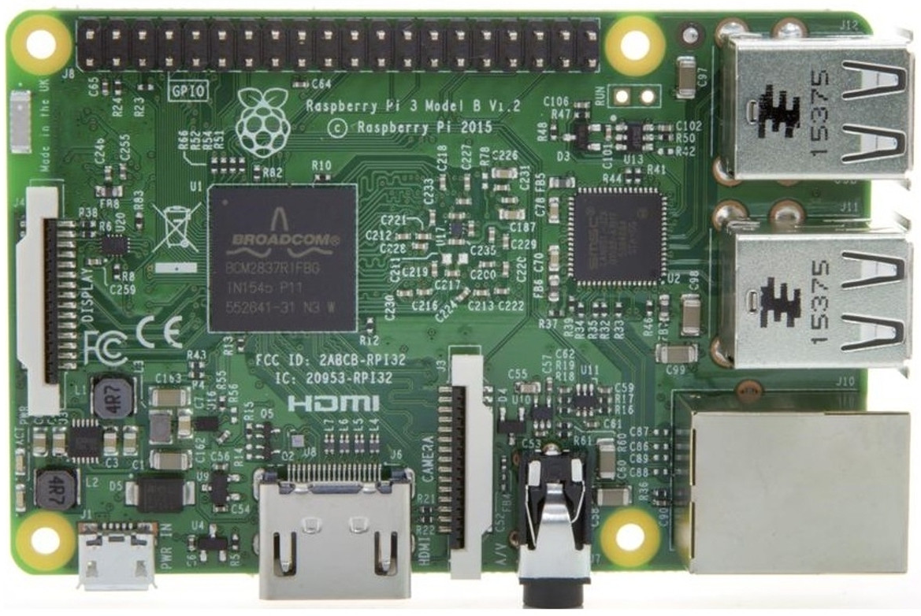
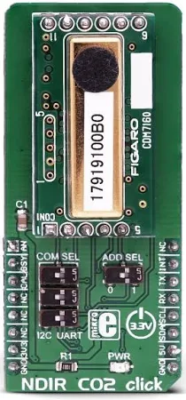
Design & Payload Concept
HAB Bounder: Data Transmitter
Carbon Dioxide Sensor:
(Under Research- Photoacoustic CO2, EE894, NDIR)
Latex Weather Balloon
Photoacoustic CO2 Sensors
EE894
Raspberry Pi 3B: Computer
Parachute
Nondispersive Infrared Sensor
BMP280: Pressure & Temperature Sensor
Balloon Package

Slide 7
References
Delene, D. J., 2011: Airborne data processing and analysis software package. Earth Sci. Inform., 4, 29–44, https://doi.org/10.1007/s12145-010-0061-4. ——, K. Hibert, M. Poellot, and N. Brackin, 2019: The North Dakota Citation Research Aircraft Measurement Platform. SAE Tech. Pap. 2019-01-1990, https://doi.org/doi: 10.4271/2019-01-1990.
Miyamoto, Y. & Inoue, Makoto & Morino, Isamu & Uchino, O. & Yokota, T. & Machida, Toshinobu & Sawa, Y. & Matsueda, H. & Sweeney, Cora & Tans, P. & Andrews, Arlyn & Patra, P.. (2013). Atmospheric column-averaged mole fractions of carbon dioxide at 53 aircraft measurement sites. Atmospheric Chemistry and Physics. 13. 10.5194/acp-13-5265-2013.
Delene, D.J. & Elizabeth Cardoza, (2024). The Conversation Article.
Miyamoto, Y., Inoue, M., Morino, I., Uchino, O., Yokota, T., Machida, T., Sawa, Y., Matsueda, H., Sweeney, C., Tans, P. P., Andrews, A. E., Biraud, S. C., & Patra, P. K. (2013). Corrigendum to “Atmospheric column-averaged mole fractions of carbon dioxide at 53 aircraft measurement sites” published in Atmos. Chem. Phys. 13, 5265–5275, 2013. Atmospheric Chemistry and Physics, 13(18), 9213–9216. https://doi.org/10.5194/acp-13-9213-2013

Slide 8
Acknowledgments
Advisors: Dr. David Delene and Dr. Ron Fevig
Elizabeth Cardoza
Space Operations Group (SOG)
Dr. Du, IREC REU Program Director
IREC REU Program at the University of North Dakota
University of North Dakota Chemistry Department
University of North Dakota Space Studies & Atmospheric Science Departments
We would like to acknowledge support from the National Science Foundation (NSF) REU IREC program in No. CHE-175 922. Any opinions, findings, and conclusions or recommendations expressed in this material are those of the author(s) and do not necessarily reflect the views of the NSF.

