Slide 1
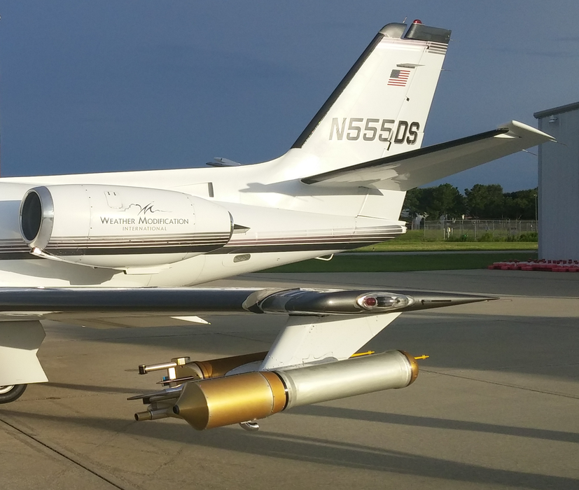
Particle Habit Imaging and Polar Scattering (PHIPS) Probe
Measure the angular light scattering function of individual cloud particles that are identifiable as belonging to a particular habit.
  Improved remote sensing observations.
Obtain high resolution stereo-graphic images with sufficient detail to improve understanding of riming and aggregation processes.
  Improved cloud micro-physical modeling.
Provide reliable phase identification on small and intermediate sized cloud particles.
  Improved understanding of precipitation.
North Dakota
Citation Research Aircraft
PHIPS Probe
16,385
Notes:
Image showing the PHIPS probe in the outside PMS can on the left wing for the CapeEx19 field project to sample Florida cirrus cloud anvils in the summer of 2019. These two slide summarize the three main features of the PHIPS probe (highlighted in red) and the corresponding scientific motivations for these features.

Slide 2
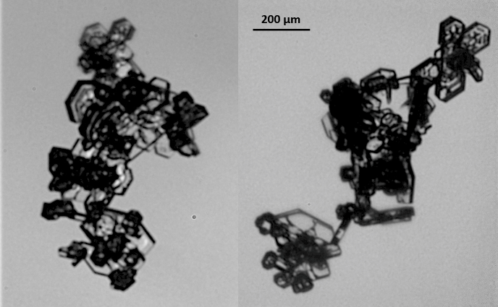

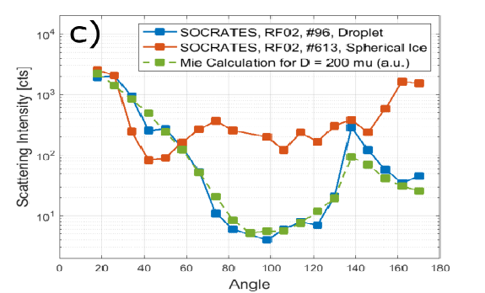
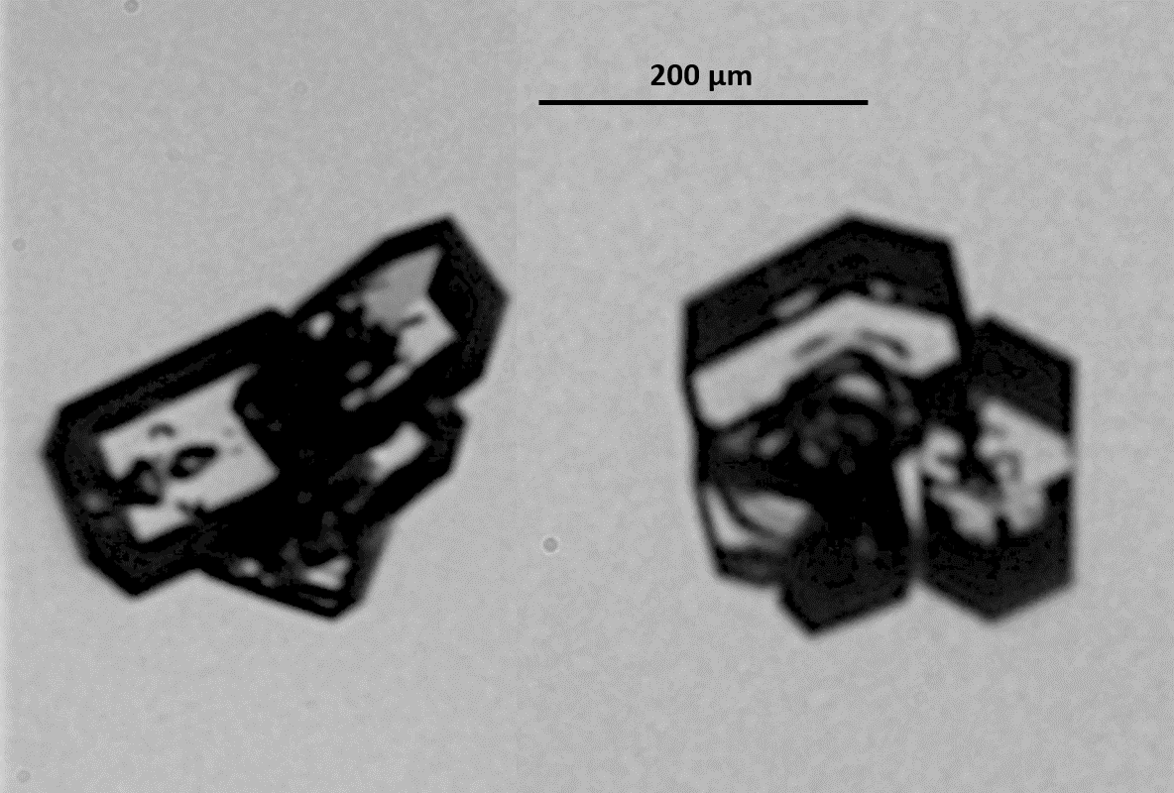
Measurements and Observations of the PHIPS Probe
Angular Light
Scattering Function
Stereo-graphic Images
Phase Identification
2019/07/26 #5,134
a)
b)
200 µm
10⁴
SOCRATES, RF02, #96, Droplet
SOCRATES, RF02, #613, Spherical Ice
Mie Calculation for D = 200 mu (a.u)
Normalized Angular Scattering Function
10³
2019/07/25 #4,434
Scattering Intensity [cts]
10²
10¹
0
20
40
60
80
100
120
140
160
180
Scattering Angle
Angle
Averaged angular scattering functions from different campaigns, which was used to validate the MODIS C6 ice optical model (Järvinen et al., 2018).
16,385
Stereo image pairs of a droplet (a) and a quasi-spherical ice particle (b), and the corresponding angular scattering function (c) (Waitz et al., AMT in preparation).
Stereo image pairs obtained within Cirrus cloud anvils over Florida.
Notes:
Examples of the three important measurements of the PHIPS Probe. Note that researchers are actively using the PHIPS probe observations to produce important scientific publications. The provided stereo-graphic images from the CapeEx19 field project illustrates the details that can be seen in the crystal aggregates. The top images pair (#5,134) is obtained at 19:51:15 UTC at an altitude 10.7 km and temperature of -33.4 °C. The bottom image pair (#4,434) is obtained at 18:53:54 UTC at an altitude of 9.6 km and temperature of -32.3 °C. While high resolution images provide an indication if spherical particles are water or ice, the difference in light scattering between 80-120 degrees clearly demonstrates the phase of the particle.

