Slide 1

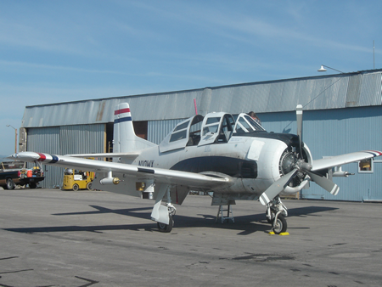
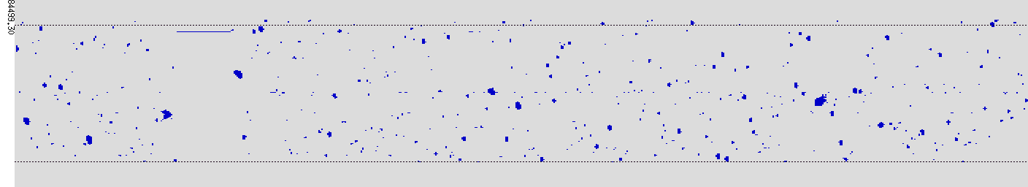
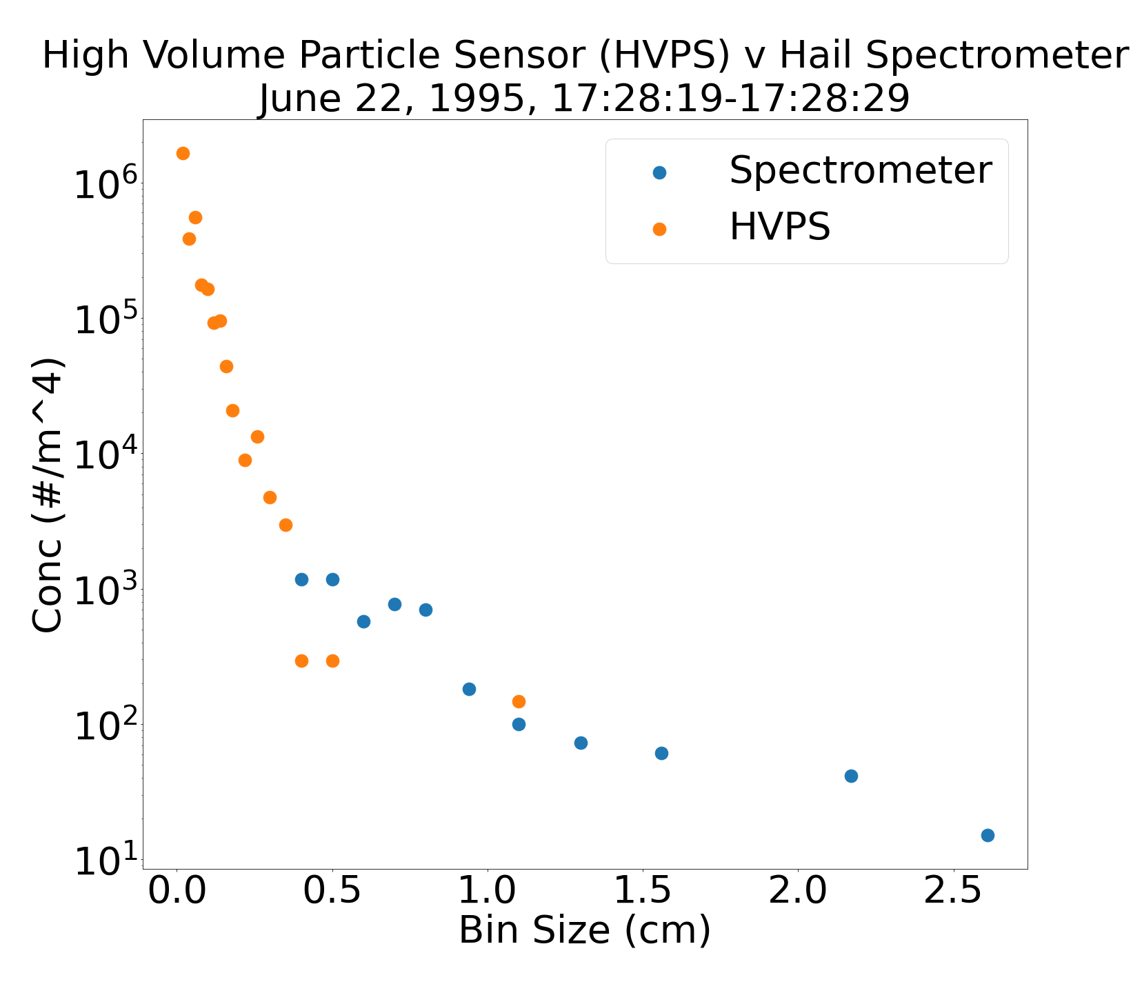
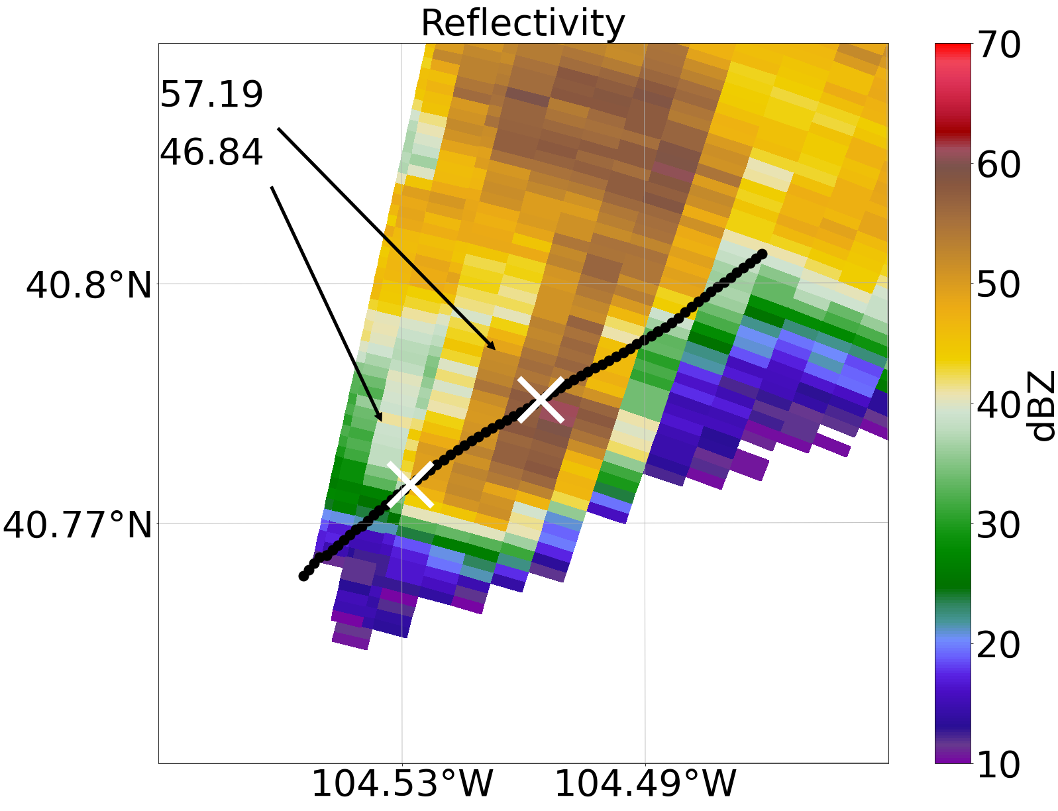
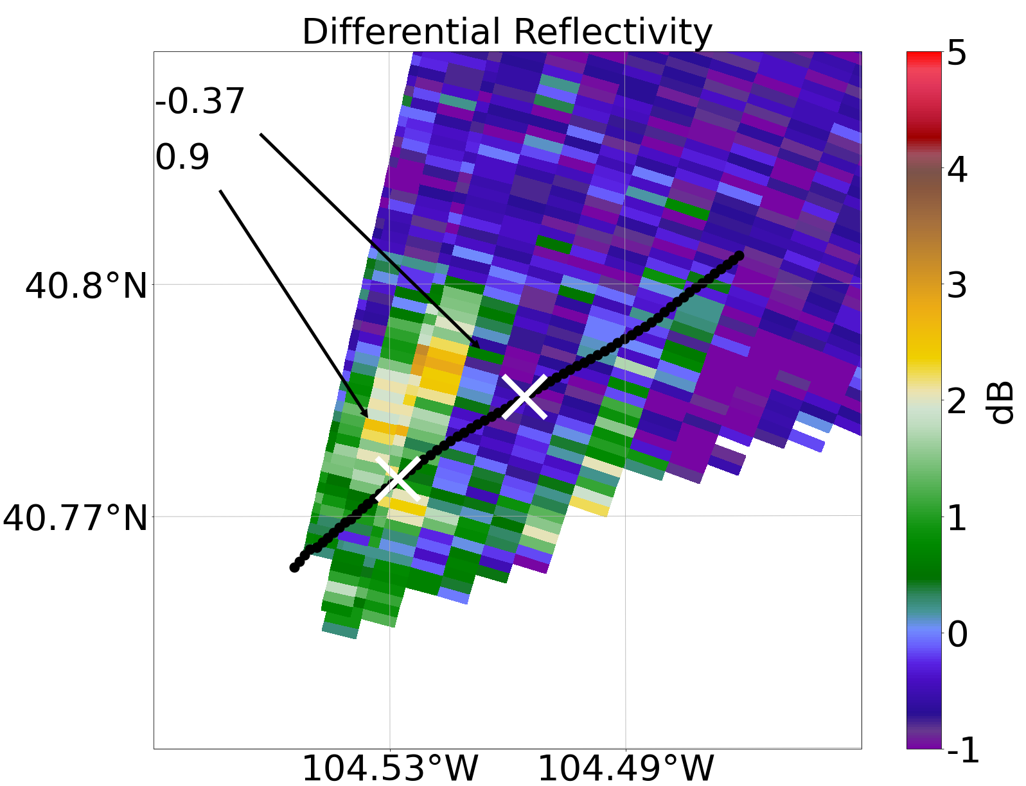
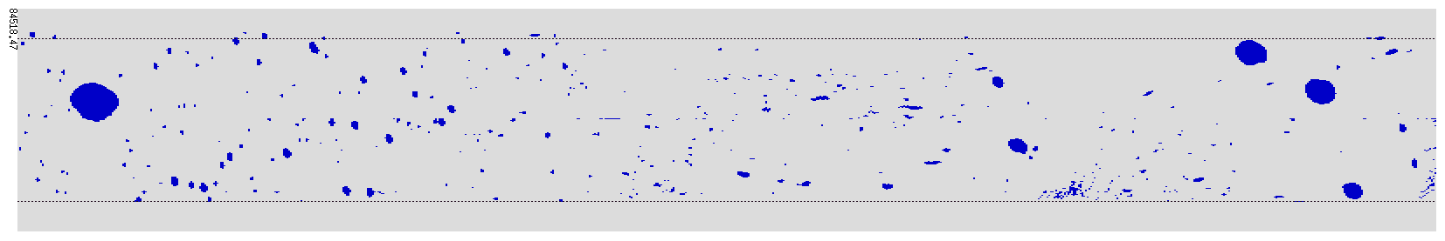
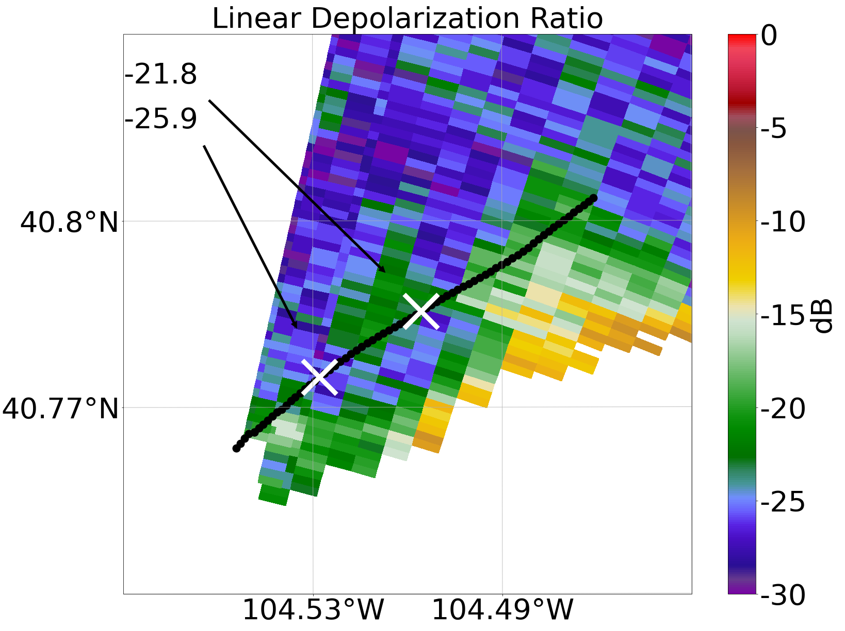
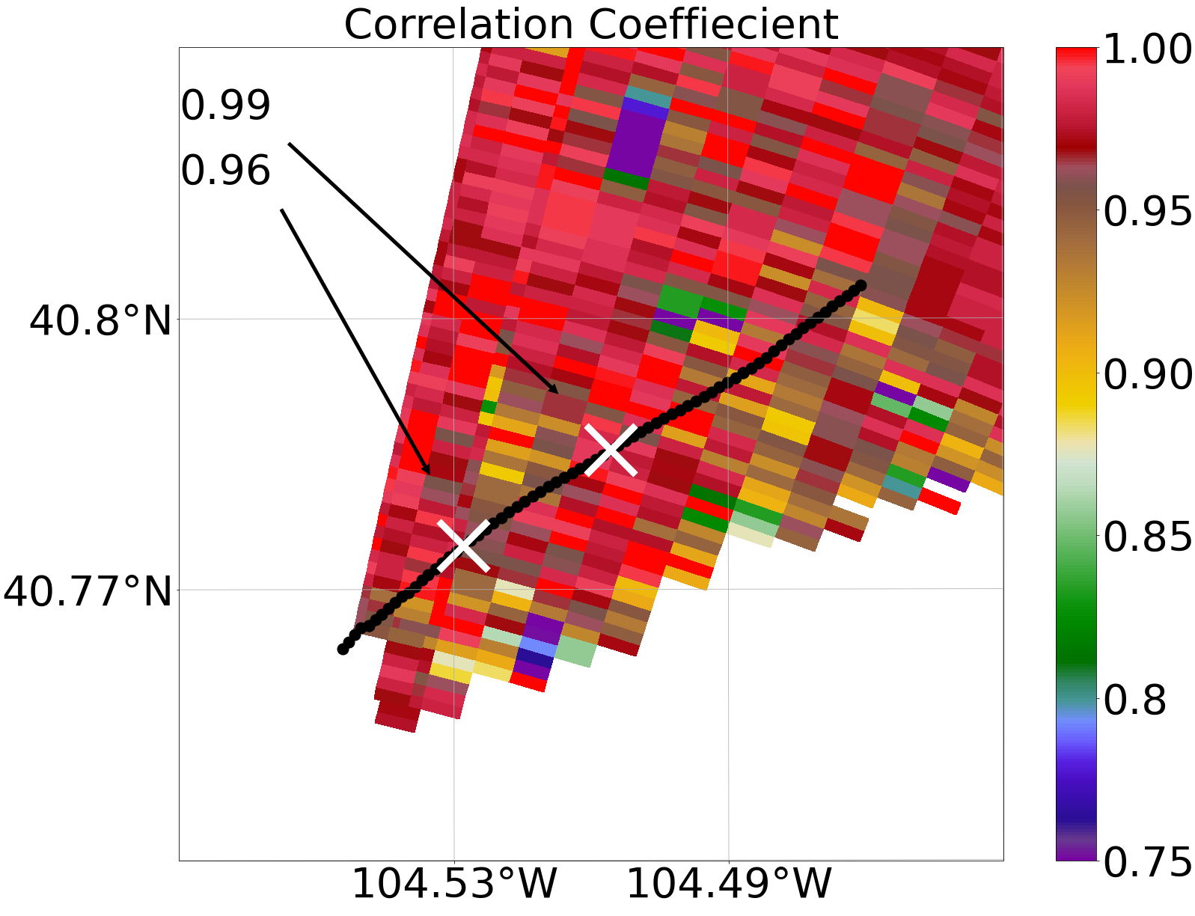
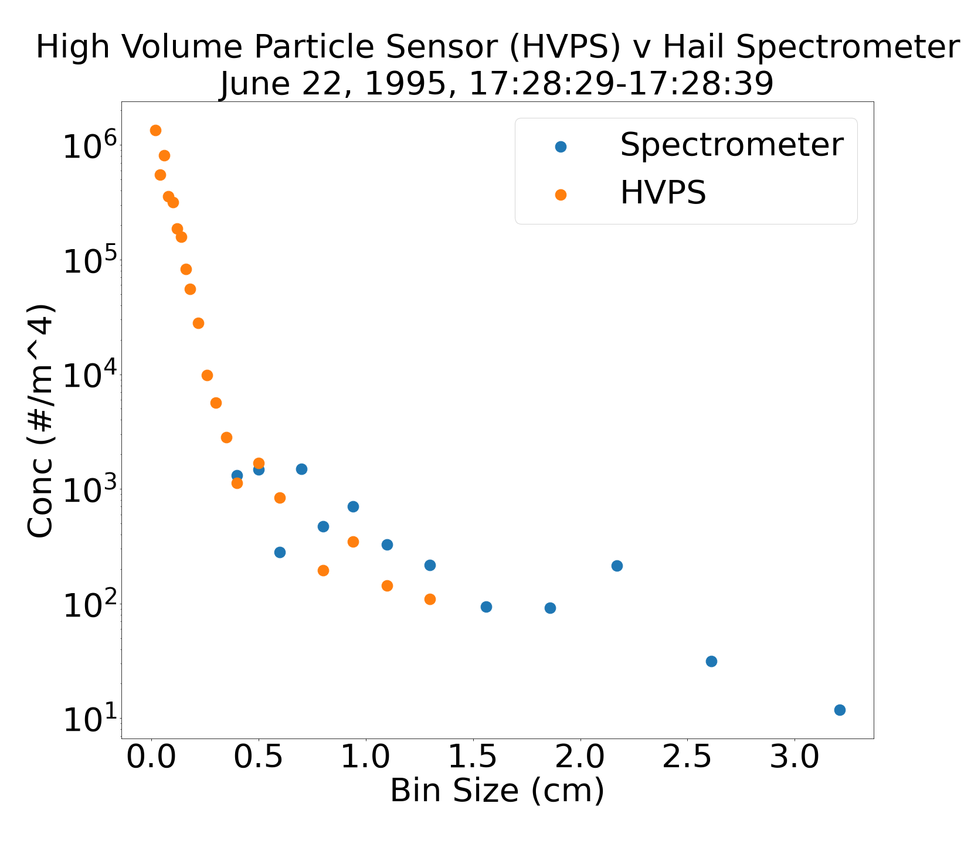
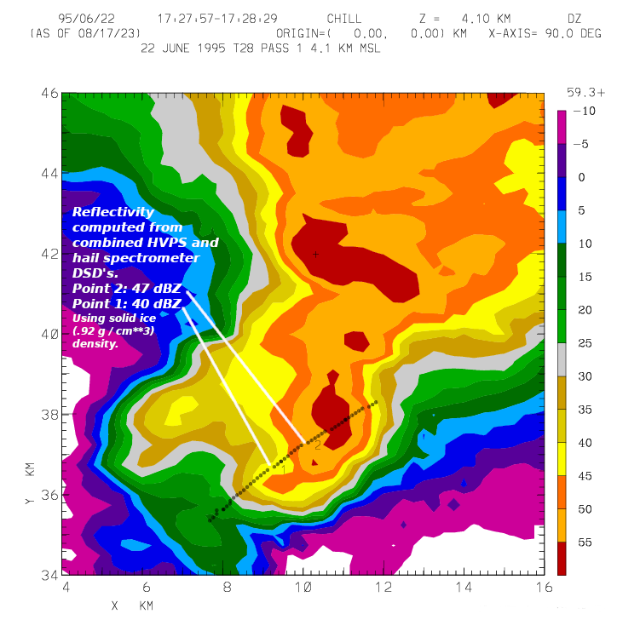
38 - Quantitative Interpretation of Polarimetric Radar Observations of Hail
James Klinman¹ , Andy Detwiler¹, Dave Delene¹, Pat Kennedy², Ivan Arias²,
V. Chandrasekar², Aaron Bansemer³, Andy Heymsfield³
¹Univeristy of North Dakota, Dept. Atmospheric Sciences, ²Colorado State University, Dept. Electrical Engineering,
³National Center for Atmospheric Science, Mesoscale & Microscale Meteorology Lab
Summary
Example: Hail In Updraft Near Melting Level and In Downdraft
We are using polarimetric signatures observed by weather radars to compare to polarimetric signatures calculated from in situ microphysical observations from hail-containing storm regions. We will improve our capability to relate polarimetric radar returns to microphysical conditions in storms, including hail size, shape, concentration, density and liquid fraction.
T28 Flight 668, June 22, 1995. Aircraft track is 17:28:00 – 17:29:15 MT.
The bottom left (Case 1) point is at 17:28:19
The upper right point (Case 2) is at 17:28:39
Case 1: Heavy rain in updraft near melting level at a height of ~2.7 km.
4.5 cm
Above: Particles imaged by High Volume Particle Sensor (HVPS).
To the right: A particle size distribution (PSD) of the particle concentration per bin.
Case 2: Centimeter sized hail near melting level in downdraft at a height of ~2.7 km
Introduction
The South Dakota School of Mines and Technology operated an armored T-28 aircraft that had the ability to obtain in situ microphysical observations in convective storms from 1970 – 2004. The armor allowed it to operate in storms containing hail up to ~5 cm. A digital archive of these observations from all research flights conducted from 1989 – 2003 is hosted at NCAR’s Data Management and Services within their Earth Observing Laboratory. These flights were almost all conducted in coordination with polarimetric weather radars, typically the CSU-CHILL radar operated by Colorado State University and the CP-2/Spol radar operated by NCAR. These radar observations are archived with the aircraft data.
4.5 cm
Above: Particles imaged by HVPS.
To the right: A (PSD) of the particle concentration per bin.
Calculating Radar Variables
Future Objectives
Using a best fit to the PSDs, along with a range of assumptions for ice density, we are developing a method to calculate the radar variables from the PSDs to compare with the observed variables.
Automate the processing of all T28 data.
Identify and carry out efficient and impactful ways to analyze the large amount of data.
Acknowledgements
Our effort is supported by the National Science Foundation collaborative research award 2221719

