Slide 1


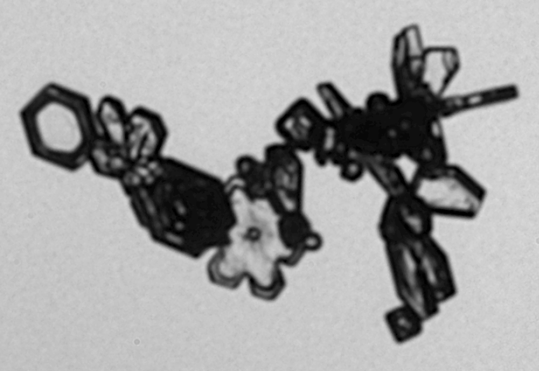
Identifying Ice Crystal Chain Aggregates in Cold-Season Storms: Leveraging Machine Learning to Map Occurrence and Distribution
Christian M. Nairy¹ (christian.nairy@und.edu), David J. Delene¹, Shawn W. Wagner¹, Joseph A. Finlon^{2, 3}, John E. Yorks²
¹University of North Dakota, Department of Atmospheric Science
²National Aeronautics and Space Administration (NASA) - Goddard Space Flight Center
³Earth System Science Interdisciplinary Center (ESSIC), University of Maryland
200 μm
5th International Summer Snowfall Workshop - 15 - 17 September 2025, Department of Meteorology, University of Reading, UK

Slide 2
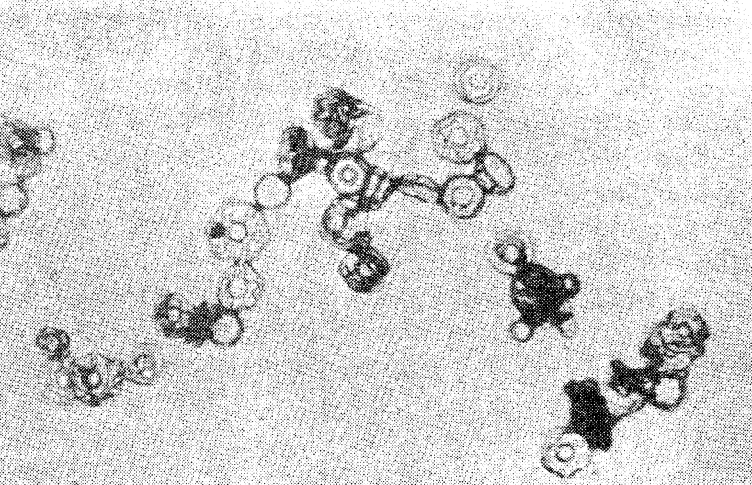
Background
Chain Aggregate: Unusually elongated, quasi-linear ice crystal aggregate consisting of three or more discernable ice monomers joined together end-to-end or by small joints (Nairy, 2022).
Laboratory experiments show that chain aggregation occurs in the presence of strong electric fields (>60 kV m⁻¹) between -5 and -37 °C (Maximum efficiency at -8 °C) [Saunders & Wahab, 1975].
Chain aggregation efficiency found to be temperature depended.
Chains are observed in mid- to upper-level tropical, subtropical, and midlatitude summertime storms.
Cirrus anvils during CapeEx19 (Florida) where in-situ E-Fields < 60 kV m⁻¹.
Deep stratiform cirrus anvils during ABFM-II (Florida) where in-situ E-Fields < 60 kV m⁻¹.
Cirrus outflow during EMERALD-II (Darwin)
Convective cloud tops during CIRCLE-II (western Europe)
Overshooting tops during DC3 (eastern Colorado)
200 μm
5th International Summer Snowfall Workshop - 15 - 17 September 2025, Department of Meteorology, University of Reading, UK
Notes:
Ice particle aggregation in the atmosphere is attributed to aerodynamic, inertial, and gravitational forces, which are applied constantly during ice crystal interactions (Finnegan & Pitter, 1988). Ice crystal interactions influenced by electrical forces have been investigated; however, the effects of electric fields and charges on ice crystals are not well understood.

Slide 3
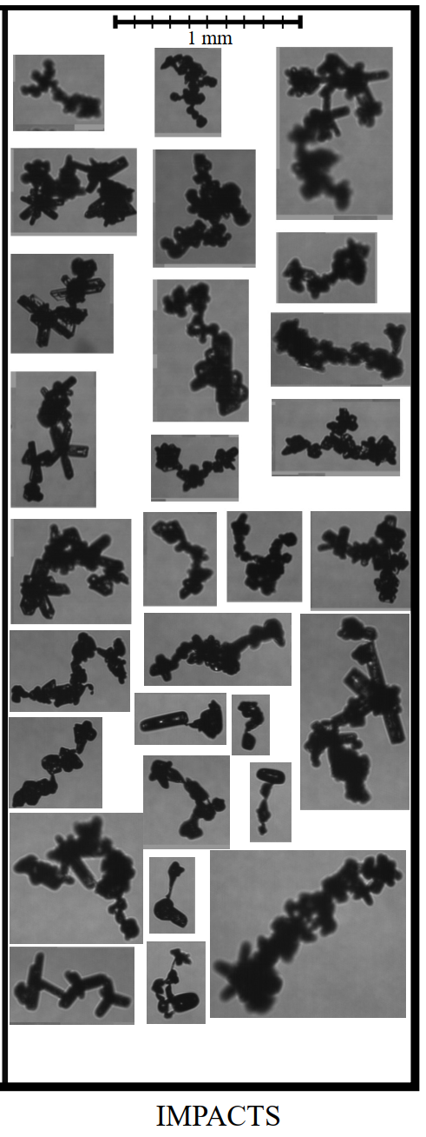
Motivation for Research
Hawkeye-CPI Images
The chain aggregation process is still not well understood.
Where and how do these aggregates form?
Laboratory results and aircraft observations are not in agreement.
Chain aggregates are not represented in current cloud models.
Recent observations of chain aggregates in cold-season storms (NASA IMPACTS) challenge existing theories and add uncertainty to our understanding.
Nairy, Christian M., David J. Delene, Joseph A. Finlon, John E. Yorks, Emma Järvinen, Martin Schnaiter, Andrew J. Heymsfield, Andrew G. Detwiler, Lynn A. McMurdie, Unveiling In-situ Observations of Ice Crystal Chain Aggregates in Winter Storms. Journal of Geophysical Research Letters, In Review, 2025. Preprint: https://d197for5662m48.cloudfront.net/documents/publicationstatus/271990/preprint_pdf/0e470a6a2eee19f7dad1defe572d8aea.pdf
5th International Summer Snowfall Workshop - 15 - 17 September 2025, Department of Meteorology, University of Reading, UK
Notes:
Ice particle aggregation in the atmosphere is attributed to aerodynamic, inertial, and gravitational forces, which are applied constantly during ice crystal interactions (Finnegan & Pitter, 1988). Ice crystal interactions influenced by electrical forces have been investigated; however, the effects of electric fields and charges on ice crystals are not well understood.

Slide 4
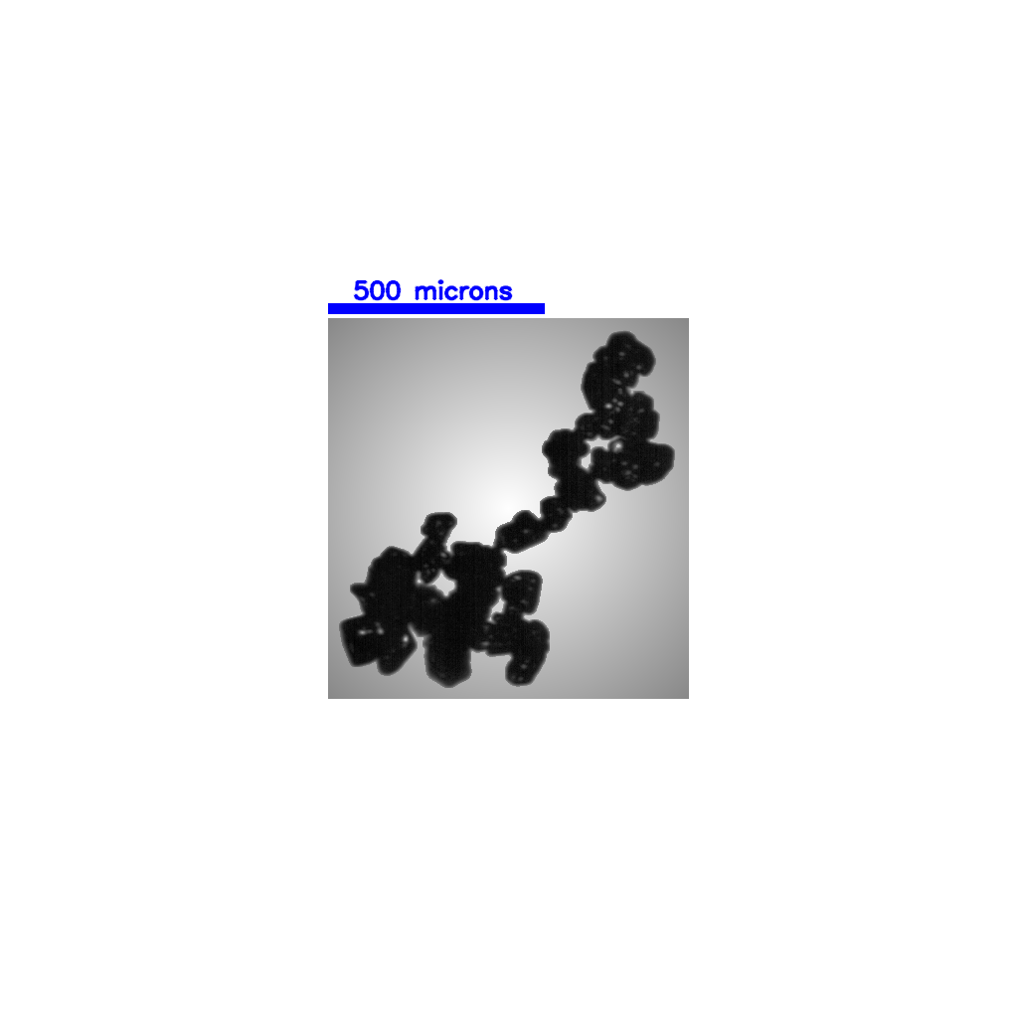
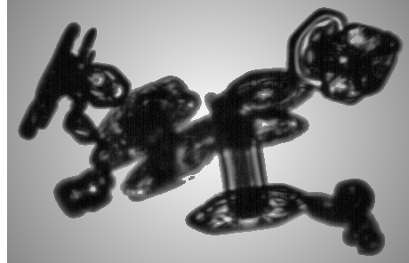
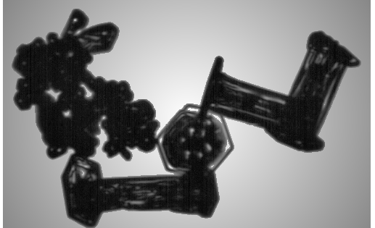
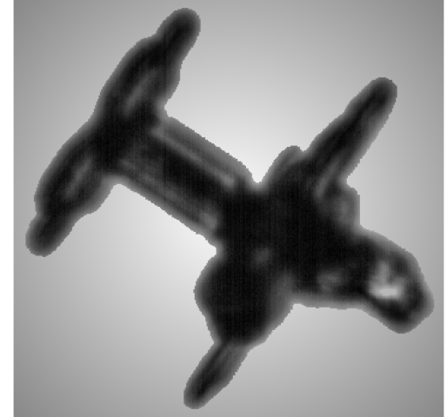
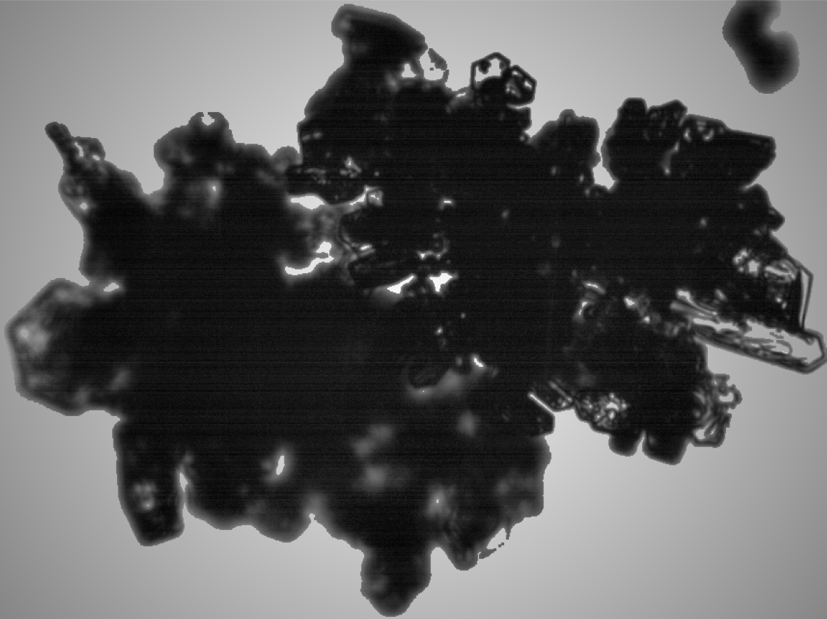
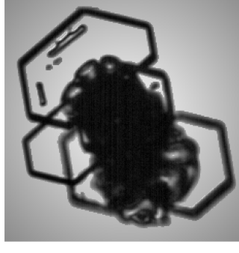
Objective
Understanding chain aggregate formation within cloud systems requires contextual analysis, but manual classification of cloud particles is extremely time-consuming.
Presentation Objective: Employ a supervised Convolutional Neural Network (CNN) to differentiate ice crystal chain aggregates from non-chain aggregates.
Convolutional Neural Network
5th International Summer Snowfall Workshop - 15 - 17 September 2025, Department of Meteorology, University of Reading, UK
Notes:
All-in particles only!

Slide 5
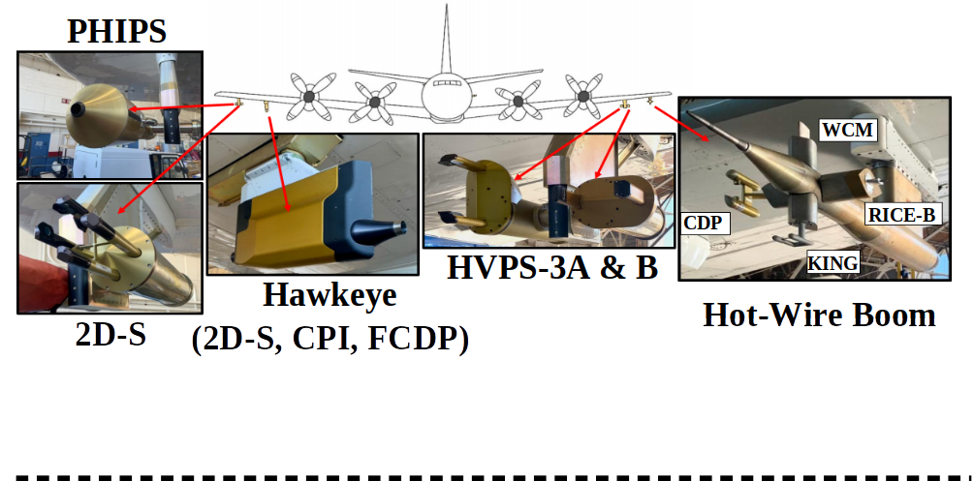
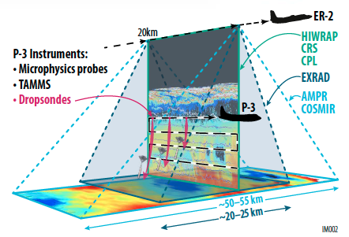
Methodology
Utilize 56,193 manually classified ice crystals (D_{max} > 150 µm) obtained from Cloud Particle Imager (CPI) observations during NASA’s IMPACTS field campaign.
Train, validate, and evaluate multiple CNN architectures.
Identify the most effective CNN for distinguishing chain aggregates.
Apply the best CNN model to classify CPI data from other IMPACTS flights.
Hawkeye-CPI
5th International Summer Snowfall Workshop - 15 - 17 September 2025, Department of Meteorology, University of Reading, UK
Notes:
All-in particles only!

Slide 6
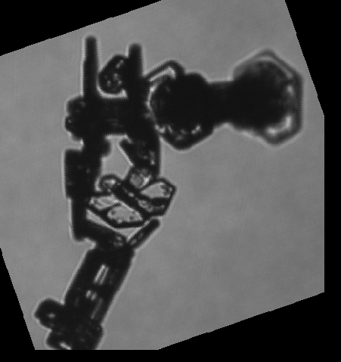
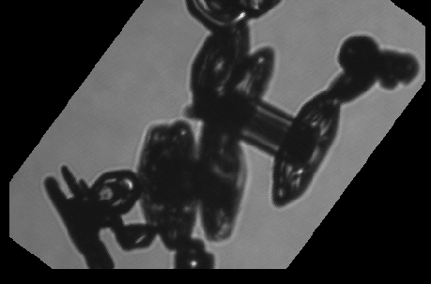
End-to-End CNN Pipeline for Chain Aggregate Classification
Classified Images
Class Balancing
Input
80/20 Train/Validation
Split
Training Dataset
Non-chains: 55,162
Chains:
1,031
Non-chains: 55,162
Chains:
55,162
Non-chains: 44,130 Chains: 44,130
Chain Agg. Image
Augmentation
Validation Dataset
Non-chains: 11,032 Chains: 11,032
Evaluation on Unseen, Labeled Data
CNN Architecture
Training
Epoch Validation
Non-chains: 5,520; Chains: 110
ResNet18/34/50/100
VGG16/19
Model Calibration Analysis
F1 Threshold Tuning
Save Best Model Epoch
Accuracy, Precision, Recall, F1 Scores
ROC-AUC
Error & Statistical Analysis
Prediction Metrics
Epochs: 30
Learning Rate: 0.0001
Batch Size: 64
Optimizer: Adam
Criterion: Binary Cross Entropy Loss
5th International Summer Snowfall Workshop - 15 - 17 September 2025, Department of Meteorology, University of Reading, UK
Notes:
Random Forest builds multiple decision trees using random subsets of data and features, then combines their predictions (via majority vote for classification) to produce a more accurate and robust result.

Slide 7
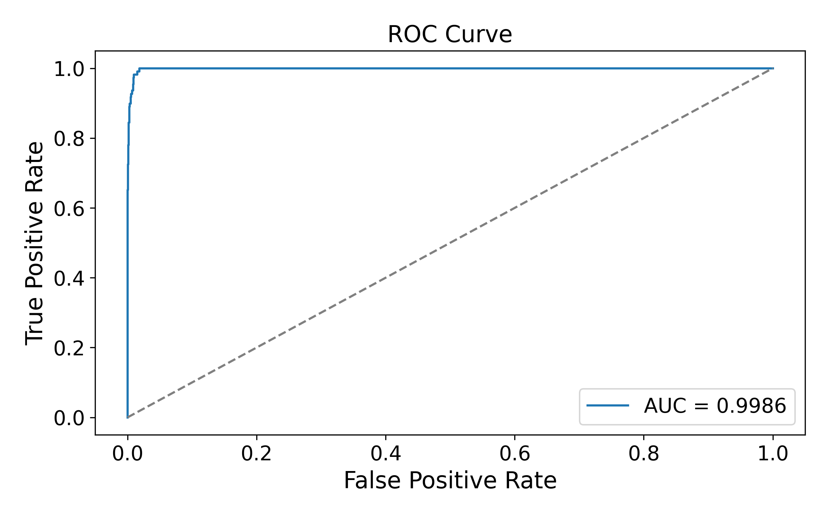
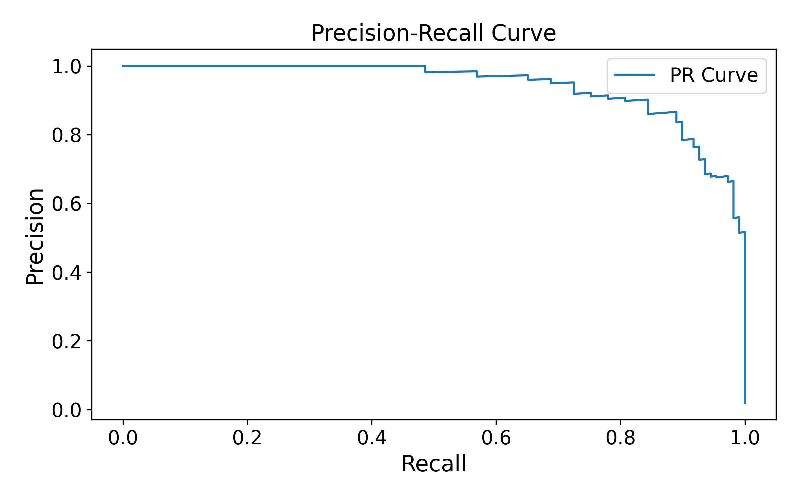
CNN Validation on Unseen Labeled Dataset
Key Takeaways (Receiver Operating Characteristic-Area Under the Curve [ROC-AUC] plot):
- AUC = 0.9986, indicating near-perfect discrimination between chain and non-chain classes.
- Very low false positive rate at high true positive rates.
Key Takeaways (P-R Curve):
- Precision remains >90% until very high recall values.
- Confirms strong detection of chains even in a highly imbalanced dataset.
- Do we maximize precision or recall?
5th International Summer Snowfall Workshop - 15 - 17 September 2025, Department of Meteorology, University of Reading, UK

Slide 8
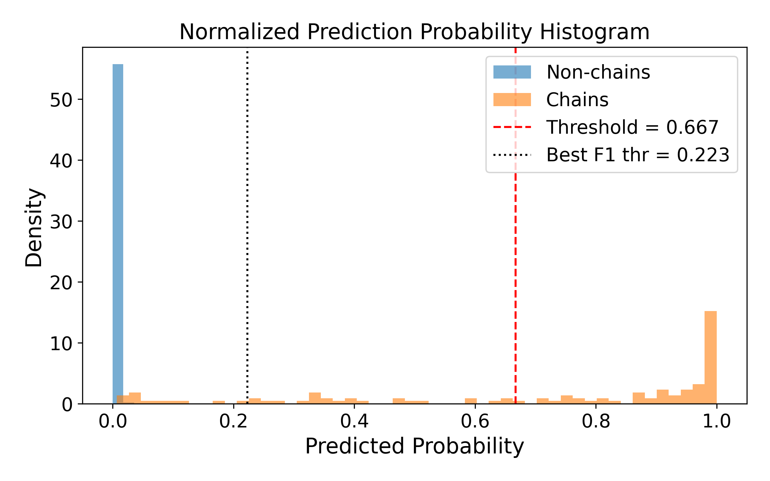
CNN Validation on Unseen Labeled Dataset
Key Takeaways:
- Model outputs are sharply separated
- Threshold choice impacts detection
Optimized F1 threshold (0.223) → more chains detected (higher recall) but susceptible to more FP.
Empirical threshold (0.667) → fewer false positives (higher precision and more conservative).
5th International Summer Snowfall Workshop - 15 - 17 September 2025, Department of Meteorology, University of Reading, UK

Slide 9
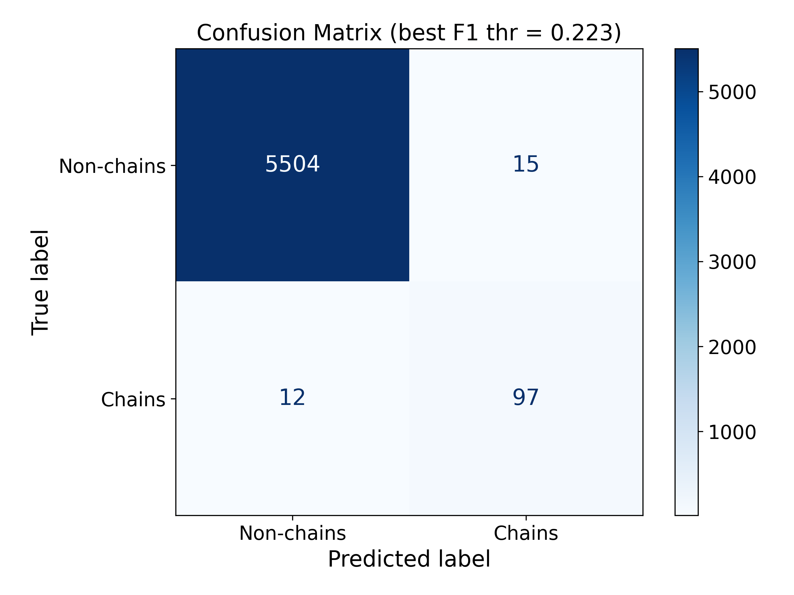

CNN Validation on Unseen Labeled Dataset
Key Takeaways:
- Lower threshold finds more chains; higher threshold ensures precision.
5th International Summer Snowfall Workshop - 15 - 17 September 2025, Department of Meteorology, University of Reading, UK

Slide 10
CNN Validation on Unseen Labeled Dataset
Class | Classification Report (Pred Thresh: 0.223) |  |  | Classification Report (Pred Thresh: 0.667)
 | Precision | Recall | F1-Score | Precision | Recall | F1-Score
Non-Chain Aggregate | 99% | 99% | 99% | 99% | 99% | 99%
Chain Aggregate | 87% | 89% | 88% | 96% | 66% | 78%
Macro Accuracy | 93% | 94% | 0.94% | 98% | 83% | 89%
Correlation Coef. | 0.88 |  |  | 0.80
Brier Score | 0.004
Key Takeaway:
- Lower threshold boosts recall, higher threshold boosts precision.
- Low Brier score (0.004) indicates our CNN’s probabilities are reliable, not just the hard classifications.
5th International Summer Snowfall Workshop - 15 - 17 September 2025, Department of Meteorology, University of Reading, UK

Slide 11
CNN Validation on Unseen Labeled Dataset
Class | Classification Report (Pred Thresh: 0.223) |  |  | Classification Report (Pred Thresh: 0.667)
 | Precision | Recall | F1-Score | Precision | Recall | F1-Score
Non-Chain Aggregate | 99% | 99% | 99% | 99% | 99% | 99%
Chain Aggregate | 87% | 89% | 88% | 96% | 66% | 78%
Macro Accuracy | 93% | 94% | 0.94% | 98% | 83% | 89%
Correlation Coef. | 0.88 |  |  | 0.80
Brier Score | 0.004
Key Takeaway:
- Lower threshold boosts recall, higher threshold boosts precision.
- Low Brier score (0.004) indicates our CNN’s probabilities are reliable, not just the hard classifications.
With strong validation and reliable probability calibration, our CNN can now be applied to map the occurrence and distribution of chain aggregates throughout the IMPACTS campaign.
5th International Summer Snowfall Workshop - 15 - 17 September 2025, Department of Meteorology, University of Reading, UK

Slide 12
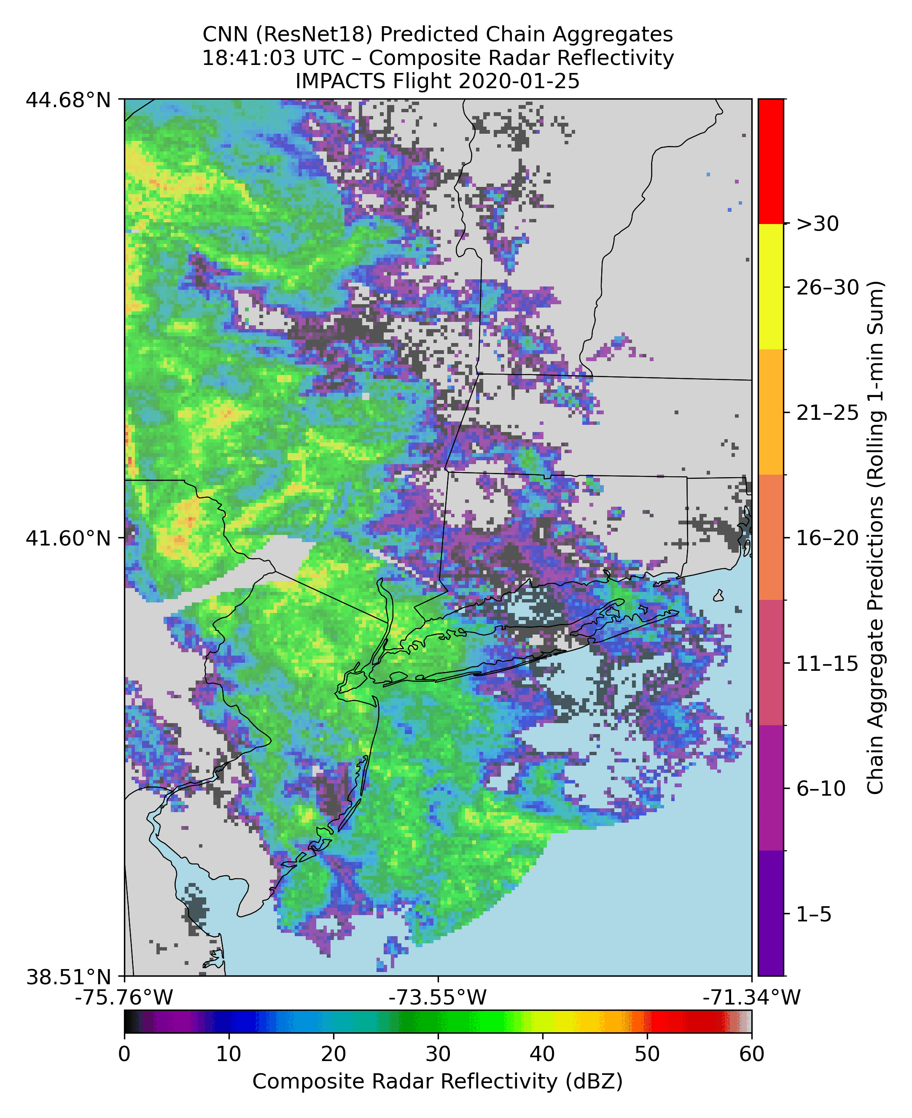
Applying CNN on IMPACTS Flight
5th International Summer Snowfall Workshop - 15 - 17 September 2025, Department of Meteorology, University of Reading, UK

Slide 13
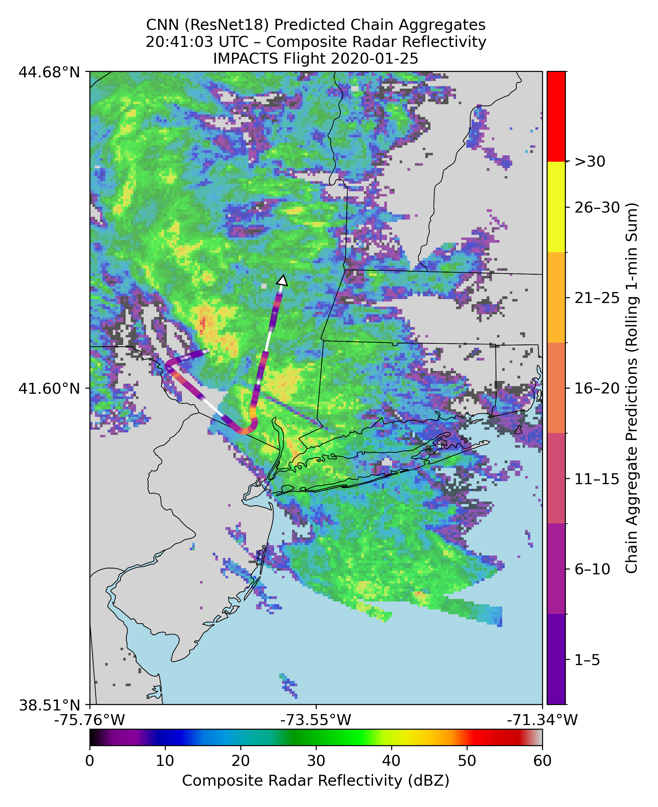
Applying CNN on IMPACTS Flight
5th International Summer Snowfall Workshop - 15 - 17 September 2025, Department of Meteorology, University of Reading, UK

Slide 14
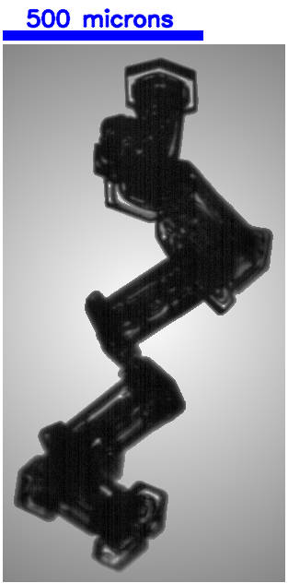
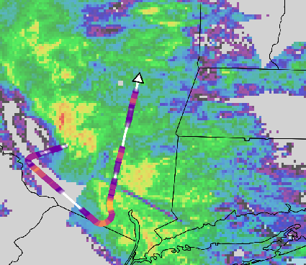
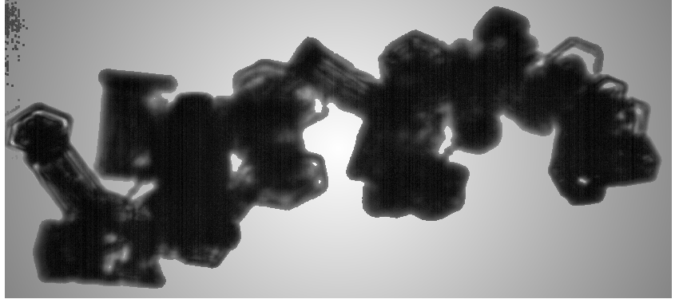
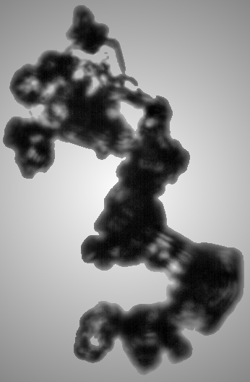
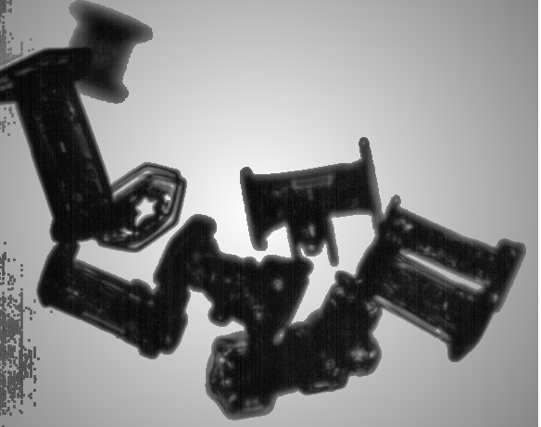
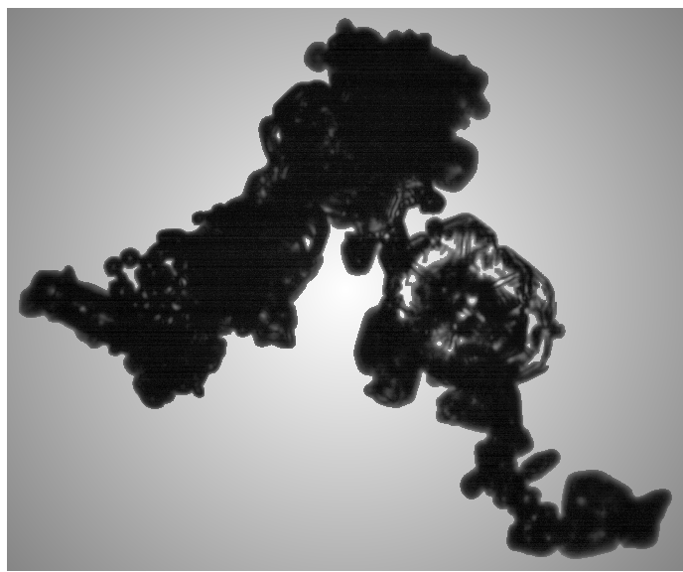
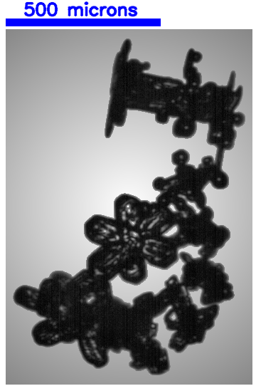
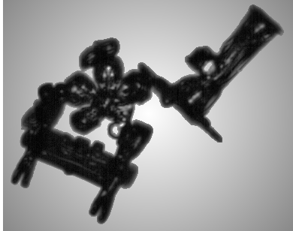
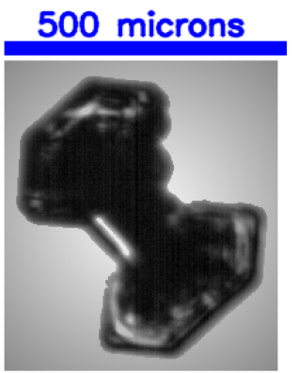
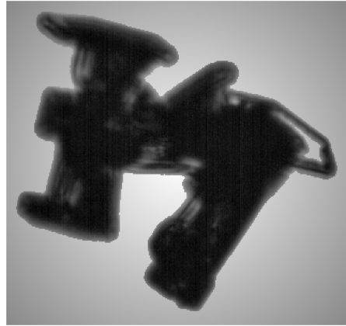
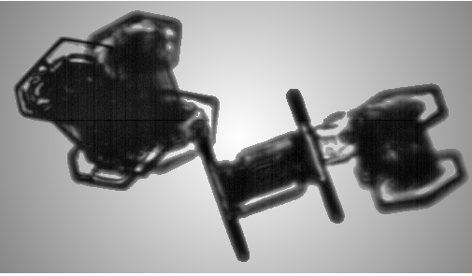
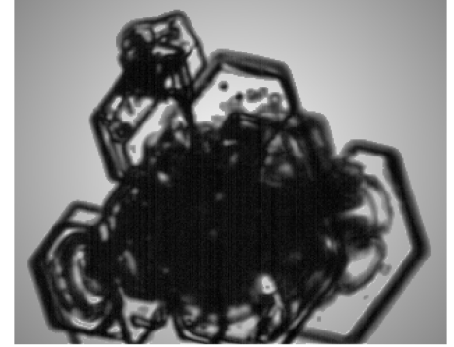
Applying CNN on IMPACTS Flight

Slide 15
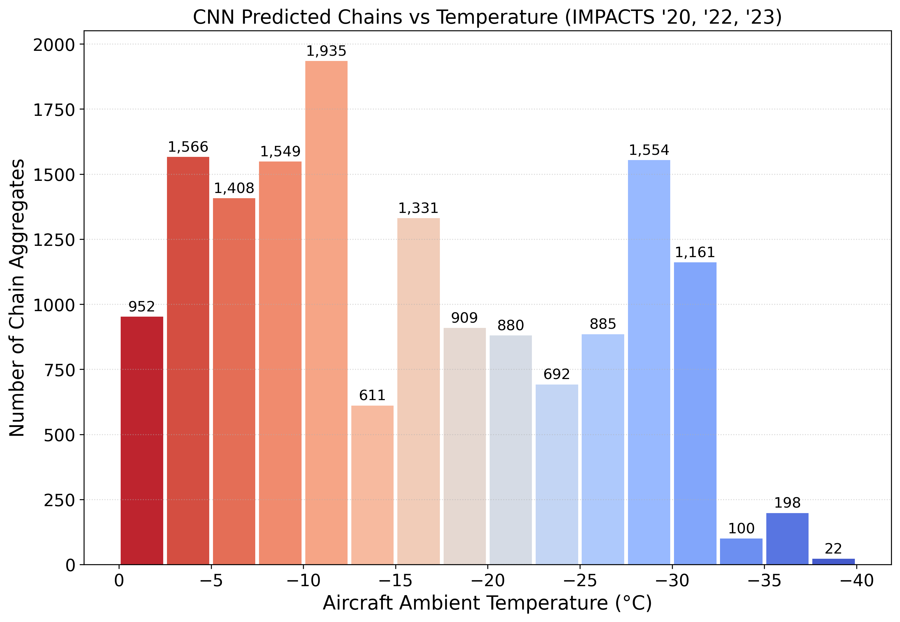
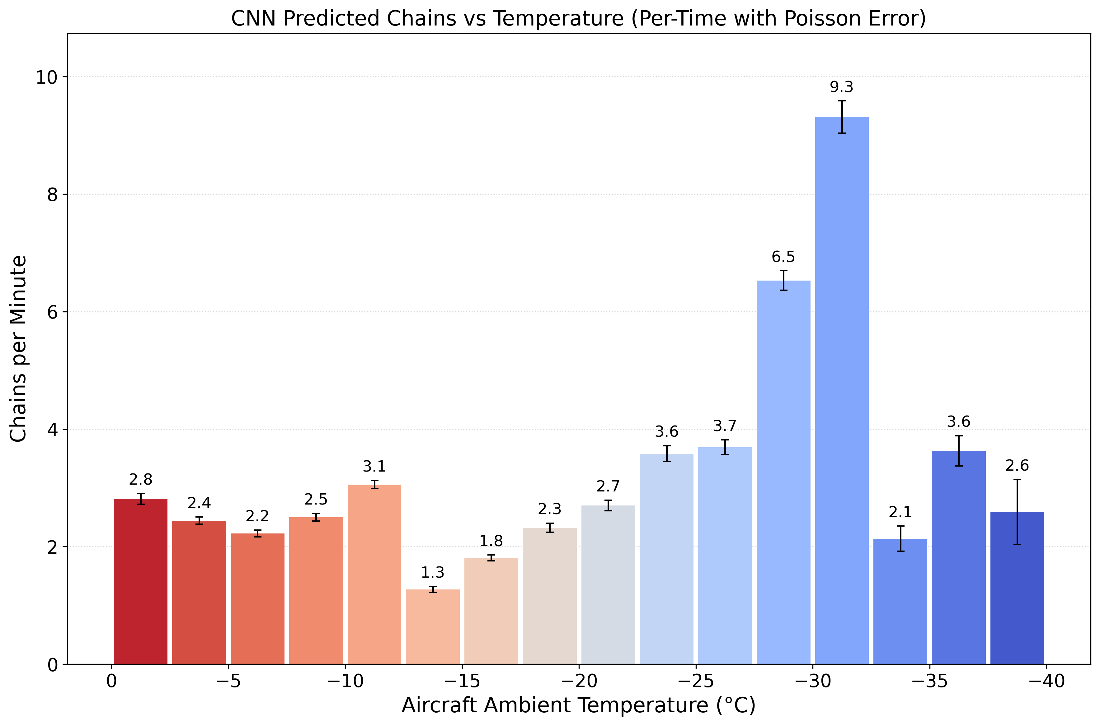
All IMPACTS Flights (34 Total)
5th International Summer Snowfall Workshop - 15 - 17 September 2025, Department of Meteorology, University of Reading, UK

Slide 16
Summary
Targeted CNN pipeline identifies chain aggregates in CPI imagery and generalizes to unseen flights.
ResNet18 is the top performer; with a conservative probability threshold (P > 0.66) it achieves high precision and minimizes false positives.
The approach enables flight-wide maps of chain-aggregate occurrence/concentration at second-level resolution.
Future Work:
Contextualize detections: identify high/low concentration regions and relate them to storm phase and environment (from coarse to fine scale).
Fuse measurements: improve along-track and 3-D localization by integrating ER-2 radar/lidar and electric-field data.
Broaden scope: apply across additional field campaigns and other habits; release code and catalogs.
5th International Summer Snowfall Workshop - 15 - 17 September 2025, Department of Meteorology, University of Reading, UK

Slide 17
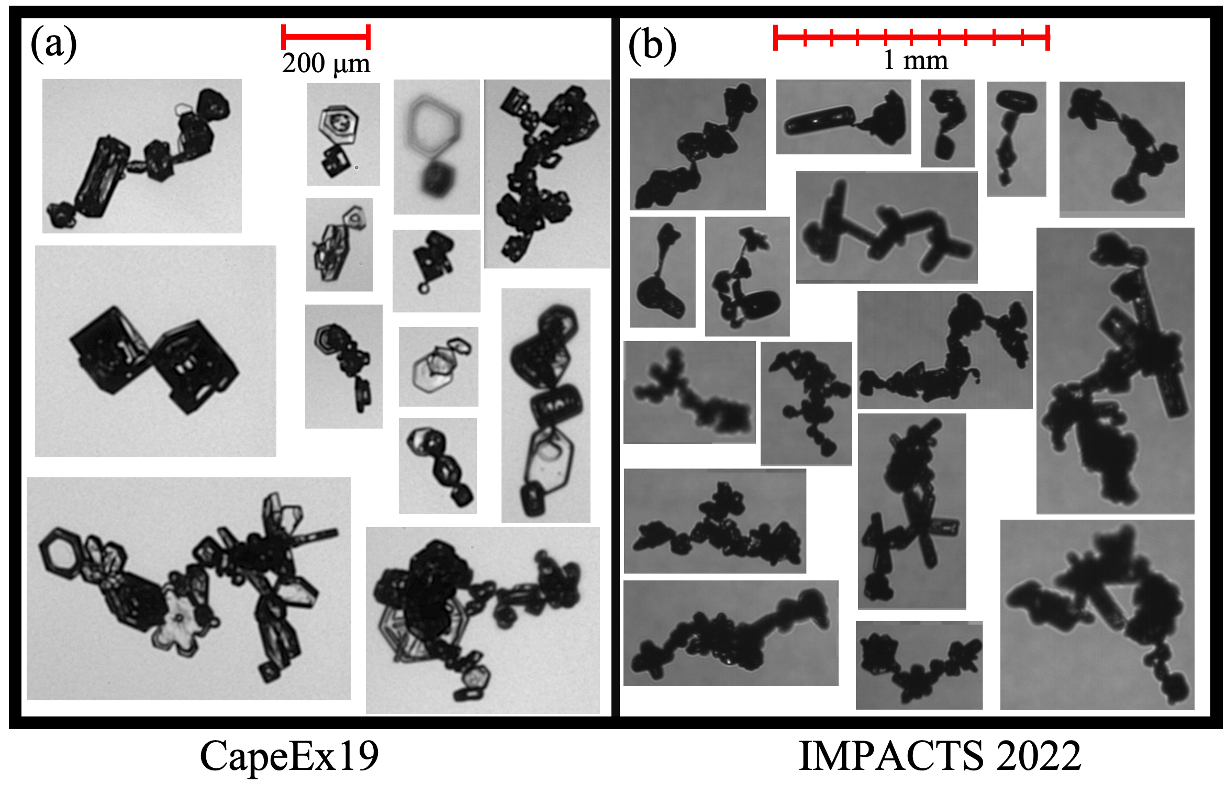
References & Acknowledgements
17
Baran, A. J. (2009). A review of the light scattering properties of cirrus. Journal of Quantitative Spectroscopy and Radiative Transfer, 110(14), 1239–1260. https://doi.org/10.1016/j.jqsrt.2009.02.026
Connolly, P. J., Saunders, C. P. R., Gallagher, M. W., Bower, K. N., Flynn, M. J., Choularton, T. W., et al. (2005), Aircraft observations of the influence of electric fields on the aggregation of ice crystals. Quarterly Journal of the Royal Meteorological Society , 131 (608), 1695–1712. https://doi.org/10.1256/qj.03.217
Liou, K. N. (1973). Transfer of Solar Irradiance through Cirrus Cloud Layers., J. Geophys. Res., 78, 1409–1418.
Nairy, C. M. (2022). Observations of Chain Aggregates in Florida Cirrus Cloud Anvils on 3 August 2019 during CAPEEX19 (Master’s thesis), Dept. of Atmospheric Sciences, University of North Dakota, Grand Forks, North Dakota. Retrieved from https://commons.und.edu/theses/4363/
Saunders, C. P. R., & Wahab, N. M. A. (1975). The Influence of Electric Fields on the Aggregation of Ice Crystals. Journal of the Meteorological Society of Japan. Ser. II, 53(2), 121–126. https://doi.org/10.2151/jmsj1965.53.2_121
Schmitt, C. G., and A. J. Heymsfield (2014), Observational quantification of the separation of simple and complex atmospheric ice particles, Geophys. Res. Lett., 41, 1301–1307, doi:10.1002/2013GL058781.
Stephens, G. L., Tsay, S.-C., Stackhouse, P. W., & Flatau, P. J. (1990). The Relevance of the Microphysical and Radiative Properties of Cirrus Clouds to Climate and Climatic Feedback. Journal of the Atmospheric Sciences, 47(14), 1742–1754. https://doi.org/10.1175/1520-0469(1990)047<1742:TROTMA>2.0.CO;2
Stith, J. L., Avallone, L. M., Bansemer, A., Basarab, B., Dorsi, S. W., Fuchs, B., et al. (2014). Ice particles in the upper anvil regions of midlatitude continental thunderstorms: the case for frozen-drop aggregates. Atmospheric Chemistry and Physics, 14(4), 1973–1985. https://doi.org/10.5194/acp-14-1973-2014
This research was supported by a NASA MOSAICS research grant to the University of North Dakota. Grant #: 435002210UND0029914. The IMPACTS dataset is publicly available at the NASA GHRC http://dx.doi.org/10.5067/IMPACTS/DATA101. We would also like to thank Andrew Heymsfield and Stephen Nicholls for their added expertise in this analysis.
Thank you.
5th International Summer Snowfall Workshop - 15 - 17 September 2025, Department of Meteorology, University of Reading, UK

Slide 18
Extra Slides

Slide 19
Dataset/Instrumentation
Investigation of Microphysics and Precipitation for Atlantic Coast-Threatening Snowstorms (IMPACTS).
NASA P-3b Orion Research Aircraft
Hawkeye-Cloud Particle Imaging (CPI) Probe
King Probe (Liquid Water Content [LWC])
Adapted from the NASA IMPACTS executive summary (https://espo.nasa.gov/impacts/).
Hawkeye-CPI
105th AMS Annual Meeting – Second Symposium on Cloud Physics: New and Emerging Measurement Methods in Cloud and Precipitation Research III

Slide 20
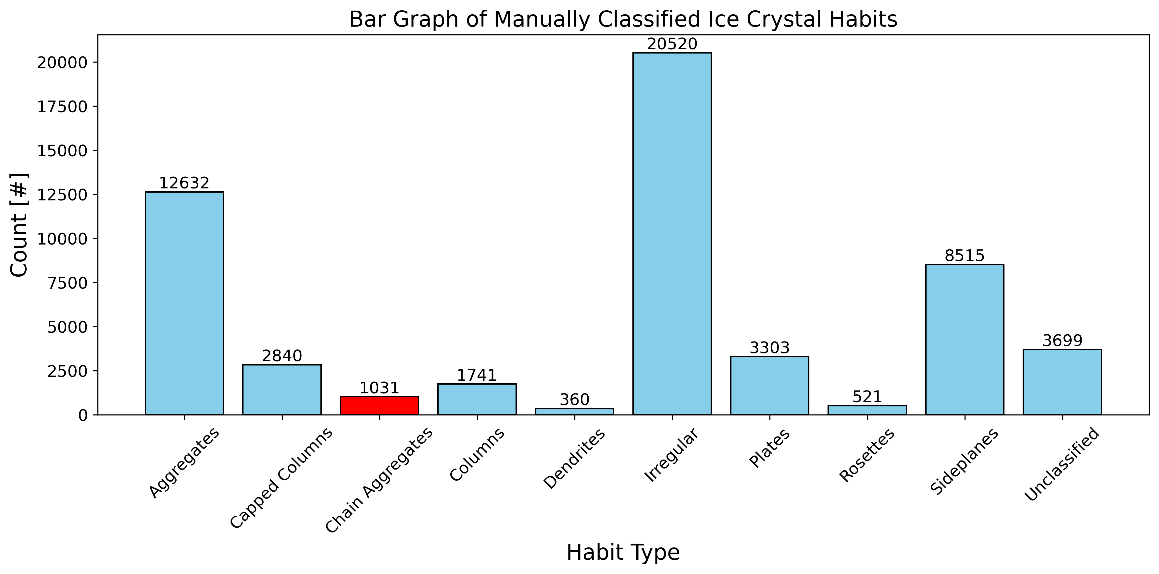
Manual Particle Classifications
CPI probe data from NASA IMPACTS.
5 Flight Segments Classified:
Temperature Range: -36 to -5 ºC
Total # of Particles Classified (after QA/QC): 56,193
# of Chain Aggregates Classified (after QA/QC): 1,031
5th International Summer Snowfall Workshop - 15 - 17 September 2025, Department of Meteorology, University of Reading, UK

Slide 21
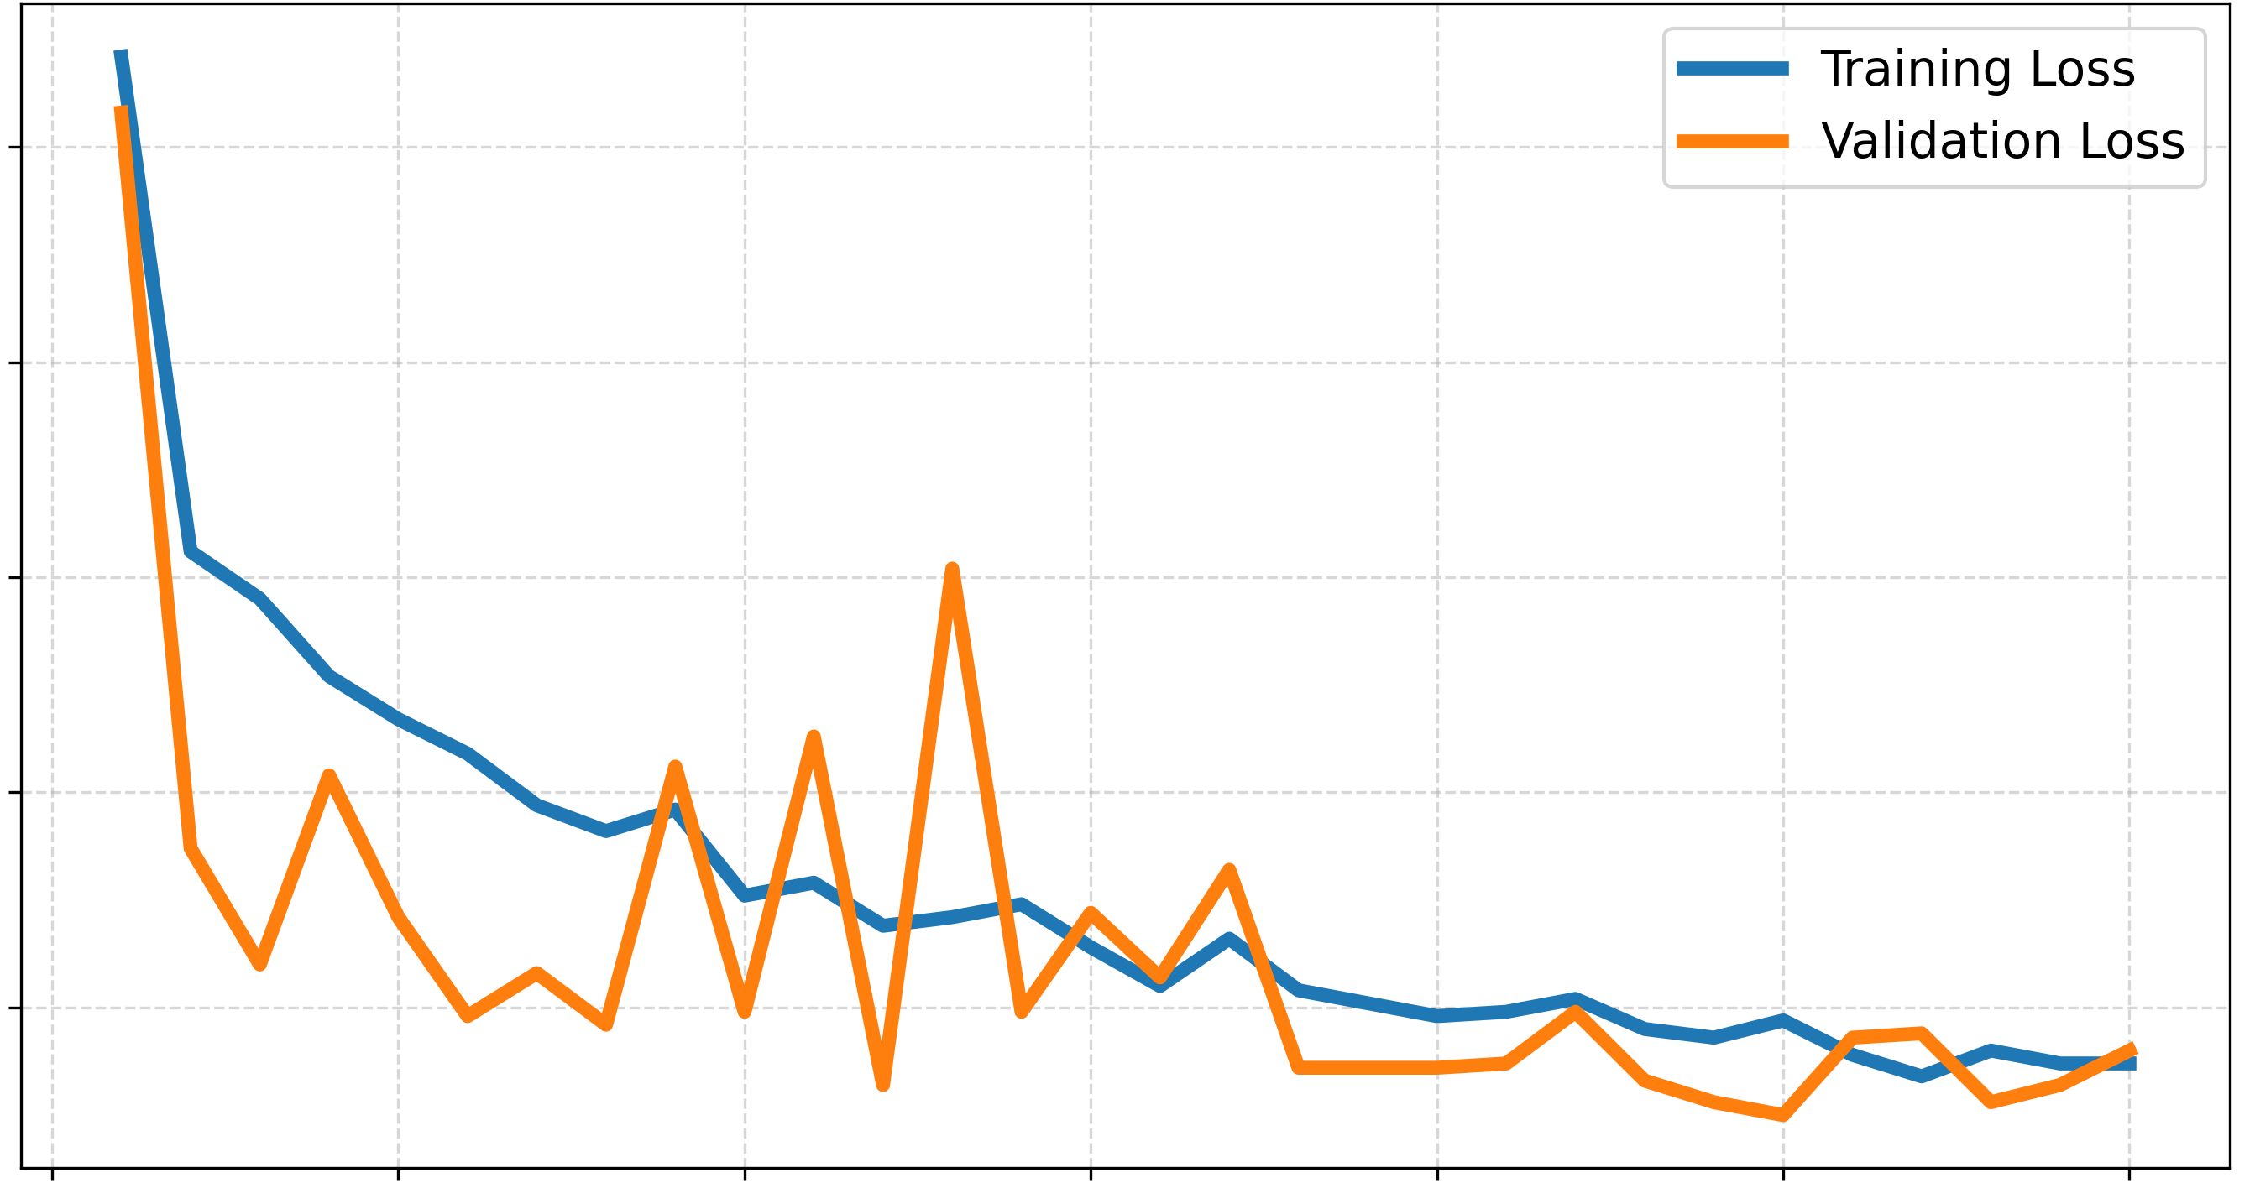
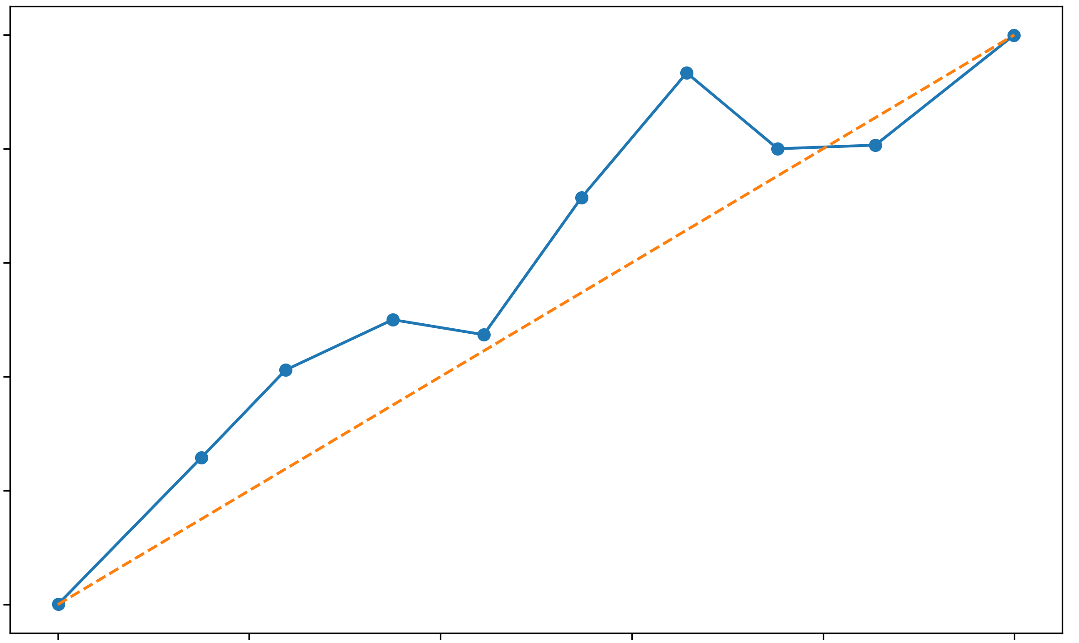
CNN Training Validation
ResNet18
Training & Validation Loss
ResNet18 (Epoch 25)
Calibration Curve
1.0
0.030
0.8
0.025
Loss
0.6
0.020
True Probability
0.4
0.015
0.2
0.010
0.0
0
5
10
15
20
25
30
0.0
0.2
0.4
0.6
0.8
1.0
Epoch
Predicted Probability
The close tracking between training and validation loss throughout the epochs suggests minimal overfitting.
The relatively low final loss implies the model has effectively learned discriminative features.
The low noise and tight coupling between the curves is a sign of a stable and well-regularized training process.
Curve implies that the model's confidence scores are reliable for both strong positives and strong negatives.
At epoch 25, the model is well-calibrated for high-confidence predictions.
Minor overconfidence in the mid-range, though, this model offers a good balance of accuracy and interpretability.
5th International Summer Snowfall Workshop - 15 - 17 September 2025, Department of Meteorology, University of Reading, UK
Notes:
Key Annotations:
Epoch 1–5:
Rapid drop in both training and validation loss.
Indicates the model quickly learned the most distinguishable features between chain aggregates and non-chains.
Epoch 6–20:
Loss curves continue to decline gradually with occasional small bumps in validation loss.
These fluctuations may correspond to momentary overfitting, but the model recovers quickly — showing robust learning and good generalization.
Epoch 21–30:
Both curves plateau and converge tightly around ~0.009.
This flattening indicates convergence — the model is no longer improving significantly, suggesting that training could be stopped here.
Key Annotations:
0.0–0.3 Range:
Predicted probabilities align closely with the ideal diagonal.
Indicates good confidence estimation for low-probability predictions (i.e., confident negatives).
0.4–0.8 Range:
Slight deviation below the diagonal suggests mild overconfidence — predicted probabilities are slightly higher than actual observed frequencies.
May benefit from post-training calibration (e.g., Platt scaling, temperature scaling) if fine-tuned confidence estimates are needed.
0.9–1.0 Range:
The model becomes well-calibrated again for high-confidence predictions (confident positives).
This is particularly important for your application, as the top ~10% of confident predictions likely reflect true chain aggregates.

Slide 22
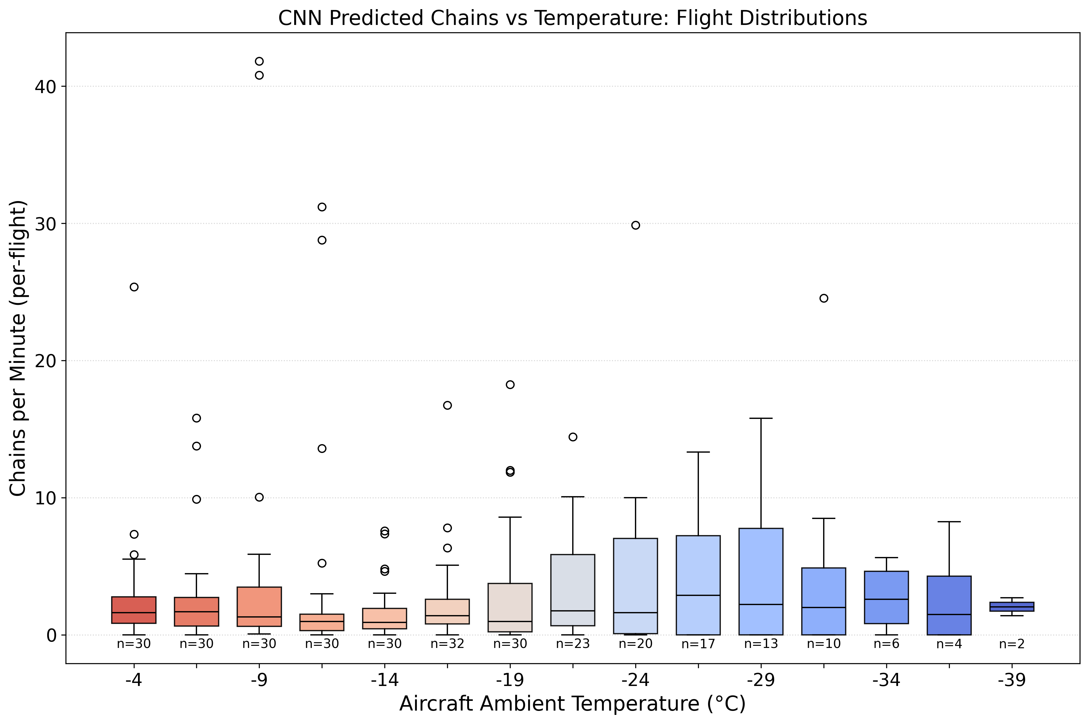
Distributions (Extra)

