Slide 1
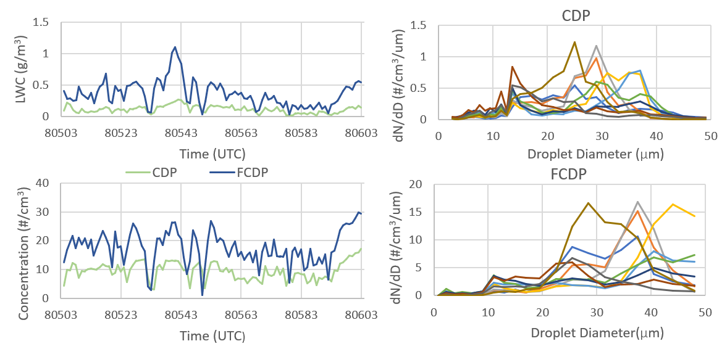
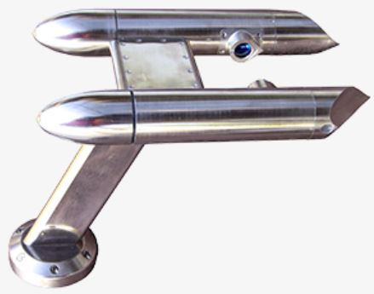
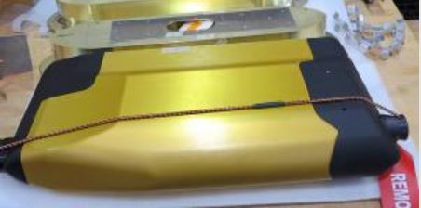
A Comparison of In-Situ Cloud Droplet Measurements during IMPACTS 2020
Patricia Hopp (patricia.hopp@und.edu), David Delene, Michael Poellot
Department of Atmospheric Sciences, University of North Dakota, Grand Forks, ND
Introduction and Motivation
The Investigation of Microphysics and Precipitation for Atlantic Coast-Threatening Snowstorms (IMPACTS) explores the formation, organization, and evolution of Northeastern snowstorms. A Cloud Droplet Probe (CDP) and Fast Cloud Droplet Probe (FCDP) were deployed onto a P-3 NASA aircraft which sampled clouds with very little ice content, gathering liquid water information based upon 2DS images.
The CDP works by measuring light scattering off cloud droplets by a laser in open air. A sample volume is also defined in the instrument so that number, number concentration, and Liquid Water Content (LWC) can be measured. The FCDP works in a similar method, only the sample area is through a double open-ended tube instead of in the open air. The FCDP is also a part of the multipurpose instrument Hawkeye.
The CDP was inoperable for the second half of flights. The objective of this project is to compare the CDP and FCDP due to their operational differences to determine if the CDP and the FCDP have agreeable data in both liquid water content and number concentration.
Results
CDP Avg: 0.110 g/m³
FCDP Avg: 0.358 g/m³
CDP Avg: 9.497 #/cm³
FCDP Avg: 17.611 #/cm³
Figures are for the Jan. 25, 2020 P-3 IMPACTS flight and time in seconds from midnight UTC. 10-second averages are used in both number concentration and liquid water content. For size distributions, central time of a 10-second interval is used. Clouds sampled have little to no ice content by using 2DS images.
CDP (left) and Hawkeye with FCDP (Right)
Conclusion
The CDP and FCDP do not agree in both liquid water content and number concentration in clouds containing little to no ice.
The FCDP recorded a higher number of droplets and larger droplets.
Acknowledgements
Research and travel was financially supported by the National Aeronautics and Space Administration (NASA)
Thank you, Michael Poellot and David Delene, for their guidance and support.
Notes:
Headings: 17 pt
Writing: 14 pt
Spacing: 12

