Slide 1
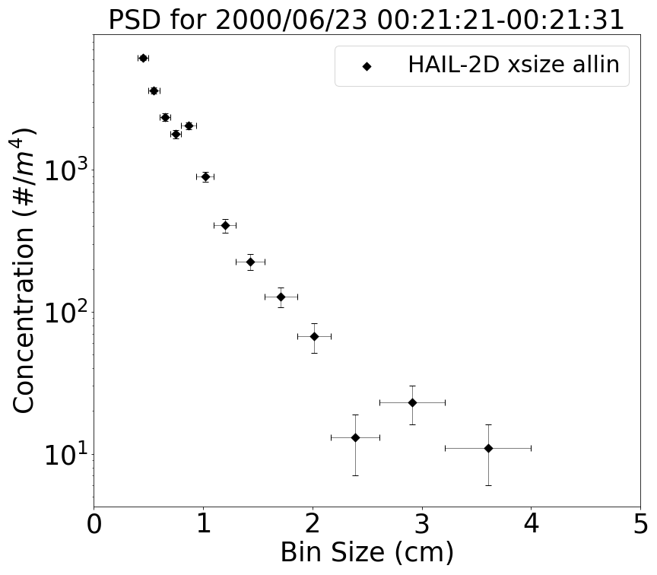
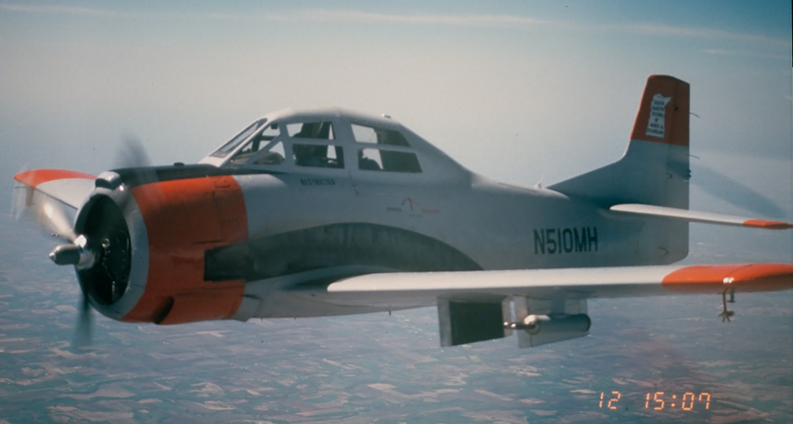
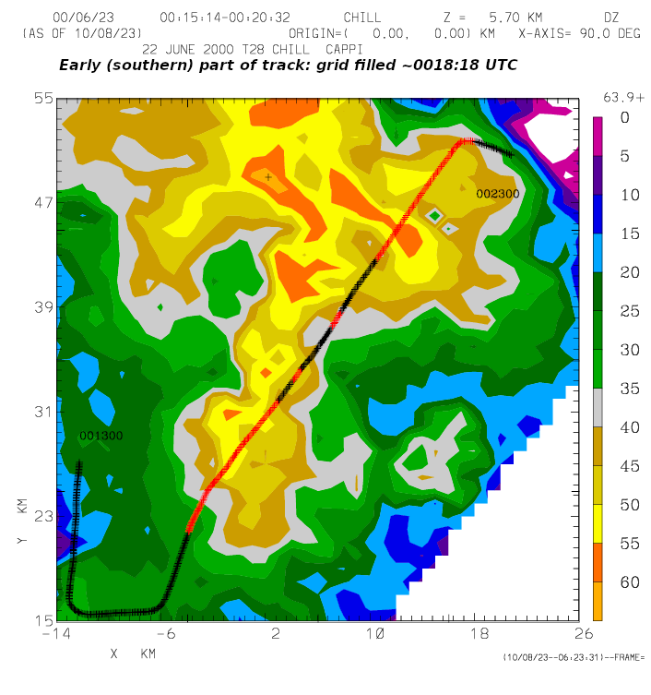
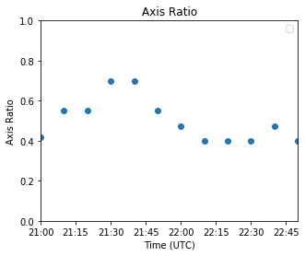
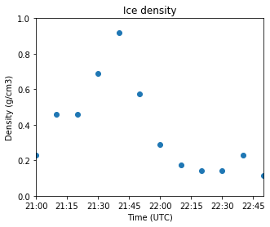
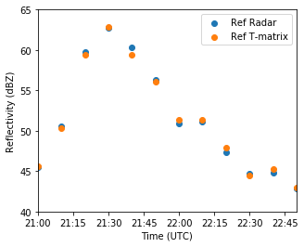
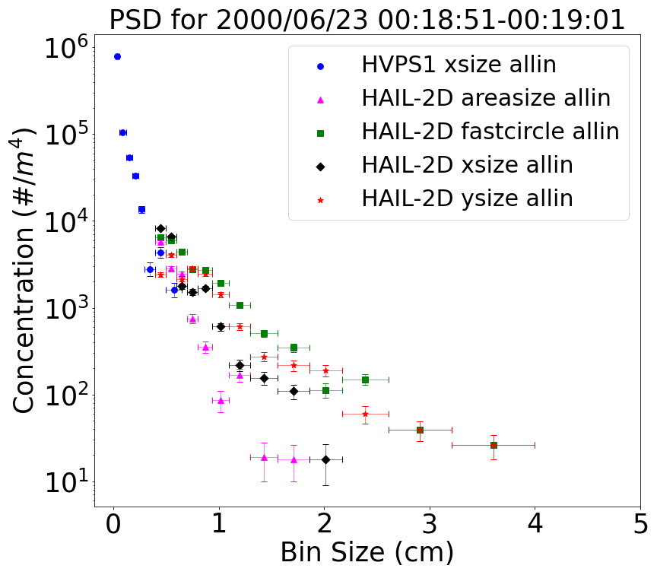
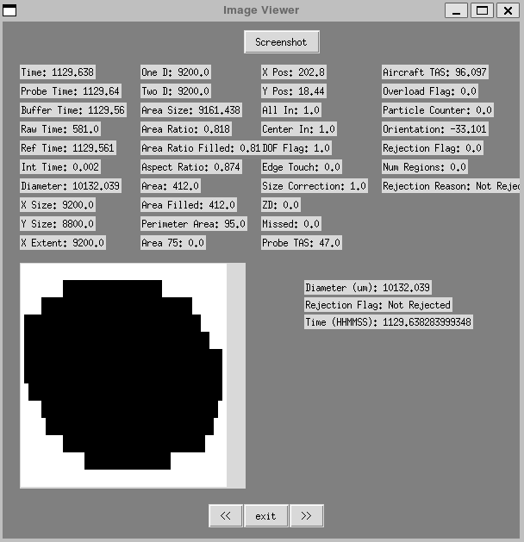
Quantitative Interpretation of Polarimetric Radar Observations of Hail
James Klinman¹ , Andrew Detwiler¹, David Delene¹, Patrick Kennedy², Ivan Arias²,
V. Chandrasekar², Aaron Bansemer³, Andrew Heymsfield³
¹Univeristy of North Dakota, ²Colorado State University, ³National Center for Atmospheric Science
Introduction & Background
Comparison of observed polarimetric radar signatures with in situ microphysical observations from storms containing hail.
Improving ability to relate polarimetric radar returns to storm microphysical conditions and hail properties.
Dataset comes from collaborations including the T28 aircraft operated by South Dakota School of Technology and Mines and the CSU-CHILL radar operated by Colorado State University during a series of field projects between the years 1989-2003.
The T28 aircraft recorded
variables such as liquid water
content and temperature. In
the initial case discussed here,
liquid water content peaked around 1.5 g/m³, and the
temperature was around -5ºC. Under these conditions,
hail stones of diameter 1 to 2 cm or more are likely to be
in a spongy growth mode with possible shedding.
Example PSD Used in Radar Calculations
For this particle size distribution (PSD), only Hail Spectrometer (Hail-2D) data was recorded for the time interval. This interval contained particles up to 4.0 cm leading to a peak in reflectivity in the calculated and observed reflectivity’s.
Calculating Radar Variables
Using PSDs along with a range of values for ice density and axis ratio, T-matrix calculations are used determine radar reflectivity and are under development to determine differential reflectivity, linear depolarization ratio, and the correlation coefficient. All three plots are from 2000/06/23 just past midnight UTC.
Radar Reflectivity for Initial Case
Aircraft track on 2000/06/23 during time period 00:13:00 – 00:23:00. Pilot took a sharp turn just before 00:22:00 to escape heavy hail. Aim was to fly into approximately 50dBz to encounter largest hail considered safe for T28 to fly in.
Time (MM:SS UTC)
Time (MM:SS UTC)
Reflectivity
Top right plot: Ice density is fraction of ice to air in the particles. It serves as a proxy for the complex refractive index of an ice particle.
Top left plot: Axis ratio is ratio of semi-major axis to major axis.
Bottom plot: Calculated reflectivity (Ref T-matrix) matches observed reflectivity (Ref Radar) very well.
Uncertainty and Quality Assurance
Diameter (um): 10131.04
Time (MM:SS UTC)
Rejection Flag: Accepted
Time (sfm): 1129.638
Future Objectives
Finish assuring data quality.
Automate identification of useful periods of data and the processing of all useful T28 and CHILL data.
Efficiently analyze the large amount of data.
The decrease in concentration observed in the five smallest HVPS channels matches the decrease seen in the corresponding Hail Spectrometer channels.
The different sizing methods highlight uncertainty in maximum particle size and concentration.
Xsize allin is preferred since it is reliable, simple, and is consistent with the sizing method used in earlier data.
Example of individual particle viewer in development. Additions to the System for OAP Data Analysis (SODA) generate individual particle images that are matched with their respective characteristics.
Acknowledgements
Our work is supported by the National Science Foundation collaborative research award 2221719 and 2221720.

