Slide 1


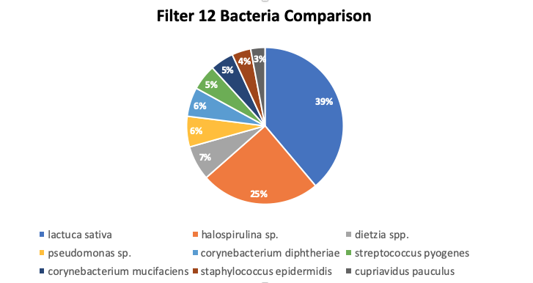
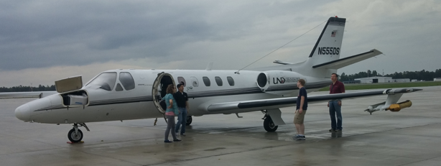
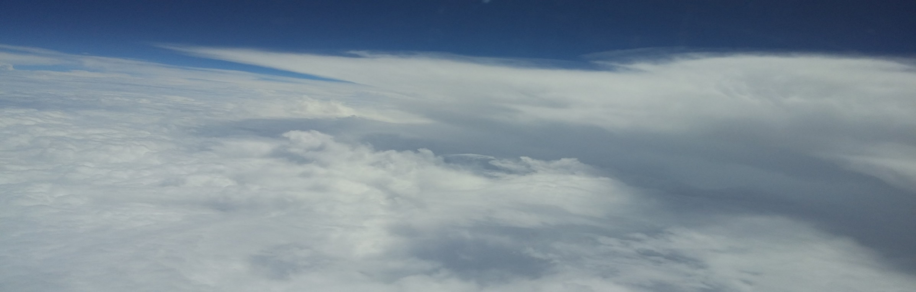
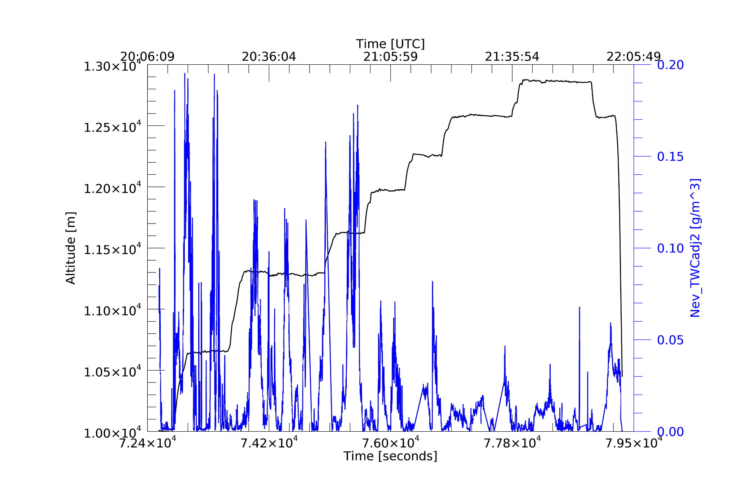
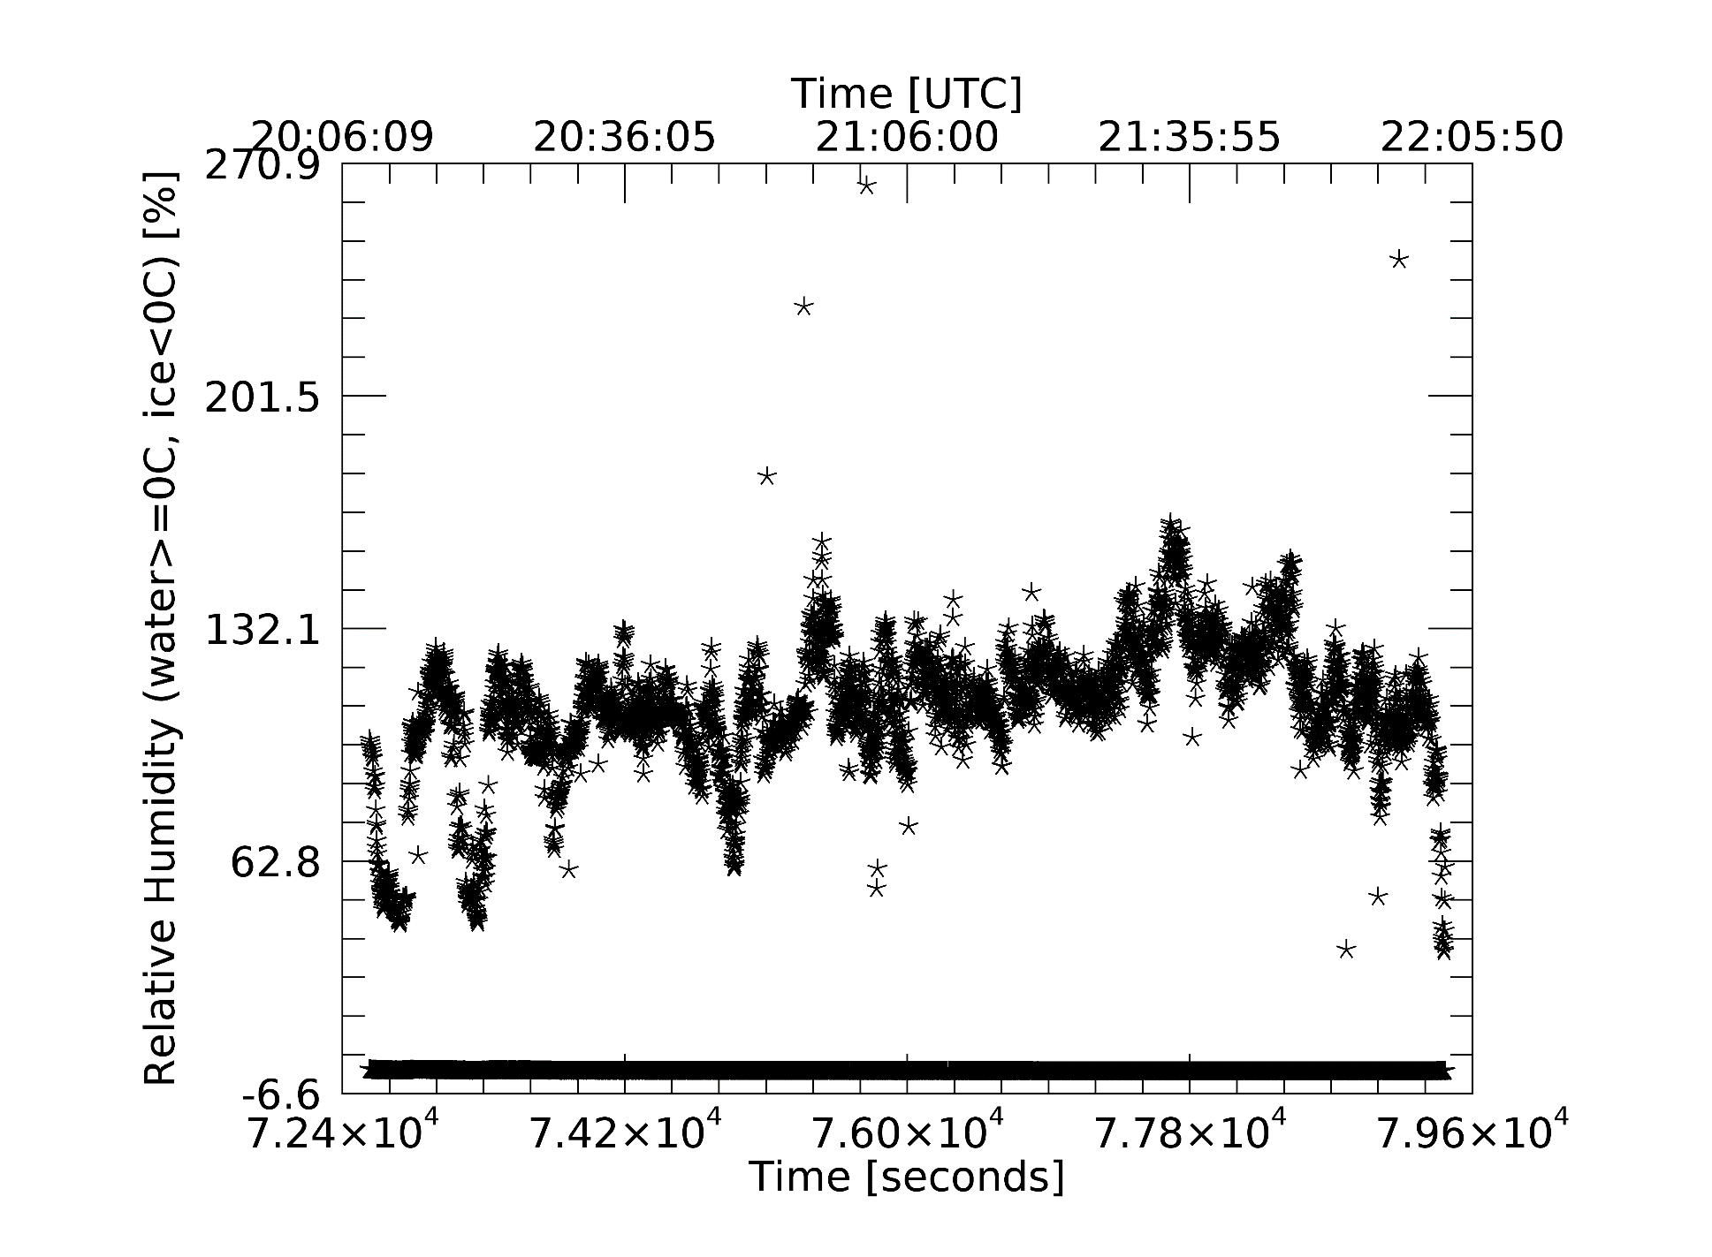
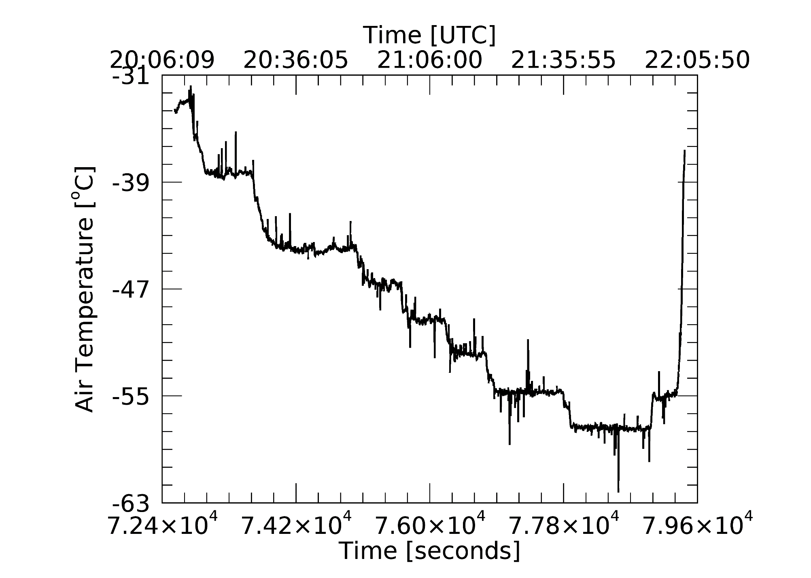
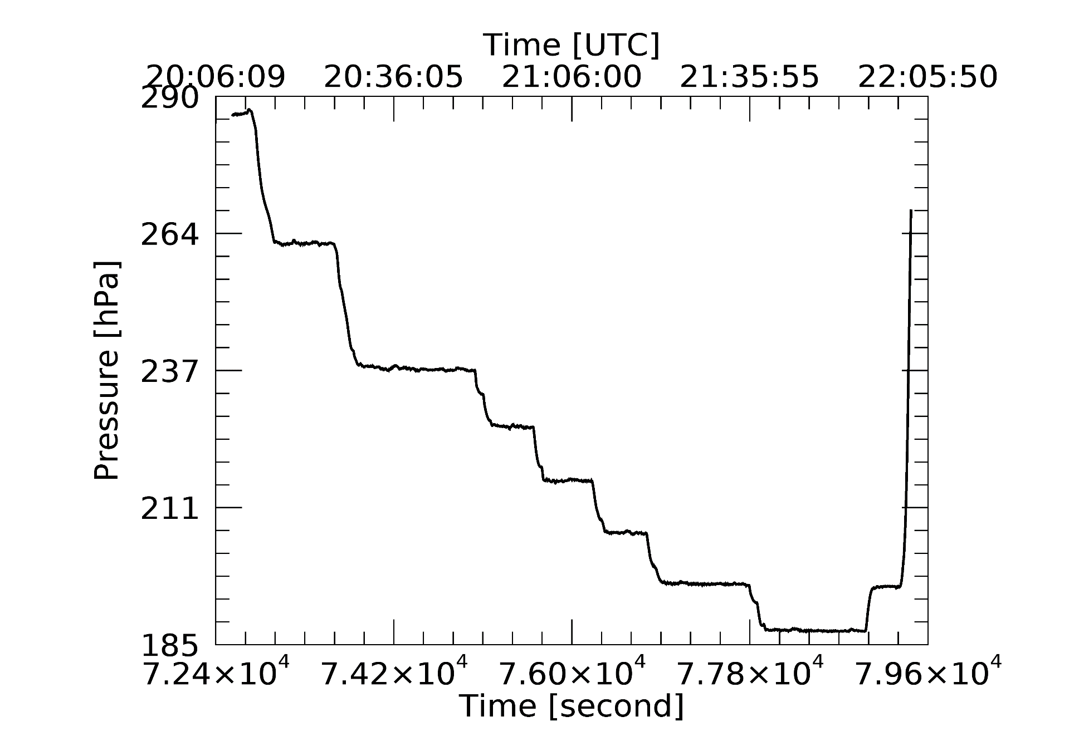
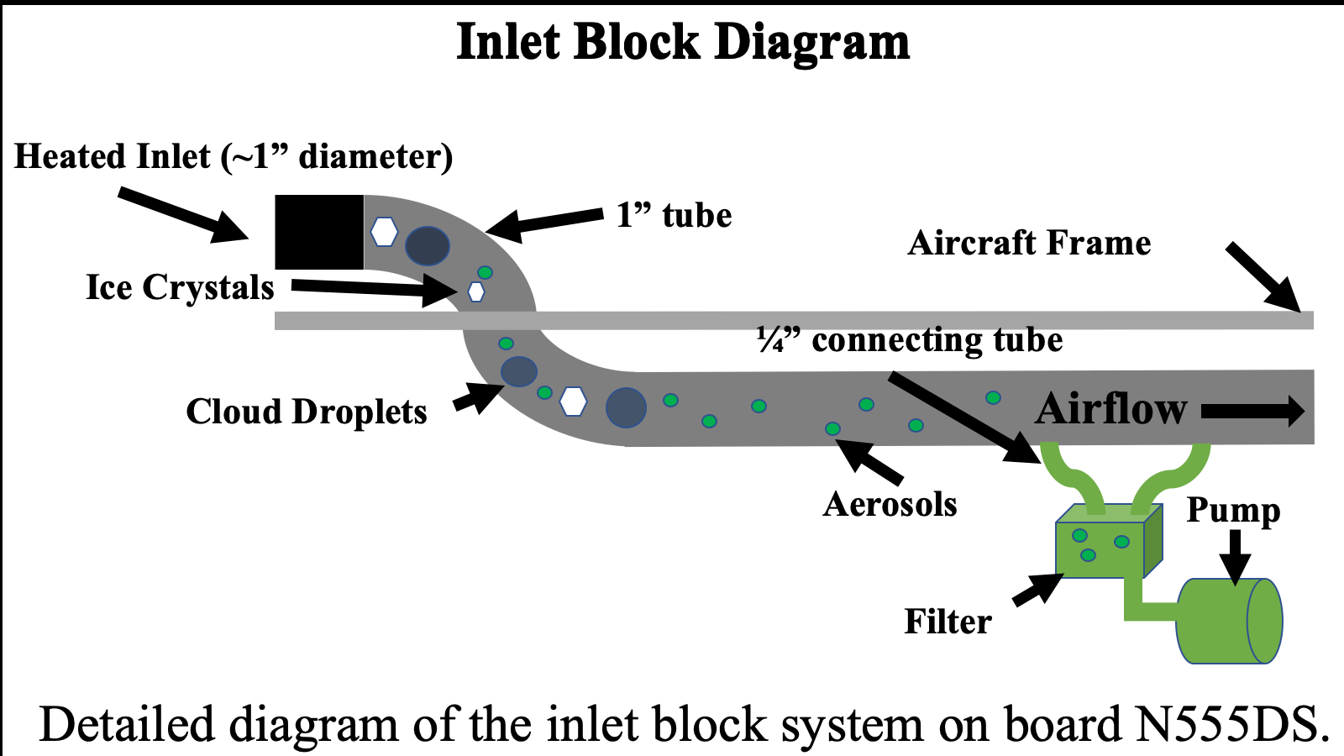
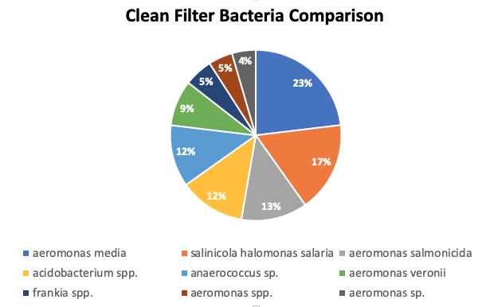
Biological Particles (Bacteria and Fungi) in Thunderstorms
¹Harrison Rademacher (harrison.rademacher@und.edu), ¹David Delene, ²Karin Ardon-Dryer, and ²Michael San Francisco
¹University of North Dakota, Grand Forks, North Dakota; ²Texas Tech University, Lubbock, Texas
Overview
Bacteria are an important source of ice nuclei which affects the microphysics of cirrus clouds. This project’s objective is to determine the different species of bacterial in the upper troposphere near the top of tropical thunderstorms. Bacteria and fungal samples were collected on filters during July 2019 aircraft flights in Florida.
Results
Citation Research Aircraft
Bacteria record from August 2, 2019 flight.
High amounts of Lactuca sativa and
Halospirulina species were found.
Lactuca sativa is likely from lettuce seeds seeds,
while Halospirulina is a salt-tolerant bacterim. Pseudomonas is the most
significant bacteria linked to ice
nuclei particles (INP) for clouds.
Conclusions
Significant amounts of human bacteria were found on most filters in this experiment.
Human-associated bacteria found linked to contamination while being processed.
The bacteria type Pseudomonas which is an INP type was found on the filter. This is the most genus bacteria found in atmospheric bacteria experiments in other studies.
Other natural bacteria species were recovered that are linked to sampling material of biological origin included lettuce, spinach, and primrose seeds (lactuca saltiva, halospirulina species).
Particle Sampling
Aerosol and cloud samples can be collected in the upper troposphere using a research aircraft. Recently transported material is likely found in and near the anvil regions of thunderstorms. A good place to study anvils is summer-time Florida due to the frequency of sea breeze-induced storms. The North Dakota Citation Research Aircraft (N555DS) operated out of Space Coast Regional Airport in Titusville, FL (KTIX) was used to obtain 15 filter samples at altitudes up to 40,000 ft MSL. Preliminary analysis has been conducted on four filters in flight, a clean filter, and a control filter. DNA sequencing was conducted to determine the species of bacterial and fungus present on the un-cultured filter samples. The identification of bacteria and fungi species was done using ribosomal internal transcribed spacer sequence ITS for fungi and 16S ribosomal RNA-encoding DNA for bacteria.
Total water content, humidity, temp, and pressure data from flight
(20:09Z to 22:03Z)
Total Water Content
Relative Humidity
Temperature
Pressure
Future Work
Process additional control filters to determine extent of human bacteria contamination.
Improve the collecting system by adding additional sampling as cloud water sampling.
Compare results to previous publish sampling of atmospheric bacteria.
.
                References
        DasSarma, P., and S. DasSarma, 2018: Survival of microbes in Earth’s stratosphere. Current Opinion in Microbiology, 43, 24-30, https://doi.org/10.1016/j.mib.2017.11.002.
        Delene, D., K. Hibert, M. Poellot, and N. brackin, 2019: The North Dakota Citation Research Aircraft Measurement Platform. SAE International, 1, 1-13, https://doi.org/10.4271/2019-01-1990.
        Murray, B.J., D. O’Sullivan, J.D. Atkinson, and M.E. Webb, 2012: Ice nucleation by particles immersed in supercooled cloud droplets. Chem. Soc. Rev., 41, 6519-6554, doi:10.1039/c2cs35200a.
A clean filter (not used in any flight activities) that was tested for bacteria present without any use. While bacteria was found in this clean filter, the 10 most abounded bacteria types were not present in the filter from the flight. Human bacteria discovered are most likely linked to contamination while being processed.
Acknowledgments
The National Institute of General Medical Sciences of the National Institutes of Health (Award T34GM122835) supported Harrison Rademacher. The content present is the author’s responsibility and does not necessarily represent the official views of the NIH. Travel support was provided by the MARC program.
Notes:
Lysis induction – the transformation of live bacteria to bacteria ghosts.

