Slide 1
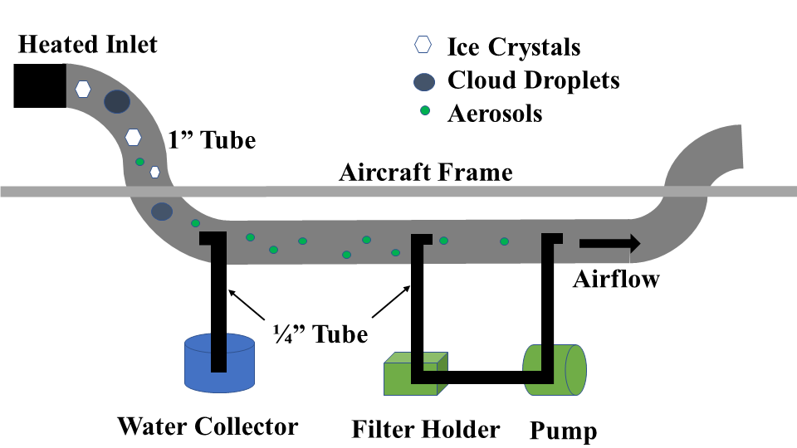
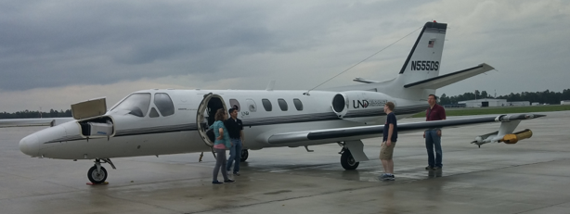
Bacteria in Thunderstorm Anvils
Harrison Rademacher (harrison.rademacher@und.edu), David Delene, and Aaron Kennedy
University of North Dakota, Grand Forks, North Dakota
Overview
Bacteria may be an important source of ice nuclei which affects the microphysics of clouds. This project’s objective is to determine the abundance of different bacterial types in top of tropical thunderstorms. Bacteria samples are planned to be collected via aircraft flights in Florida in July 2019.
Inlet Design
Diagram of the proposed inlet system on Citation Research Aircraft.
Citation Inlet
Aircraft Sampling
Aerosol and cloud samples can be collected via an airborne research aircraft. A good place to collect this data is in Florida, where the ocean waters help fuel thunderstorm activity on a frequent basis. Funding was approved for a research project during the summer of 2019 using the North Dakota Citation Research Aircraft (N555DS), owned by Weather Modification International (WMI) in Fargo, ND. The aircraft will be flown to Space Coast Regional Airport in Titusville, FL (KTIX). It will fly research missions for approximately 30 hours, or 2 weeks during the month of July. The aircraft will fly research missions at altitudes of up to 43,000 ft MSL. It is capable of flying up to 4 hours at speeds of up to 340 knots, and sampling speeds of up to 160 knots. The bacteria for this experiment will be collected at the top of thunderstorms.
Cloud Water Sampling
Name | Technique | Size Range | Reference
CSU-NCAR Airborne Cloud Water Collector | Axial Flow Cyclone | Up to 50 μm. | Straub and Collett, 2004
Brechtel Counterflow Virtual Impactor | Counterflow Virtual Impaction | Controllable Cut Size 7-15 μm. | Glantz et al., 2003
Axial Cyclone Cloud water Collector (AC3) | Axial Cyclone | > 10 μm. | Crosbie and Coauthors, 2018
Sampling Methodology
Collect aerosol and cloud water samples.
Culture the samples to grow bacteria for DNA sequencing.
Collect samples at different altitude and on different days.
References
Crosbie, E., and Coauthors (2018). Development and Characterization of a High-Efficiency , Aircraft-Based Axial Cyclone Cloud Water Collector. Atmospheric Measurement Techniques, 5025-5048doi:https://doi.org/10.5194/amt-11-5025-2018
Glantz, P., Noone, K. J., & Osborne, S. R, 2003: Comparisons of Airborne CVI and FSSP Measurements of Cloud Droplet Number Concentrations in Marine Stratocumulus Clouds. URL https://journals.ametsoc.org/doi/full/10.1175/1520-0426(2003)0202.0.CO;2
Straub, D. J., & Collett, J. L. (2004). An Axial-Flow Cyclone for Aircraft-Based Cloud Water Sampling. Journal of Atmospheric and Oceanic Technology, 21(12), 1825-1839. doi:10.1175/jtech-1670.1
Citation Research Aircraft
2D-S Image Buffer
The two-dimensional stereographic cloud imager (2D-S) image is a cross section of the ice crystals collected by the Citation Research Aircraft (N555DS) during the CAPE project on 1 August 2015 at 20:21:22.71 UTC. The aircraft was flying at an altitude of 11.6 km (38,000 ft) with a temperature of -46.7 $℃$. The small pixels are approximately 10 μm, with the larger ones estimated to be ~500 μm.
Acknowledgments
The National Institute of General Medical Sciences of the National Institutes of Health (Award T34GM122835) supported Harrison Rademacher. The content present is the author’s responsibility and does not necessarily represent the official views of the NIH. Travel support was provided by the MARC program.
Notes:
Lysis induction – the transformation of live bacteria to bacteria ghosts.

