Slide 1



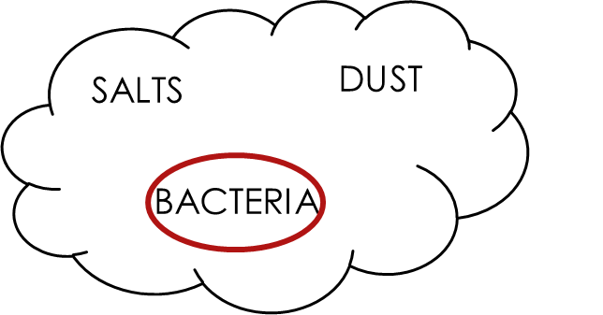
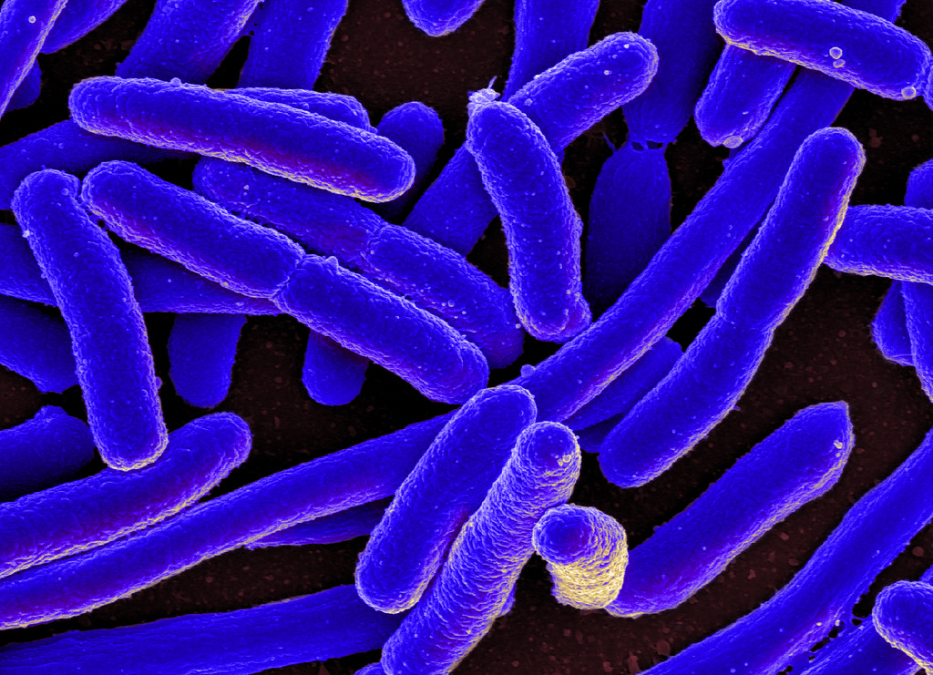

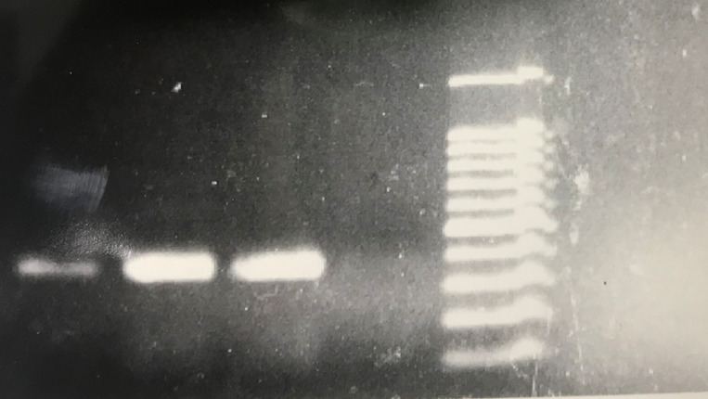
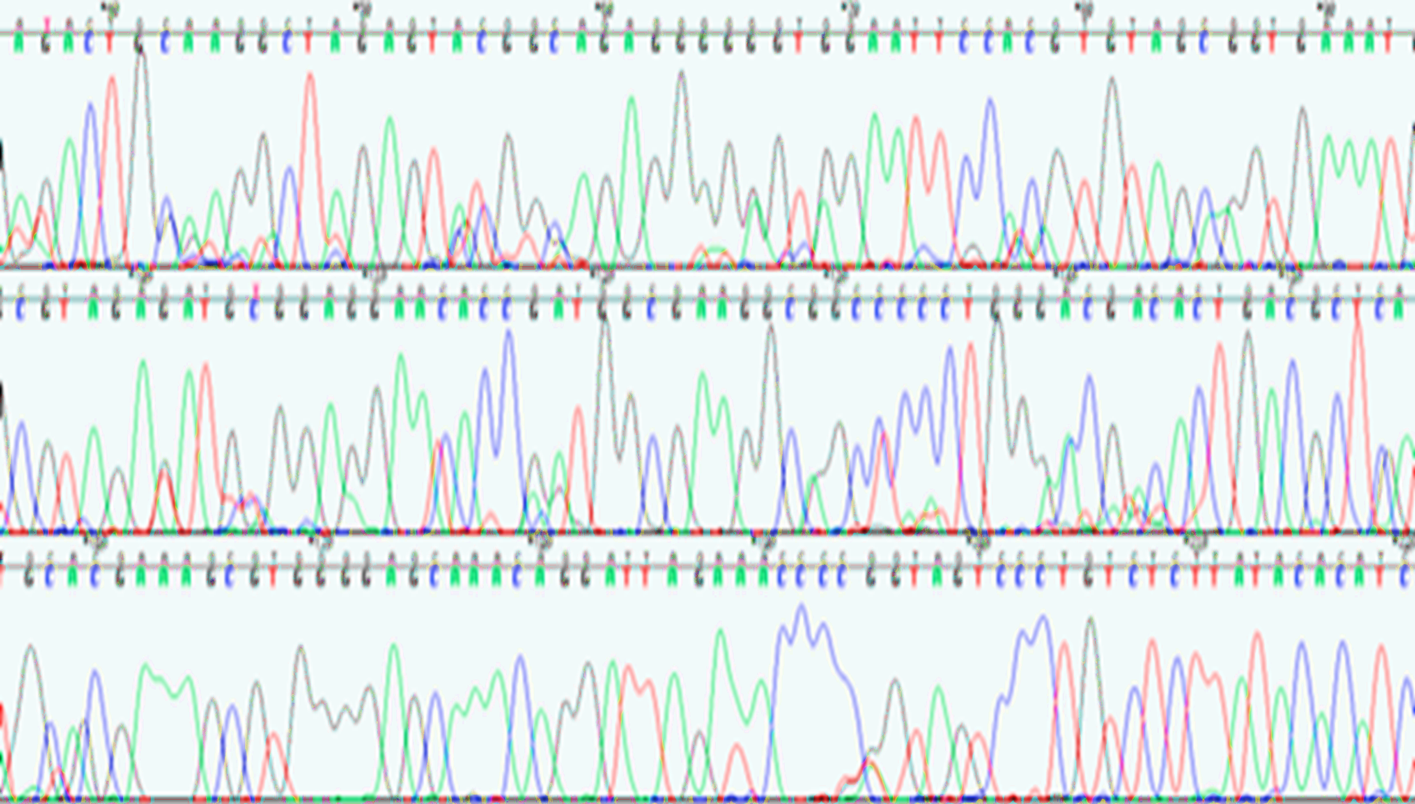
Analysis of E.coli bacteria on atmospheric filters
Frida Garcia¹, David Delene², and Rebecca Simmons³
¹Mayville State University, North Dakota
²Department of Atmospheric Sciences, University of North Dakota
³Deparment of Biology, University of North Dakota
Interdisciplinary
Renewable & Environmental
Chemistry REU
INTRODUCTION
Bacteria cause ice to form at warmer temperatures, making them effective ice nuclei. Ice nuclei are responsible for causing precipitation. There are two ways to properly collect bacterial samples: 1. TSI atomizer and 2. Sparging Liquid Aerosol Generator (SLAG). We tested an known sample (E.coli C41) as a way to test the effectiveness of both methods, because it is a good model organism, safe, and commonly used.
The goal of the project is to demonstrate a proof of concept and establish the best way to collect atmospheric samples.
TSI Atomizer
CONCLUSIONS
DNA was detected in the filters.
Filters contain from -0.3ng/μL to 15ng/μL DNA.
Longer collecting times result in higher concentrations of DNA.
E.coli was not detected in samples. The collected bacteria appear to be contaminates from water.
Bleaching and autoclaving equipment is effective for avoiding contamination.
Compressed Air (1.884Lpm)
Air Filter
TSI
Atomizer
Diffusion Dryer
Filter
E. coli and Water Mixture
SLAG
E. coli C41
Air Filter
Compressed Air (4 Lpm)
Filter
FUTURE WORK
Aerodynamic Particle Sizer (APS)
  Measures the sizes of particles to verify the presence of bacteria
Scanning Electron Microscope
  Allows visualization of bacteria to see differences in TSI and SLAG collecting methods
QUESTIONS
  Is DNA detected in the filters?
  How much DNA is in the filters?
  How does the amount of collection time impact how much DNA is collected?
  Did we find E. coli?
  What the best procedure to avoid bacterial contamination?
SLAG
E. coli
Sample | Time | DNA Concentration | Result | Identity (percentage)
TSI.Blank | Overnight | 15.0 ng/μL | Capriavidus sp. | 92%
TSI.A | Overnight | 15.4 ng/μL | Cupriavidus sp. | 95%
TSI.B | Weekend | 48.8 ng/μL | Propionivibrio limicola | 93%
SLAG.Blank | Hour | -0.3 ng/μL | No DNA | 0%
SLAG.A | Hour | 2.4 ng/μL | Cupriavidus sp. | 97%
SLAG.B | Hour | 3.1 ng/μL | Zoogloeaceae bacterium | 91%
ACKNOWLEDGEMENTS
METHODS
Atmospheric collections
TSI Atomizer
  Sparging Liquid Aerosol Generator (SLAG)
DNA identification
Polymerase Chain Reaction (PCR)
    16S rDNA (300-400bp)
  Dideoxy-sequencing
  Assembled forward and reverse sequences using the program Sequencher
  Compared resulting sequences with published sequences contained in National Center of Biotechnology Information (NCBI) using BLAST searches.
  Dr. Frank Bowman
  Dr. Brian Darby
  Arlete Lohnes
  Madison Jochim
  Matthew Flom
  Julie Hibarger
  We would like to acknowledge support from National Science Foundation (NSF) REU IREC program in No. CHE-1757 922. Any opinions, findings, and conclusions or recommendations expressed in this material are those of the author(s) and do not necessarily reflect the views of the NSF.
1000
900
800
700
600
500
400
300
200
100
Bp (base pairs)
TSI.BLANK
TSI.A
TSI.B
NEGATIVE
  Figure 1. Results from one PCR amplification of TSI samples. This gel indicates that the TSI collecting device was contaminated. The ladder on the left is an indicator for amplicon size, indicating that the correct region is amplified.
Figure 2. A representative DNA chromatogram that shows the DNA sequence for one bacterial fragment

