Slide 1

Removal of Microdust from the Atmosphere
Dr. David J. Delene
(http://aerosol.atmos.und.edu)
Department of Atmospheric Sciences
University of North Dakota
Notes:
The Department of Atmospheric Sciences provides undergraduate and graduate education as part of the world-renowned John D. Odegard School of Aerospace Sciences at the University of North Dakota. The Department has historically focused on cloud physics research utilizing aircraft and radar measurements. Recently, the Department’s research has broaden to include Unmanned Aircraft System (UAS) research and atmospheric modeling. The Department’s vision is to be socially relevant, foster interdisciplinary activities, and serve the scientific community. The Department continues cloud physics research with current NASA and DOD projects.

Slide 2
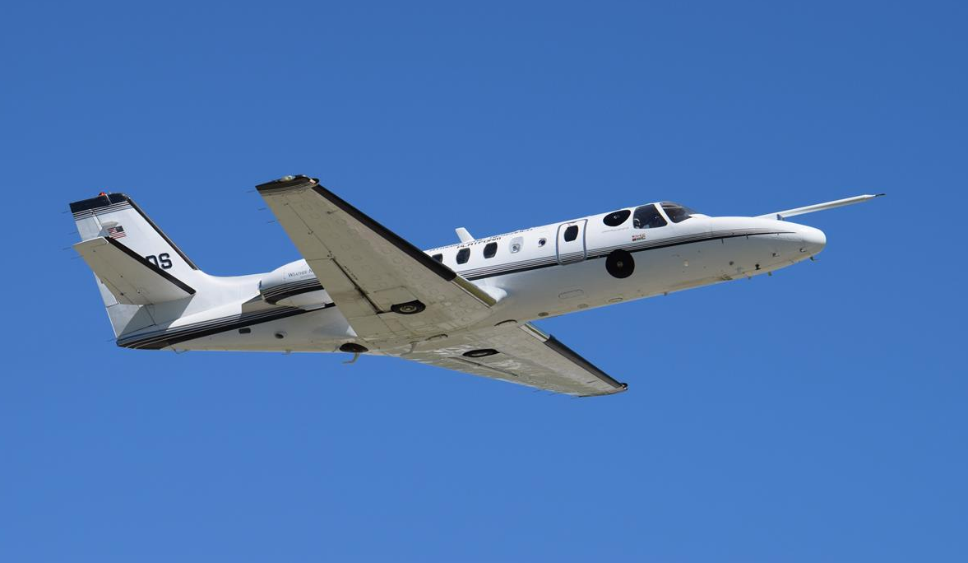

Improve Air Quality for South Korea
Review our knowledge of microdust, clouds, and precipitation.
Define how microdust affects precipitation development and how cloud seeding can mitigate high levels of pollution.
Measurements allow construction of a model of how effective microdust is removed with cloud seeding in South Korea.

Slide 3
Classification of Particles
Cloud
Droplets
Cloud
Drops
Dust Mode
Aerosol
Precipitation
(rain/hail)
Nucleation Mode
Aerosol
Accumulation
Mode Aerosol
Black carbon + fine dust
Microdust
10⁻⁹
10⁻⁸
10⁻⁷
10⁻⁶
10⁻⁵
10⁻⁴
10⁻³
10⁻²
nm
cm
Particle Diameter [m]
Precipitation and atmospheric mixing reduces particles.

Slide 4
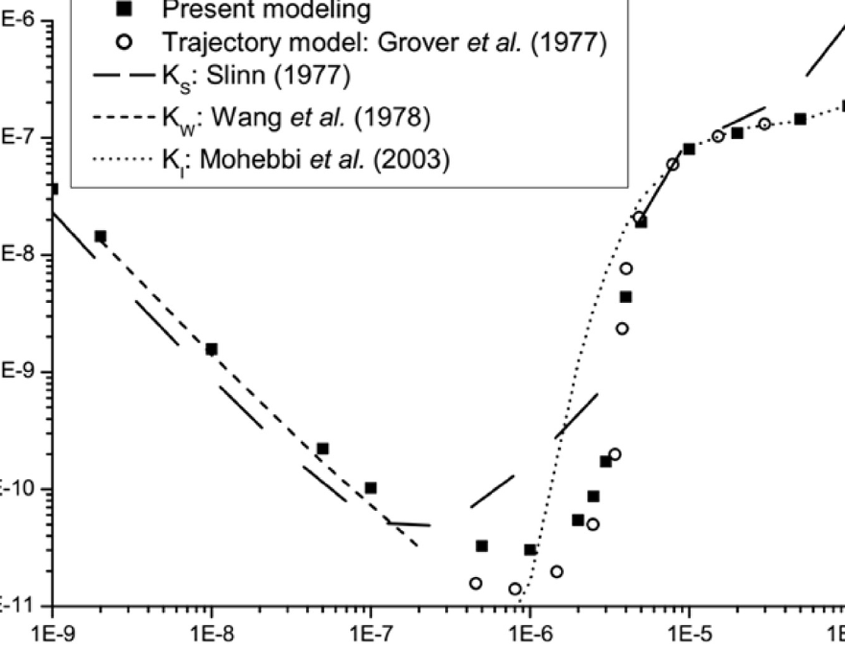
Cherrier, G., E. Belut, F. Gerardin, A. Tanière, and N. Rimbert, 2017: Aerosol particles scavenging by a droplet: Microphysical modeling in the Greenfield gap. Atmospheric Environment, 166, 519–530, doi:10.1016/j.atmosenv.2017.07.052.
Modeling of droplet scavenging (removal) of aerosols.
Fig. 6 – Collection kernel values at Re_{d} = 30 and H = 0 as a function of particle aerodynamic diameter. Here K_{w} = K_{B} because of the null value of H.
Microdust of 0.1 to 1 µm in diameter are not removed as effectively as larger or smaller sized particles.
Collection Kernel [m³ s⁻¹]
Particle Aerodynamic Diameter [m]
Notes:
4

Slide 5
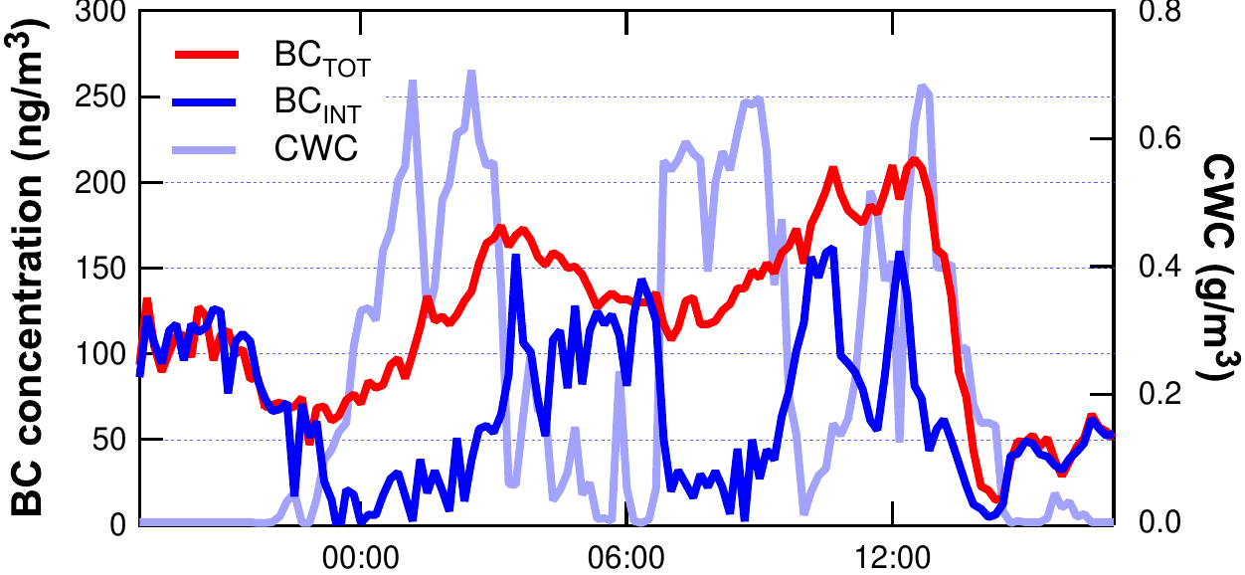
Cozic, J., B. Verheggen, S. Mertes, P. Connolly, K. Bower, A. Petzold, U. Baltensperger, and E. Weingartner, 2007: Scavenging of black carbon in mixed phase clouds at the high alpine site Jungfraujoch. Atmos. Chem. Phys., 7, 1797–1807, doi:10.5194/acp-7-1797-2007.
Black carbon (BC) microdust is scavenged (removed) as effectively as other microdust, which indicates that black carbon microdust is covered with soluble material.
Fig. 2 – Temporal evolution of the total and interstitial black carbon concentrations along with the temporal evolution of the cloud water content (CWC) for a liquid cloud (i.e., no ice phase).
Microdust, including Black Carbon (pollution), is incorporated into cloud droplets.
July 20, 2004
BC Concentration [ng/m³]
Cloud Water Content [g/m³]
Time [min]
Notes:
5
5

Slide 6
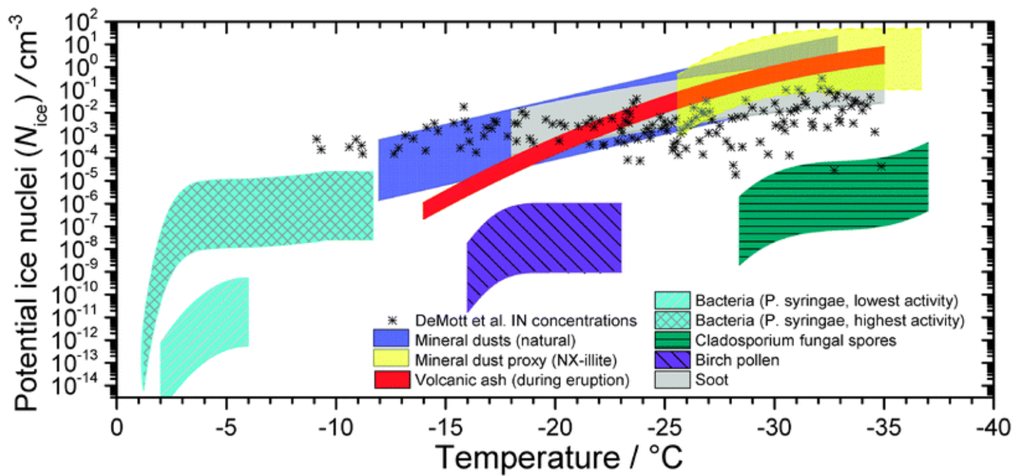
Murray, B. J., D. O’Sullivan, J. D. Atkinson, and M. E. Webb, 2012: Ice nucleation by particles immersed in supercooled cloud droplets. Chem. Soc. Rev., 41, 6519–6554, doi:10.1039/C2CS35200A.
Mineral dust, biological species, and carbonaceous combustion produced particles immersed within supercooled water droplets nucleate the formation of ice.
Potential Ice Nuclei [cm⁻³]
Temperature [⁰C]
The atmosphere lacks microdust that nucleates ice at warm temperatures.
Fig. 19 – Potential immersion mode ice nuclei concentrations as a function of temperature for a range of atmospheric aerosol species. Calculations performed using concentrations of different particle sizes.
Notes:
6
6

Slide 7
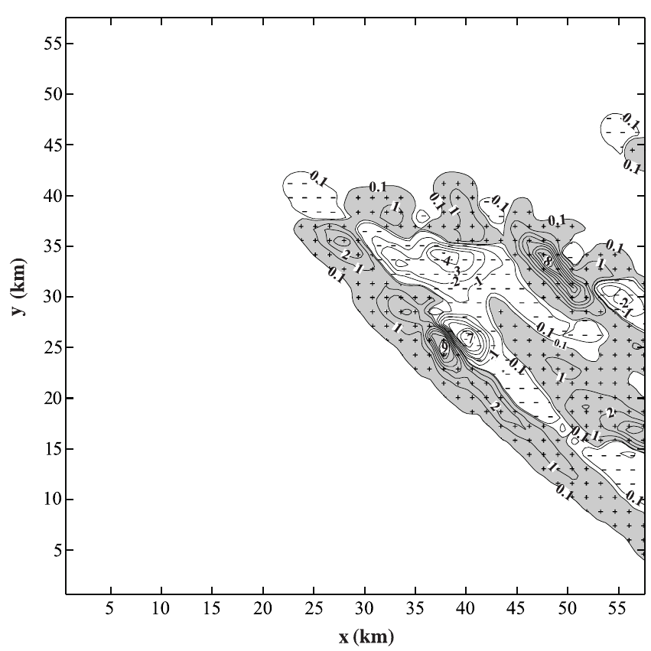
Ćurić, M., D. Janc, and V. Vučković, 2007: Cloud seeding impact on precipitation as revealed by cloud-resolving mesoscale model. Meteorol. Atmos. Phys., 95, 179–193, doi:10.1007/s00703-006-0202-y.
Cloud-resolving mesoscale model shows cloud seeding increases precipitation.
Fig. 10 – Differences in cumulative precipitations between test A1 and unseeded case. Contour interval is 1 mm, while isolines of 0.1 and 1.0 mm are also depicted.
Cloud seeding with ice nuclei increases precipitation and hence increases the removal of microdust incorporated into cloud particles.
Y [km]
X [km]
Notes:
7
7

Slide 8
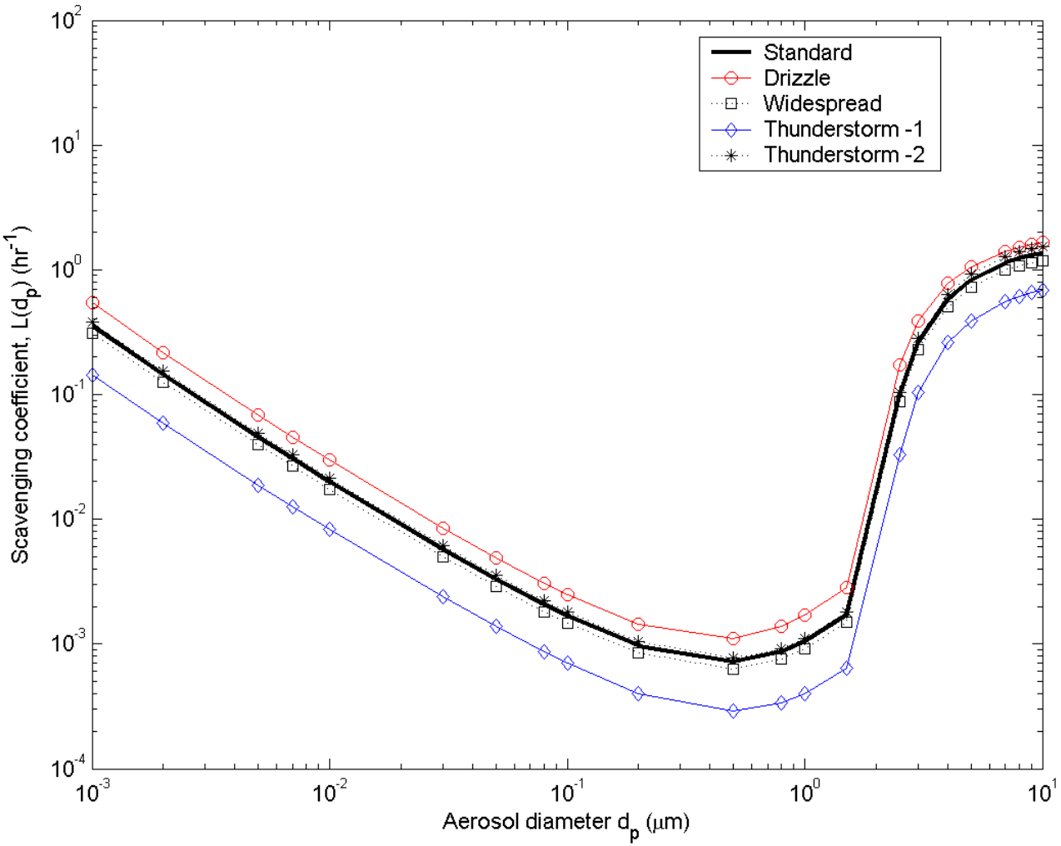
Andronache, C.: Estimated variability of below-cloud aerosol removal by rainfall for observed aerosol size distributions, Atmos. Chem. Phys., 3, 131-143, https://doi.org/10.5194/acp-3-131-2003, 2003.
Below-cloud scavenging (removal) of microdust by rainfall increases with rainfall rate and has a significant dependence on particle size.
Fig. 3B – Scavenging coefficient L(dp ) versus aerosol diameter for the same raindrop size distributions. The plots are for rain rate of (R) of 1 mm hr⁻¹.
Microdust of 0.1 to 1.0 µm in diameter are not removed by rainfall as effectively as larger or smaller sized particles.
Scavenging Coefficient [hr⁻¹]
Aerosol Diameter [um]
Notes:
8
8

Slide 9




Microdust Levels
Low Precipitation
High Precipitation
Activation
Temperature Inversion
(Traps Pollution)
Scavenging

Slide 10

Evaluating the Removal of Microdust
𝚫 CCN and/or 𝚫 IN -> ↑ Precipitation -> ↓ Microdust
Comparison of the activated microdust in seeded clouds to that of unseeded clouds.
Comparison of microdust at cloud base prior to precipitation to after precipitation.
Compare microdust upwind and downwind of precipitating clouds.
Notes:
10

Slide 11
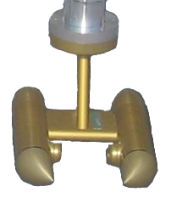
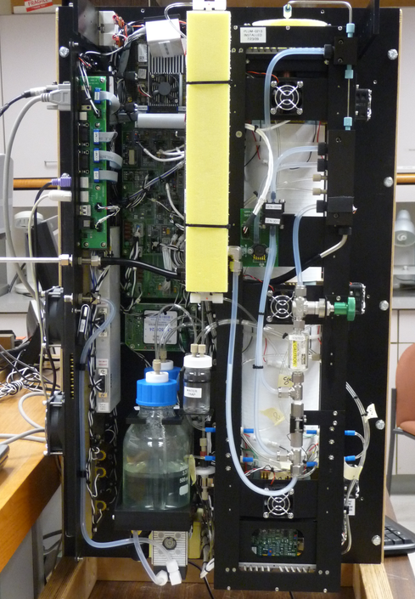
Korean Specific
Measurements Required
The concentration of aerosols (cloud condensation nuclei and microdust) related to clouds and precipitation development on the Korean Peninsula.
Microdust impact on the ability of clouds to produce large drops and ice particles.
Microdust impact on the temperature of ice formation in seeded and un-seeded clouds.
What are the commonalities and differences between urban and rural clouds?

Slide 12
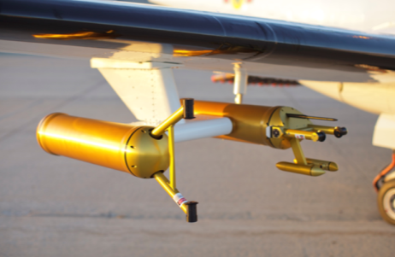
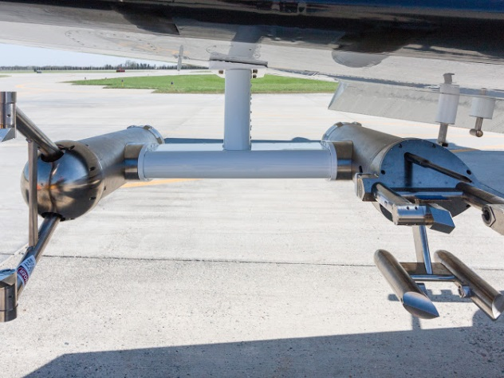
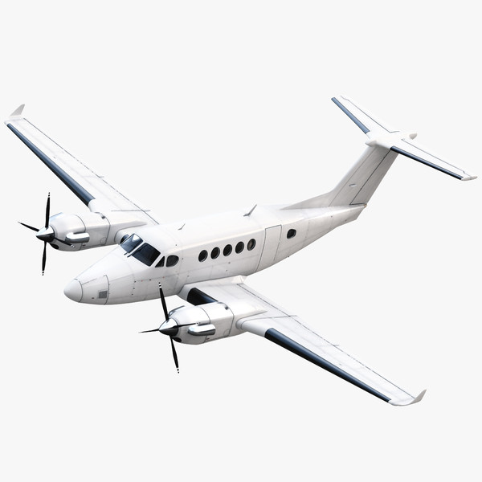
Aircraft Observations
40,000
Convective Cloud
35,000
30,000
Altitude (ft)
25,000
20,000
15,000
10,000
5,000

Slide 13
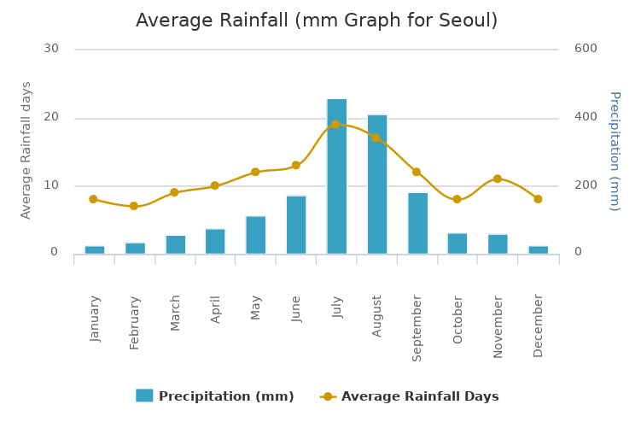
Seoul Average Rainfall (mm)
30
600
30
600
20
400
20
400
Average Rainfall Days
Precipitation (mm)
10
200
10
200
0
0
0
JAN
FEB
MAR
APR
MAY
JUN
JUL
AUG
SEP
OCT
NOV
DEC
Late Spring (May/June) and Early Fall (Sep/Oct)
Important Time Periods for Field Measurements.

Slide 14
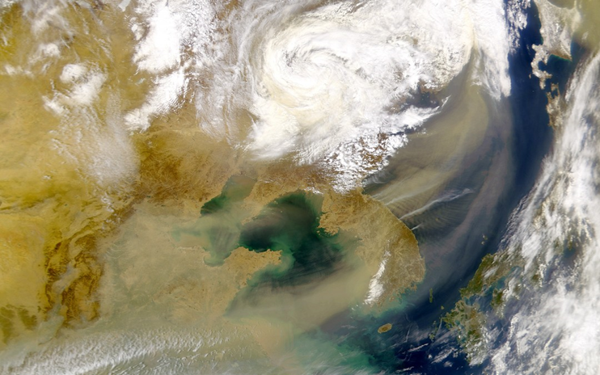
Summary
Proven Science, Technology, Equipment, and Operators
Cloud Seeding Increases Precipitation and Air Mixing
Precipitation and Air Mixing Reduces Microdust
Cloud Seeding Increases Precipitation/Reduces Microdust
Multiple Additional Benefits
  Enhance Understanding of
  Microdust Origin, Definition,
  Tracking, and Forecasting

Slide 15
References – Microdust Removal
Cherrier, G., E. Belut, F. Gerardin, A. Tanière, and N. Rimbert, 2017: Aerosol particles scavenging by a droplet: Microphysical modeling in the Greenfield gap. Atmospheric Environment, 166, 519–530, doi:10.1016/j.atmosenv.2017.07.052.
Cozic, J., B. Verheggen, S. Mertes, P. Connolly, K. Bower, A. Petzold, U. Baltensperger, and E. Weingartner, 2007: Scavenging of black carbon in mixed phase clouds at the high alpine site Jungfraujoch. Atmos. Chem. Phys., 7, 1797–1807, doi:10.5194/acp-7-1797-2007.
Murray, B. J., D. O’Sullivan, J. D. Atkinson, and M. E. Webb, 2012: Ice nucleation by particles immersed in supercooled cloud droplets. Chem. Soc. Rev., 41, 6519–6554, doi:10.1039/C2CS35200A.
Ćurić, M., D. Janc, and V. Vučković, 2007: Cloud seeding impact on precipitation as revealed by cloud-resolving mesoscale model. Meteorol. Atmos. Phys., 95, 179–193, doi:10.1007/s00703-006-0202-y.
Andronache, C.: Estimated variability of below-cloud aerosol removal by rainfall for observed aerosol size distributions, Atmos. Chem. Phys., 3, 131-143, https://doi.org/10.5194/acp-3-131-2003, 2003.
Notes:
15

