Slide 1

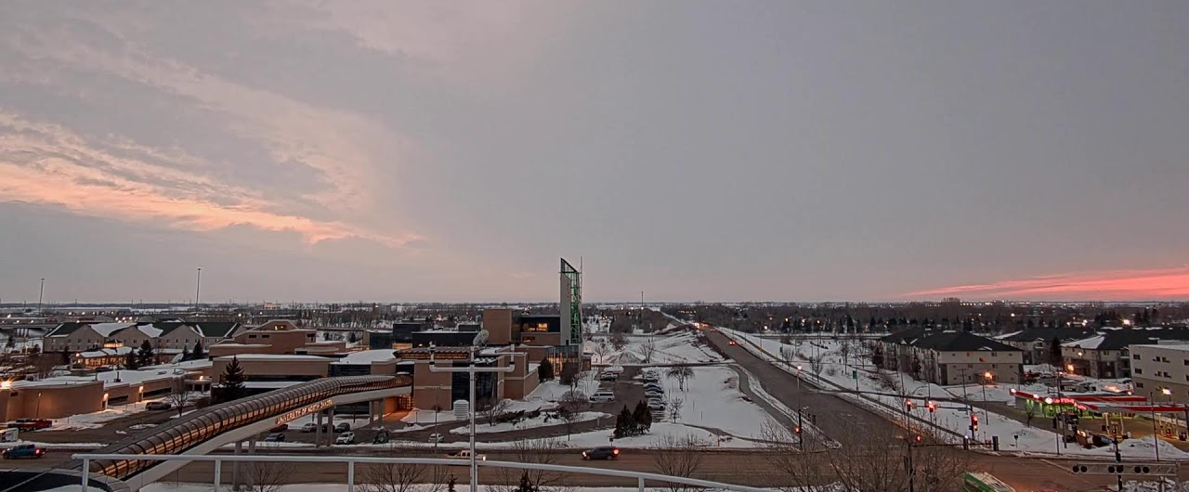



Faculty Support for Proposal Writing in the
John D. Odegard School of Aerospace Sciences
David J. Delene
Notes:
1

Slide 2
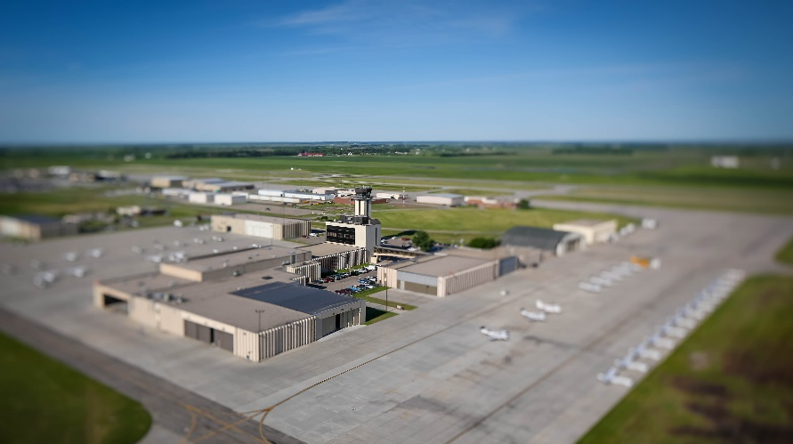
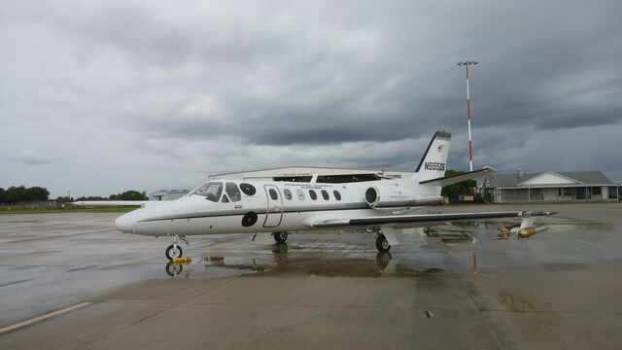
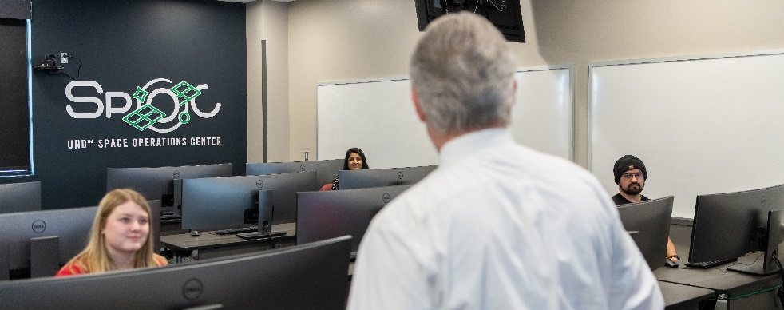
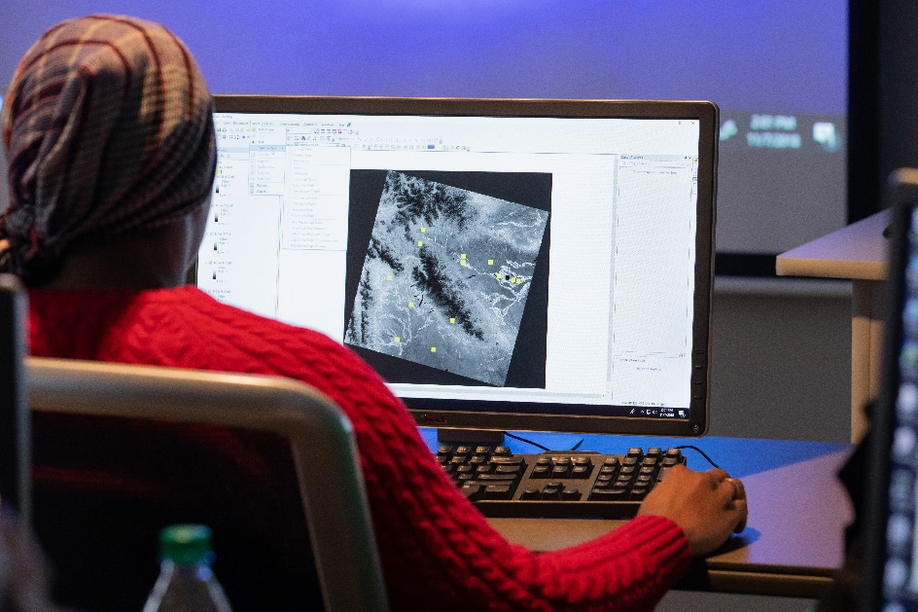
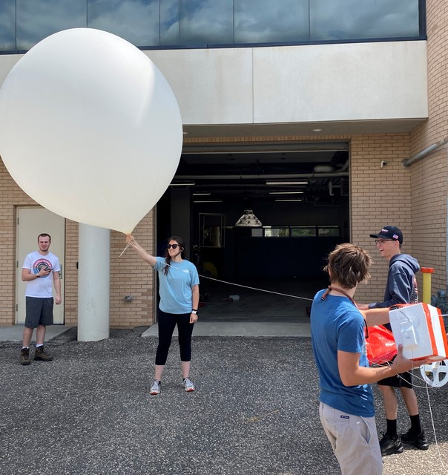
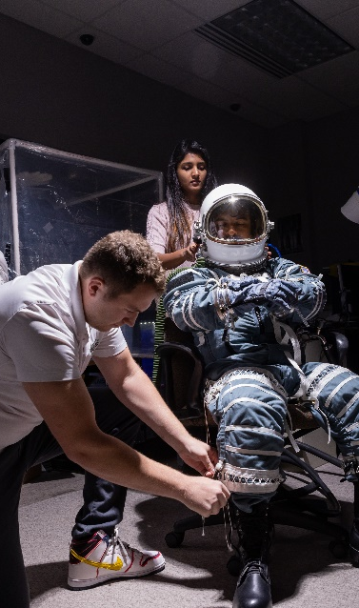
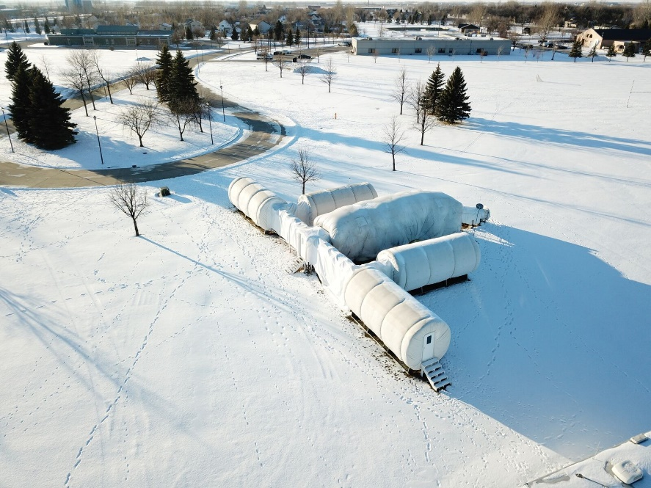
Research Actives
What is the need requirement for sustainable, externally funded research. Critical for new Assistant Research Professors.
Notes:
<number>

Slide 3
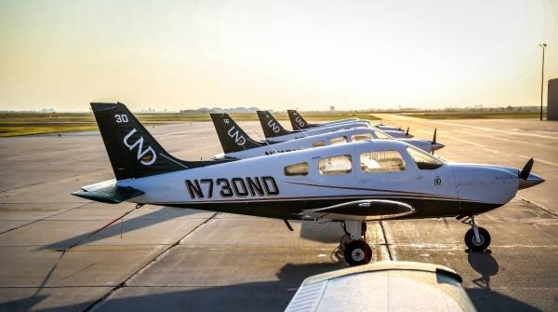
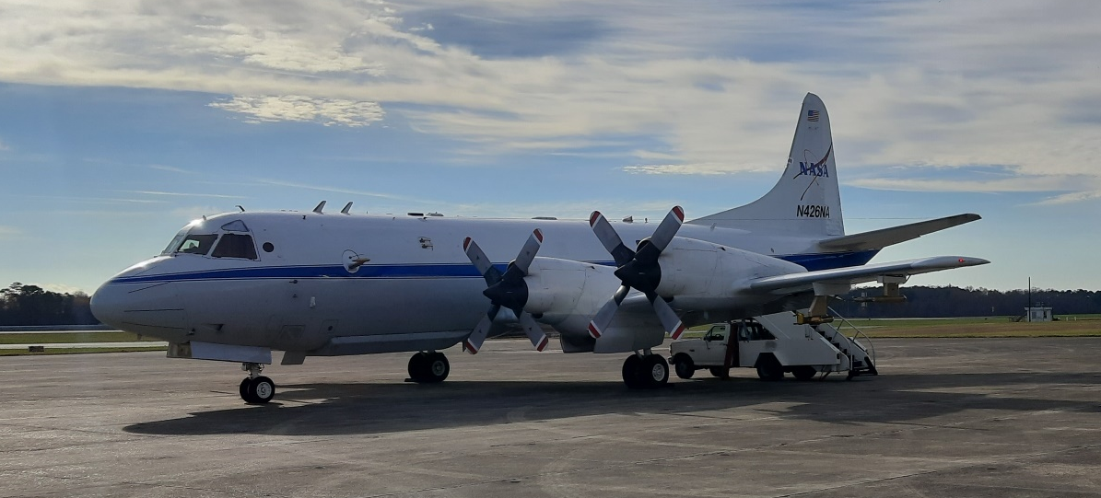
Support Needs for Sustainable Research Program
Time to write competitive proposal in STEM.
  National Science Foundation style proposal.
    One Month of Time
Number of Proposals Needed.
  Three per Year
    3 year, 300 – 400 k Grant
    1/3 Funded
Percentage (3 Months)
  12 Month Appointment – 25 %
  9 Month Appointment – 33 %

