Slide 1

Airborne Measurements of Microdust
Dr. David J. Delene
(http://aerosol.atmos.und.edu)
Department of Atmospheric Sciences
University of North Dakota
Notes:
The Department of Atmospheric Sciences provides undergraduate and graduate education as part of the world-renowned John D. Odegard School of Aerospace Sciences at the University of North Dakota. The Department has historically focused on cloud physics research utilizing aircraft and radar measurements. Recently, the Department’s research has broaden to include Unmanned Aircraft System (UAS) research and atmospheric modeling. The Department’s vision is to be socially relevant, foster interdisciplinary activities, and serve the scientific community. The Department continues cloud physics research with current NASA and DOD projects.

Slide 2
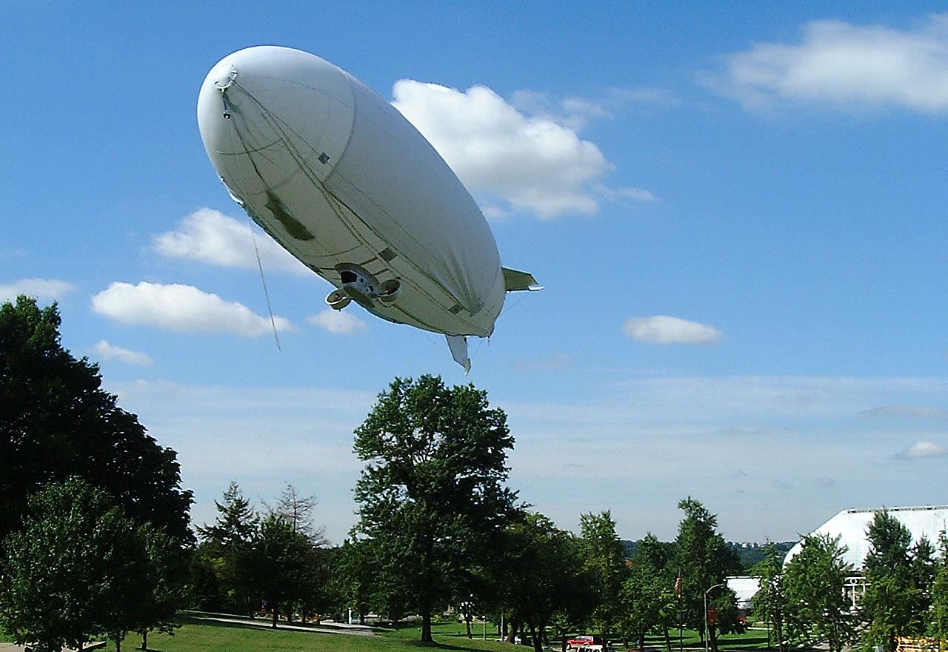
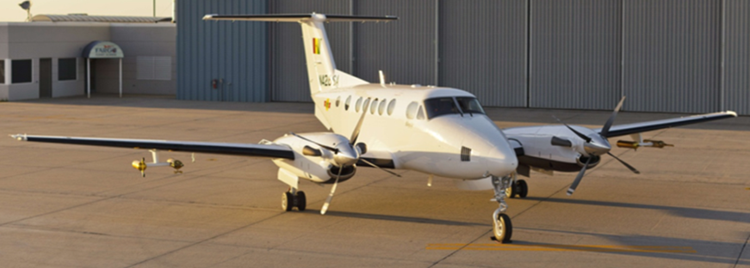
Measurements for Improved Air Quality
Review our knowledge of microdust, clouds, and precipitation.
Define the sources and sinks of microdust, including removal by clouds and precipitation.
Airborne measurements fill caps in surface measurements and allow source and removal process to be understood.
Kantor et al., 2001

Slide 3
Classification of Particles
Cloud
Droplets
Cloud
Drops
Dust Mode
Aerosol
Precipitation
(rain/hail)
Nucleation Mode
Aerosol
Accumulation
Mode Aerosol
Particular Matter 2.5 (PM_{2.5})
Black carbon + fine dust
Microdust
10⁻⁹
10⁻⁸
10⁻⁷
10⁻⁶
10⁻⁵
10⁻⁴
10⁻³
10⁻²
nm
cm
Particle Diameter [m]
Precipitation and atmospheric mixing reduces particles (PM_{2.5}).

Slide 4
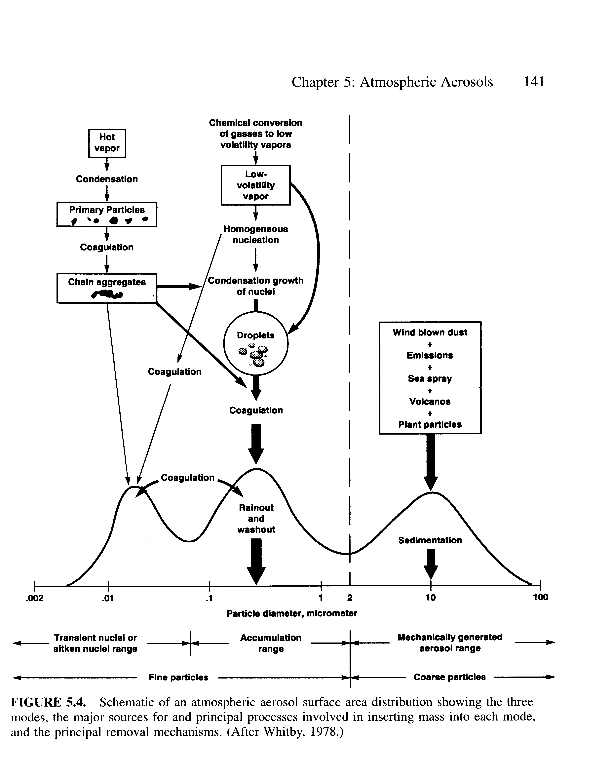
Sources and Sinks of Particles
Condensation
from Vapor
Coagulation of
Aerosols
Mechanical Generation
Wind Blown Dust
Sea Spray
Volcano
Plant Particles
Courtesy of Singh: Figure 5.4

Slide 5


Airborne Measures for Microdust Source
Atmospheric Wind
Production
Loss
P
L
X
Inflow F_{in}
Outflow F_{out}
E
D
Emission
Deposition

Slide 6
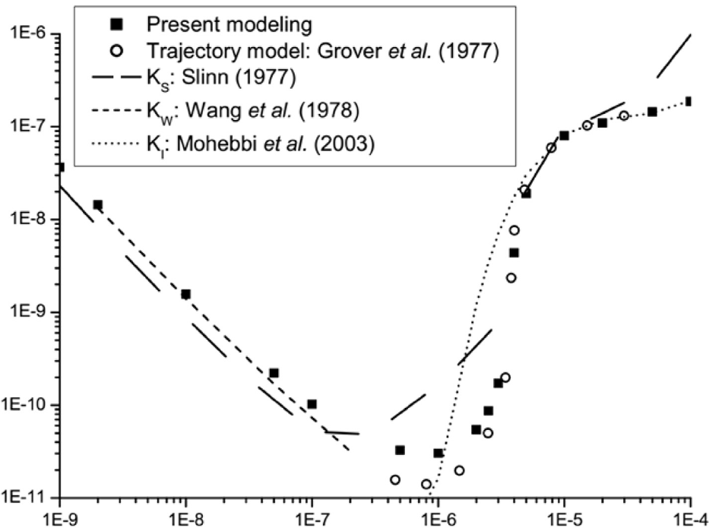
Cherrier, G., E. Belut, F. Gerardin, A. Tanière, and N. Rimbert, 2017: Aerosol particles scavenging by a droplet: Microphysical modeling in the Greenfield gap. Atmospheric Environment, 166, 519–530, doi:10.1016/j.atmosenv.2017.07.052.
Modeling of droplet scavenging (removal) of aerosols.
Fig. 6 – Collection kernel values at Re_{d} = 30 and H = 0 as a function of particle aerodynamic diameter. Here K_{w} = K_{B} because of the null value of H.
Microdust of 0.1 to 1 µm in diameter are not removed as effectively as larger or smaller sized particles.
Collection Kernel [m³ s⁻¹]
Particle Aerodynamic Diameter [m]
Notes:
6

Slide 7
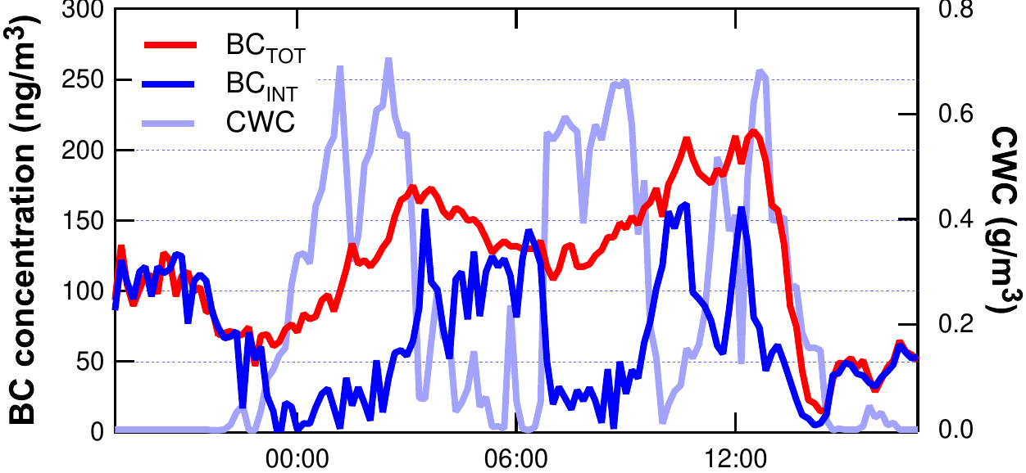
Cozic, J., B. Verheggen, S. Mertes, P. Connolly, K. Bower, A. Petzold, U. Baltensperger, and E. Weingartner, 2007: Scavenging of black carbon in mixed phase clouds at the high alpine site Jungfraujoch. Atmos. Chem. Phys., 7, 1797–1807, doi:10.5194/acp-7-1797-2007.
Black carbon (BC) microdust is scavenged (removed) as effectively as other microdust, which indicates that black carbon microdust is covered with soluble material.
Fig. 2 – Temporal evolution of the total and interstitial black carbon concentrations along with the temporal evolution of the cloud water content (CWC) for a liquid cloud (i.e., no ice phase).
Microdust, including Black Carbon (pollution), is incorporated into cloud droplets.
July 20, 2004
BC Concentration [ng/m³]
Cloud Water Content [g/m³]
Time [min]
Notes:
7
7

Slide 8
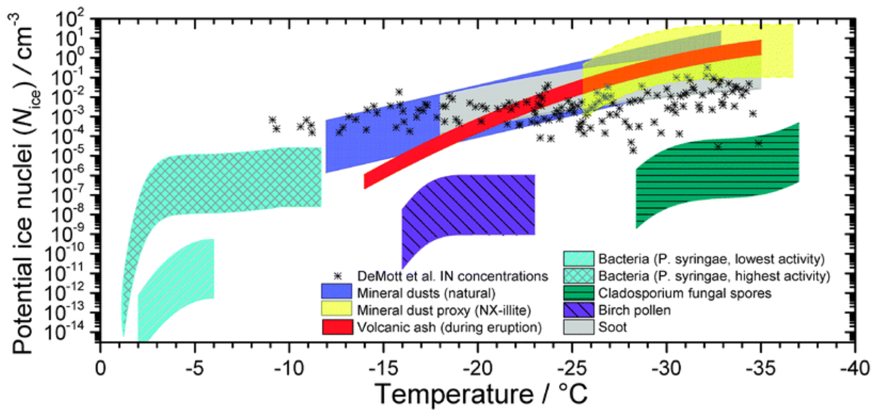
Murray, B. J., D. O’Sullivan, J. D. Atkinson, and M. E. Webb, 2012: Ice nucleation by particles immersed in supercooled cloud droplets. Chem. Soc. Rev., 41, 6519–6554, doi:10.1039/C2CS35200A.
Mineral dust, biological species, and carbonaceous combustion produced particles immersed within supercooled water droplets nucleate the formation of ice.
Potential Ice Nuclei [cm⁻³]
Temperature [⁰C]
The atmosphere lacks microdust that nucleates ice at warm temperatures.
Fig. 19 – Potential immersion mode ice nuclei concentrations as a function of temperature for a range of atmospheric aerosol species. Calculations performed using concentrations of different particle sizes.
Notes:
8
8

Slide 9
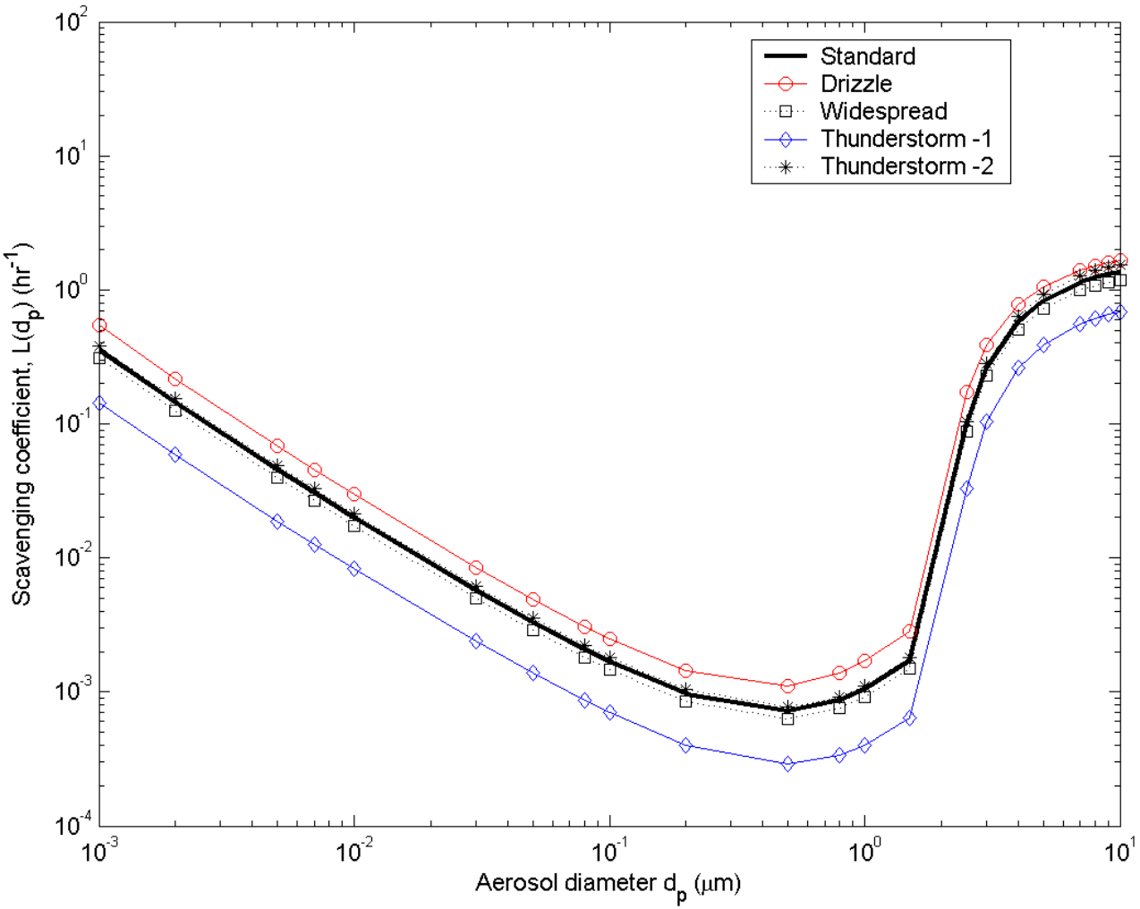
Andronache, C.: Estimated variability of below-cloud aerosol removal by rainfall for observed aerosol size distributions, Atmos. Chem. Phys., 3, 131-143, https://doi.org/10.5194/acp-3-131-2003, 2003.
Below-cloud scavenging (removal) of microdust by rainfall increases with rainfall rate and has a significant dependence on particle size.
Fig. 3B – Scavenging coefficient L(dp ) versus aerosol diameter for the same raindrop size distributions. The plots are for rain rate of (R) of 1 mm hr⁻¹.
Microdust of 0.1 to 1.0 µm in diameter are not removed by rainfall as effectively as larger or smaller sized particles.
Scavenging Coefficient [hr⁻¹]
Aerosol Diameter [um]
Notes:
9
9

Slide 10
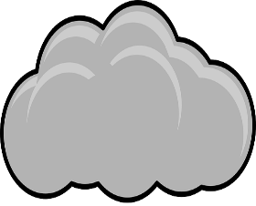

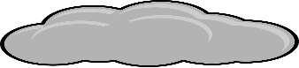
Airborne Measurements for Microduct Sink
Low Precipitation
High Precipitation
Activation
Temperature Inversion
(Traps Pollution)
Scavenging

Slide 11
Evaluating the Removal of Microdust
𝚫 CCN and/or 𝚫 IN -> ↑ Precipitation -> ↓ Microdust
Comparison of microdust at cloud base prior to precipitation and after precipitation.
Compare microdust upwind and downwind of precipitating clouds.
Measure changes in cloud properties due to difference in cloud base microdust concentrations.
Notes:
11

Slide 12
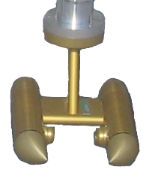
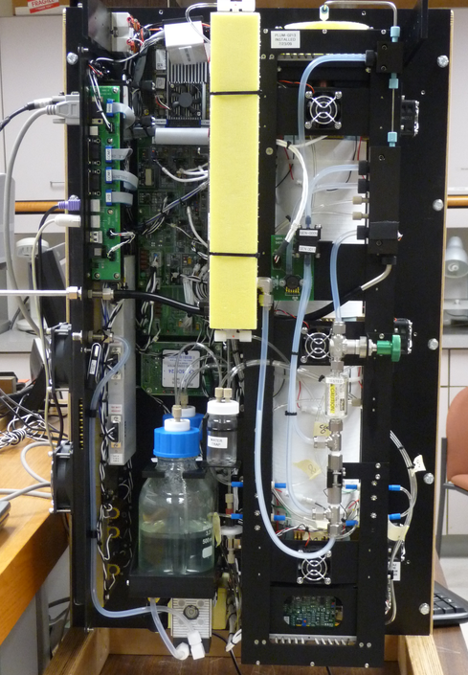
Korean Specific
Measurements Required
The concentration of aerosols (cloud condensation nuclei and microdust) related to clouds and precipitation development on the Korean Peninsula.
Microdust impact on the ability of clouds to produce large drops and ice particles.
Microdust impact on the temperature of ice formation in clouds.
What are the commonalities and differences between urban and rural clouds?

Slide 13
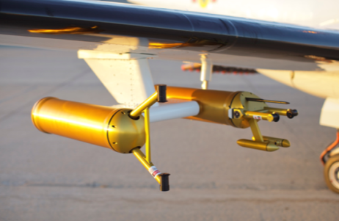
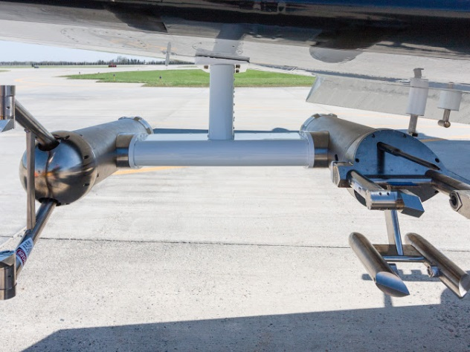
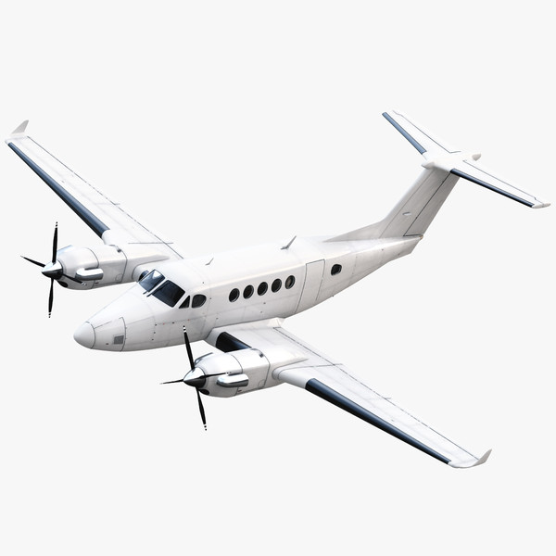
Aircraft Observations
40,000
Convective Cloud
35,000
30,000
Altitude (ft)
25,000
20,000
15,000
10,000
5,000

Slide 14
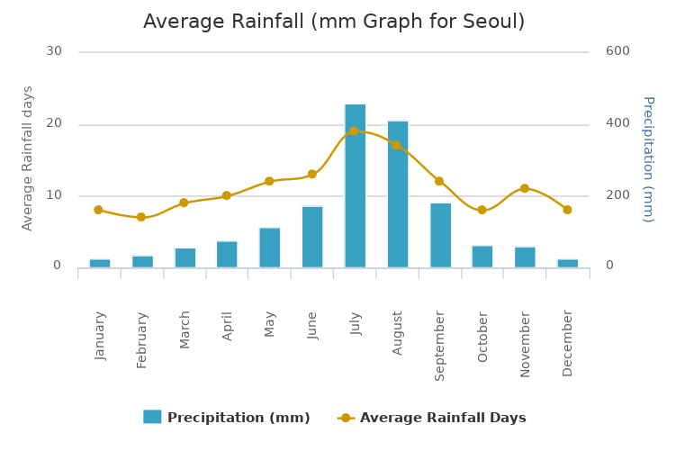
Seoul Average Rainfall (mm)
30
600
30
600
20
400
20
400
Average Rainfall Days
Precipitation (mm)
10
200
10
200
0
0
0
JAN
FEB
MAR
APR
MAY
JUN
JUL
AUG
SEP
OCT
NOV
DEC
Late Spring (May/June) and Early Fall (Sep/Oct)
Important Time Periods for Field Measurements.

Slide 15
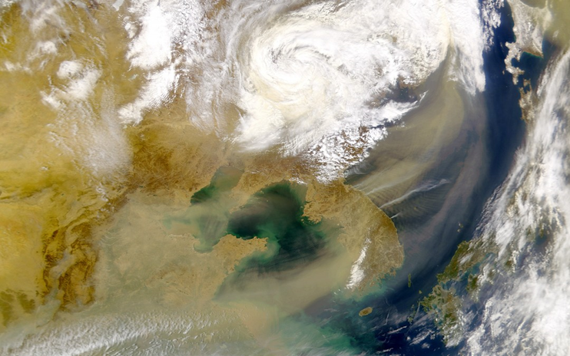
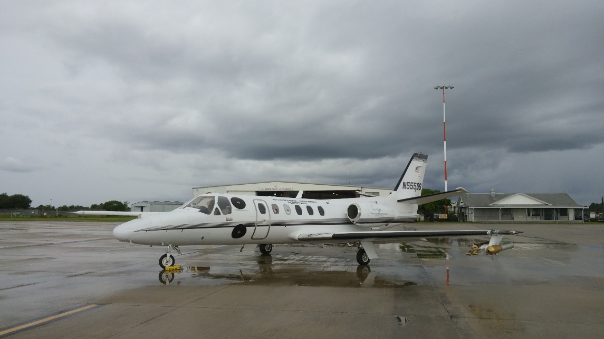
Summary and Conclusions
Measurements are key to understanding changes in the amount of Microdust.
Measurement are necessary for determining sources.
Precipitation and air mixing reduces microdust (sink).
Delene et al., 2019

Slide 16
References – Airborne Measurements
Andronache, C.: Estimated variability of below-cloud aerosol removal by rainfall for observed aerosol size distributions, Atmos. Chem. Phys., 3, 131-143, https://doi.org/10.5194/acp-3-131-2003, 2003.
Cherrier, G., E. Belut, F. Gerardin, A. Tanière, and N. Rimbert, 2017: Aerosol particles scavenging by a droplet: Microphysical modeling in the Greenfield gap. Atmospheric Environment, 166, 519–530, doi:10.1016/j.atmosenv.2017.07.052.
Cozic, J., B. Verheggen, S. Mertes, P. Connolly, K. Bower, A. Petzold, U. Baltensperger, and E. Weingartner, 2007: Scavenging of black carbon in mixed phase clouds at the high alpine site Jungfraujoch. Atmos. Chem. Phys., 7, 1797–1807, doi:10.5194/acp-7-1797-2007.
Delene, D., Hibert, K. Poellot, M., and Brackin N., The North Dakota Citation Research Aircraft Measurement Platform, SAE Technical Paper 2019-01-1990, 2019, doi: 10.4271/2019-01-1990.
George A. Kantor, David Wettergreen, James P. Ostrowski and Sanjiv Singh Conference Paper, Proceedings of the SPIE Conference on Sensor Fusion and Decentralized Control in Robotic Systems IV, Vol. 4571, pp. 76-83, October, 2001
Murray, B. J., D. O’Sullivan, J. D. Atkinson, and M. E. Webb, 2012: Ice nucleation by particles immersed in supercooled cloud droplets. Chem. Soc. Rev., 41, 6519–6554, doi:10.1039/C2CS35200A.
Notes:
16

