Slide 1
IMPACTS 2020
Cloud Probes – Science
David Delene, Mike Poellot,
Kendra Sand, Greg Sova,
and Trece Hopp
University of North Dakota
28 September 2021

Slide 2
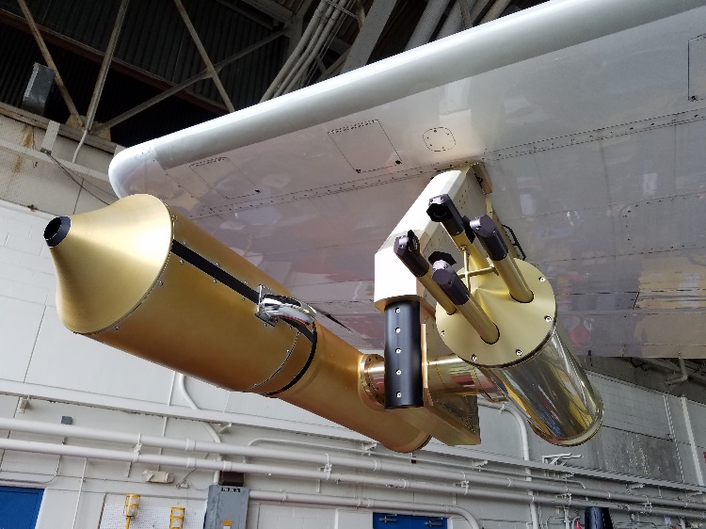
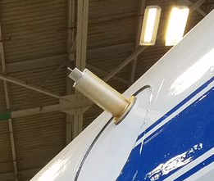
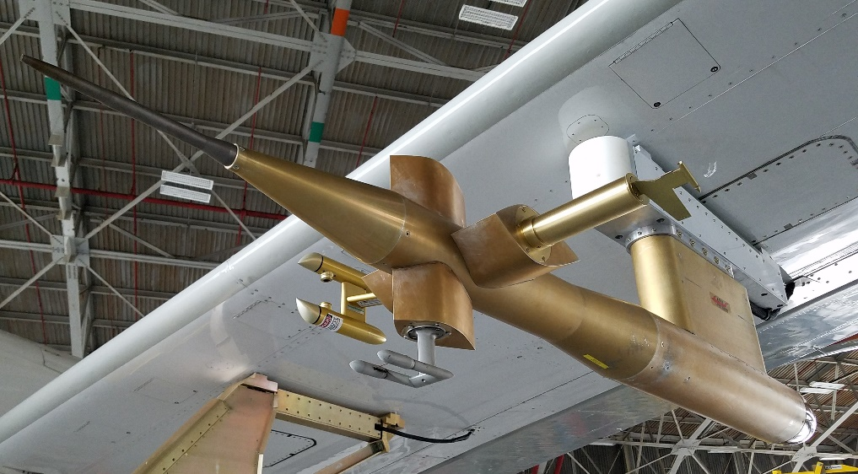
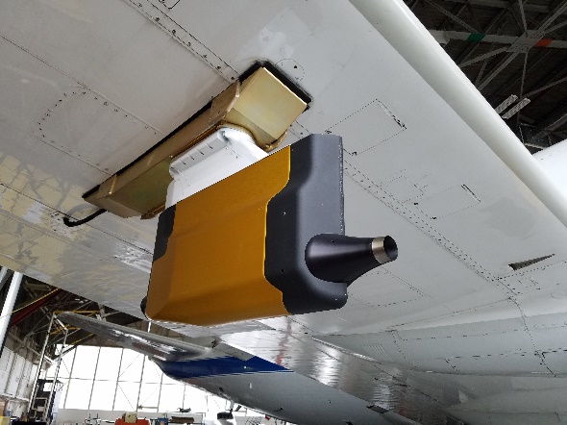
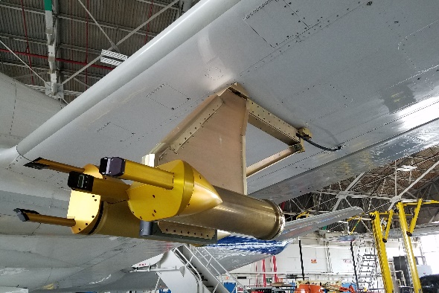
IMPACTS 2020 Cloud Probes
Hotwire Boom
X
RICE
CDP
Nevzorvo
RICE
RICE
PHIPS
2DS
King
FCDP
2D-S
CPI
HVPS3-B
Hawkeye
HVPS3-B

Slide 3
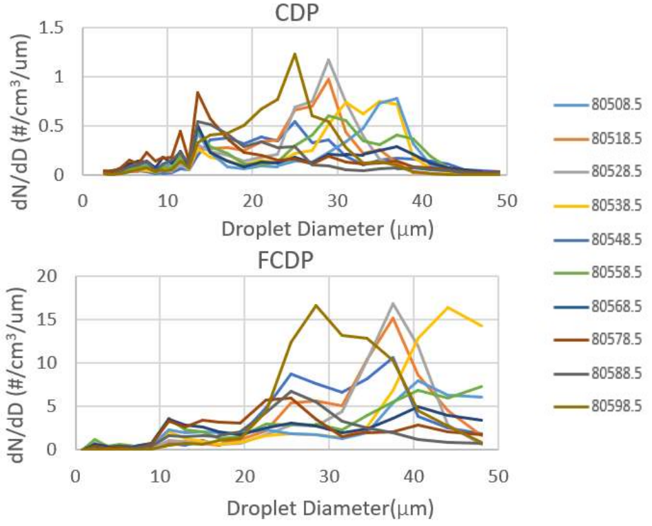
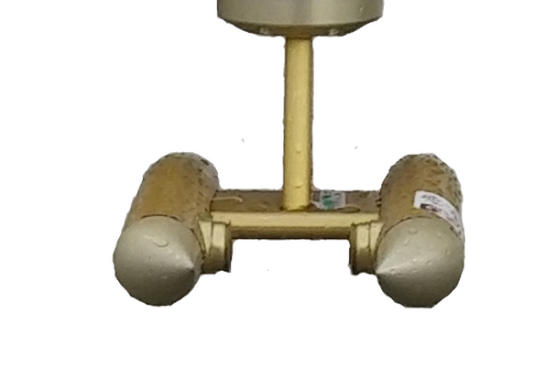
IMPACTS P3 - 2020/01/25

Slide 4
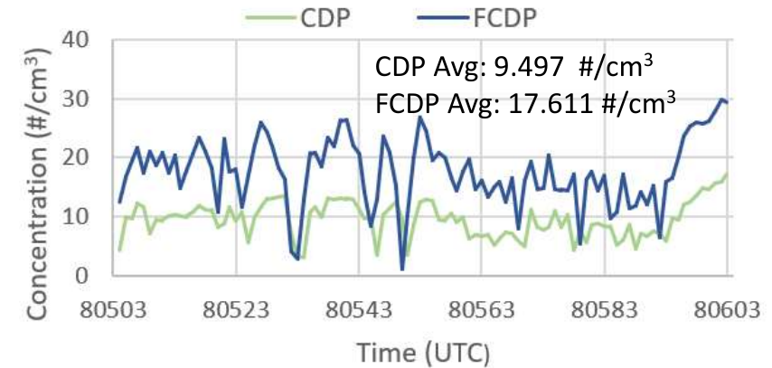
IMPACTS P3 - 2020/01/25

Slide 5
IMPACTS P3 - 2020/01/25

Slide 6
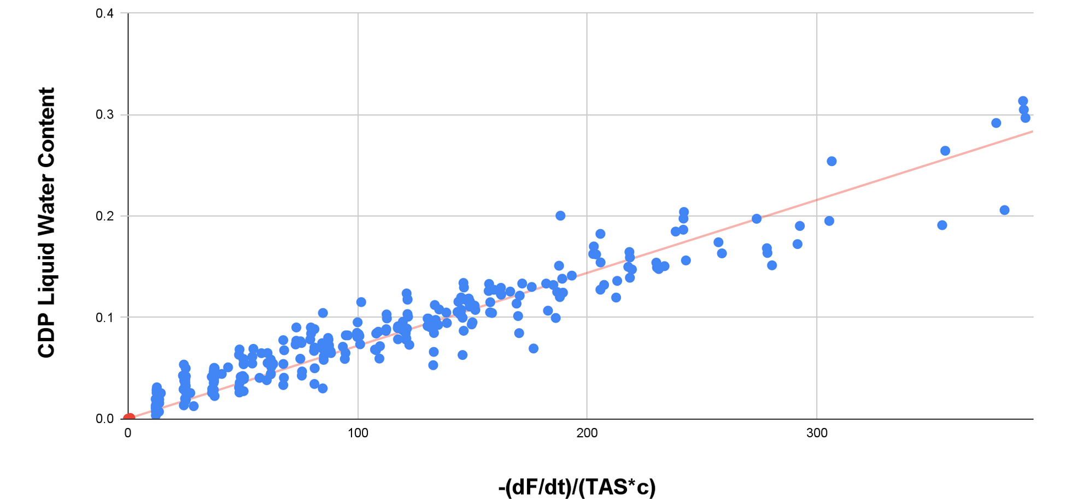
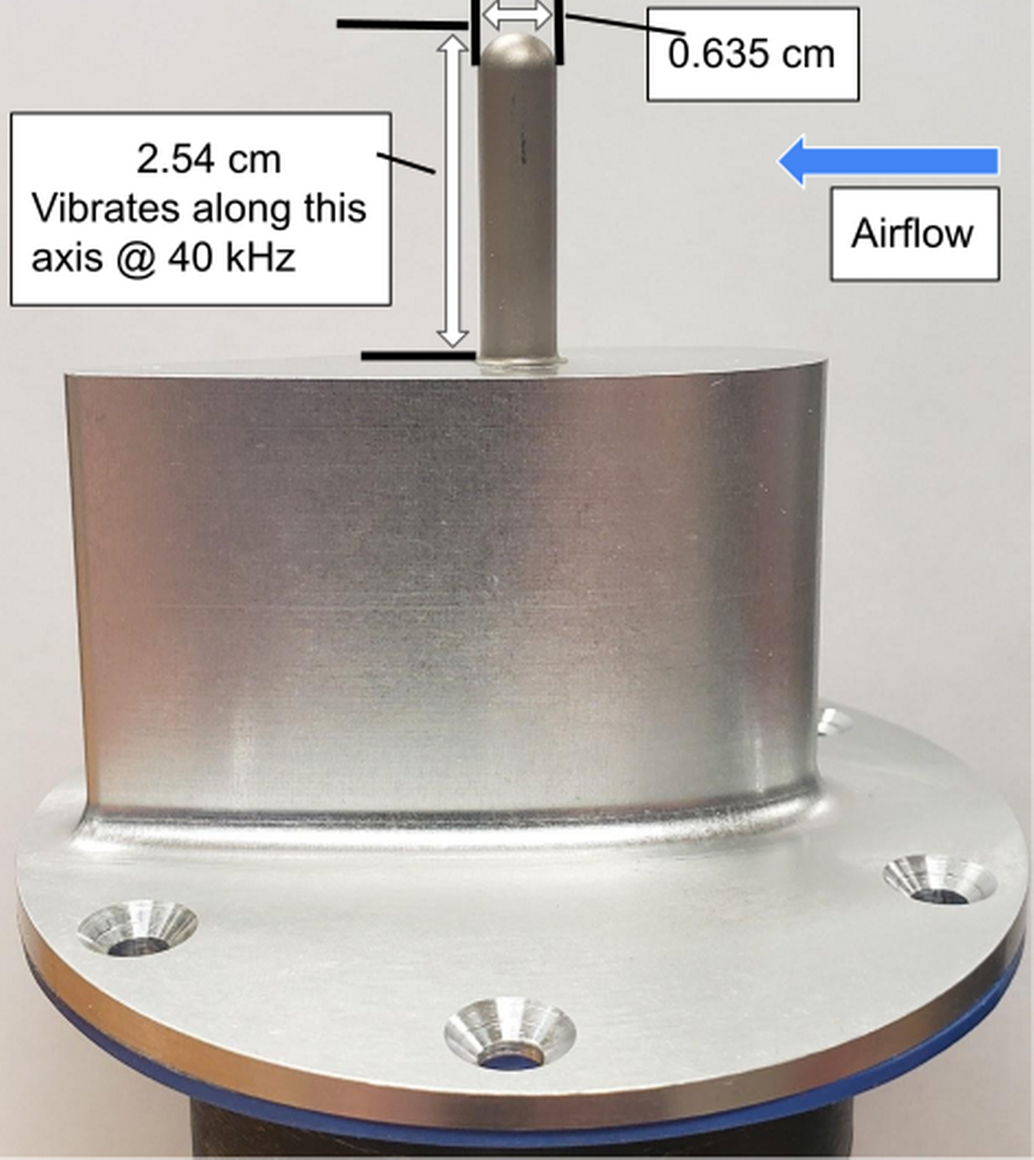


Rosemount Icing (RICE) Detector During IMPACTS 2020

Slide 7
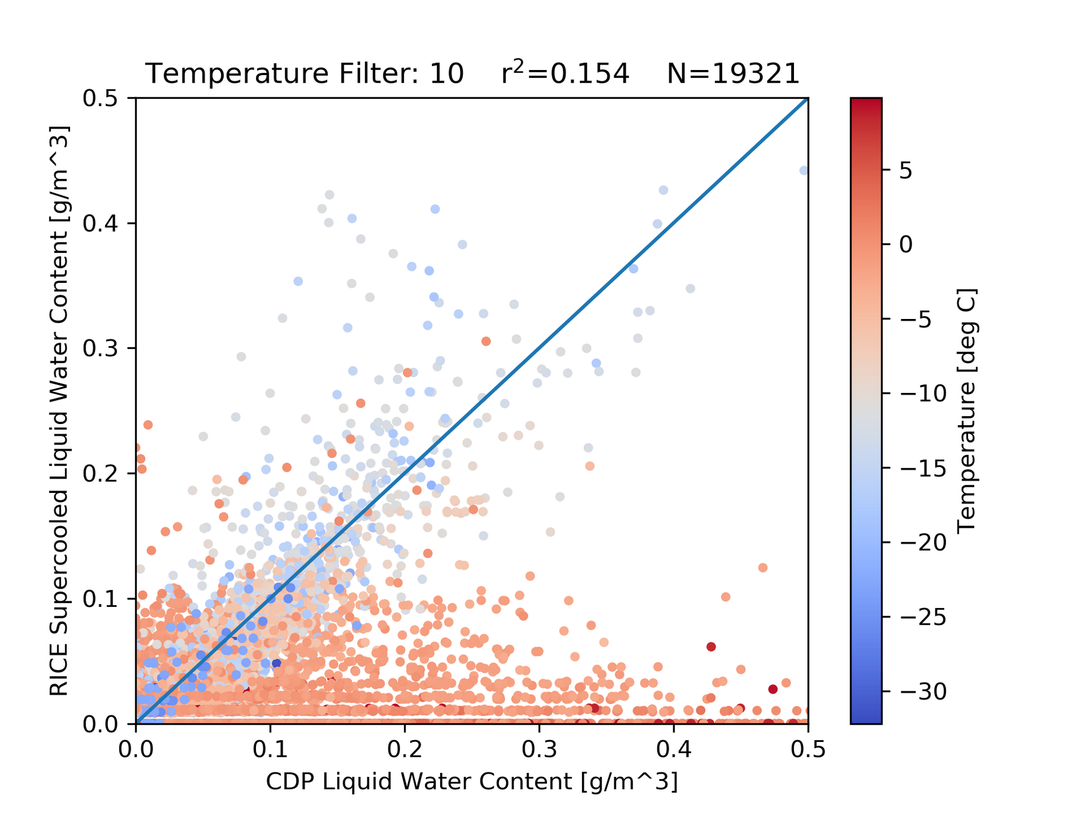

Rosemount Icing (RICE) Detector During IMPACTS 2020

Slide 8

Conclusions
The FCDP has higher number of droplets and larger sized droplets than the CDP.
The RICE Probe derived SLWC product is a valid product when operating at temperatures colder than -3 ℃ and with a pitch angle less than 3°.

