Slide 1
IMPACTS 2022 Cloud Probes – Status and Updates
David Delene, Mike Poellot,
Kendra Sand, Greg Sova,
and Trece Hopp
University of North Dakota
29 September 2021

Slide 2
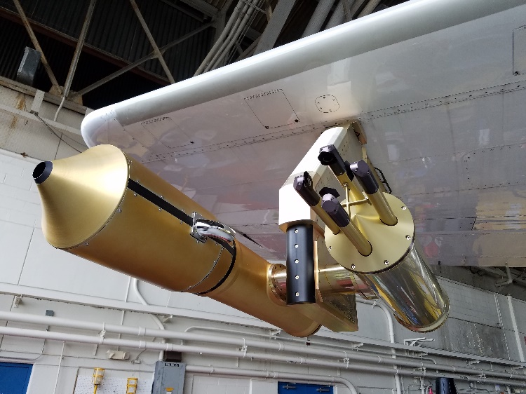
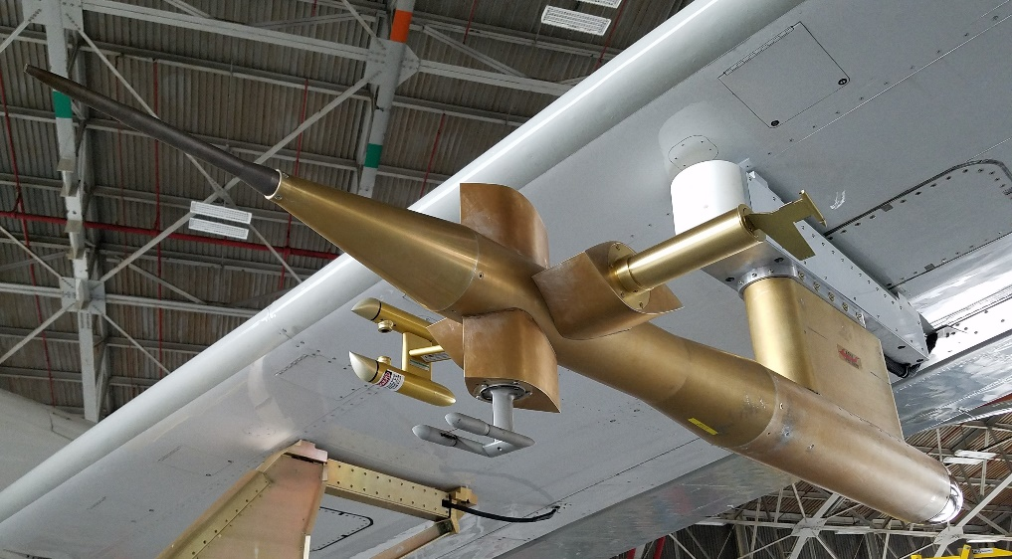
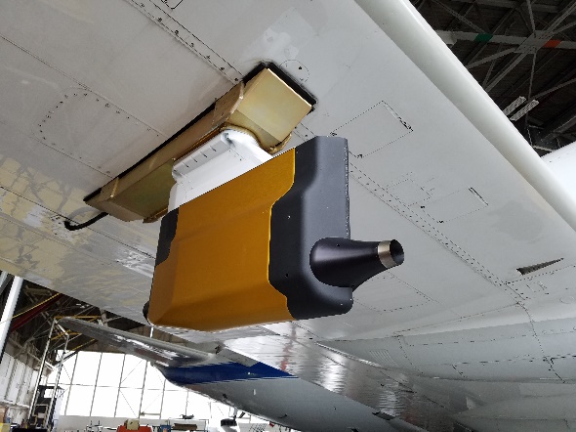
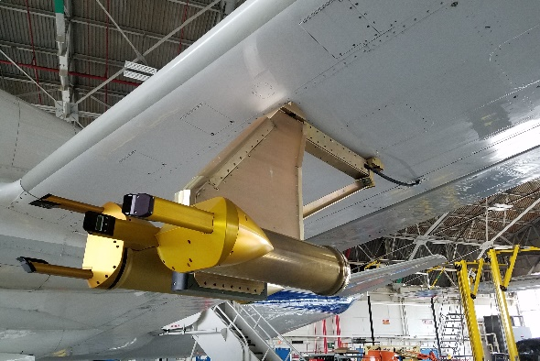
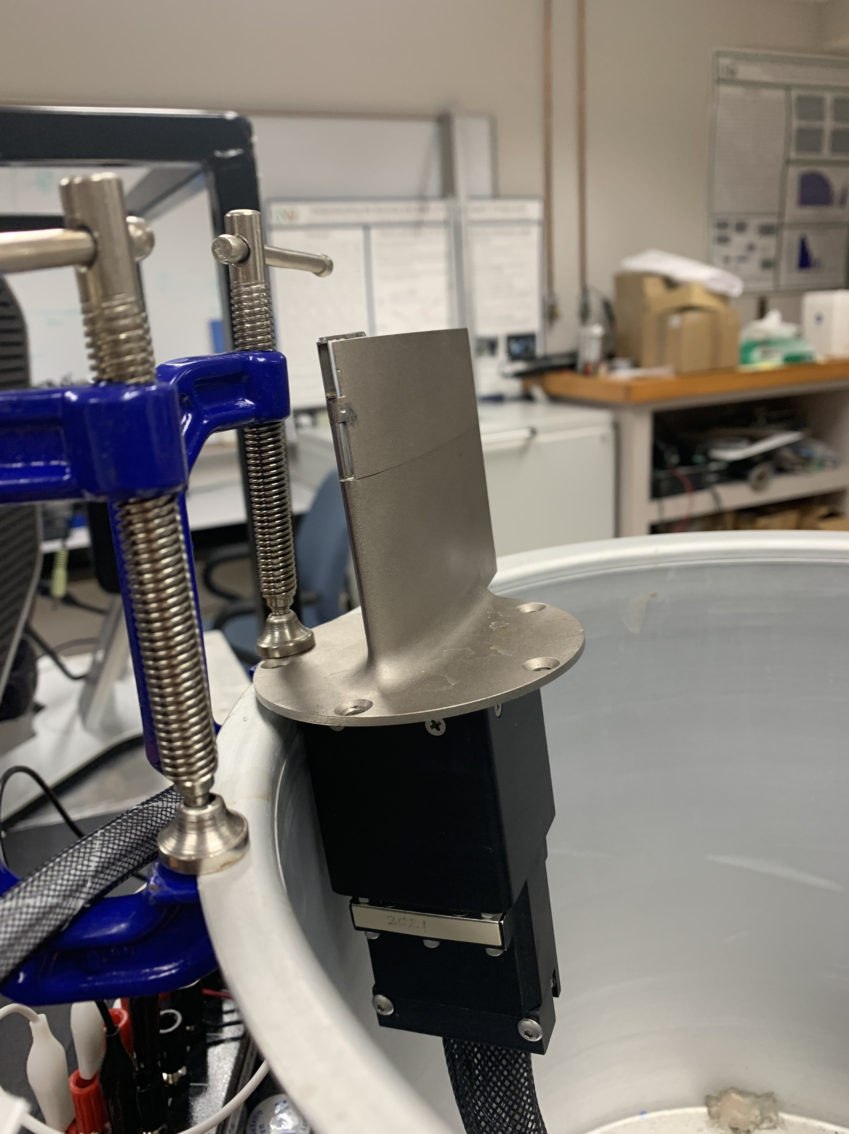
IMPACTS Cloud Probes
Hotwire Boom
WCM
X
RICE
CDP
Nevzorvo
RICE
RICE
PHIPS
2DS
King
HVPS3-B
Hawkeye
HVPS3-A
WCM – New 2022

Slide 3
IMPACTS 2022 Cloud Probes
Measurement Size Range
Measurement
Method
1 um 10 um 100 um 1 mm 10 mm
CDP (2.0-50.0 μm)
Forward Scattering Probes
FCDP (2.0-50.0 μm)
CPI (2.3 um to 1 mm)
PHIPS (3 um to 2 mm)
Imaging
Probes
2DS (10/50 um to 1.280/6.400 mm)
HVPS-3 (150 um to 19.2 mm)
King (wire) (LWC for 5 to 200 um)
Hot-wire Probes
WCM (wire) (LWC for 5 to 200 um)
Rosemount Ice Detector (RICE) (SLW)
Vibrating Cylinder

Slide 4
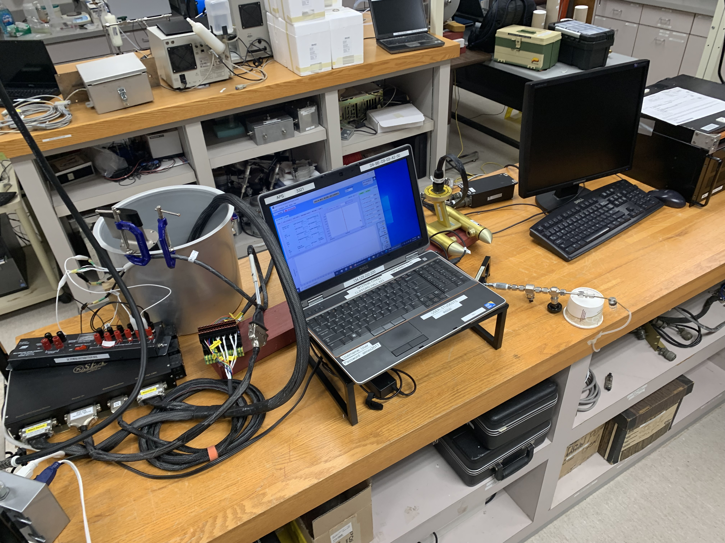
Instrument Status
All Probes Calibrated
WCM and CDP Test in UND Lab

Slide 5
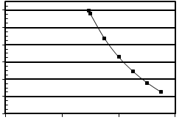
WCM - Total Water Content System
Science Engineering Associates (SEA) Model WCM-3000
Total Water
140 °C Sensor Temperature
10
9
8
7
Max Water Content (g/m³)
6
5
4
0
0
0
100
200
300
Air Speed (m/s)
Liquid Water

