Slide 1
The North Dakota Citation Research Aircraft Measurement Platform
David Delene¹, Kurt Hibert², Michael Poellot¹, and Neil Brackin²
¹University of North Dakota
²Weather Modification International

Slide 2
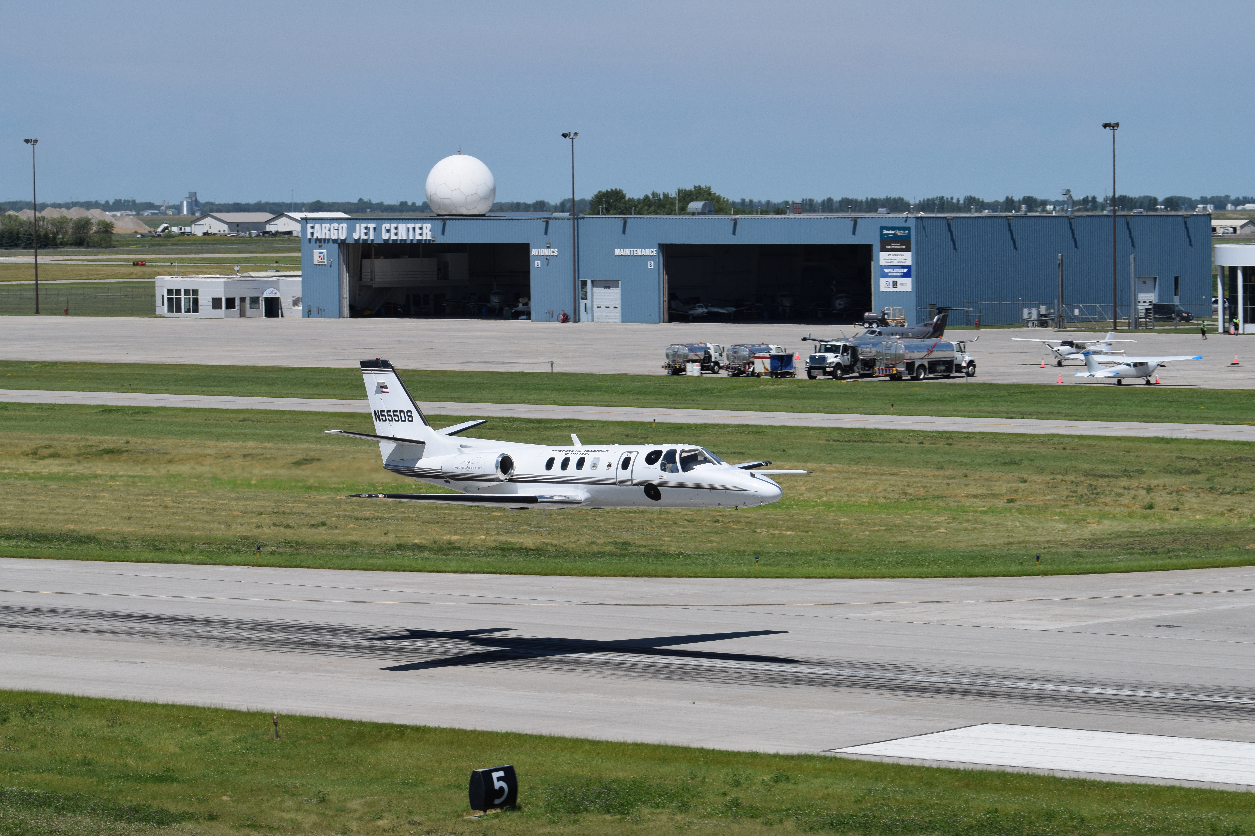
North Dakota Citation Research Aircraft
Modifications
    Two Wing-Tip Pylons with four Particle Measuring Systems (PMS) Cans
    Five Reinforced Fuselage Instrument Mounting Locations
    Six Fuselage Ports for Instruments, such as Electric Field Mills
    Four Side-looking Window Inserts that House Specialized Glass for Lidar Instruments
    Anti-ice Sampling Inlets for Cabin-based Gas and Aerosol Sampling
2

Slide 3
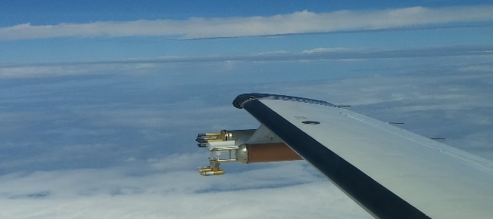
Citation Research Aircraft Capabilities
General Aircraft Specifications
CAPE2015 – 2 Aug 2015
Payload .……………………………. 693 – 1147 kg (1,528 – 2,528 lbs)
Range ………………………………. 2,222 km (1,200 nmi)
Ceiling without/with Pylons ……….. 13. 1 km (43,000 ft) / 12. 1 km (40,000 ft)
Climb Time ………………………..... 13 min (to 25,000 ft), 24 min (to 35,000 ft)
Endurance ………………………..… 3 to 5 hours
Weather ……………………………. Known Icing and Storm Penetration
Airspeed Range ……………………. 150 – 225 knots IAS
3

Slide 4
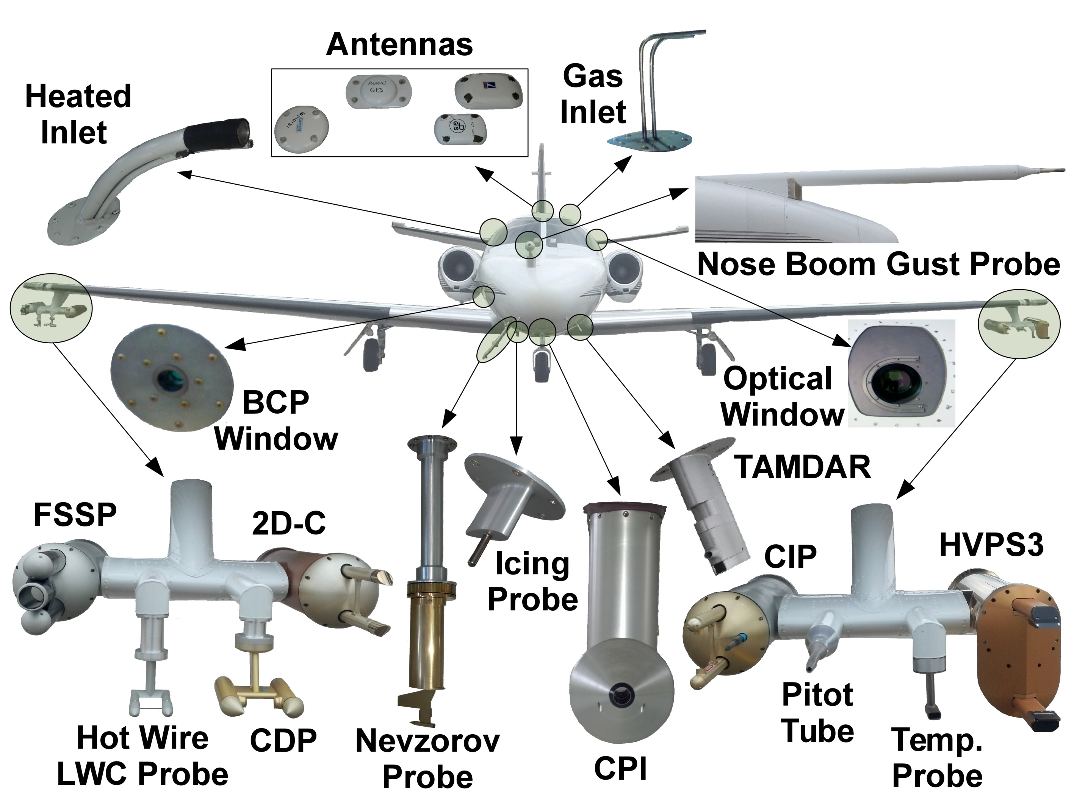
Areas of Measurement Focus of the Citation Research Aircraft
Fall 2012
Configuration
Instrument Suite
    Aircraft Icing
    Instrumentation Testing
    Cloud Physics
    Electric Fields
    Atmospheric Chemistry
    Weather Modification
4

Slide 5
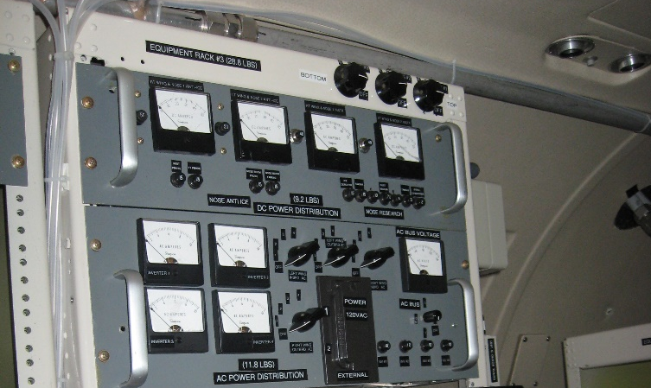
Citation Research Aircraft Resources
Available Power Specifications
Total Available Research Power ……………. 7,300 W (Below 35,000 ft)
5,400 W (35,000 ft and Above)
Alternating Current Instruments …………….. 4,000 W of 110 Volts at 60 Hz
Direct Current Anti-icing Instruments ……….. 80 Amps of 28 Volts
Direct Current Power Instruments …………... 40 Amps of 28 Volts
5

Slide 6
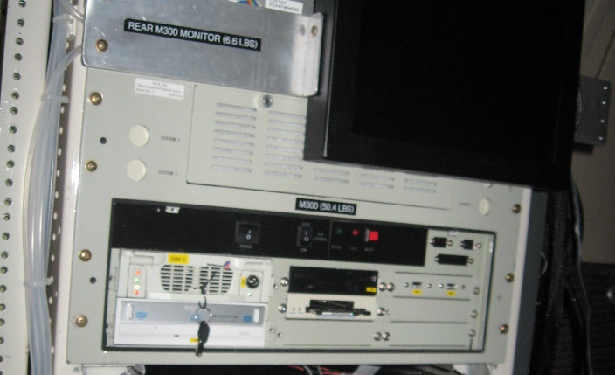
Data Acquisition System
Science Engineering Associates M300
Real-time Data Acquisition Operating System.
Displays Data in Graphic and Alphanumeric Formats.
A 12bit, analog to digital 32 channel, is used to acquire voltage measurements at frequencies up to 100 Hz.
Digital data acquisition is available on 25 serial (RS232/RS422) ports at speed of up to 1.8 Mbps, on ARINC-429 ports, and internet ports.
Special M300 interface cards are used to acquire data from Cloud Imaging probes (CAPS, CIP, PIP) and the Applanix System.
Data acquisition configurations and instrument calibration is documented for each field project and incorporated into post-processing software.
6

Slide 7
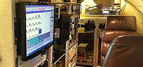
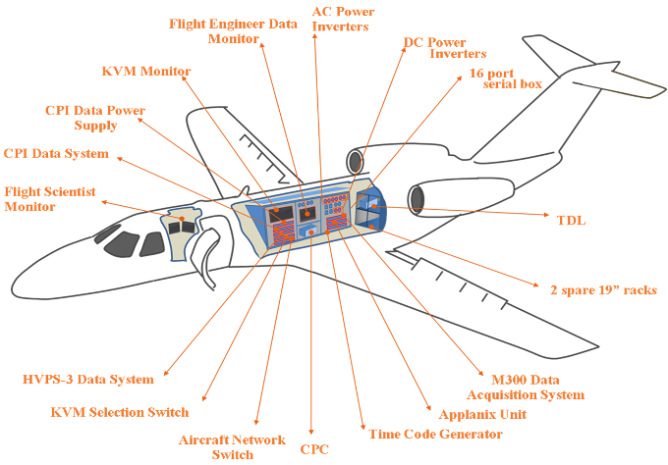
Citation Research Aircraft Flight Crew
Seating Configuration
Fall 2012
Configuration
Pilot …………….. Front Left Seat
Co-Pilot ……….... Front Right Seat
Flight Scientist .... Front Middle Seat
Flight Engineers (2) … Rear Seats
7

Slide 8
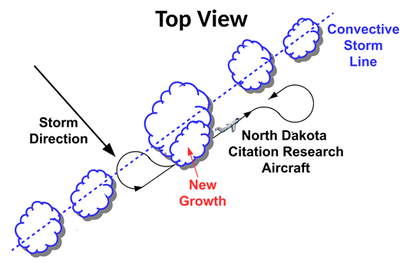
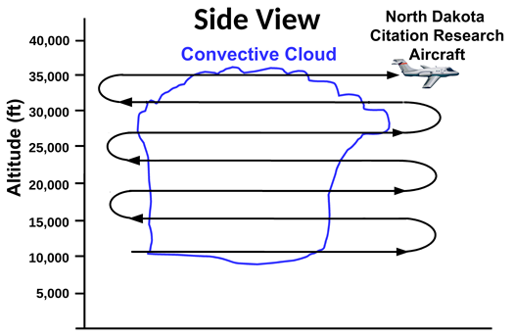
Flight Profiles for Aircraft Sampling
Cumulus Cloud Sampling
Field projects develop sampling profiles.
The pilots are responsible for safe operation.
Flight scientist is responsible obtaining objectives.
Flight engineers operate the research equipment and monitor instruments using the real-time data displays.
Detailed checklists are followed.
Notes are made of interesting observations.
8

Slide 9
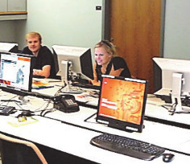
Scientific Software Processing Packages
Package | Availability
ADPAA | svn://svn.code.sf.net/p/adpaa
D2G | Local Team Software, Alexei Korolev
EGADS | https://github.com/eufarn7sp/egads-eufar
OASIS | Droplet Measurement Technologies
SAMAC | https://github.com/StephGagne/SAMAC
SODA | https://github.com/abansemer/soda2
SPEC | http://www.specinc.com/downloads
UIOPS | https://github.com/weiwu5/UIOPS
Software packages presented at the European Facility for Airborne Research (EUFAR) International Conference on Clouds and Precipitation (ICCP) Workshop on Data Processing, Analysis, and Presentation Software.
9

Slide 10
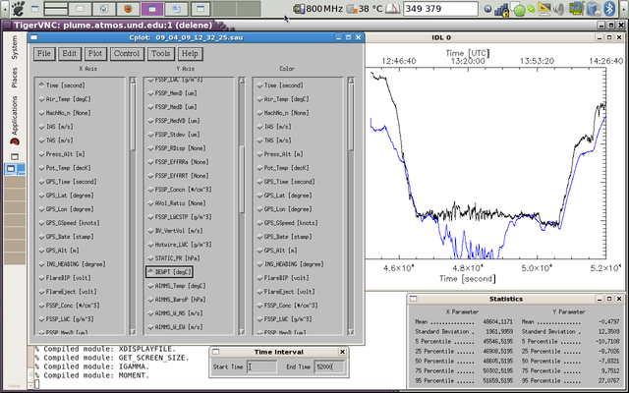
Community Packages for Airborne Science
Package | Languages | Summary of Features
ADPAA | IDL, Python, Bash, Perl | Tools for processing instrument data, quality assurance, and visualization.
D2G | Matlab | Process, quality assurance, and visualization of aircraft and radar data.
EGADS | Python | Toolbox for handling meta-data and units for processing data.
OASIS | Igor | Package for OAPs (CIP, PIP/CIP-100, SPEC 2DS and HVPS).
SAMAC | Python | Tools for calculating, displaying and storing segments summaries.
SODA | IDL | Package for OAPs that provides options to derive particle spectra.
SPEC | Matlab, IDL | Tools for SPEC probe data (2D-S, HVPS3, CPI, etc.).
UIOPS | Matlab, C++ | University of Illinois analysis package for OAPs.
10

Slide 11

Available Aircraft Data Sets
20 Years of Airborne Data
    Several field projects have been done for companies to test airborne instruments (Ophir, UT Corp, Goodrich, and TAMDAR projects).
    Field project conducted for natural icing studies (Sikorsky and L3Com).
    The main government sponsor recently has been NASA.
    The data sets are readily available for further scientific analysis since the raw data was recorded on an 8 mm tape (before 2005) or directly to a hard drive (2005 onward).
    Several data sets (e.g., NASA GPM data sets) are available in open repositories, with ongoing work devoted to archiving additional data sets.
11

Slide 12
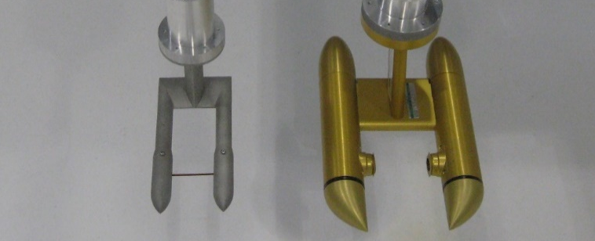
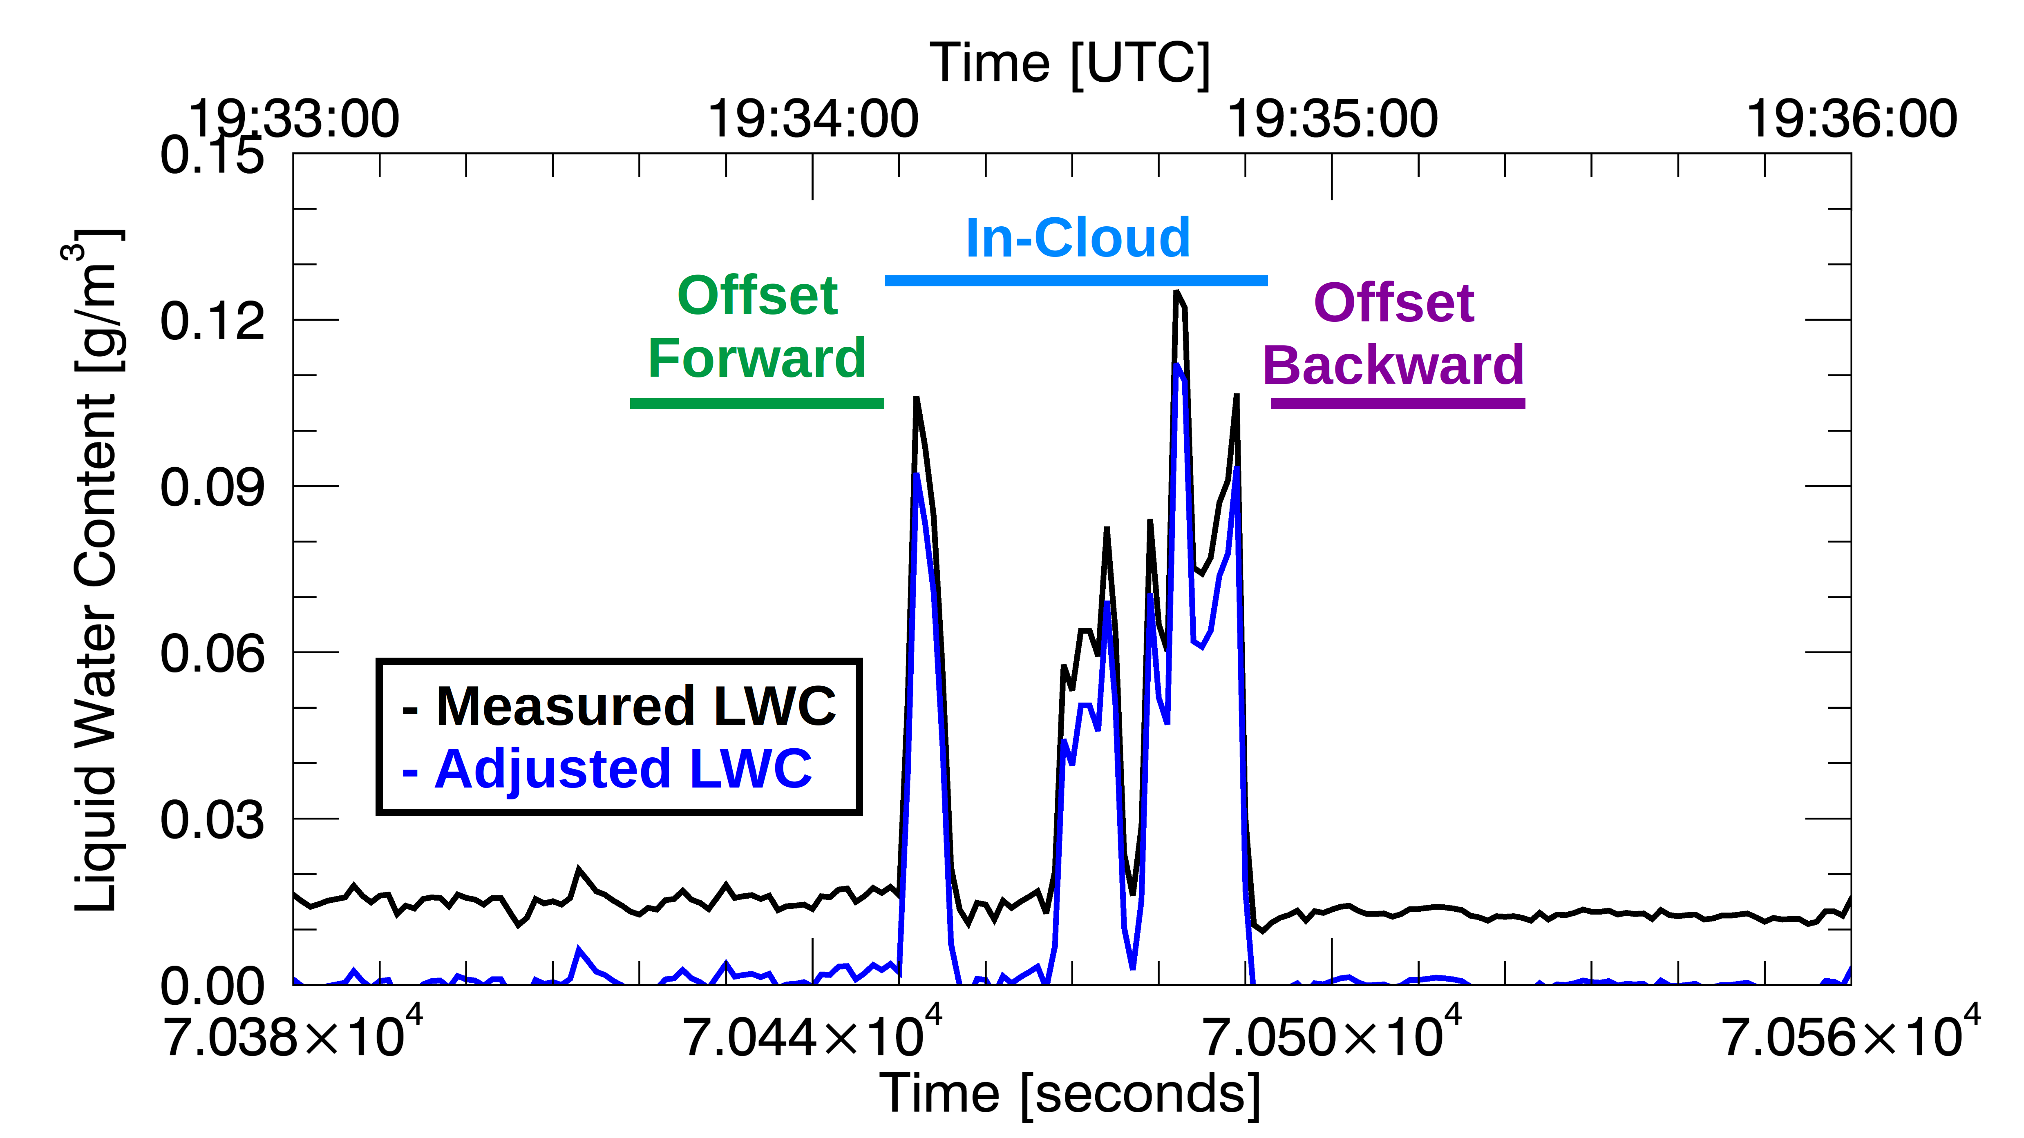
Liquid Water Content Data Processing
Automatic Offset Adjustment
Cloud penetration on 9 March 2004 showing an offset of ~0.015 g/m³ being applied to the measured liquid water content (LWC) to obtain the Adjusted LWC. The Adjusted LWC is obtained by linear interpolation of the average measured LWC during the “Offset Forward” segment and the “Offset Backward” segment.
12

Slide 13
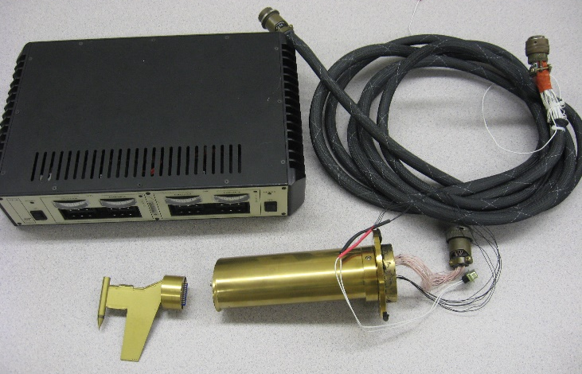
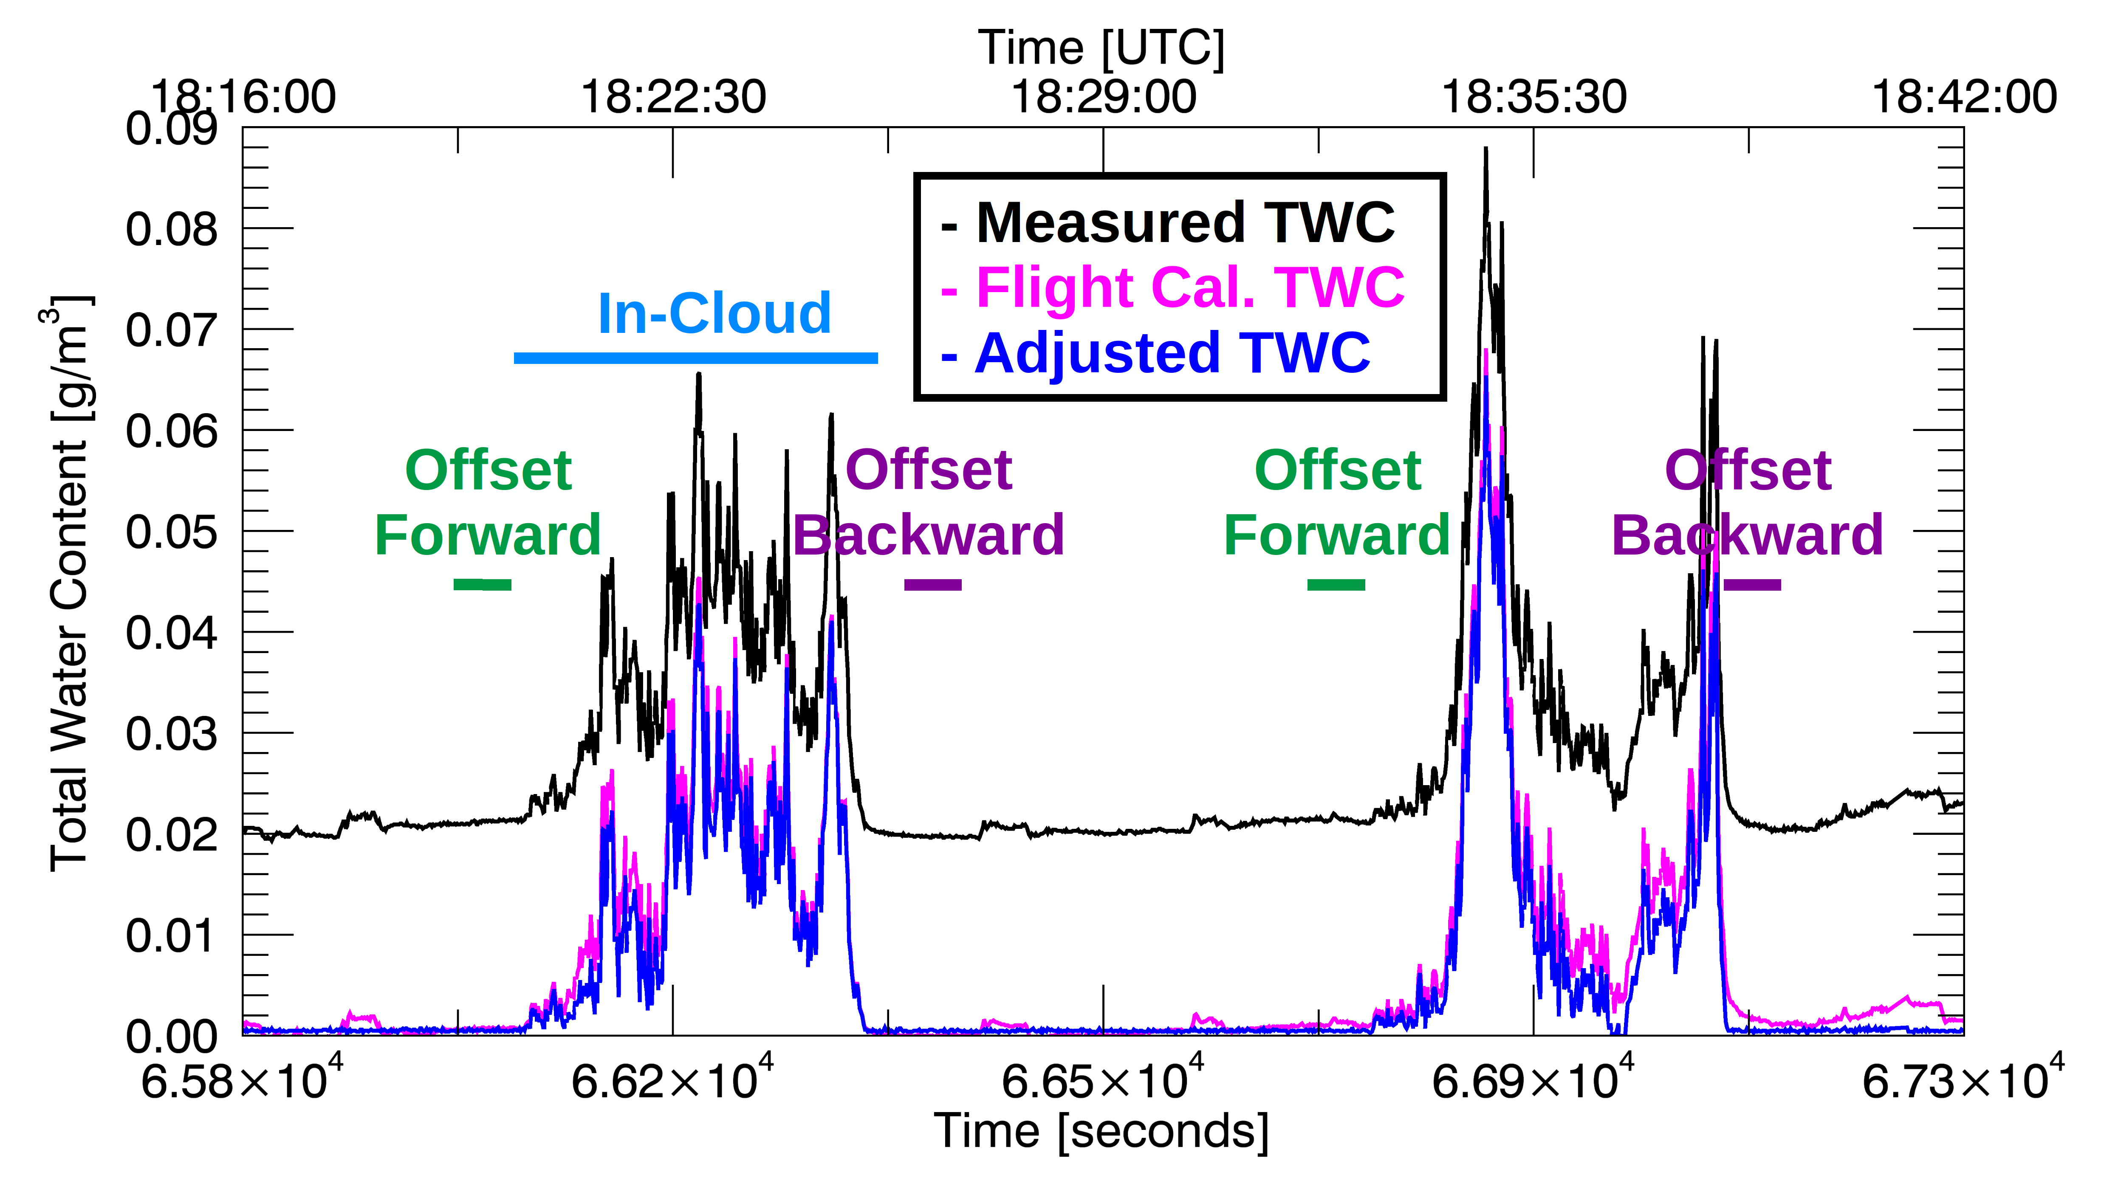
Total Water Content Processing
Nevzorov Probe Measurements
Cloud penetration by the Citation Research Aircraft on 30 July 2015. The Adjusted TWC is obtained by a linear interpolation of the average measured TWC during the “Offset Forward” segment and the “Offset Backward”.
13

Slide 14
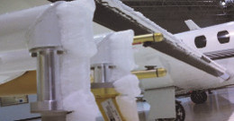
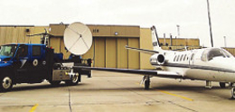
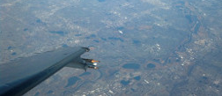
Conclusions
Themes:
    One theme is the use of aircraft for observing properties of flight environments (icing, turbulence, etc.) and the instrumentation used to measure that environment. This requires consideration of calibration and performance issues of the selected instruments.
    Theme two is the need for open source software for data processing and the need to build a community that tests the quality of its software.
    Theme three is a history of past research projects, the creation/availability of aircraft data sets, and what the near future will bring.
    Overall, the correct aircraft platform, with the correct instrumentation, software and people, is necessary for obtaining required observations.
14

Slide 15
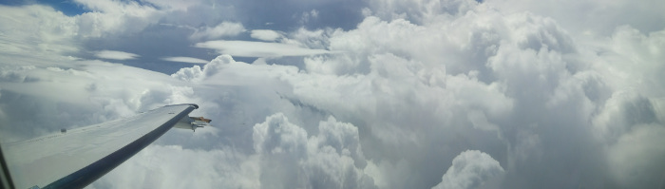
Future Field Projects
Next 20 Years
    The future is bright for utilization of North Dakota Citation Research Aircraft platform.
    The first joint UND/WMI field project (CapeEx19) utilizing the North Dakota Citation Research Aircraft is scheduled for July and August 2019.
    Instrumentation Advancements: 10 µm cloud imaging resolution, anti-shattering probe tips, and polar scattering measurements
    Instrumentation advances with more robust software allows us to effectively address topics of interest that have existed for a long time.
15

