Slide 1
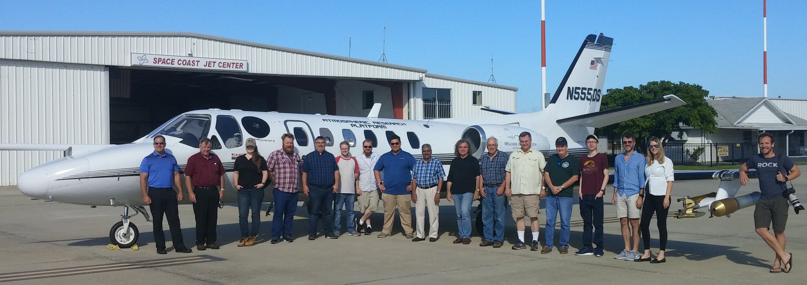
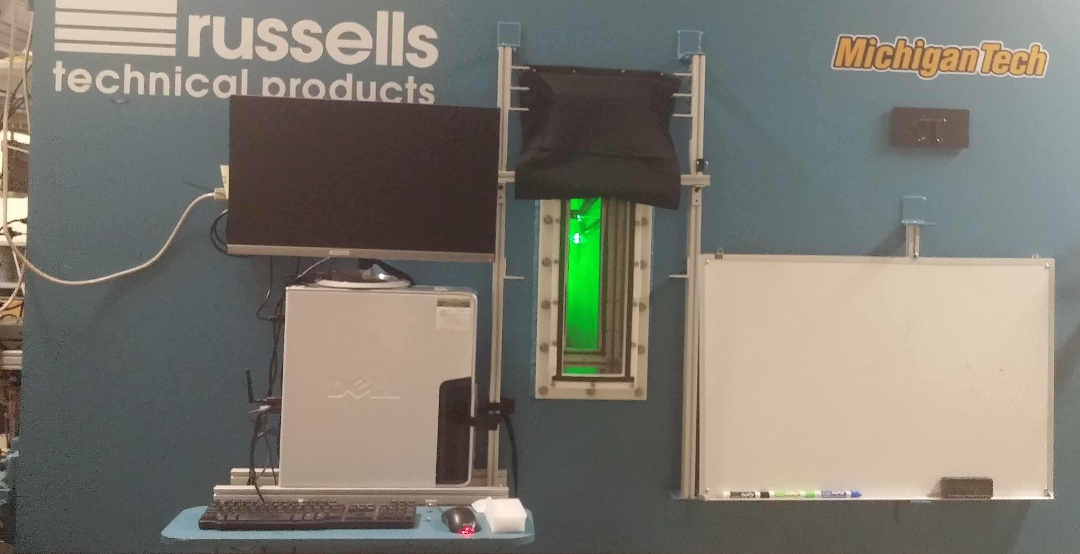
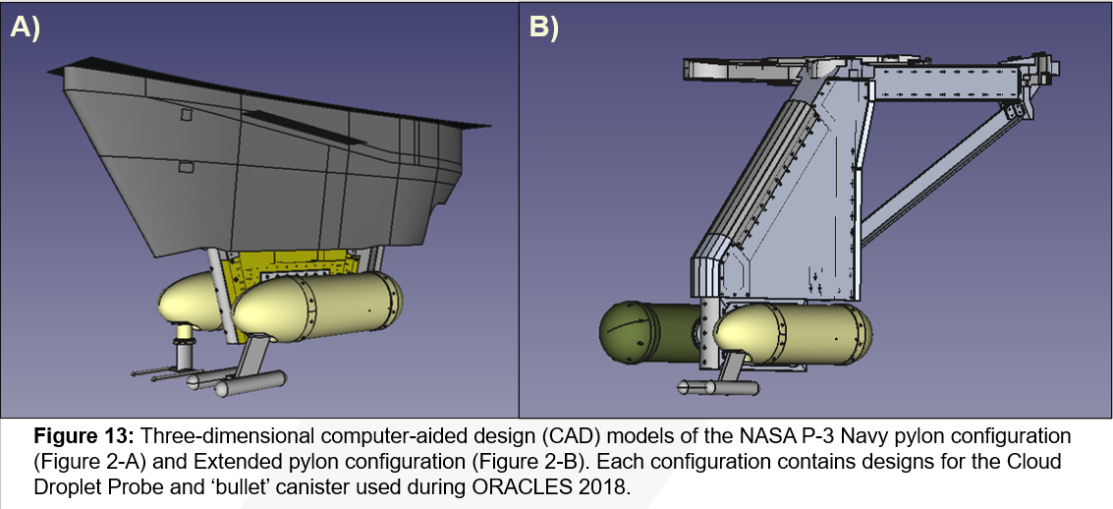
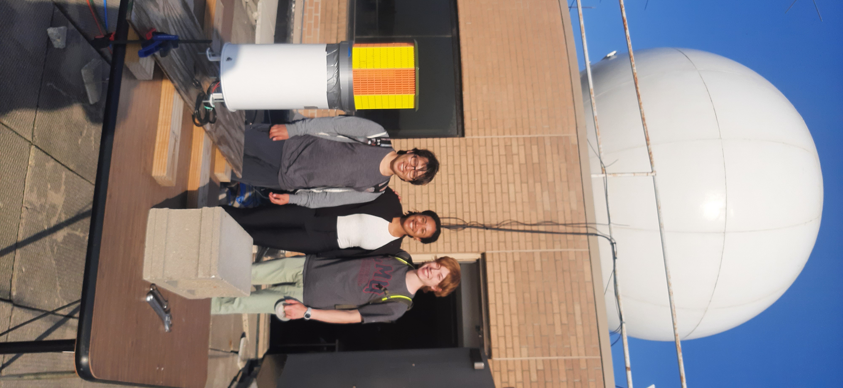
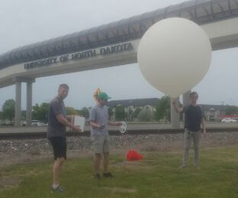
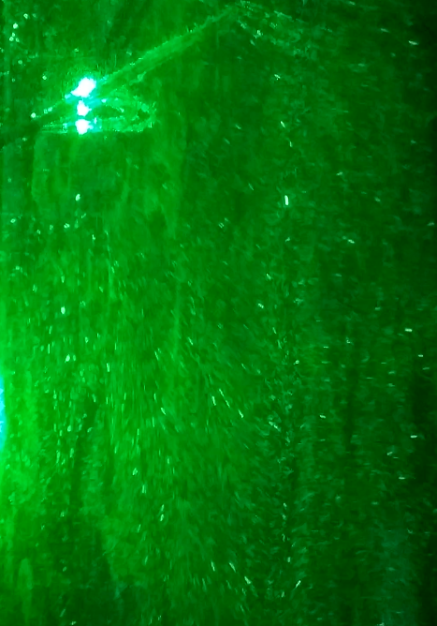
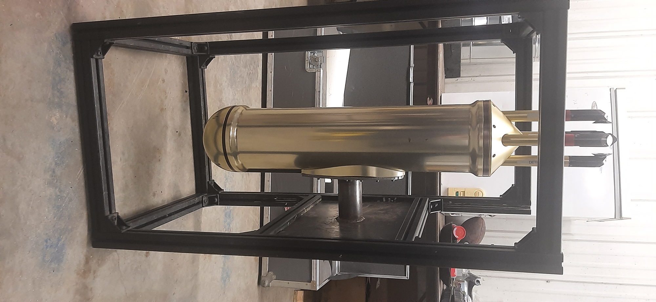
Dr. David James Delene
Department of Atmospheric Sciences, Aerospace College
Observations
Laboratory
Modeling

Slide 2
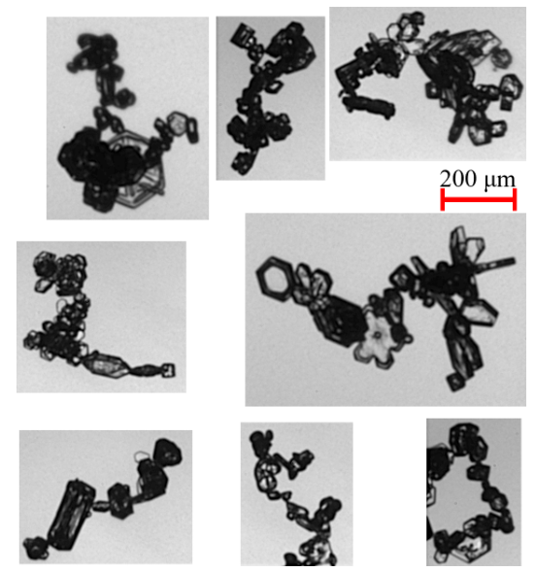
Ice Crystal Chain Aggregate Occurrence in Cirrus Cloud Anvils and Implications for Hypersonic Flight Operations
Need/Problem
Apparatus/Facility
Objective/Goals
Knowing the location and extent of chain aggregates is important since their relatively large mass, compared to individual crystal monomers, enables chain aggregates to impact the nose cones of hyper-sonic vehicles instead of being directed away as occurs with smaller crystals with less momentum. Such impacts affect flight trajectories and can extensively damage heat shields; hence, knowing where, and how frequent, chain aggregates occur in the atmosphere is important for hypersonic flight operations.
The Navy sponsored a 2019 field project to obtain in-situ observations of cirrus cloud properties. Aircraft instruments measured the electric field, cloud particle distribution, and obtained high-resolution particle images.
Analyze the all 13 flights using the methodology established by the 3 August 2019 case study to obtain a statistically robust representation of chain aggregate occurrence in cirrus cloud anvils. Determine the consistency between the chain aggregate observation and current theoretical understanding. Analysis is conducted to check if the observations of chain aggregate are consistent with a state-of-the-art, one-dimensional cloud aggregation (1D) model.
Concept/Overview
Advancement/Expect Outcome
High magnitude, electric fields within storms are likely the predominate mechanism that promotes the formation of large sized, quasi-linear chains of individual crystals. The chain aggregates are composed of individual crystal monomers that collide and stick together via a micro-physical process termed aggregation. The extent of chain-aggregates occurring in cirrus clouds is not known. Additionally, their formation process is not well understood, which limits the modeling efforts
Knowing the extent of coverage of chain-aggregates enables global estimation of their occurrence and the likelihood of vehicle encounters. Hypersonic flight operations would use predictions, with known uncertainties, for the location, size and concentration of chain aggregates to enable determination of the impacts on heat shields and trajectory accuracy.
End Users/Proposal Call
Naval Surface Warfare Center, Dahlgren Division
Applicability: Hypersonic, Clouds, Ice, Heat Shields, In-situ Environmental Observations
10/02/2025

Slide 3

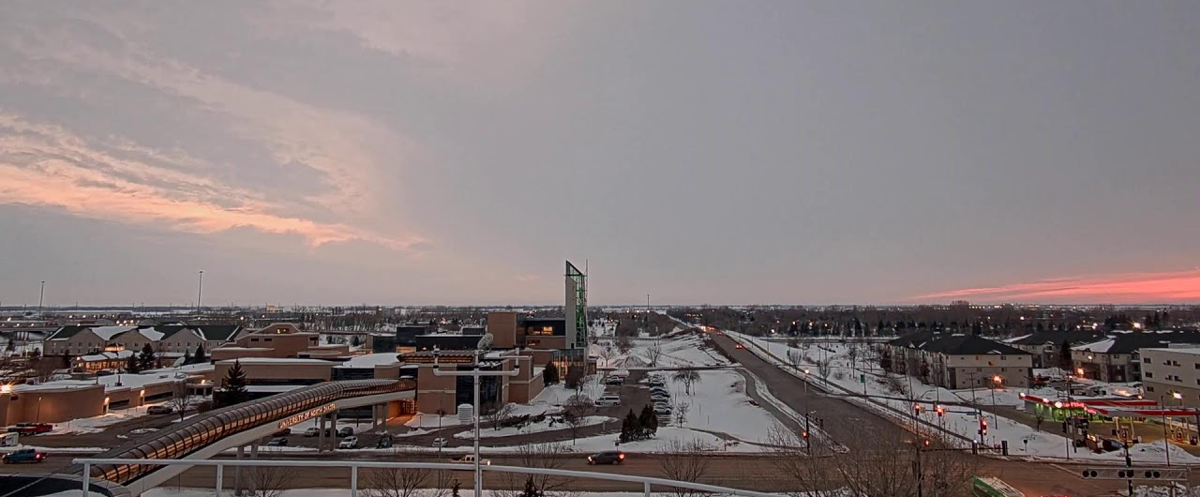



David J. Delene, Aerospace Research Fellow
Attending - Marwa Majdi and Aaron Kennedy
Additional Researchers - Mounir Chrit, Daile Zhang, Shawn Wagner, and Marcos Fernandez-Tous

