Slide 1
T-28 Research Aircraft and Polarimetric Radar Observations of Hailstorms
P3.5
David Delene*, Andrew Detwiler, V. Chandrasekar, Andrew Heymsfield, Aaron Bansemer
2022 North American Workshop on Hail and Hailstorms
September 20-22, Boulder, Colorado USA

Slide 2
Basic Idea
In situ observations of hail in storms that are also being observed with a polarimetric radar.
Compute polarimetric signature in a region based on aircraft in situ observations.
Compare computed signatures to observed signatures.
Try to understand the agreement and disagreement between the in situ and radar observations.

Slide 3
Assess Uncertainties
Test sensitivity of computed signature to variations in the in situ observations within the uncertainty of those observations.
Temperature, LWC, Particle Shape, Particle Size and Density Distribution
Computation using Discrete Dipole vs T-matrix Approach
Assess uncertainty in observed radar signature resulting from constraints due to time and spatial resolution of radar.

Slide 4
In situ Airborne Data Set
Start with hail observations identified in Field et al. 2019.
There are 18 flights from 1995-2003.
More than 300 10-sec flight segments with hail reported in pilot audio recordings.
Add windscreen audio recordings for these segments.
Add optical array probe imagery when available.
Expand data set by adding additional flights from several earlier years for which audio recordings are not available but hail is indicated in written field notes.

Slide 5
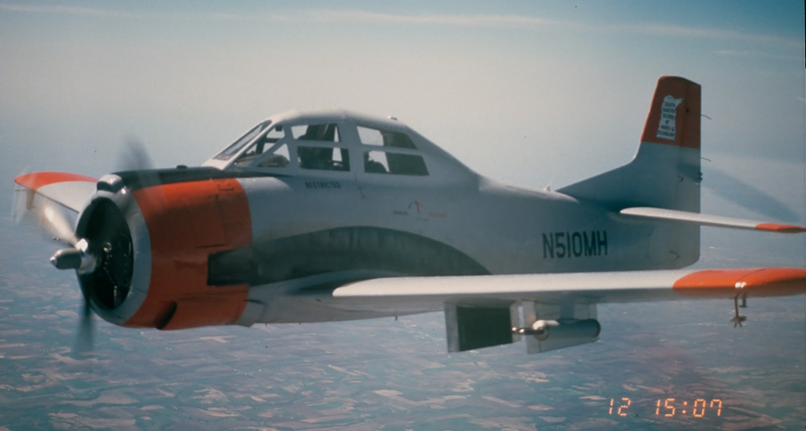
In situ Airborne Data Set

Slide 6
Typical Storm Sampling Pass
14
The Raymer Hailstorm
9 July 1973
12
Storm
Motion
-40 °C
10
8
-20 °C
Height (km MSL)
T-28 Track
6
0 °C
4
2
Distance Ahead of Outflow Boundary (km)

Slide 7
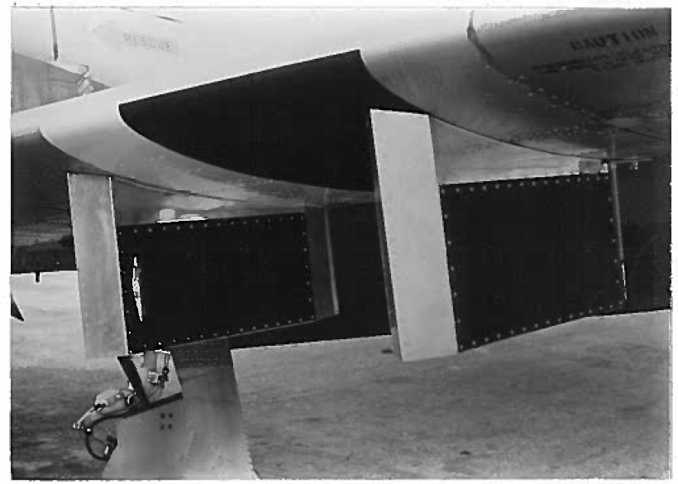
Hail Spectrometer
T-28 Wing
Sample
Area

Slide 8
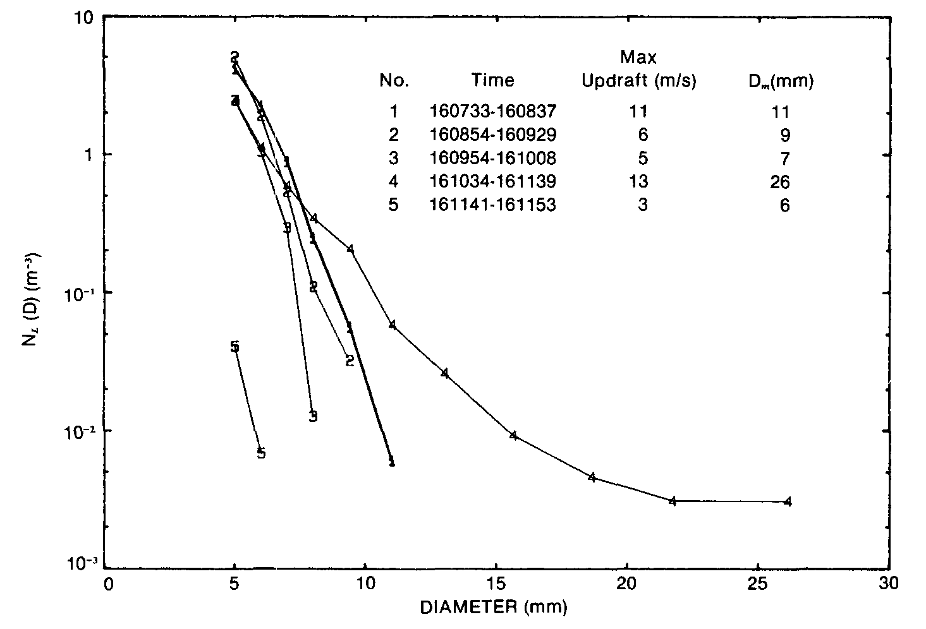
Hail Spectrometer “1D” Size Spectrum (CCOPE 1981)
Hail Spectrometer “1D” size spectrum example from CCOPE in 1981
10
1
N (D) (m⁻³)(mm)
10⁻¹
10⁻²
10⁻³
0
5
10
15
20
25
30
Diameter (mm)
Musil et al. 1991: Some interior observations of southeastern Montana hailstorms. J. Appl. Meteor.

Slide 9
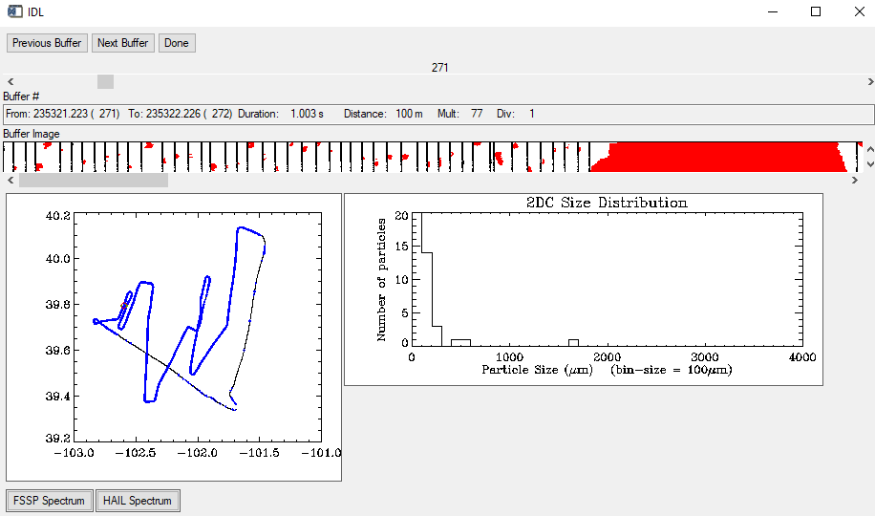
PMS 2D-C Imagery
0.8 mm

Slide 10
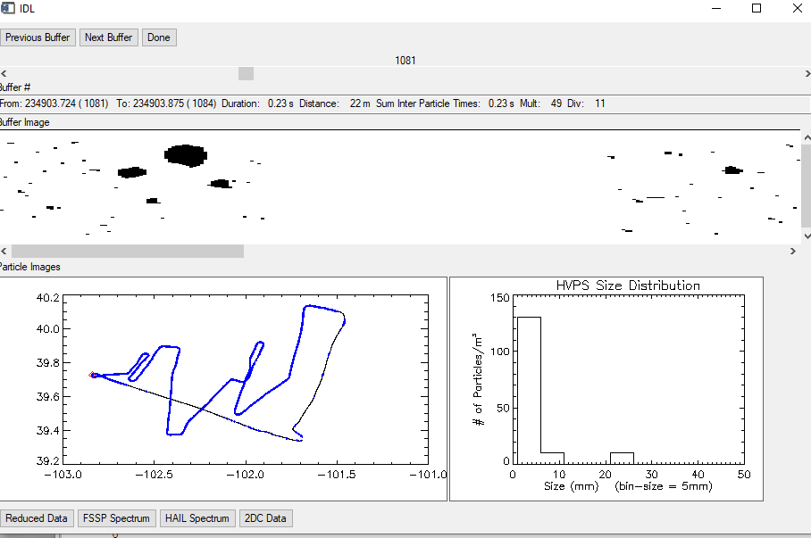
SPEC HVPS-2 Imagery
4.0 cm

Slide 11
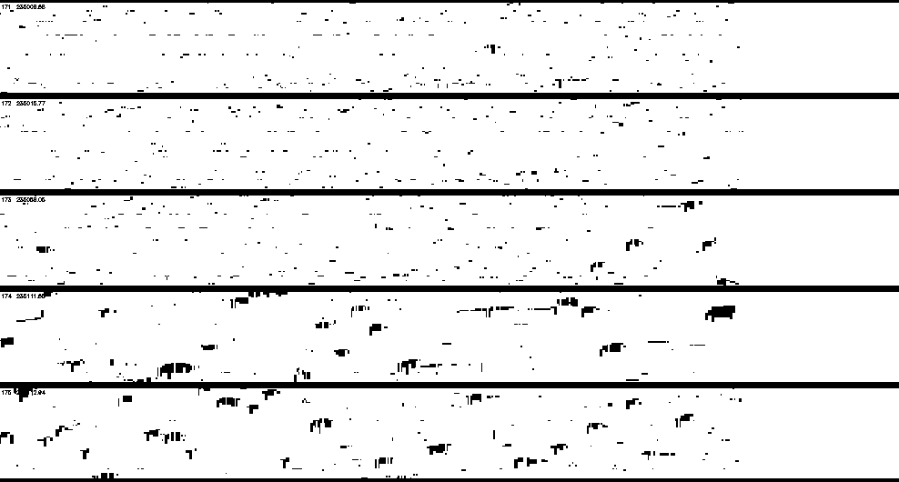
Hail Spectrometer Imagery
10 cm

Slide 12
Radar Data Set
Radar data is from EOL field project archive for flight days.
Z_{h} and Z_{v} – Reflectivity at Horizontal and Vertical Polarization
Z_{dr} – Differential Reflectivity
ρ_{hv} – Co-polar Correlation Coefficient
K_{dp} – Specific Differential Phase
Φ_{dp} – Differential Propagation Phase
LDR – Linear Depolarization
Mainly CHILL, some Spol

Slide 13
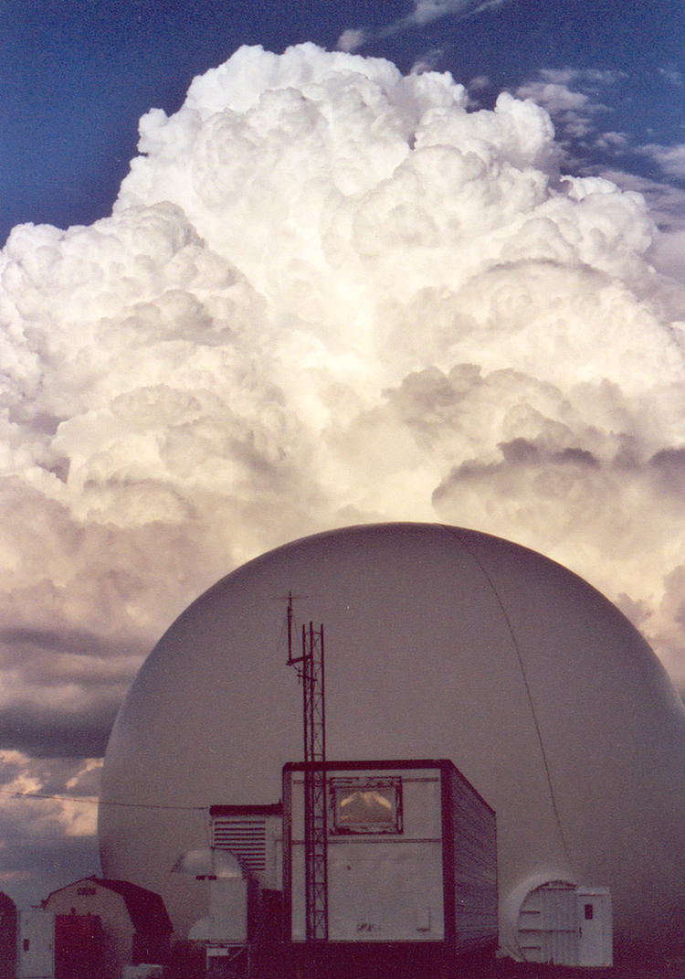
CSU CHILL
S-band
Polarimetric Radar
13
Notes:
From “A History of the CHILL Radar’s Technical Evolution” found at http://www.chill.colostate.edu/w/A_History_of_the_CHILL_Radar%E2%80%99s_Technical_Evolution

Slide 14
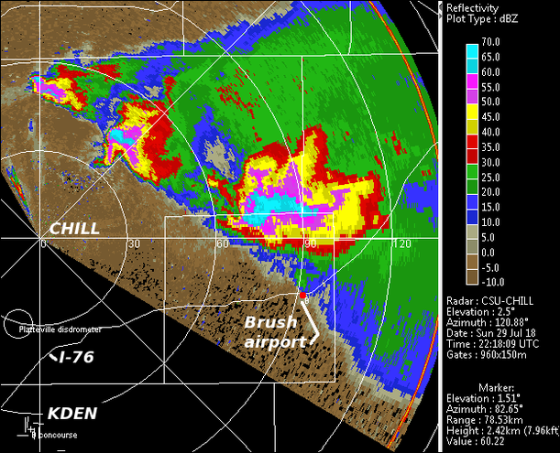
Low-elevation Angle PPI through a Group of Hailstorms
Notes:
http://www.chill.colostate.edu/wiki/images/thumb/3/3d/WEB_29jul2018_DZ_overview_anot.png/611px-WEB_29jul2018_DZ_overview_anot.png

Slide 15
Outcome
Produce more quantitative interpretation of polarimetric radar returns from hail-bearing storm regions.
Hail Size, Shape, Density, and Liquid Water Content
Hail Mass Concentration
Hail Kinetic Energy and Kinetic Energy Flux
June 16, 2022

Slide 16
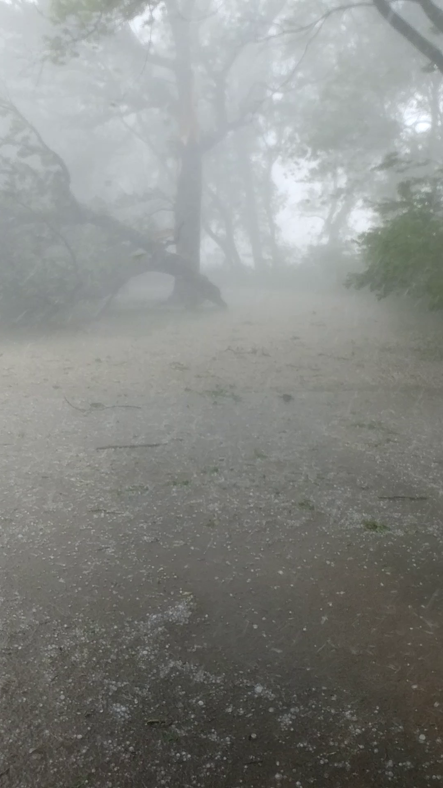
Questions and Suggestion
Student Position Available
david.delene@und.edu
June 16, 2022
David Delene

