Slide 1
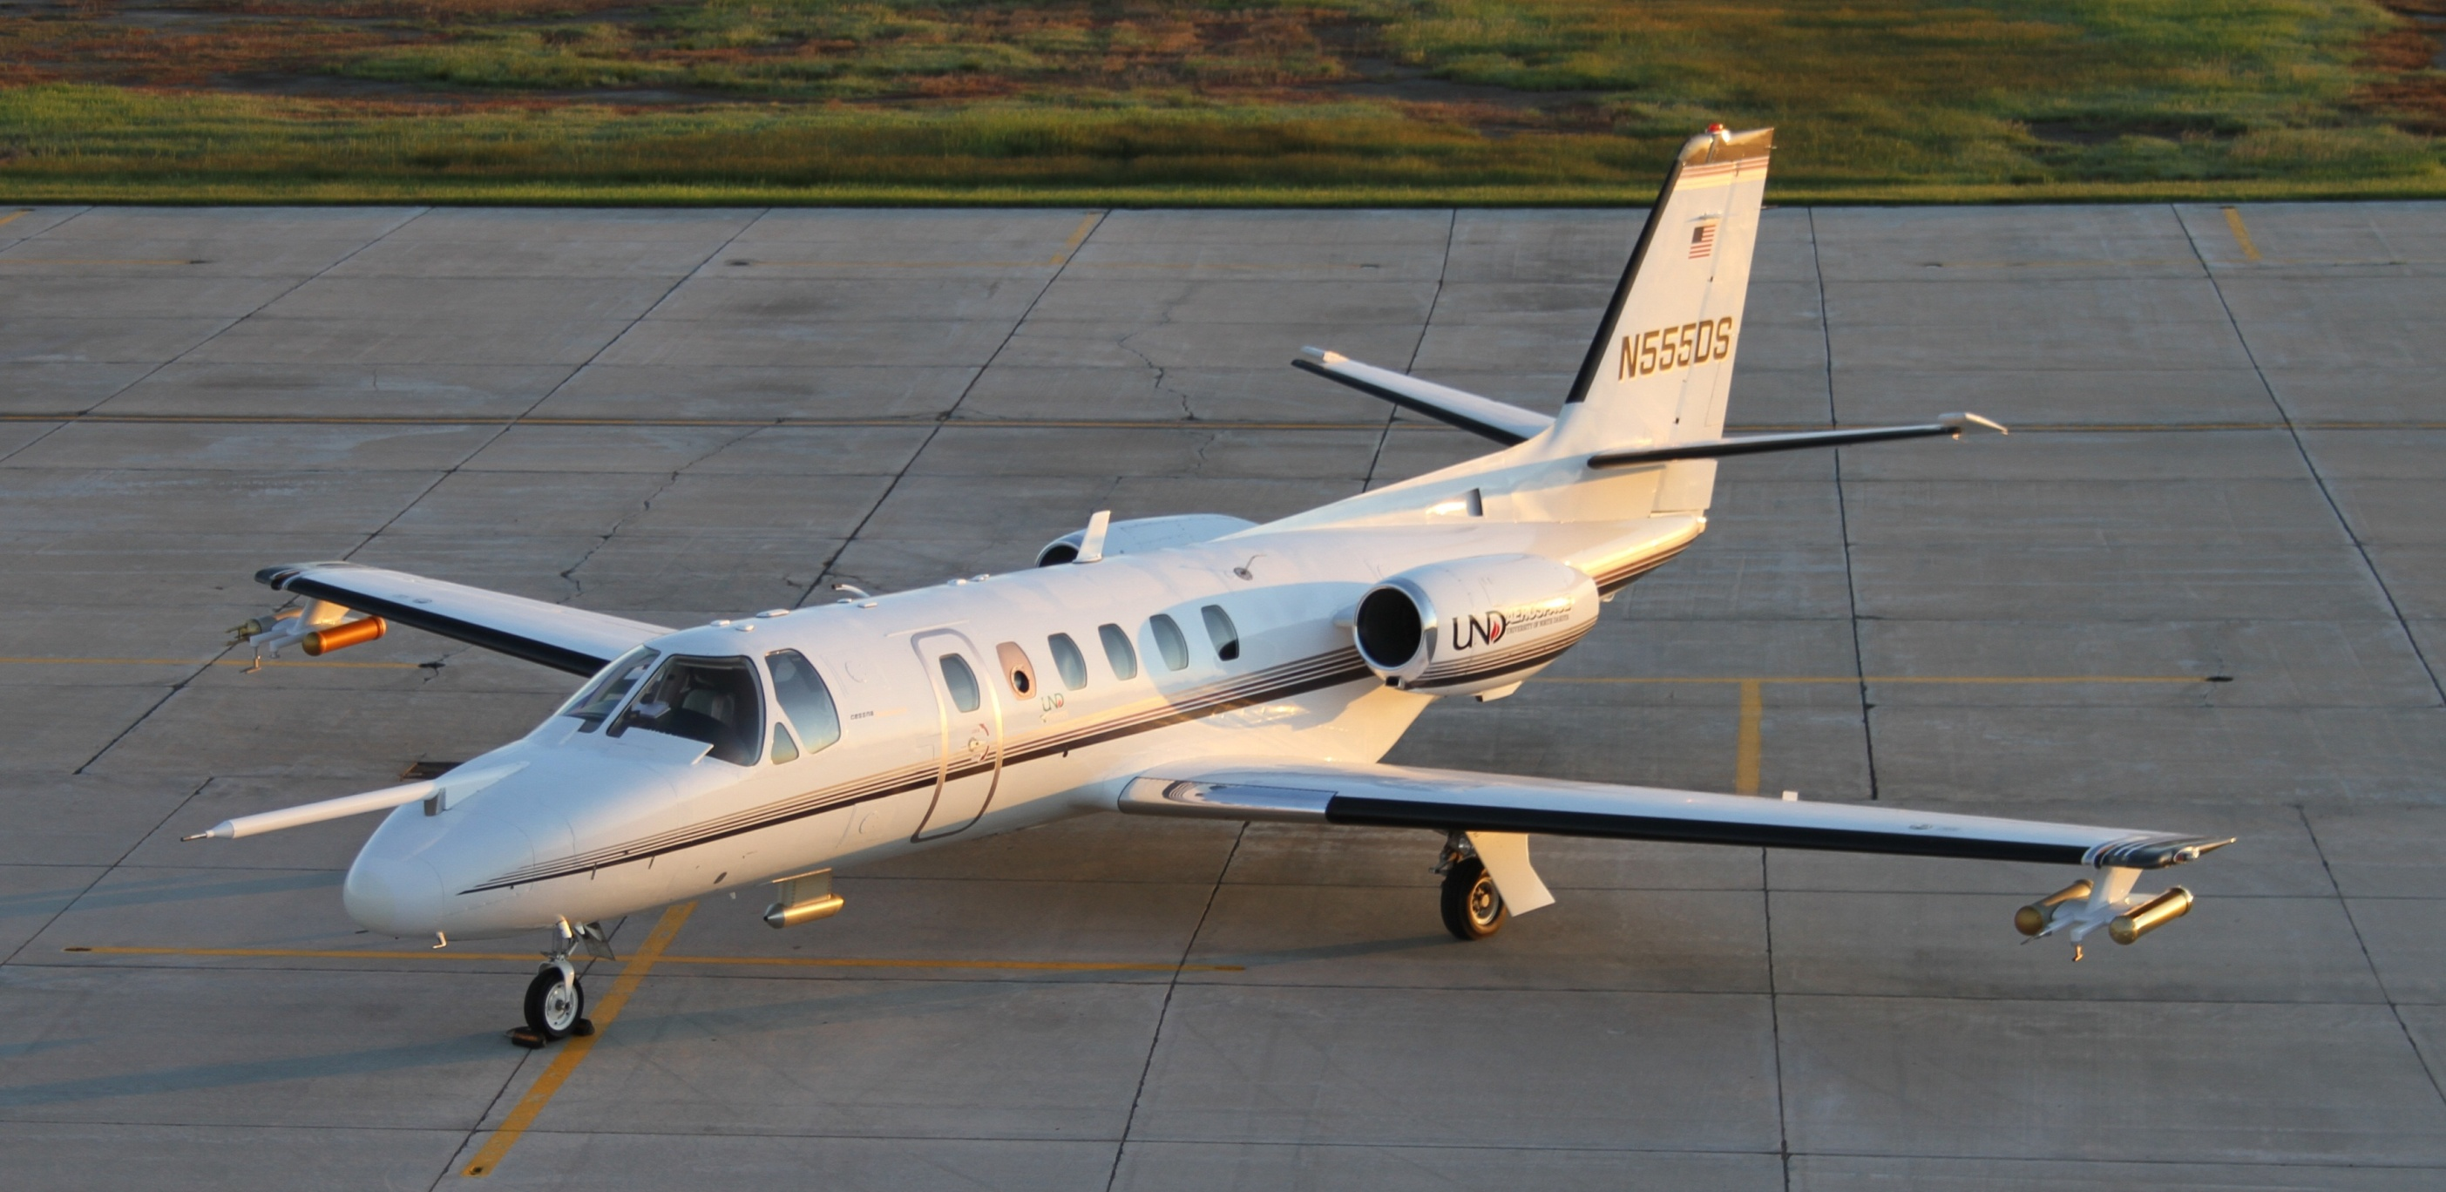
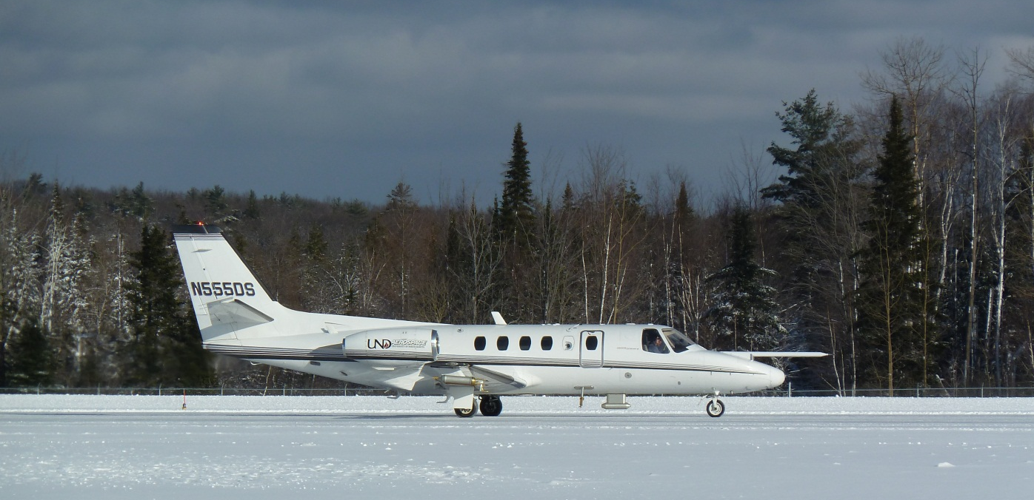
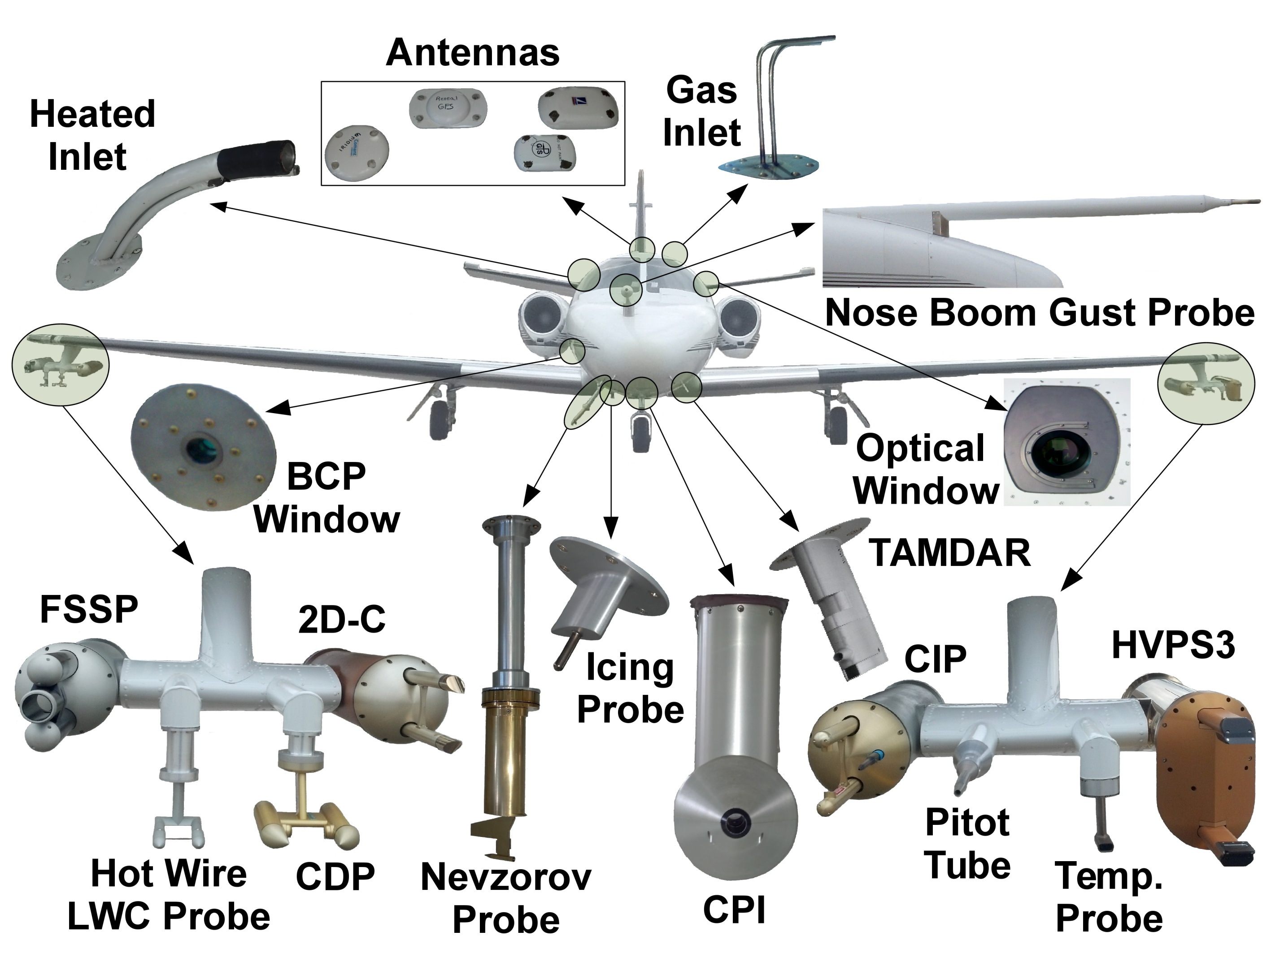
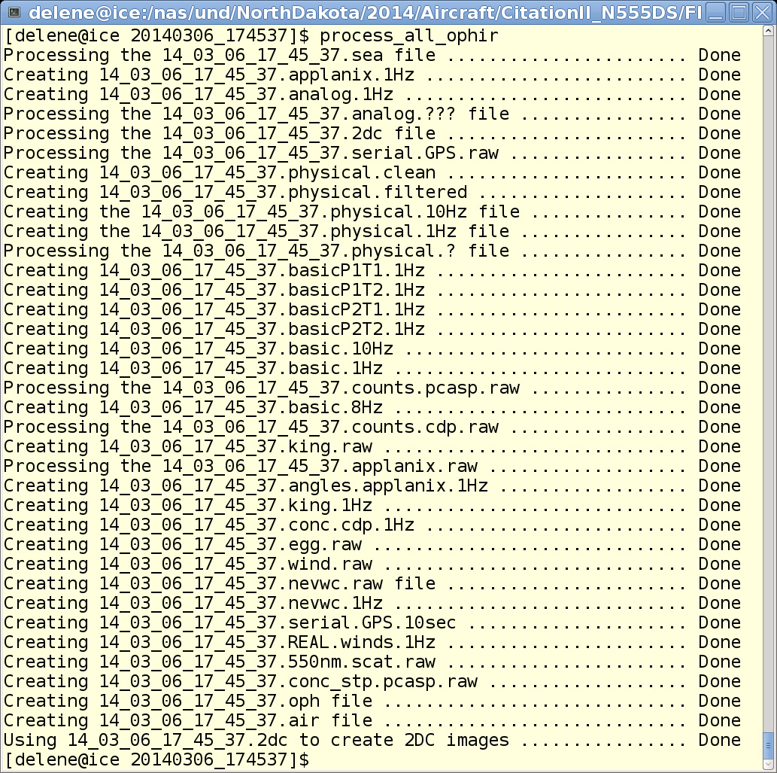
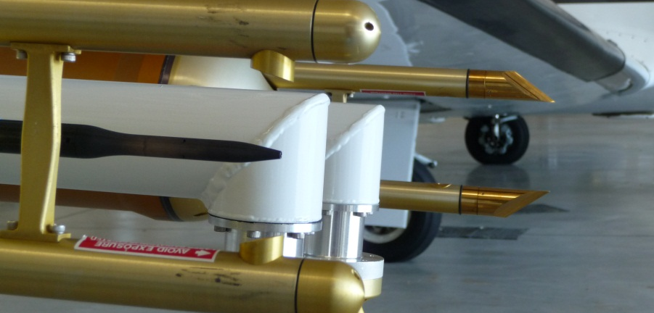
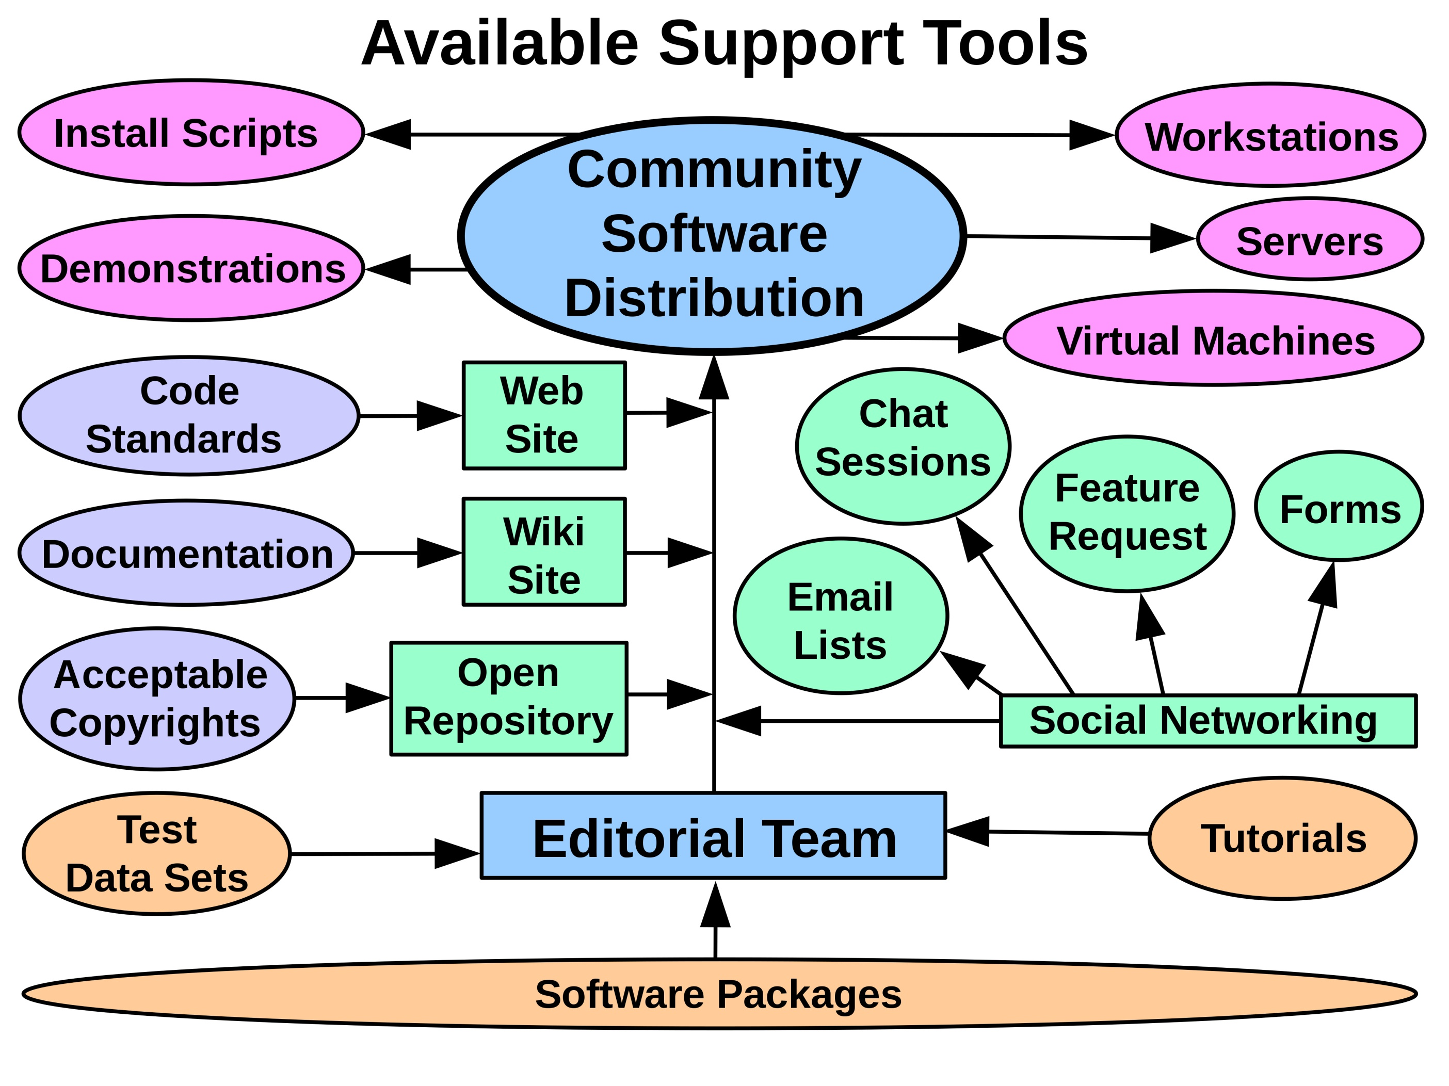
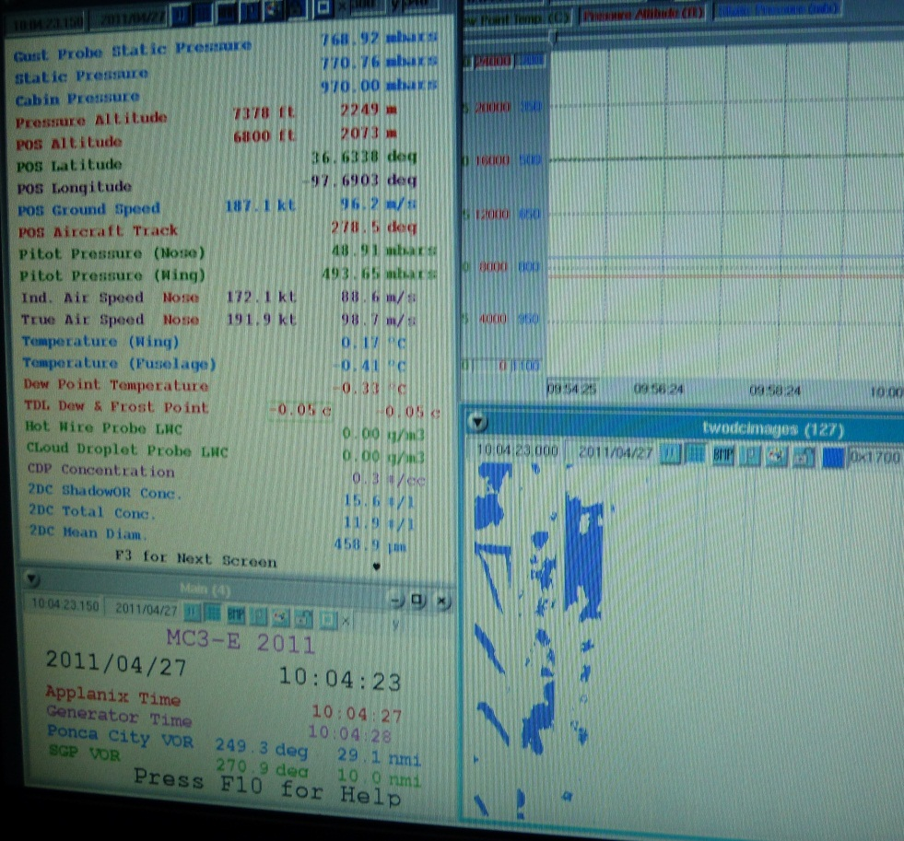
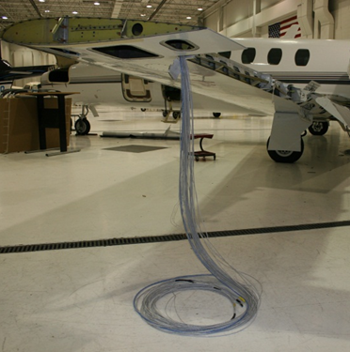
The North Dakota Citation Research Aircraft
David J. Delene (delene@aero.und.edu)¹, Nicholas J. Gapp¹, and Dennis Afseth²
¹University of North Dakota, Grand Forks, North Dakota, United States of America
²Weather Modification International, Fargo, North Dakota, United States of America
Overview
Aircraft Measurements
Aircraft Data Processing
The Cessna Citation II twin-engine fanjet aircraft that the University of North Dakota (UND) has used on many field projects since the 1970s is now operated by Weather Modification International (WMI) of Fargo, North Dakota. WMI and UND working together provide a platform capable of conducting a wide range of field projects in a cost-effective manner, while providing a unique educational experience for students. The Citation Research Aircraft has a number of design and performance characteristics that make it an ideal platform for a wide range of atmospheric studies, including sampling at high altitude (40,000 ft) and the ability to be flown at the slower speeds necessary for many types of measurements. WMI has the experience to install the custom scientific instrumentation required for a specific field project and the expertise to conduct the most demanding aircraft sampling, including thunderstorm in-situ measurements. UND provides the scientific knowledge of how to obtain measurements at the required accuracy and the ability to quickly process data to ensure flights obtain the necessary observations. The WMI/UND team has provided the complete solution for conducting very challenging airborne field projects that have obtained the data set required to meet all scientific objectives.
Probes onboard UND’s Cessna Citation II Research Aircraft in the Fall of 2012.
Data processing done with the open source Airborne Data Processing and Analysis (ADPAA) software package, https://sourceforge.net/projects/adpaa/.
Specifications
Payload | 1528 – 2528 lbs.
Range | 1200 nmi
Ceiling | 43,000 ft
Time to Climb: 25,000 ft / 35,000 ft | 13 / 24 min
Endurance | 3 - 5 hours
Weather | Known Icing Storm Penetration 45 dBz
Sampling Airspeeds | 150 – 225 KIAS
Research Power
Towards Community Software Development
Total | Below 35,000 ft: 7,300 W
 | At or Above 35,000 ft: 5,400 W
AC | 4 KW 110VAC 60Hz
DC | 80 A 28VDC Instrument Anti-icing
 | 40 A 28VDC Instrument Power
Modifications
Rack Space
Two Wing Tip Pylons
Five Reinforced Fuselage Locations
Six Ports for Electric Field Mills
Side-looking Window Insert
Anti-iced Gas Sampling Inlets
130 inches of 19 inch Wide Rack Space
Specialized Racks, Cabin and Un-pressurized

