Slide 1
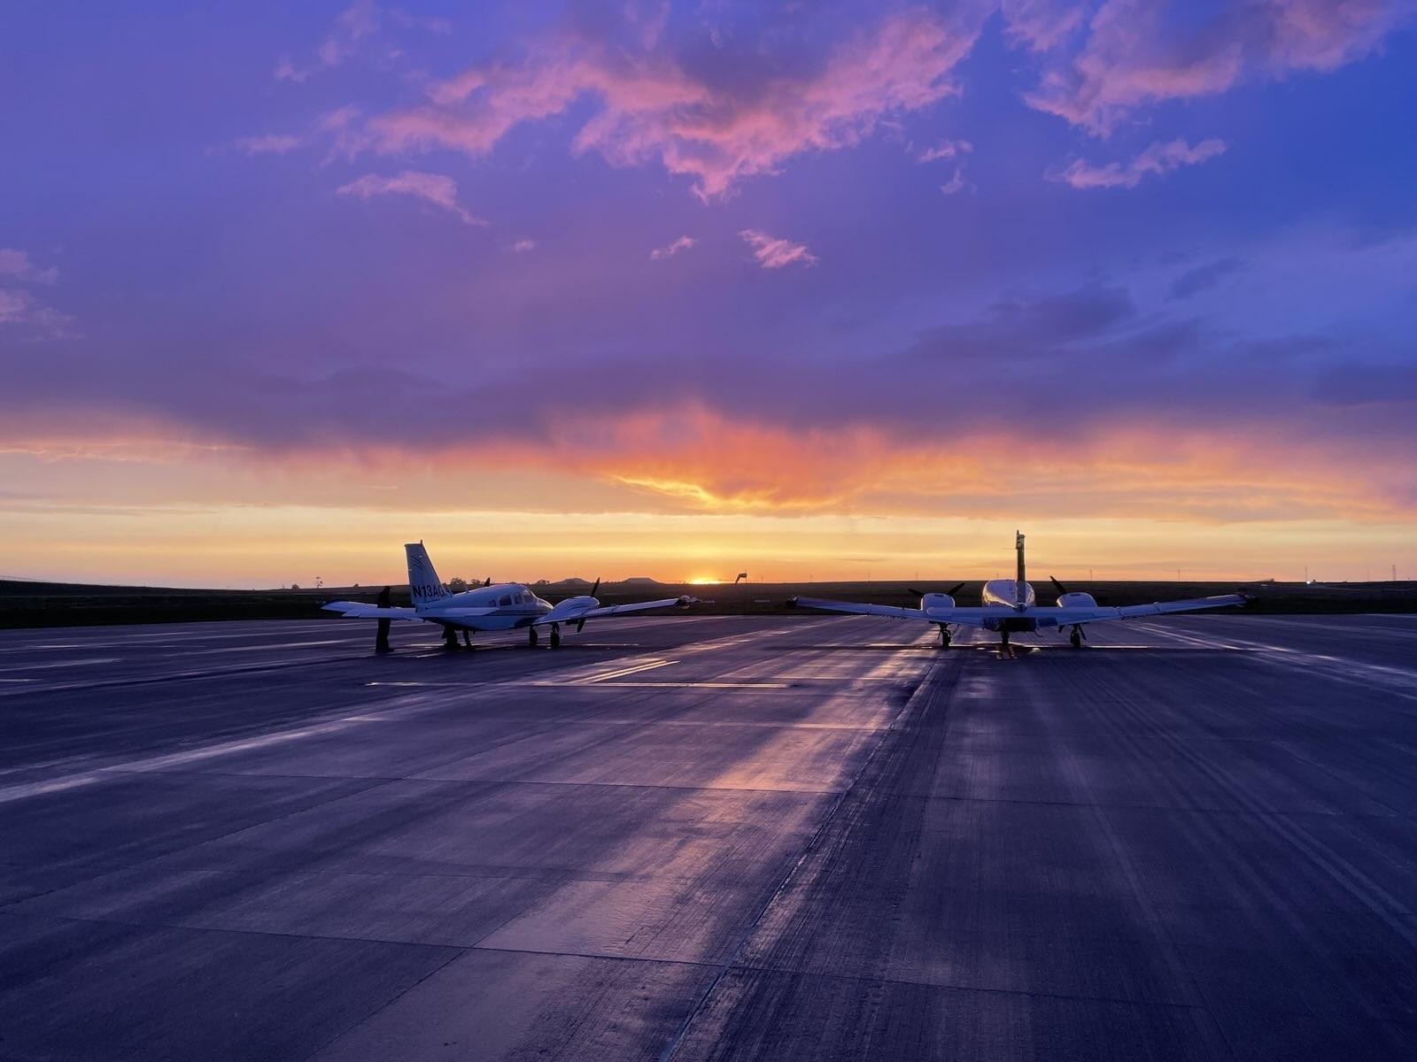
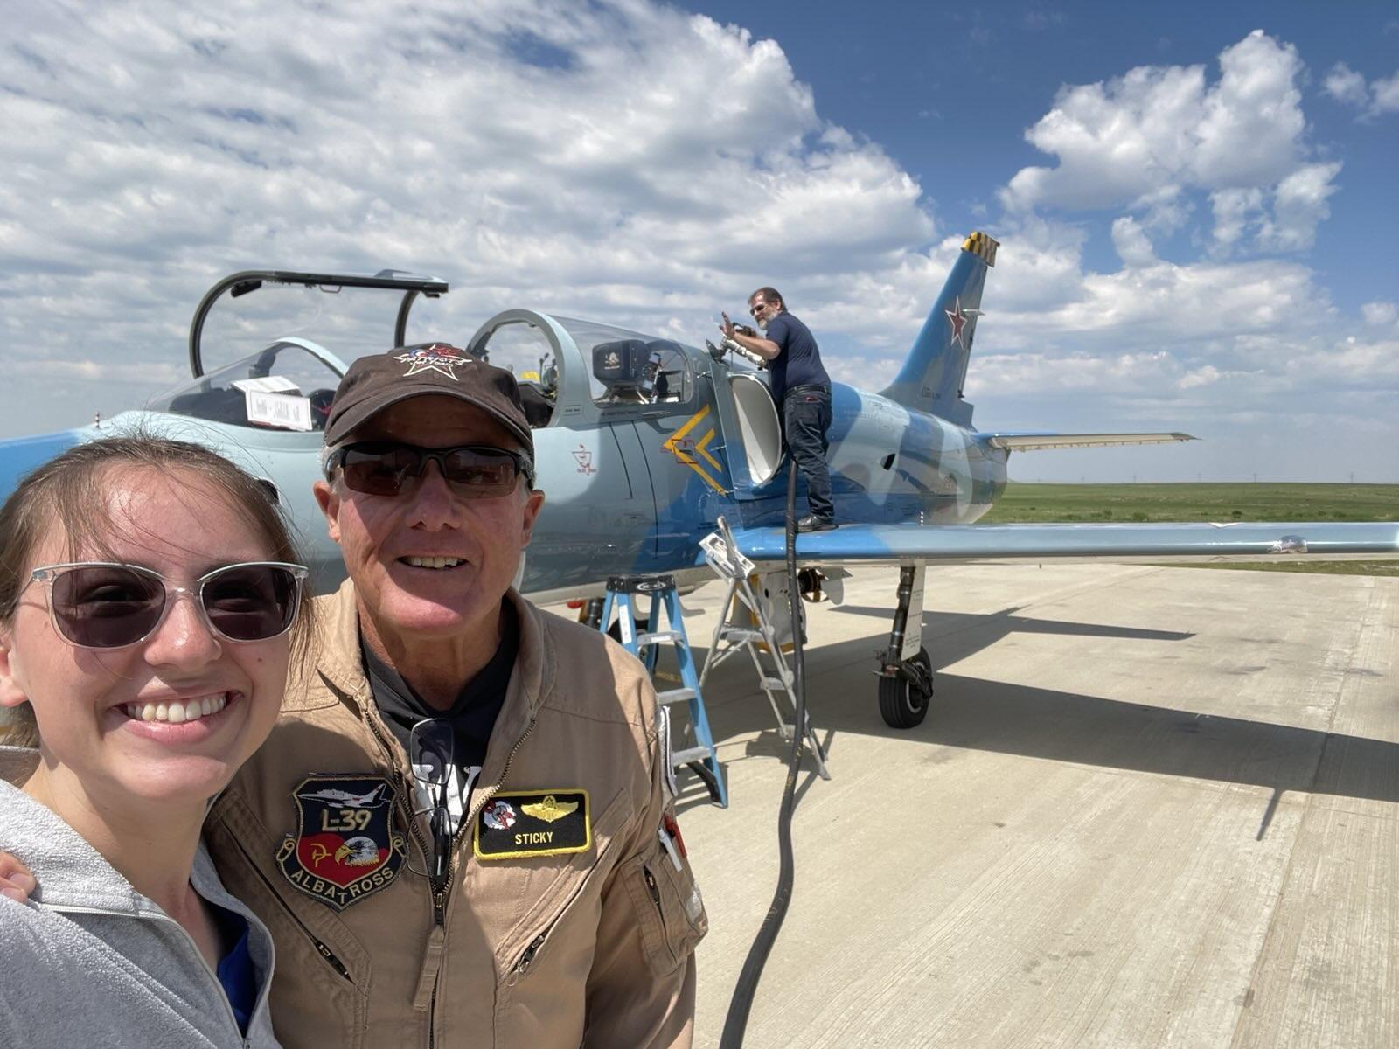
Cloud Seeding Internship Experience
Vivian Broughton

Slide 2
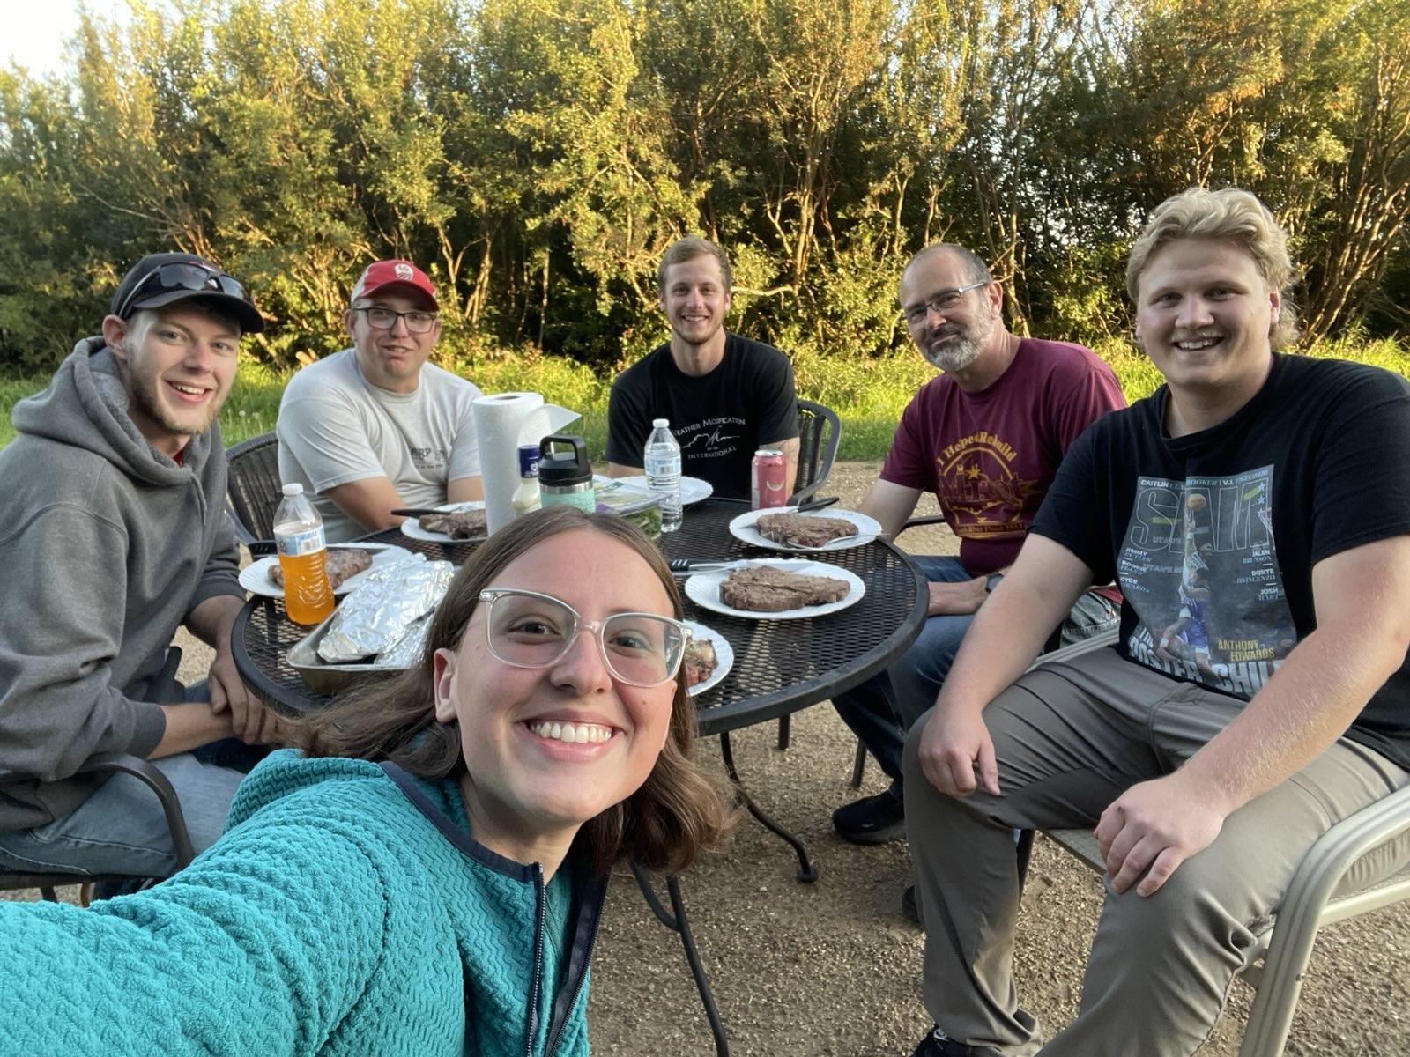
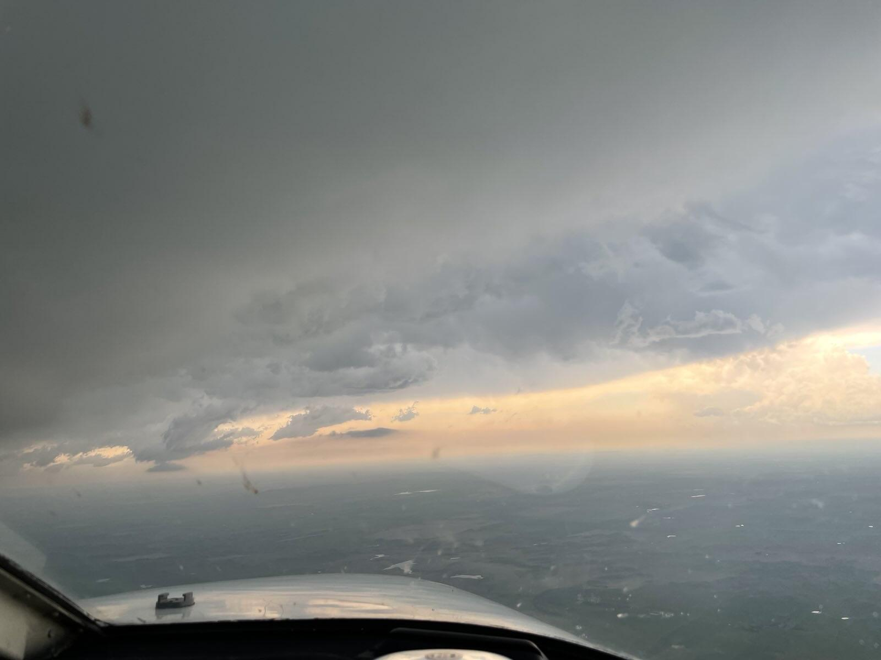
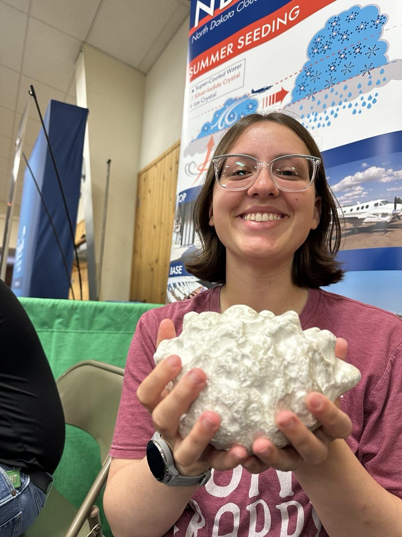
About me
4th year
Aviation Safety Major
Used to be Commercial Aviation with Atmospheric Sciences Minor
Plan to be an FAA Aircraft Dispatcher
Used career services to help prepare for interview

Slide 3
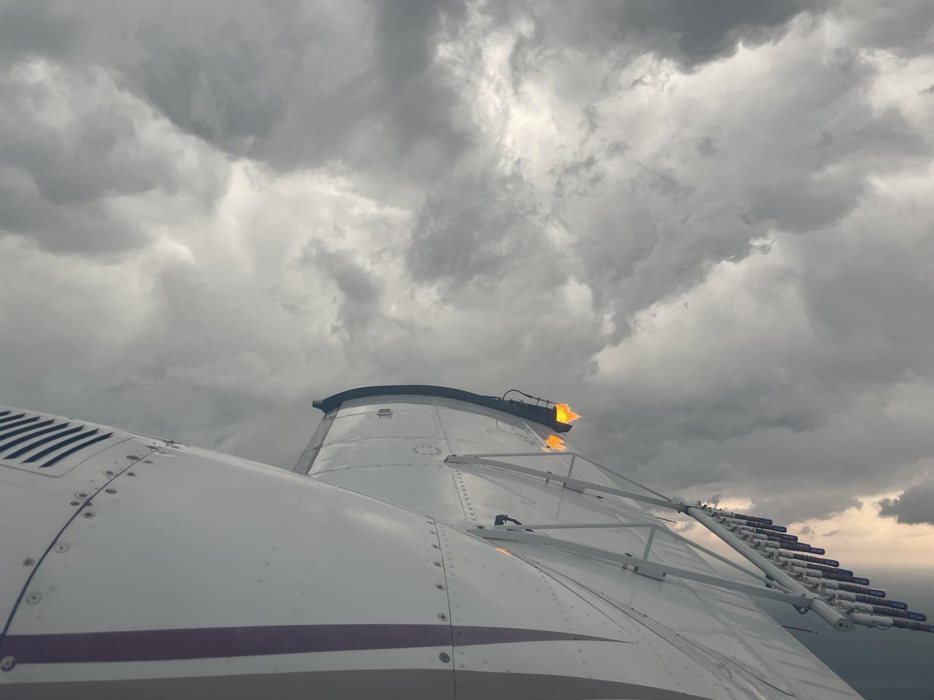
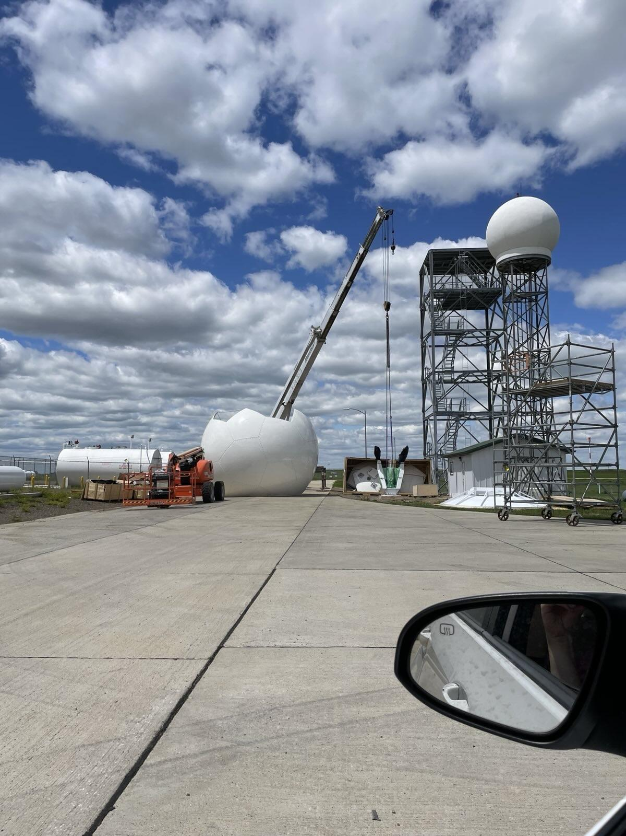
About The Internship
Fly Piper Seneca II
Need Multi-Engine add on
Mix chemicals, get plane ready for next launch, assist PIC in flight, record keeping, talk with public
Based in Bowman, ND
24/7 on call
Lasts June 1st to August 31st, but can leave early

Slide 4
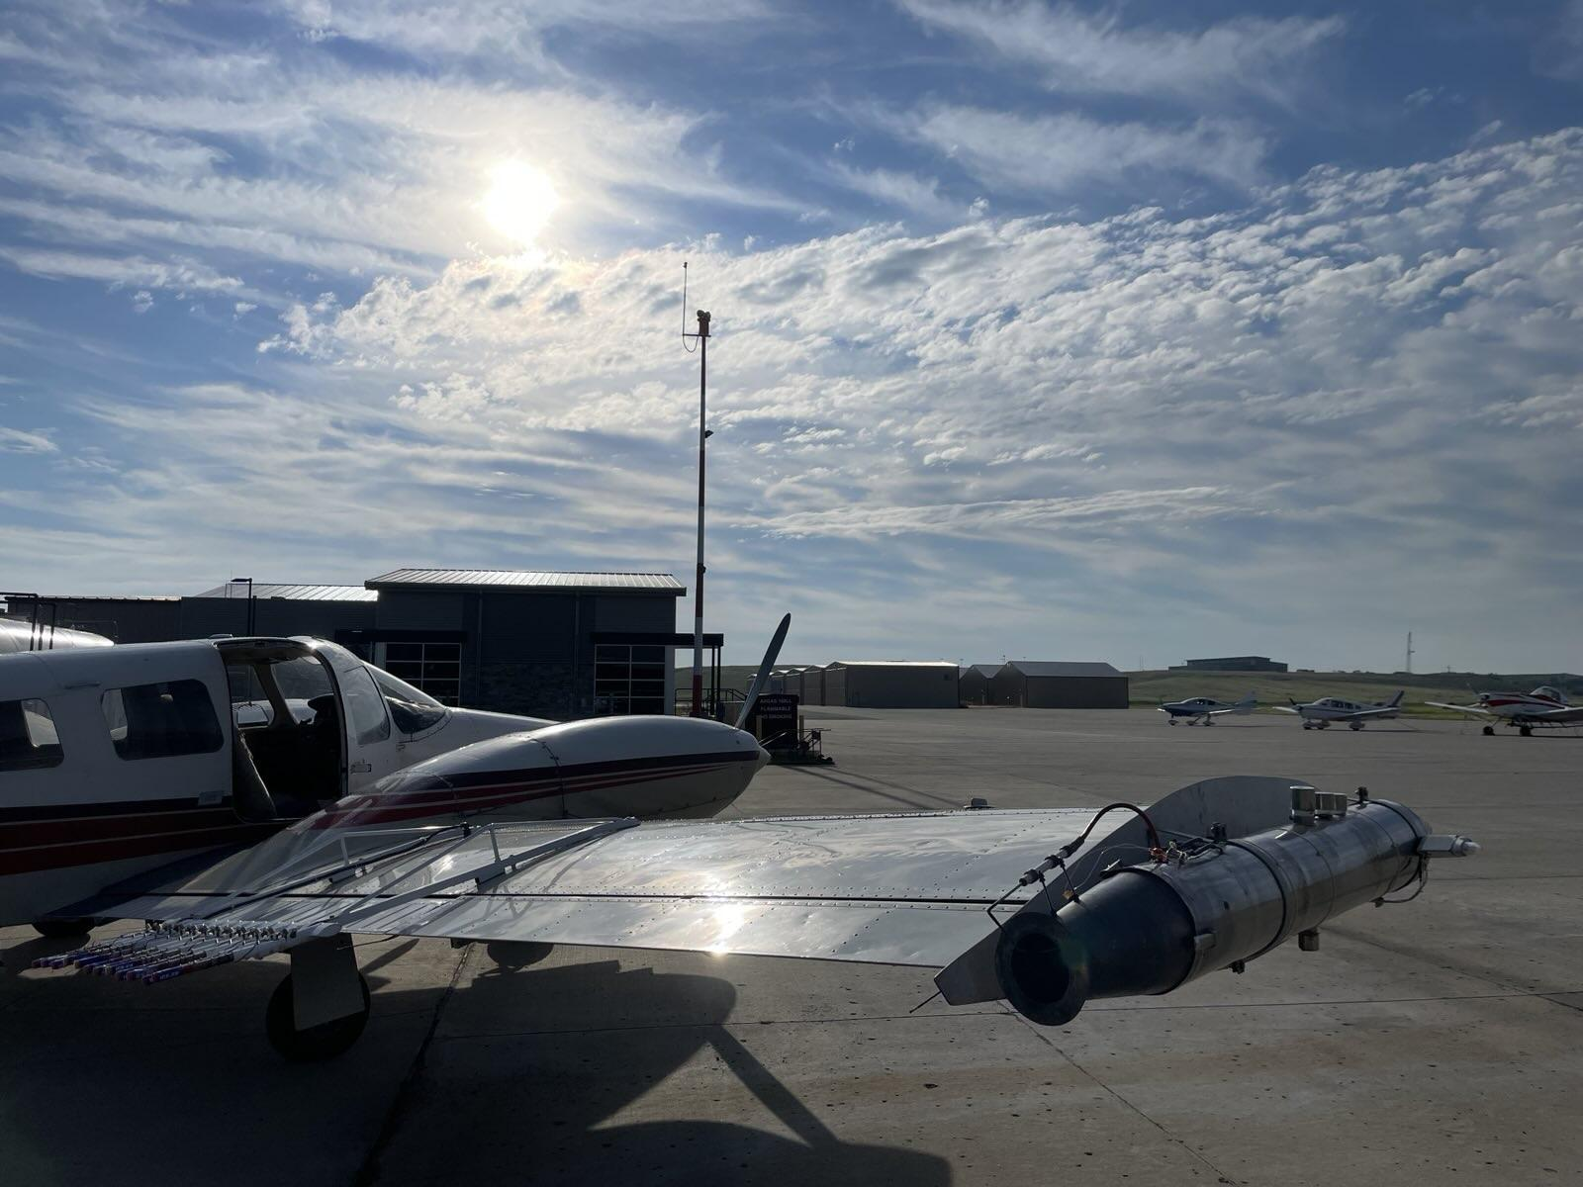
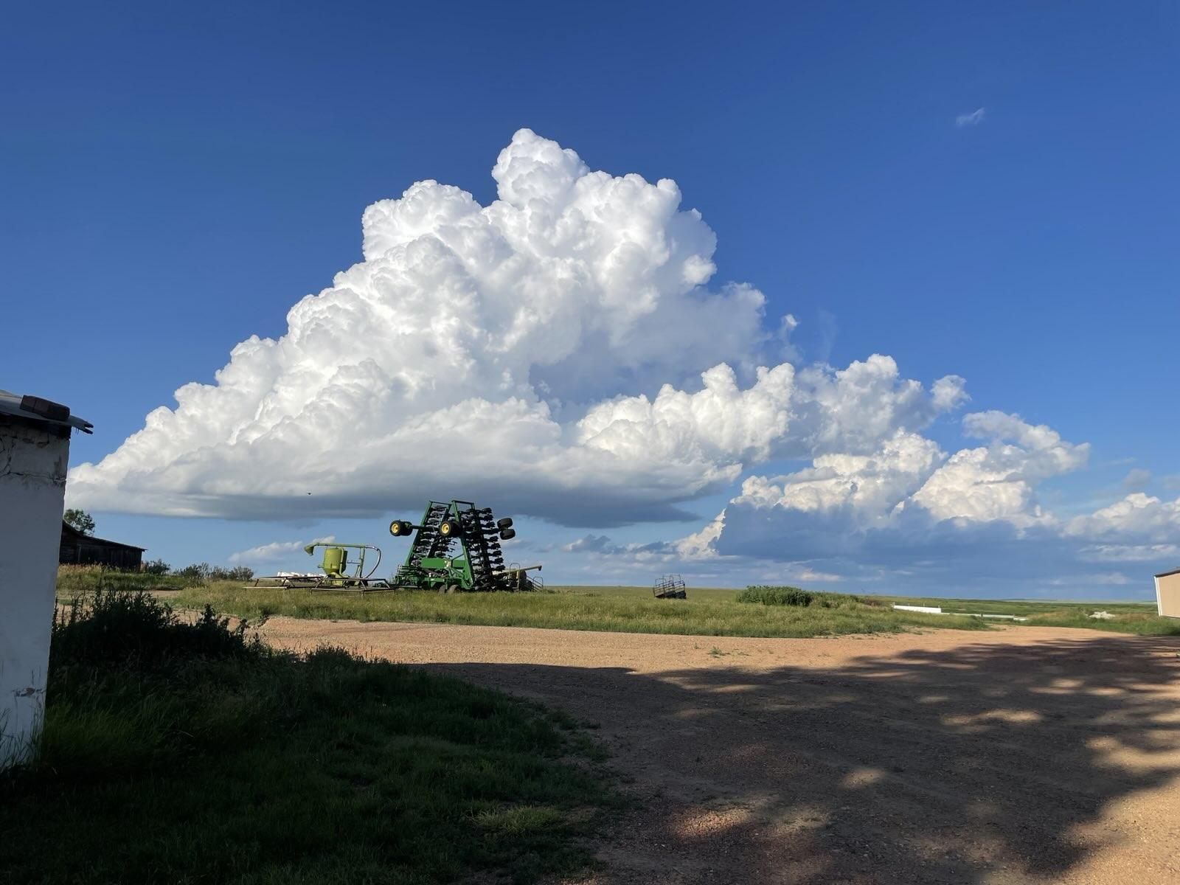
About The Internship
7 days of vacation you can use if scheduled ahead of time
Option to live with coworkers, separate rent
I got paid $20 an hour
Interns selected on ranked point system with flight hours being big factor
Can be dicey, very different to flying at UND

Slide 5
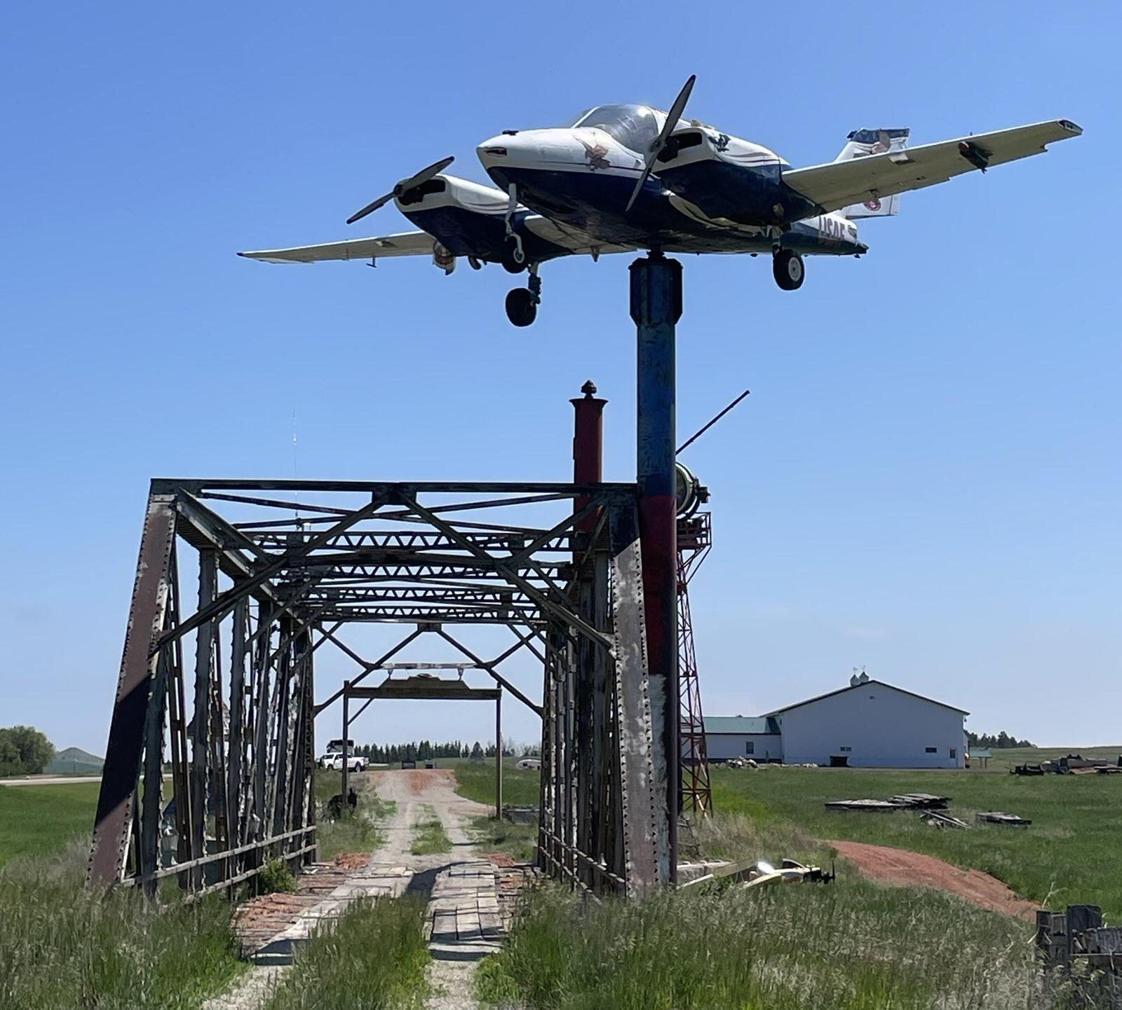
Case Study
July 20th, 2025, evening
Two rounds of storms
1st storm was very good
Initially launched as rain enhancement, but it grew into hail suppression criteria by the time we got to it
Landed back in Bowman due to running out of chemical mix in burners
Refueled, cleaned burners, refilled chem, reracked BIPs

Slide 6
Case Study
Initially could not relaunch due to low cloud deck
Deck cleared out after about 30 minutes, and I was comfortable going back up
Second storm was a hail threat, but after 30 minutes of working on it, night was imminent, and low cloud deck came back
Landed in Spearfish, ND and spent the night

Slide 7
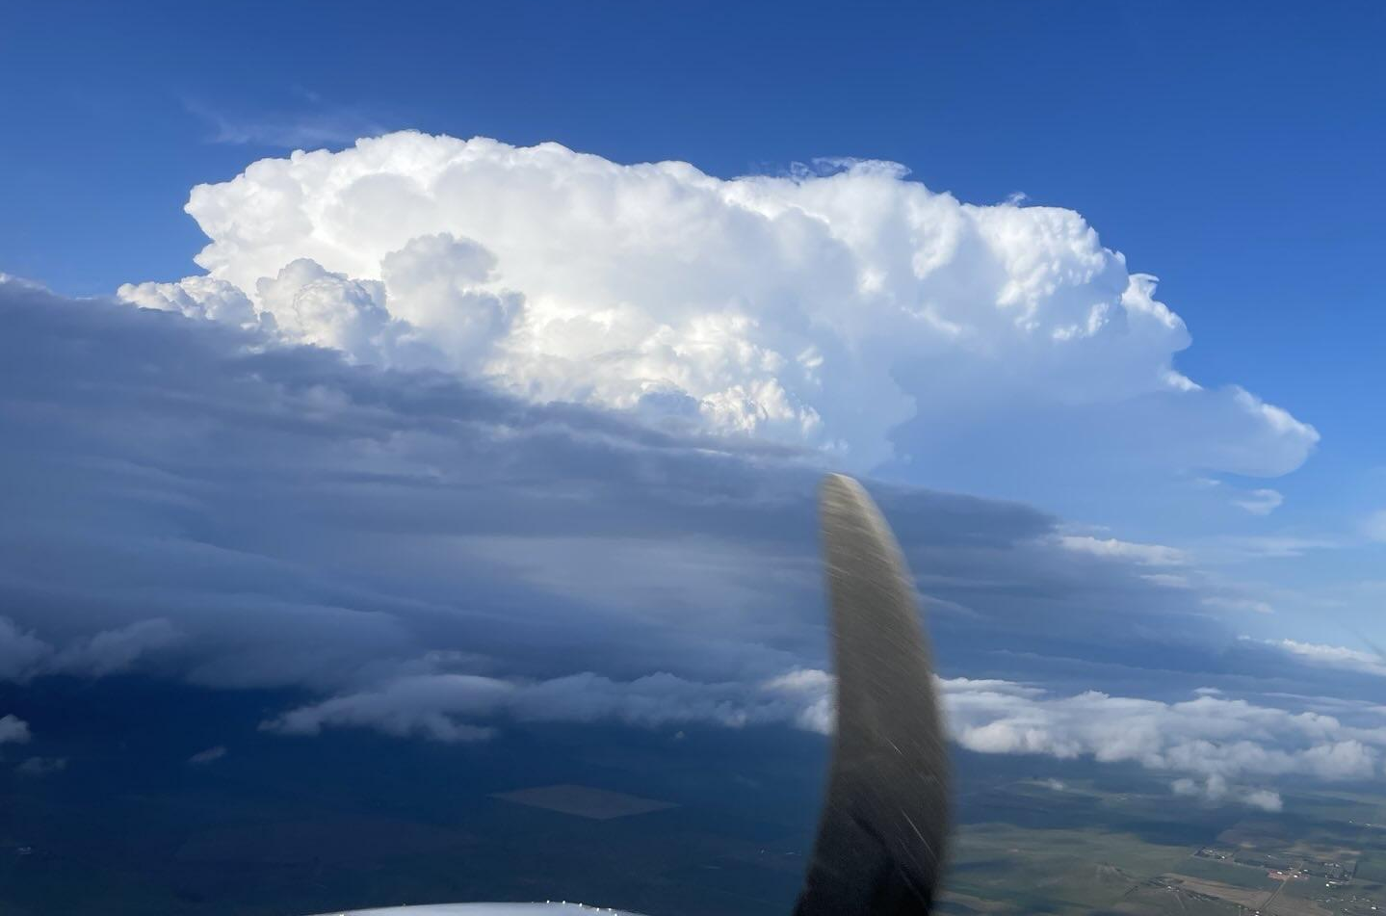
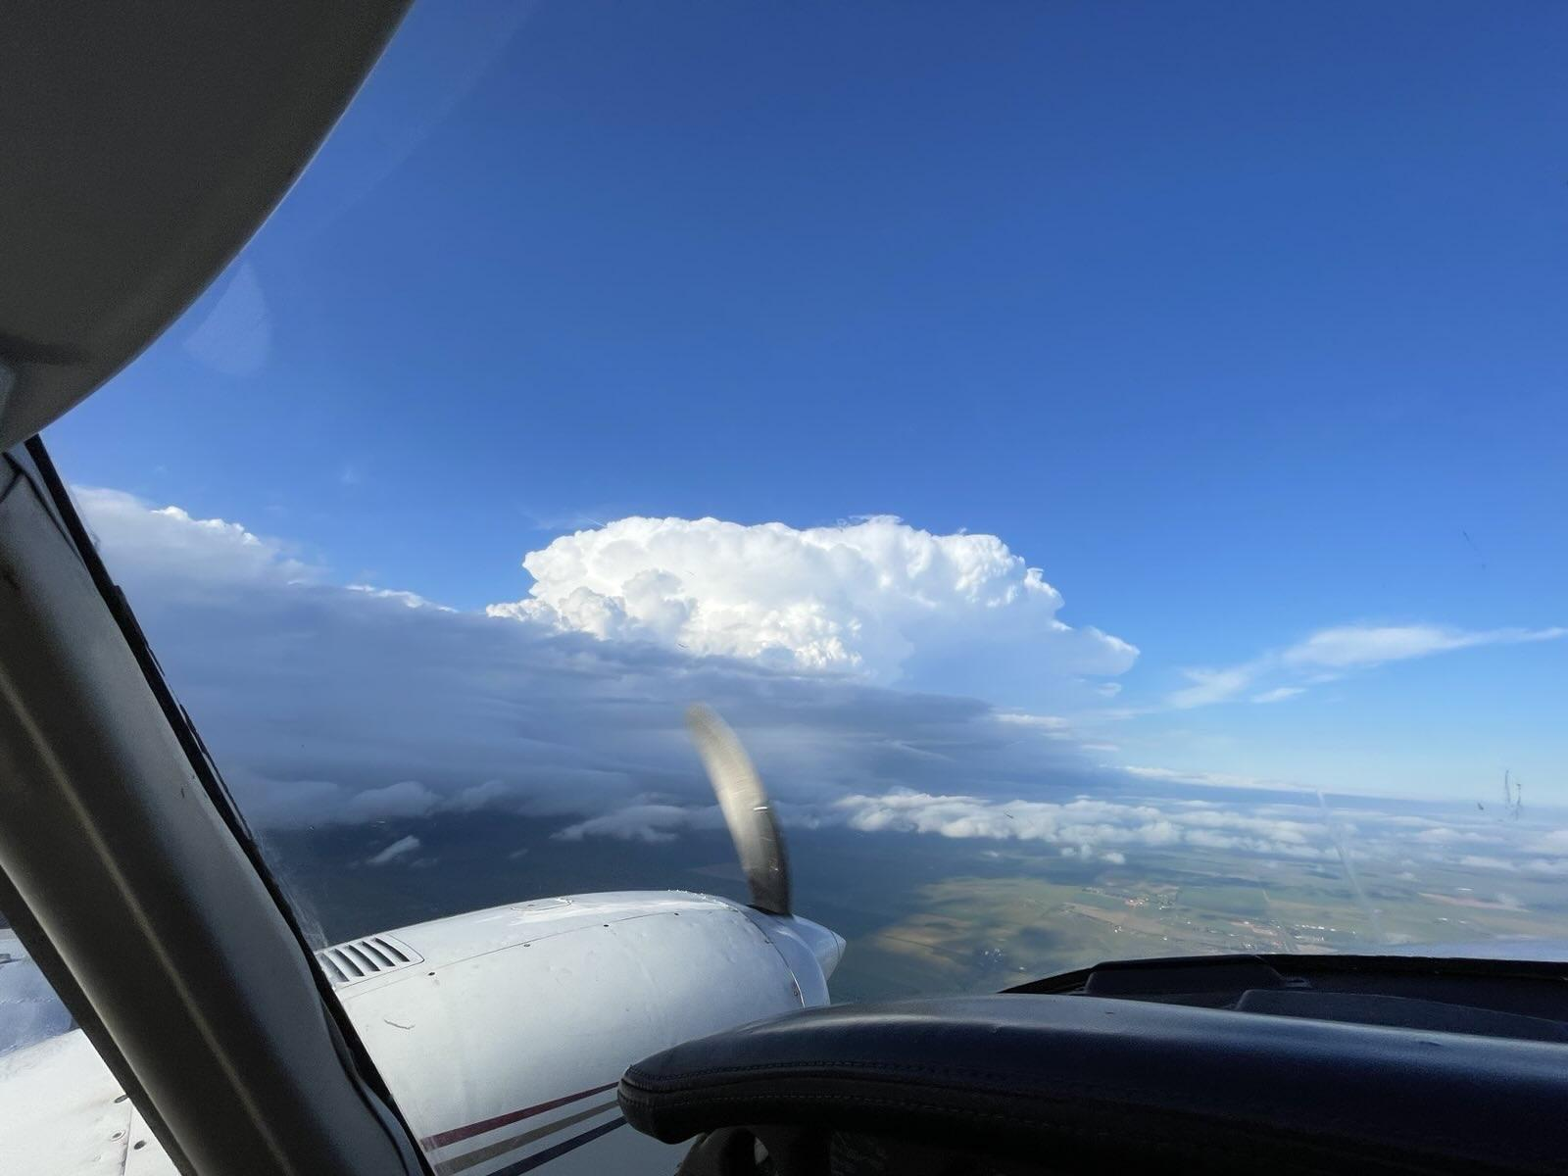
Took photo when arrived at first storm
Shows strong tops that are not fuzzy
Clear target with defined base

Slide 8
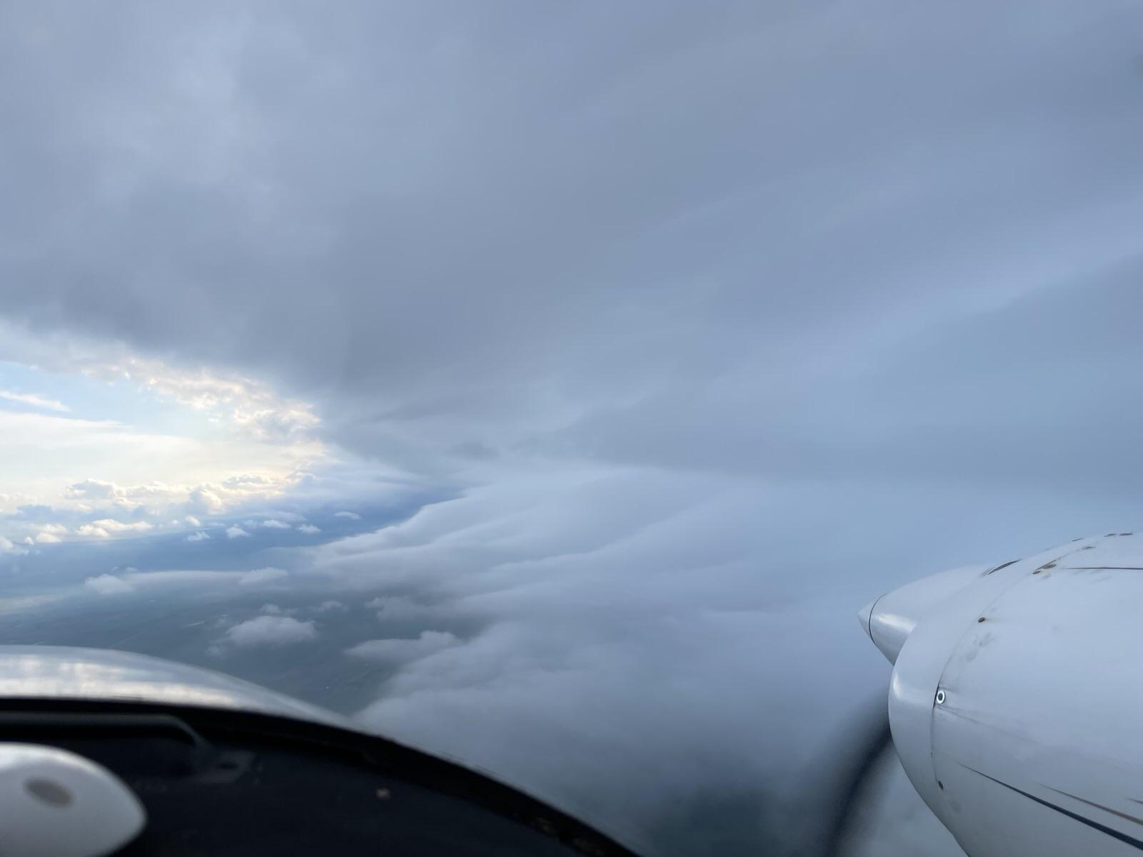
Few minutes later
Shows defined bases
Notice the “fingers” below

Slide 9
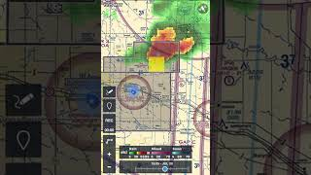

Slide 10
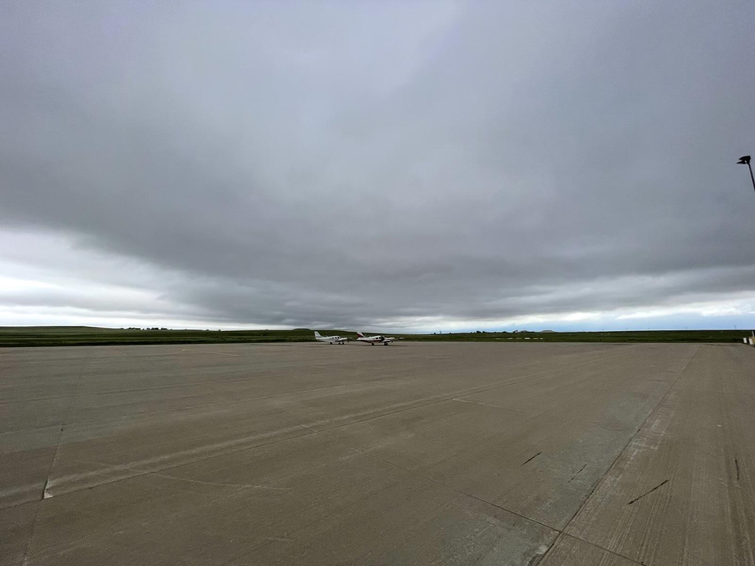
Low cloud deck rolled in as we prepped the plane
We used our spare for the next flight

Slide 11
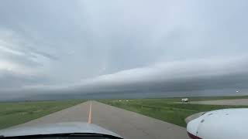

Slide 12
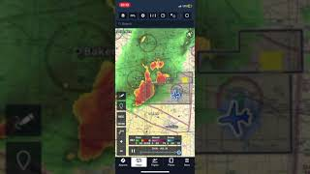

Slide 13
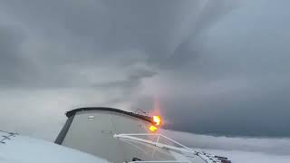

Slide 14
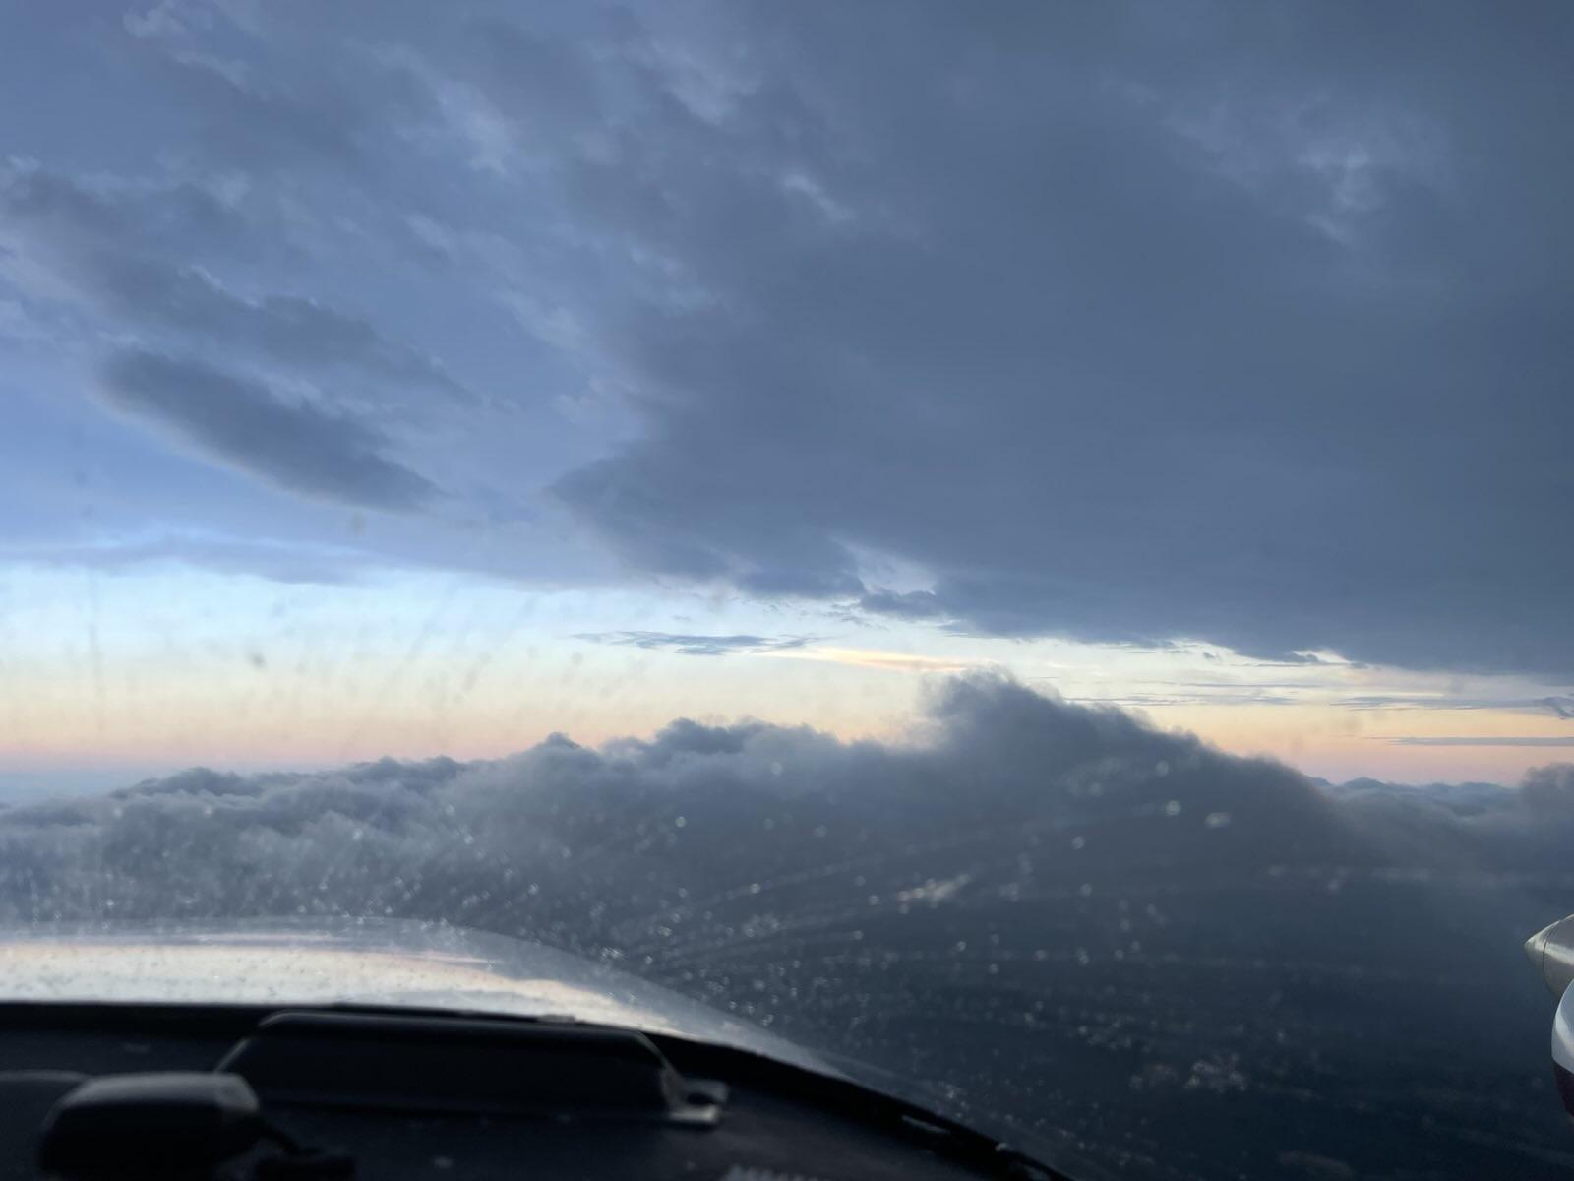
Raining a little bit in this photo
See the lower clouds
Left is bad target
Right is better target

Slide 15
At this point, I stopped taking photos because I had slightly more important things to do.
Like escape looming IMC and night…

Slide 16
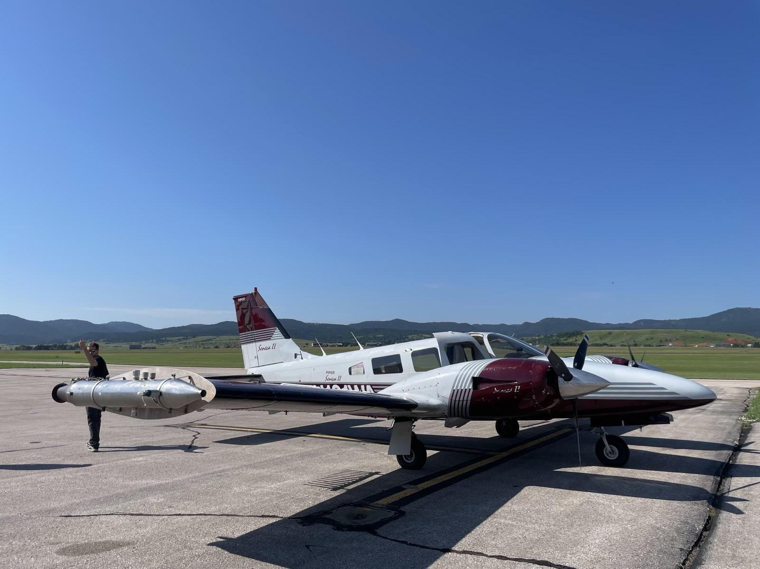
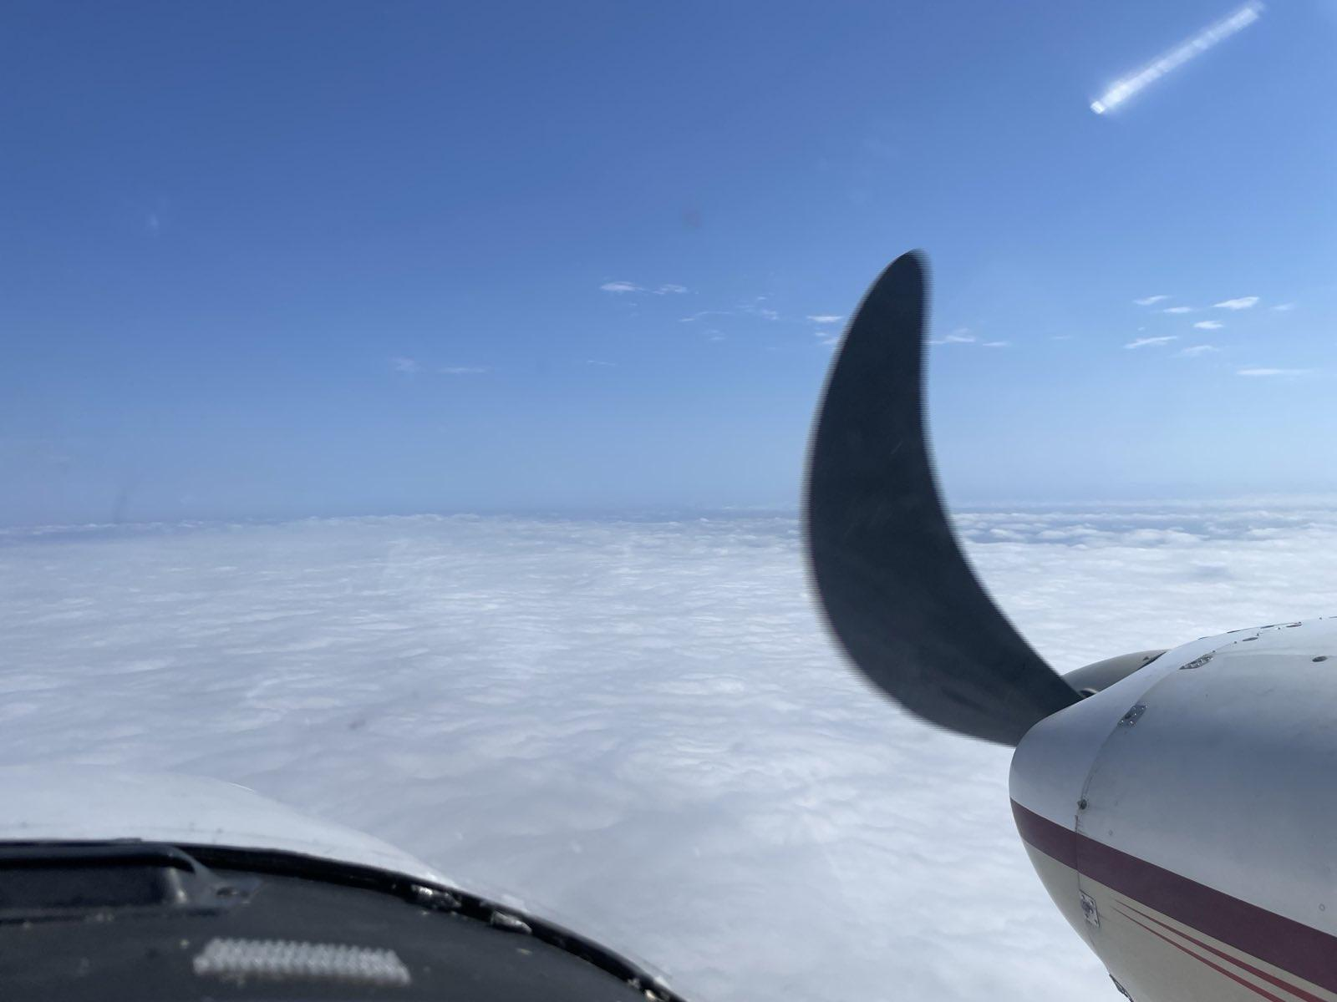
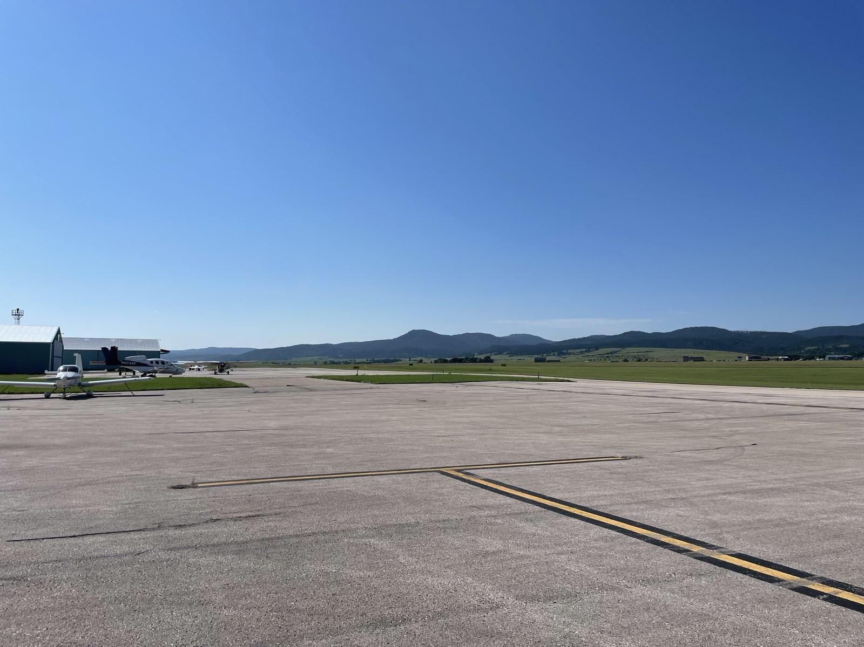
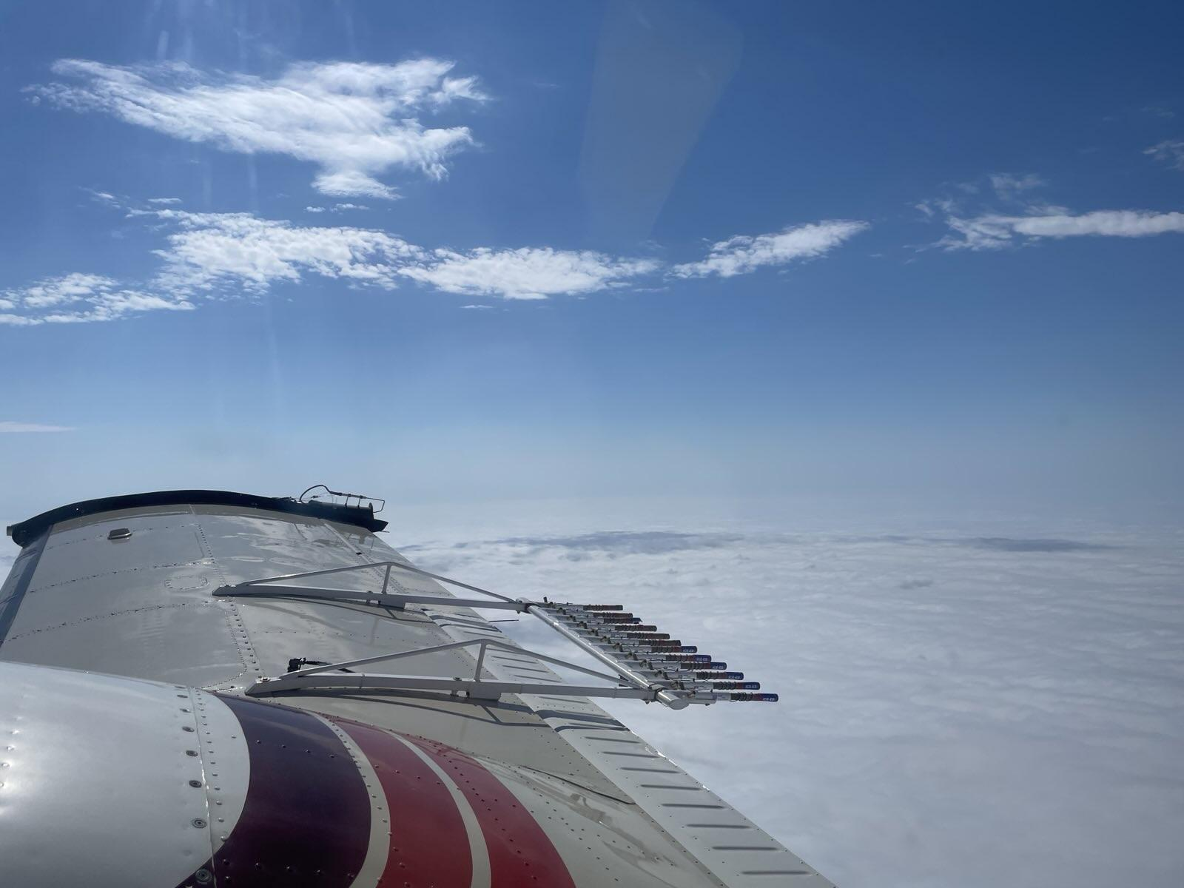
Coming back from Spearfish the next day

Slide 17
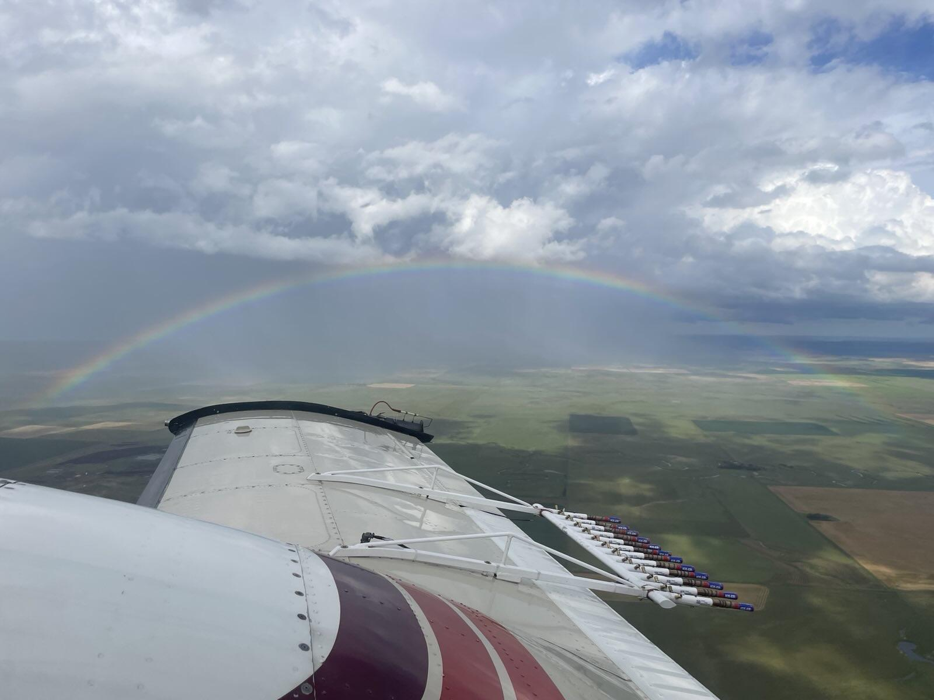

Slide 18
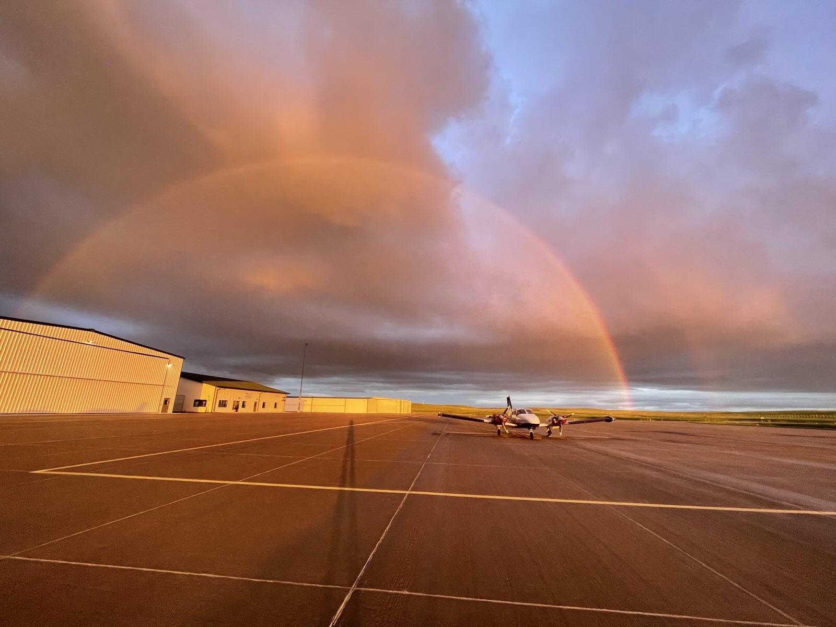
Thank you :)

