Slide 1
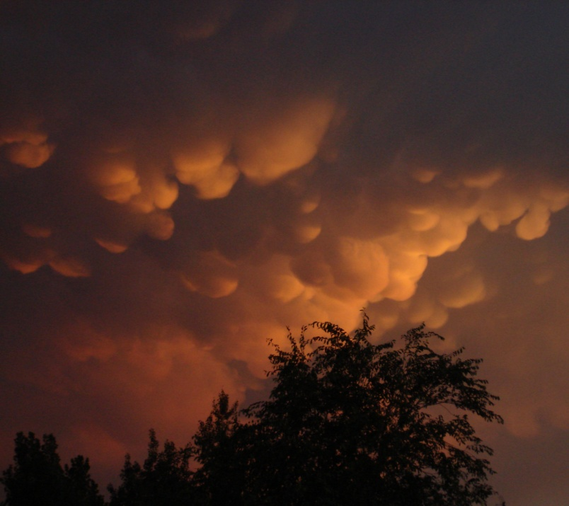
Training in the use of Airborne Instrumentation, Data Collection, Archival and Processing
PREPARED FOR PROGRAMME SAAGA
ARMÉE DE L’AIR
BURKINA FASO
2-DC Probe Data Analysis
David Delene, Ph.D.
Professor and Good Guy
February-March 2012
Fargo, North Dakota - USA

Slide 2
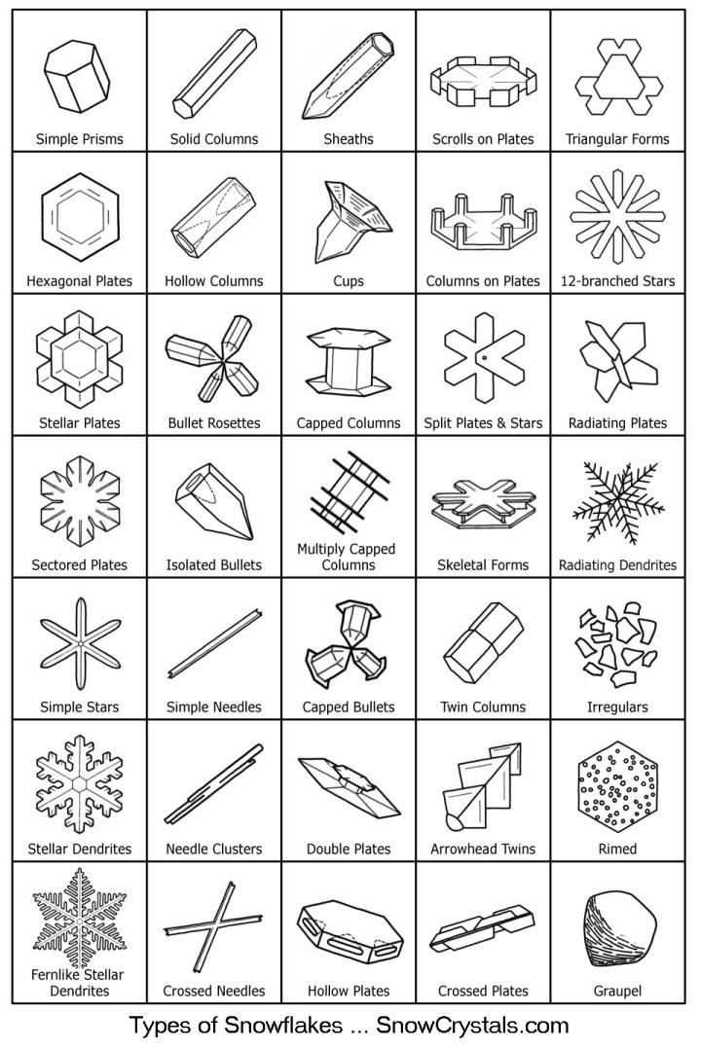
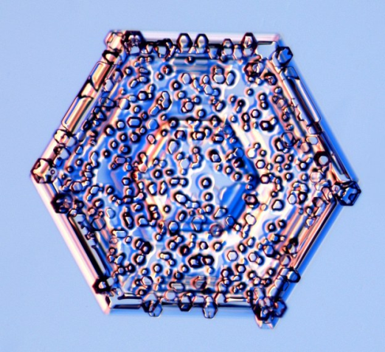
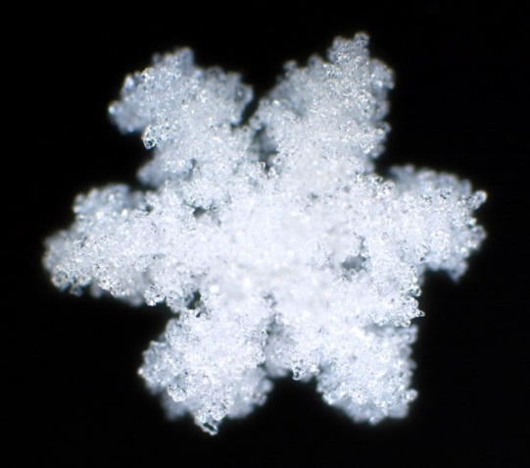
Crystal Shapes
http://www.its.caltech.edu/~atomic/snowcrystals/class/class.htm
Spheres
Needles
Dendrites
Irregulars
Rimed

Slide 3
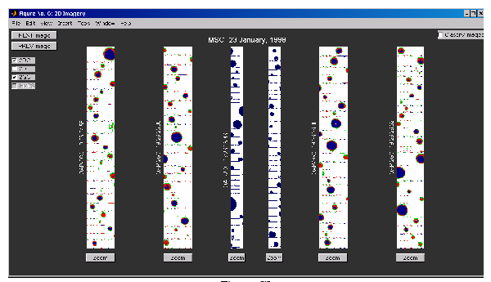
2-DC Probe: Spheres

Slide 4
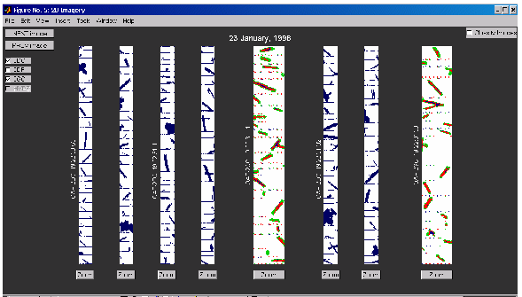
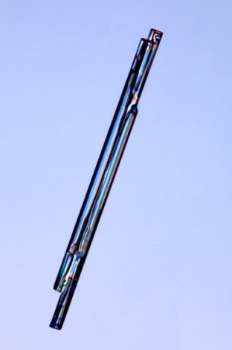
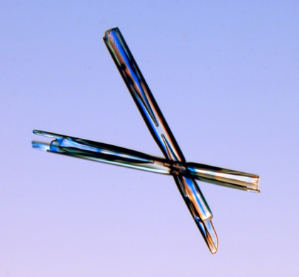
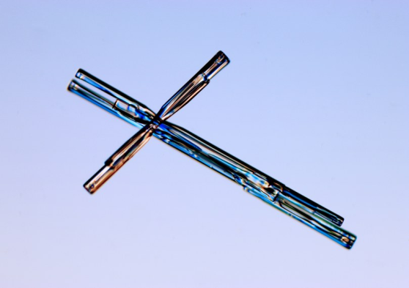
2-DC Probe: Needles

Slide 5
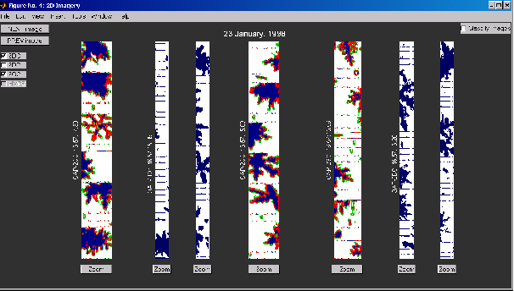
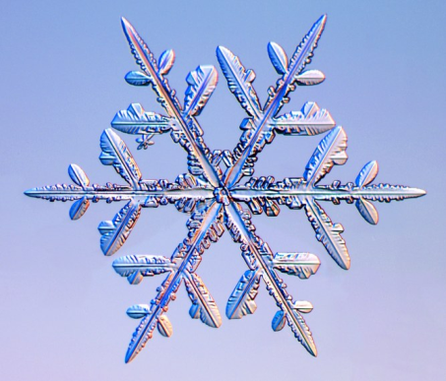
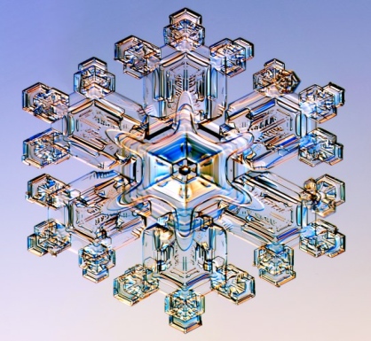
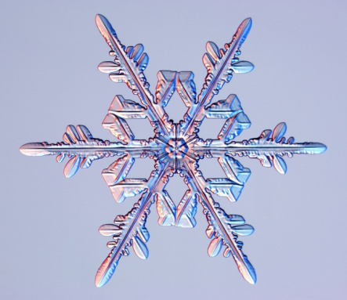
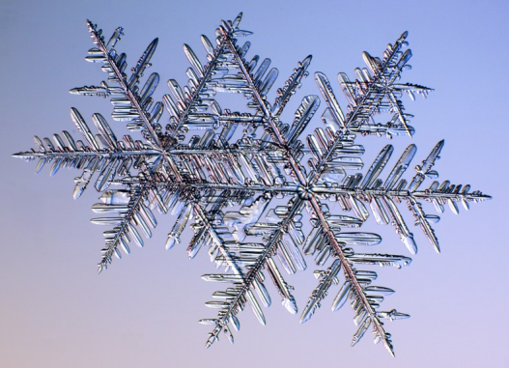
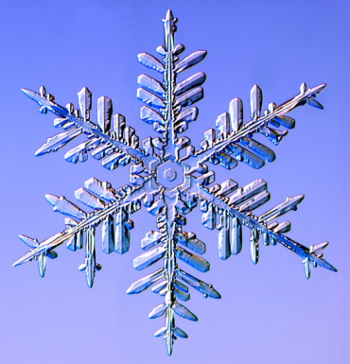
2-DC Probe: Dendrites

Slide 6
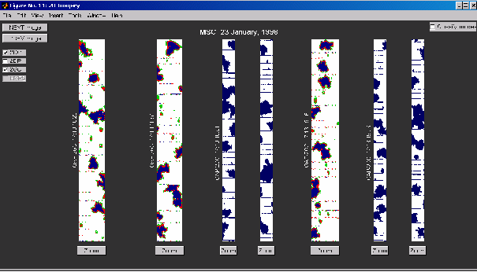
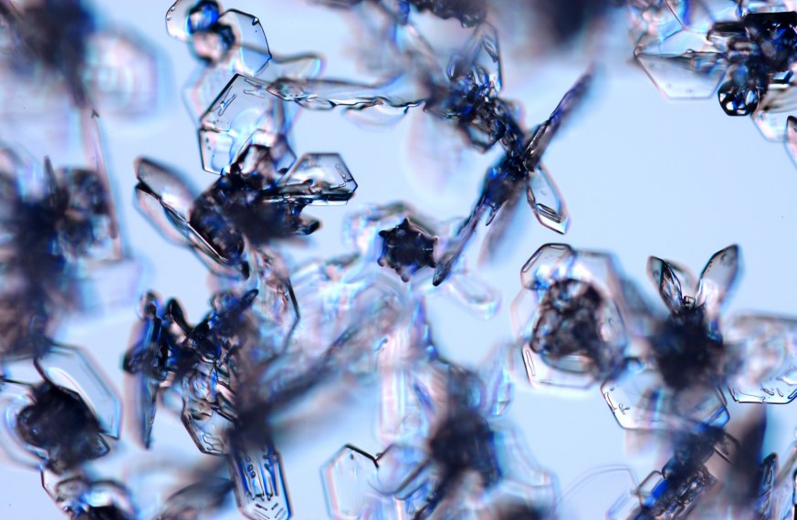
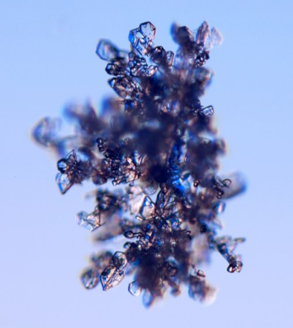
2-DC Probe: Irregulars

Slide 7
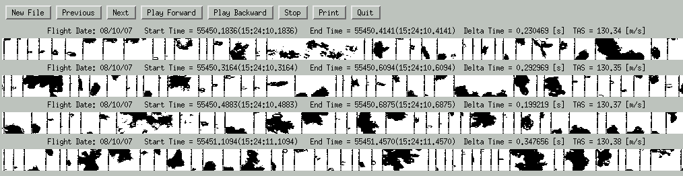
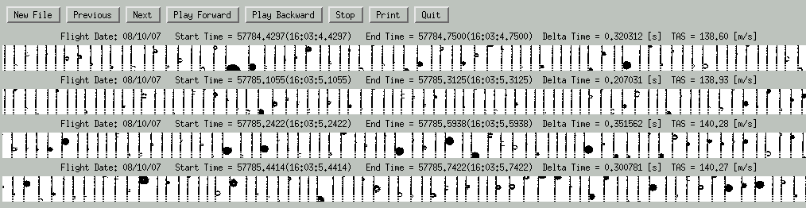
Images from 2-DC Probe
Percentage of particle losses based on the measured FSSP activity.

Slide 8
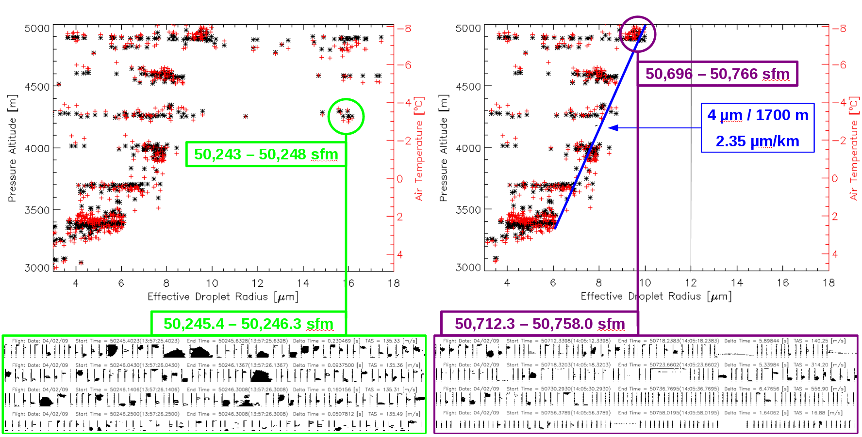
Droplet Effective Radius
Sampling of cloud cell between cloud base and cloud top during time interval 49,100 to 50,800 sfm on 2 April 2008. Left panel shows all observations, while the right panel only includes FSSP concentrations at STP that are greater than 100 #/cm³. The blue line gives the approximate rate of increase of effective droplet radius with height.

Slide 9
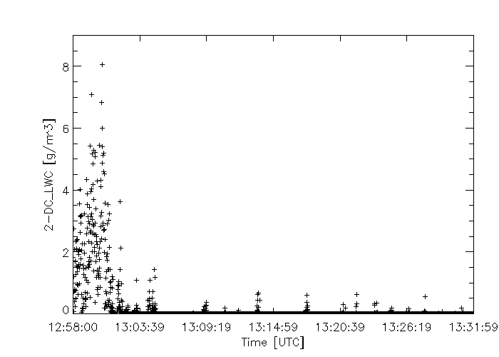
9 April 2009 Flight
Peak: 46827 – 46828 sfm
2DC Equivalent LWC [g/m³]
Low: 48292 – 48299 sfm
Time [UTC]
Liquid water content equivalent (1 Hz data) at 18,000 ft measured by 2-DC probe on a research flight in Saudi Arabia.

Slide 10
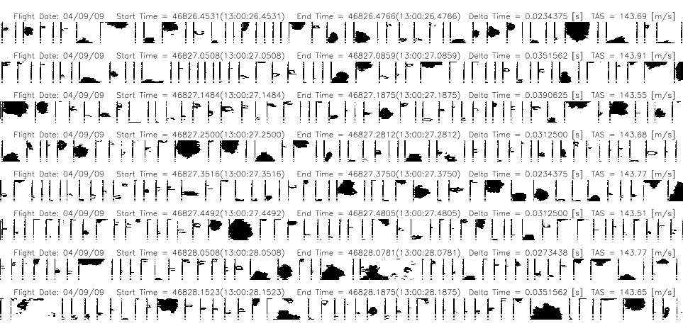
9 April 2009 Flight
Images from the 2-DC between 13:00:26.45 and 13:00:28.19 (less than 2 seconds total) which correspond to the maximum liquid water content equivalent (1 Hz data) measured by 2-DC probe between on 9 April 2009 research flight in Saudi Arabia.

Slide 11
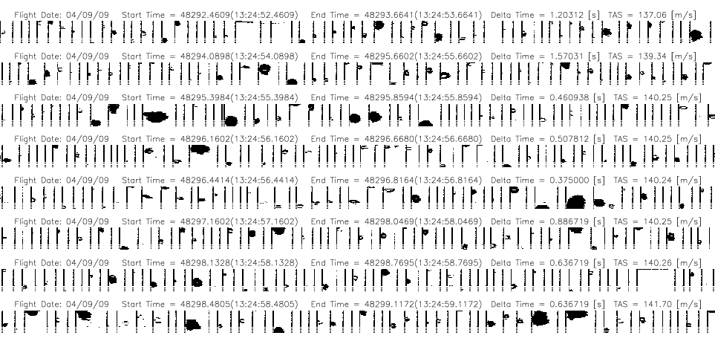
9 April 2009 Flight
Images from the 2-DC between 13:24:52.46 and 13:24.59 (9 seconds total) which correspond to the low liquid water content equivalent (1 Hz data) measured by 2-DC probe on 9 April 2009 research flight in Saudi Arabia.

Slide 12
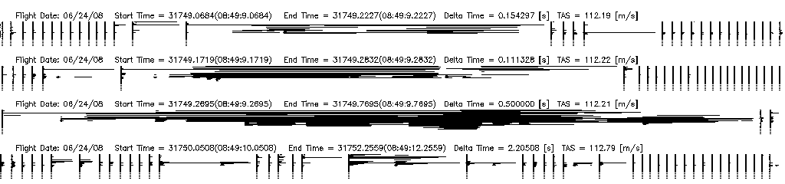
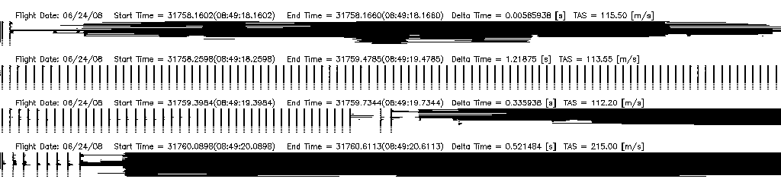
Conclusions
  Liquid Droplets are round, ice is not.
Spheres, Needles, Dendrites, Irregulars

Slide 13
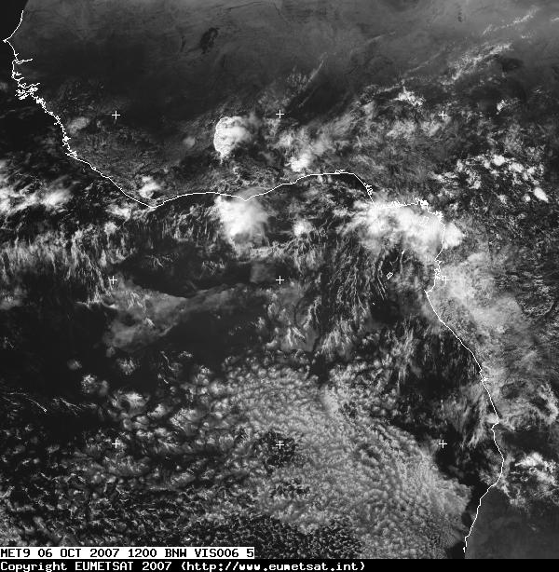
Any Questions

