Slide 1
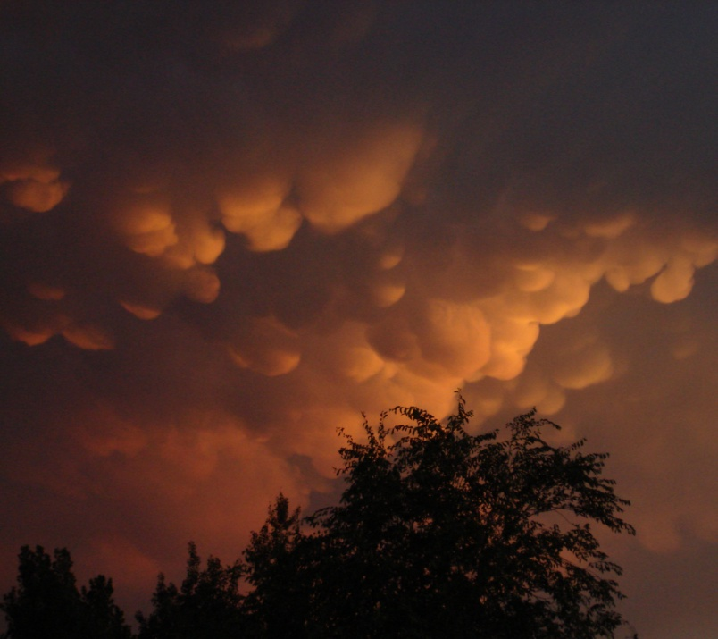
Training in the use of Airborne Instrumentation, Data Collection, Archival and Processing PREPARED FOR PROGRAMME SAAGA ARMÉE DE L’AIR BURKINA FASO
Introduction to the 2-DC Probe
David Delene, Ph.D.
Professor and Good Guy
February-March 2012
Fargo, North Dakota - USA

Slide 3
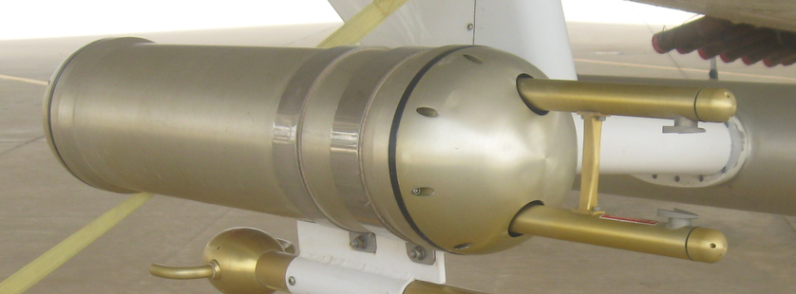
Drizzle + Collision/Coalescence
Rain
FSSP, 2D-C
2D-P, Radar

Slide 4
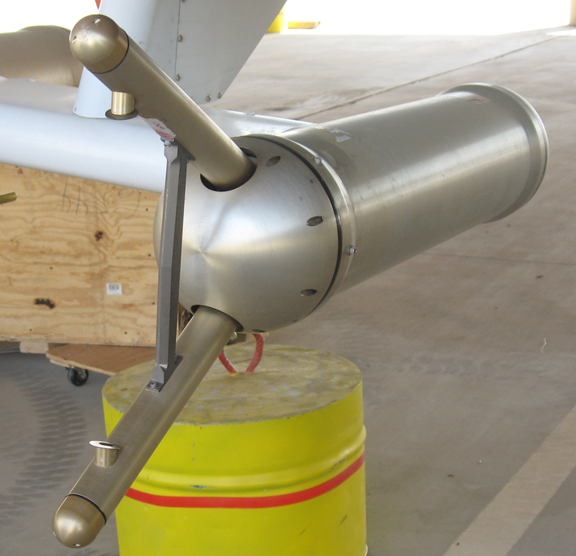
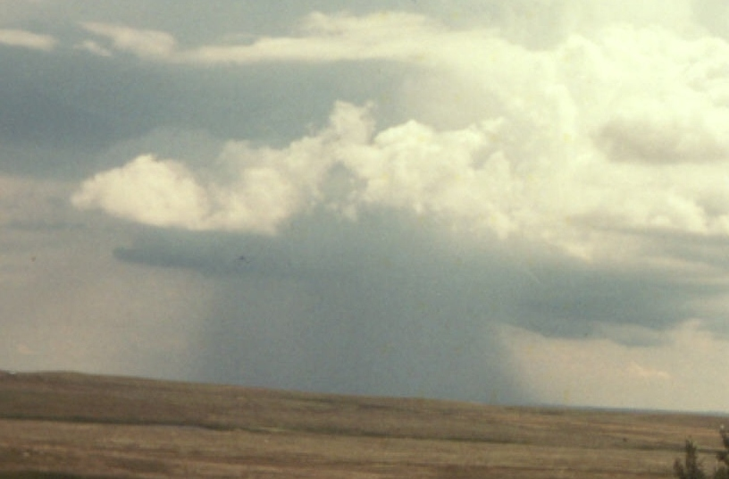
Rain + Water Content Profile
Precipitation
2D-P, Radar
Balloon, Aircraft
Rain Gauge

Slide 5
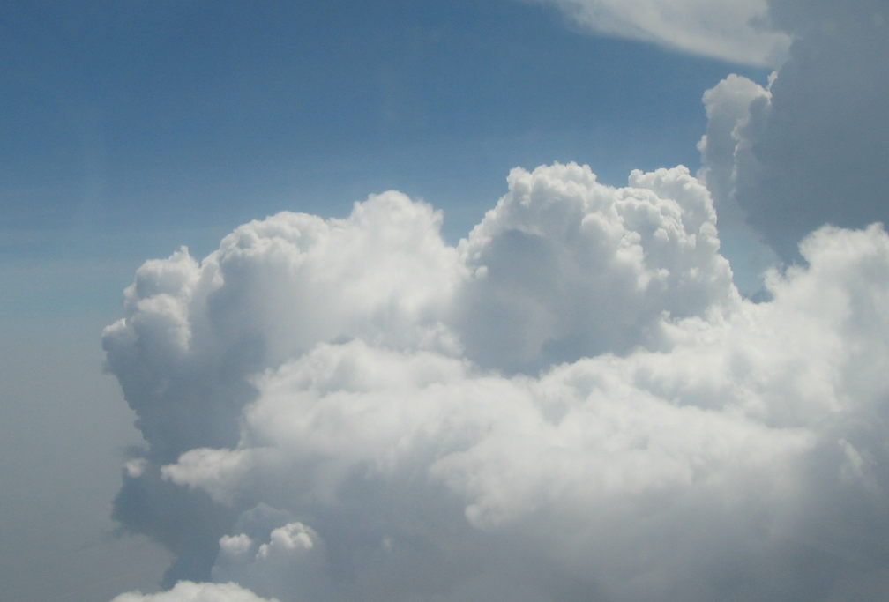
Glaciogenic Seeding
(Cloud Top)‏
Find good updraft with lots of liquid water.
Percentage of particle losses based on the measured FSSP activity.

Slide 6
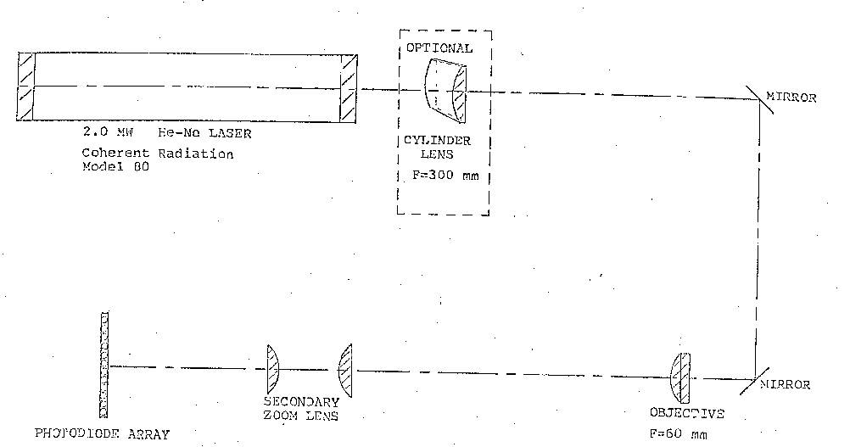
2DC Optics
Mirror
2.0 MW He-Ne Laser
Mirror
Secondary
Zoom Lens
Objective
Photodiode Array

Slide 7
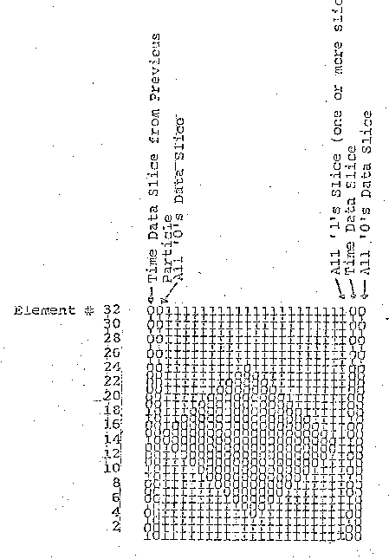
Image Array Elements

Slide 8
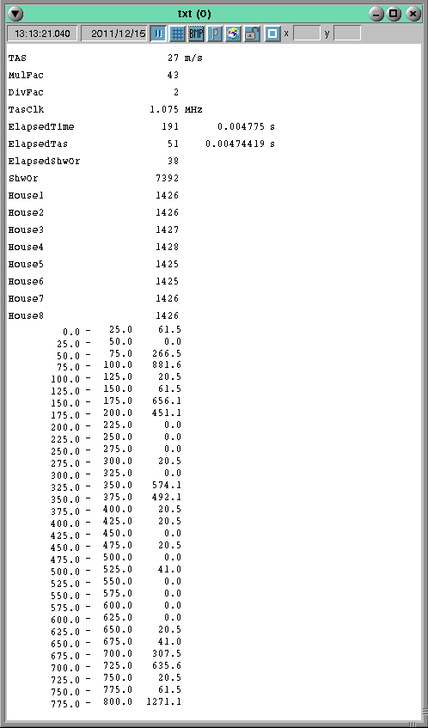
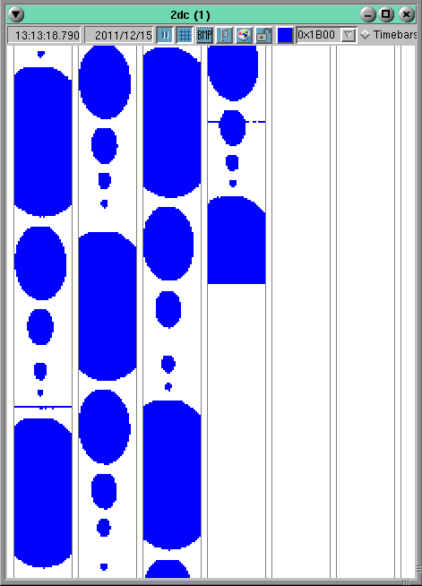
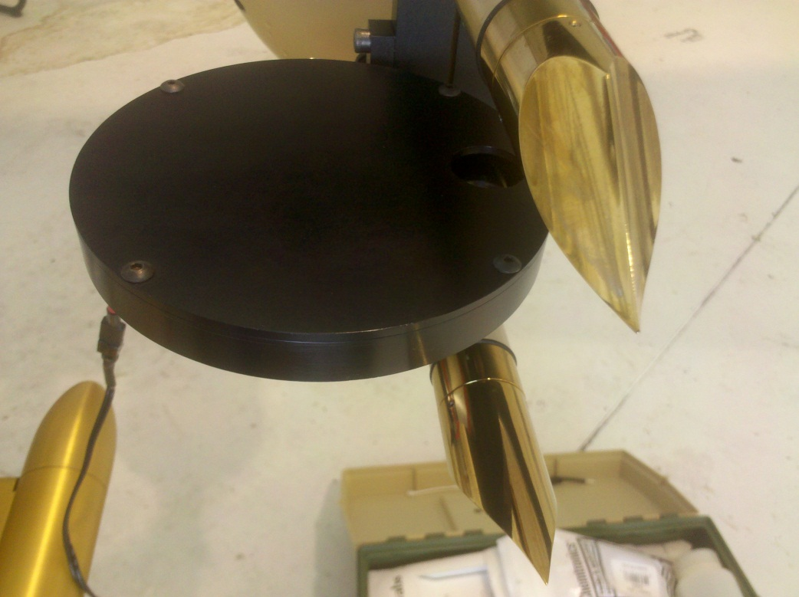
2-DC
Spinning
Disk

Slide 9
2-DC Spinning Disk

Slide 10
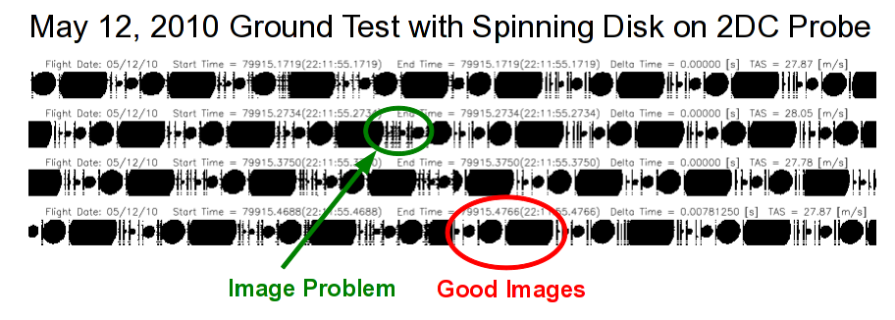

Slide 11
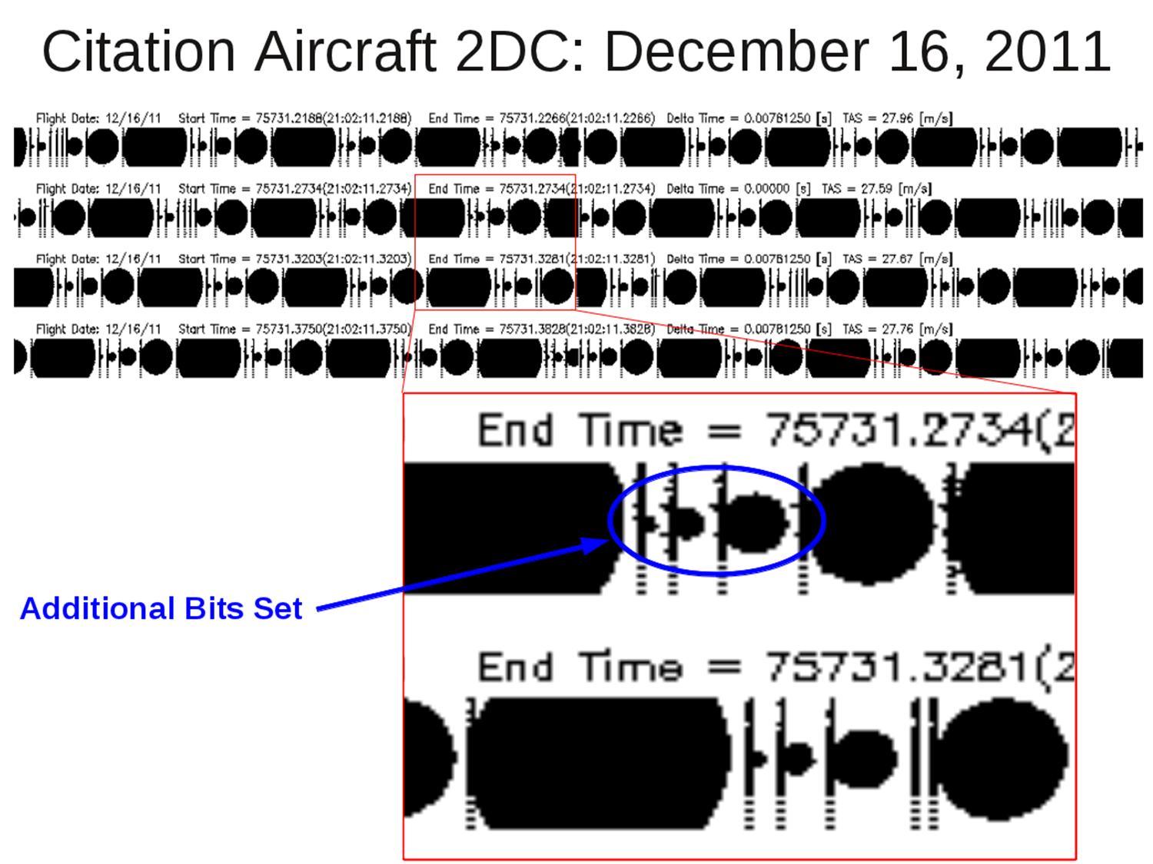

Slide 12
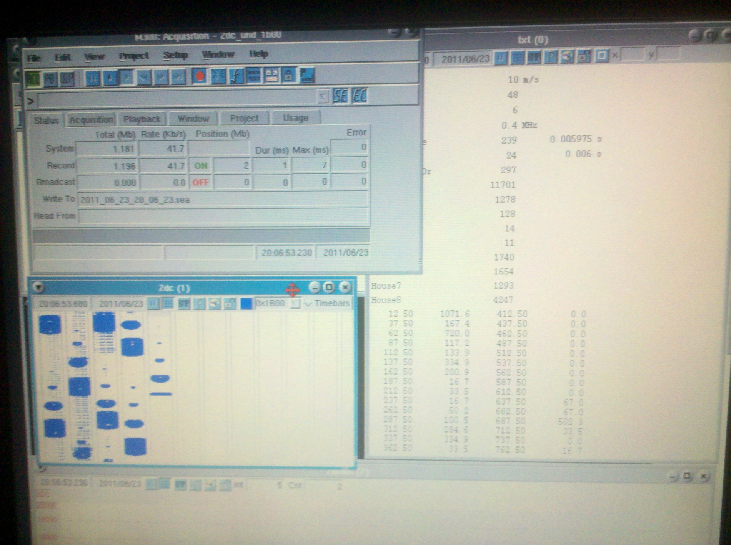
Images from 2-DC Probe

Slide 13
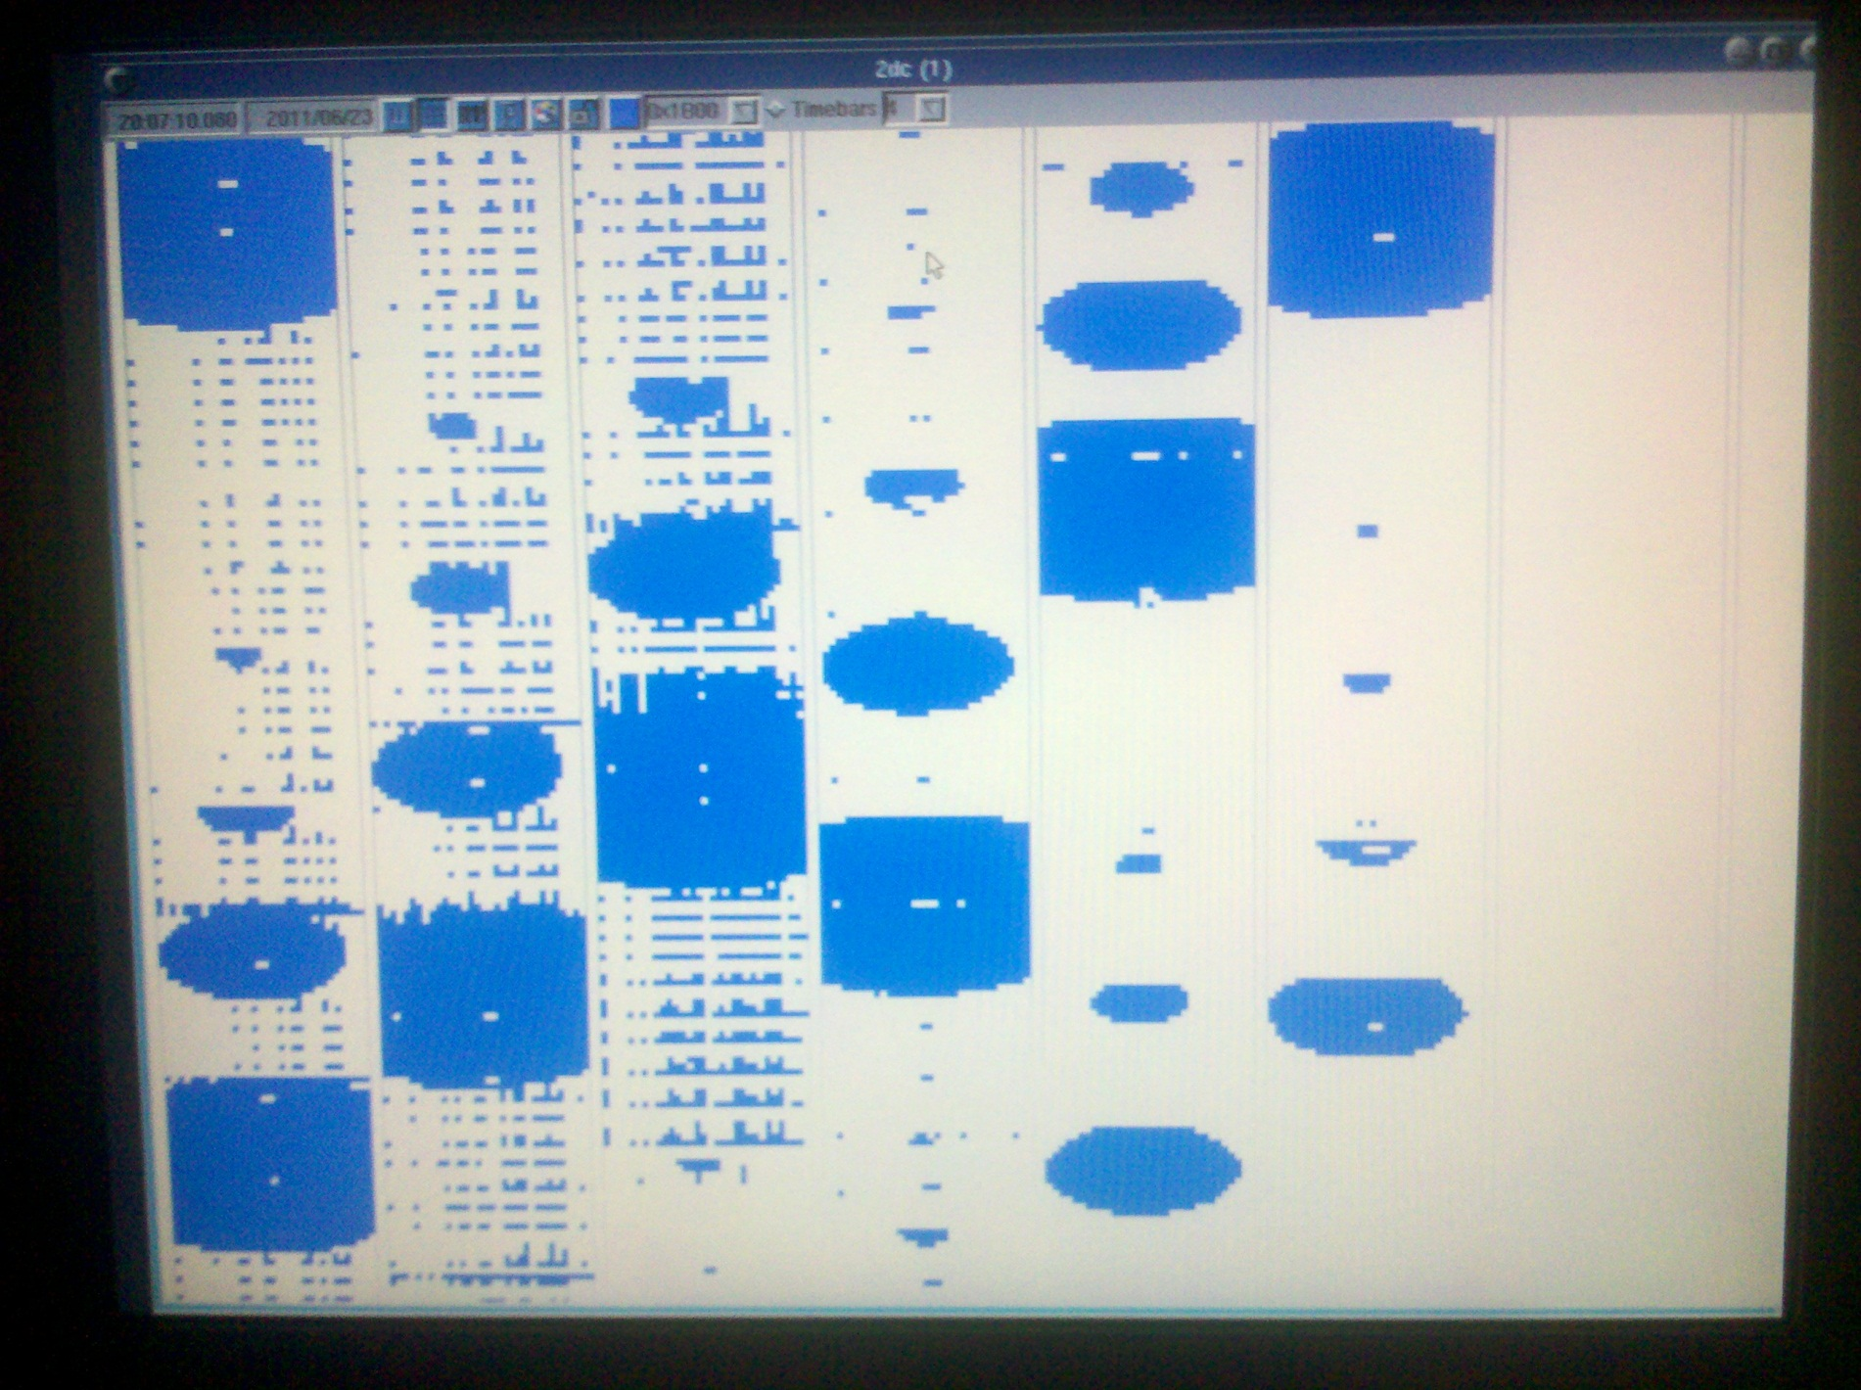
Images from 2-DC Probe
Percentage of particle losses based on the measured FSSP activity.

Slide 14
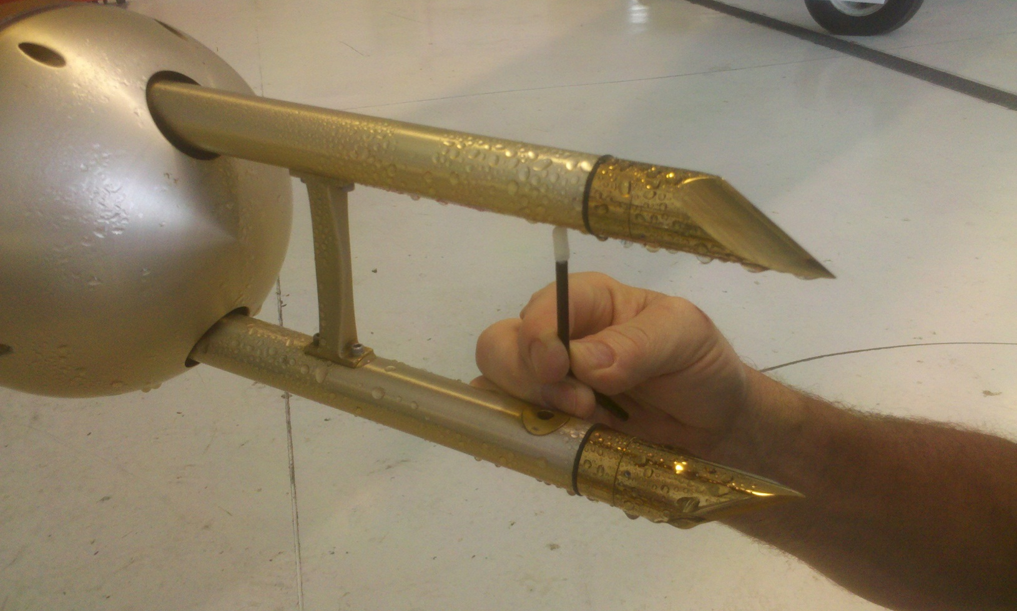
Conclusions
It is important to conduct performance test on the 2DC using a spinning disk.
It is important to clean the 2DC optics.

Slide 15
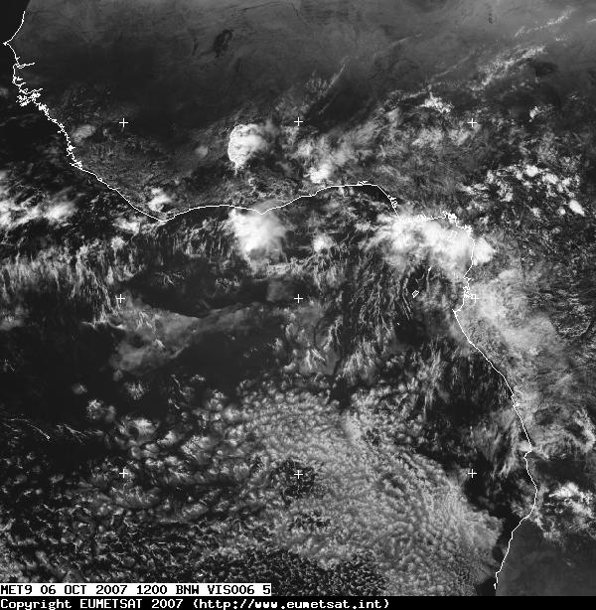
Any Questions

