Slide 1
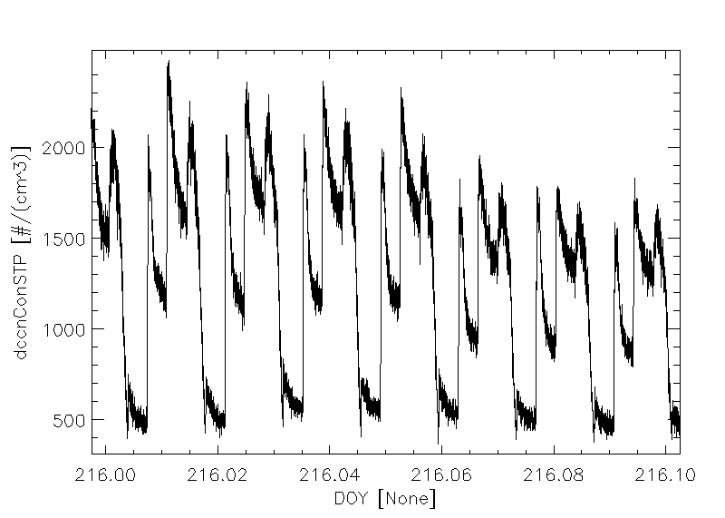
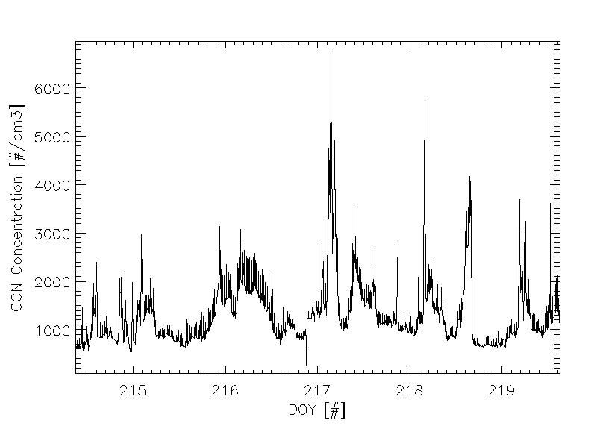
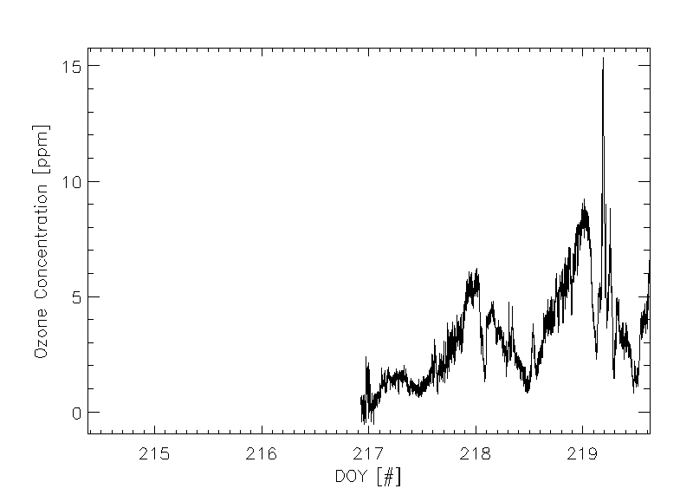
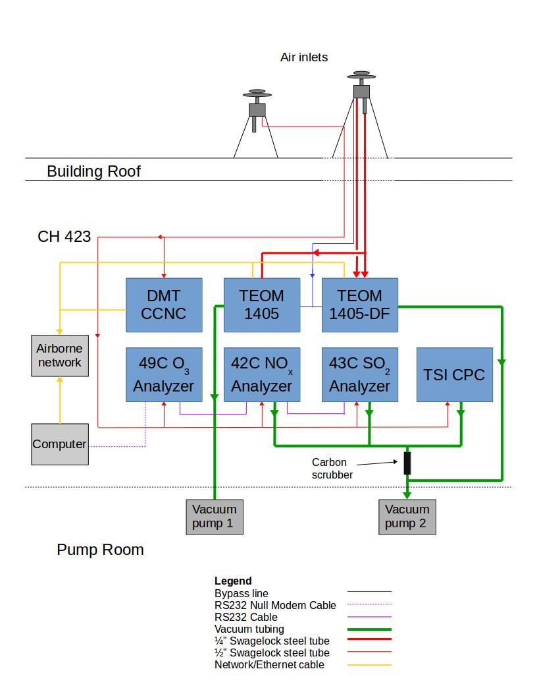
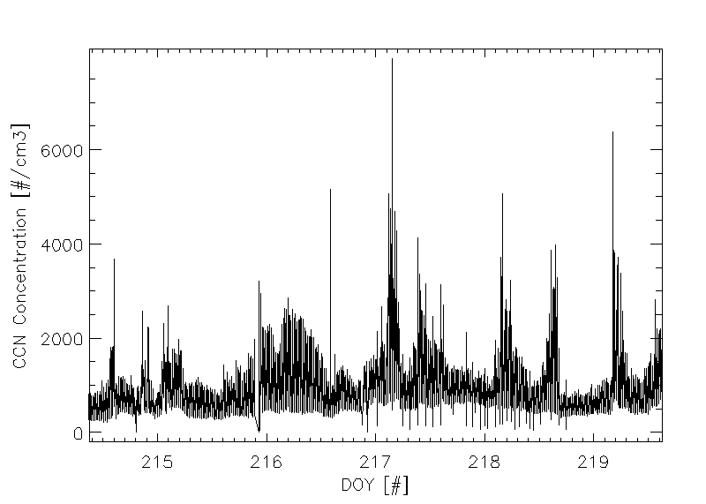
Investigating Diurnal Cycles in a Spectrum of Cloud Condensation Nuclei
Interdisciplinary
Renewable & Environmental
Chemistry REU
Jesus Bautista Cid, Kurt Hibert, and David Delene
University of North Dakota, Grand Forks, ND
OBJECTIVES
RESULTS
CONCLUSIONS
Determine the presence of diurnal cycles in cloud condensation nuclei and test for correlation with other atmospheric measurements.
Calibrate and setup various particulate matter instruments in preparation for data collection.
Analyze data collected and automate the data collection and analysis using the ADPAA software used by UND.
Challenge the results found by CCN modeling experiments using real time atmospheric data.
Overall there is a noticeable change in CCN throughout the day and night cycle
There is a strong correlation between ozone and solar radiation.
There are various other unaccounted factors that show a strong presence in the CCN count data, such as passing automobiles and trains, and cloud coverage.
A large sample of data is needed to create a proper model of the current atmosphere in Grand Forks.
Further work would entail an automated process allowing for various months of continuous data.
0.6%
0.9%
CCN Concentration [#/cm³]
0.3%
0.2%
Figure 1. Plot showing the ambient CCN concentration over 2 hours. The CCN concentration is at 4 supersaturations (red text), corresponding to different particle size ranges. Assuming ammonium sulfate, supersaturations of 0.2, 0.3, 06, and 0.9 correspond to 80, 60, 40, 20 nm, respectively. The day of year (DOY) is using UTC time.
Figure 2. Measurements of CCN counter concentration at 0.9% supersaturation over 5 days, averaged every 30 seconds
BACKGROUND
Cloud condensation nuclei (CCN) are particles that form water droplets in a supersaturated environment.
Aerosols that become CCN are dependent on many factors, explained by Kappa-Kohler theory ^{[1]}.
High intensity of UV light from the sun during the day typically results in large concentrations of small sized aerosols and ozone.
http://www.physics.uu.se/research/molcond/ongoingresearch/molecules-and-liquids/aerosols/
ACKNOWLEDGEMENTS
Alexa Otto
University of North Dakota REU program
Department of Chemistry
Department of Atmospheric Science
This material is based upon work supported by the National Science Foundation Research Experience for Undergraduates under Grant No. CHE 1460825 and CHE1156584. Any opinions, findings, and conclusions or recommendations expressed in this material are those of the authors and do not necessarily reflect the views of the National Science Foundation.
Methodology
Figure 3. Time series plot of Ozone concentration and Solar Radiation^{[2]} over 5 days.
Determine the CCN counter‘s average time to adjust temperature gradient, using a constant flow of ammonium sulfate aerosol.
Calibrate the CCN counter using a constant flow of ammonium sulfate aerosol, an electrostatic classifier, and an x-ray neutralizer.
Data collected over a period of 6 days using instruments in the Clifford Hall 423 lab at the University of North Dakota in Grand Forks, North Dakota (see setup figure to the right).
REFERENCES
Figure 4. Measurement of CCN counter concentration at 0.2% supersaturation over 5 days
Petters, M. D.; Kreidenweis, S. M. Atmospheric Chemistry and Physics 2007, 7 (8), 1961–1971.
Emerado ND010: Grand Forks August 7, 2017.

