Slide 1
Weather Mod Internship
By Payton Belzer

Slide 2
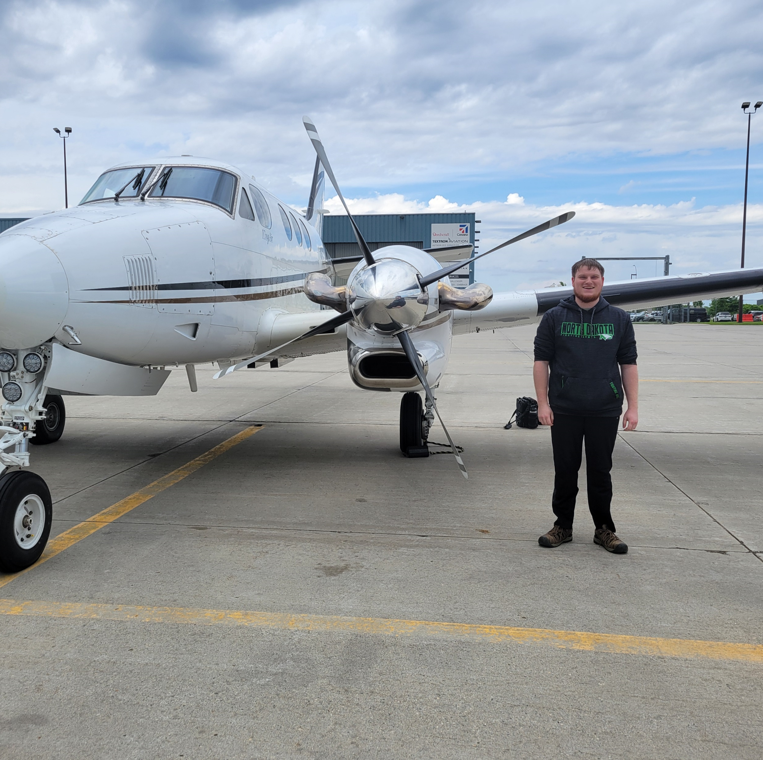
Background:
Commercial aviation and atmospheric science dual major
Senior here at UND
Was with the NDCMP Project as an intern during the Summer of 2024
Seed 2 stationed in Bowman, ND

Slide 3
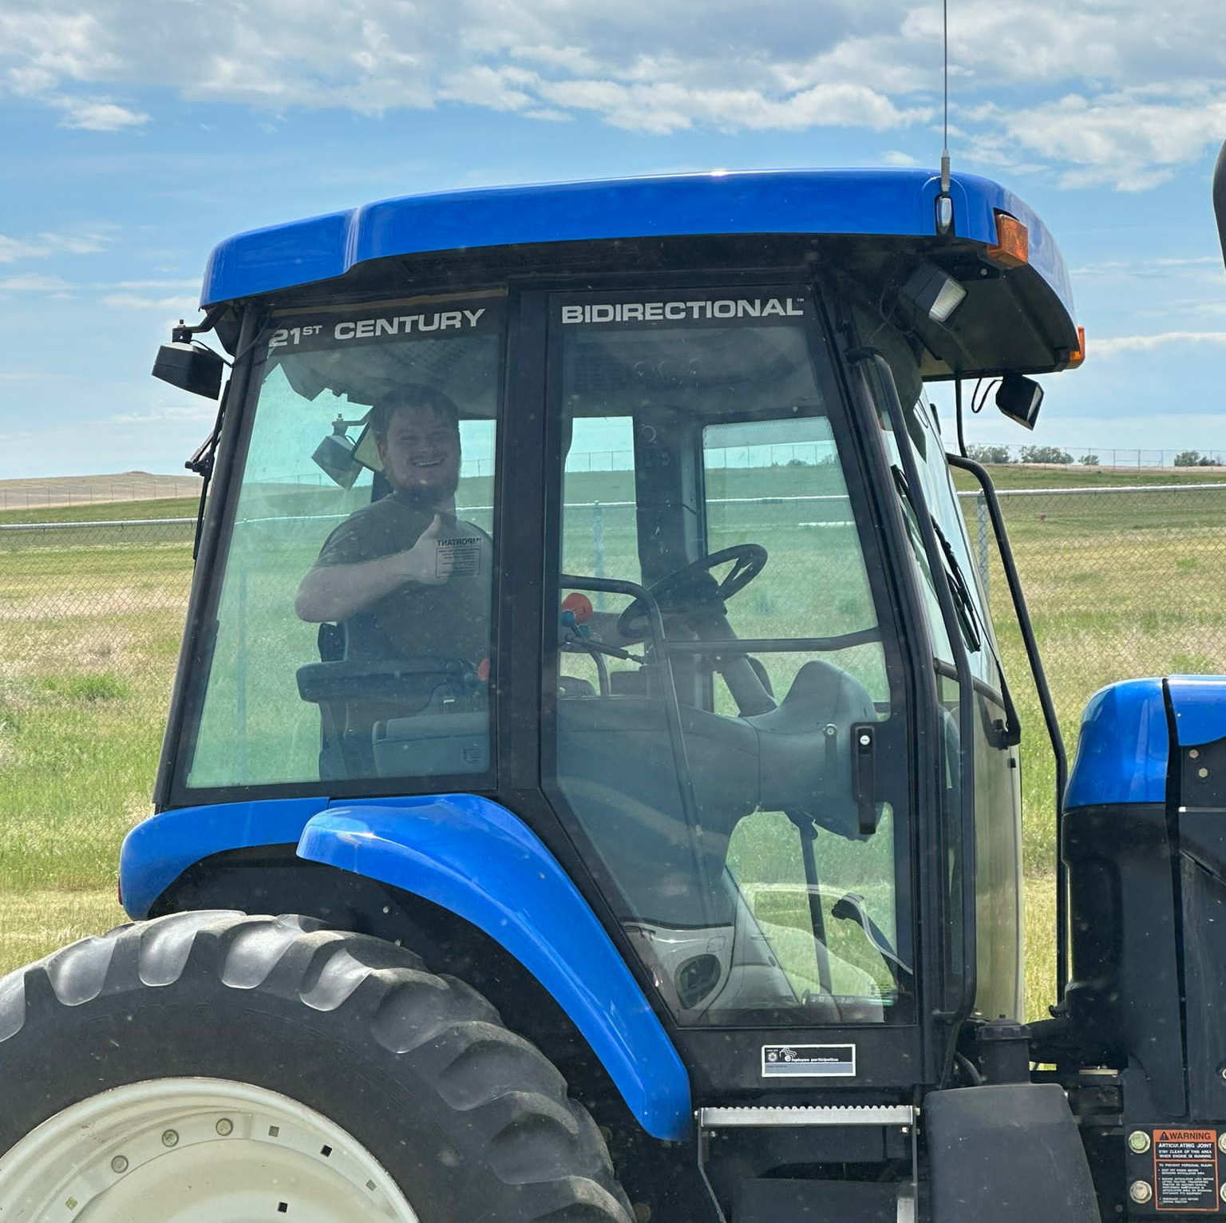
Internship
Work around 30 – 40 hours per week
Flying missions
Paperwork for the missions
Mixing chemicals (Silver Iodide) and chemical inventory
Keeping airplanes/burners clean
Public outreach
Helping at the airport

Slide 4
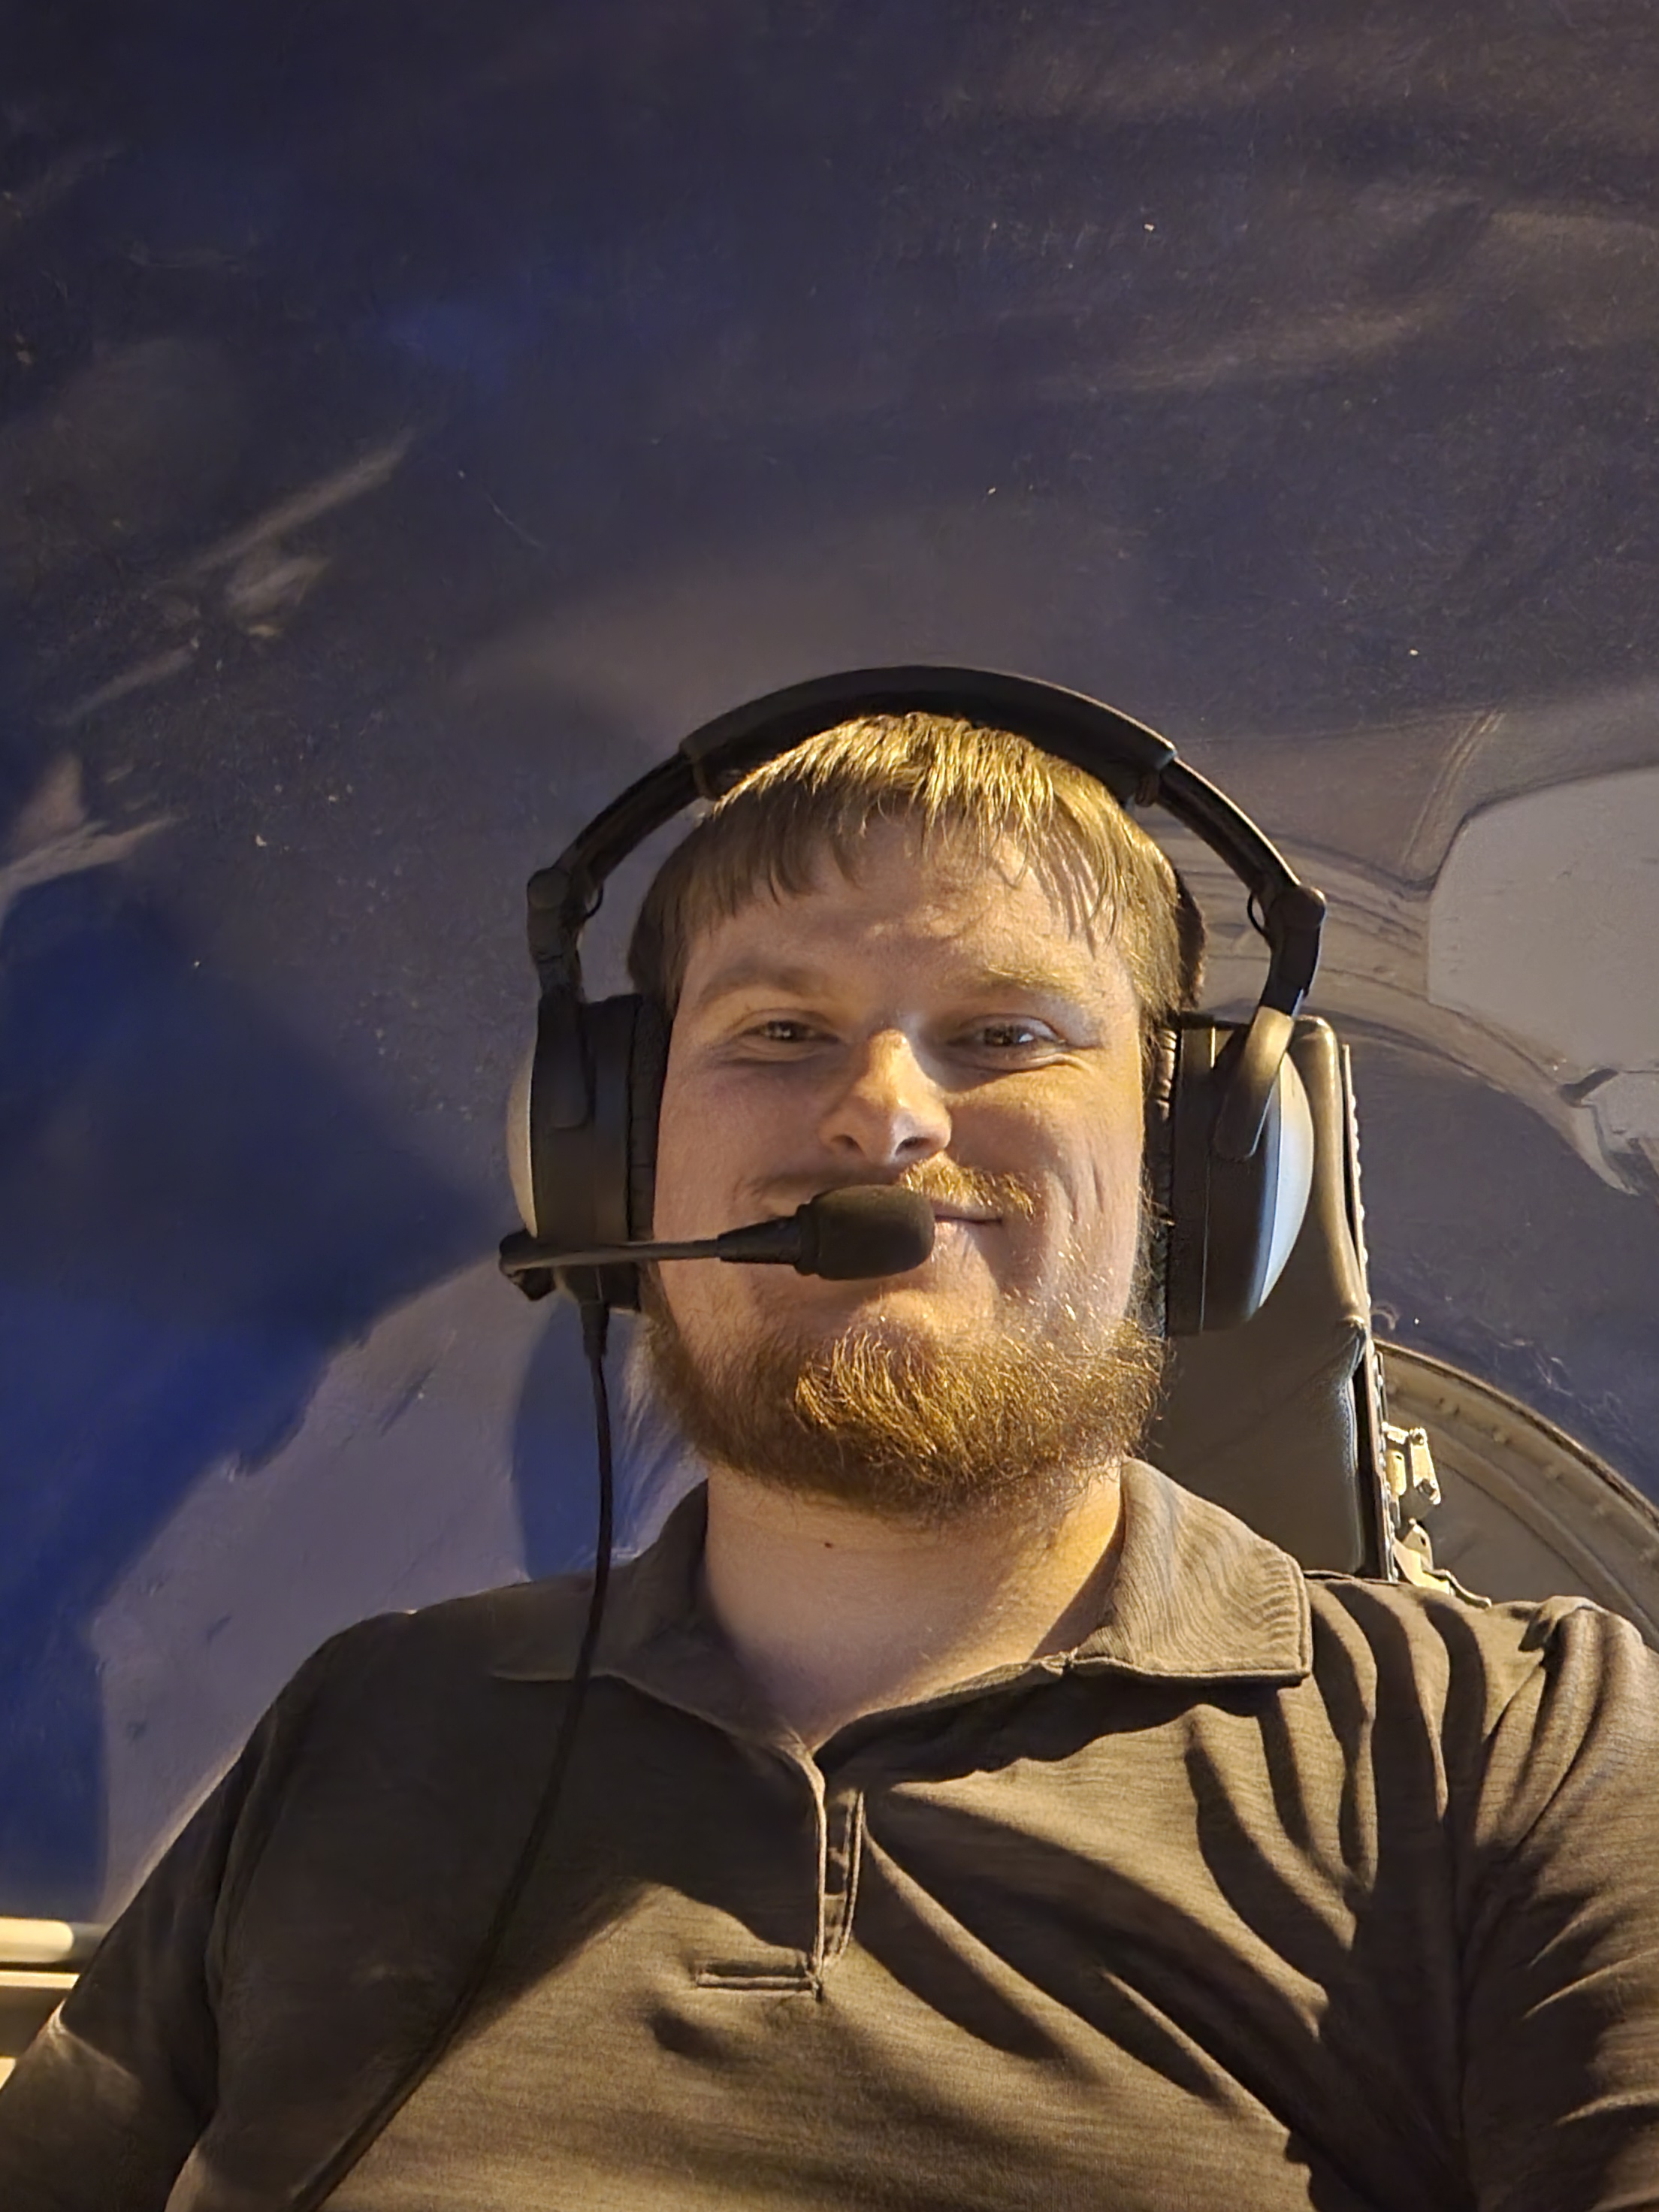
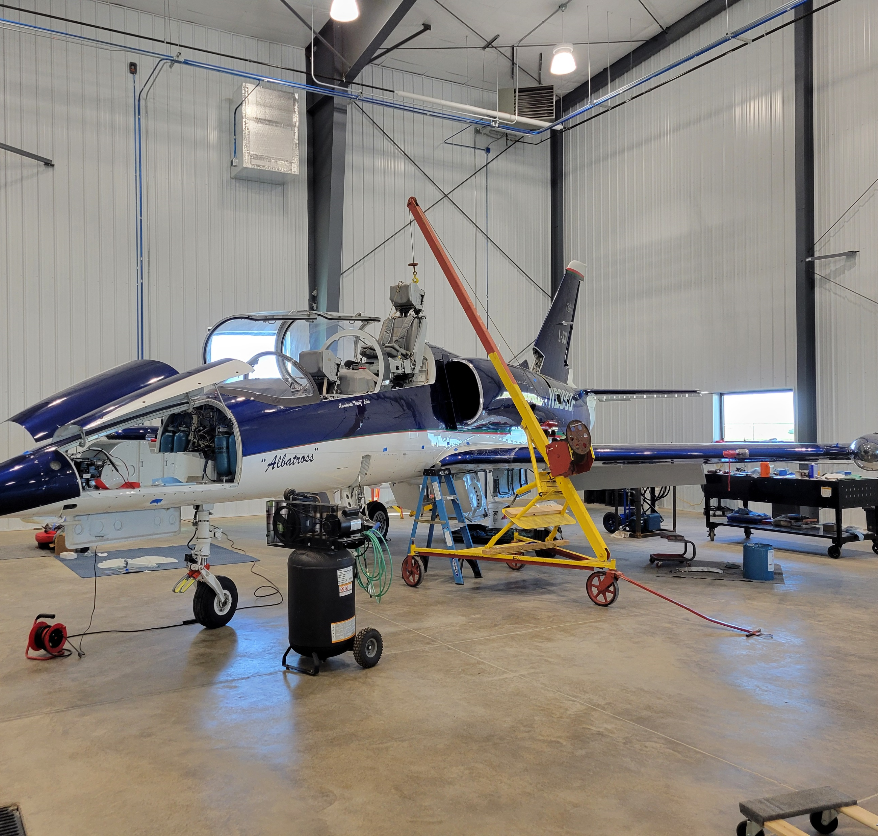
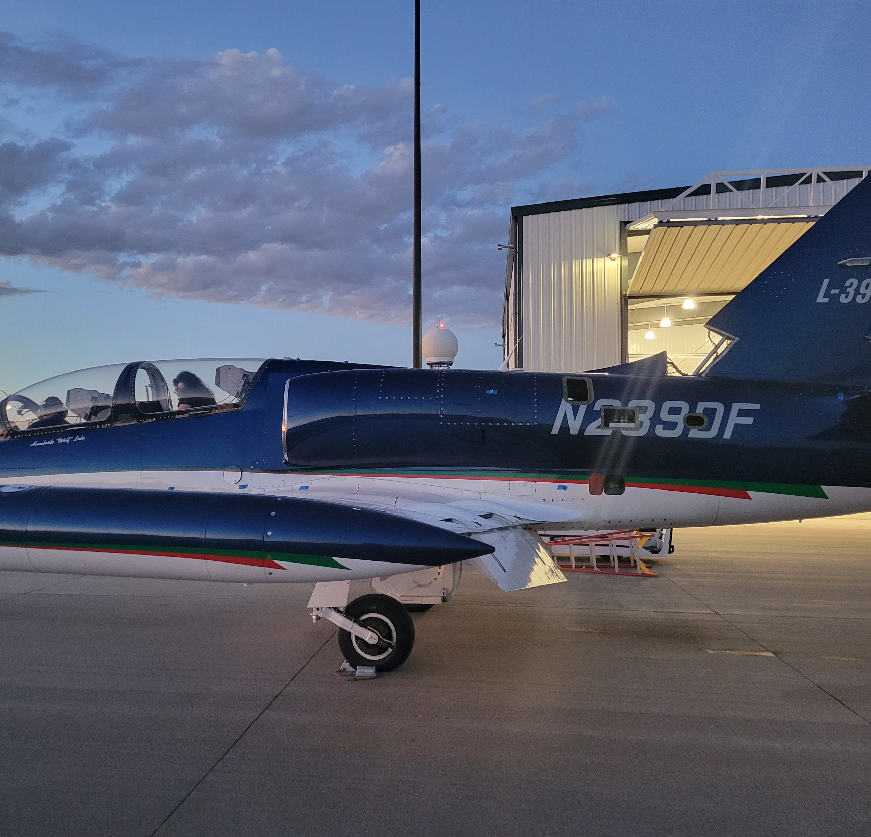
Opportunities:
I worked with the airport manager at Bowman on an L-39
Helped with getting the ejection seats into place
Helped with run-up of the plane

Slide 5
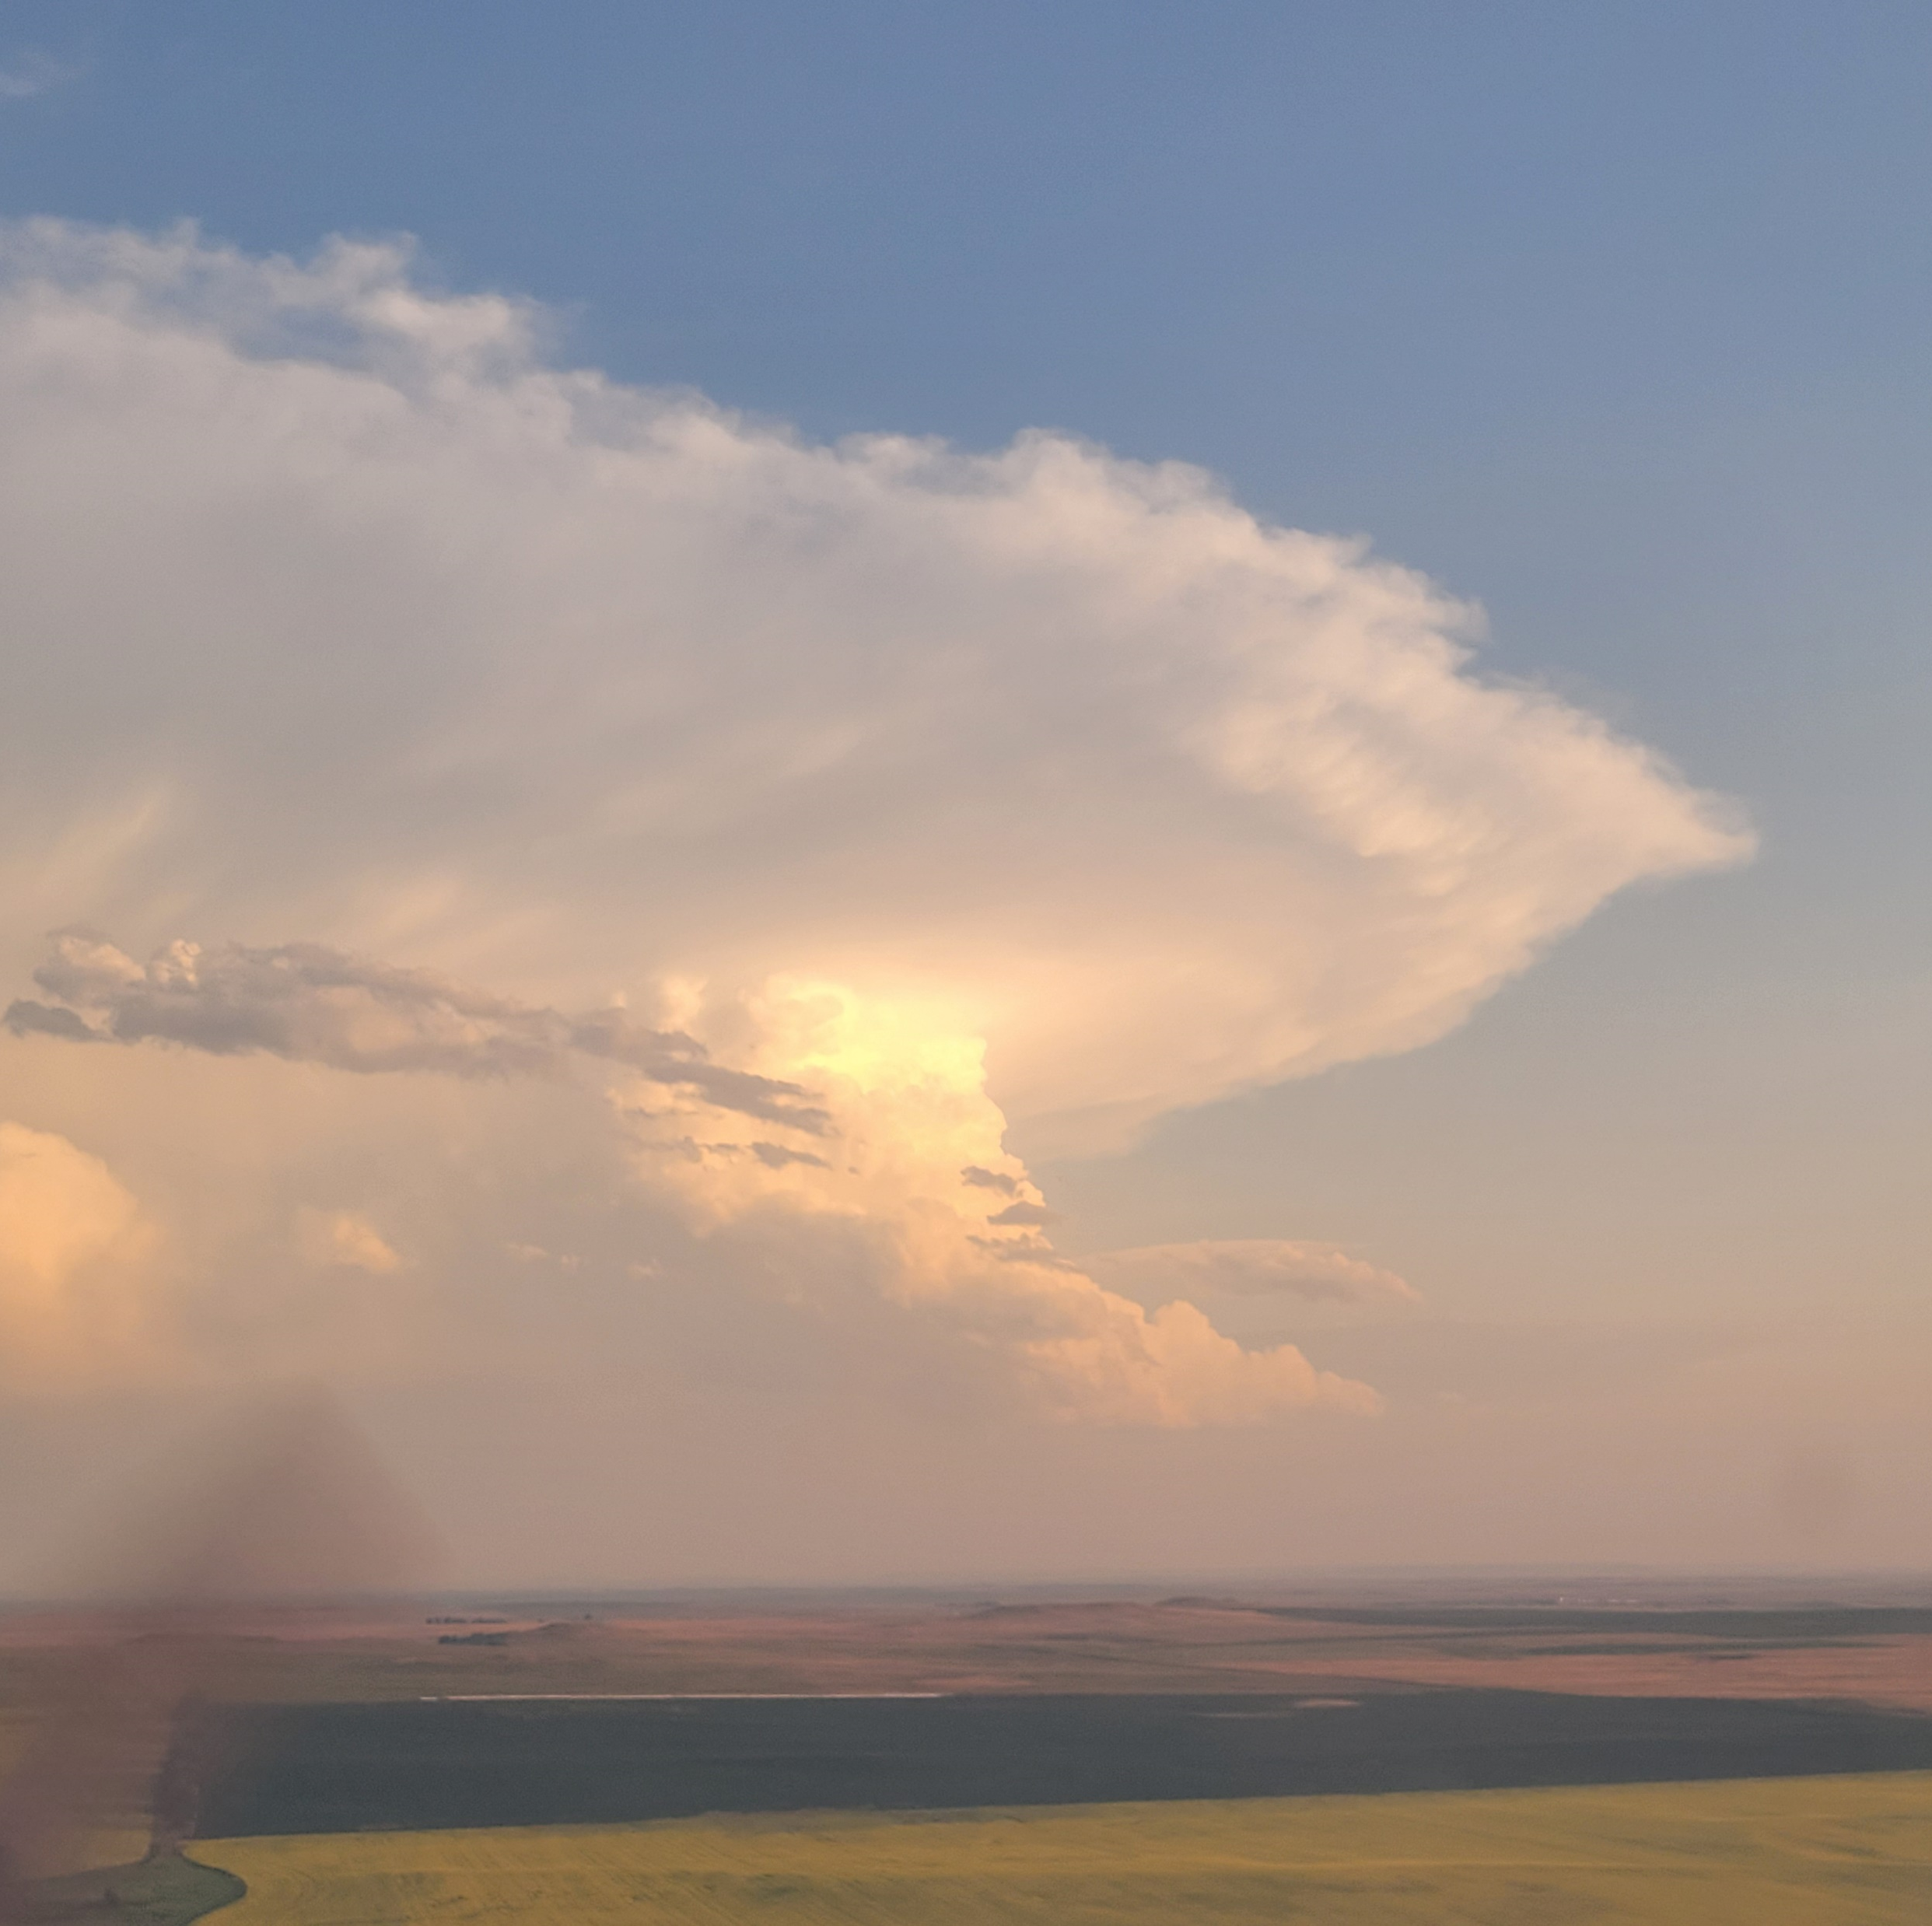
Day to Day Routine:
On call, so whenever the weather happens, you have to be ready to go
Late nights and early mornings
Night missions
Daily preflight of the aircraft to ensure readiness to launch
Daily weather briefing outlining expectations of weather for that day

Slide 6
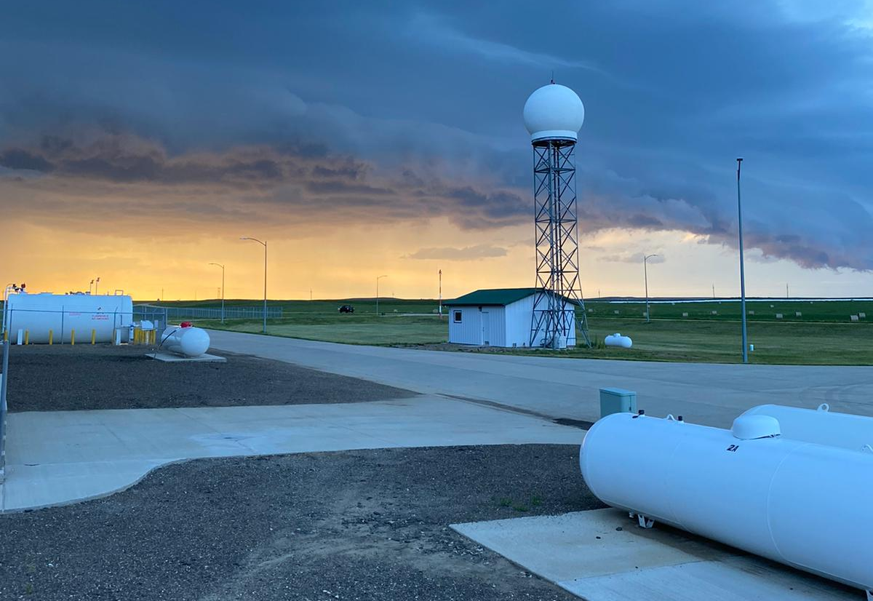
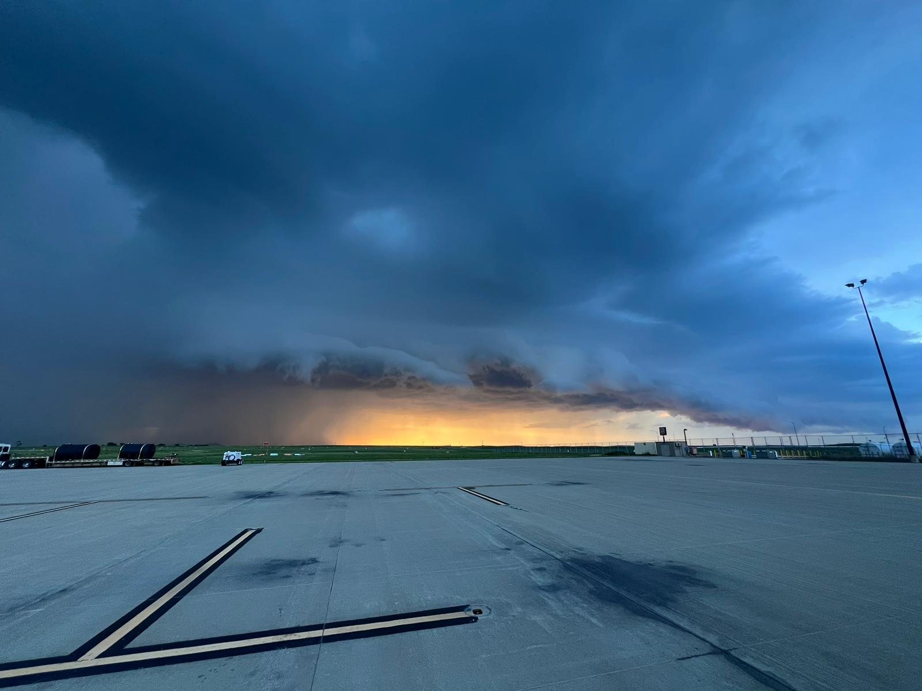
Missions:
Variety of purposes:
Maintenance
Recon
Seeding mission
Hail
Rain enhancement

Slide 7
2024 Season:
The 2024 season was not very good, especially in district 1, where I was located
Below average precipitation for much of the season and even mild drought conditions in district 1

Slide 8
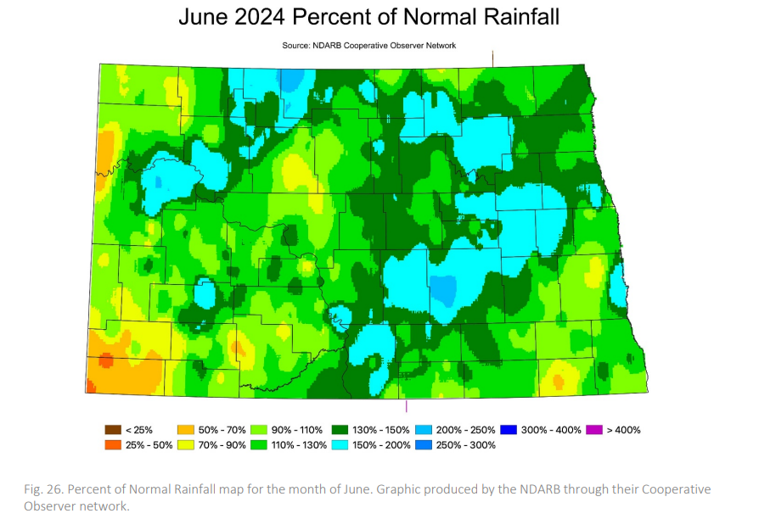
2024 Rainfall: June
Lower precipitation in district 1
Lower precipitation in parts of district 2, but more area with higher precipitation amounts

Slide 9
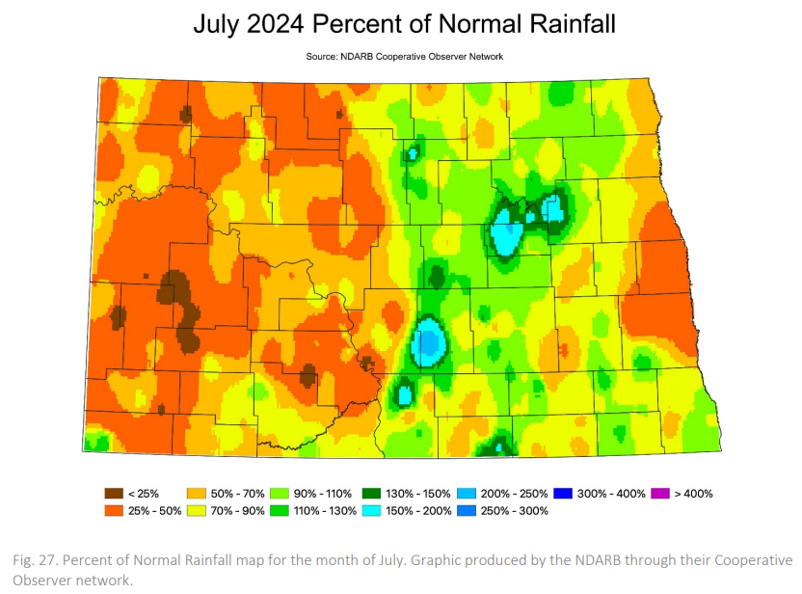
2024 Rainfall: July
Overall low precipitation amounts across the entirety of western North Dakota, including districts 1 and 2

Slide 10
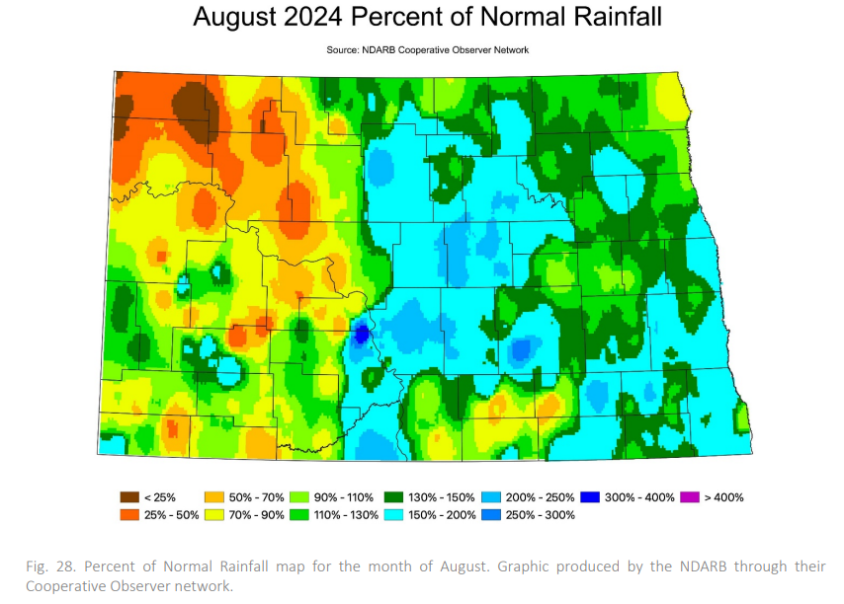
2024 Rainfall: August
Lower precipitation amounts across areas of district 1 and much of district 2

Slide 11
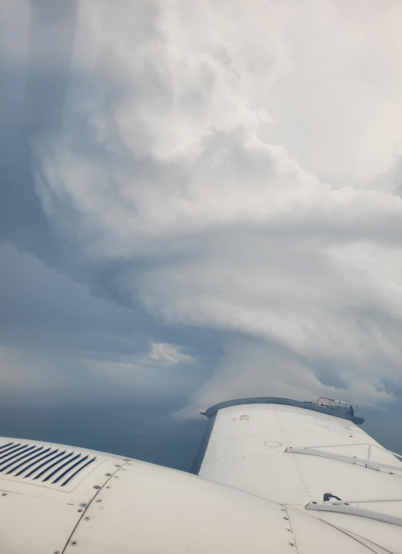
June 27 Mission
Squall line moving through
Convection ahead of the squall line
Both planes launched, line jumped on top of us
Both planes fled to Rapid City, SD

Slide 12
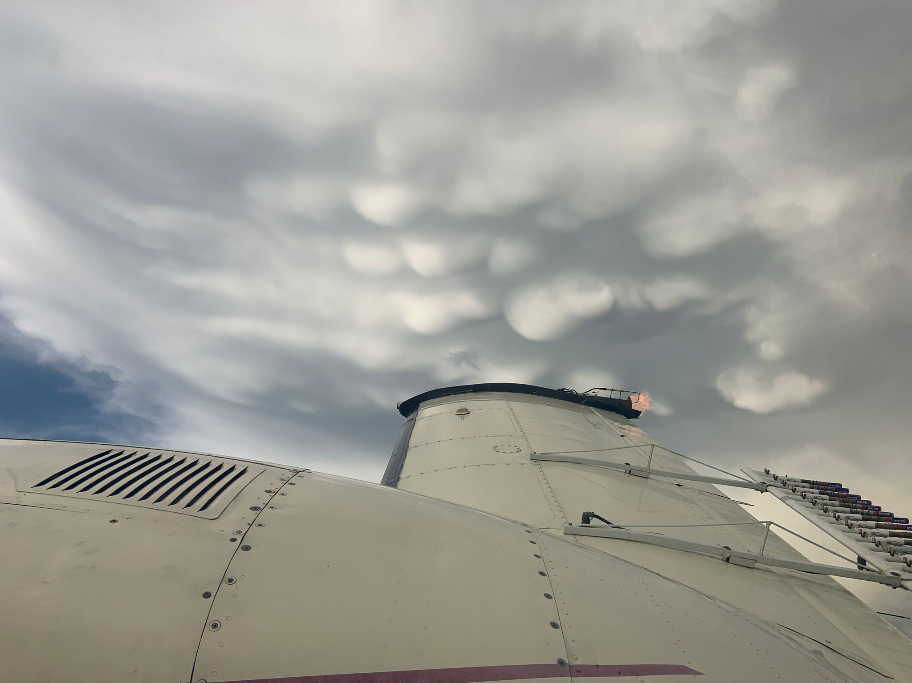
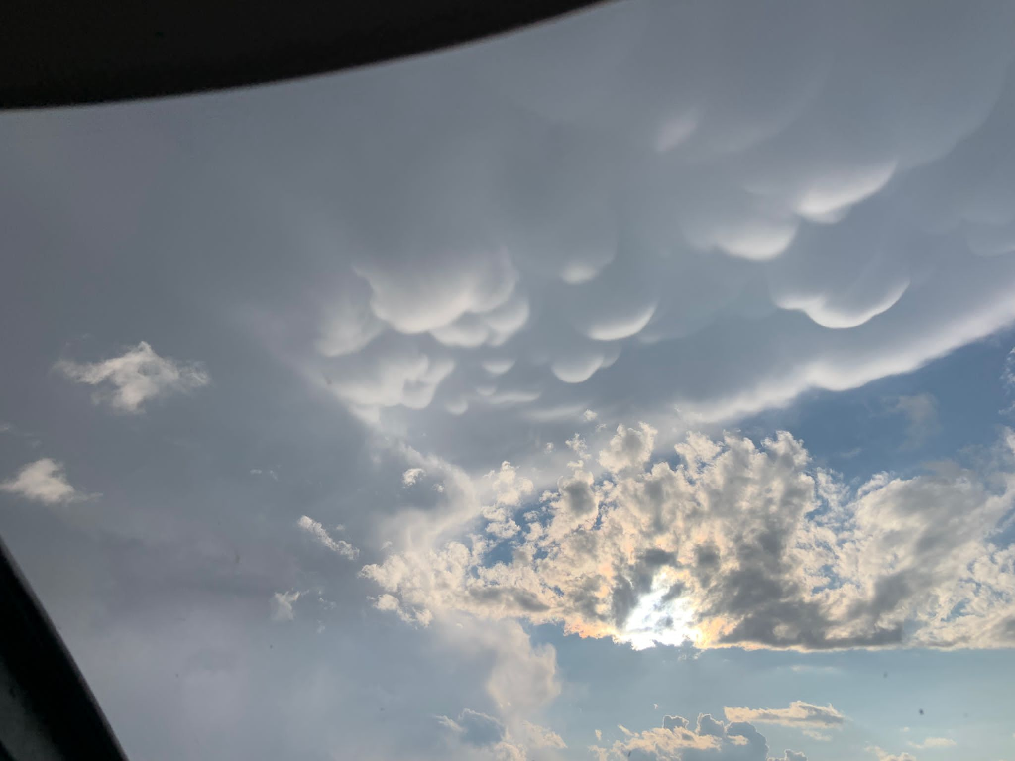
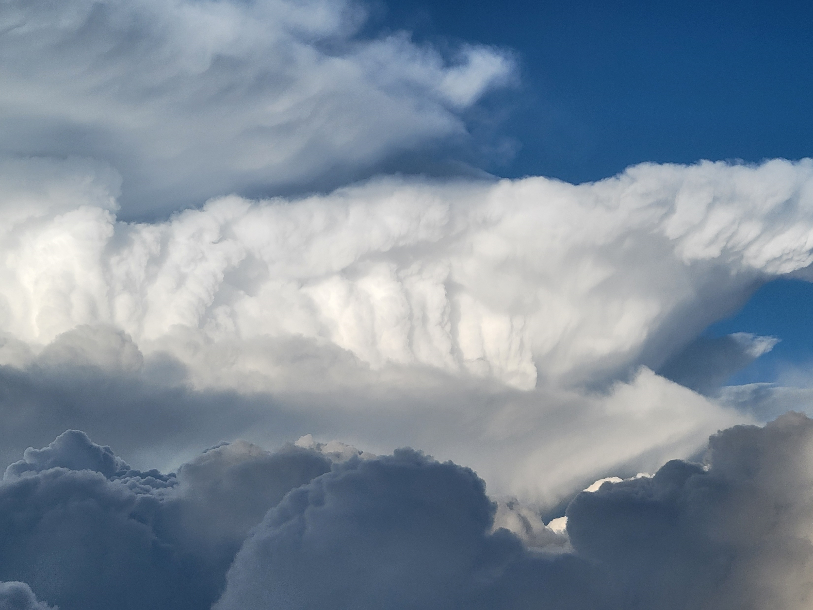
Pictures:

Slide 13
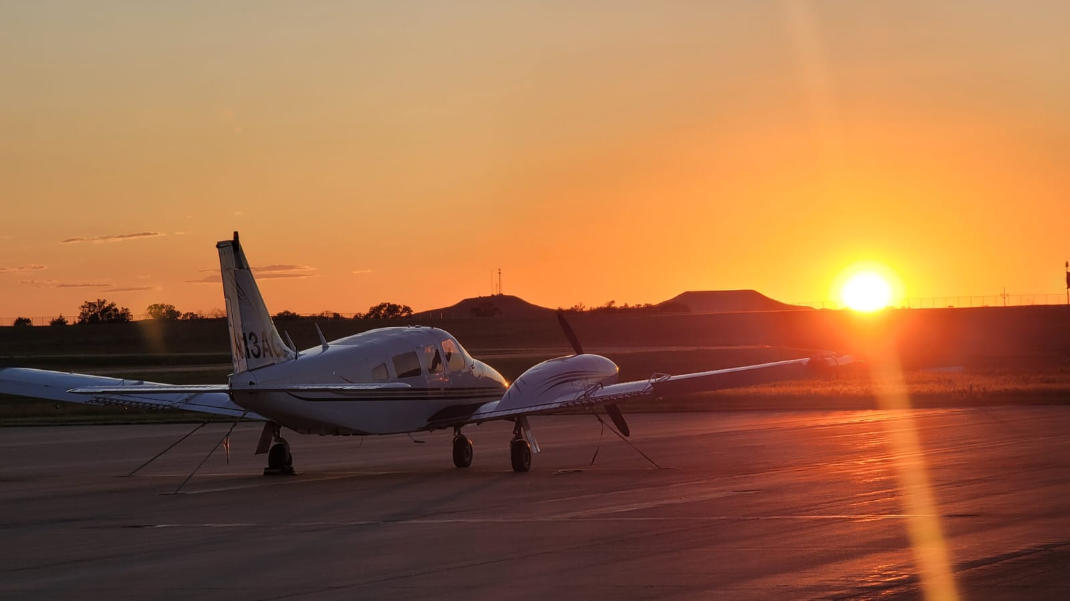
Thank You!
Questions?

