Slide 1
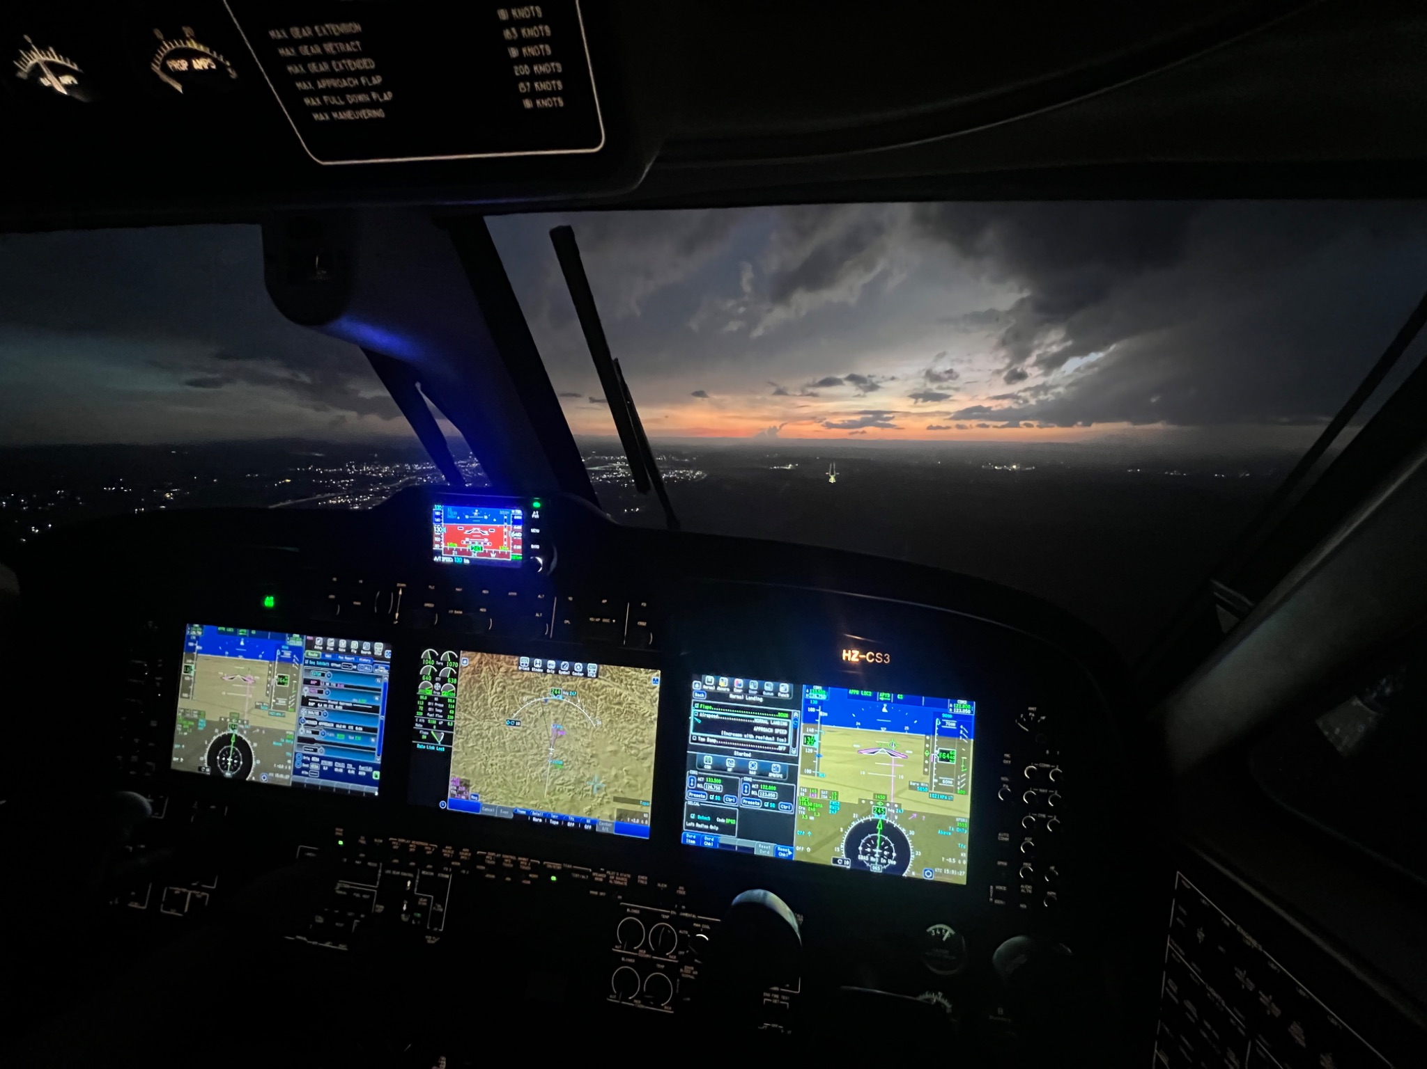
Flight Safety in Weather Modification Operations
Flight Safety in Weather Modification Operations

Slide 2
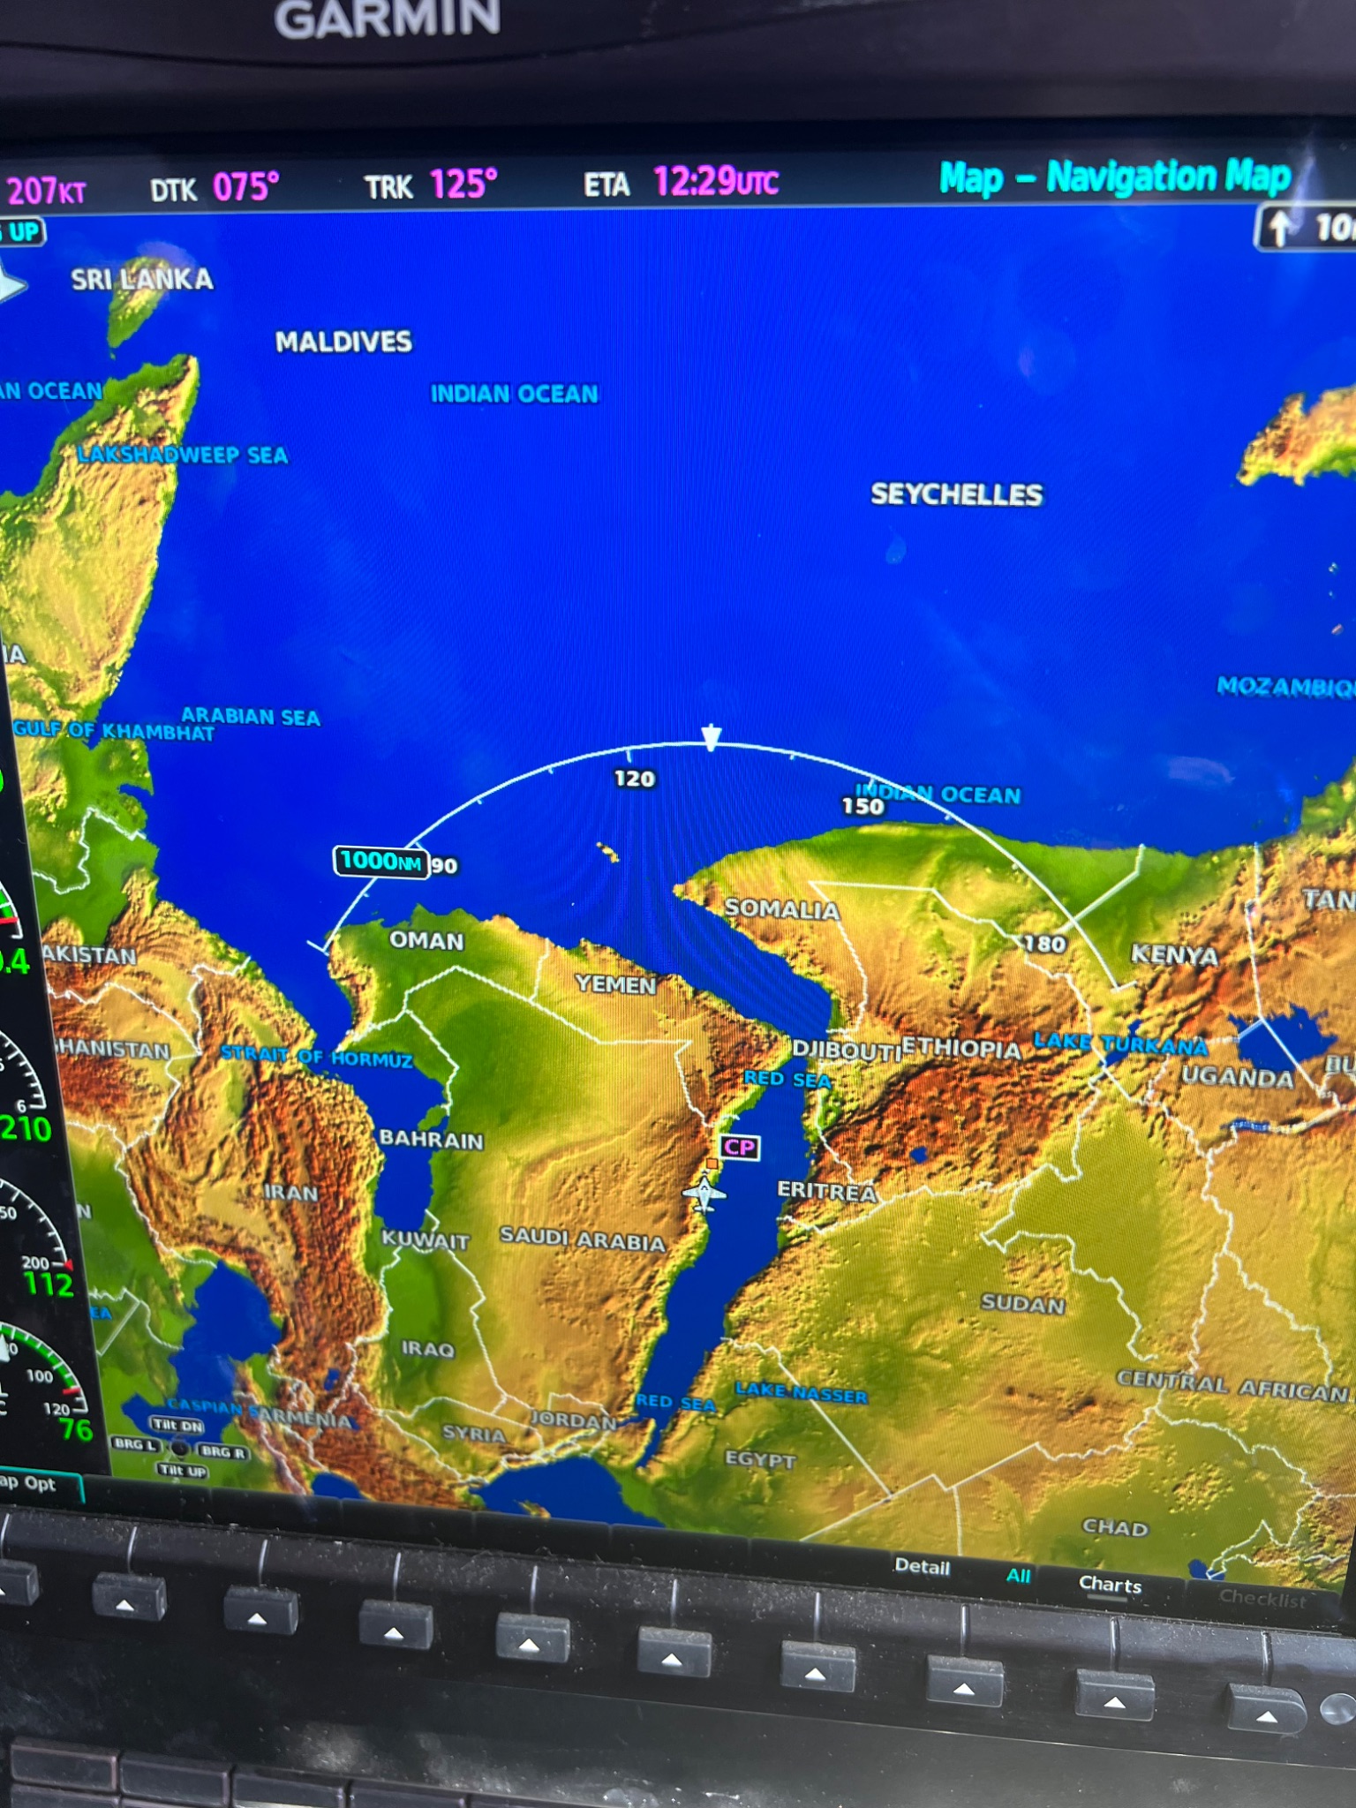
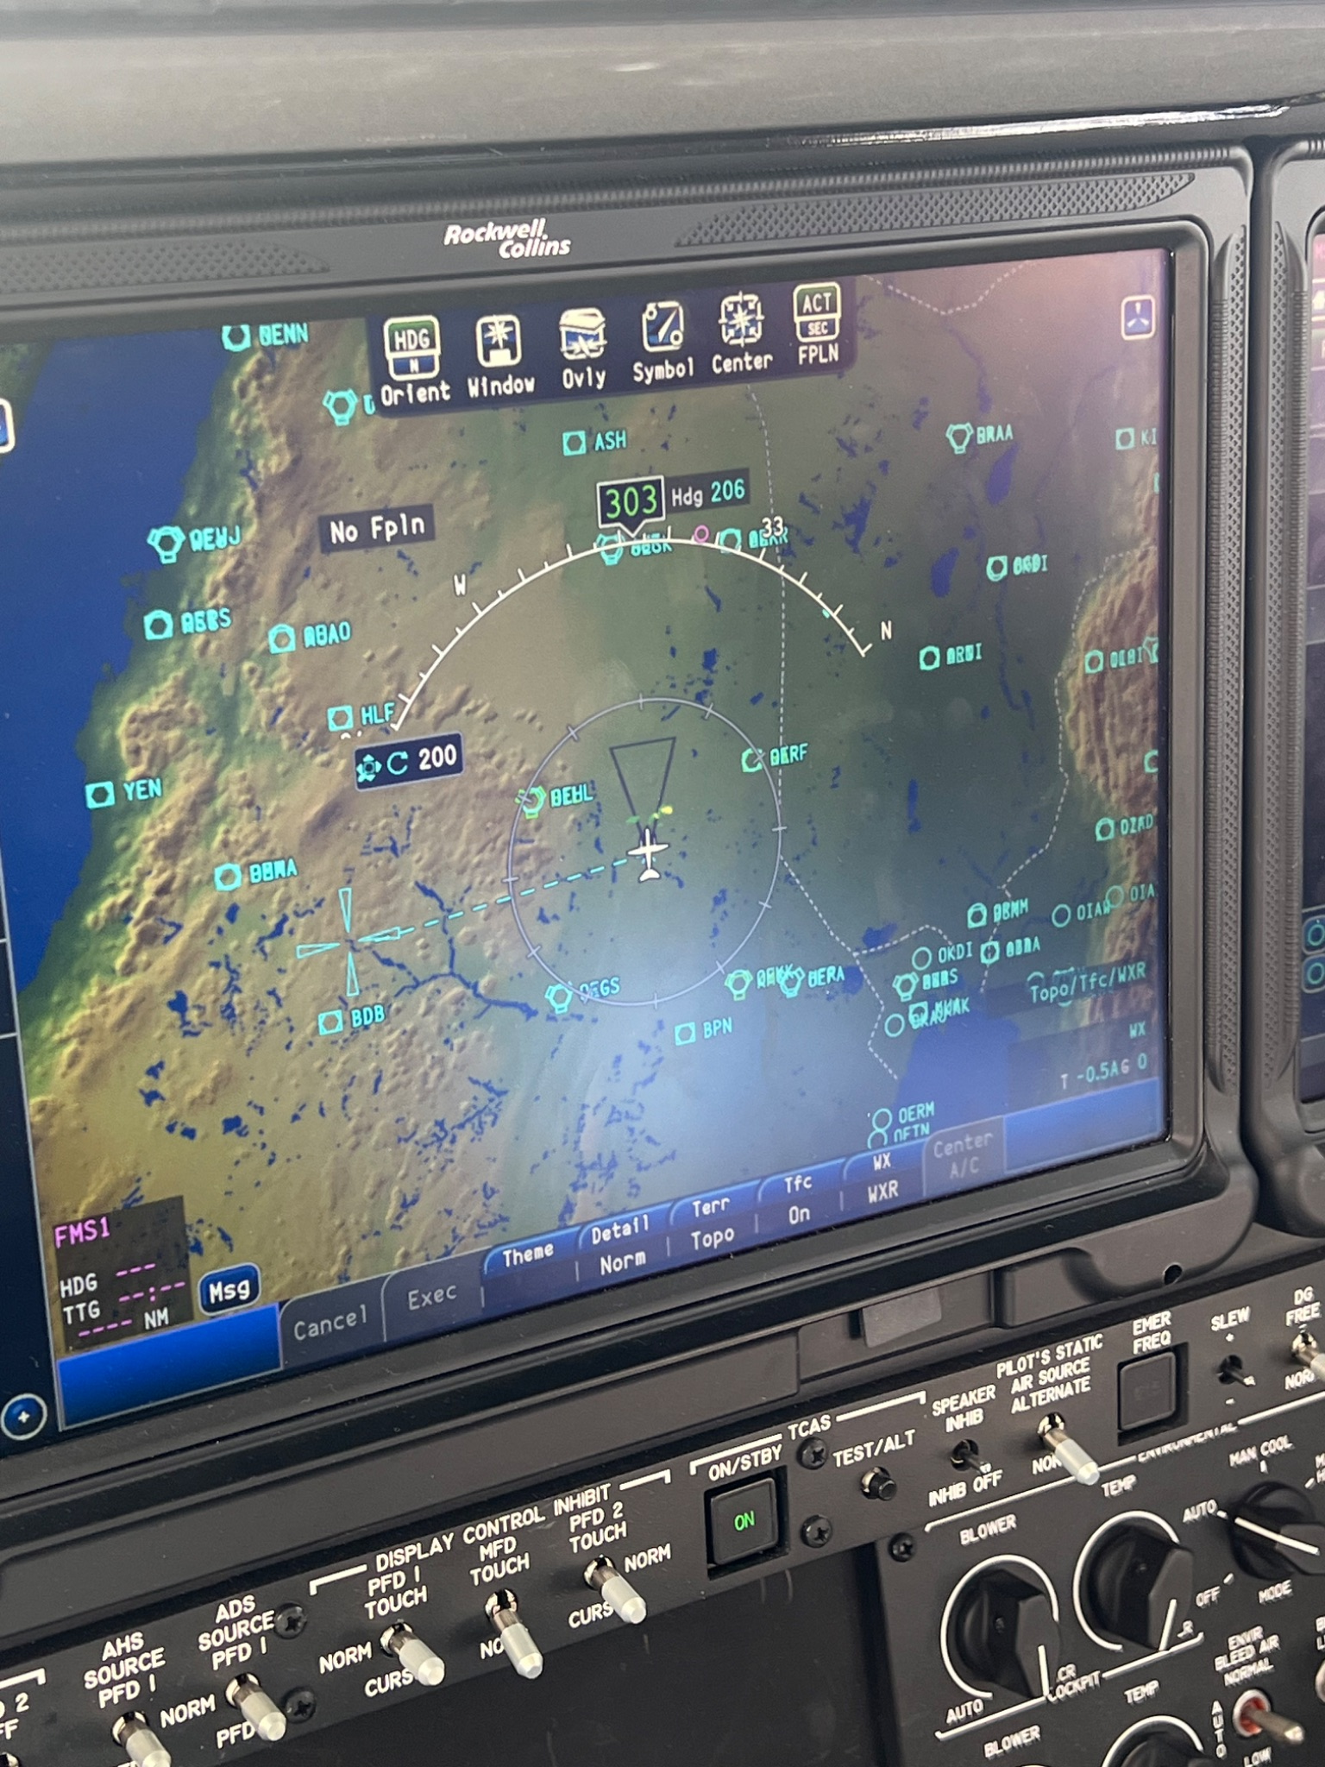
Key Flight Segments
Flight Planning
Departure
En-route
Seeding Considerations
Landing
Notes:
Talk about the location for flying in these picturesd

Slide 3
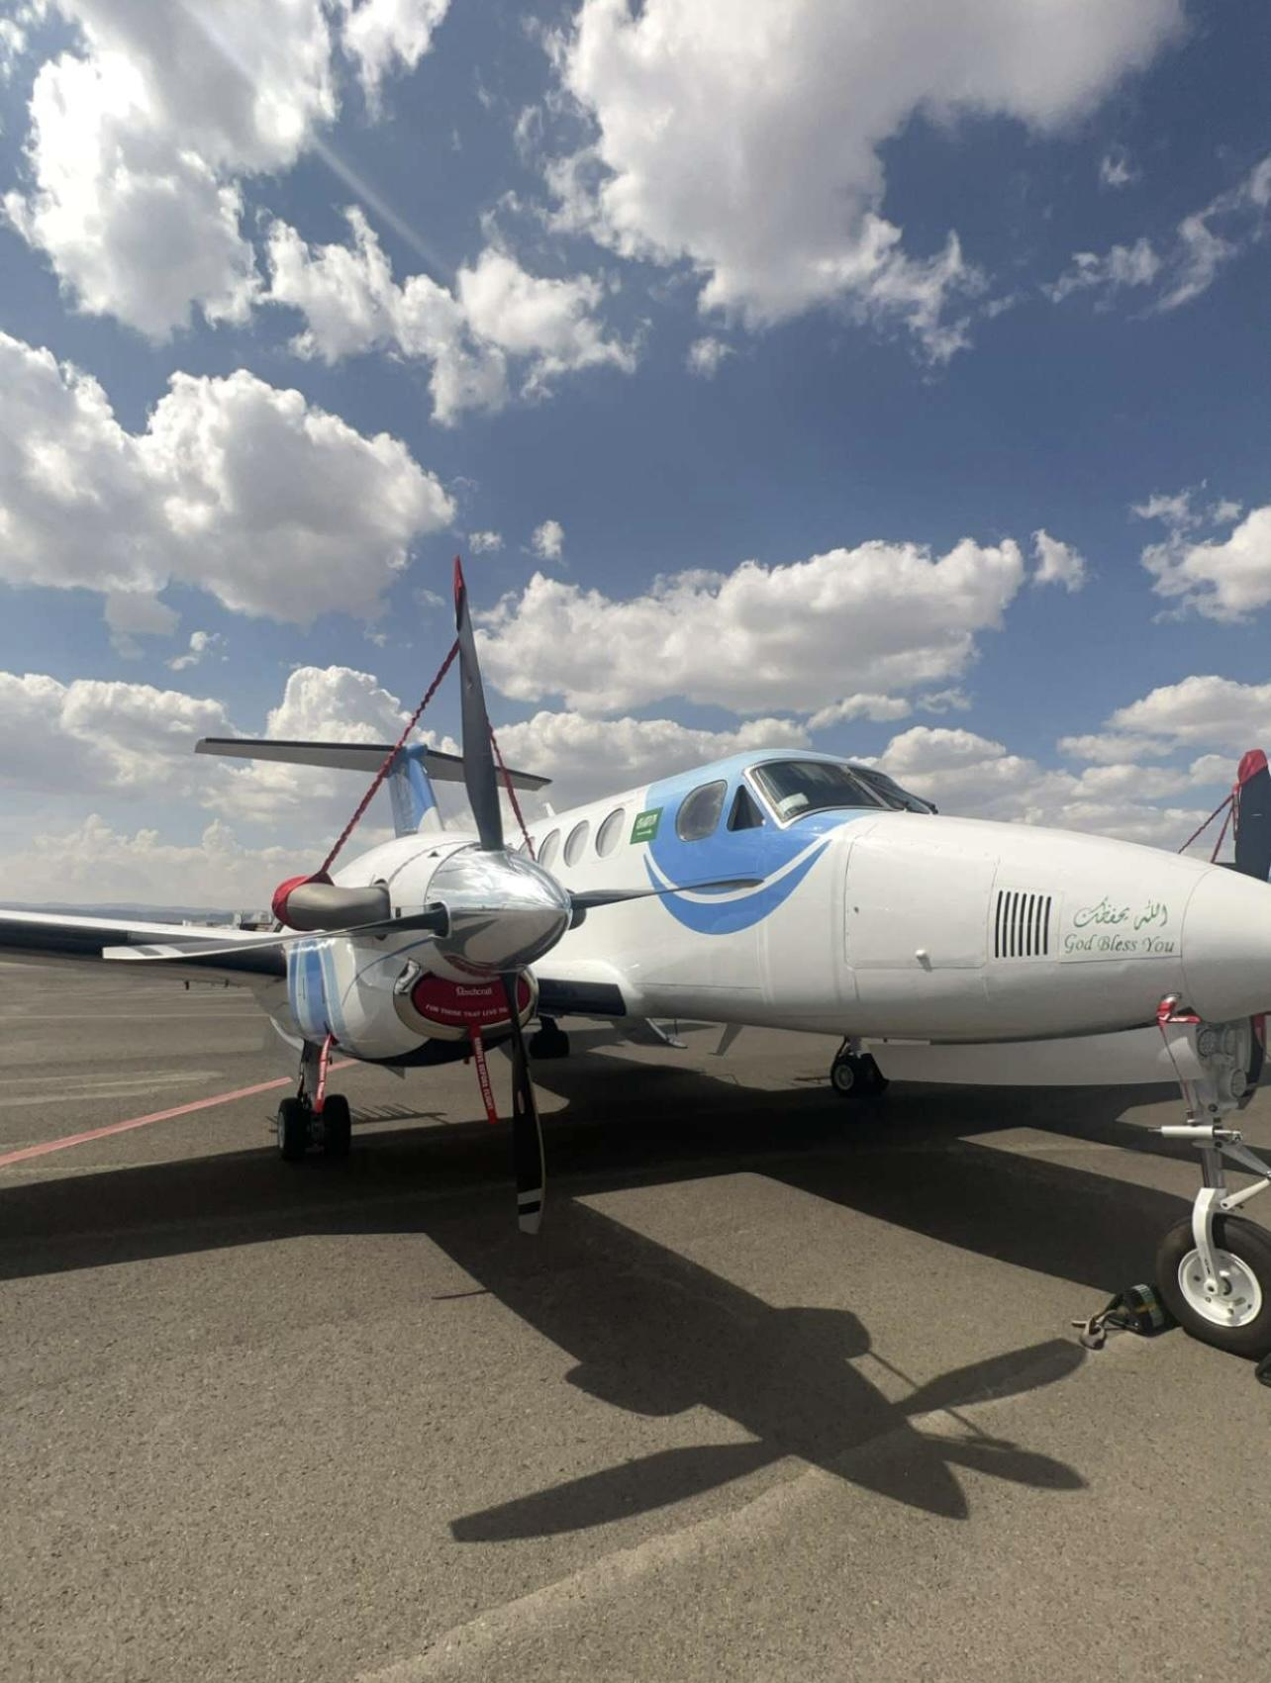
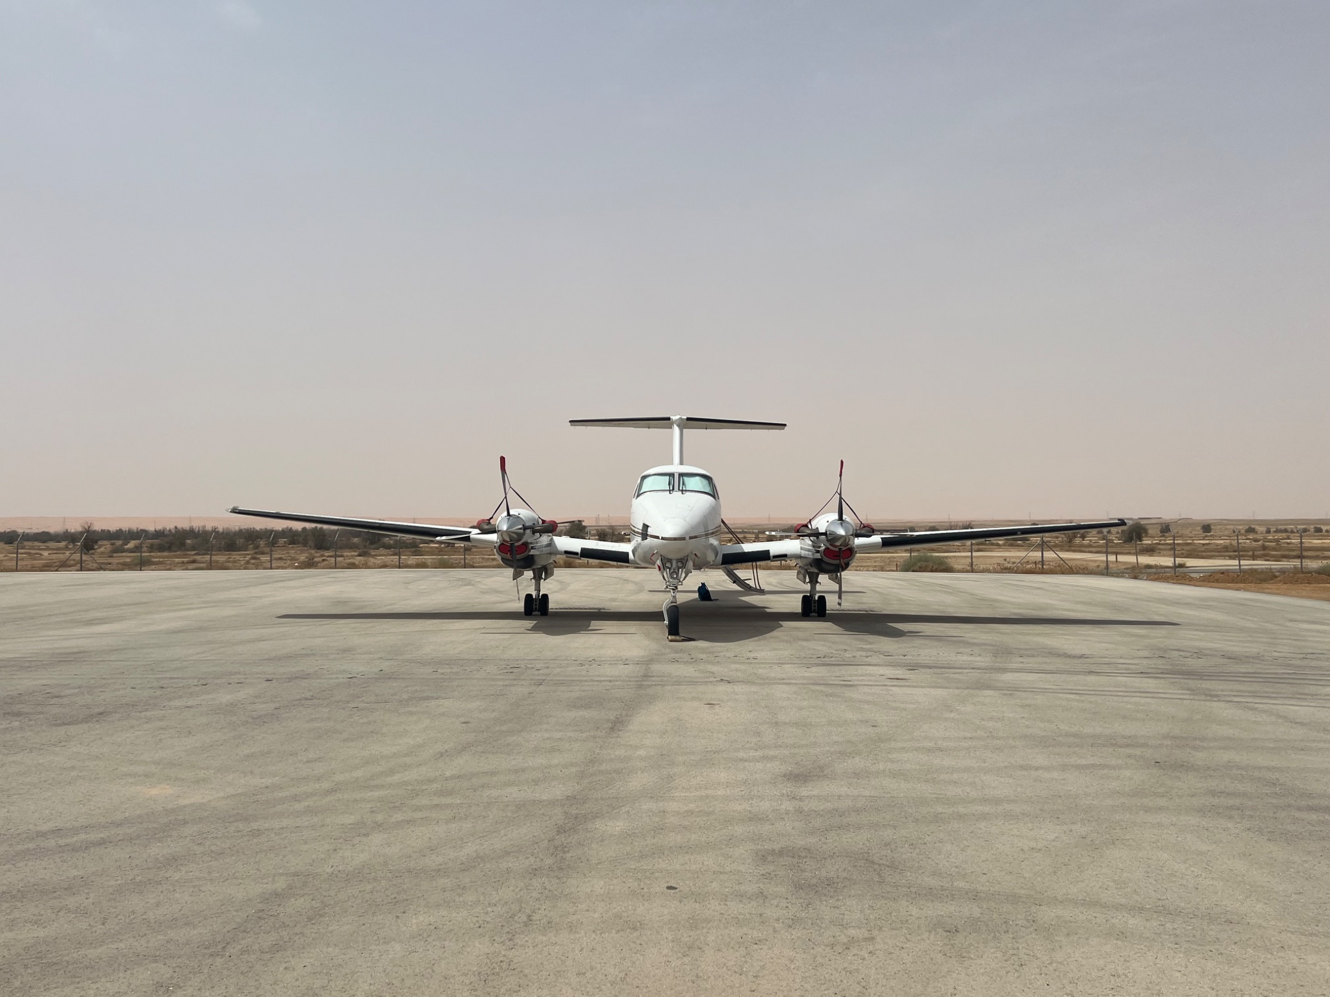
Flight Planning
Know your Airplane
Capability
Airworthiness
Serviced
Supplies
Cockpit
Notes:
Airfraft is tilted on the right picture from improper fuelling

Slide 4
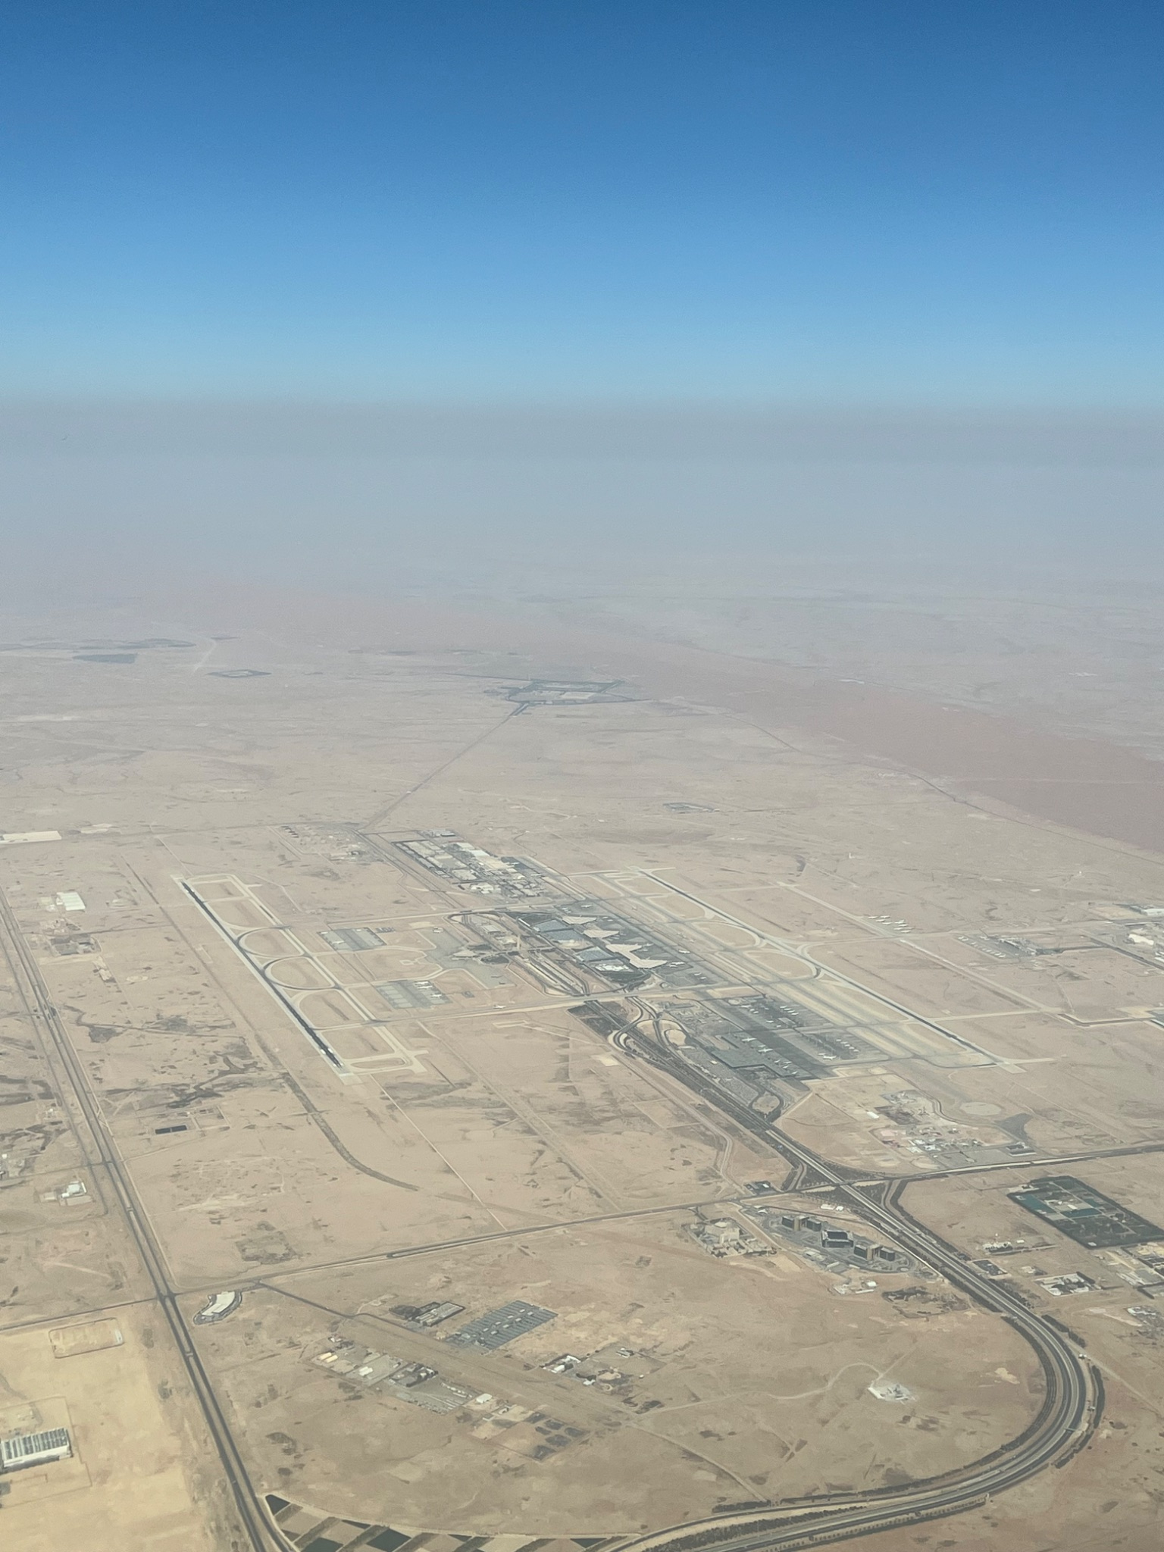
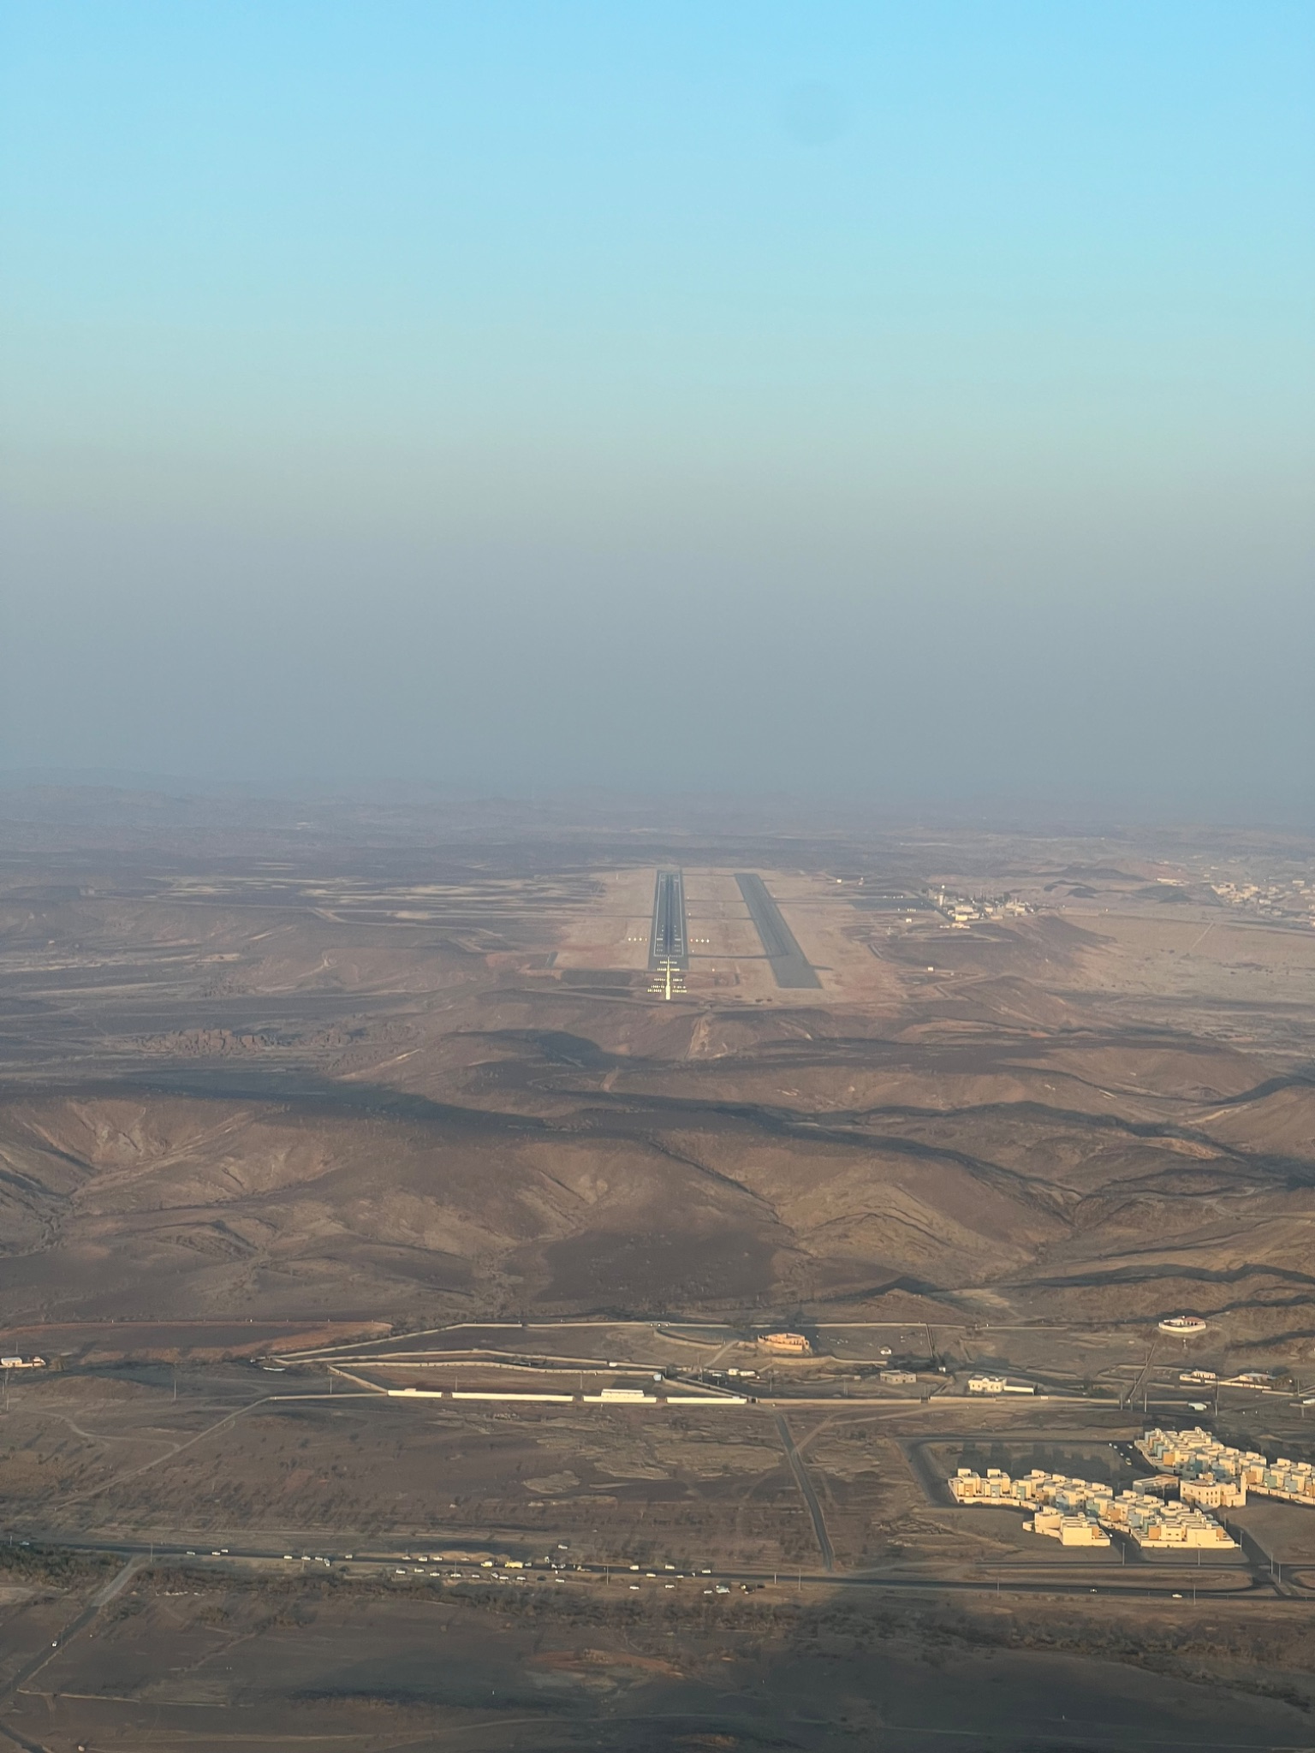
Flight Planning
Know Your Airports
Alternates VFR/IFR
Approaches
Lighting
Notes:
note the large runways in saudi and the long distances for alternates

Slide 5
Flight Planning
Know Your Atmosphere
Stability
Winds
Storm Motion
Off-field Landing Options
Forecast
Duration, Coverage, Intensity

Slide 6
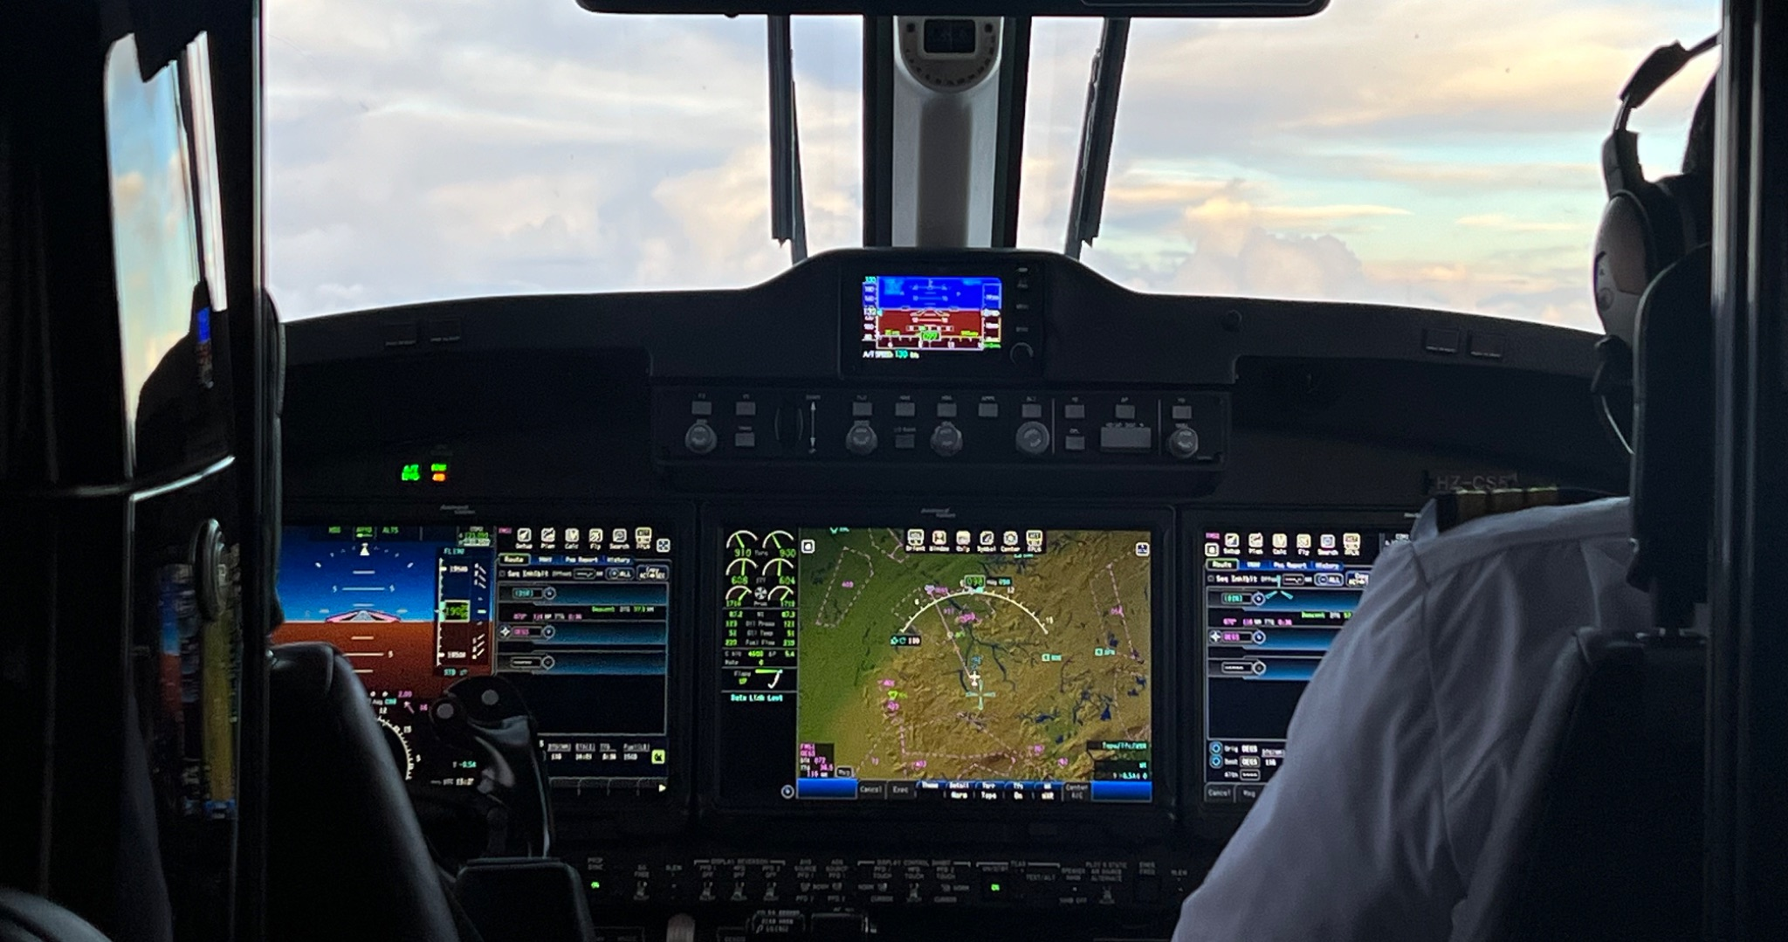
Flight Planning
Know Yourself
Physiology
Are you safe to fly?
Limitations
What are your personal minimums?
Notes:
Night seeding in the US can make proper rest times difficult. Saudi it is easy

Slide 7
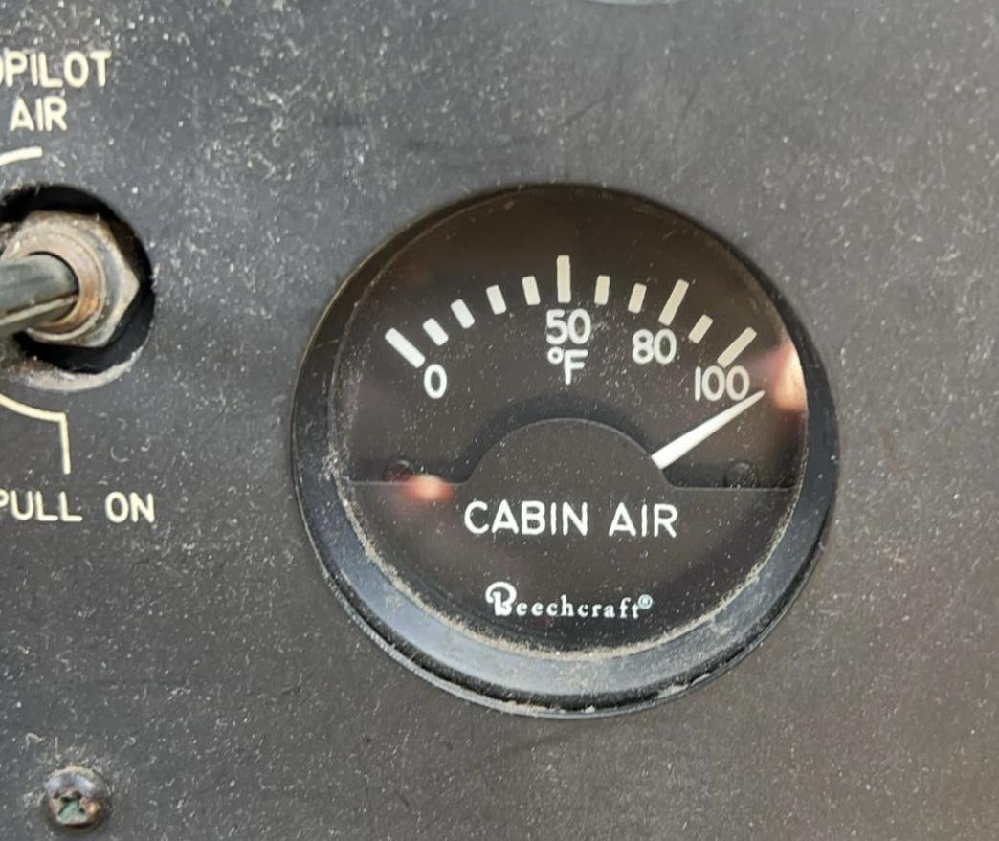
Flight Takeoff and Landing
Weather
Primary hazard is low level wind shear due to:
Gust fronts
Micro-bursts
High temperature runway requirements.
Airport
Lights
Obstructions
Notes:
Hot air considerations. 49C (120F) takeoff, max temp, hot cabin air.

Slide 8
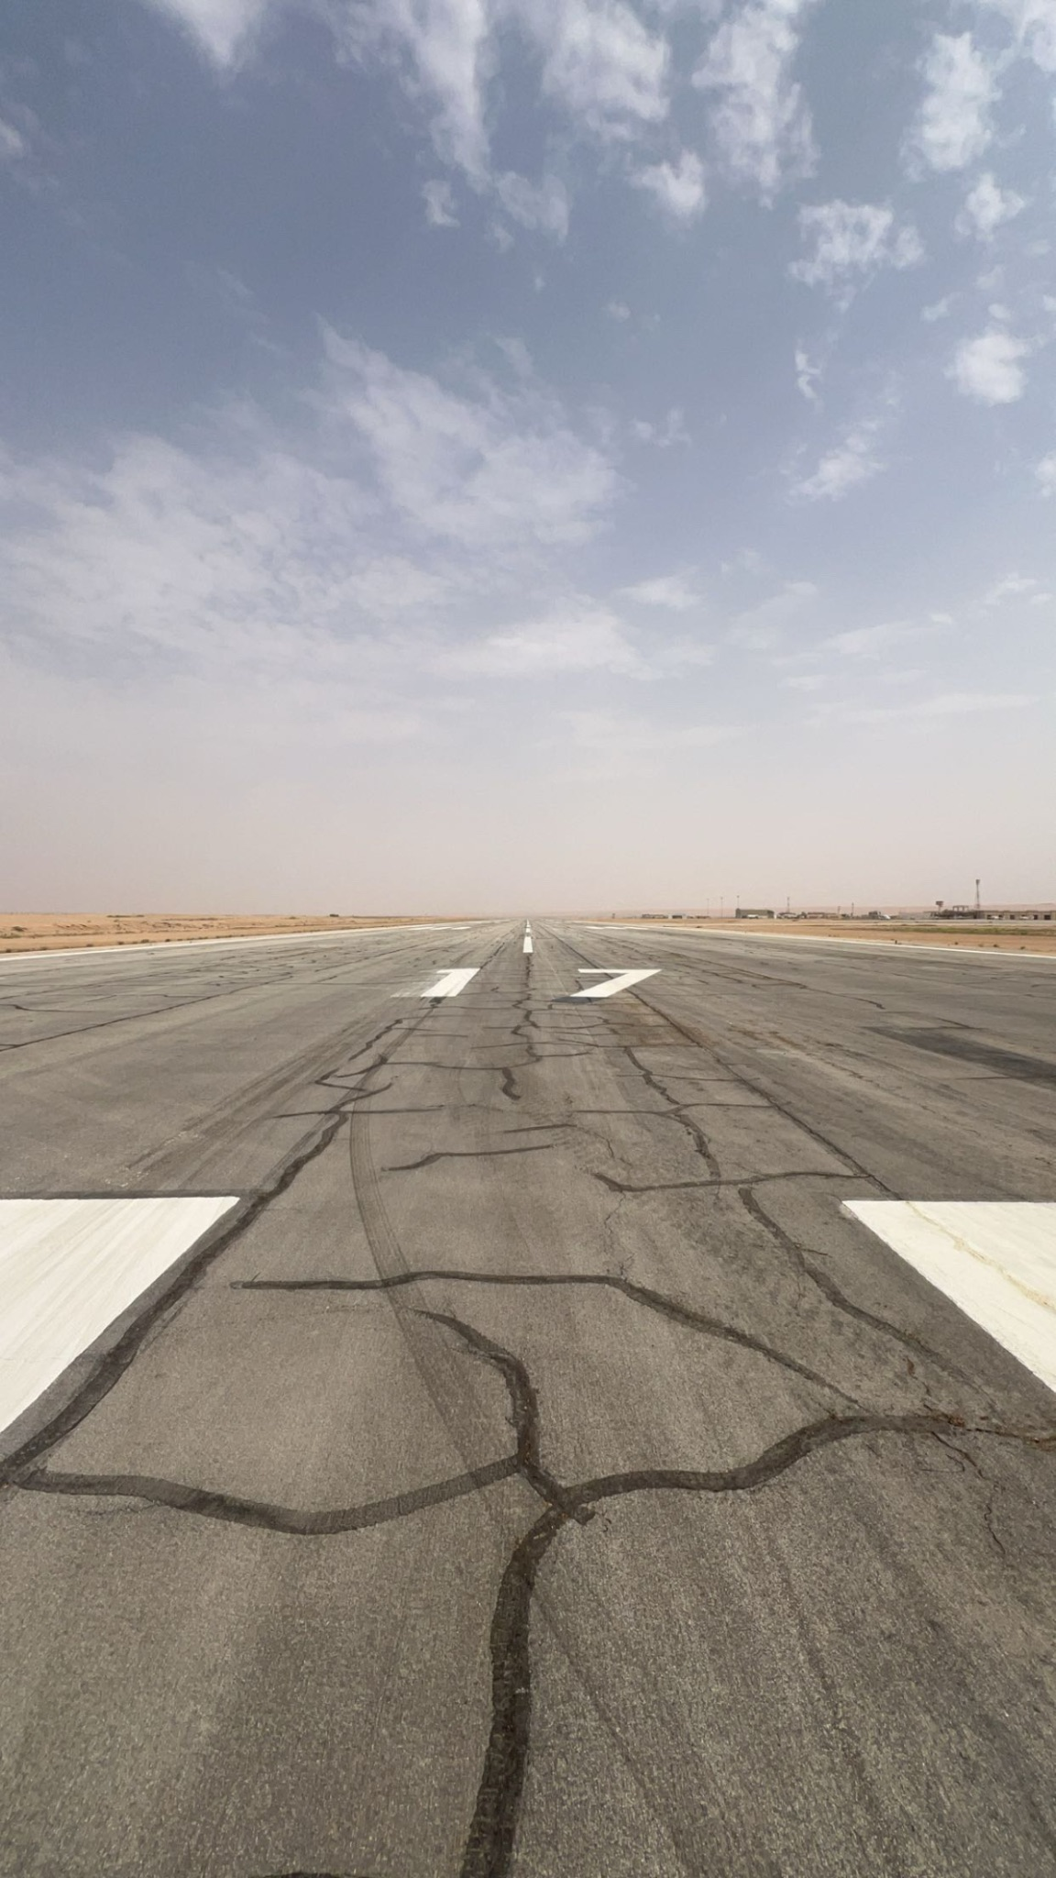
Flight Departure
Main hazard is low level wind shear due to:
Gust Fronts
Micro-bursts
High temp rwy requirement.
Notes:
long runways here

Slide 9
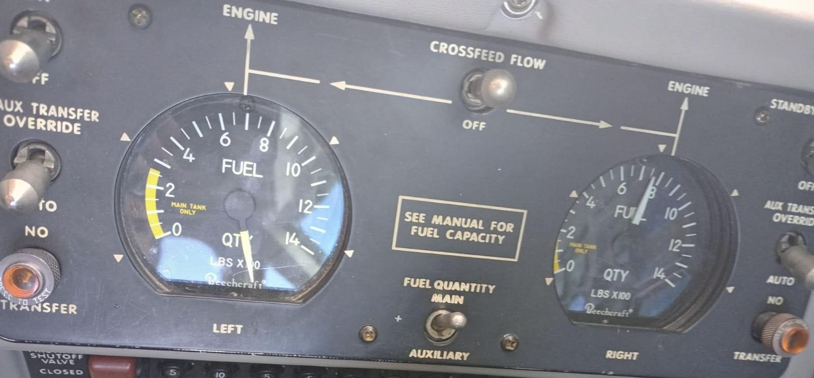
On Station
What is going to happen?
What is the forecast?
What do your eyes tell you?
What is the timing?
What is overall picture?
Projection for your aircraft operations.
Notes:
fuel gauge problem, need to know your aircraft so you are aware of the fuel load you have.

Slide 10
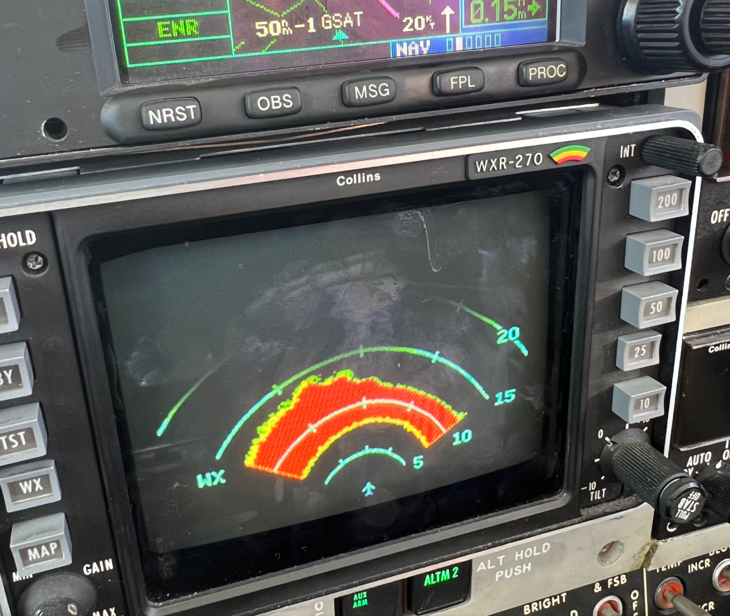
On Station
Where am I?
Storm Reference
Target Area Reference
Other Aircraft
Clearances
Notes:
Onboard weather radar is helpful but it can let you down

Slide 11
On Station
What is happening?
Weather Trend
Visual (Tops, Bases, Outflows, Lightning)
Radar
Communications
Below-base Conditions
Scud, Inflow Strength, Cloud Base Features

Slide 12
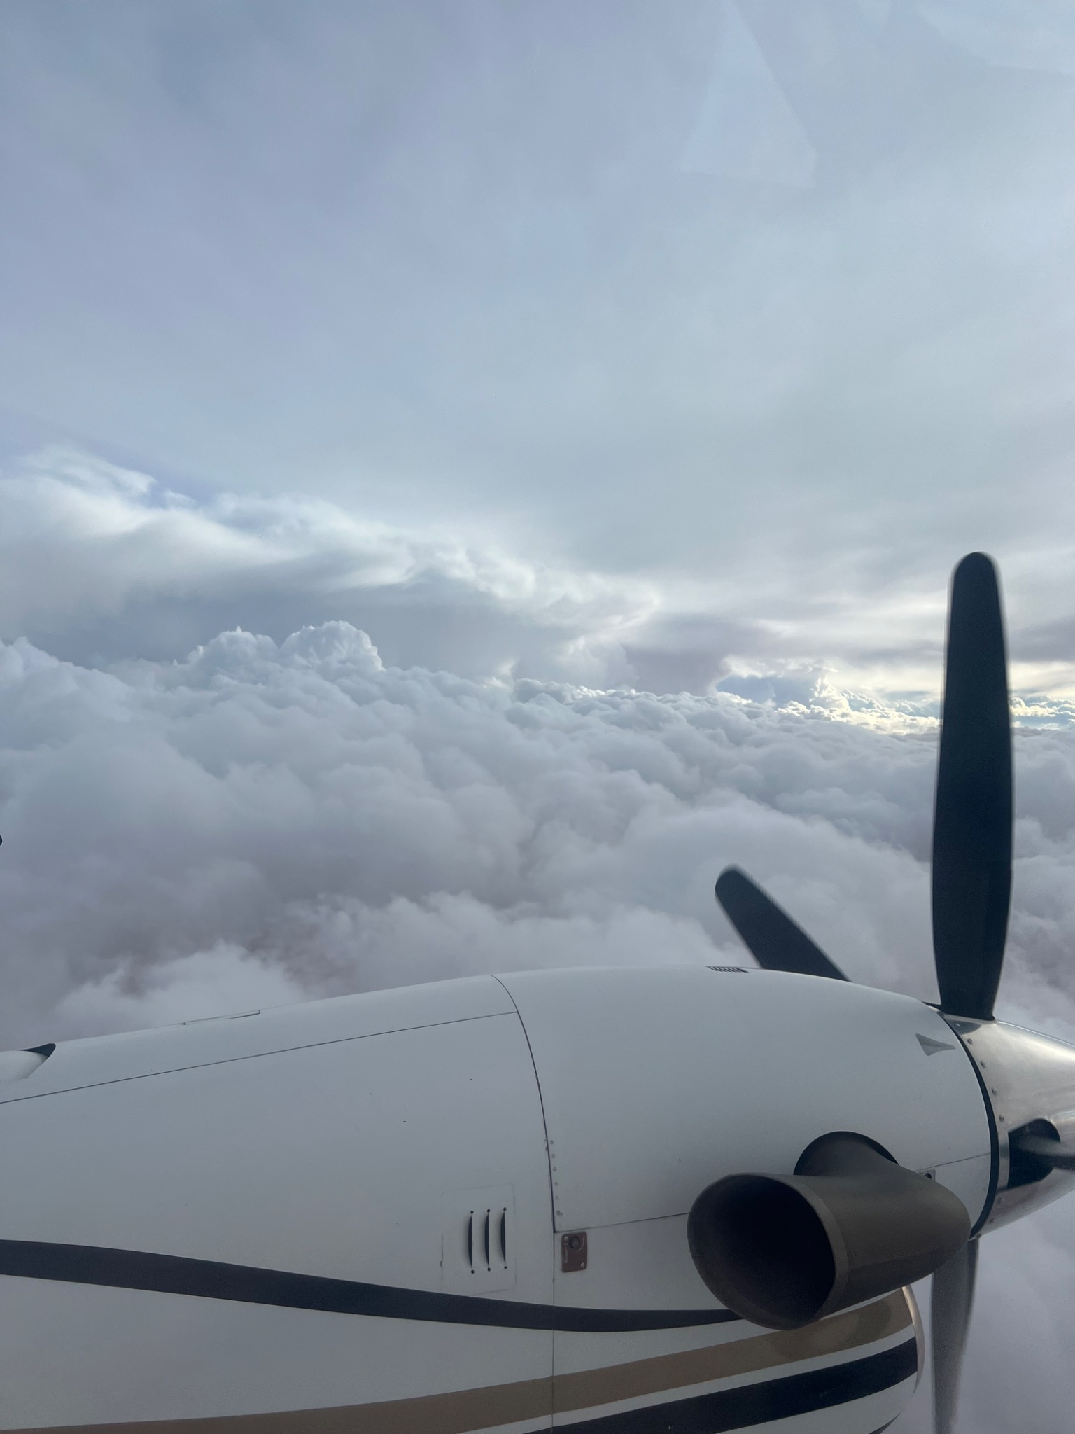
On Station – Where is the OUT
Bail-out Heading
Radar Help
Notes:
How to work with the mets and your own resources on where to find an out in messy conditions

Slide 13
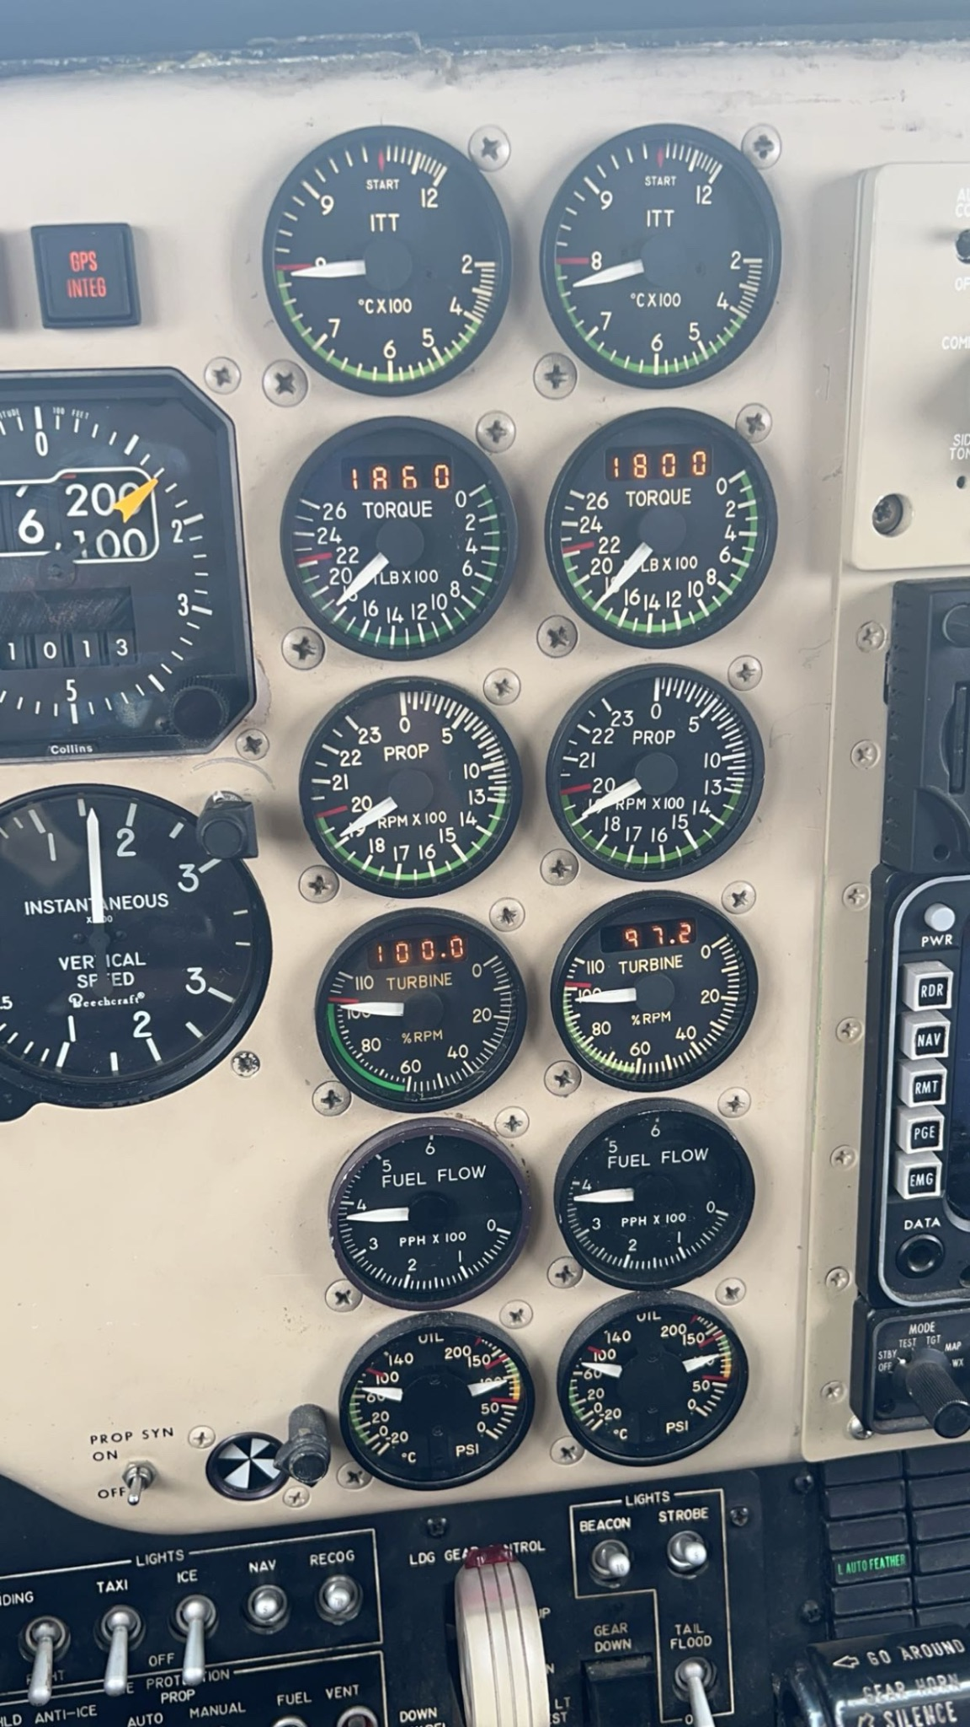
Flight Operations
Emergency Procedures
FLY THE AIRPLANE
Gather Facts
Go to Bail-out Heading
Communicate
Leave power alone.
Need two of the following:
Altitude
Airspeed
Ideas
Notes:
Power is maxed out on the left engine and near on the right, you don’t have an unlimited amount of power to save yourself so be careful where you go. Can talk about a gear failure I had in Riyadh

Slide 14
Flight Operations – Top Seeding
Maintain attitude and watch airspeed.
Don’t penetrate without knowing what’s on the other side.
Generally penetrate perpendicular to the shear.
Test the cloud edge if in doubt.
Turn on anti-ice before penetration.
If props ice up, change revolutions per minute (RPM).

Slide 15
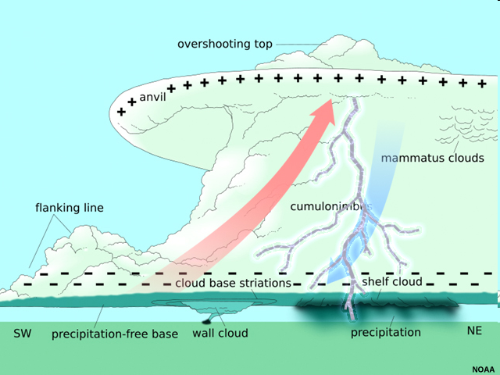
Flight Operations – Base Seeding
Don’t get sucked up.
Beware of lowering bases.
Avoid outflow boundaries, back side of storm.
Watch for other aircraft.
Where is the back side of the storm?

Slide 16
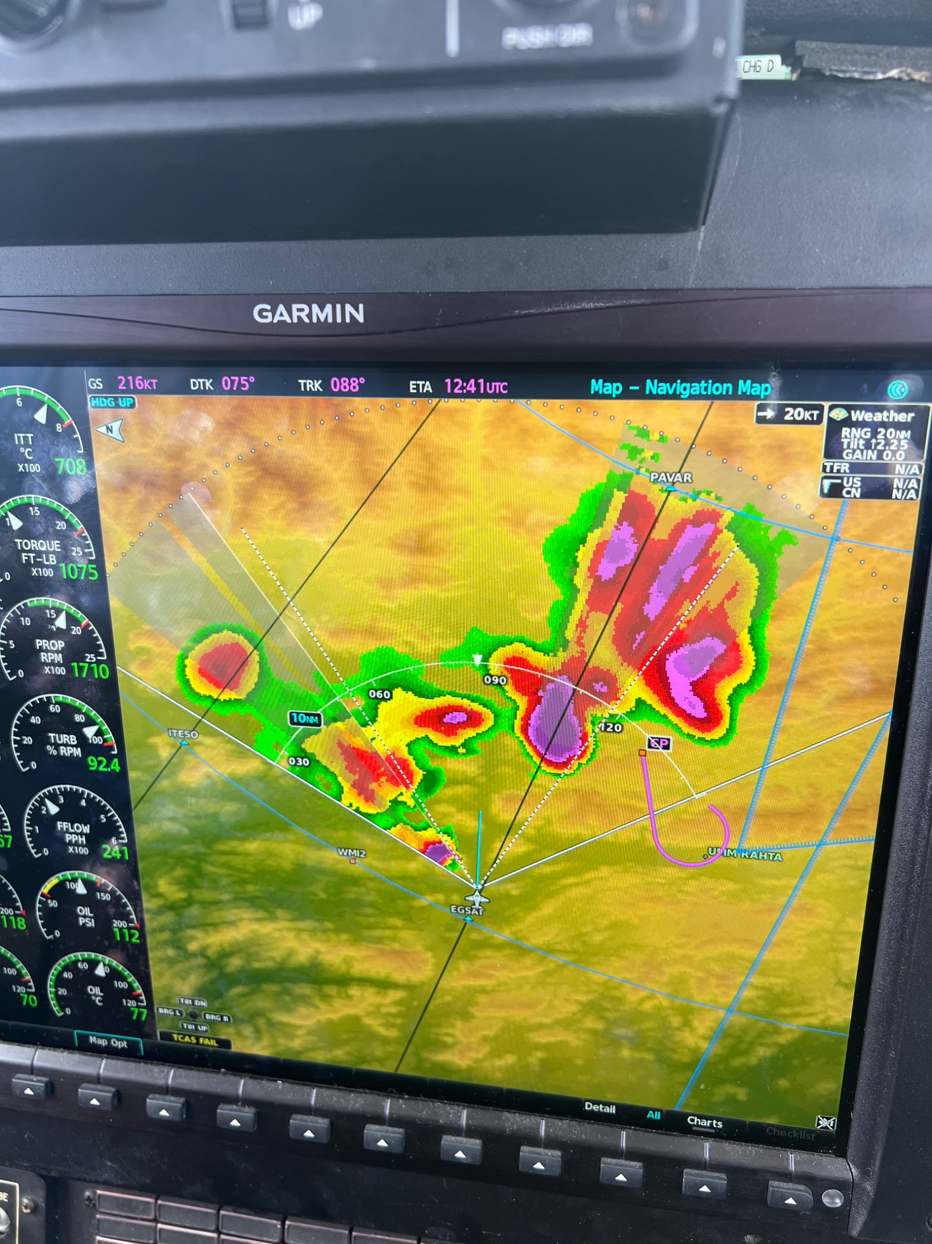
Flight Operations
Use on-board radar.
Be careful about penetrating storm with cloud tops greater than 30,000 ft.
Do not fly through reflectivities more than 50 dBz.
Do not ever fly toward a radar shado
Notes:
How to use onboard weather radar. Embedded seeding techniques as well

