Slide 1
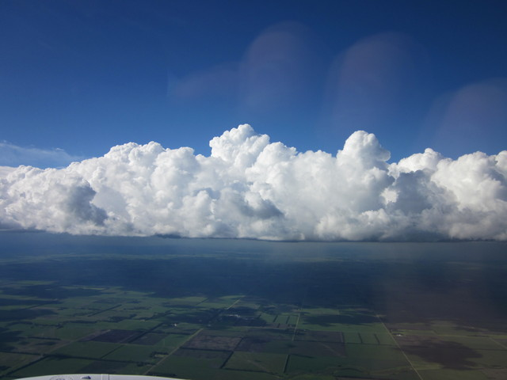
Opportunity Recognition & Seeding Methods

Slide 2
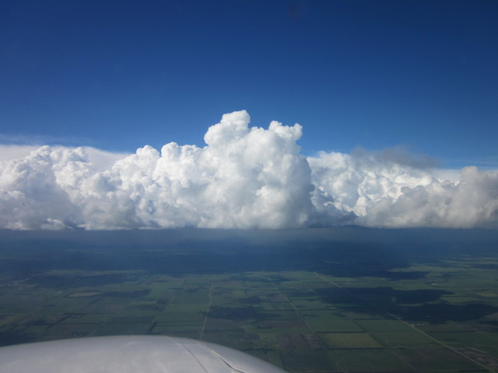
Operational Program Outline
Seeding Opportunity
Cloud Structures
Seeding Criteria
Delivery Techniques
Seeding Procedures
Strategy

Slide 3
Opportunities to Conduct Cloud Seeding
Operational Program
Seed all Possible Opportunities
Produce Maximum Effect
Pilot’s Primary Job
Recognize Opportunity
Deliver Seeding Material
Right Amount
Right Time
Right Place
What makes a seedable cloud?
Depends on the hypothesis.

Slide 4
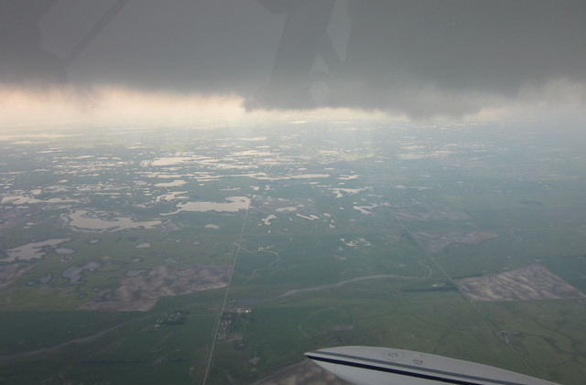
Rain Increase Cloud Seeding Opportunity
Liquid Water
Updraft
Lack of Ice
Cloud Bulk
Cold Cloud
Low Bases

Slide 5
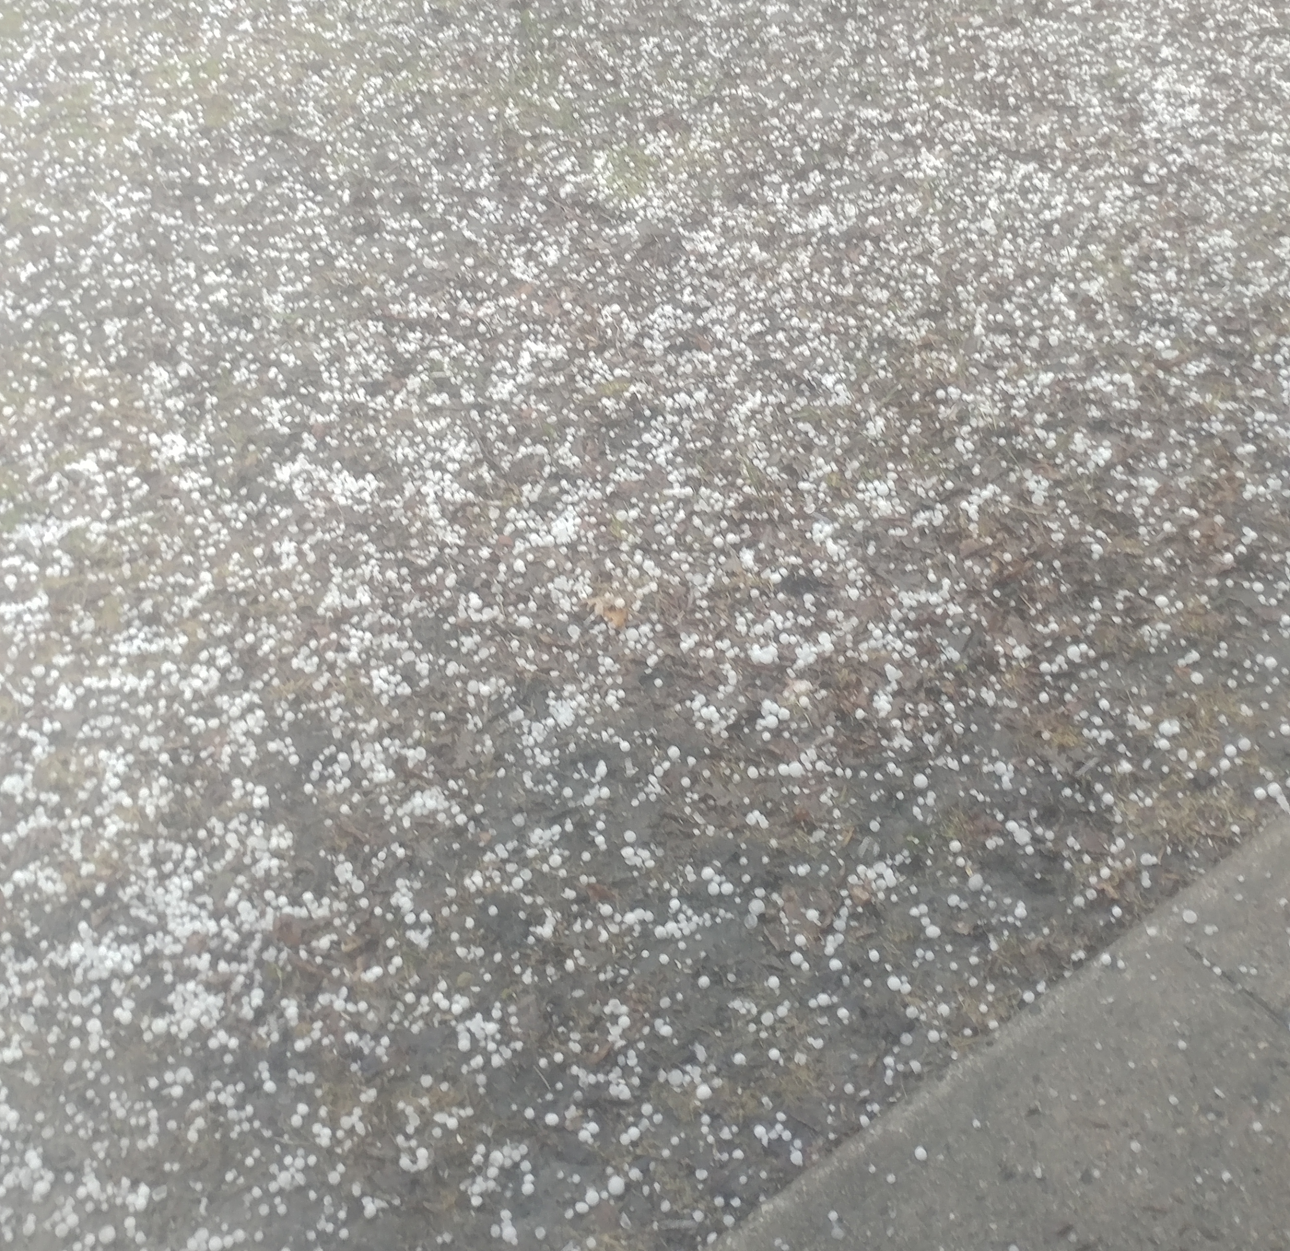
Hail Suppression Cloud Seeding Opportunity
Very strong updrafts.
High liquid water content.
High radar reflectivity or hail forecast.
Occur in a very unstable atmosphere.

Slide 6
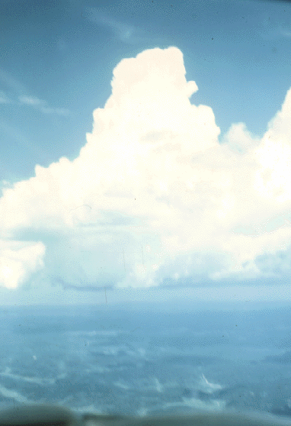
Rain Increase – Isolated Tcu- Single Cell
Visible Growth
“Hard” Tops
Solid Base
Depth of 6,000-8,000’ and Growing
Lifetime ~15 - 30 minutes
May, or May Not be sheared.

Slide 7
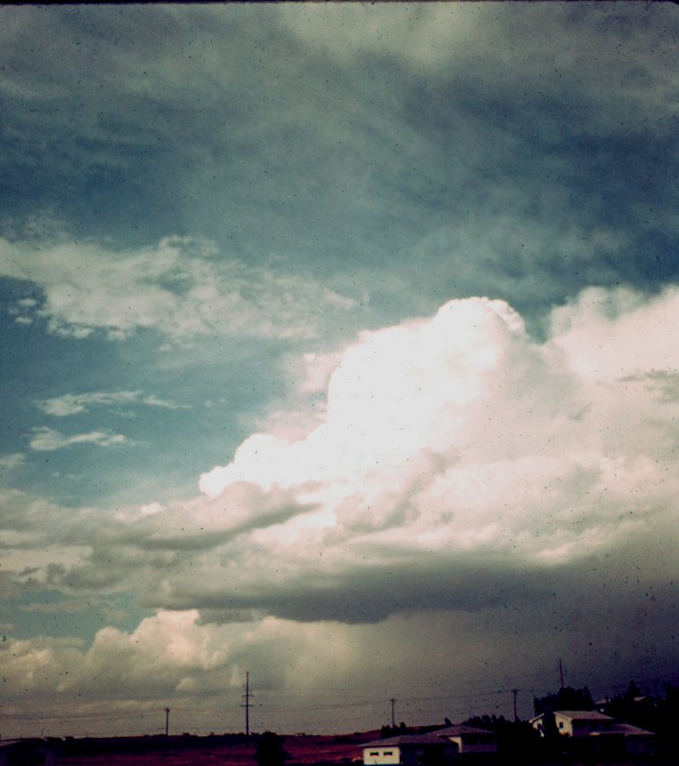
Rain Increase – Non-Severe Storm Complex
Multiple Cells, Updrafts
Cells Develop and Mature, with Precipitation
New Cells Develop Close to Mature and are Called “Feeder Cells”
Visible Growth of Turrets
Often Merge with Mature Storm

Slide 8
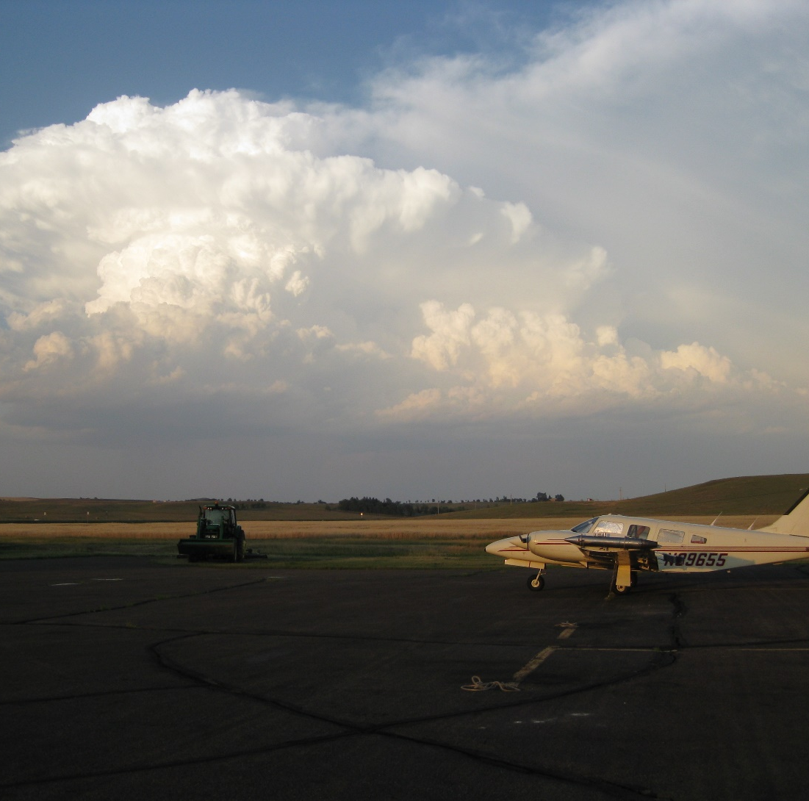
Hail Suppression – Multi-cell Storm
A stronger convective complex.
Cells build and merge with mature cell.
Feeders on side of low level flow, or feeders develop along convergence line.
Outflow may change location of inflow.

Slide 9
Hail Suppression – Squall Line Storm
Long Line of Multi-cell Storms
Inflow (new development) along Front of Line
Preceded by Cirrus Shield
May be Accompanied by Shelf, Roll, Pedestal Clouds
Inflow Weakens with Distance from Line
Inflow may be Marked by Scud Clouds

Slide 10
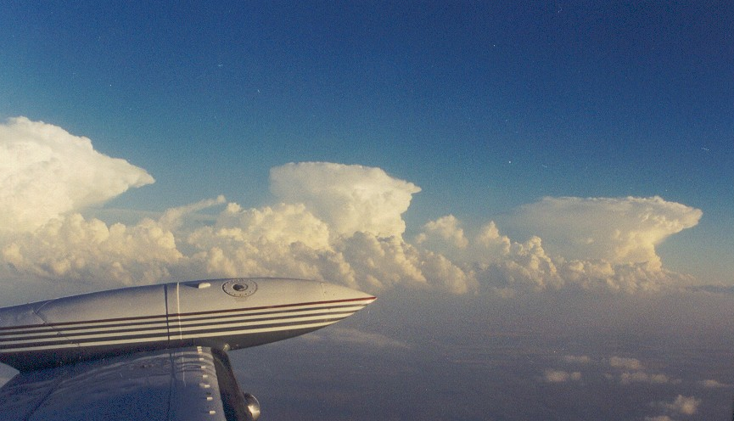
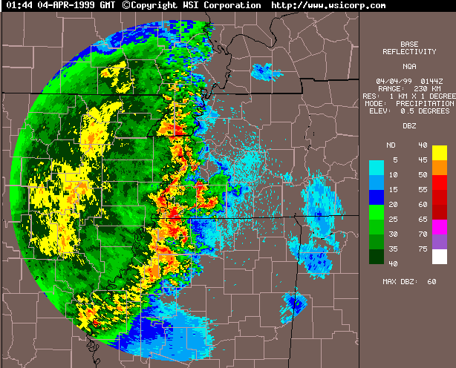
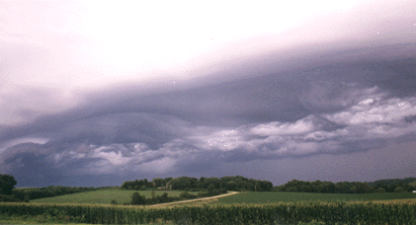
Cloud Structures – Squall Line Storm

Slide 11
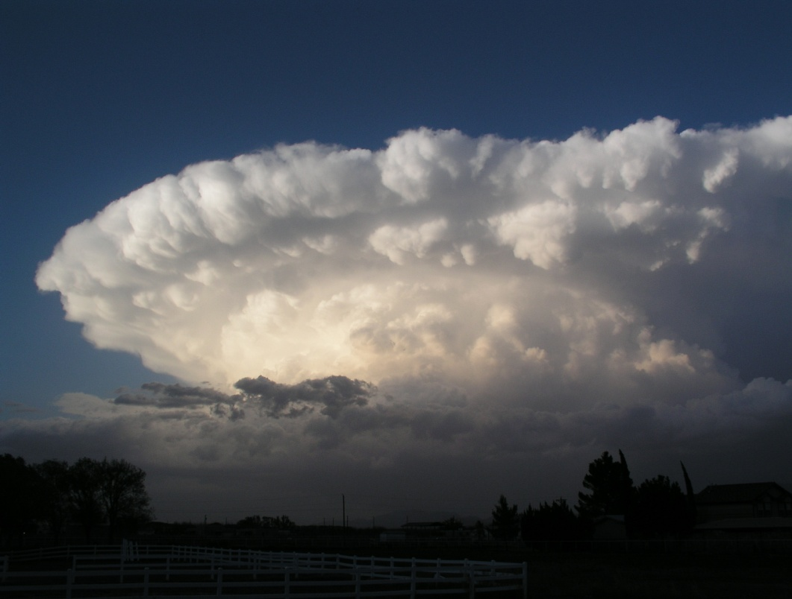
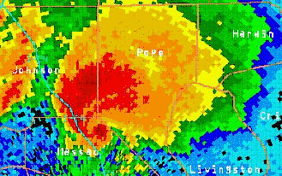
Cloud Structures – Supercell Storm
Steady-state
Shelf Cloud
Inflow in Front, on South Portions

Slide 12
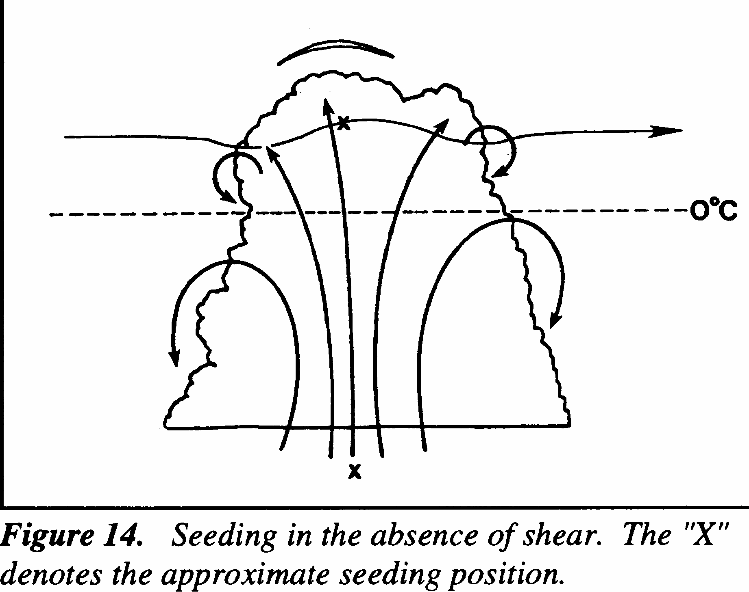
Rain Increase – Delivery Techniques
Best done at cloud top.
Fly at -5 °C to -10 °C.
Stabilize before penetration.
Look for updraft, liquid water.

Slide 13
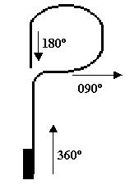
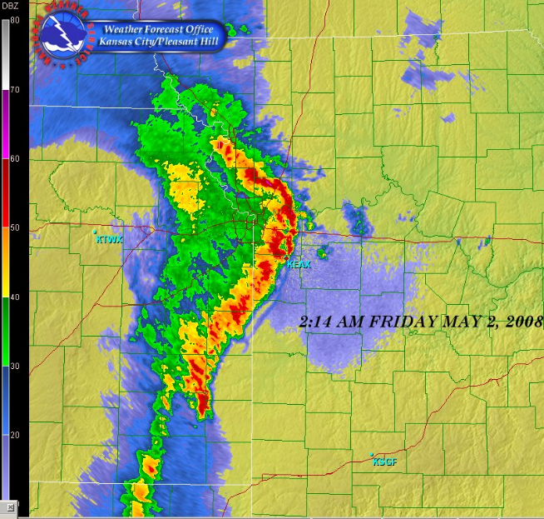
View Effects of Seeding (90/270 Turns)

Slide 14
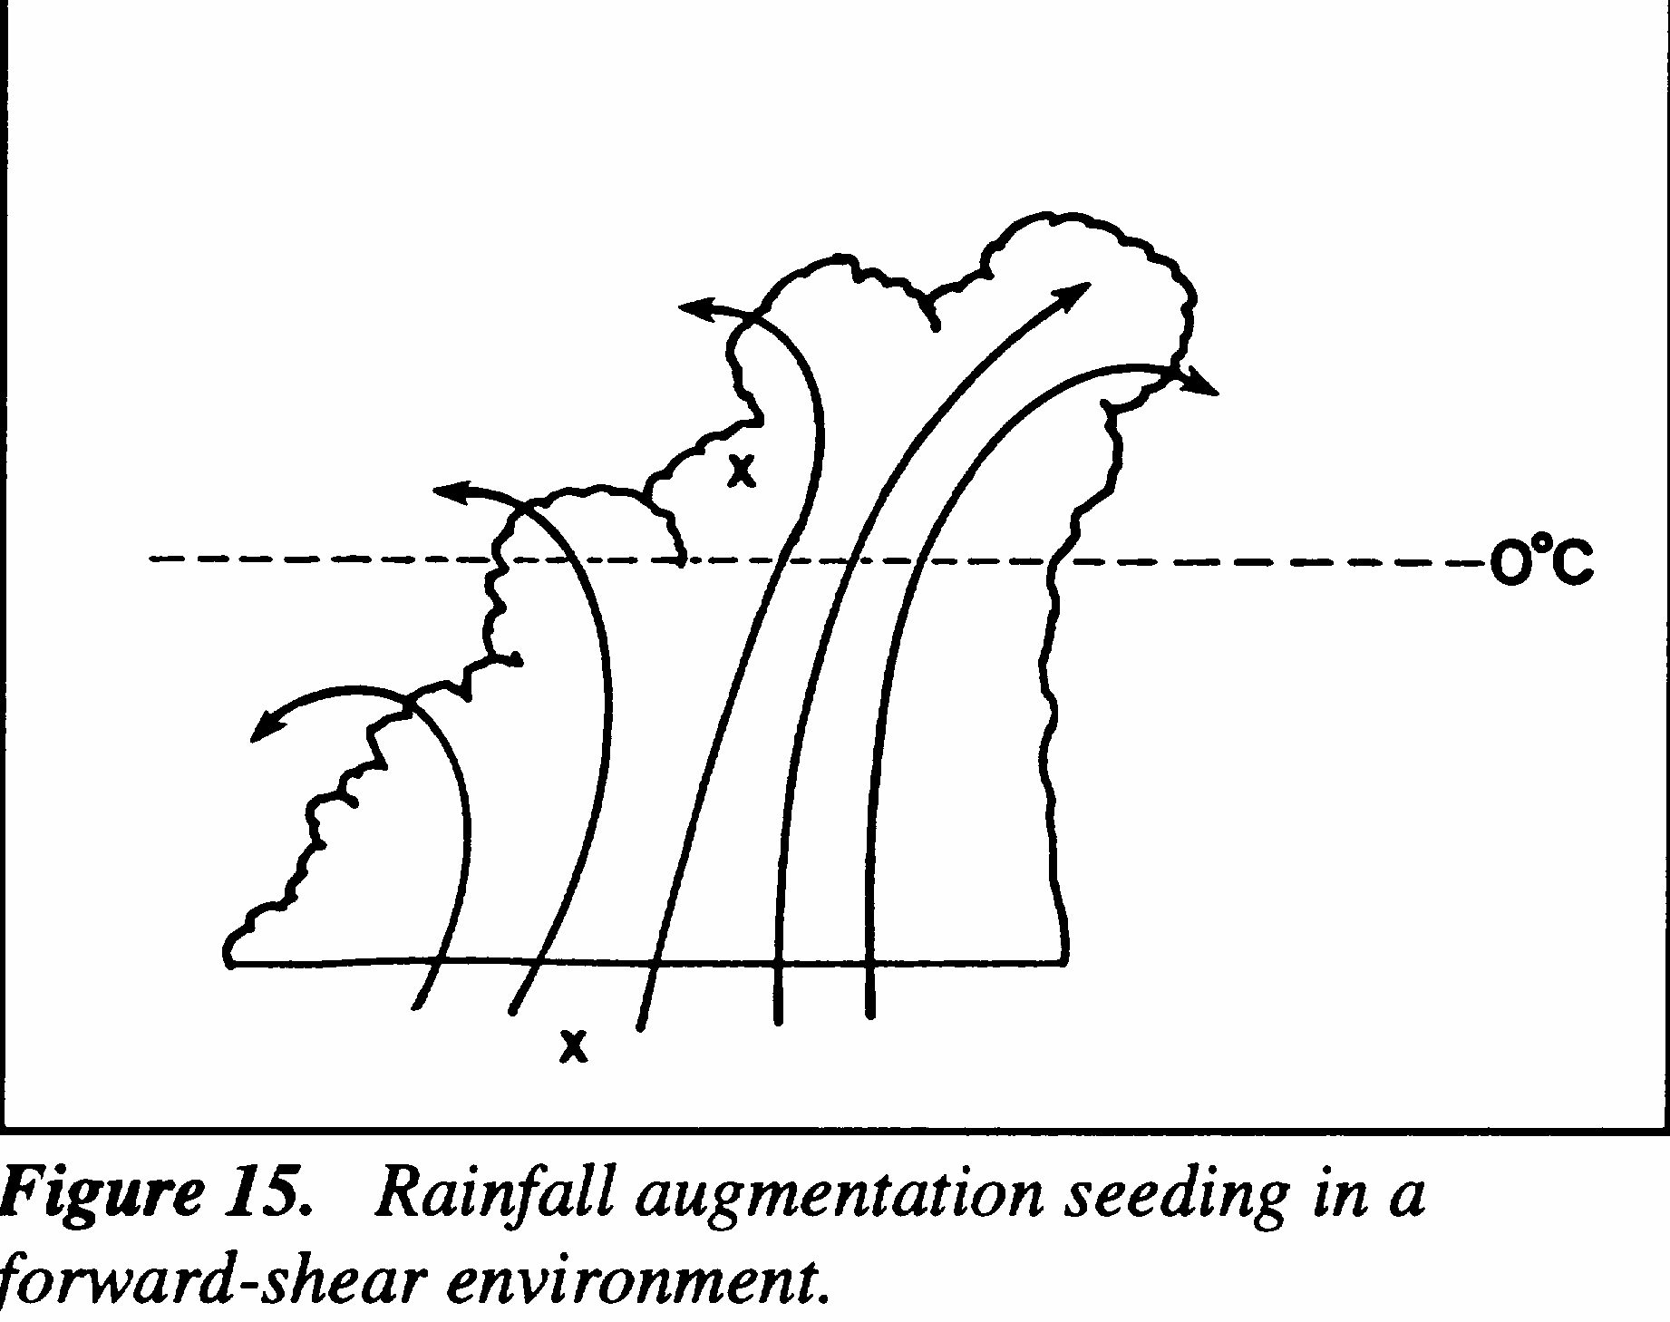
Multi-cell Storm – Delivery Techniques
Smooth, dark base.
500 ft below base.
Racetrack pattern.
500 fpm updraft.
Adjust power, configuration to hold altitude.
Back off if updraft increases.
Rainfall augmentation seeding in a forward-shear environment.

Slide 15
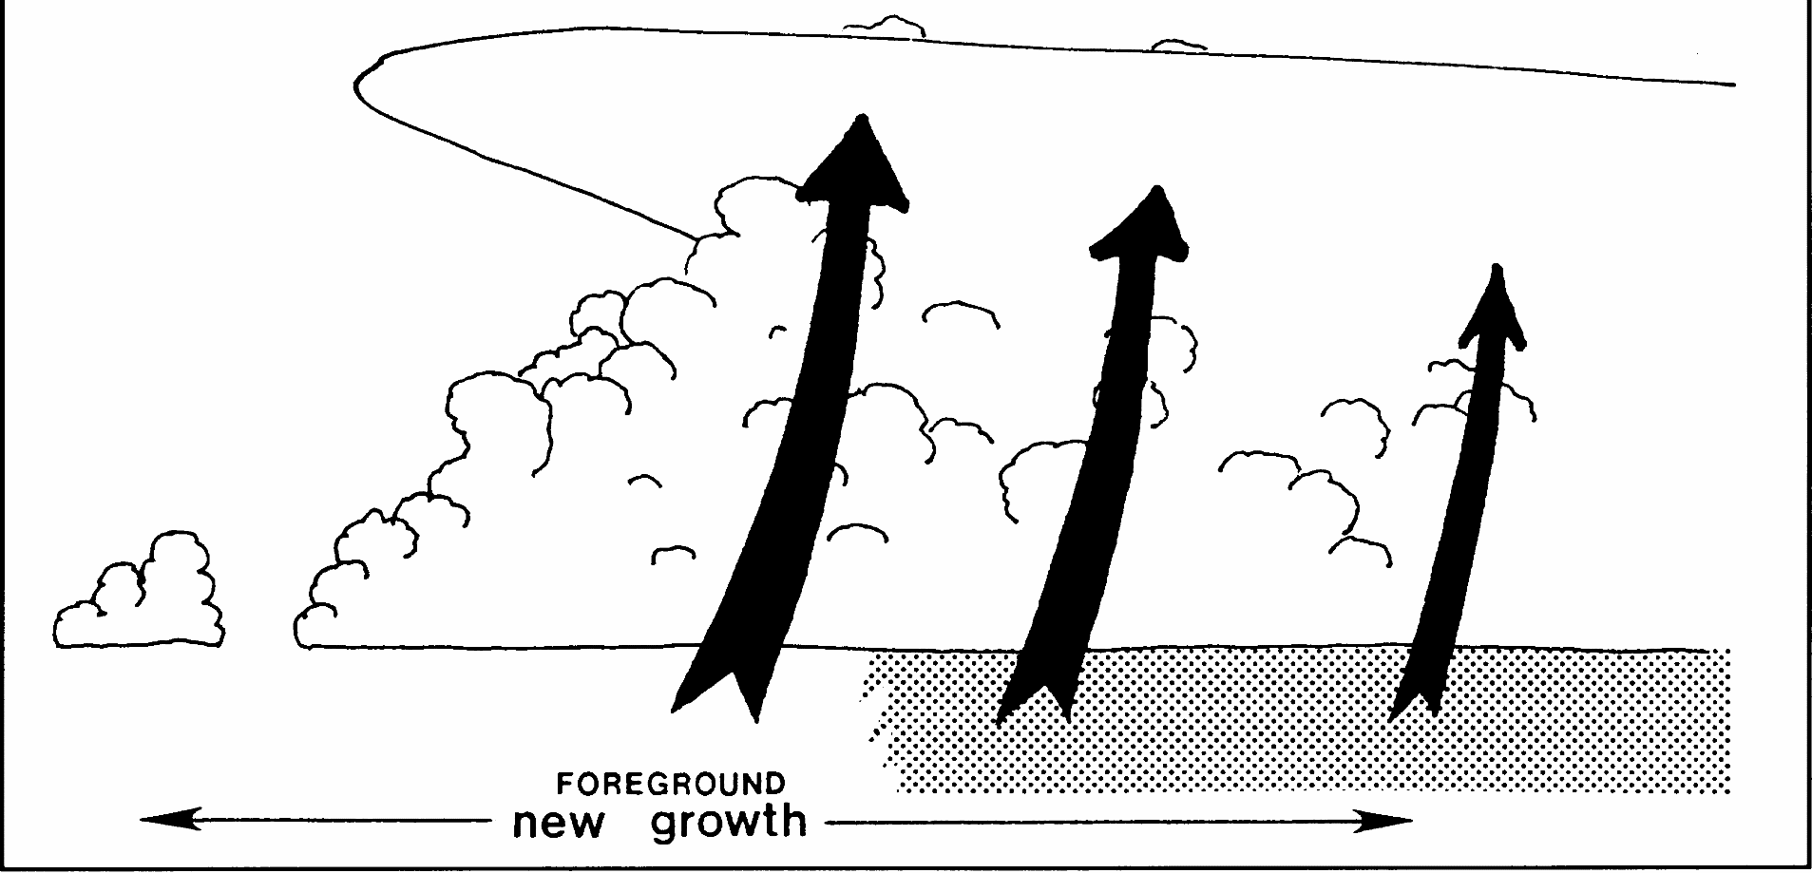
Mulit-cell Storm – Delivery Techniques
Seeding Location

Slide 16
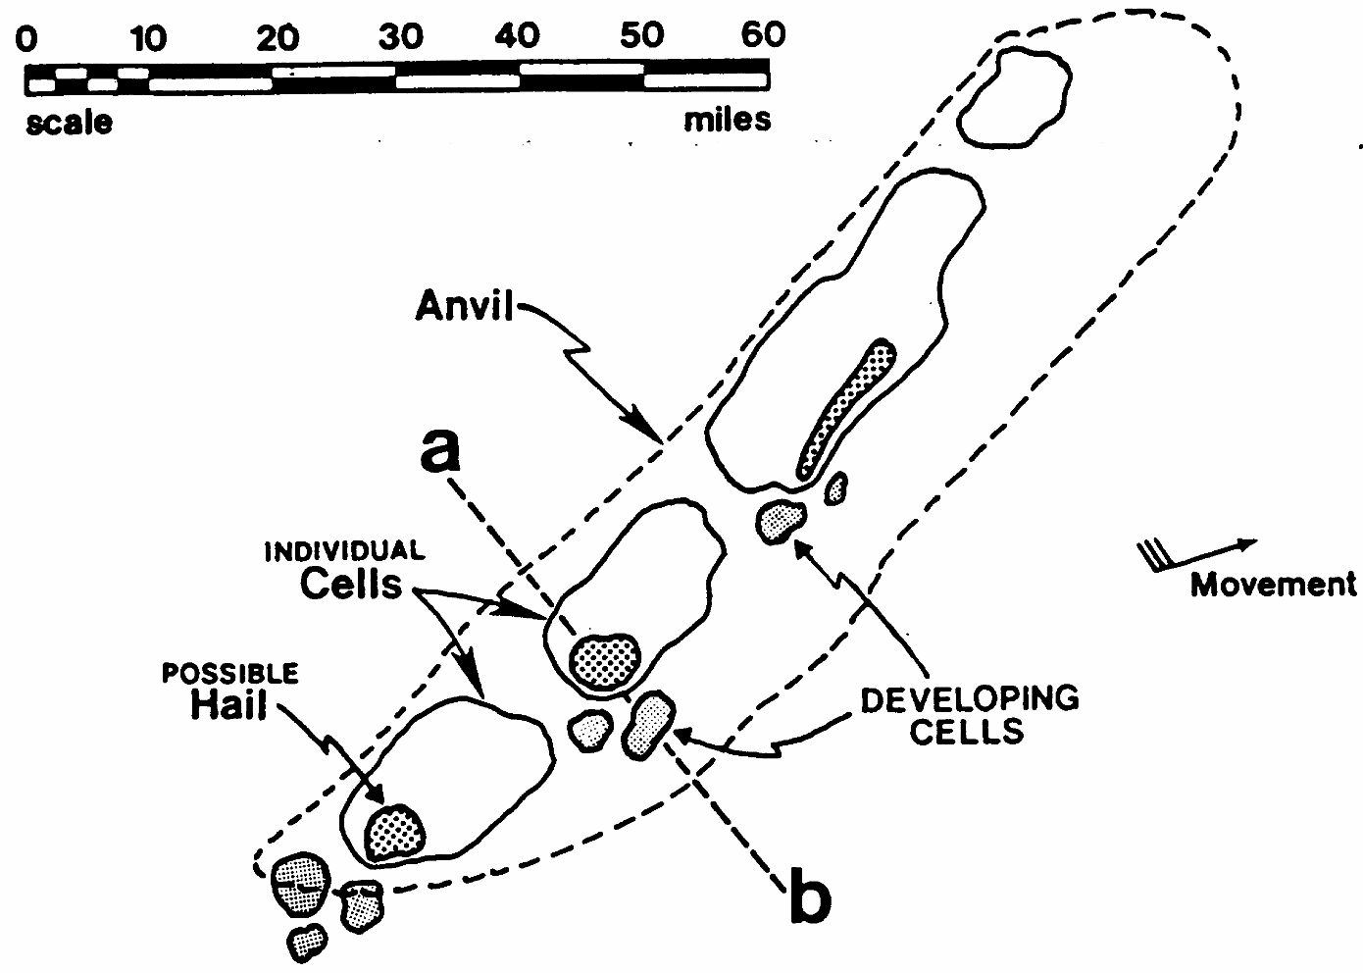
Squall Line Storm – Delivery Techniques
Below shelf, 1000’ below base.
500 fpm updraft
2-10 miles from precipitation.
Racetrack pattern.
Move out if updraft increase.
Scale
Miles
If on top, fly parallel to line, turns away from line.

Slide 17
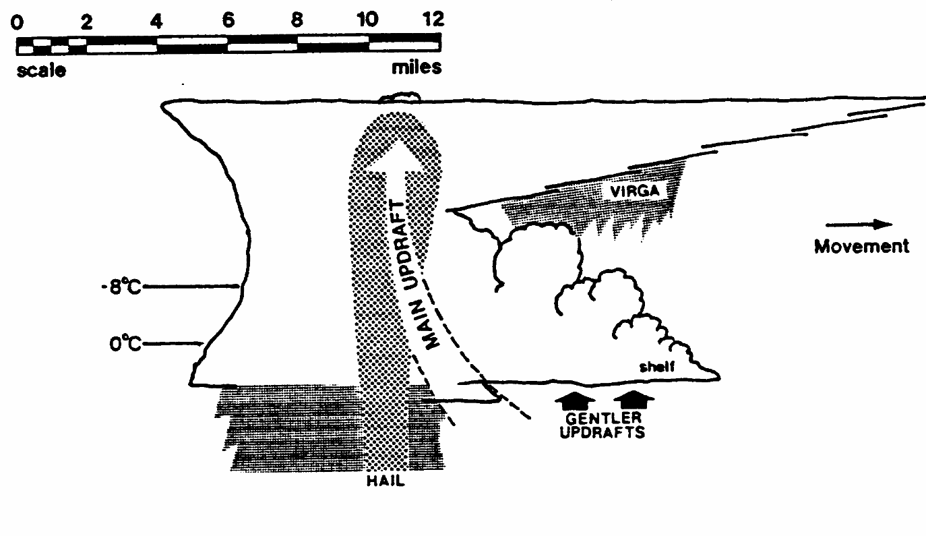
Squall Line Cloud – Delivery Techniques
Scale
Miles
Virga
Movement
-8 °C
0 °C
Shelf
Gentle Updrafts
Hail
Seeding Location

Slide 18
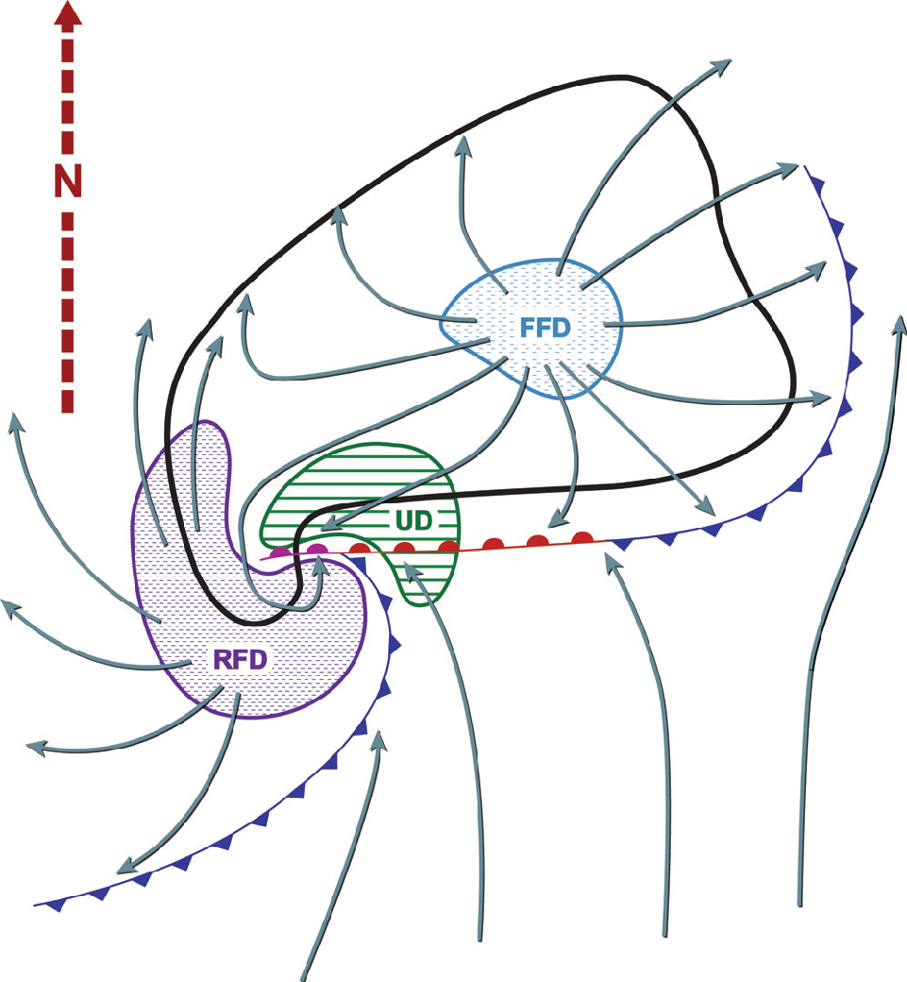
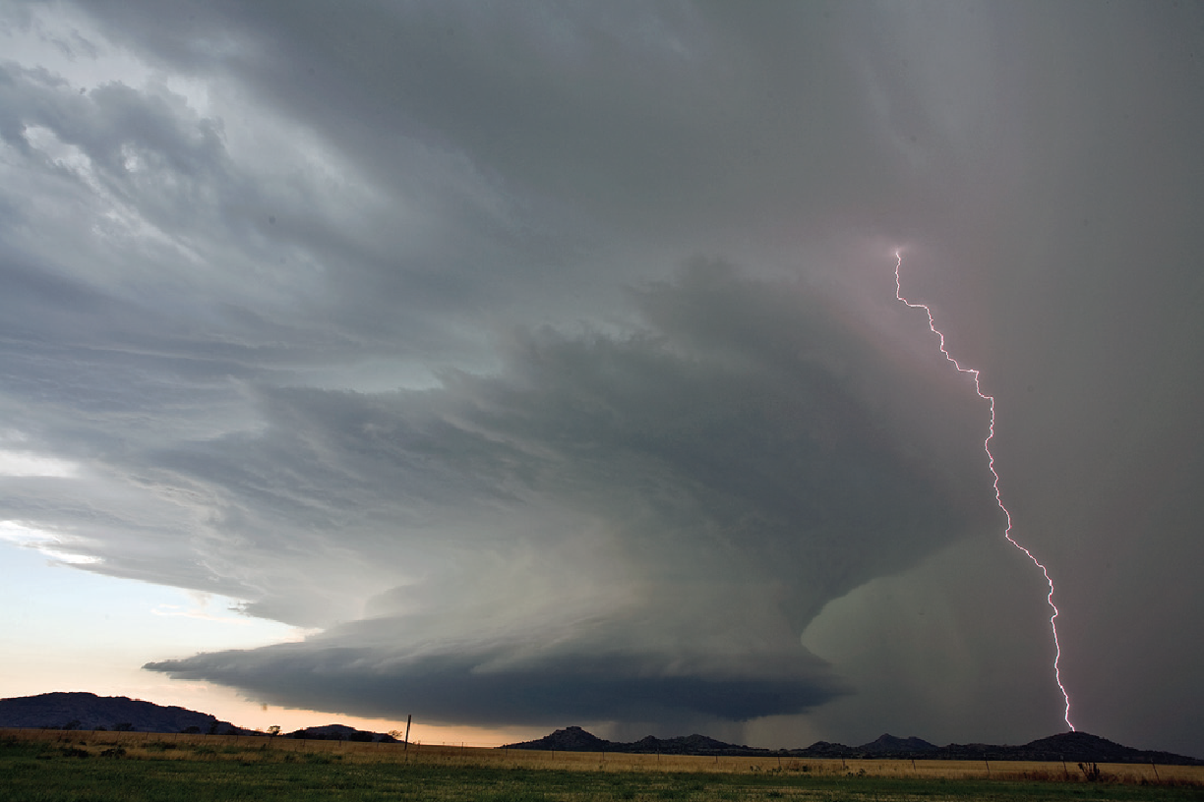
Supercell Storm – Delivery Techniques
1000’-2000’ below base.
500 fpm updraft.
On top may be hazardous.

Slide 19
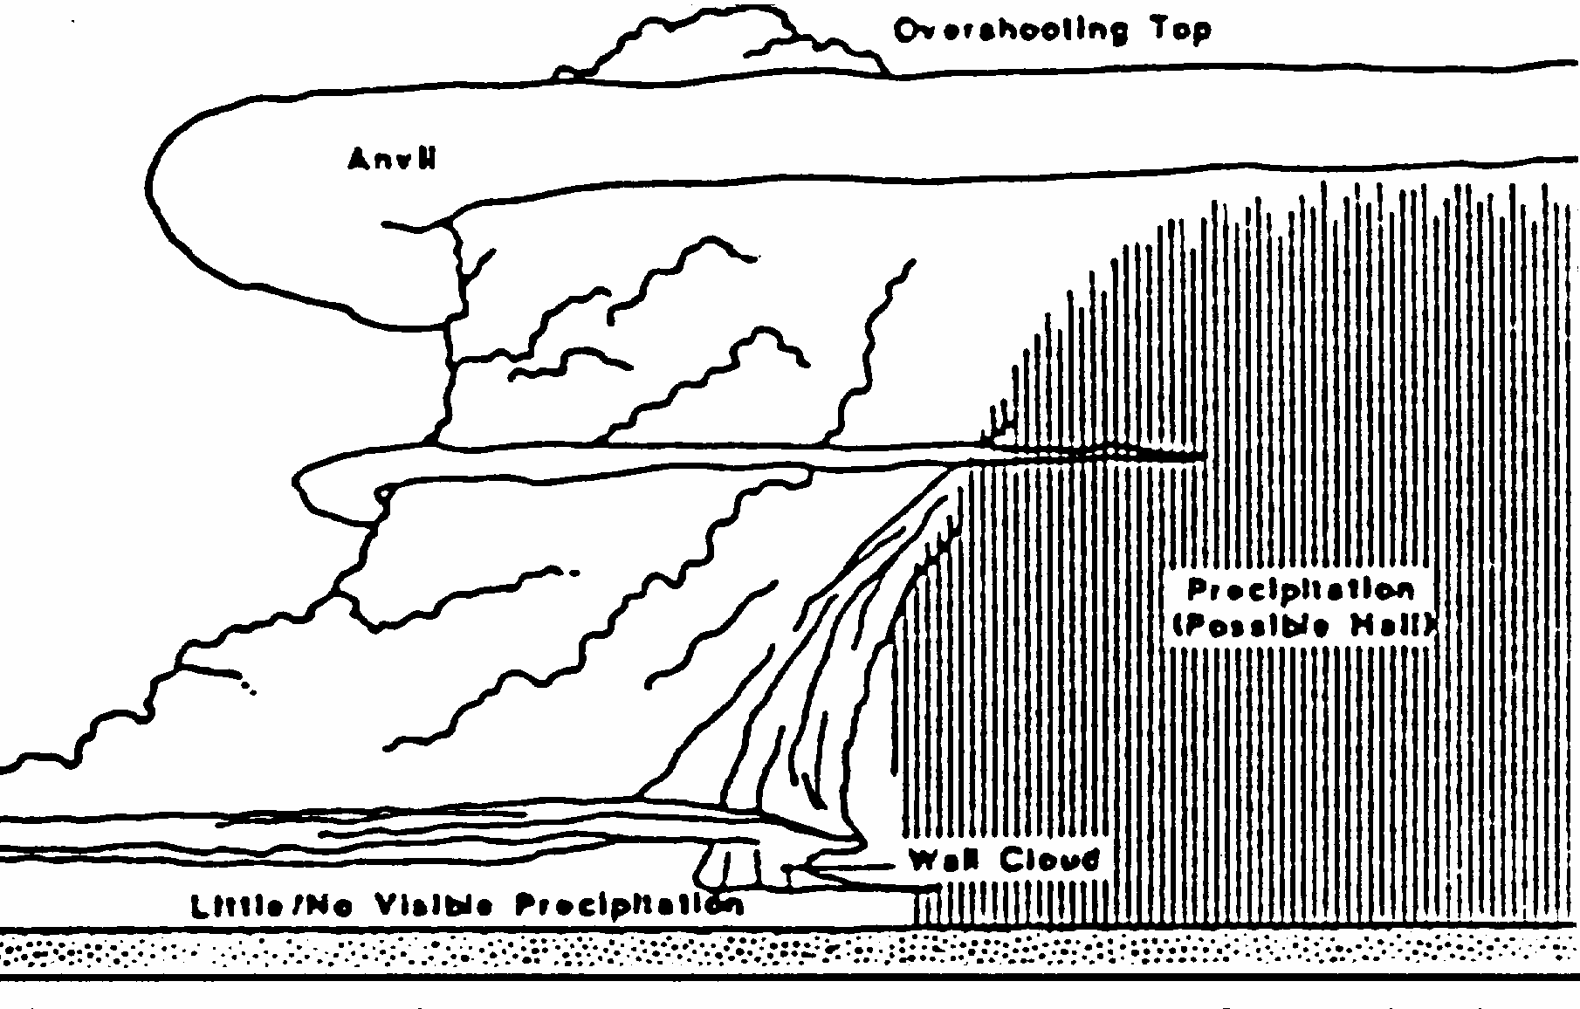
Supercell Storm – Delivery Techniques
Overshooting Top
Anvil
Precipitation
(Possible Hail)
Wall Cloud
Little / No Visible Precipitation

