Slide 1
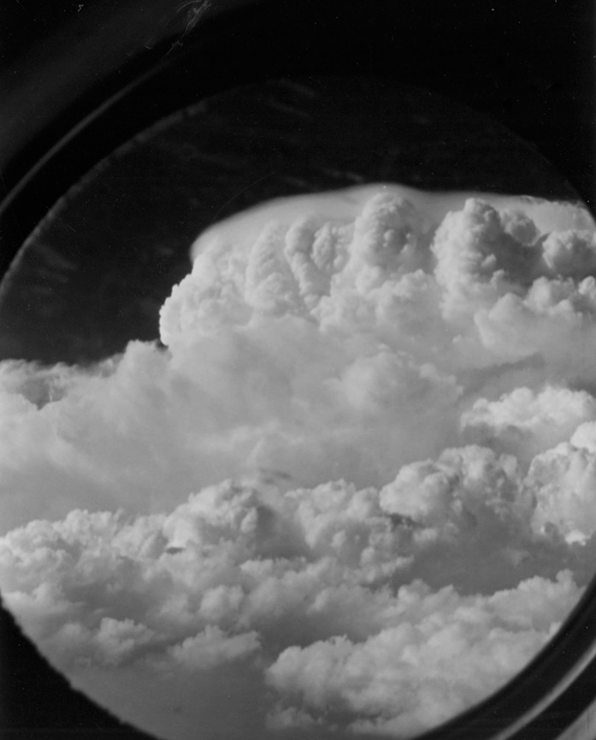
Airborne Research in Hailstorms
Applied Weather Modification
AtSc 252
Guest presenters: Wayne Sand (recorded) and Andy Detwiler

Slide 2
Flying through a Hailstorm– presented by Wayne Sand
Day 3 - 2022 North American Workshop on Hail & Hailstorms (youtube.com) (scroll ahead to 3:41:40 to position at start of the presentation by Wayne Sand)

Slide 3
The concept of “cells” in convective clouds and storms

Slide 4
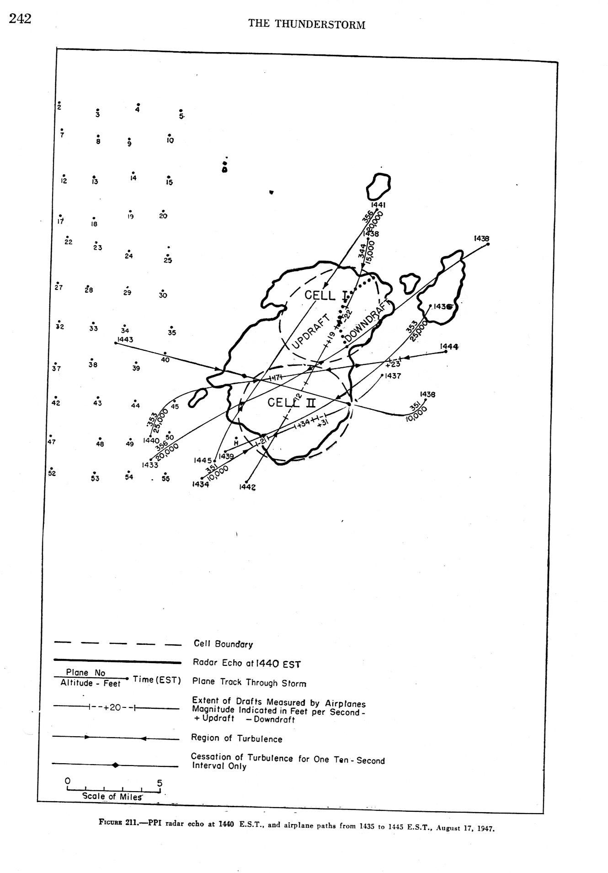

Slide 5
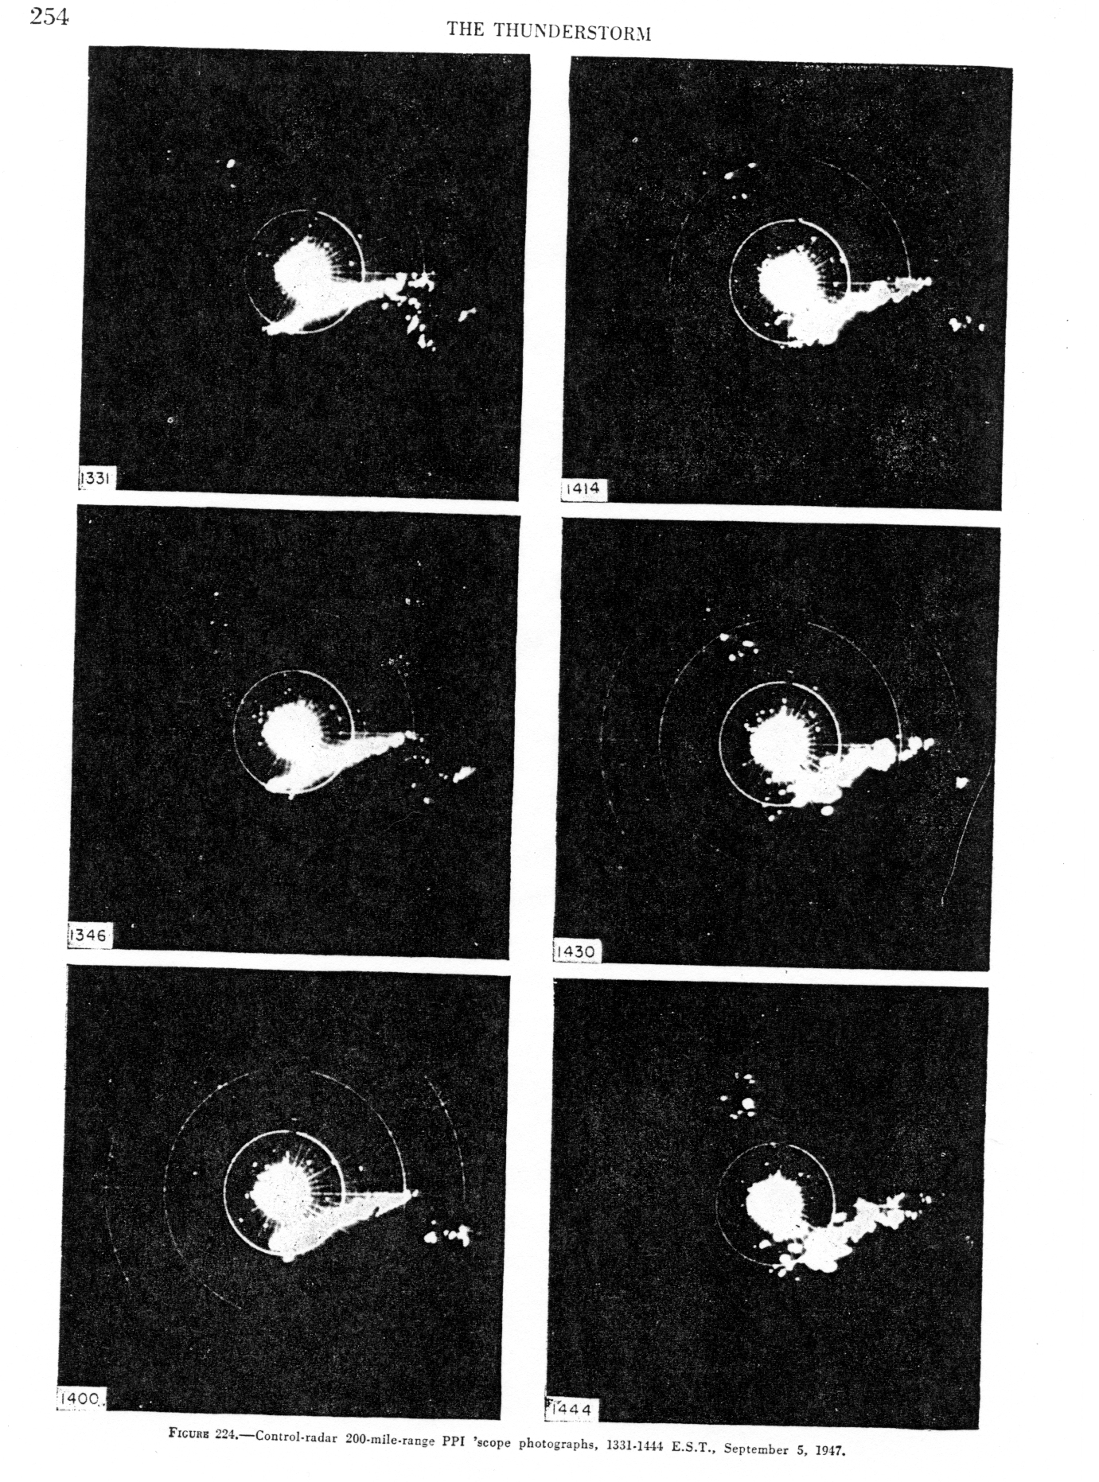

Slide 6
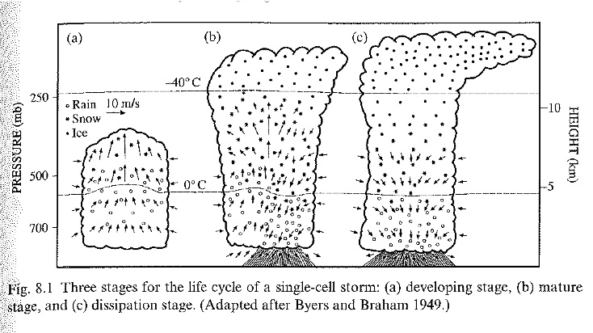
air mass thunderstorm
stages of development
weak vertical wind shear
entrainment at low levels, detrainment aloft (idealized)
Thunderstorm Project in field in 1946 – 1947 in Florida and Ohio
led by Horace Byers and Roscoe Braham

Slide 7
Graupel and Hail – insights from NHRE

Slide 8
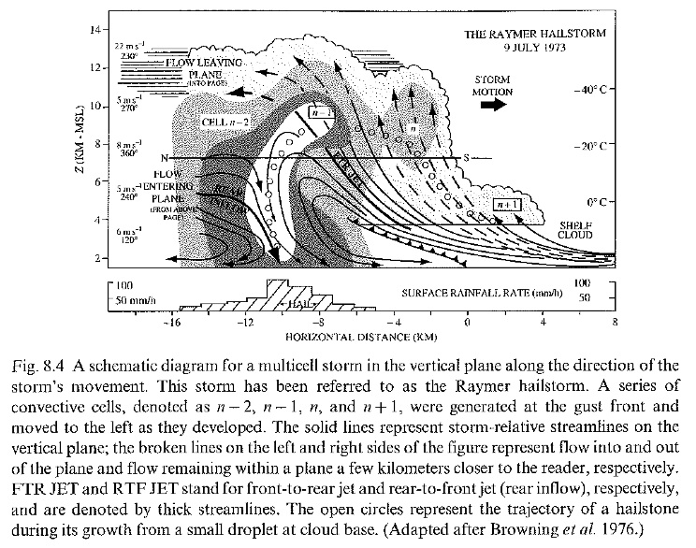
Multicell storm
new cells form as air lifted at gust front (become buoyant)
multicell system can last several hours
moderate-strong shear
front-to-rear jet: ascending air, above cold pool
rear-to-front jet: low-θ_{e} air from rear part of storm brought into cold pool
(jets part of more mature multicell system)
cold pool
gust front

Slide 9
mid-tropospheric
winds
storm motion
new cell formation
low level
winds

Slide 11
Graupel and Hail – insights from NHRE
Stage 1—Hailstone Embryo Stage.
Embryos (of a finite size) are needed because otherwise they would be ejected out of the top of the storm upon traveling into the updraft.
Notes:
Image from Browning and Foote (1976).

Slide 12
Graupel and Hail – insights from NHRE
Stage 2—Translation Stage.
Hailstone embryos become positioned so that they may be injected into and traverse the main updraft of the storm.
Stage 3—Accretional Growth Stage.
Hailstone embryos are injected into the main updraft and grow through accretion of supercooled cloud drops.
Hailstones grow to large sizes in 10-30 minutes.
Notes:
Image from Browning and Foote (1976).

Slide 13
Graupel and Hail – insights from NHRE

Slide 14
Graupel and Hail – insights from NHRE
From Knight and Knupp, 1986

Slide 15
Graupel and Hail – insights from NHRE

Slide 16
Graupel and Hail Summary
Large damaging ice hydrometeors can develop in thunderstorms with persistent strong updrafts
Main growth process is accretion/riming on mm-diameter “embryos” formed in less vigorous regions of storms, then transported to the vicinity of a strong updraft where there is a high concentration of supercooled liquid water. Rapid growth then occurs.

Slide 17
Graupel and Hail Summary
Hail growth has mainly been studied in long-lived supercellular storms where a steady-state circulation persists for 10’s of minutes.
Less is known or predictable about hail formation in multicellular and “air mass” thunderstorms.
Many scenarios proposed….

Slide 18
Hail Suppression Concepts (from Bruce Boe, Weather Modification International)

Slide 20
