Slide 1
North Dakota Cloud Modification Project ~ 2021
Storms and Internship

Slide 2
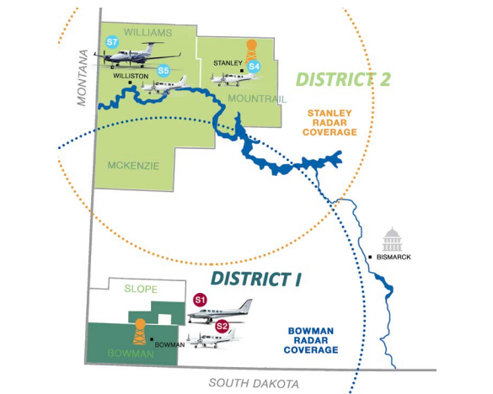
Notes:
Here was our operations area for 2021. All in western ND which was a nice change of scenery to easten ND.

Slide 3
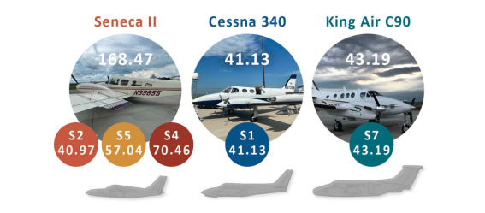
Notes:
We operated 3 Seneca II which are very similar to the Seminoles but a little large and a little more Brick-Shaped. All the interns get to fly the senecas and these aircraft are used for base seeding. The Cessna 340 was based in District 1 and could top seed as well as base seed, it is still undecided if it will return to project in 2022. The king air is based in district 2 and only topseeded, every intern gets a rotation in the king air as well.

Slide 4
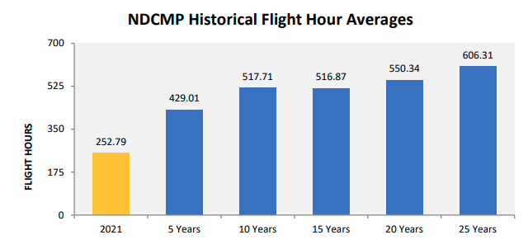
Notes:
Last year was a well known drought and is shown here on our flight hour averages. Despite the drought, I still flew about 60 hours over the course of last summer. You can get quite a few more hours during “wet” years.

Slide 5
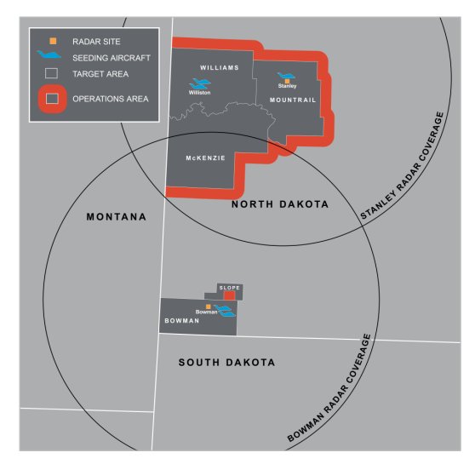
Notes:
This is our operations area. District one is covers Bowman county in the bottom west corner of ND as well as participating townships in Slope county. In district 2 we seed over Williams, Mountrail, and McKenzie county. On this map the red areas show buffer. In the buffer area we can fly if we are making passes while seeding, it’s ok to fly through this area and maybe have seeding equipment active but try to avoid it. If we need or want to fly outside of our districts, our seeding equipment needs to be off and checked off. As you can see here, District two is a lot larger than district one, so you’re more likely to get more air time in district 2.

Slide 6



Notes:
North Dakota’s weather mod project is run by the North Dakota Atmospheric Resource Board under the department of Water Resources. The ARB hires the interns and meteorologists for the summer project and contracts with Weather Modification International for pilots and aircraft. WMI is based out of the Fargo Jet Center and has projects all over the world such from California to Saudi Arabia.

Slide 7
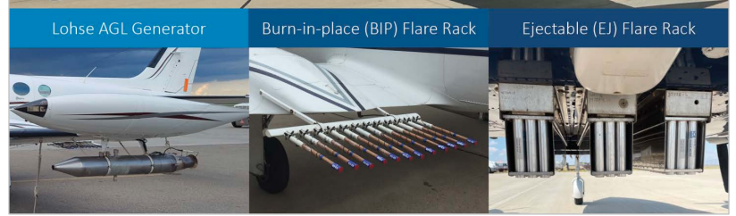
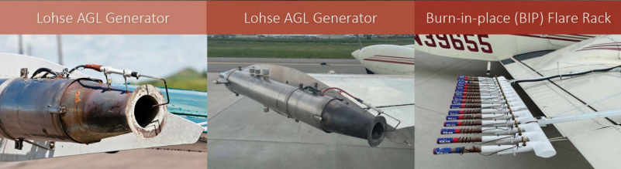
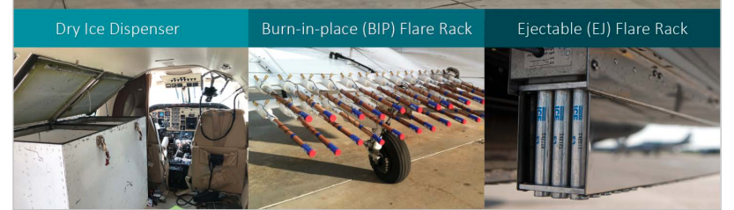
Notes:
These are the devices we use to disperse the seeding the seeding material. The top row is the C340 which has two Lohse generators and two Burn-in-Place (BIPs) Flare Racks and 3 Ejectable (EJ) flare racks on the belly. The Lohse generators and BIPs are used for base seeding, the EJs are used for top seeding. The middle row is the Senecas which just have Lohse generators and BIP racks. The bottom row is for the King Air which has a dry ice hopper, two double BIP racks and 3 EJ racks, all of which are only used for top seeding.

Slide 8
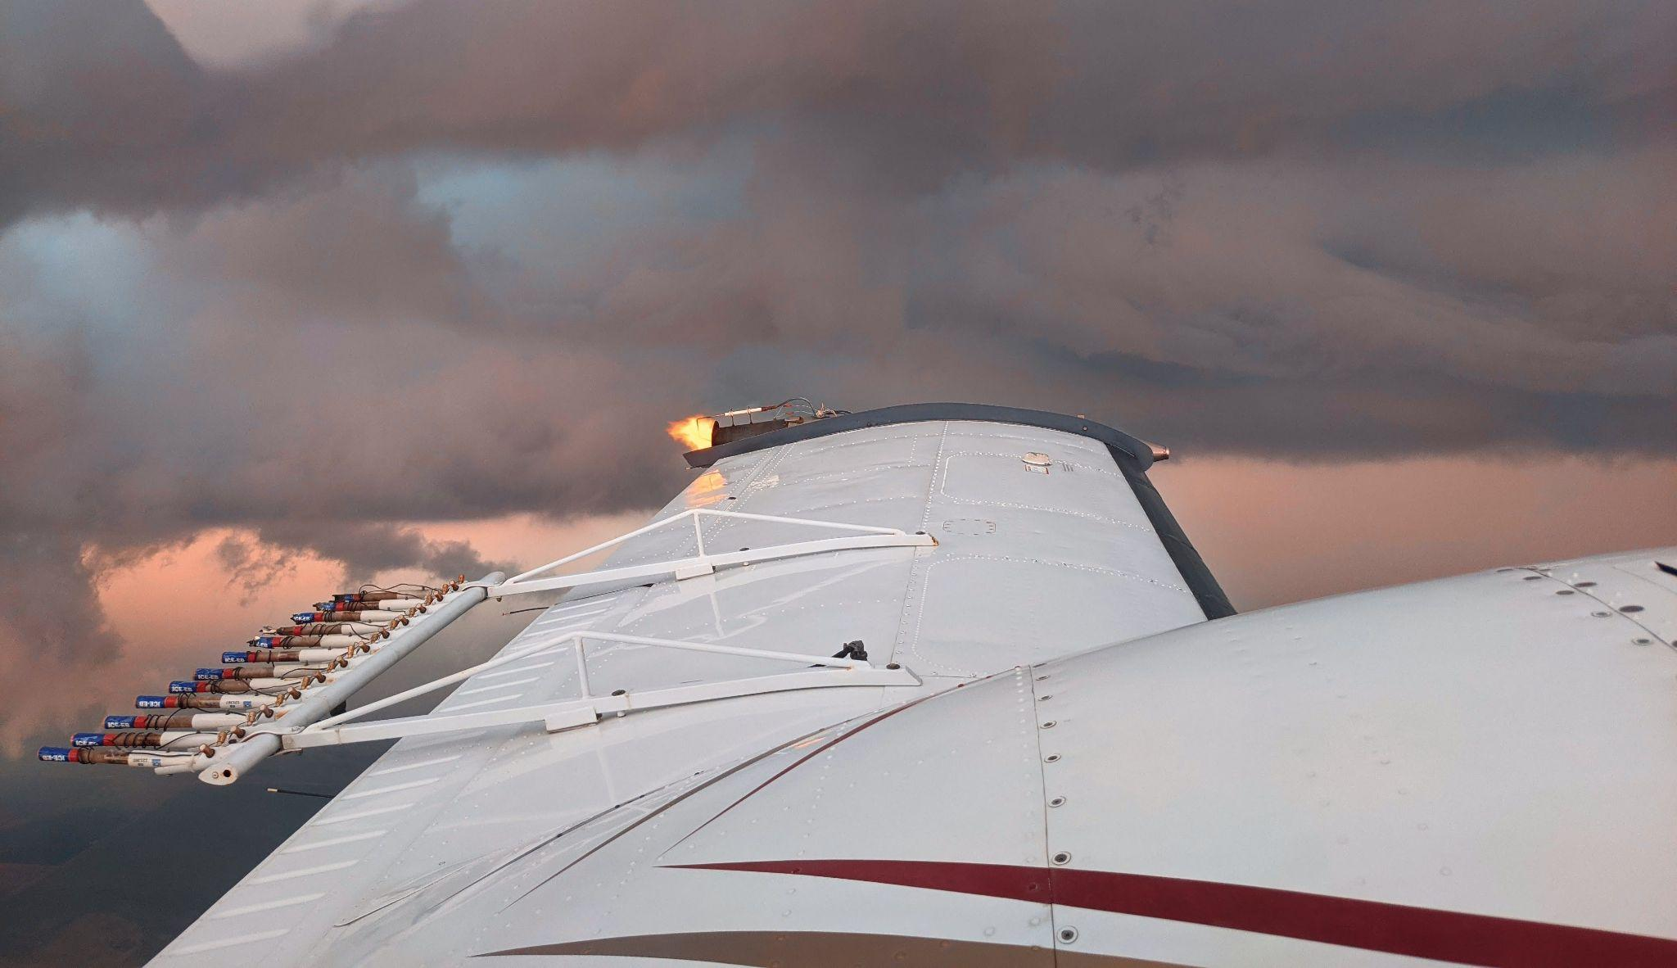
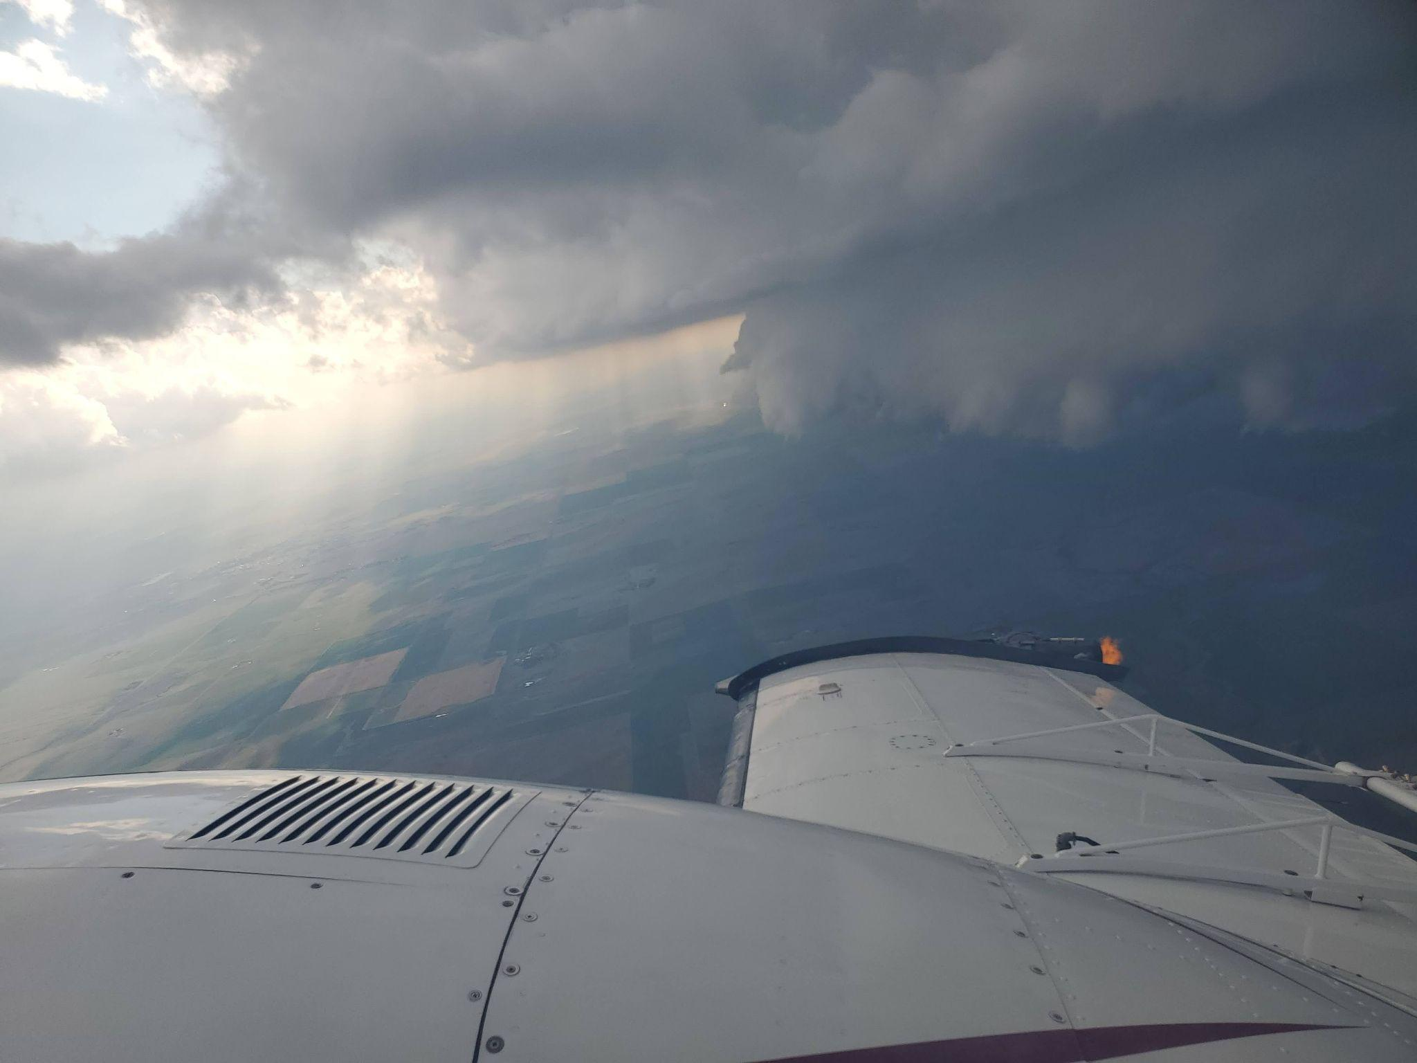
Notes:
Here are a few of the many photos I have from storms. The top left was a shelf cloud that was tinted orange by the sunset. Many missions will be flown at night or late in the afternoon. The bottom right photo shows a (weak) double shelf cloud that we were turning around to make our next pass along. Big storms will have solid shelf clouds and sometimes even double shelf clouds.

Slide 9
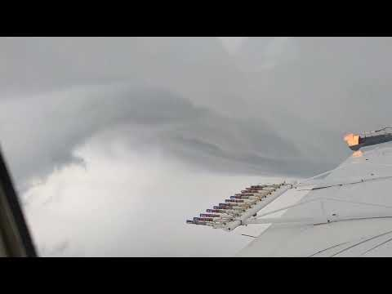
Notes:
This video was taken on a large storm we seeded and what looked like a shelf cloud getting pulled over by some inflow.

Slide 10
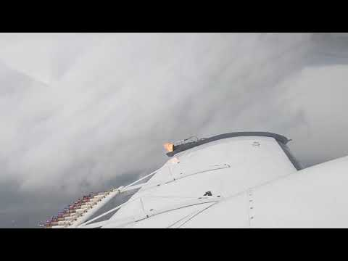
Notes:
This is a video I took of a shelf cloud. This is typically a great area to be when seeding for getting the materials into the system.

Slide 11
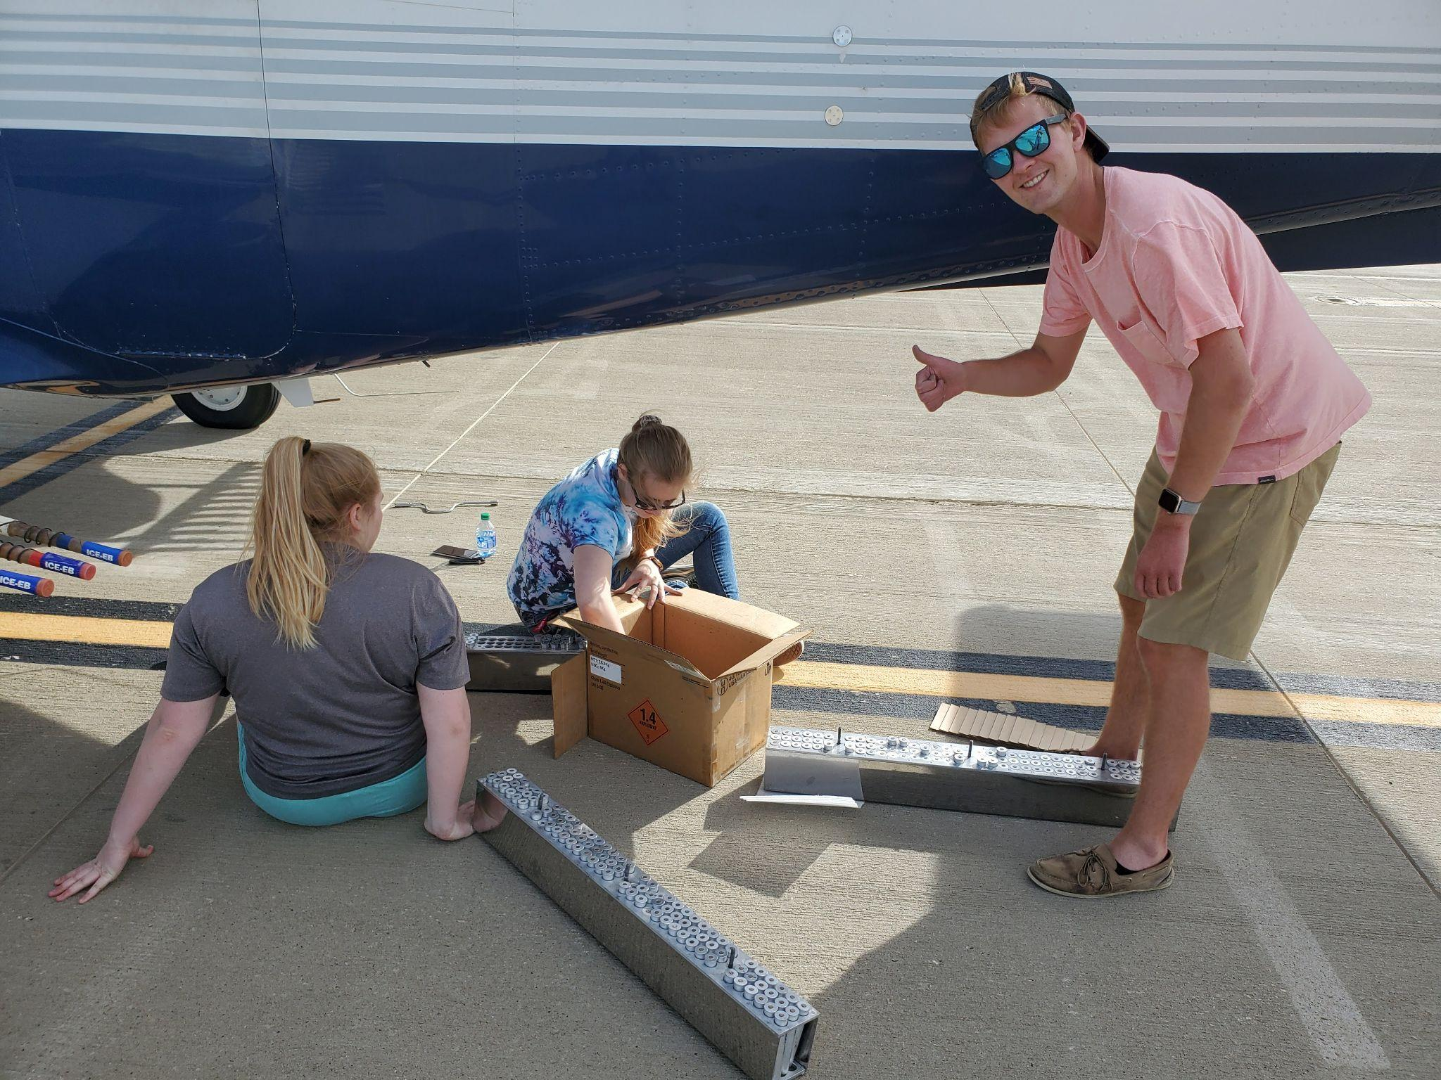
Notes:
Some of the stuff we do in between storms is reset flares and refill generators….

Slide 12
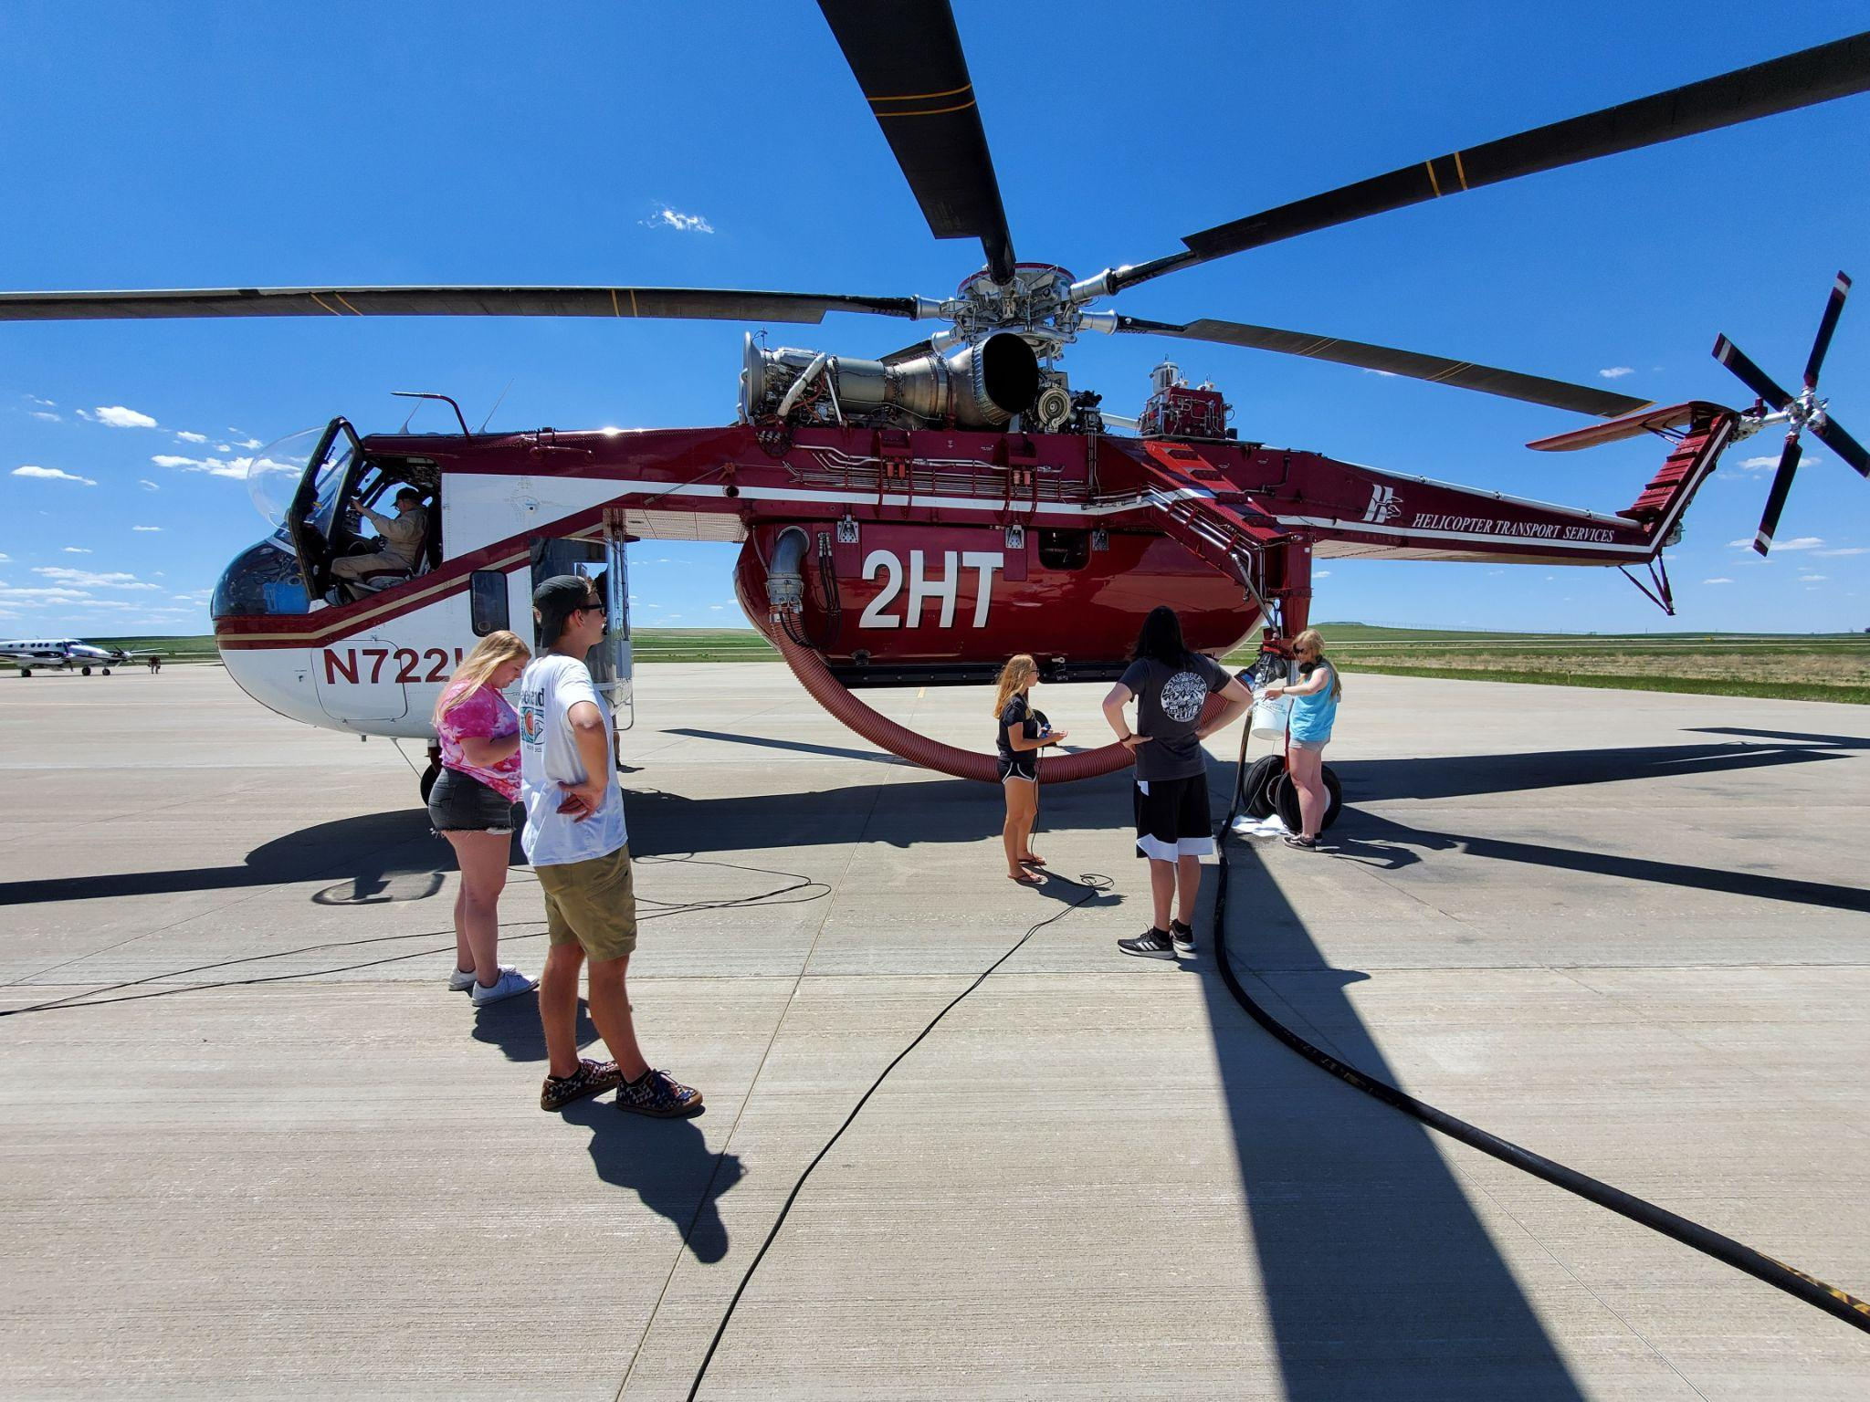
Notes:
…help other aircraft that come visit our airfield…

Slide 13
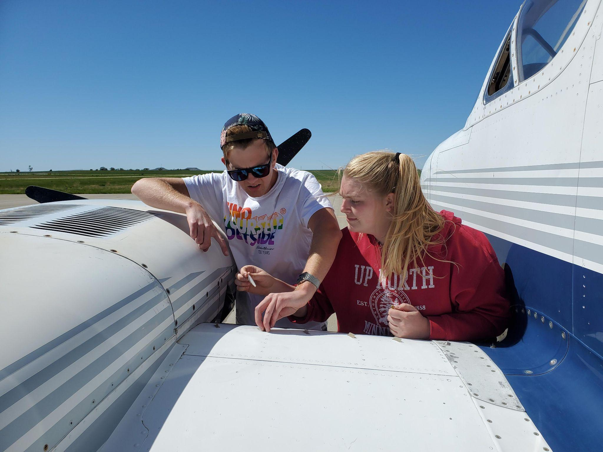
Notes:
…Do general preventative maintenance on our aircraft…

Slide 14
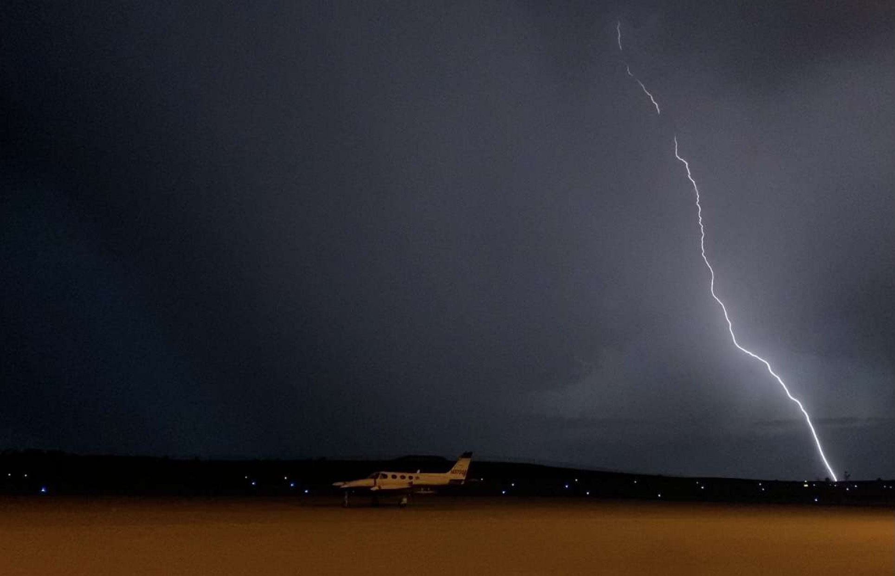
Notes:
…watch for storms coming our way (super important!)...

Slide 15
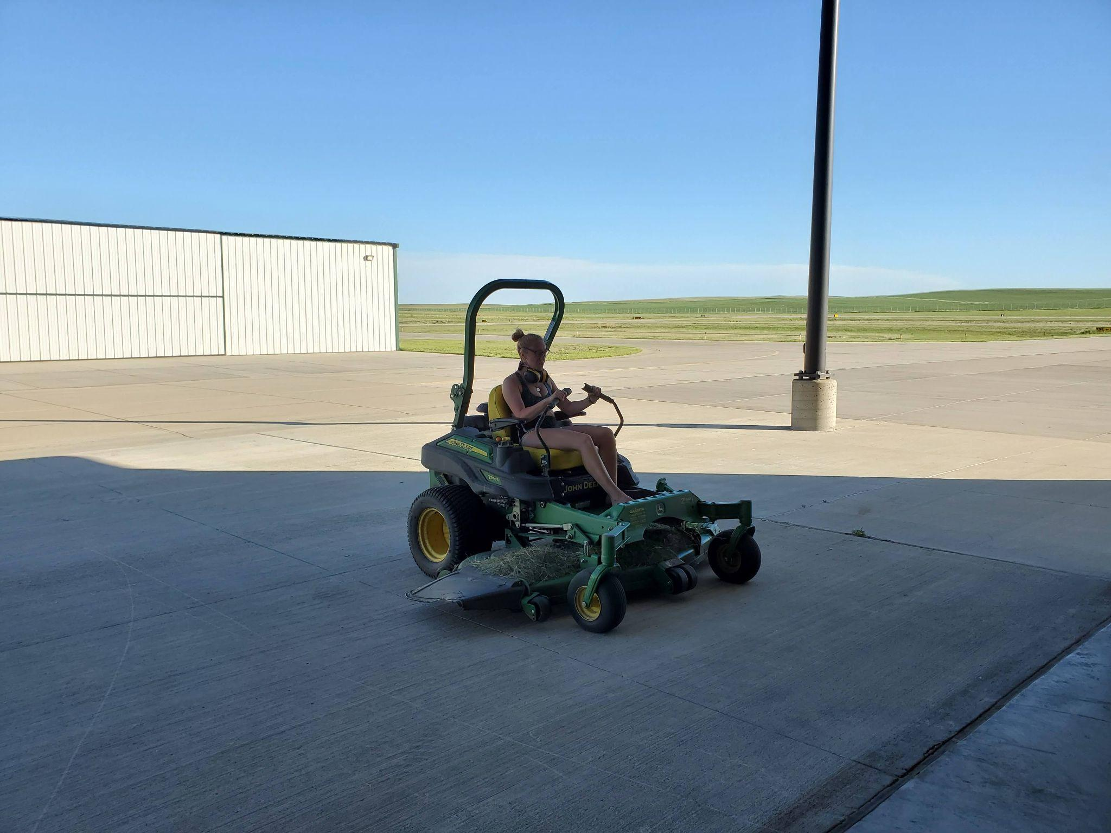
Notes:
…Help with airfield maintenance like mowing…

Slide 16
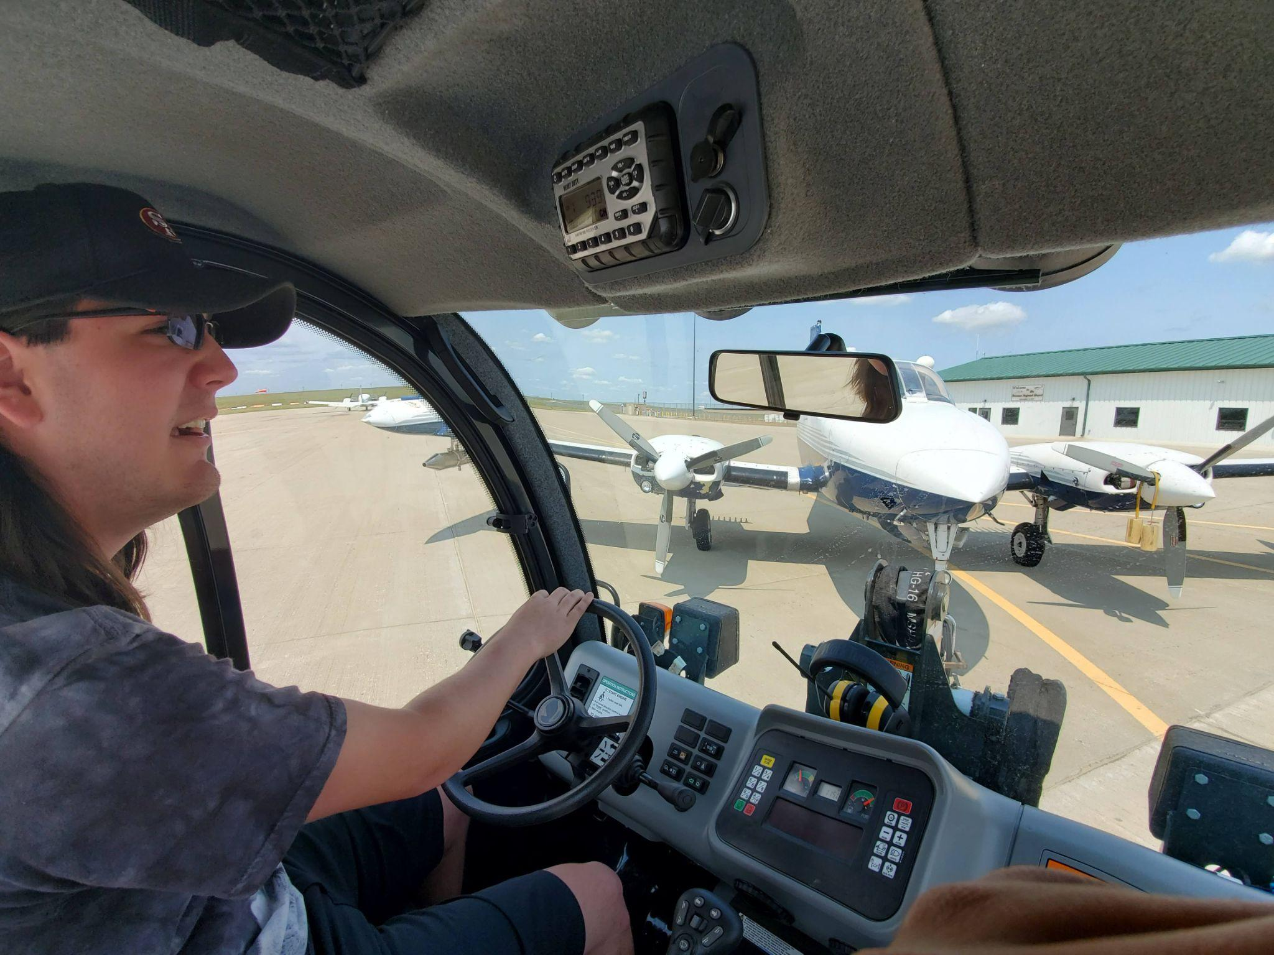
Notes:
…Learn how to move and refuel aircraft…

Slide 17
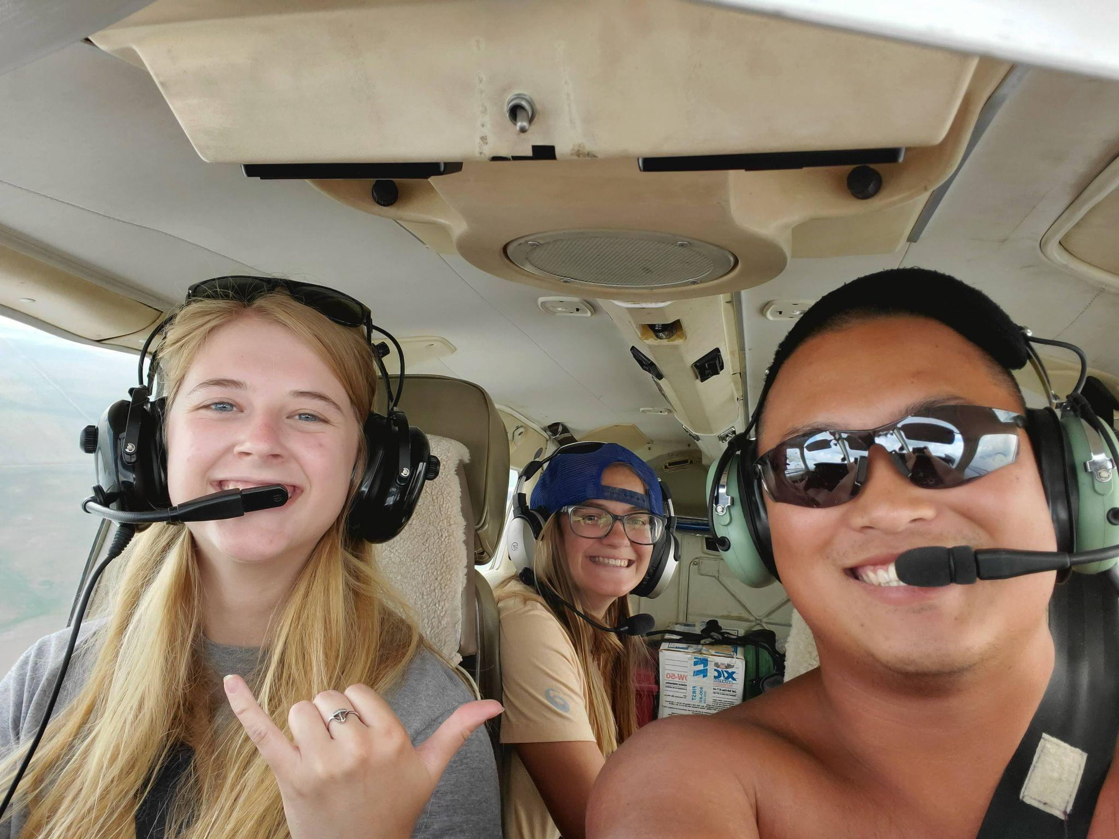
Notes:
…Teach our meteorologists how to fly….

Slide 18
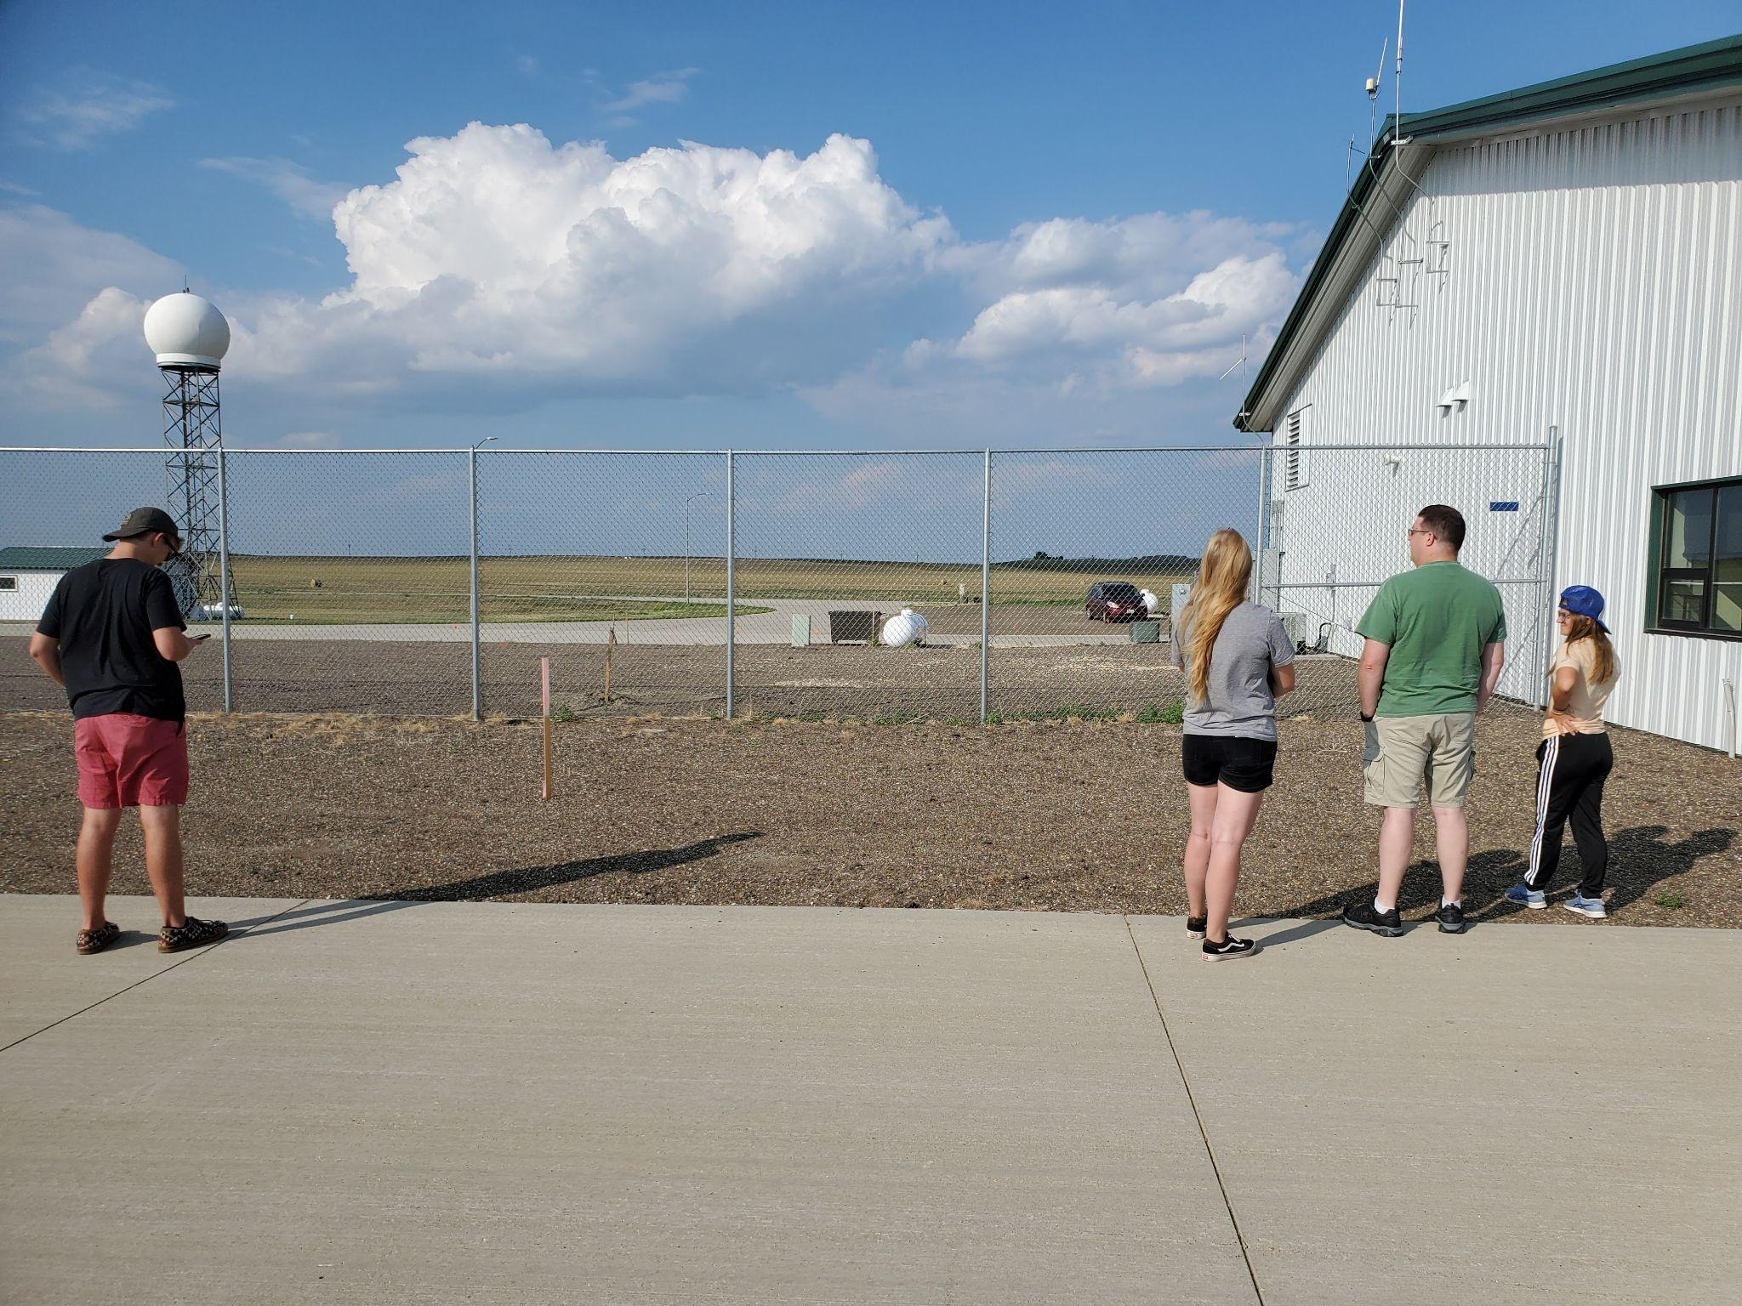
Notes:
…Watch for more storms…

Slide 19
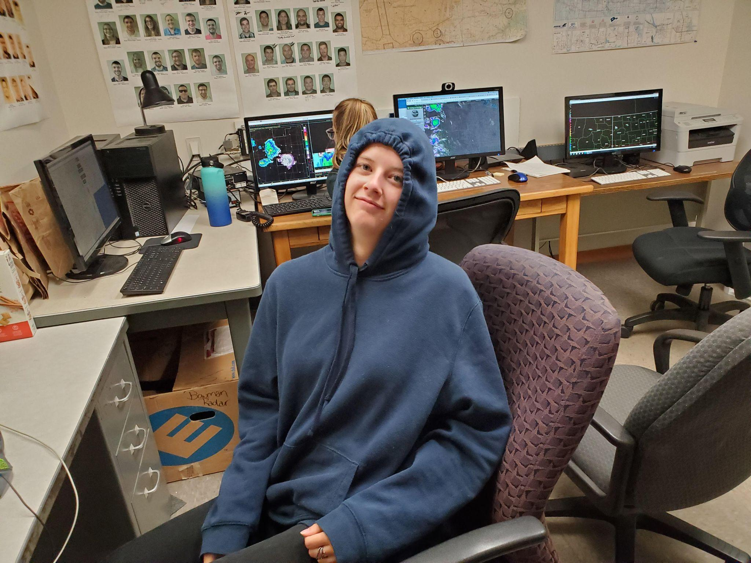
Notes:
…watch the RADAR…

Slide 20
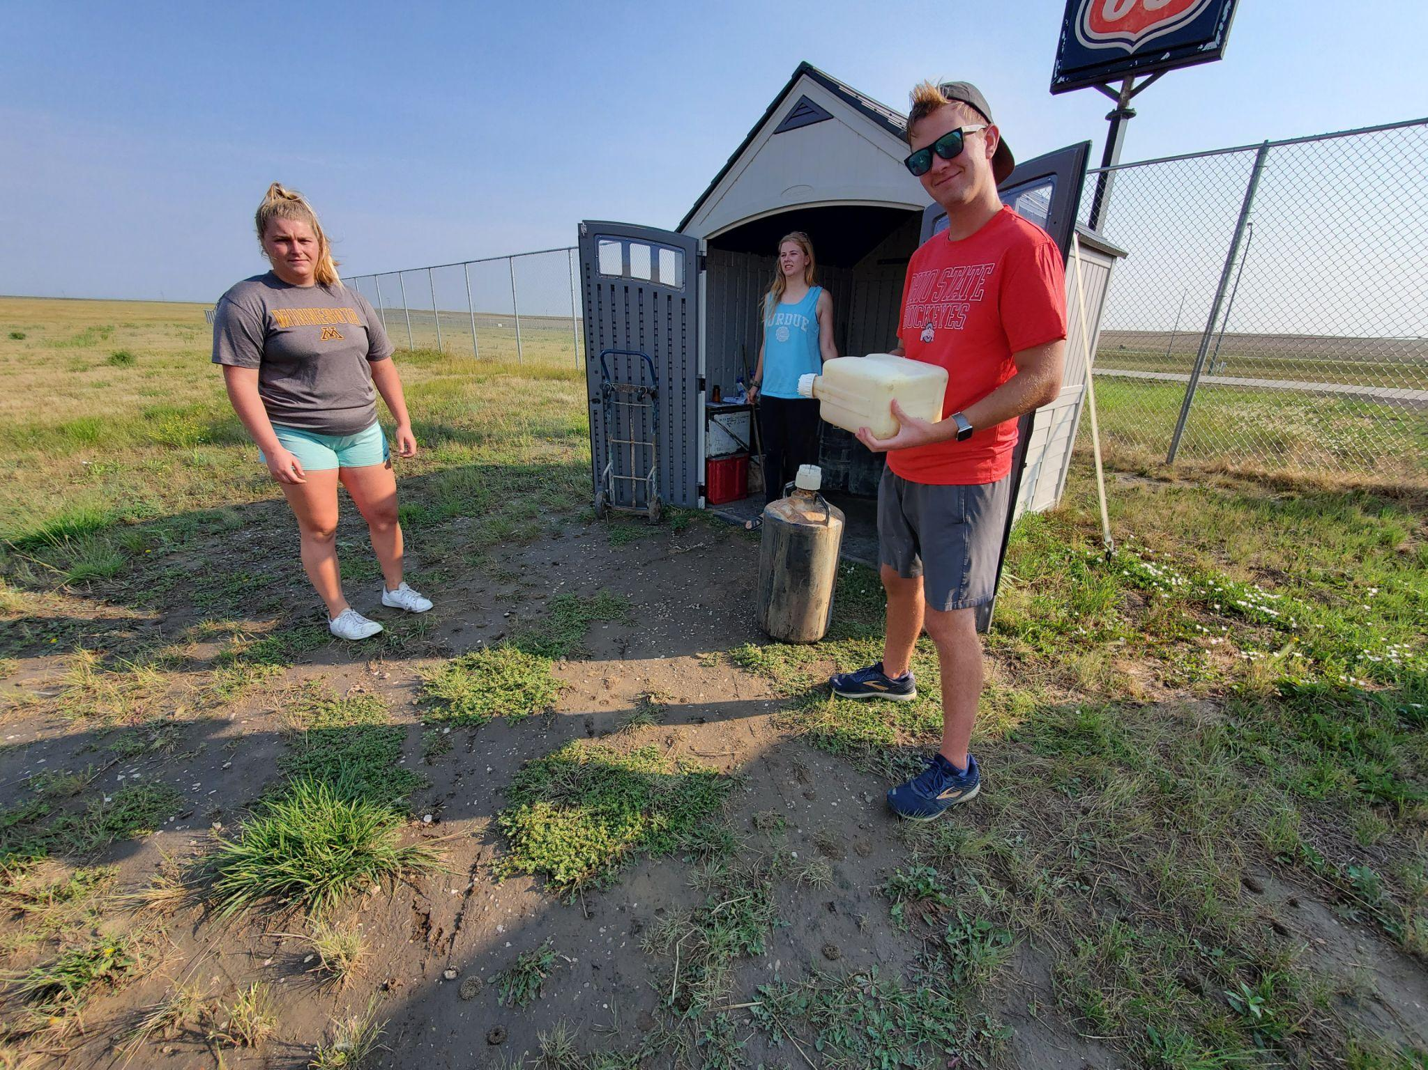
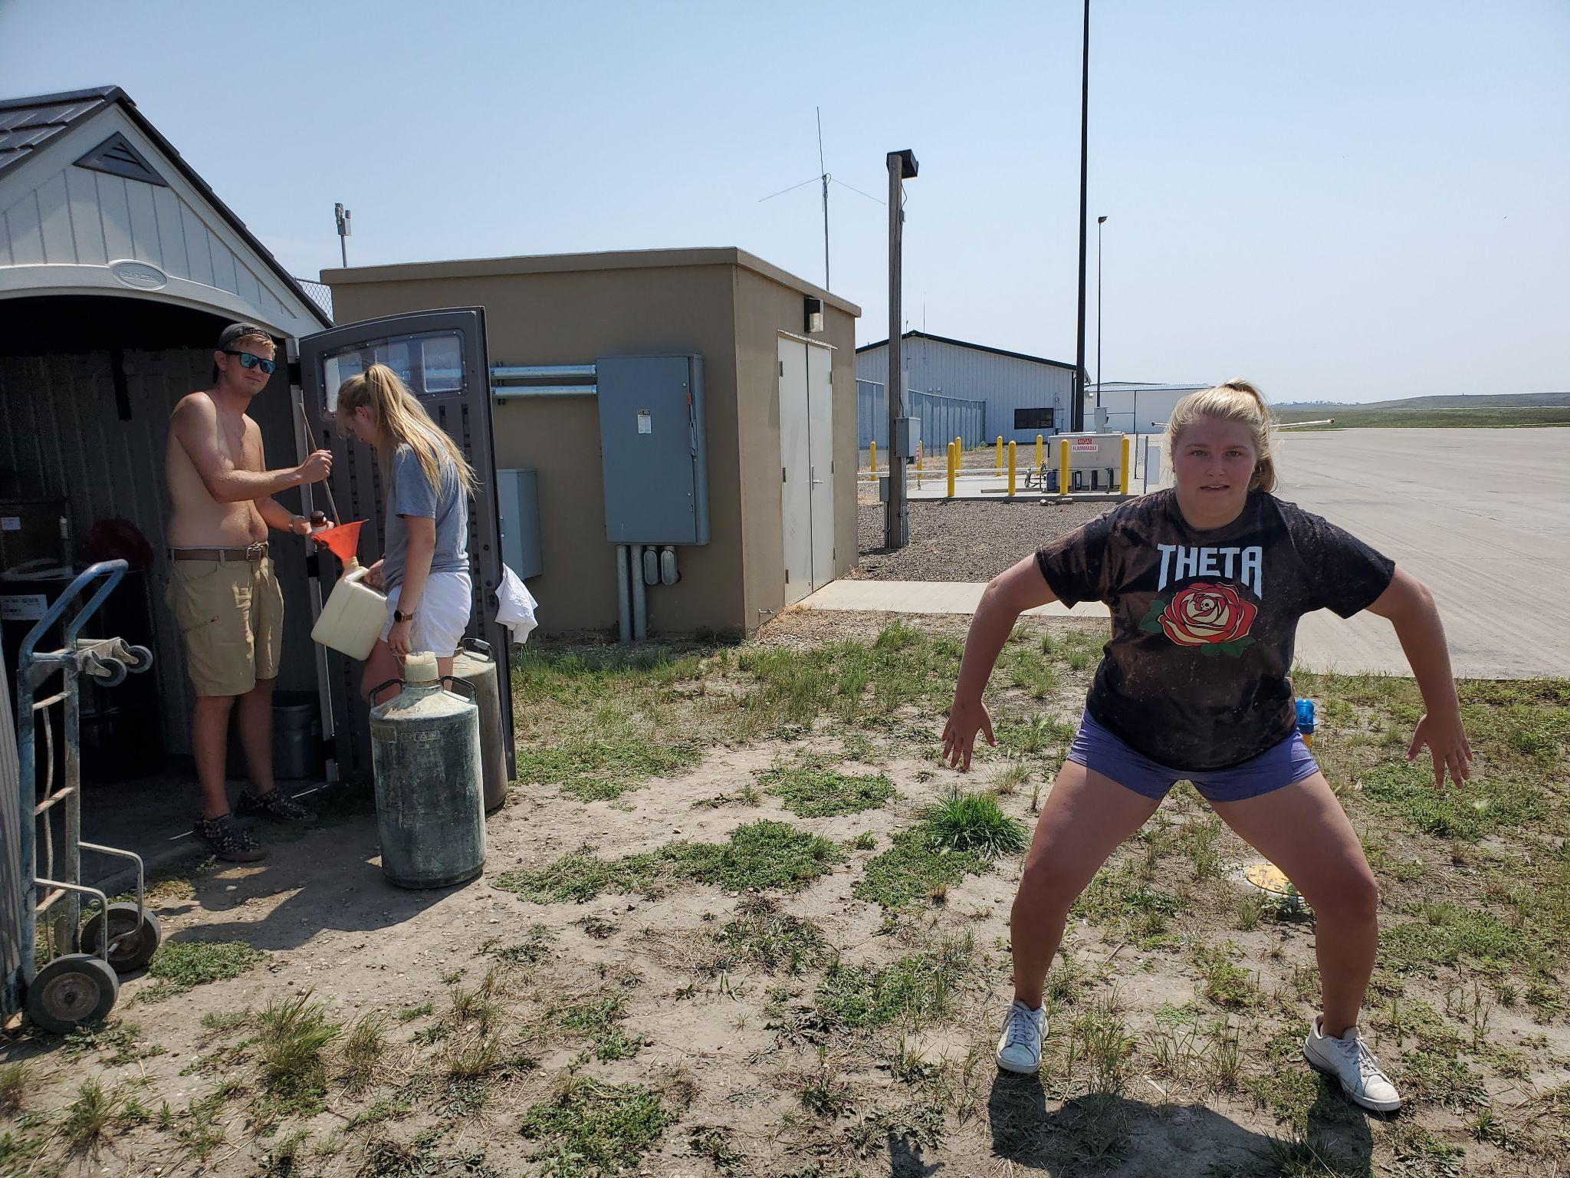
Notes:
….Mix chemicals…

Slide 21
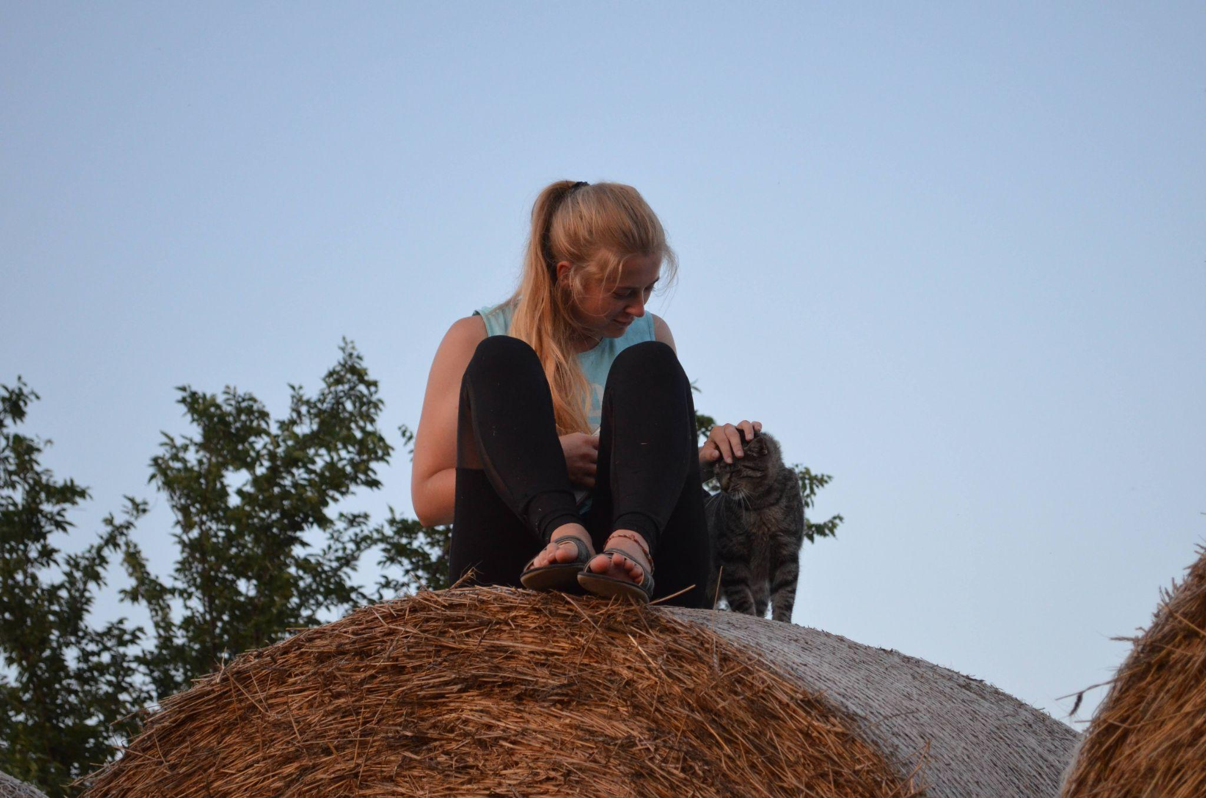
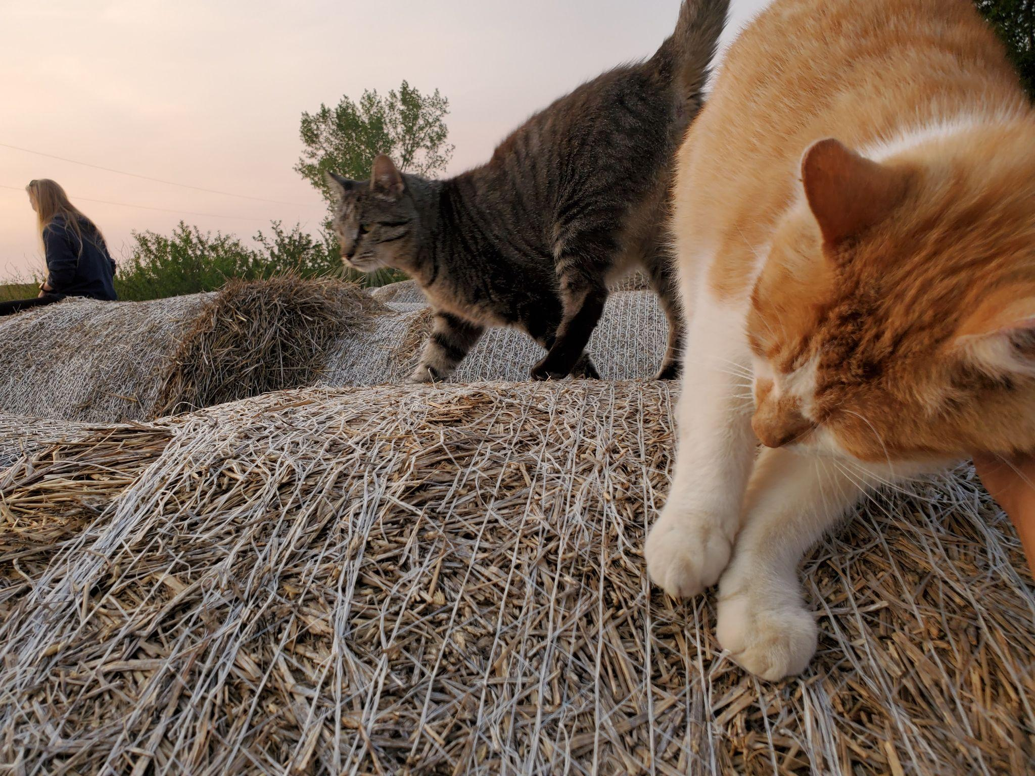
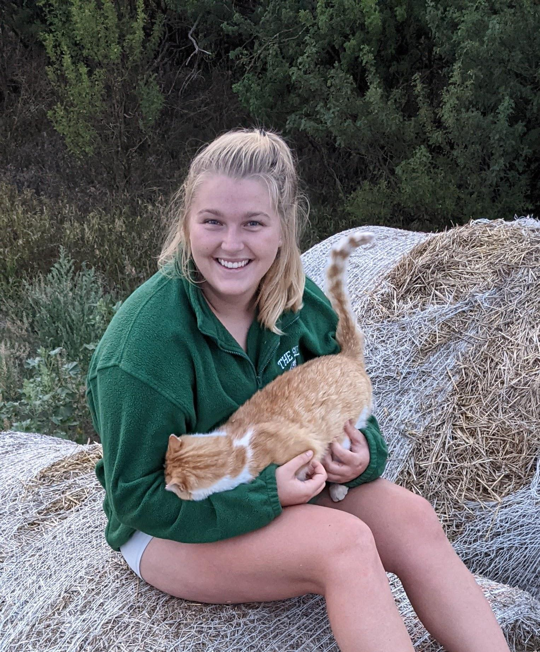
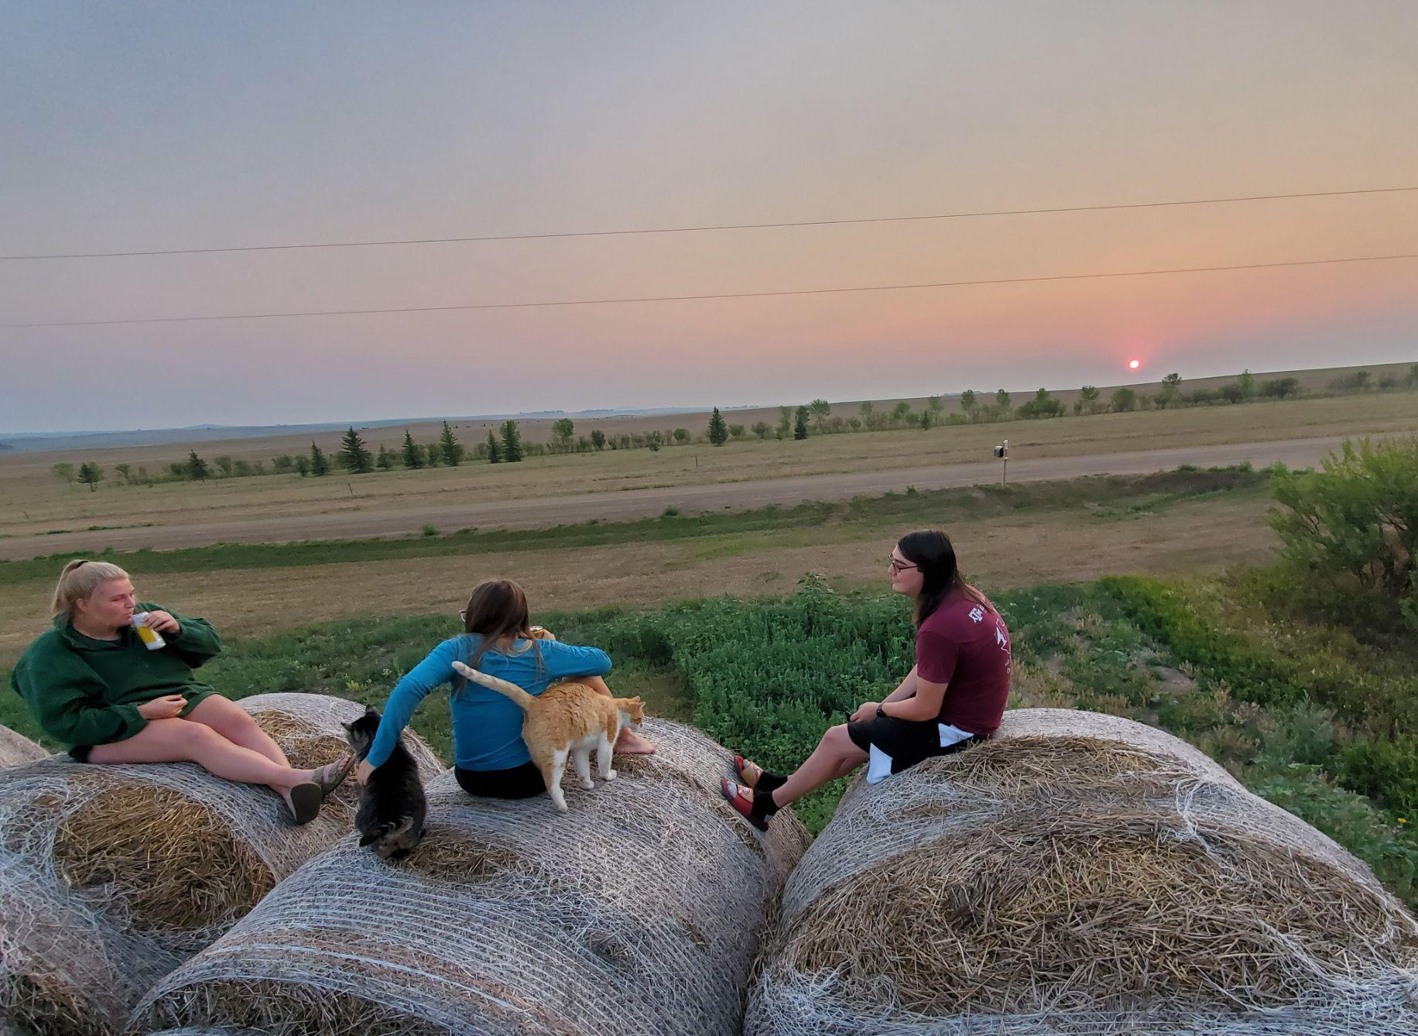
Notes:
…Pet the neighbor’s cats…

Slide 22
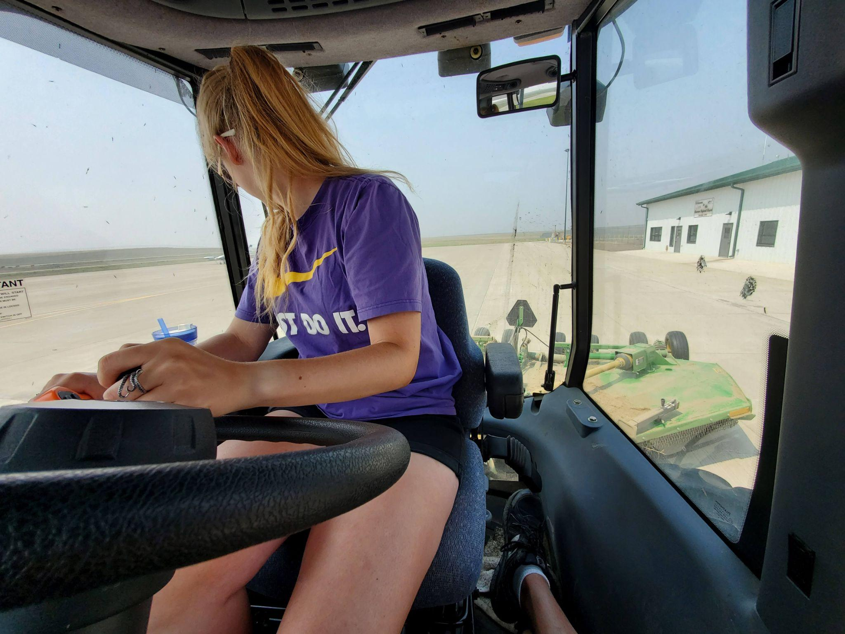
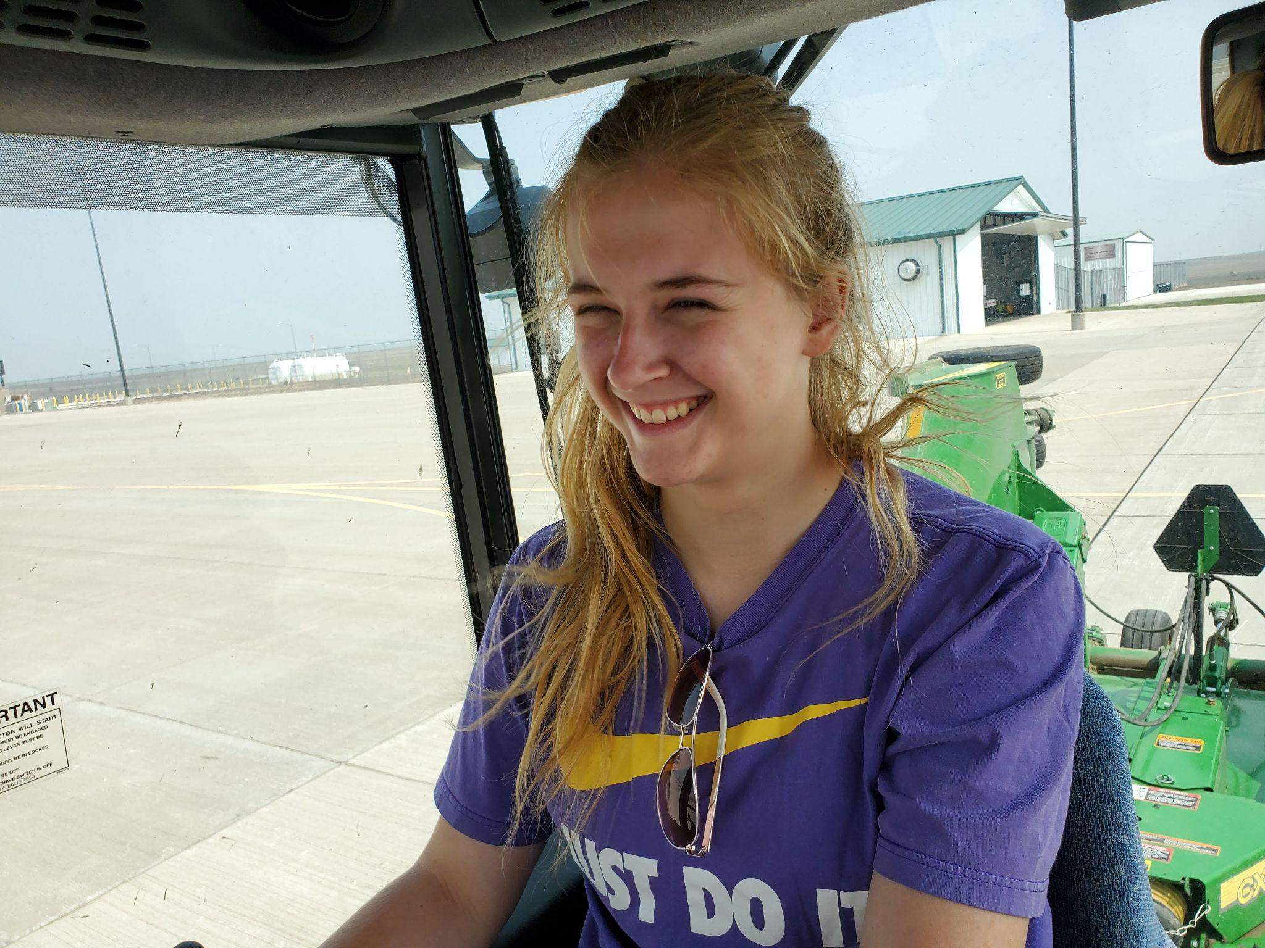
Notes:
…learn how to drive the tractor for mowing purposes of course…

Slide 23
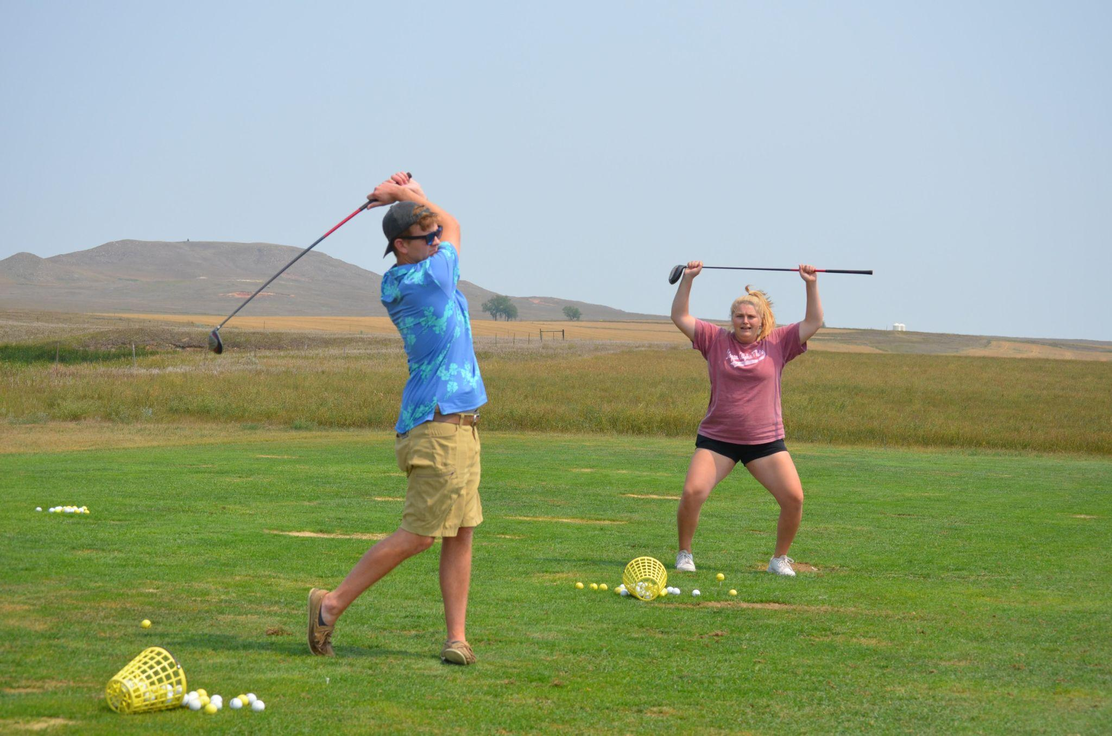
Notes:
On days where there’s no chances of storms you get to hang out with other people and blow off steam. In Bowman we golfed…

Slide 24
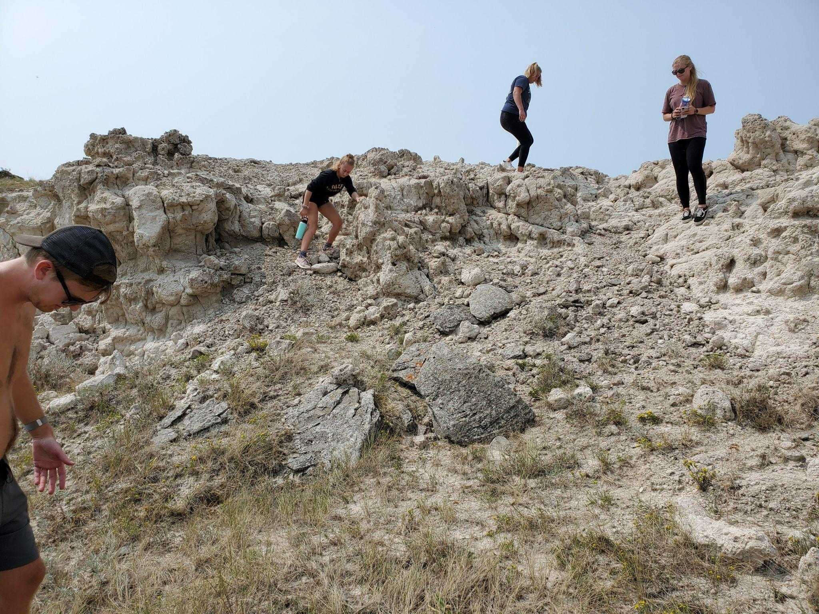
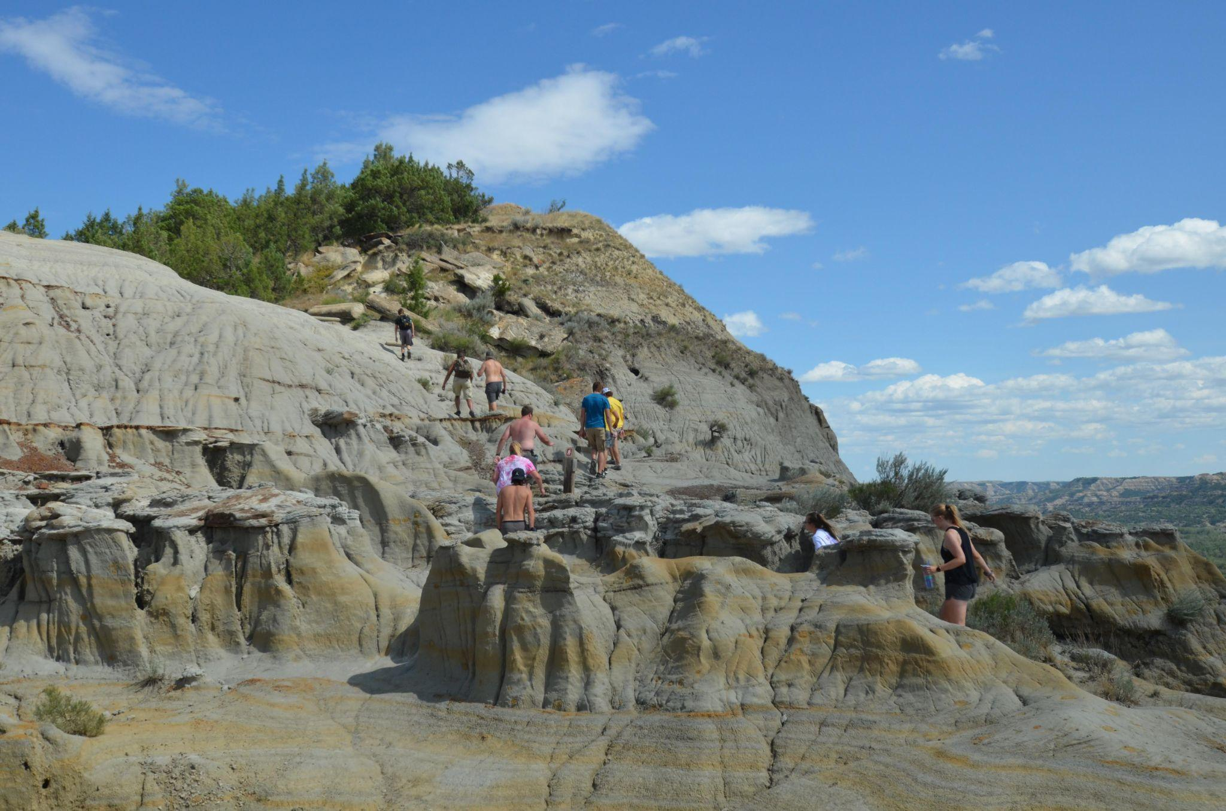
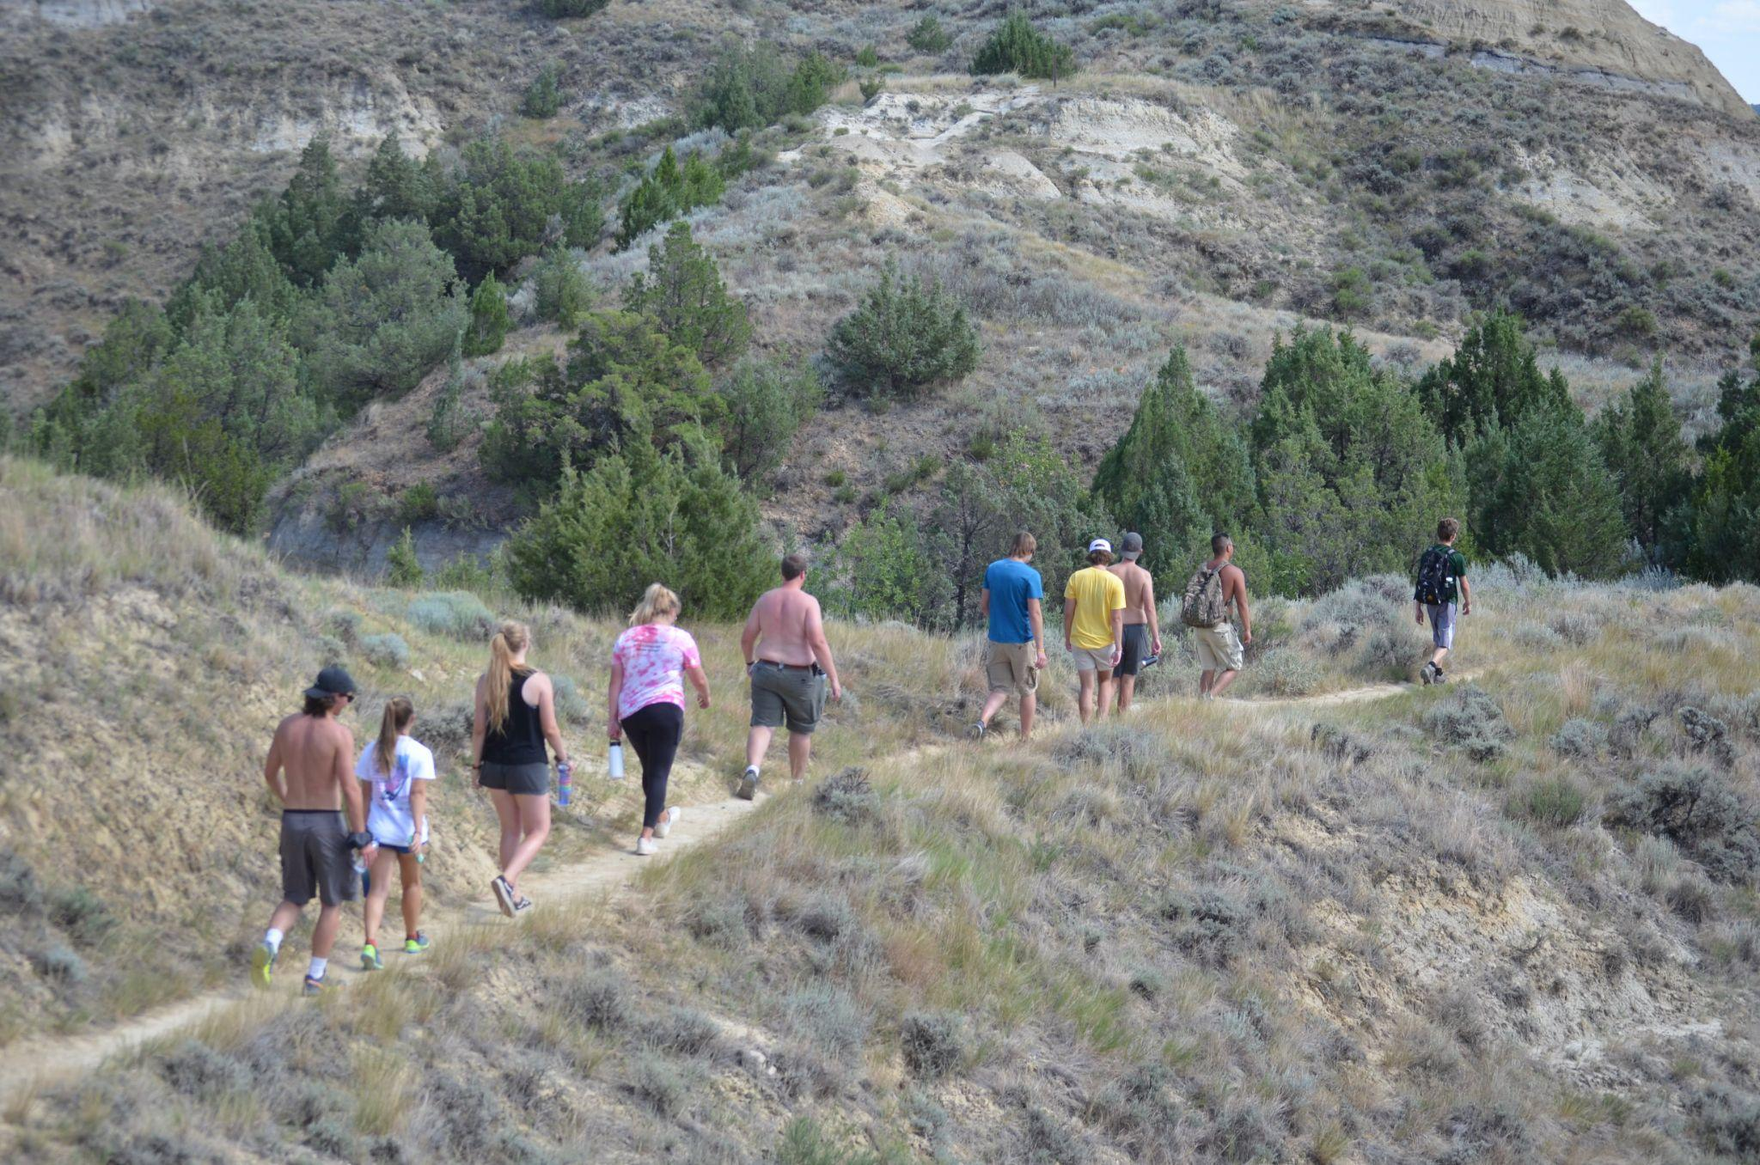
Notes:
…Hiked the national parks…

Slide 25
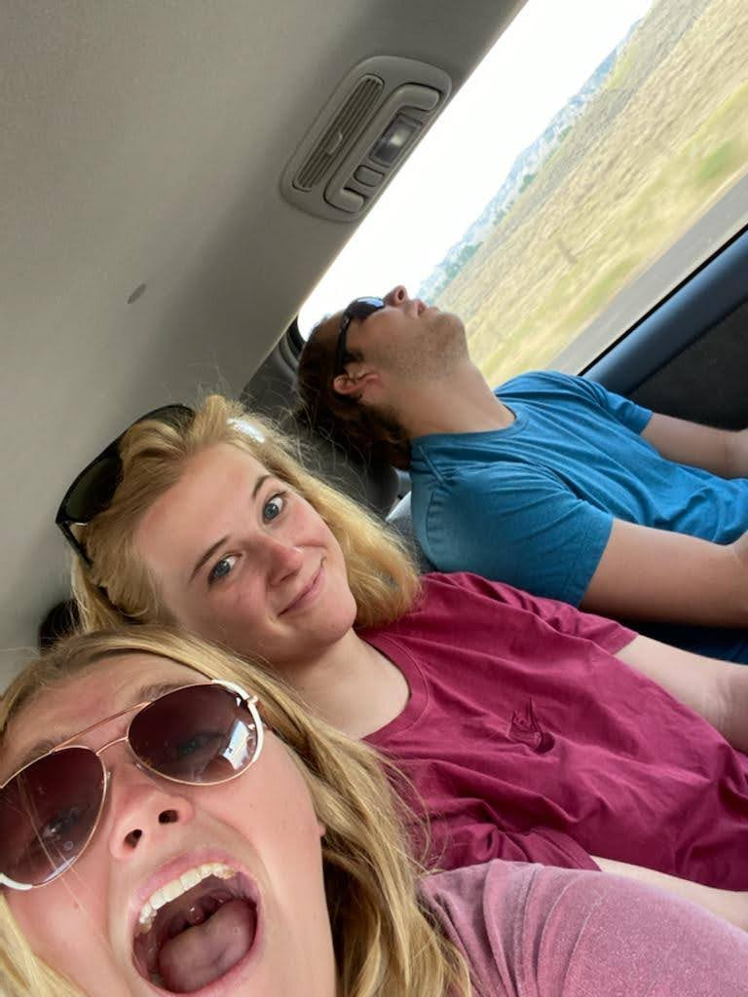
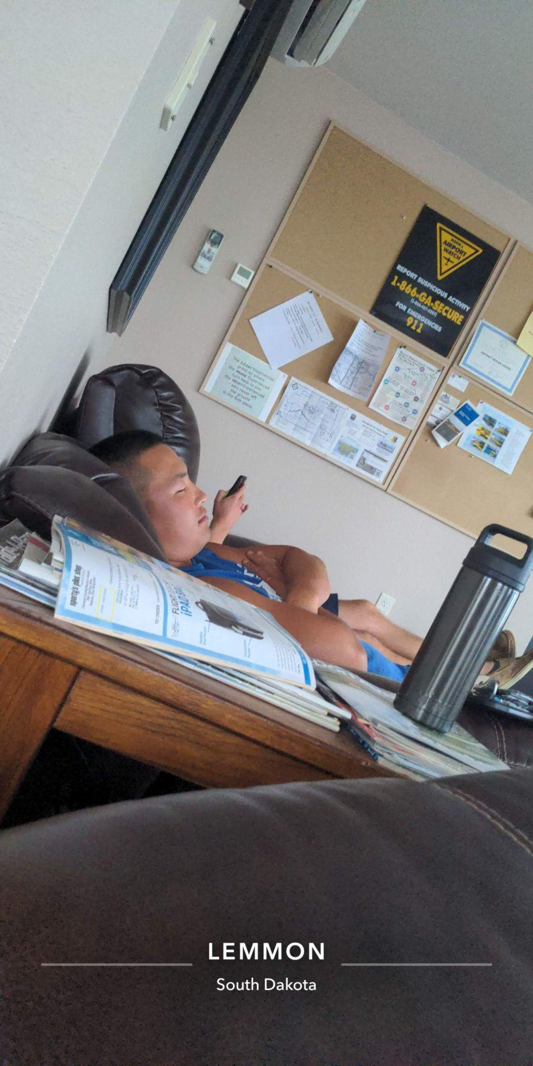
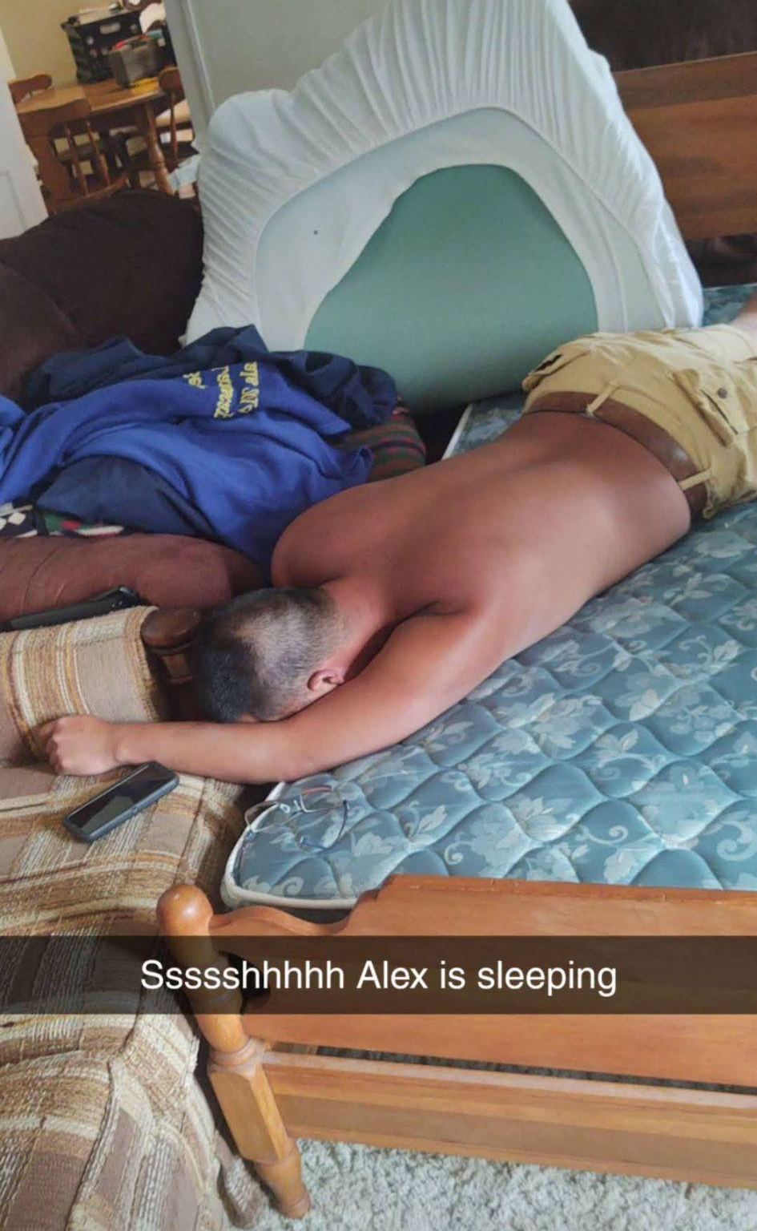
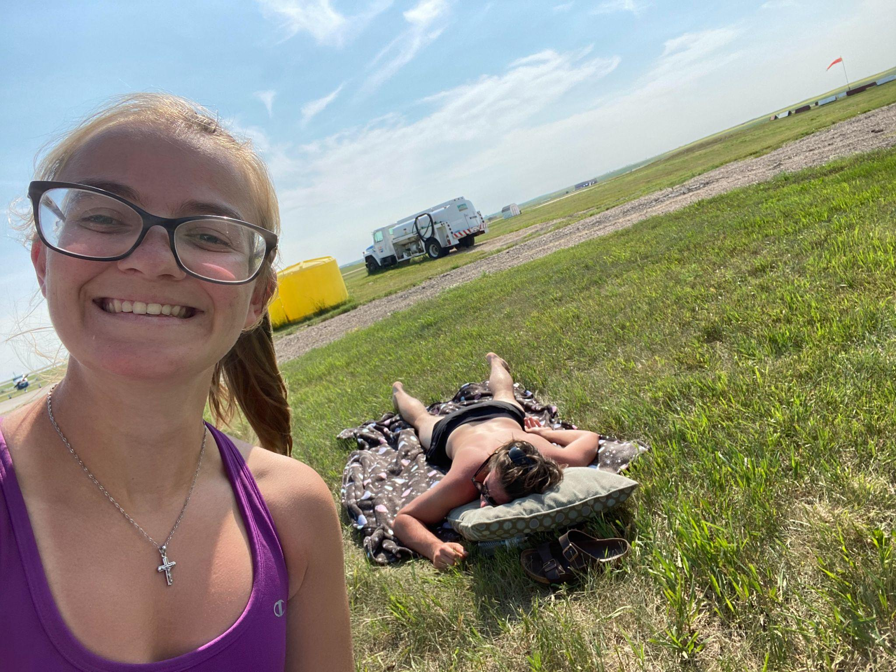
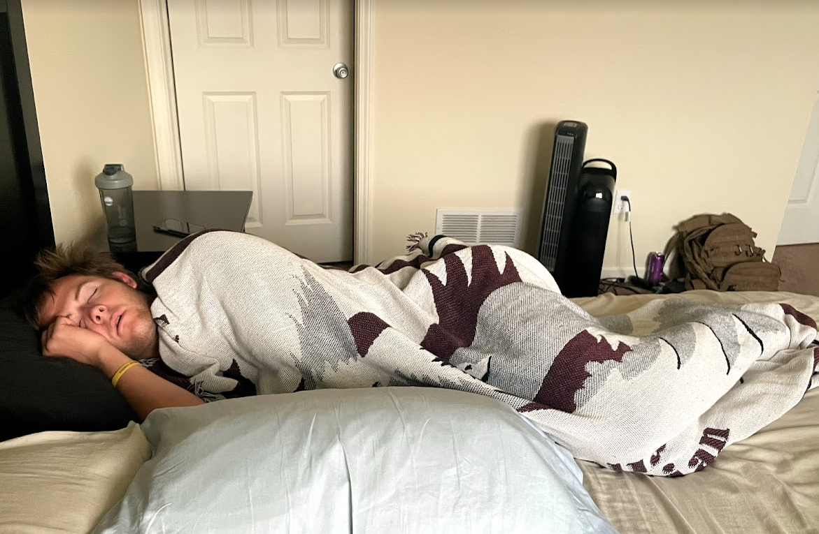
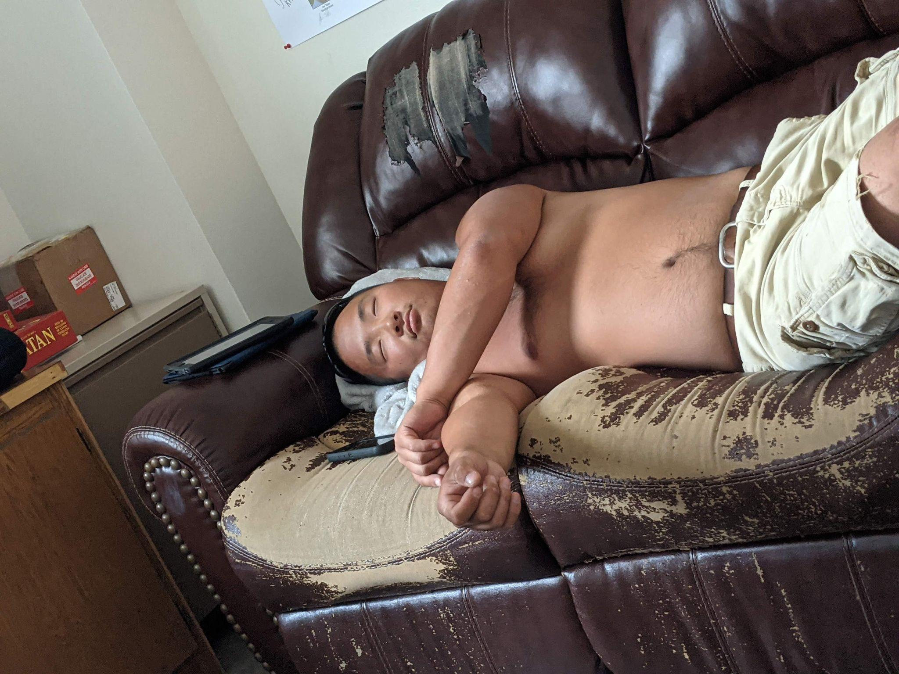
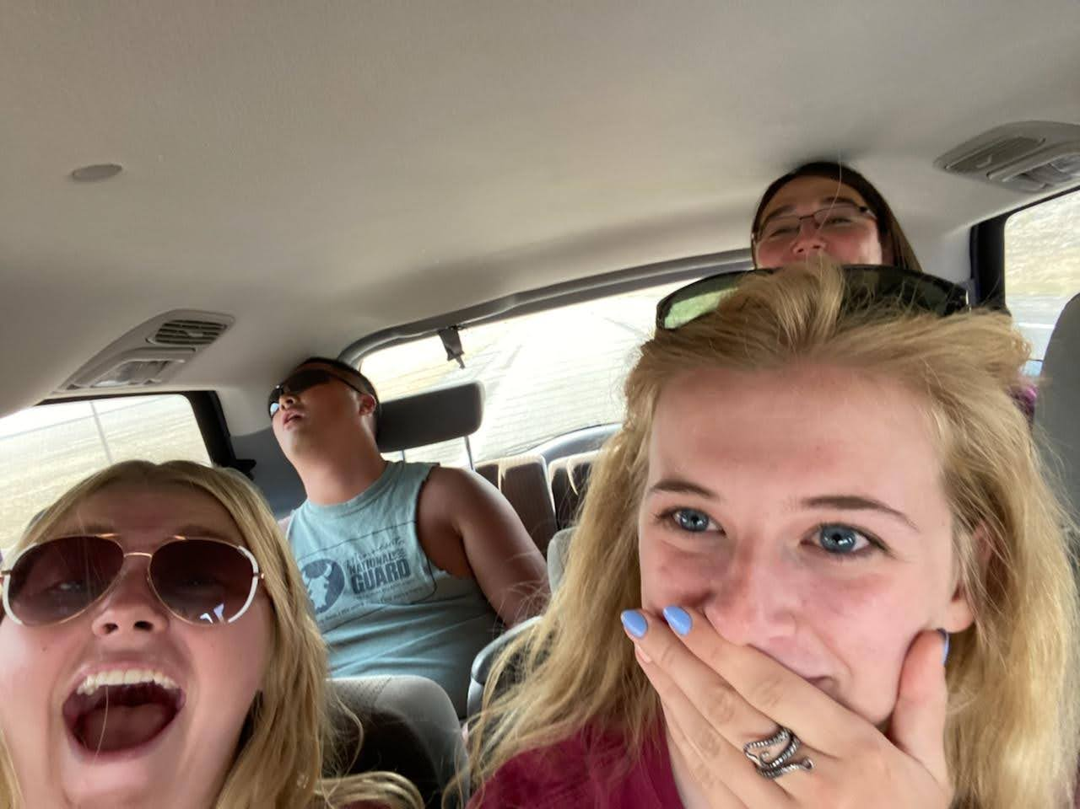
Notes:
…napped….

Slide 26
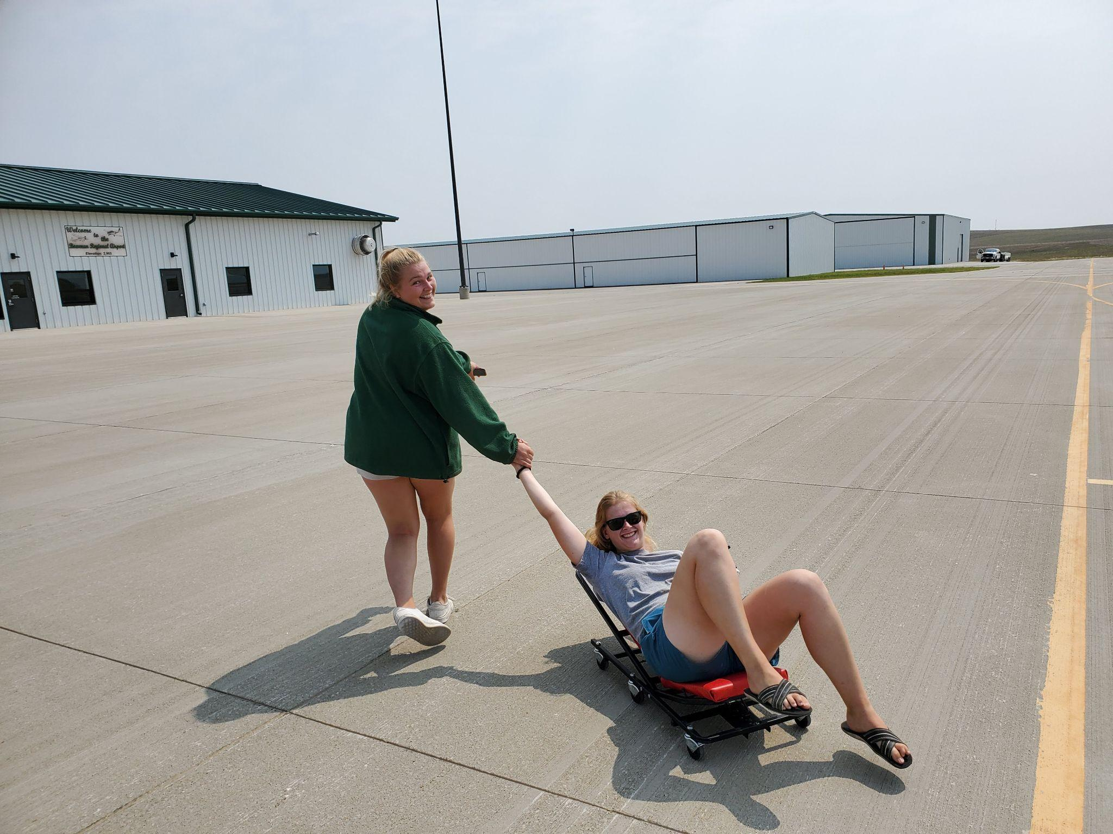
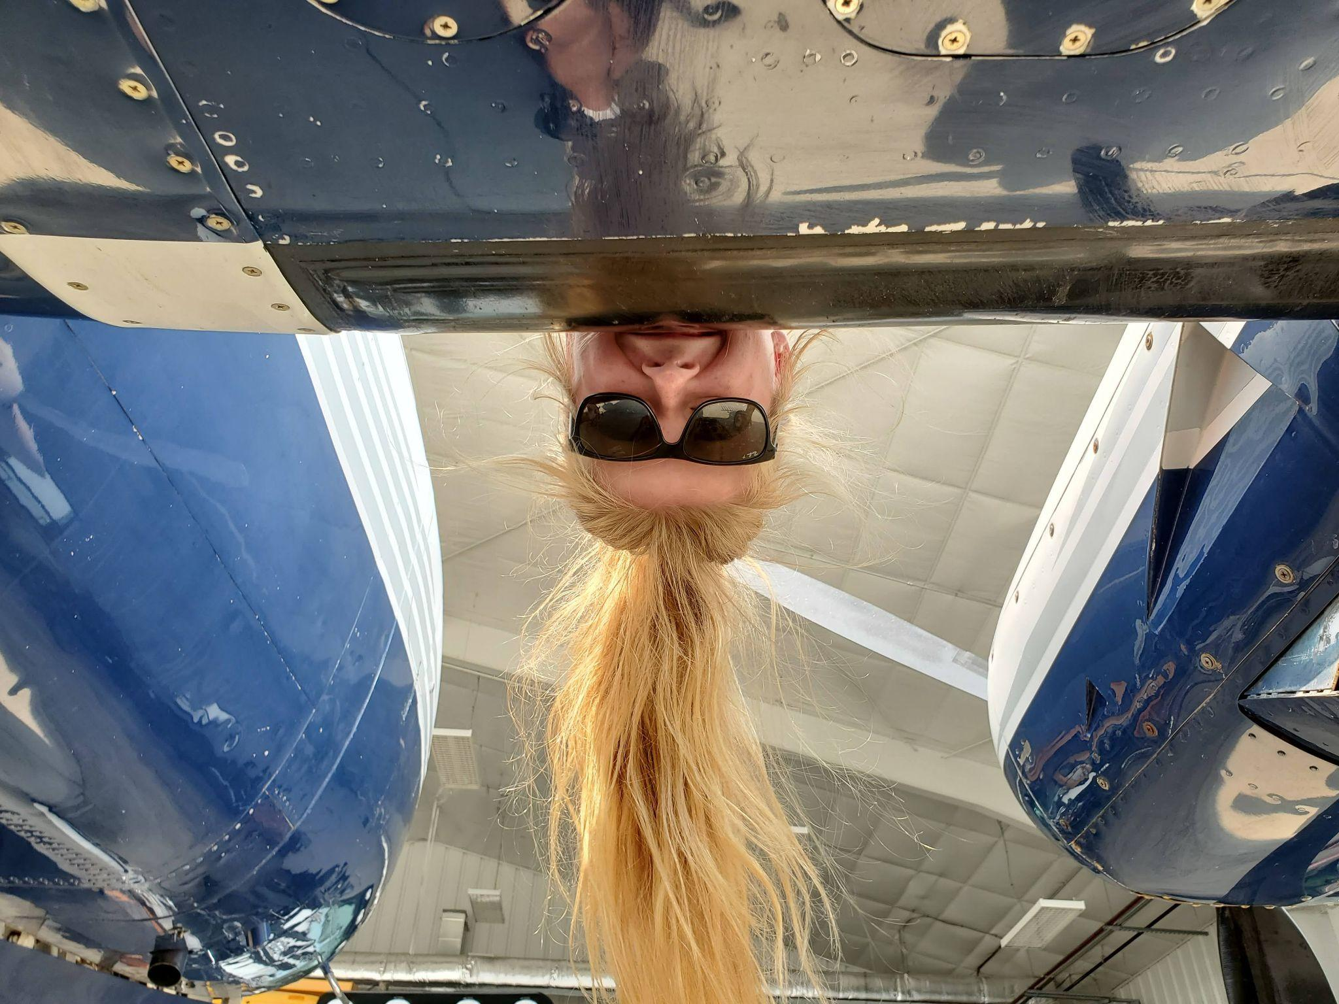
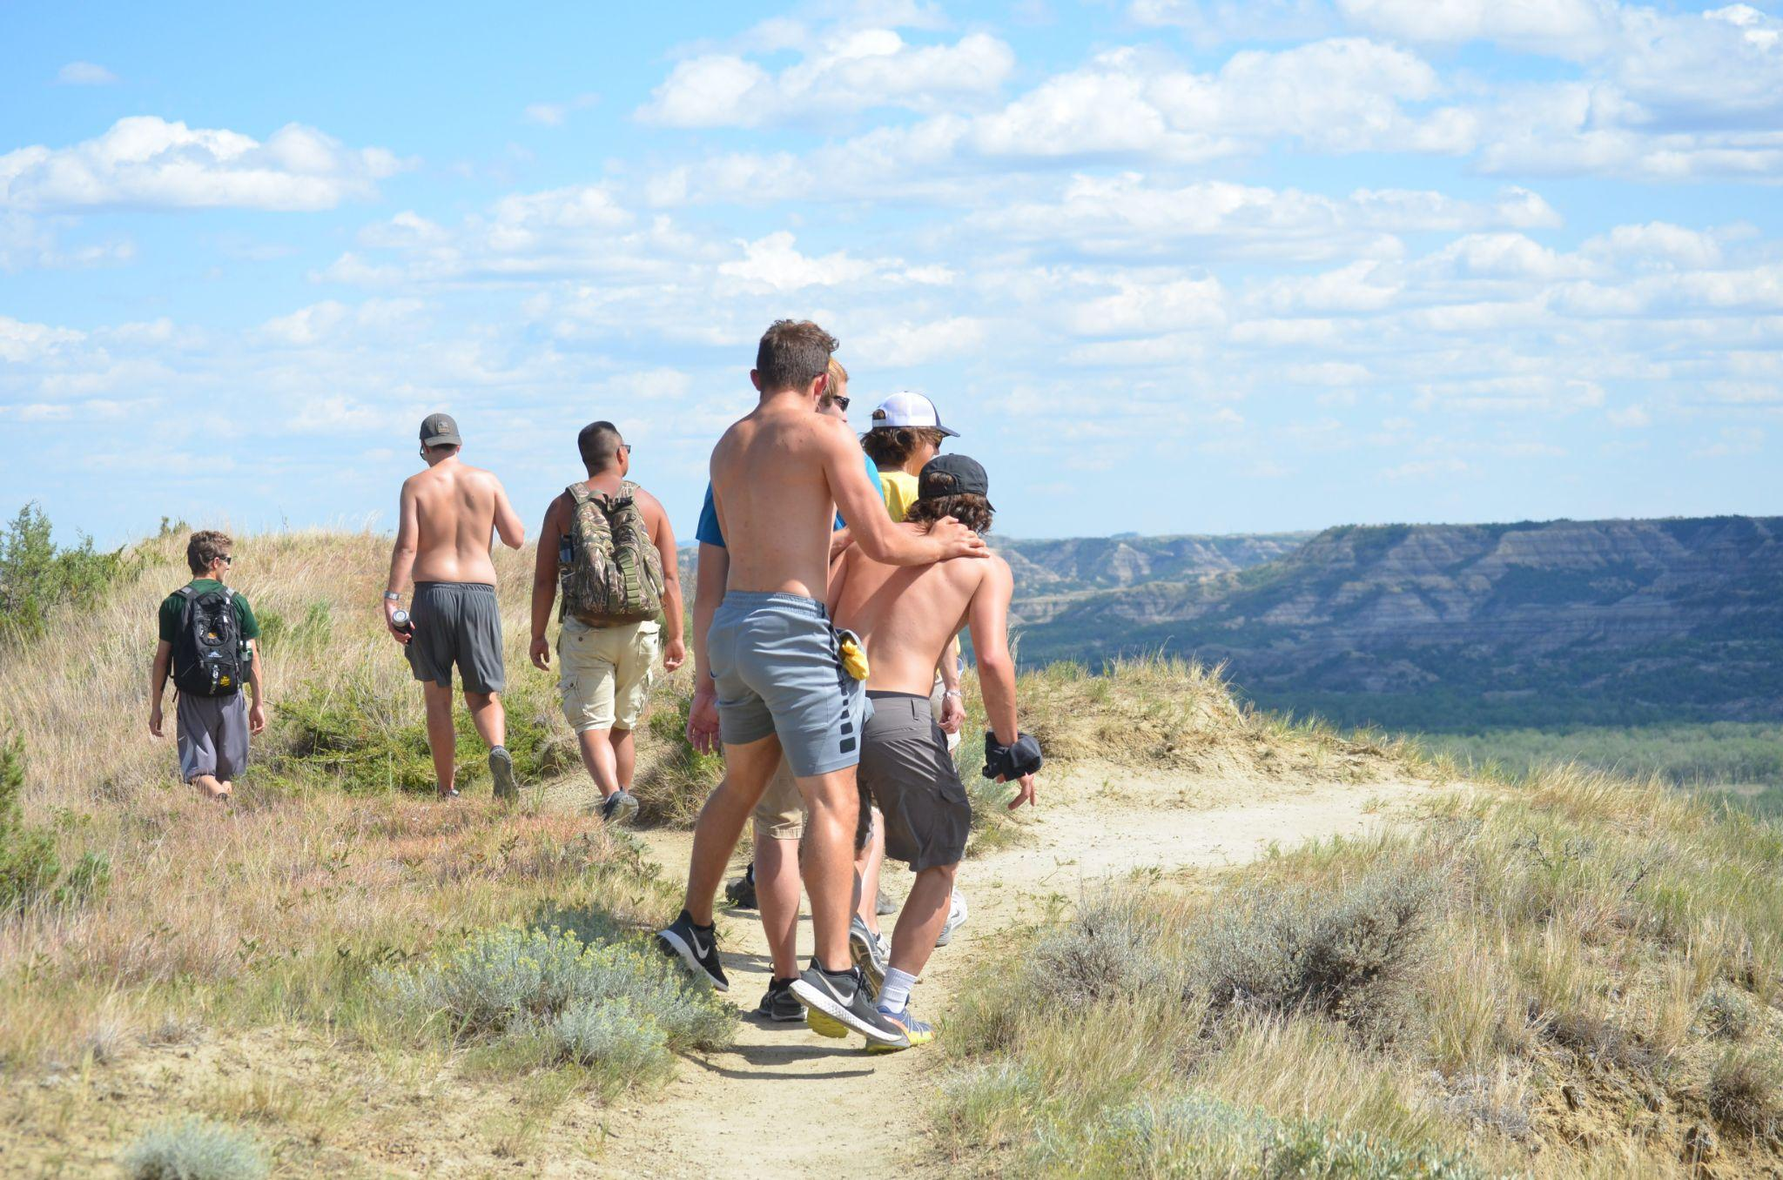
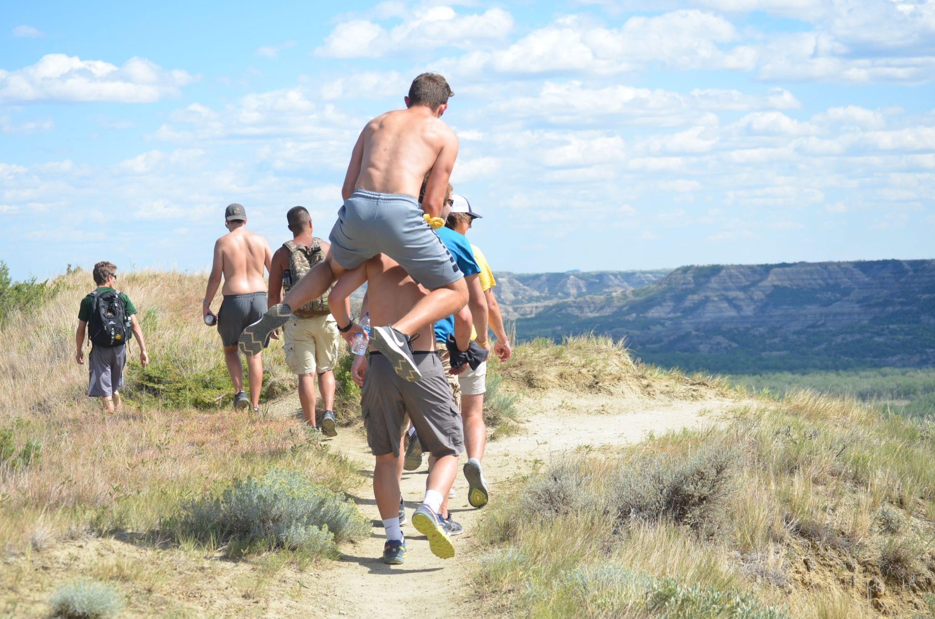
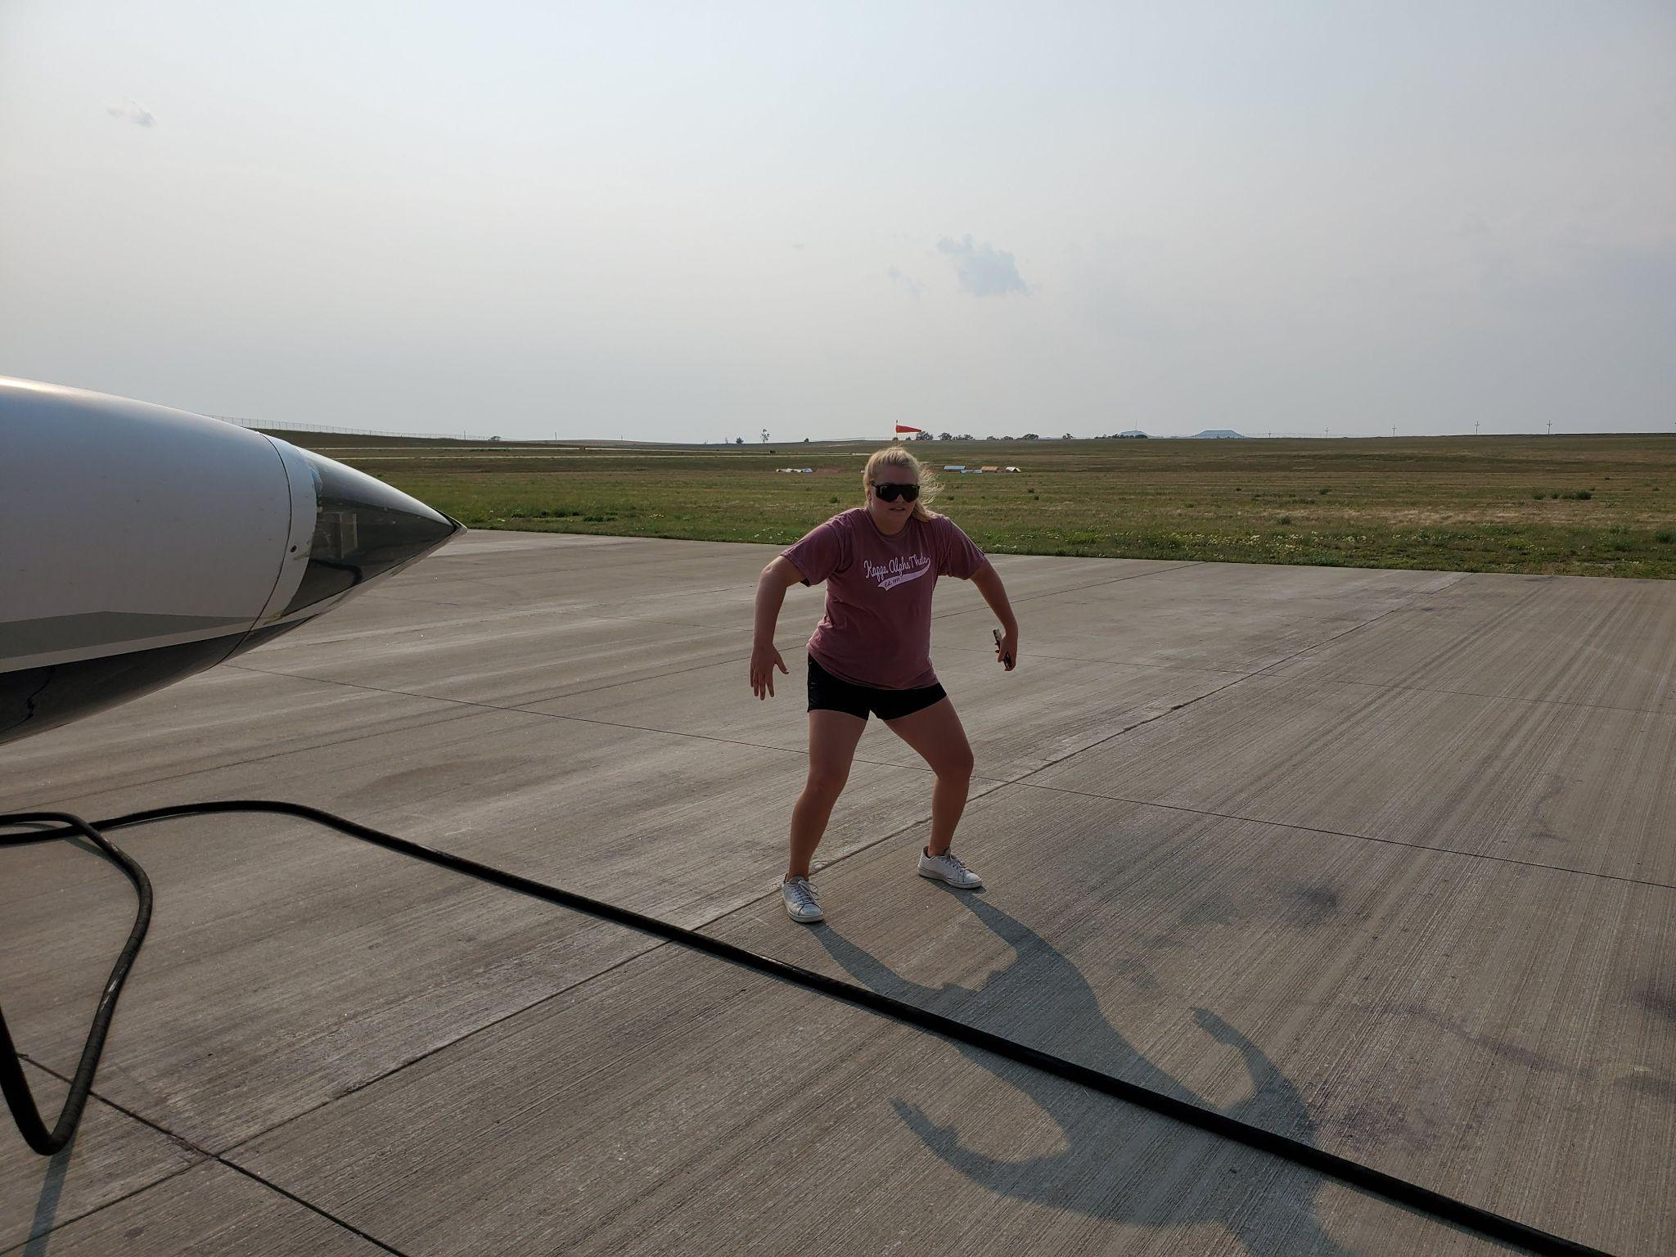
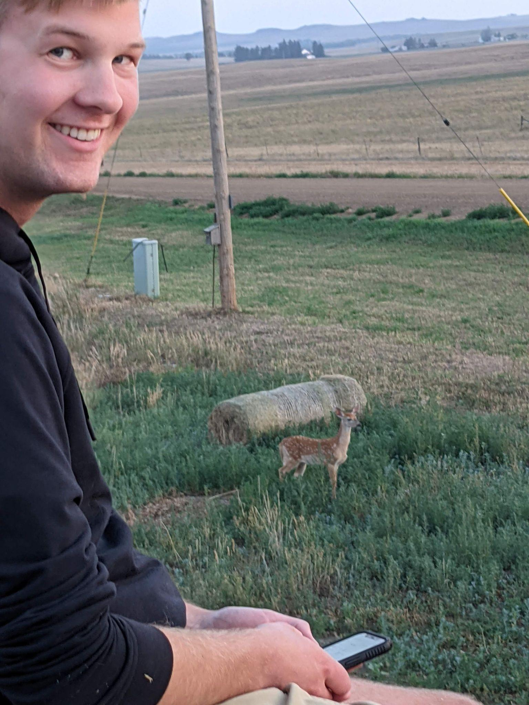
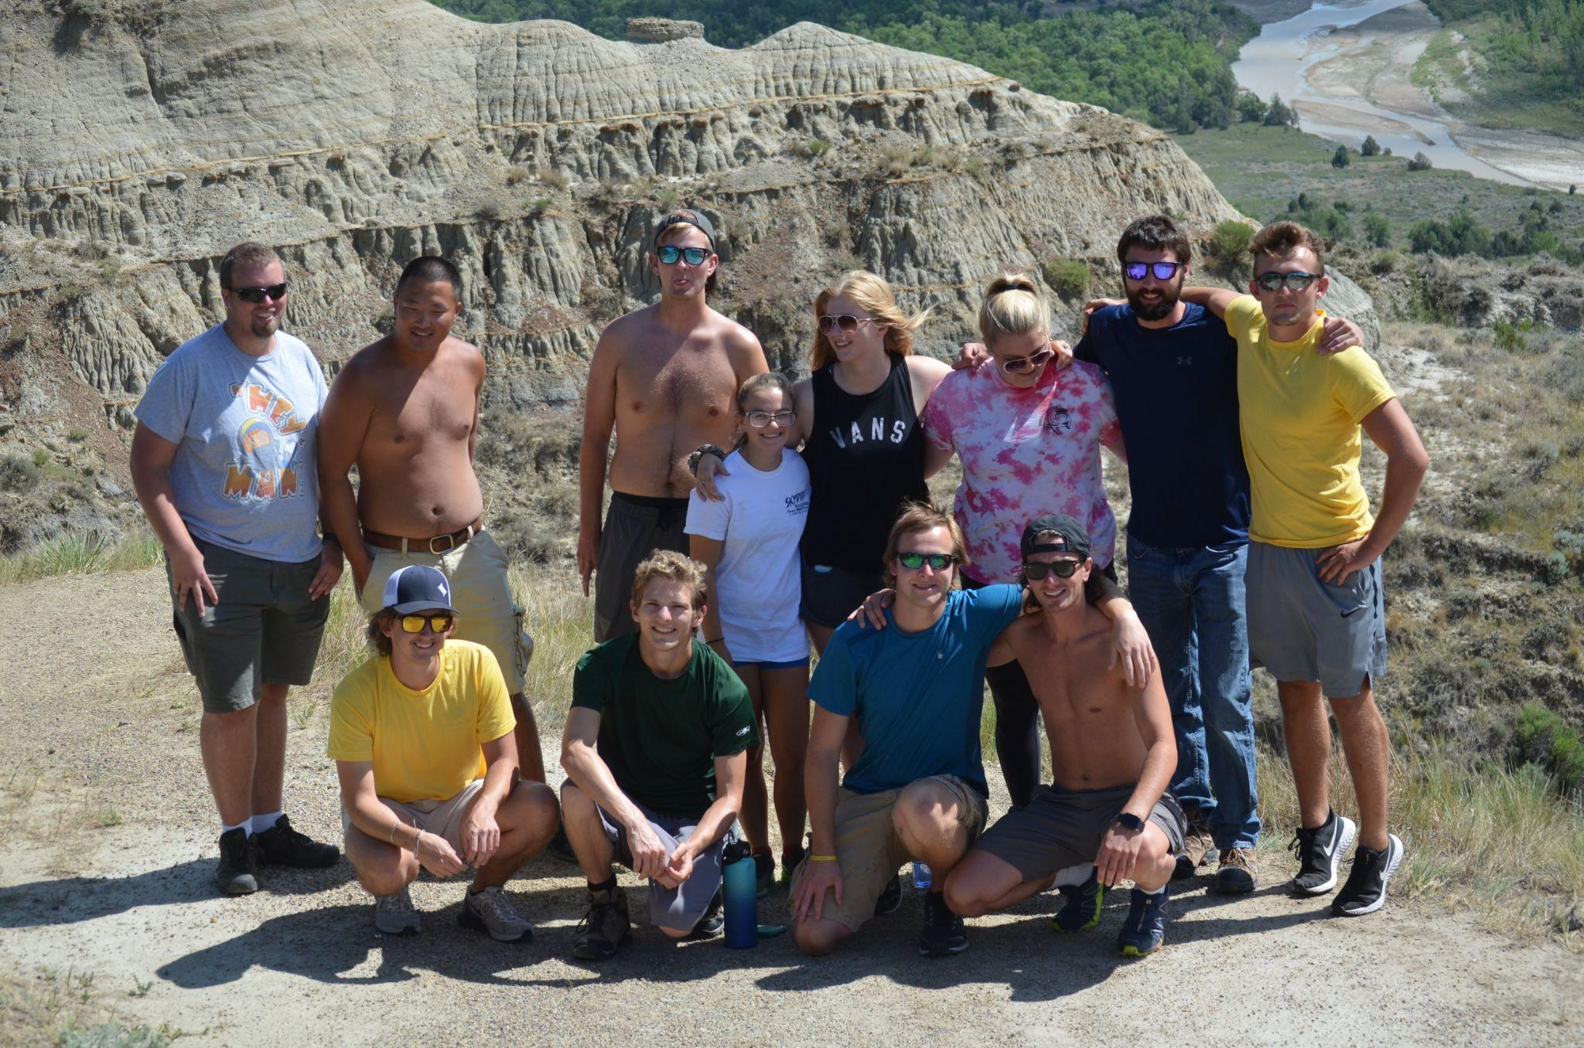
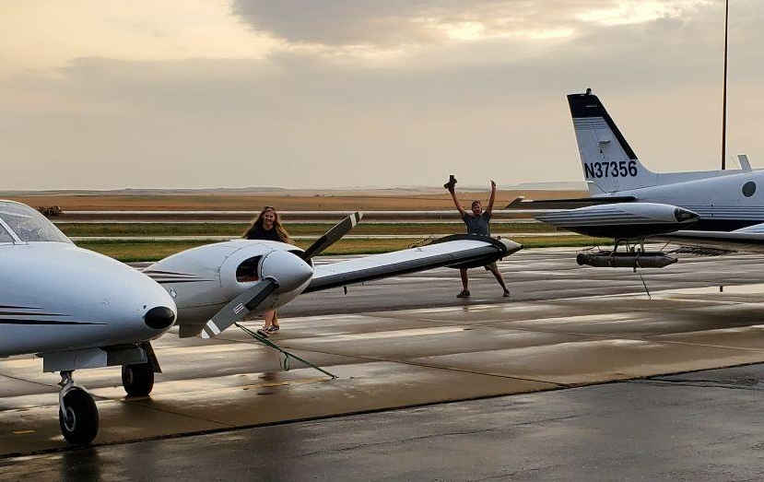


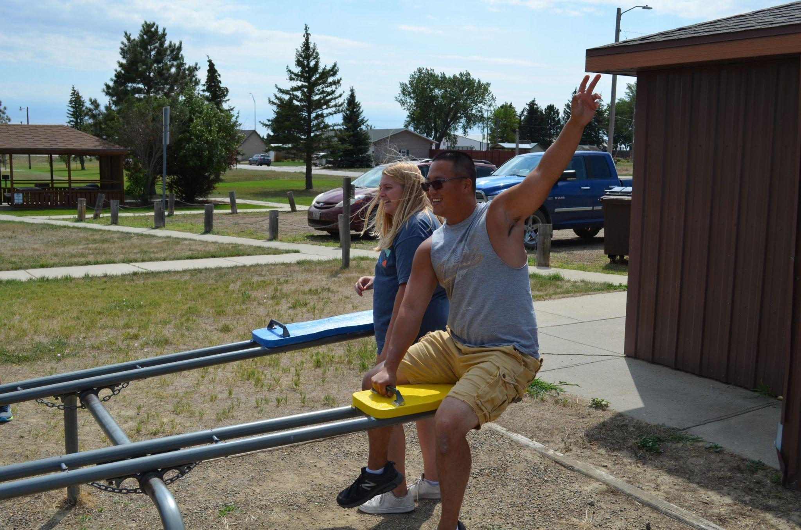
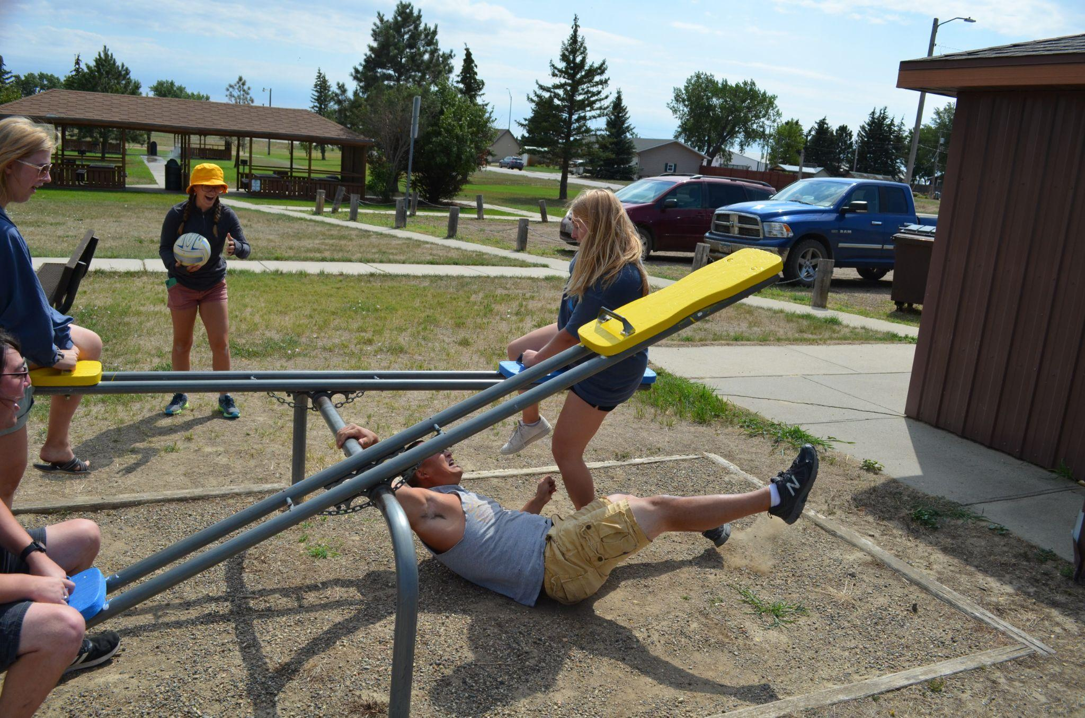
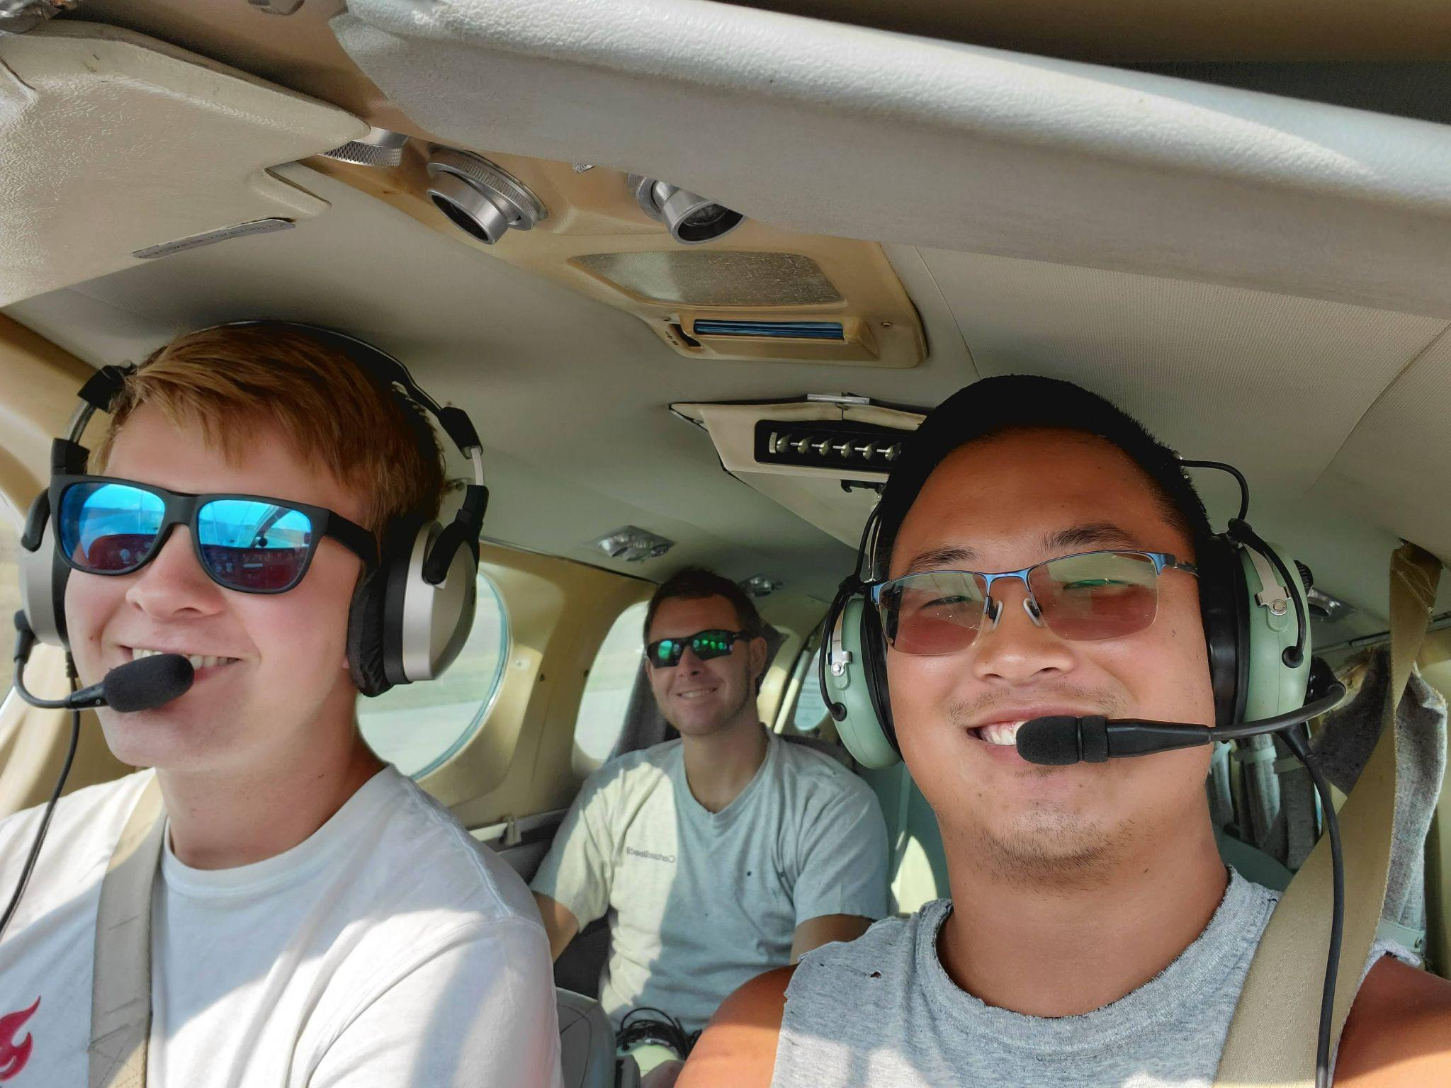

Notes:
…and just overall had a fun time.

Slide 27


Slide 28
Reach me at:
Email:
isabelle.adams@und.edu
Insta:
@izack085 or @izzycantpark
ND Wx Mod Website:
https://www.swc.nd.gov/arb/ndcmp/
Notes:
Feel free to contact me with any questions and check the ND weather mod project site for some great information!

Slide 29
July 8th Mission

Slide 30


Slide 31



Slide 32


Slide 33
Notes:
This video was taken on a large storm we seeded and what looked like a shelf cloud getting pulled over by some inflow.

Slide 34
Notes:
This is a video I took of a shelf cloud. This is typically a great area to be when seeding for getting the materials into the system.

Slide 36


Slide 37


Slide 38


