Slide 1
Droplet Growth
Supersaturated Environment
Undetectable
Particle
Detectable
Particle

Slide 2
Factors Affecting Growth of Droplets
Curvature Effect
Solute Effect
    Droplets grow when more water molecules at surface go into the droplet than escape from the surface.
r

Slide 3
Effect of Curvature
Effect of curvature is to enhance the equilibrium vapor pressure by a factor of 1/r.
Small droplets have a difficult time to keep from evaporating.
This is the primary reason for the fact that large aerosols make better CCN.
r

Slide 4
Solute Effect on Droplet Growth
Effect of dissolved substances in the water is to lower the vapor pressure required for equilibrium.
The more concentrated the dissolved substance, the greater the depression of the equilibrium vapor pressure.
  Saltier droplets need less supersaturation to survive.

Slide 5
Soluble Particle Affect on Growing Droplet
As water begins to condense on the soluble particle, the concentration of salt is very high.
As more and more water vapor condenses (the bigger the droplet gets), the more dilute the solute becomes and the smaller the solute effect becomes.

Slide 6
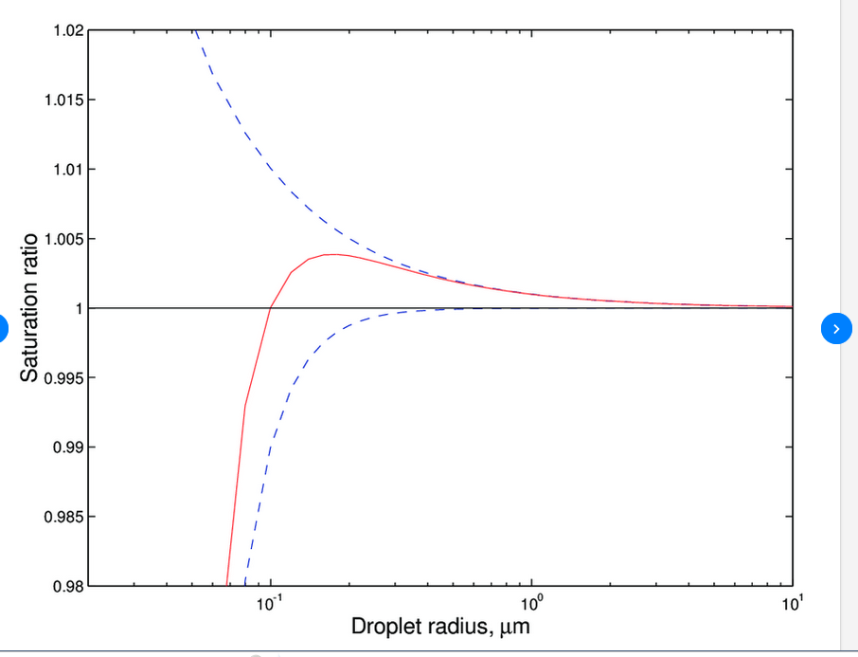
Equilibrium around a Small Droplet
Combining the Three Effects
  Clausius-Clapeyron Relationship
    Temperature
  Curvature Effect
    Radius of the Droplet
  Solute Effect
    Characteristics of the Cloud Condensation Nucleus
Solute
Curvature

Slide 7
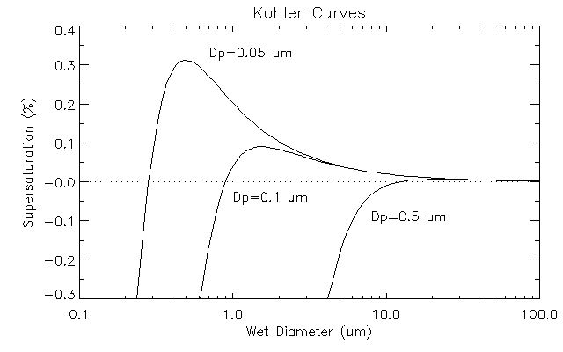
Köhler (Koehler) Curves
Families of curves showing the effects of curvature and solute on the vapor pressure required for equilibrium.

Slide 8
Cloud Formation
Rising air expands and cools.
Relative humidity increases.
Hygroscopic/soluble/large CCN activate.
Drops Grow.
Relative humidity continues to increase past 100% and more droplets form.
Droplets exceed critical size and continue taking up available water vapor even supersaturation decreases.
Relative humidity starts decreasing back toward 100% and no new droplets are formed.

Slide 9
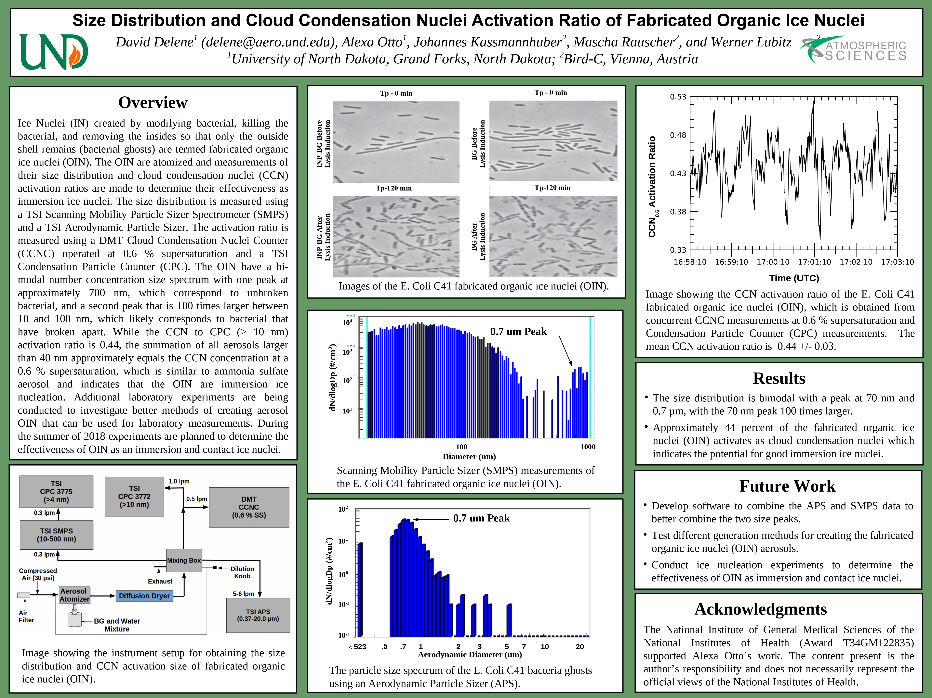
Sources Ice Nuclei
Nucleation
Certain Types of Clay
Certain Bacteria
Homogeneous Nucleation
Heterogeneous Nucleation (Supercooled Droplets)
  Similar in concept to supersaturation.
  Statistical process.
  A supercooled drop will freeze after a long enough time.

Slide 10
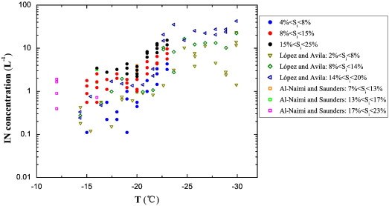
Effectiveness of Ice Nuclei
Effectiveness is often measured by “threshold temperature”.
Threshold temperature is when one particle in 10,000 will produce an ice crystal.
Different substances have different threshold temperatures ranging from about -5 °C to -40 °C.
Ice Nuclei Concentration (L⁻¹)
Temperature (°C)

Slide 11
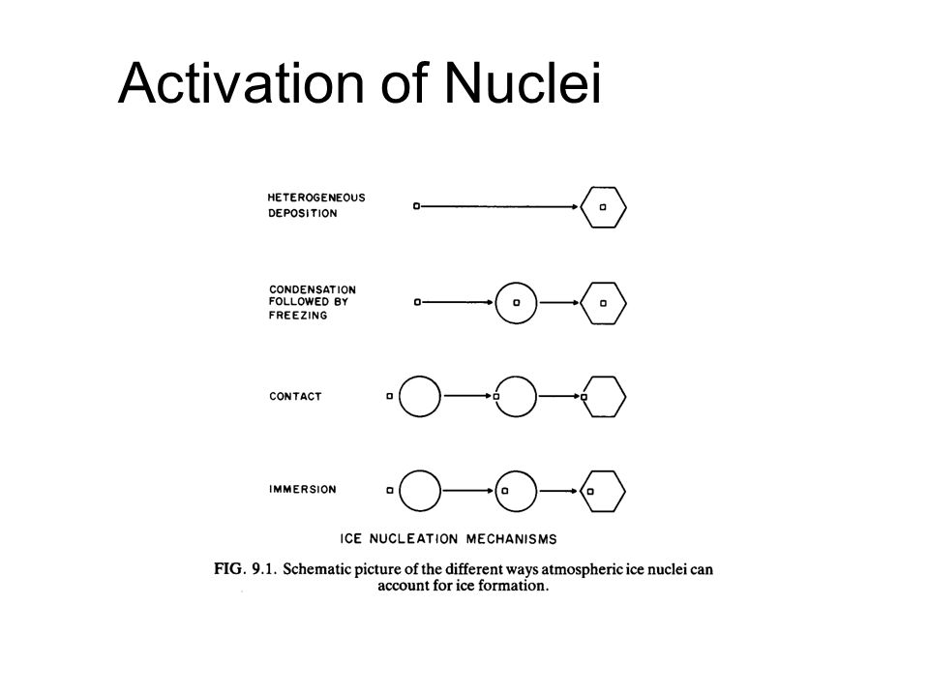
Activation of Ice Nuclei
Deposition (Sublimation)
Condensation-freezing (Absorption)
Contact Nucleation
Immersion (Bulk Freezing)

Slide 12
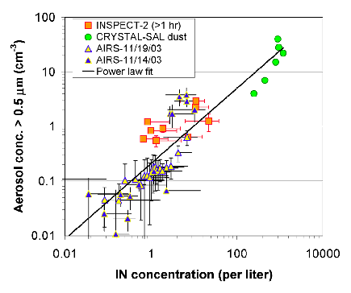
Concentration of Ice Nuclei
Depends upon temperature, ice nuclei concentrations are commonly measured at -20 °C.
At -20 °C concentrations are often 10³ m⁻³ or lower. (Cloud droplet concentrations are typically of the order of 10⁸ m⁻³)
  Important point in most weather modification programs.
Aerosol Concentration > 0.5 µm (cm³)
Ice Nuclei Concentration (L⁻¹)

Slide 13
Relative Concentrations
Condensation Nuclei (> 10 nm)
Cloud Condensation Nuclei (CCN)
Ice Nuclei (IN)

