Slide 1
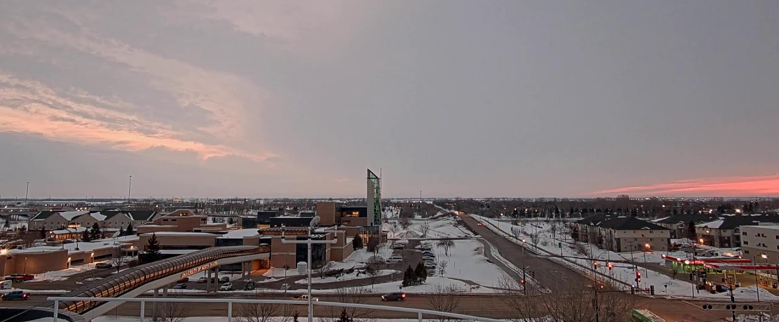
Research at the
John D. Odegard School of Aerospace Sciences
David J. Delene, PhD
Aerospace Research Fellow

Slide 2
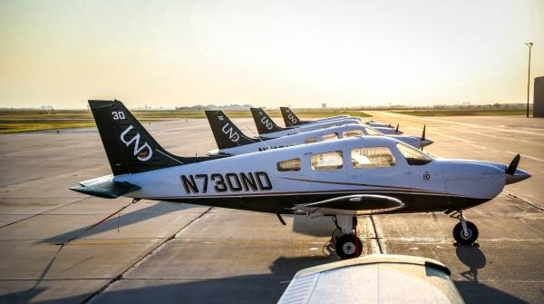
College Research Focus Areas
Operations
Aircraft, Airport, UAS, Space Environment
Newer Focus – Stratosphere, Rockets
Observations (Atmosphere, Space, Earth)
Aircraft, UAS, Satellite, Balloons, Surface, Telescope
Partnerships
Government (NASA, FAA, DOD)
Foundation
Private Companies
Colleges

Slide 3
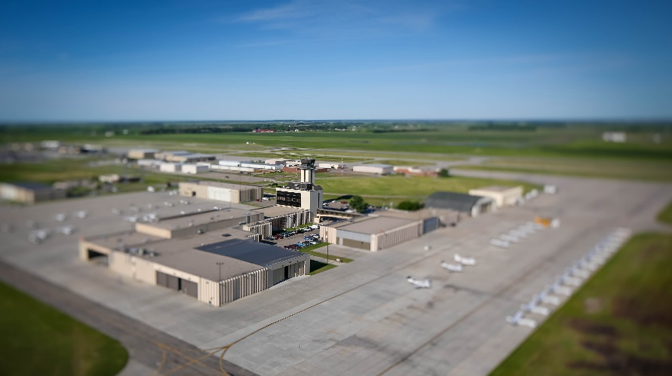
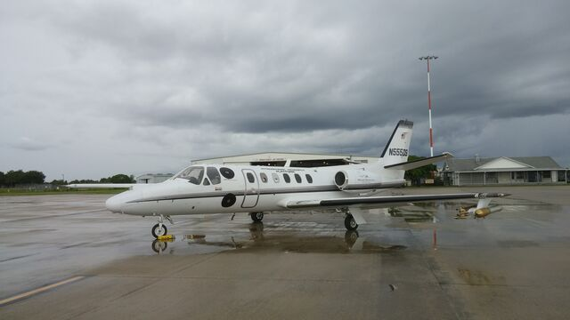
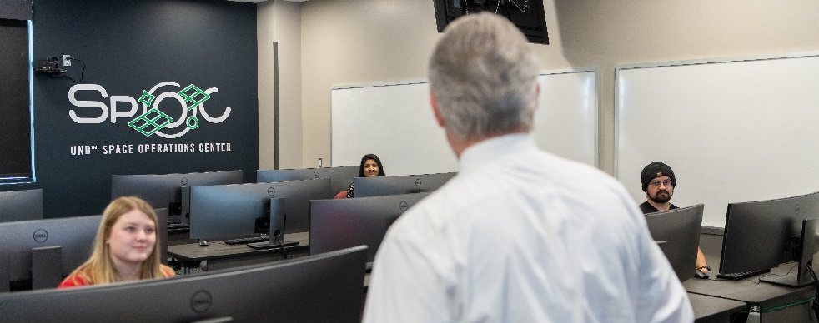
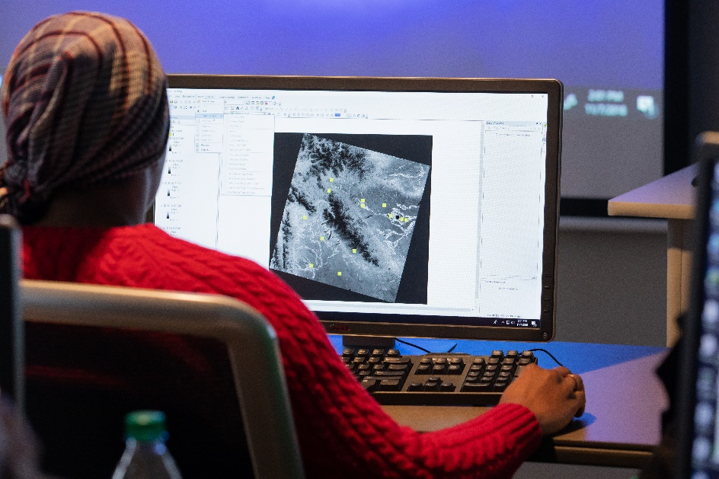
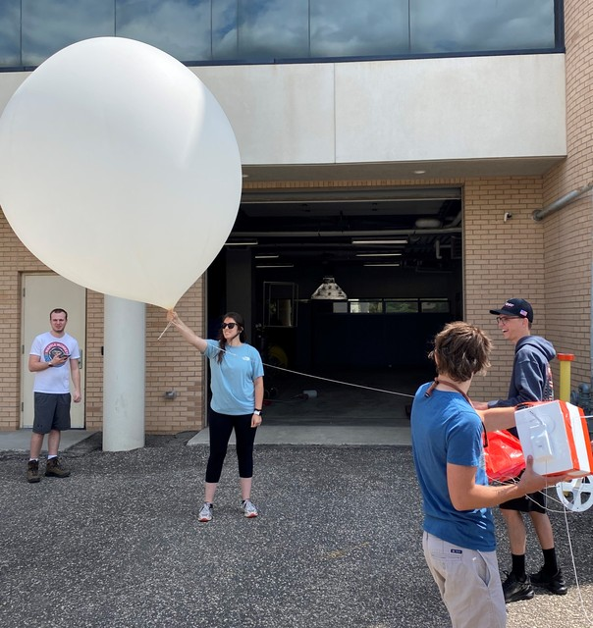
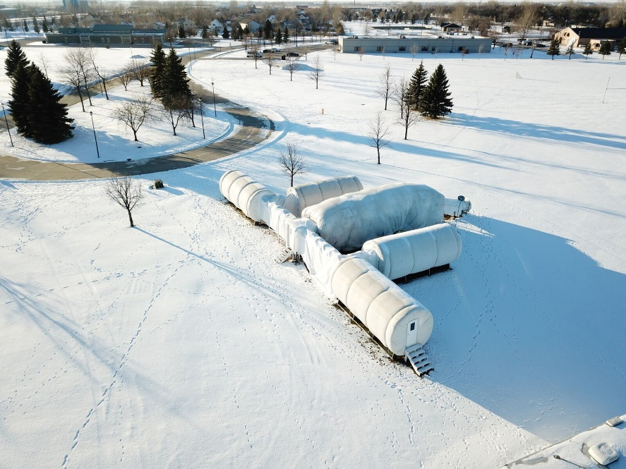
Research Facilities
Research projects should focus on the problem to address, background and experience of personnel, and lastly facilities.

Slide 4
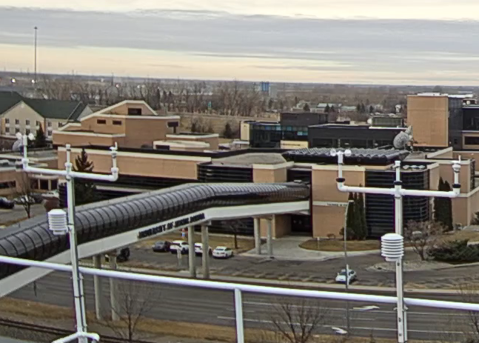
College Research Proposal Support
Proposal Budget Preparation and Support
Laurie Baumgartner and Amber Holien
Computer System Design/Support
Neil Nowatzki and John Wold
College Seed Funding
Annual Proposal Calls
Vetting Proposal Ideas
David Delene, Research Fellow
Aerospace Research Council
FAST (Future Aerospace Strategic Thinking) Presentations

