Slide 1
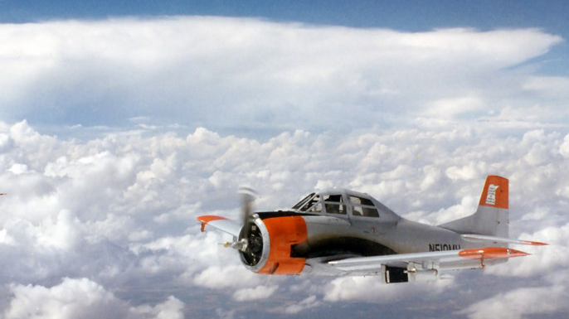
Processing of In-Situ T-28 Aircraft Data for Coupling with Radar Observation of Hail Storms
James Klinman, David J. Delene (Presenter), Andrew Detwiler, Ivan Arias Hernandez, Patrick Kennedy, and V. Chandrasekar
Photo provided by Tom Warner
Notes:
Thank you all for coming.
Excited to share what we been working on related to multi-field project analysis of the T-28 aircraft dataset, which was retired in 2003.
We are focused on data from 1995-2003.

Slide 2
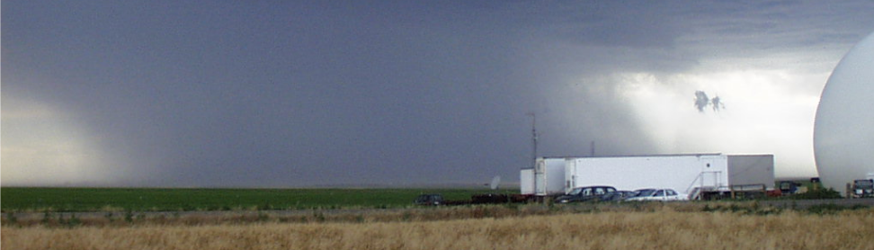
Motivation
Annually, hailstorms cause ~1.433 billion USD in damage to crops within the US.
Improved understanding hailstorms improves forecasts and modeling.
2000/06/23
<number>
Notes:
T28 projects collected in-situ measurements and ground based radar that is time/space synchronous.
Dataset is unique
No future plans
All we have to work with
Motivation is to improve physical understanding of hail, which could ultimately improve forecasts and models of hailstorms.

Slide 3
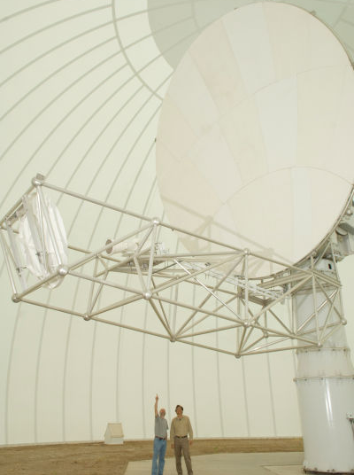
Research Objectives
Compare T-28 aircraft in-situ measurements of hail with CSU-CHILL radar observations.
    Assess the data quality of Optical Array Probe (OAP) measurements.
    Assess uncertainty in using T-28 in-situ data for calculating radar signatures such as reflectivity.
Photo of CSU-CHILL Radar by John Eisele
<number>
Notes:
Focus is on analysis of the uality of the OAP measurements with an assessment of uncertainty.

Slide 4
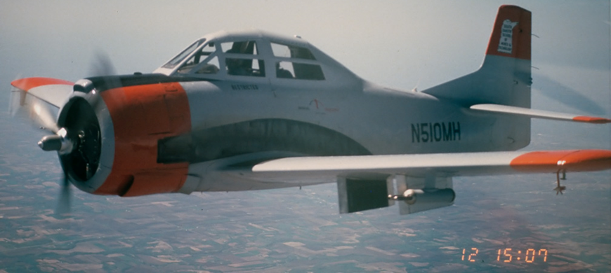
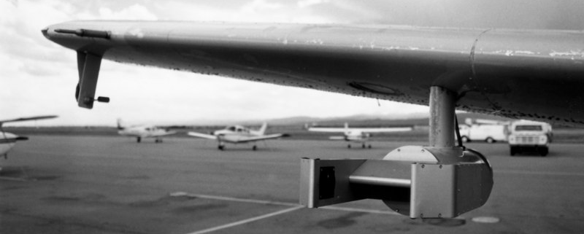
T-28 Aircraft
Able to fly in hail up to 7.5 cm (3 inch)
Analyze 14 flights.
Deployed two optical array probes (OAP),
    Hail Spectrometer
    HVPS-V1
Hail Spectrometer
Photo provided by Tom Warner
High Volume Particle Spectrometer v1
Photo provided by Tom Warner
<number>
Notes:
Project uses 14 flights, from 5 campaigns over 4 unique years.
Data is from two OAPs
Hail spec is primary probe, operational for entirety of all 14 flights
However, no de-icing
HVPS would often crash in high particle concentrations conditions.
Can use HVPS to verify hail spec, but hail spec is required for quantitative analysis.

Slide 5
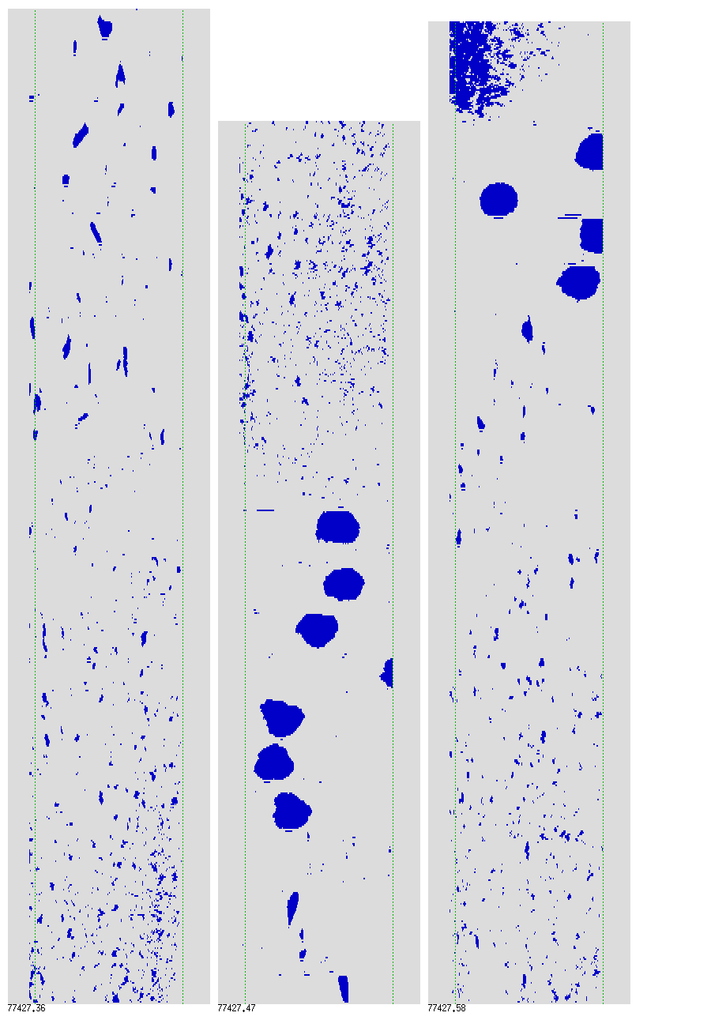
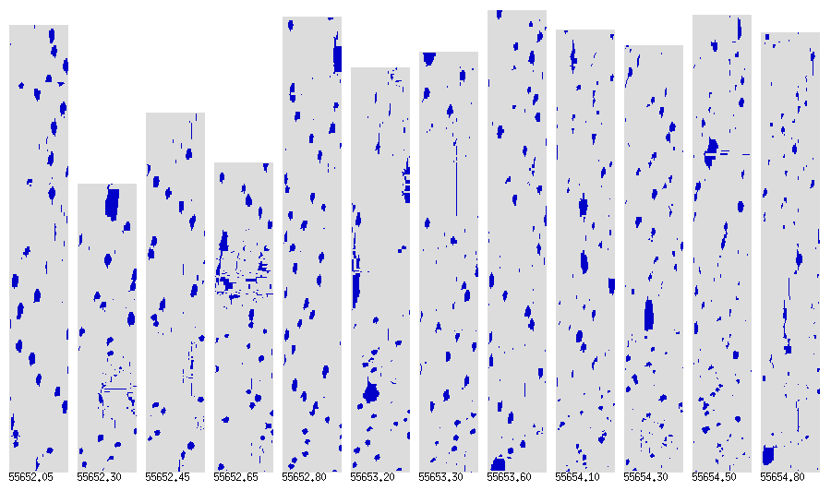
Optical Array Probe (OAP) Images
High Volume Particle Spectrometer (HVPS)
3.7 cm
Hail Spectrometer
5.7 cm
Photo provided by Tom Warner
Airflow
<number>
Notes:
Can use HVPS to verify hail spec, but hail spec is required for quantitative analysis.
Hail Spec has larger sample volume that better for large particles (hail) but can have coincidence issues at smaller sizes.

Slide 6
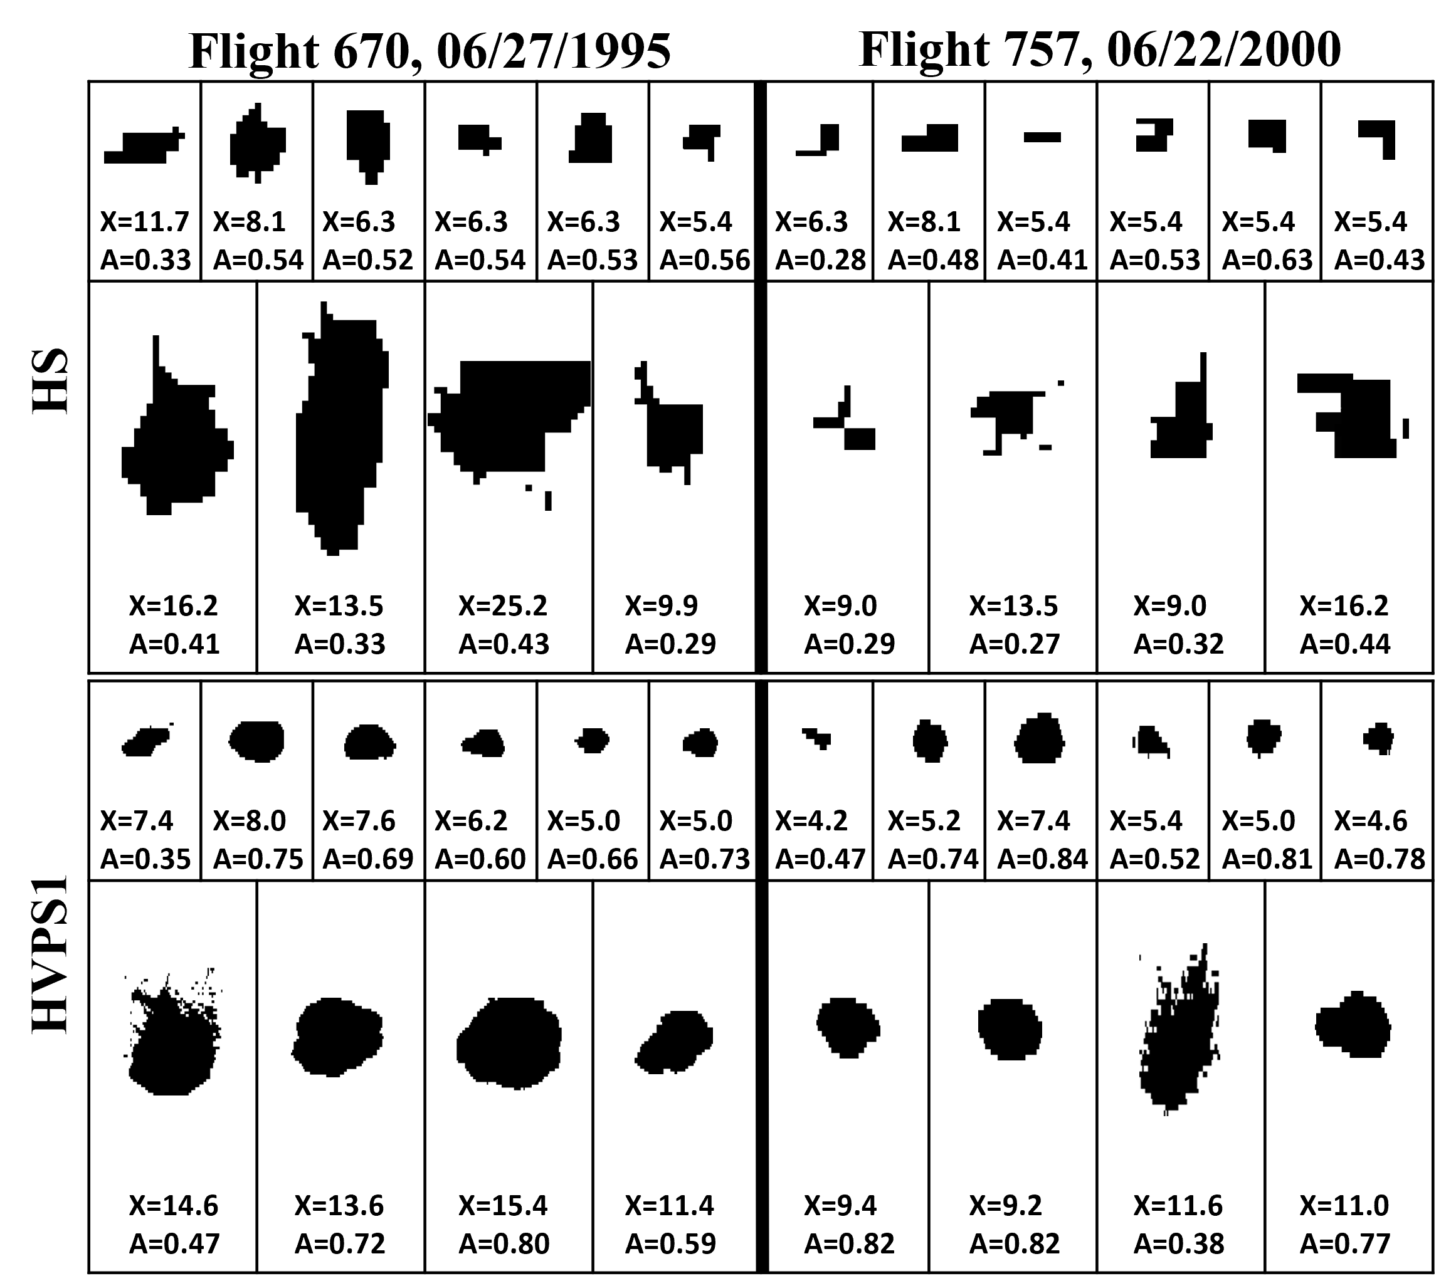
Review of Individual Particles
Overall assessment of image quality.
Provide confidence in area ratio threshold (0.3) used for particle rejection using SODA processing software.
Hail Spectrometer
HVPS1
Legend:
X = x-size diameter (mm)
A =Area ratio
<number>
Notes:
Used newly developed individual particle viewing software to conduct extensive quality assurance of the dataset.
Determined that a area ratio threshold of 0.3 is good for rejection of 2D processed data.

Slide 7
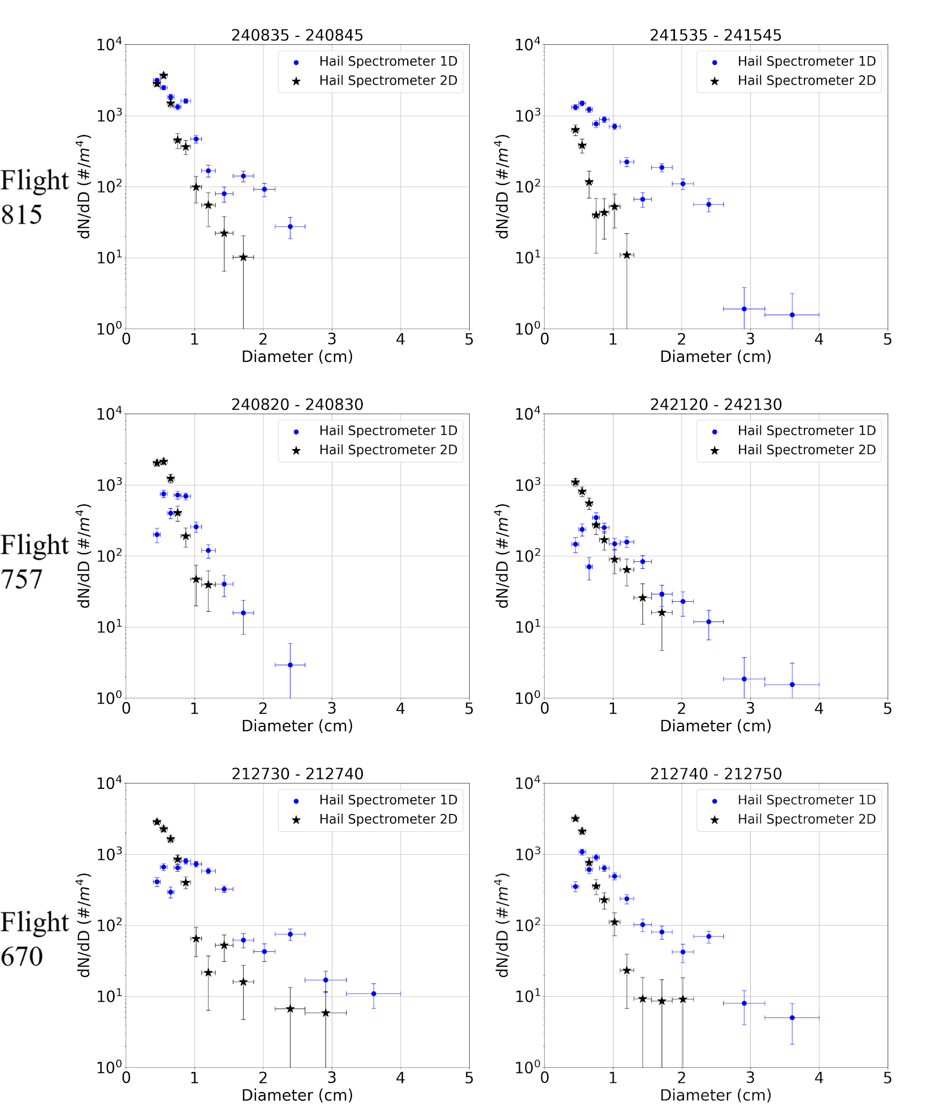
T-28 Flight 815
Particle Size
Distributions (PSD)
Analysis quantitatively evaluates 2D image quality.
1D and 2D PSDs do not agree.
1D PSDs have too many large particles and too few small particles.
T-28 Flight 757
<number>
Notes:
There are to methods for processing the Hail Spectrometer data.
A 1 dimensional method (1D)
After 1995 – 2 dimensional method (2D)
Methods do not agree.
Shape of Spectrum suggest 1D PSDs have too many large particles and too few small particles.

Slide 8
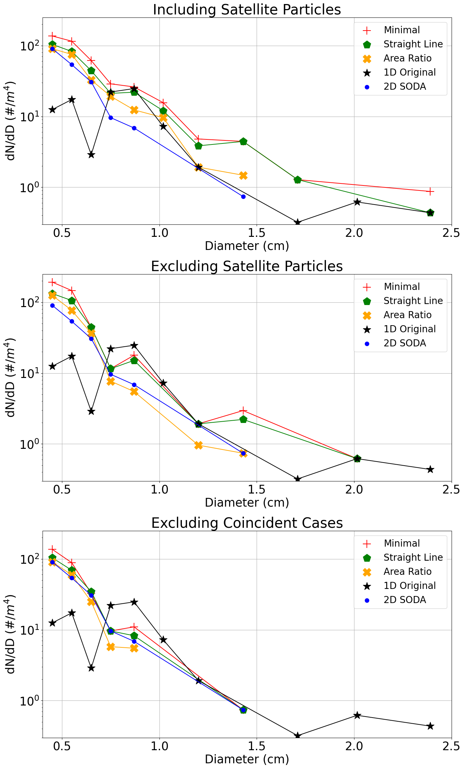
June 22, 2000 (Flight 757) 24:21:00-24:21:10 UTC)
1D Standard Processing
2D X-size (AR>0.3)
Minimal (No Rejection)
Linear Particle Rejection
All-in Processing (AR>0.3)
<number>
Notes:
Plot show the results of manually sizing particles for 10 second interval where coincident particles are rejected.
1D Standard Processing – Data from standard 1D counts file.
2D x-size processing using SODA with 0.3 area ratio rejection threshold.
Minimal – All particles accepted with x-size larger than 5 pixels (0.45 cm).
Linear Particle Rejection – Like minimal but rejects particles which are in straight line (rejection linear particles).
All-in Processing - < 0.3 Area Ratio Rejection like 2D-Size but with rejections of edge touching particles.
Using any 2D processing does not match 1D standard processing; hence 1D issue.

Slide 9
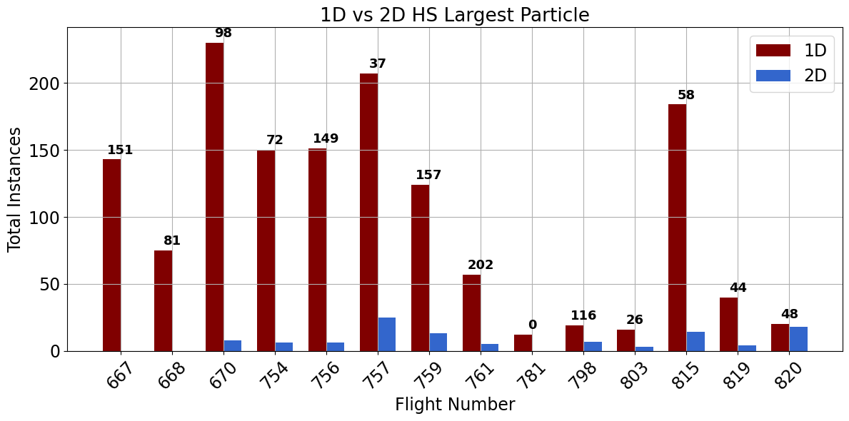
Summary of 1D and 2D PSD Largest Particles
<number>
Notes:
The issues with the 1D processing results in the 1D processing having sufficiently larger particles than the 2D processing which would affect reflectivity calculations.
1D processing has historically been used for T-28 data analysis.

Slide 10
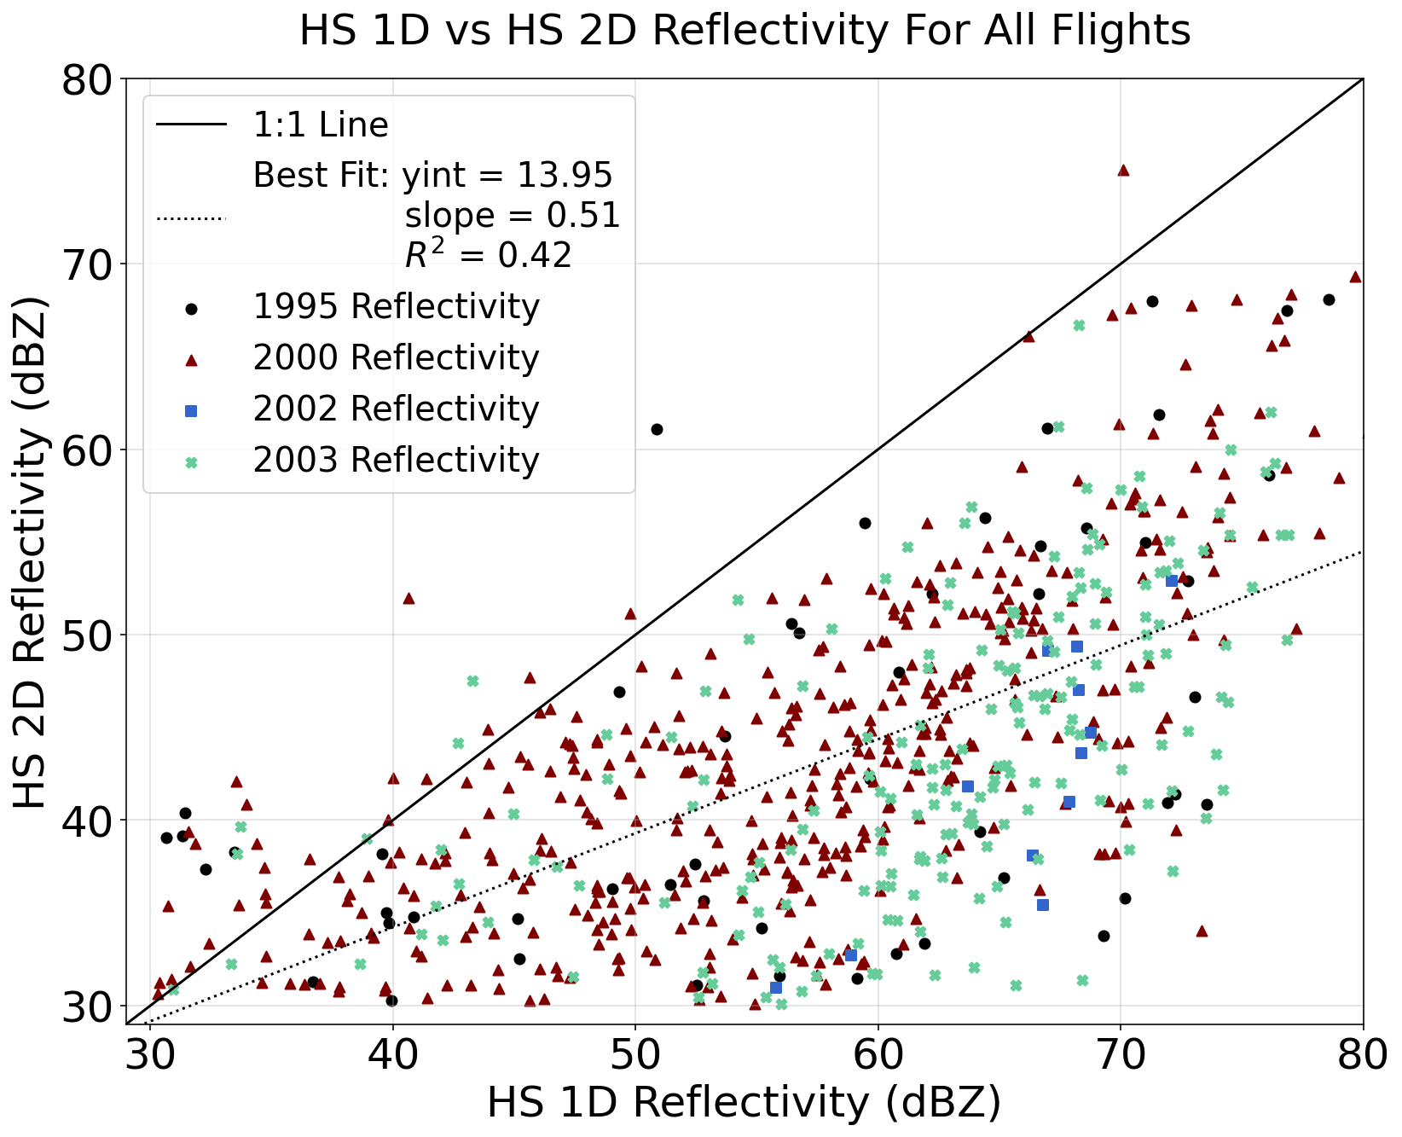

Impact on Reflectivity
1 Particle, 1 cm:
Ze = 37.6 dBZ
1 Particle, 2 cm:
Ze = 56.4 dBZ (x76)
1 Particle, 3 cm:
Ze = 67.2 dBZ (x917)
<number>
Notes:
Looking at several field project, the 1D reflectivity is much larger than the reflectivity calculated from 2D (x-size, AR>0.3).
Reflectivity for each particle was computed by creating a PSD for each single particle, impact of the sample volume would be consistent with research presented.
The 3 cm particle is 917 times larger in linear units.

Slide 11
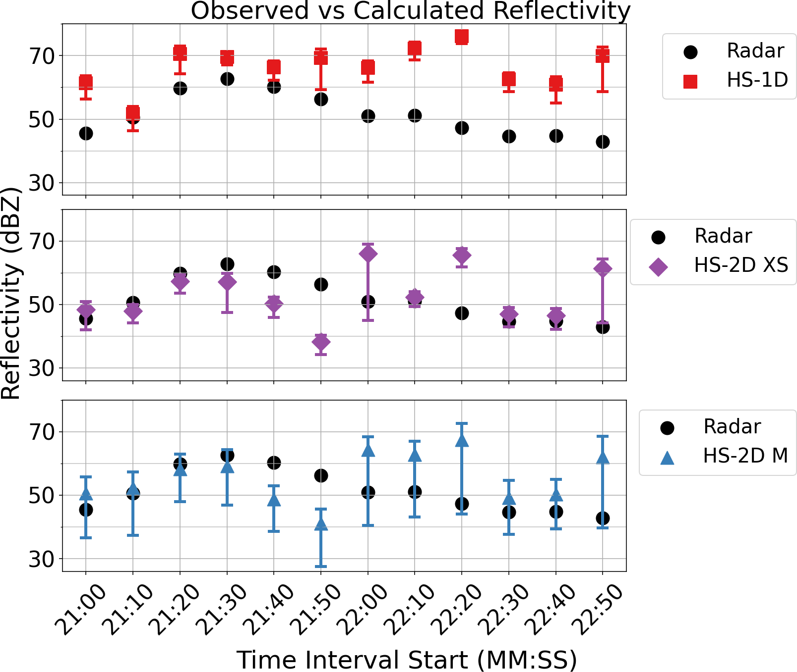
June 22, 2000 (Flight 757): Radar Comparison
1D PSD has reflectivity consistently higher than the radar.
2D x-size (XS) PSD reflectivity has over and underestimates compared to the radar.
2D mean (M) of all PSD overlaps within the Uncertainty for 10 out of 12 for the 10 s intervals.
<number>
Notes:
2D Processing using AR>0.3
Flight 670 data. Has good images.
The AR>0.3 is good for processing 2D data.
Flight 670 plots also has the good images but more complicate things; however, still seem to support the overall argument that the 2D images provide a better match with the radar.

Slide 12
Conclusions
1D processing has consistently higher concentration of large particles than the 2D processing PSDs.
The 2D processing should be used when available.
    More consistent PSD shape.
    More consistent with manual image analysis.
Manuscript under development for publication.
<number>

Slide 13
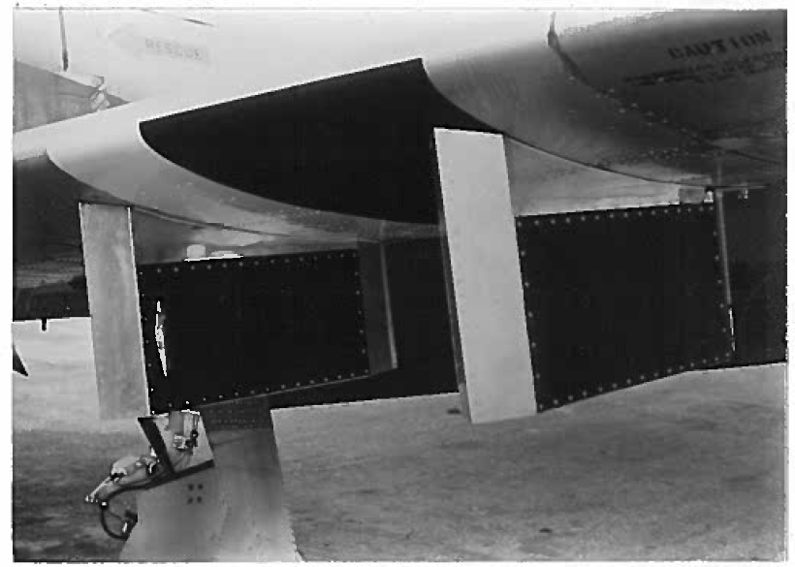
James Klinman Thesis, “Evaluating Hail Spectrometer Data Quality and Uncertainty for Calculating Radar Reflectivity Factor”, Fall 2025, in press, 2026. (See https://commons.und.edu)
T-28 Wing
Sample Area
<number>

