Slide 1
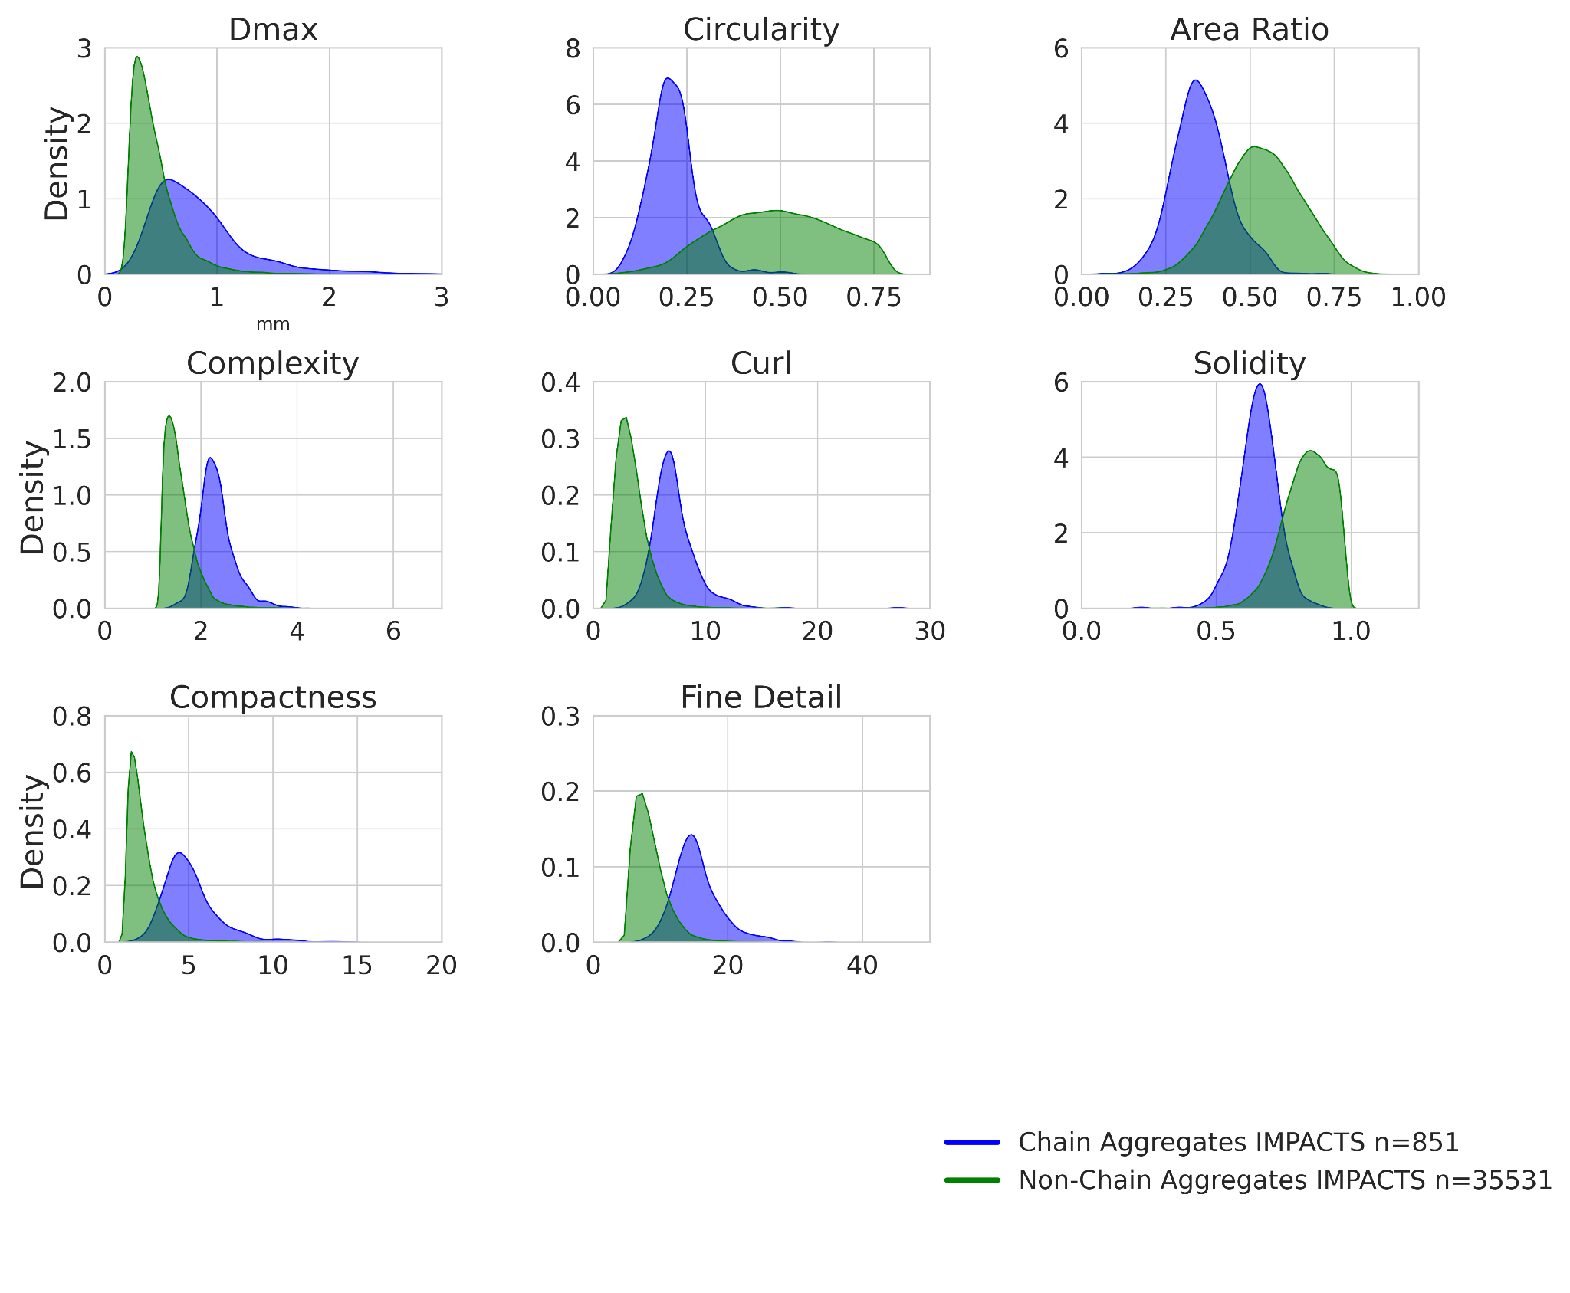
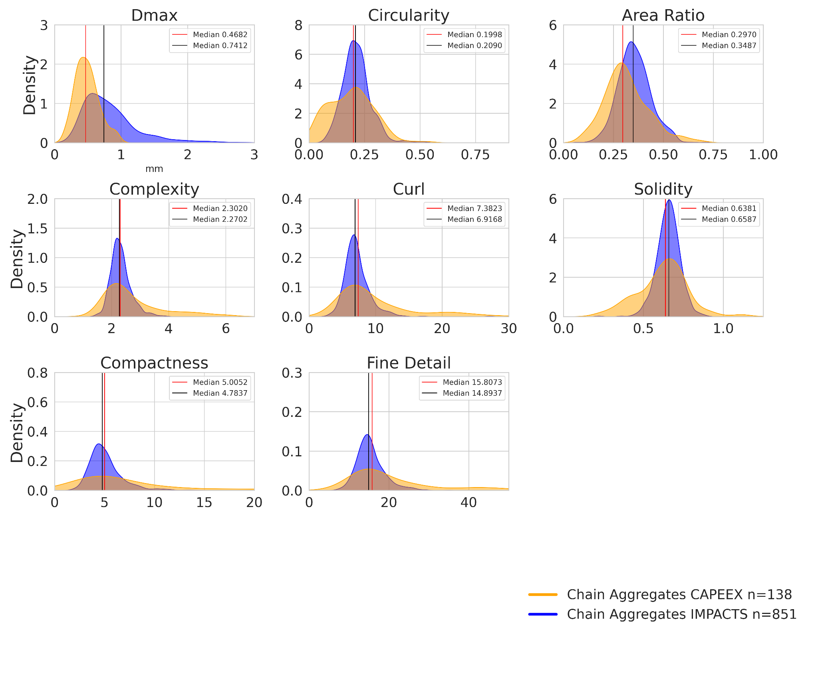
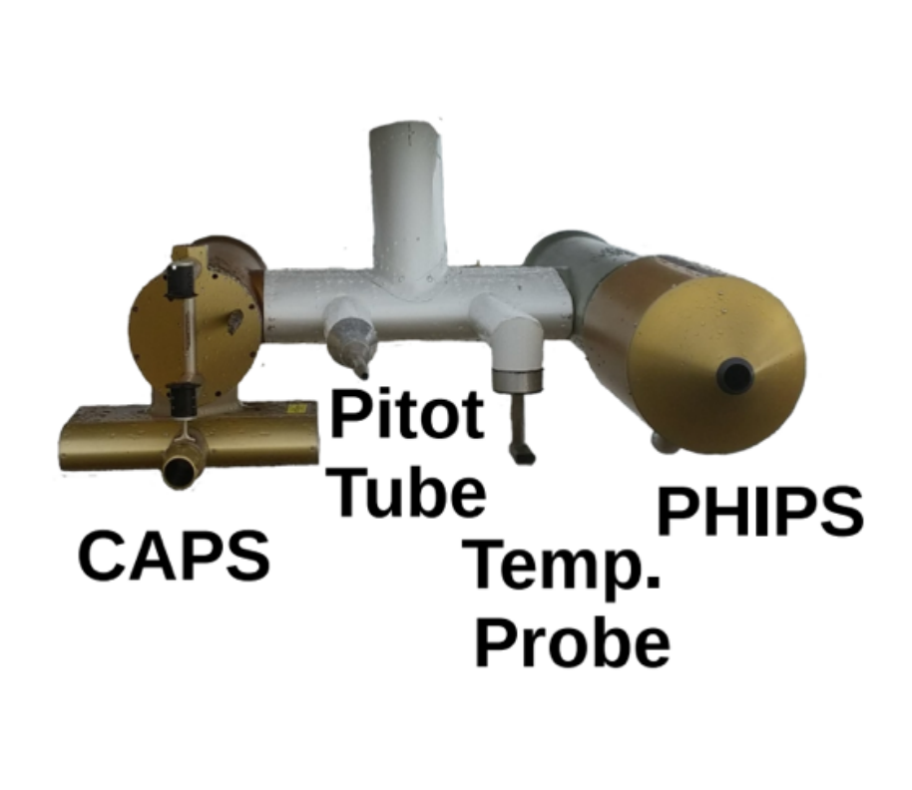
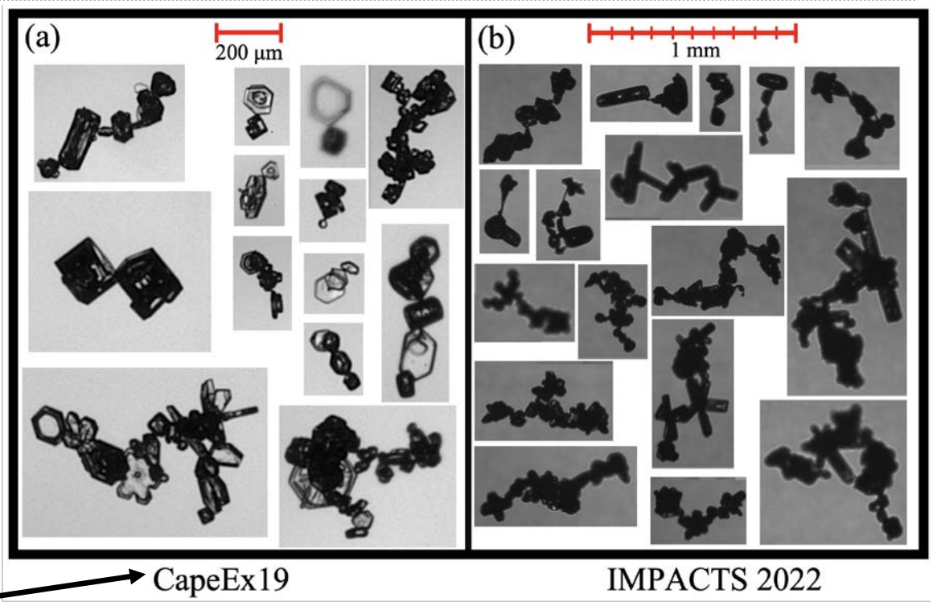

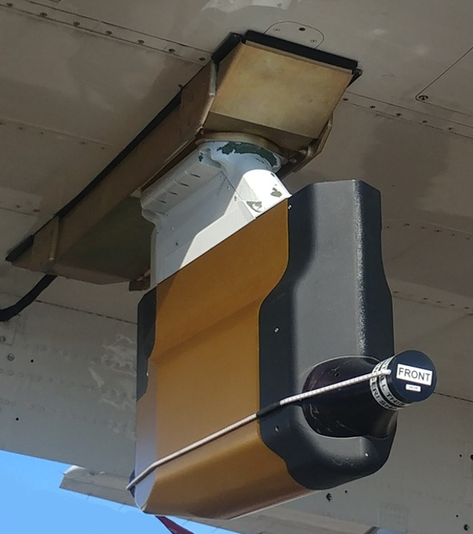
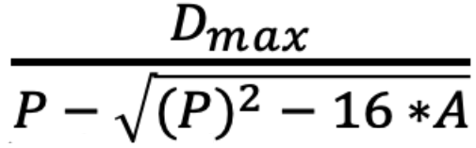
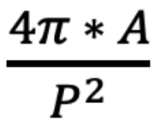
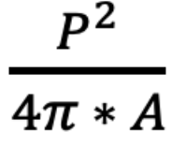
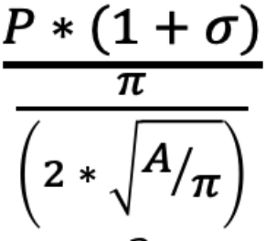
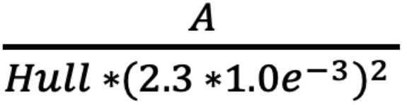
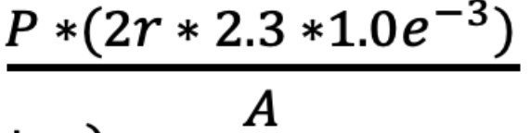
Quantification of Chain Aggregate Morphology in Recent Field Campaigns
David J. Delene, Christian M. Nairy, Conrad O. Slad, Bryce R. Rickbeil, Shawn W. Wagner and Marwa Majdi
Department of Atmospheric Sciences, University of North Dakota
Motivation and Objective
Identify key morphology parameters of chain aggregates (e.g. circularity, complexity, etc.) during recent field projects.
Compare morphological properties of chain aggregates in mid- upper-level cirrus anvils of summertime convection (CapeEx19) to chain aggregates found within wintertime nor’easters and extra-tropical storms (IMPACTS).
Provide the foundation for quantification of chain aggregates morphology parameters between observational, laboratory and model datasets.
Results
Conclusions
The IMPACTS field project has larger sized chain aggregates compared to non-chain aggregates.
The IMPACTS field project has larger sized chain aggregates compared to the CapeEx19 field project.
The IMPACTS field project has smaller area ratios for chain aggregates than non-chain aggregates; however, the IMPACTS and CapeEx19 field projects have similar area ratios for chain aggregates.
The chain aggregate classification parameters’ density distributions are different between chain and non-chain aggregates; however, the density distributions and medians are similar, indicating similarity between chains aggregates.
Dmax
Area Ratio
Circularity
Complexity
Diameter (mm)
Diameter (mm)
Compactness
Curl
Solidity
Fine Detail
CapeEx19 Summer-time Florida Dataset
IMPACTS Winter-time NE-US Dataset
References
Nairy, Christian M., David J. Delene, Joseph A. Finlon, John E. Yorks, Emma Järvinen, Martin Schnaiter, Andrew J. Heymsfield, Andrew G. Detwiler, Lynn A. McMurdie, 2026: In situ Observations of Ice Crystal Chain Aggregates in Winter Storms. Geophysical Research Letter, 53, e2025GL118365, https://doi.org/10.1029//2025GL118365.
(2019/08/03 14:23 UTC)
D_{max}- Smallest Enclosing Circle Dimension
Area Ratio - Ellipse Fit A / Circle Fit A
Circularity - (1 is Perfect Circle)
Complexity - (Closer to 1, Circular)
A - Area P - Perimeter r - Radius Hull - Smallest Convex Polygon that Encloses a Shape
Curl - (0 is Circle; > 0 is curly)
Compactness - (1 is Circle > 1 is Irregular)
Solidity - Fine Detail -
Acknowledgements
Funding provided by the NASA IMPACTS project (grant number 80NSSC1K0328) and NASA MOSAICS Seed Funding - Cohort 4 (grant number 80NSSC25K7971).
2022/01/19 12:26 UTC 2022/01/29 20:34 UTC 2022/02/17 18:31 UTC
2023/01/15 16:07 UTC

