Slide 1
Applying and Evaluating Tree-Based Ensemble Methods to Identify Ice Crystal Chain Aggregates during the IMPACTS Field Campaign
Christian Nairy¹ (christian.nairy@und.edu), David Delene¹, Joseph Finlon^{2, 3}, John Yorks², and Kenneth L. Thornhill⁴
¹University of North Dakota, Department of Atmospheric Science
²National Aeronautics and Space Administration (NASA) - Goddard Space Flight Center
³Earth System Science Interdisciplinary Center (ESSIC), University of Maryland
⁴National Aeronautics and Space Administration (NASA), Langley Research Center
200 μm
105th AMS Annual Meeting – Second Symposium on Cloud Physics: New and Emerging Measurement Methods in Cloud and Precipitation Research III

Slide 2
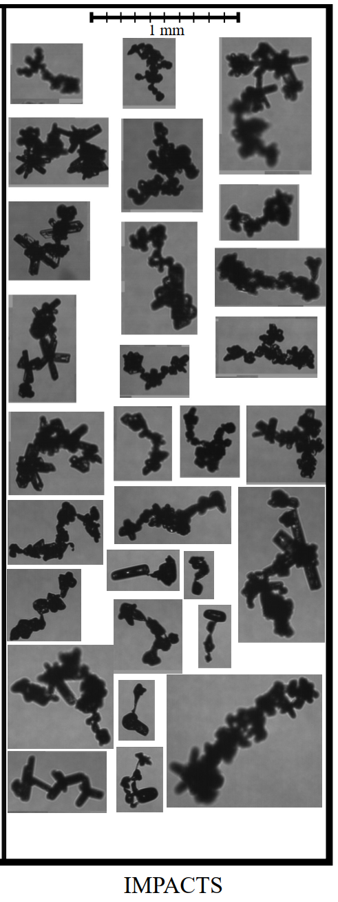
Motivation for Research
Hawkeye-CPI Images
The chain aggregation process is still not well understood.
Where/How?
Inconsistencies between cloud chamber experiments and aircraft observations.
Lack of representation in atmospheric cloud models.
Influence on cloud radiative transfer properties (Liou 1973; Stephens et al. 1990; Baran 2009).
Contextualizing chain aggregates within storm life-cycles requires analyzing diverse cases, but manually classifying tens of thousands of particles is highly time-intensive.
105th AMS Annual Meeting – Second Symposium on Cloud Physics: New and Emerging Measurement Methods in Cloud and Precipitation Research III
Notes:
Ice particle aggregation in the atmosphere is attributed to aerodynamic, inertial, and gravitational forces, which are applied constantly during ice crystal interactions (Finnegan & Pitter, 1988). Ice crystal interactions influenced by electrical forces have been investigated; however, the effects of electric fields and charges on ice crystals are not well understood.

Slide 3
Objective
Employ supervised decision tree-based methods to differentiate ice crystal chain aggregates from non-chain aggregates.
Methods:
Particle Classifications
Classify observed (in-situ) chain and non-chain aggregates from diverse cloud regions from the IMPACTS field campaign.
Morphological Particle Attributes and Environmental Parameters
Extract attributes and parameters for each classified particle
Particle Attributes: D_{max}, Area Ratio, Complexity, Compactness, Curl, Fine Detail, etc.
Environmental Parameters: Temperature & Liquid Water Content (LWC)
Hyper-tune Two Tree-Based Classifiers
Train ➣ Test ➣ Validate
Comparison of Decision Tree-Based Methods
105th AMS Annual Meeting – Second Symposium on Cloud Physics: New and Emerging Measurement Methods in Cloud and Precipitation Research III
Notes:
All-in particles only!

Slide 4
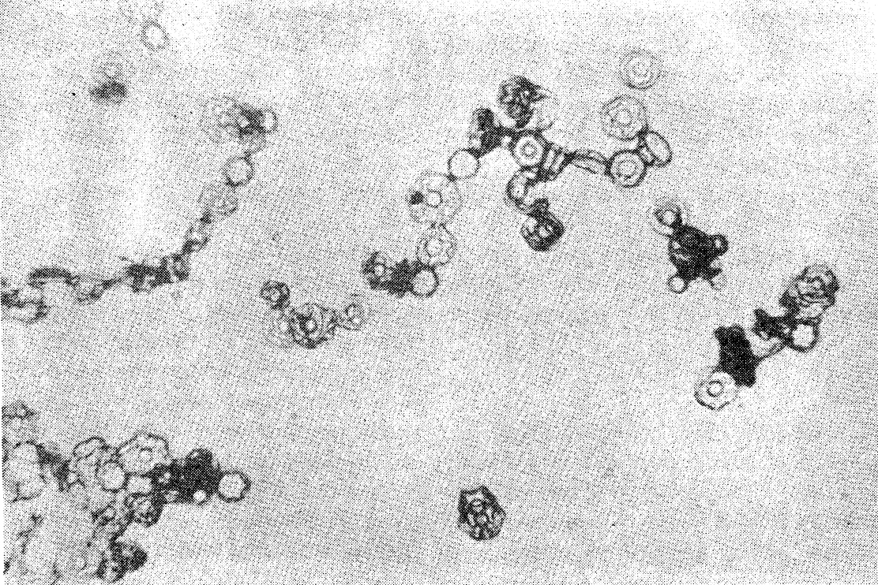
Previous Chain Aggregate Observations
Laboratory Observations of Chain Aggregates:
In High Electric Fields (Minimum Threshold: 60 kV m⁻¹)
-5 and -37 °C (Maximum efficiency at -8 °C)
Ice Crystal Concentrations Between 3 and 4 ✕ 10⁶ m⁻³
Aggregation found to be temperature-dependent with electric fields.
Chain Aggregates on formvar slides that were generated in a cloud chamber. Adapted from Saunders and Wahab, 1975.
105th AMS Annual Meeting – Second Symposium on Cloud Physics: New and Emerging Measurement Methods in Cloud and Precipitation Research III

Slide 5
Previous Chain Aggregate Observations
Laboratory Observations of Chain Aggregates:
In High Electric Fields (Minimum Threshold: 60 kV m⁻¹)
-5 and -37 °C (Maximum efficiency at -8 °C)
Ice Crystal Concentrations Between 3 and 4 ✕ 10⁶ m⁻³
Aggregation found to be temperature-dependent with electric fields.
Chain Aggregates on formvar slides that were generated in a cloud chamber. Adapted from Saunders and Wahab, 1975.
105th AMS Annual Meeting – Second Symposium on Cloud Physics: New and Emerging Measurement Methods in Cloud and Precipitation Research III

Slide 6
Previous Chain Aggregate Observations
Laboratory Observations of Chain Aggregates:
In High Electric Fields (Minimum Threshold: 60 kV m⁻¹)
-5 and -37 °C (Maximum efficiency at -8 °C)
Ice Crystal Concentrations Between 3 and 4 ✕ 10⁶ m⁻³
Aggregation found to be temperature-dependent with electric fields.
Chain Aggregates on formvar slides that were generated in a cloud chamber. Adapted from Saunders and Wahab, 1975.
Aircraft Observations of Chain Aggregates:
Mid- to upper-level clouds produced by summertime continental convection in the tropics and sub-tropics.
Field Campaigns: CapeEx19, CRYSTAL-FACE, ABFM-II, EMERALD-II
-8 to -65 °C (but mainly found < -25 °C)
In-situ E-Fields (CapeEx19 & ABFM-II) < 60 kV m⁻¹
Wintertime Continental Convection in the Midlatitudes.
Field Campaigns: IMPACTS
-13 to -35 °C
105th AMS Annual Meeting – Second Symposium on Cloud Physics: New and Emerging Measurement Methods in Cloud and Precipitation Research III

Slide 7
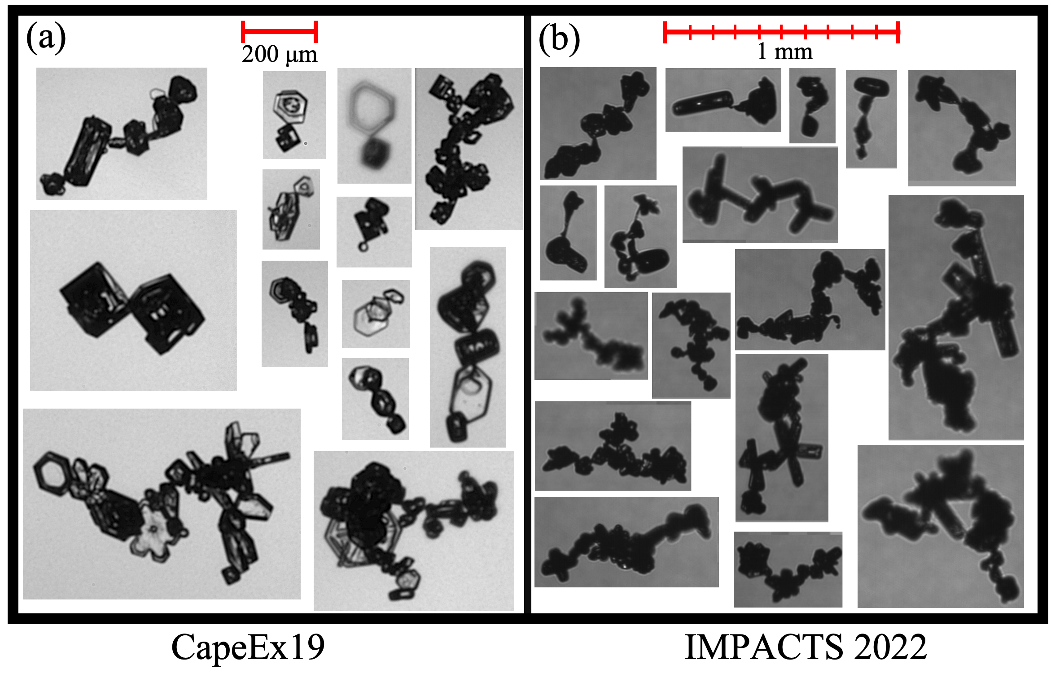
Previous Chain Aggregate Observations
Laboratory Observations of Chain Aggregates:
In High Electric Fields (Minimum Threshold: 60 kV m⁻¹)
-5 and -37 °C (Maximum efficiency at -8 °C)
Ice Crystal Concentrations Between 3 and 4 ✕ 10⁶ m⁻³
Aggregation found to be temperature-dependent with electric fields.
Chain Aggregates on formvar slides that were generated in a cloud chamber. Adapted from Saunders and Wahab, 1975.
Aircraft Observations of Chain Aggregates:
Mid- to upper-level clouds produced by summertime continental convection in the tropics and sub-tropics.
Field Campaigns: CapeEx19, CRYSTAL-FACE, ABFM-II, EMERALD-II
-8 to -65 °C (but mainly found < -25 °C)
In-situ E-Fields (CapeEx19 & ABFM-II) < 60 kV m⁻¹
Wintertime Continental Convection in the Midlatitudes.
Field Campaigns: IMPACTS
-13 to -35 °C
Nairy, C. M., D. J. Delene, A. G. Detwiler, J. M. Schmidt, P. R. Harasti, M. Schnaiter, E. Järvinen, T.
D. Walker, Ice Crystal Chain Aggregates in Florida Cirrus Cloud Anvils - 3 August 2019 Case Study.
Journal of Geophysical Research: Atmospheres. In Review, 2025
(a) PHIPS images (in-situ) of chain aggregates comprised of ice crystals found in cirrus anvil clouds during the CapeEx19 field campaign and (b) CPI images (in-situ) of chain aggregates found near the parameter of a convective band associated with a nor’easter off the New England coast.

Slide 8
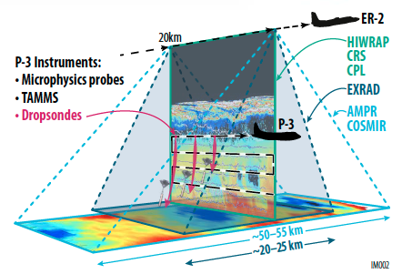
Dataset/Instrumentation
Investigation of Microphysics and Precipitation for Atlantic Coast-Threatening Snowstorms (IMPACTS).
NASA P-3b Orion Research Aircraft
Hawkeye-Cloud Particle Imaging (CPI) Probe
King Probe (Liquid Water Content [LWC])
Adapted from the NASA IMPACTS executive summary (https://espo.nasa.gov/impacts/).
Hawkeye-CPI
King Probe
105th AMS Annual Meeting – Second Symposium on Cloud Physics: New and Emerging Measurement Methods in Cloud and Precipitation Research III

Slide 9
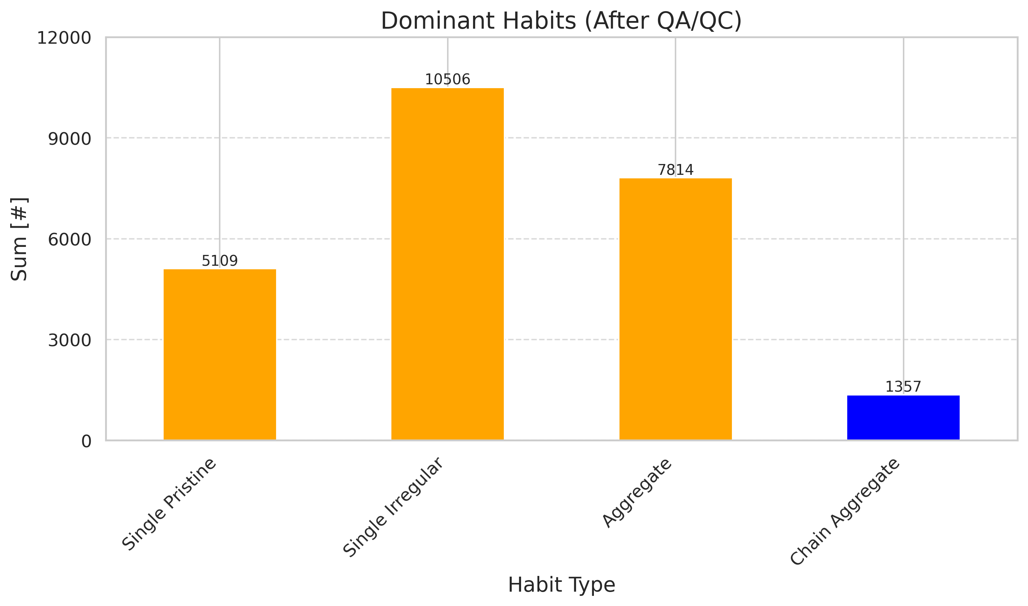
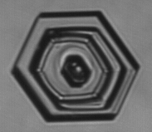
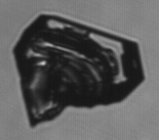
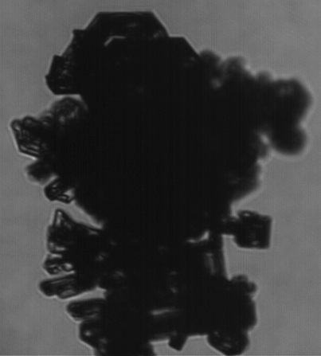
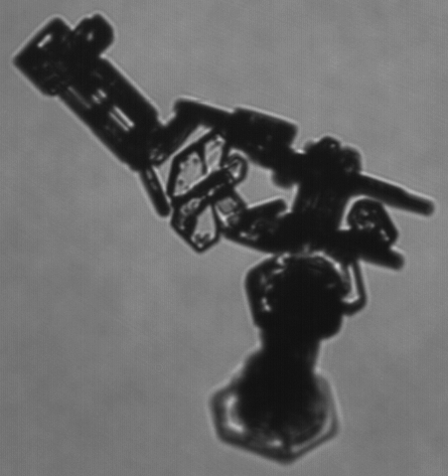
Particle Classifications
5 Flight Segments Classified:
Total Time Coverage: 1hr 40m 49s
Temperature Range: -36 to -5 ºC
Total # of Particles Classified (after QA/QC):
24,786
# of Chain Aggregates Classified (after QA/QC):
1,357
*NOT TO SCALE*
105th AMS Annual Meeting – Second Symposium on Cloud Physics: New and Emerging Measurement Methods in Cloud and Precipitation Research III

Slide 10
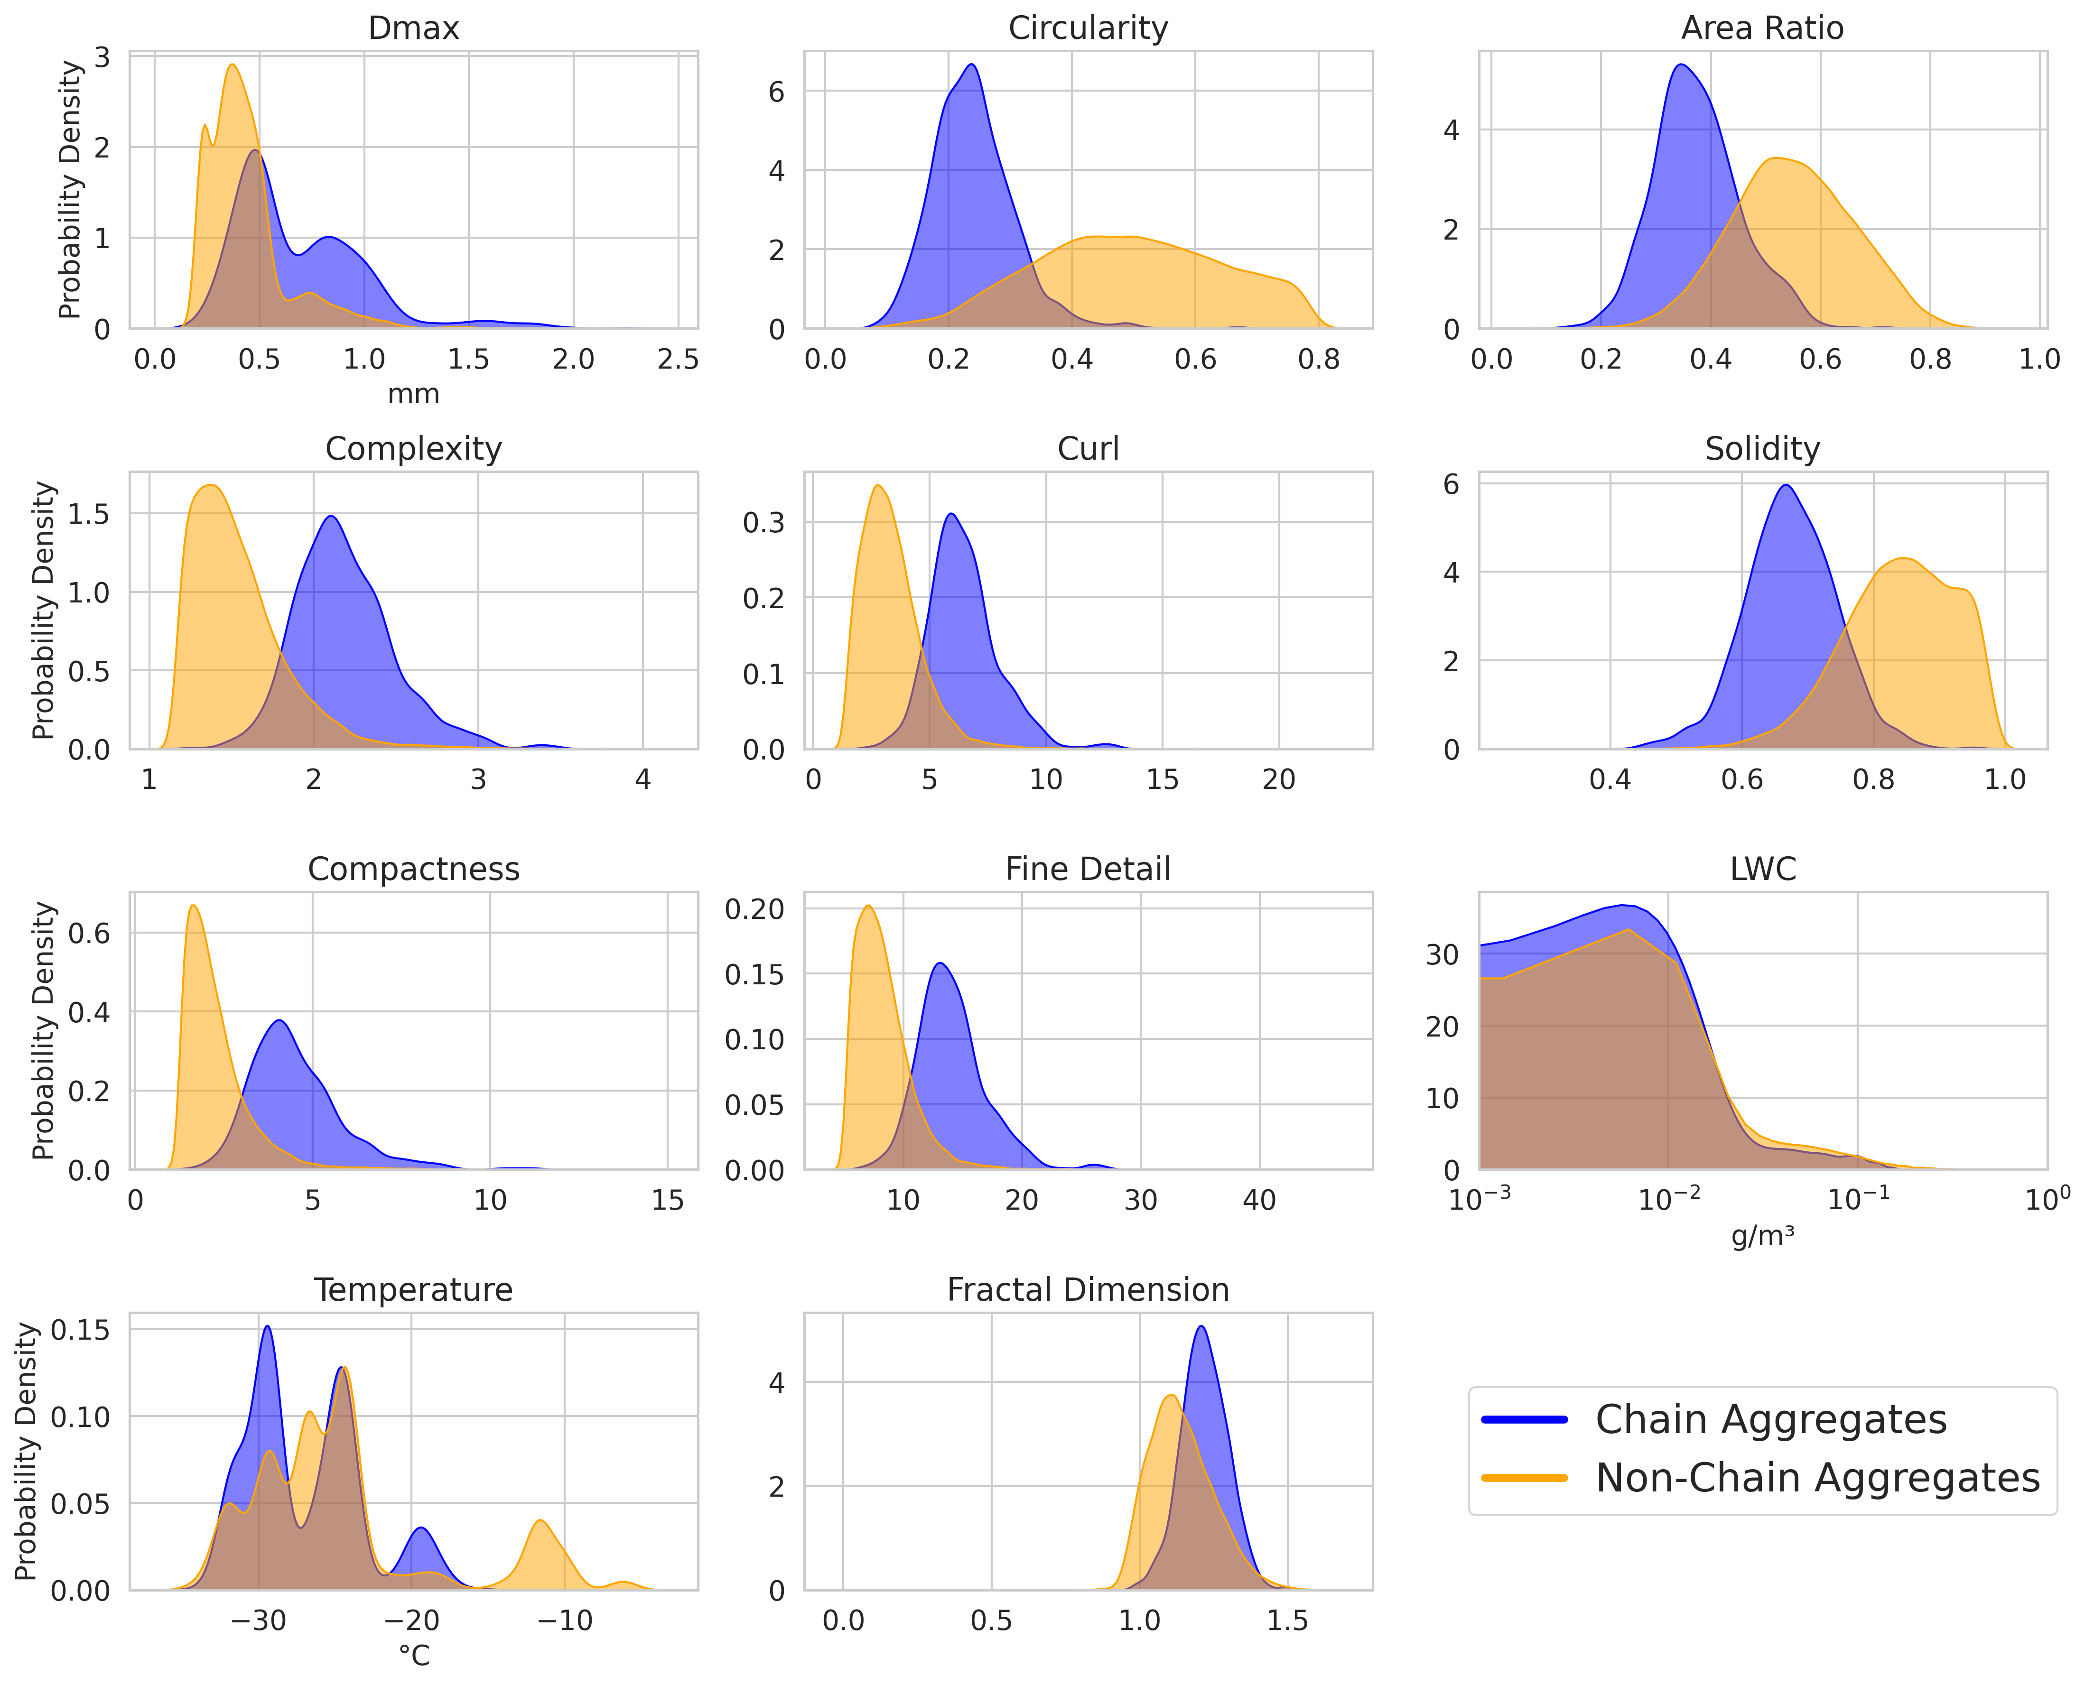
Morphological Particle Attributes and Environmental Parameters
Attributes calculated for “all-in” CPI imaged particles
Key attributes/parameters used found that optimized the decision tree methods:
D_{max}, Complexity*, Curl*, Compactness*, Fine Detail*, Solidity*, & Temperature
*Equations in extra slides
105th AMS Annual Meeting – Second Symposium on Cloud Physics: New and Emerging Measurement Methods in Cloud and Precipitation Research III

Slide 11
Tree-Based Classifier Setup
Hyper-tuned for the most optimal result.
Key Parameters Used: D_{max}, Complexity*, Curl*, Compactness*, Fine Detail*, Solidity*, & Temperature
Random OverSampling (ROS) is applied to balance the dataset, improving sensitivity to rare chain aggregate occurrences.
Total particles after ROS performed: 46,804 (50% chains, 50% non-chains)
70% (36,762) used for training; 30% (14,042) used for testing and validation
Random Forest Classifier
eXtreme Gradient Boosting (XGBoost) Classifier
*Equations in extra slides
105th AMS Annual Meeting – Second Symposium on Cloud Physics: New and Emerging Measurement Methods in Cloud and Precipitation Research III
Notes:
Random Forest builds multiple decision trees using random subsets of data and features, then combines their predictions (via majority vote for classification) to produce a more accurate and robust result.

Slide 12
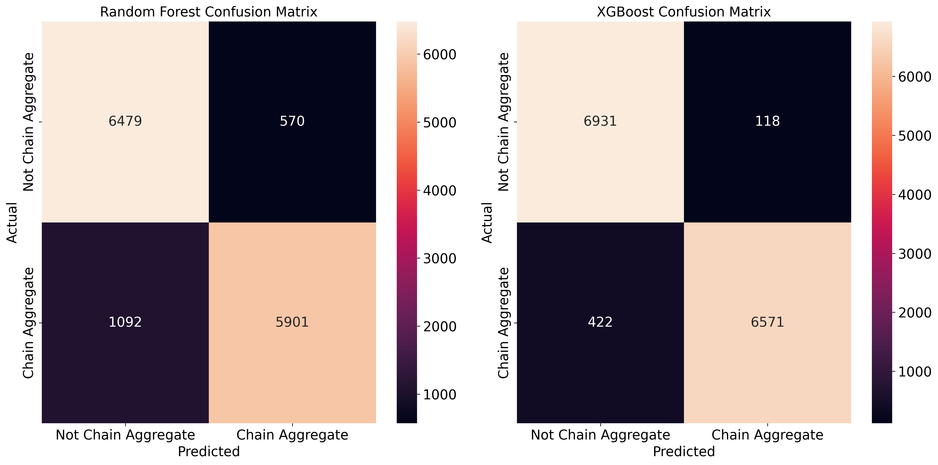
Comparison: Random Forest to eXtreme Gradient Boosting (XGBoost)
Key Takeaway:
- Less false positives (upper-right) and false negatives (lower left) using the XGBoost Classifier.
105th AMS Annual Meeting – Second Symposium on Cloud Physics: New and Emerging Measurement Methods in Cloud and Precipitation Research III

Slide 13
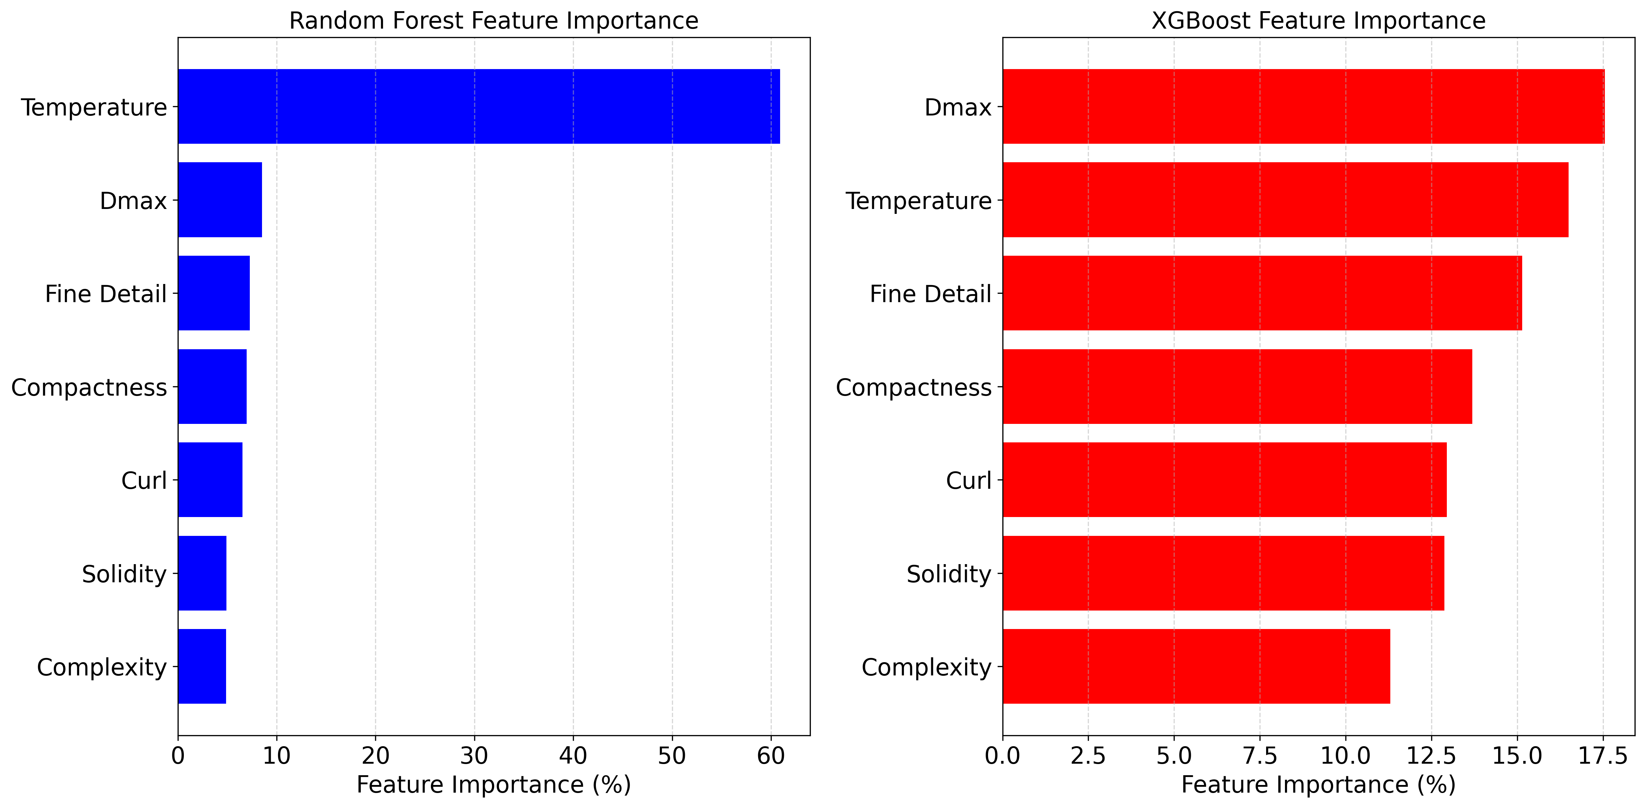
Comparison: Random Forest to eXtreme Gradient Boosting (XGBoost)
Key Takeaways:
Random Forest weighs temperature strongly, though, accounts for most of the errors in the model.
XGBoost recognizes and accounts for those errors, resulting in relatively balanced feature importance weights.
105th AMS Annual Meeting – Second Symposium on Cloud Physics: New and Emerging Measurement Methods in Cloud and Precipitation Research III

Slide 14
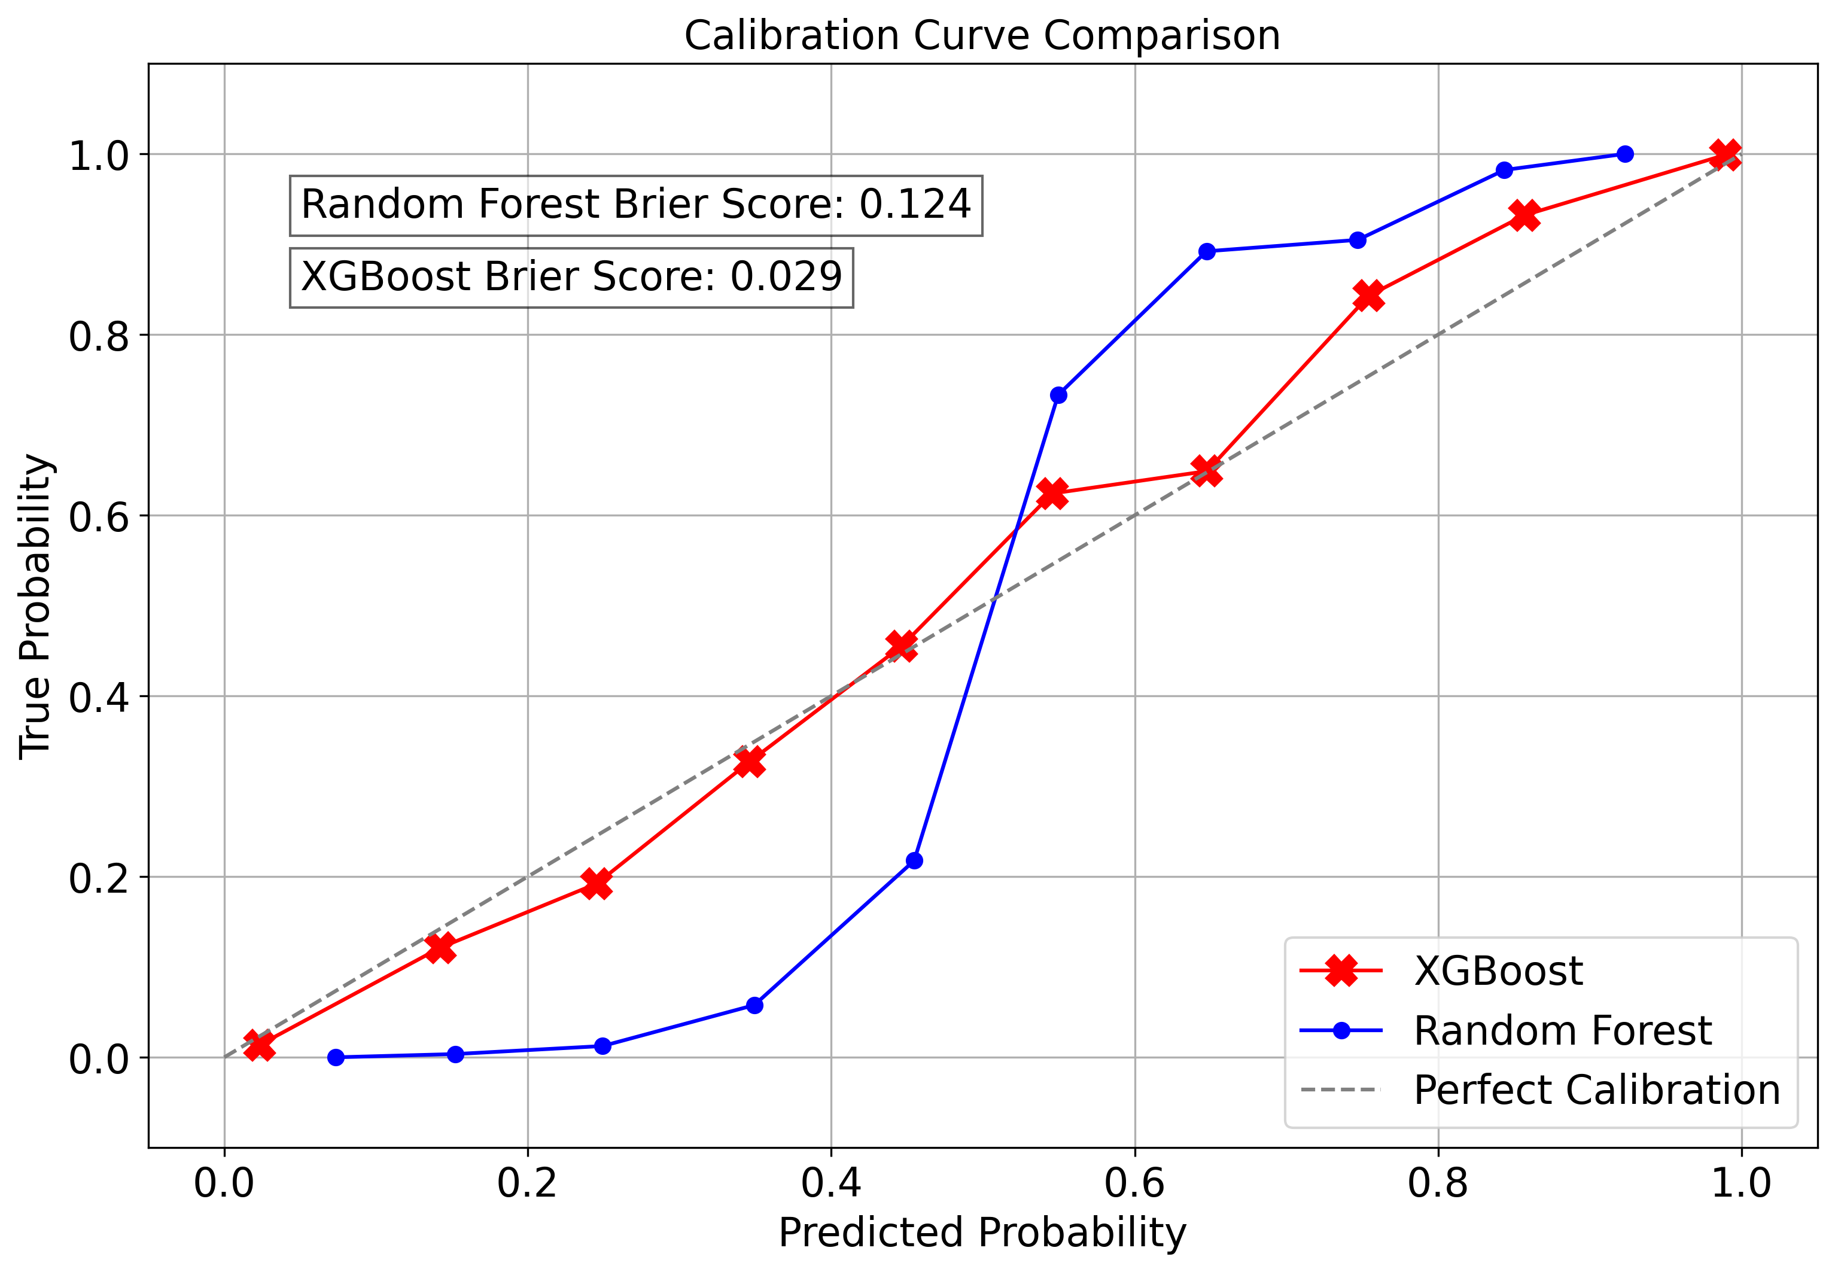
Comparison: Random Forest to eXtreme Gradient Boosting (XGBoost)
Key Takeaways:
XGBoost demonstrates superior calibration, as reflected in its lower Brier score, meaning it provides more reliable probability estimates.
105th AMS Annual Meeting – Second Symposium on Cloud Physics: New and Emerging Measurement Methods in Cloud and Precipitation Research III

Slide 15
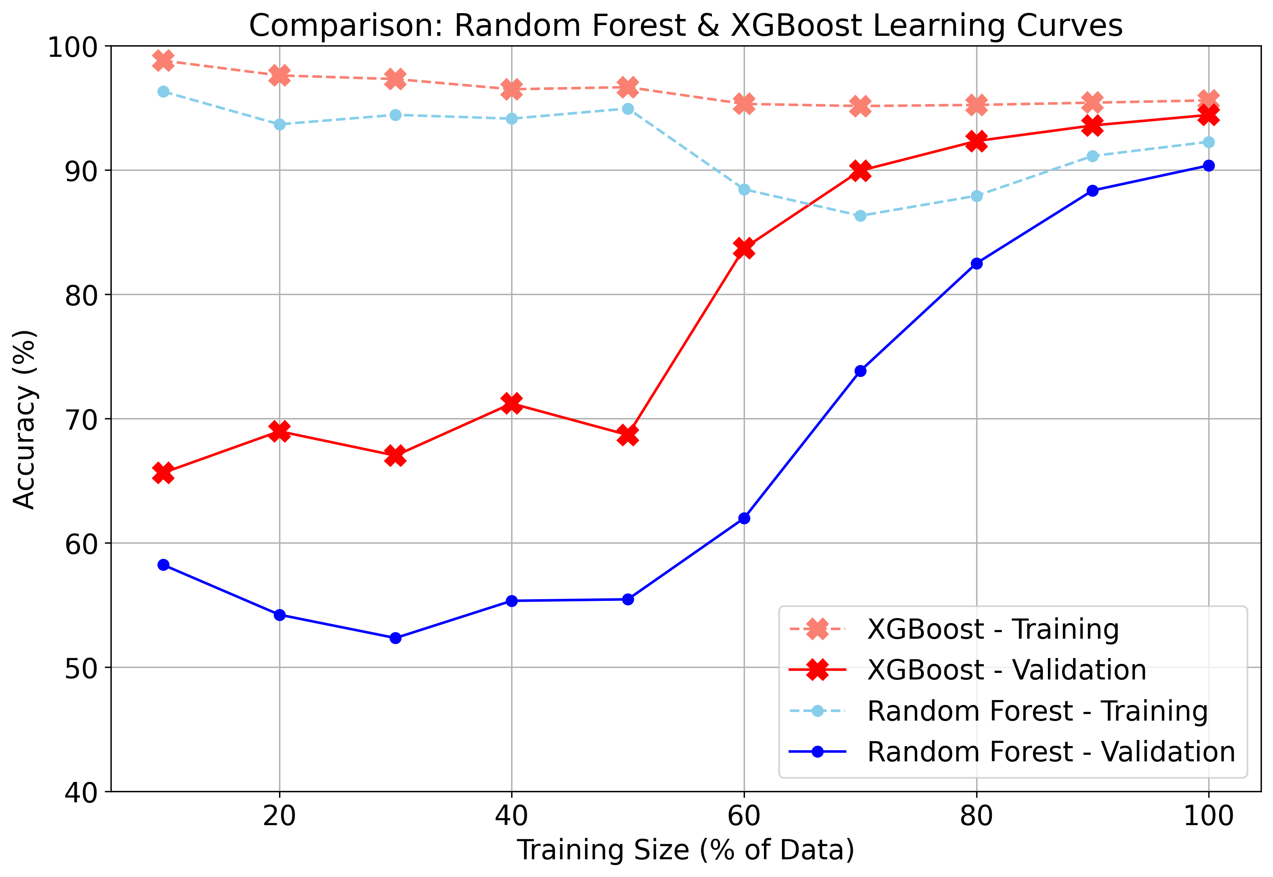
Comparison: Random Forest to eXtreme Gradient Boosting (XGBoost)
Key Takeaways:
XGBoost consistently achieves higher accuracy with less data, indicating better learning efficiency.
XGBoost outperforms Random Forest on validation accuracy.
Less overfitting (gaps between training and validation curves) with XGBoost.
105th AMS Annual Meeting – Second Symposium on Cloud Physics: New and Emerging Measurement Methods in Cloud and Precipitation Research III

Slide 16
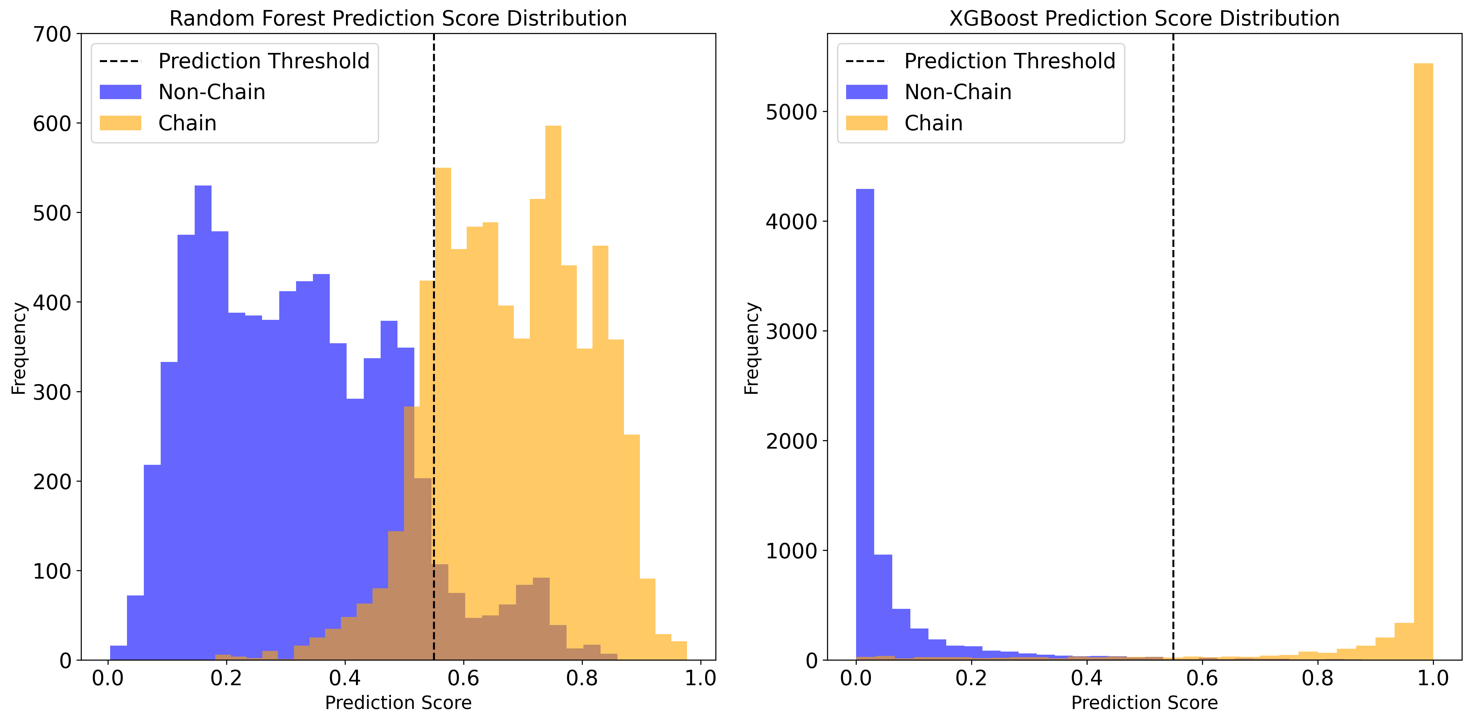
Comparison: Random Forest to eXtreme Gradient Boosting (XGBoost)
Key Takeaways:
Polarized (with minimum overlap) in XGBoost predictions (more confidence).
Random Forest is less confident likely due to errors arising from the highly weighted temperature attribute.
105th AMS Annual Meeting – Second Symposium on Cloud Physics: New and Emerging Measurement Methods in Cloud and Precipitation Research III

Slide 17
Comparison: Random Forest to eXtreme Gradient Boosting (XGBoost)
Class | Random Forest Classification Report |  |  | XGBoost Classification Report
 | Precision | Recall | F1-Score | Precision | Recall | F1-Score
Non-Chain Aggregate | 86% | 92% | 89% | 94% | 98% | 96%
Chain Aggregate | 91% | 84% | 88% | 98% | 94% | 96%
Overall Accuracy | 88% |  |  | 96%
RMSE | 0.34 |  |  | 0.17
CV Accuracy | 96% |  |  | 96%
 | Random Forest Classifier | XGBoost Classifier
Tree Building | Parallel (bagging) | Sequential (boosting)
Error Handling | Averages results across many trees | Corrects previous tree errors iteratively
Focus | Reducing variance (stabilizing predictions) | Reducing bias (minimizing error)
Speed | Slower, especially with large datasets | Optimized for faster performance
Overfitting Control | Uses tree pruning and randomness | Built-in regularization
105th AMS Annual Meeting – Second Symposium on Cloud Physics: New and Emerging Measurement Methods in Cloud and Precipitation Research III

Slide 18
Summary
Both the Random Forest and XGBoost classifications can accurately discriminate between chain aggregates and non-chain aggregates.
XGBoost excels in both predictive accuracy and calibration, making it a better tool for classifying chain aggregates from other particle habits imaged by the CPI.
Integration of advanced sampling and preprocessing strategies further boosts model generalizability in both the Random Forest and XGBoost classifiers.
Future Work:
Apply XGBoost (and possibly the Random Forest concurrently) across all research flights conducted during the IMPACTS field campaign.
Contextualize chain aggregates within storm life-cycles for improved understanding in the chain aggregation process.
105th AMS Annual Meeting – Second Symposium on Cloud Physics: New and Emerging Measurement Methods in Cloud and Precipitation Research III

Slide 19
References & Acknowledgements
19
Baran, A. J. (2009). A review of the light scattering properties of cirrus. Journal of Quantitative Spectroscopy and Radiative Transfer, 110(14), 1239–1260. https://doi.org/10.1016/j.jqsrt.2009.02.026
Liou, K. N. (1973). Transfer of Solar Irradiance through Cirrus Cloud Layers., J. Geophys. Res., 78, 1409–1418.
Nairy, C. M. (2022). Observations of Chain Aggregates in Florida Cirrus Cloud Anvils on 3 August 2019 during CAPEEX19 (Master’s thesis), Dept. of Atmospheric Sciences, University of North Dakota, Grand Forks, North Dakota. Retrieved from https://commons.und.edu/theses/4363/
Saunders, C. P. R., & Wahab, N. M. A. (1975). The Influence of Electric Fields on the Aggregation of Ice Crystals. Journal of the Meteorological Society of Japan. Ser. II, 53(2), 121–126. https://doi.org/10.2151/jmsj1965.53.2_121
Schmitt, C. G., and A. J. Heymsfield (2014), Observational quantification of the separation of simple and complex atmospheric ice particles, Geophys. Res. Lett., 41, 1301–1307, doi:10.1002/2013GL058781.
Stephens, G. L., Tsay, S.-C., Stackhouse, P. W., & Flatau, P. J. (1990). The Relevance of the Microphysical and Radiative Properties of Cirrus Clouds to Climate and Climatic Feedback. Journal of the Atmospheric Sciences, 47(14), 1742–1754. https://doi.org/10.1175/1520-0469(1990)047<1742:TROTMA>2.0.CO;2
Stith, J. L., Avallone, L. M., Bansemer, A., Basarab, B., Dorsi, S. W., Fuchs, B., et al. (2014). Ice particles in the upper anvil regions of midlatitude continental thunderstorms: the case for frozen-drop aggregates. Atmospheric Chemistry and Physics, 14(4), 1973–1985. https://doi.org/10.5194/acp-14-1973-2014
This research was supported by a NASA research grant to the University of North Dakota. Grant #: 80NSSC19K0328. The IMPACTS dataset is publicly available at the NASA GHRC http://dx.doi.org/10.5067/IMPACTS/DATA101. We would also like to thank Andrew Heymsfield, Stephen Nicholls, Mircea Grecu, Andrew Detwiler, & Patrick Britt for their added expertise in this work.
Thank you.
105th AMS Annual Meeting – Second Symposium on Cloud Physics: New and Emerging Measurement Methods in Cloud and Precipitation Research III

Slide 20
Extra Slides – Equations and Descriptions of Particle Attributes
Dmax = Maximum Dimension
Area Ratio = area ratio from ellipse fit
Solidity = $\frac{A}{Hull ∗(2.3 ∗1.0e^{−3})^{2} }$
Circularity = $\frac{4π ∗ A}{P^{2}} ;(1 →perfect circle)$
Fine Detail Ratio = $\frac{P ∗(2r ∗ 2.3 ∗1.0e^{−3})}{A}$
Complexity = $\frac{P ∗ (1 + σ)}{\frac{π}{\left(2 ∗ \sqrt{A/π}\right)}}$ ; (Closer to 1 -> circular, rimed; > 1 -> aggregate, less rimed)
Compactness = $\frac{P^{2}}{4π ∗ A}$ ; 1 -> circle (droplet); > 1 -> irregular
Curl = $\frac{D_{max}}{P − \sqrt{(P)^{2} − 16 ∗A}}$; Measures the degree to which an object is ‘curled’ up (0 -> circle; > 0 elongated and curly)
105th AMS Annual Meeting – Second Symposium on Cloud Physics: New and Emerging Measurement Methods in Cloud and Precipitation Research III

Slide 21
Extra Slides – Random Forest
Param Grid: {n_estimators: 250, max_depth: 12, min_samples_split: 10, min_samples_leaf: 4, max_features: ‘sqrt’, criterion: ‘gini’}
cv = StratifiedKFold(n_splits=10)
105th AMS Annual Meeting – Second Symposium on Cloud Physics: New and Emerging Measurement Methods in Cloud and Precipitation Research III

Slide 22
Extra Slides – XGBoost
num_boost_round = 500
params = {'objective': 'binary:logistic’, 'max_depth': 8, 'learning_rate': 0.1, 'colsample_bytree': 0.8, 'subsample': 0.8, 'gamma': 0.1, 'reg_alpha': 1, 'reg_lambda': 1, 'eval_metric': 'logloss', # Evaluation metric}
# Train the model with early stopping
evals = [(dtest, 'eval'), (dtrain, 'train')]
bst = xgb_train(params, dtrain, num_boost_round=num_boost_round, evals=evals, early_stopping_rounds=10, verbose_eval=False)
105th AMS Annual Meeting – Second Symposium on Cloud Physics: New and Emerging Measurement Methods in Cloud and Precipitation Research III

Slide 23
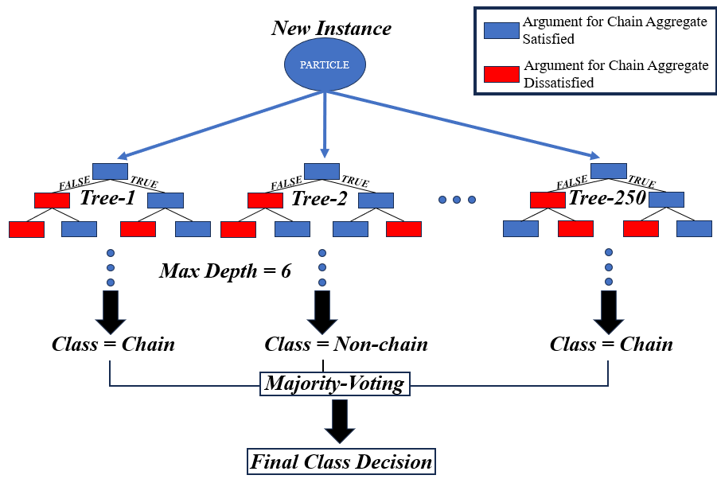
Comparison: Random Forest to eXtreme Gradient Boosting (XGBoost)
Random Forest Classifier
Simple schematic of the random forest workflow used for this analysis. Used scikit-learn random forest python package (https://scikit-learn.org/1.5/modules/generated/sklearn.ensemble.RandomForestClassifier.html). For additional information regarding the random forest used in this analysis see extra slides.
105th AMS Annual Meeting – Second Symposium on Cloud Physics: New and Emerging Measurement Methods in Cloud and Precipitation Research III

