Slide 1


Chain Aggregate Particles in Mid-to-upper Tropospheric Clouds during IMPACTS – 15 January 2023 Case Study
Christian Nairy¹ (christian.nairy@und.edu), David Delene¹, Andrew Detwiler¹, John Yorks², and Joseph Finlon^{2, 3}
¹University of North Dakota, Department of Atmospheric Science
²National Aeronautics and Space Administration (NASA) - Goddard Space Flight Center
³Earth System Science Interdisciplinary Center (ESSIC), University of Maryland
104th AMS Annual Meeting – First Symposium on Cloud Physics: Cloud Properties in Winter Storms II

Slide 2
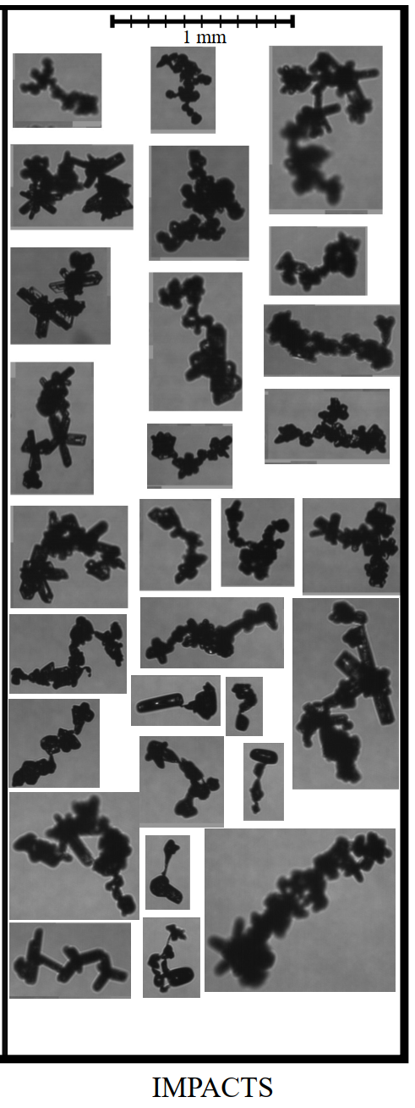
Motivation for Research
Hawkeye-CPI Images
The chain aggregation process is still not well understood
Where/How?
Inconsistencies between cloud chamber experiments and aircraft observations.
Lack of representation in atmospheric cloud models.
Influence on cloud radiative transfer properties (Liou 1973; Stephens et al. 1990; Baran 2009).
104th AMS Annual Meeting – First Symposium on Cloud Physics: Cloud Properties in Winter Storms II
Notes:
Inconsistencies: Cloud chamber experiments have different environmental parameters than where the chain aggregates are observed in the real atmosphere.
Cirrus clouds have global and regions climatological influences
To accurately measure their impacts on the climate, we must figure out and analyze the particle types found in these clouds. This is because it is known that cirrus cloud radiative impacts are based on many different parameters, but more importantly the particle sizes found in the cirrus, and their asymmetry factor.
The relative change in asymmetry factor is about 5% when going from the initial monomer to the three- and six-component hexagonal column aggregate. This decrease in asymmetry factor would imply an instantaneous local flux shortwave error of about 15 W m⁻² and the difference in reflected incident solar radiation could be as much as 20%.

Slide 3
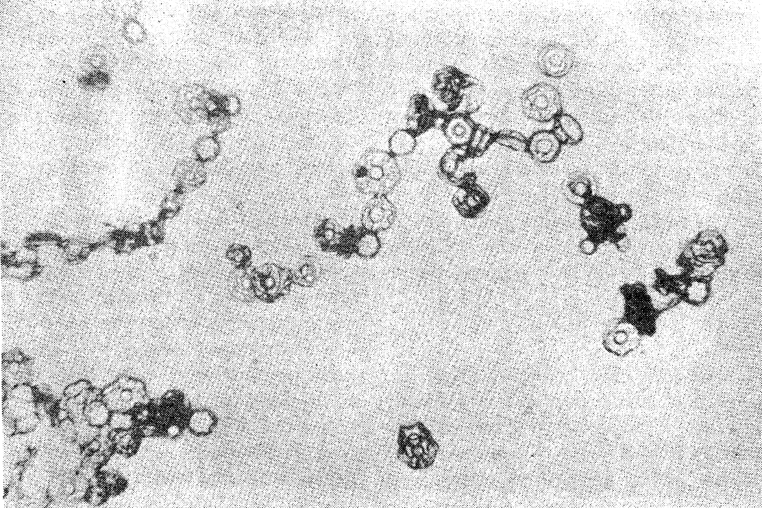
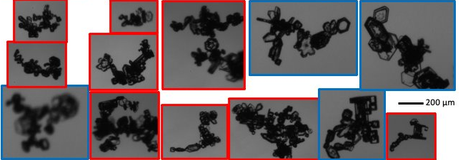
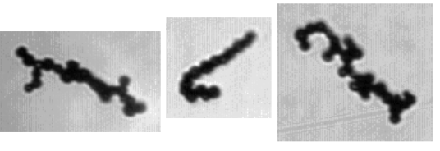
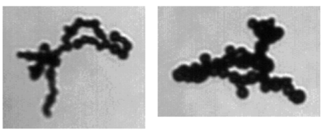
Previous Chain Aggregate Observations
Cloud Chamber Experiments
Chain Aggregates Were Generated:
⎼ In High Electric Fields (Minimum Threshold: 60 kV m⁻¹)
⎼ In Temperatures Between -5 and -37 °C
⎼ Ice Crystal Concentrations Between 3 and 4 ✕ 10⁶ m⁻³
⎼ Ice Crystals Sizes Between 30 to 50 μm
Aggregation found to be temperature-dependent with electric fields.
Aircraft Observations
Chain Aggregates of Pristine Ice Crystals Observed
Mid- to upper-level clouds produced by continental convection in the tropics and sub-tropics.
-25 to -65 °C
Chain Aggregates of Frozen Droplets Observed
Continental Convection in the Midlatitudes.
-13 to -60 °C
Chain Aggregates generated in a cloud chamber Adapted from Saunders and Wahab, 1975.
PHIPS images (in-situ) of chain aggregates comprised of ice crystals found in cirrus anvil clouds during the CapeEx19 field campaign. Adapted from Nairy, 2022.
Chain aggregates comprised of frozen droplets observed (in-situ) in mid-latitude cirrus anvil clouds. Adapted from Stith et al. 2014.
104th AMS Annual Meeting – First Symposium on Cloud Physics: Cloud Properties in Winter Storms II
Notes:
Main take-away: chains found in many different regions around the globe in mid-to-upper levels of convection. Mainly in the cirrus cloud anvil region

Slide 4
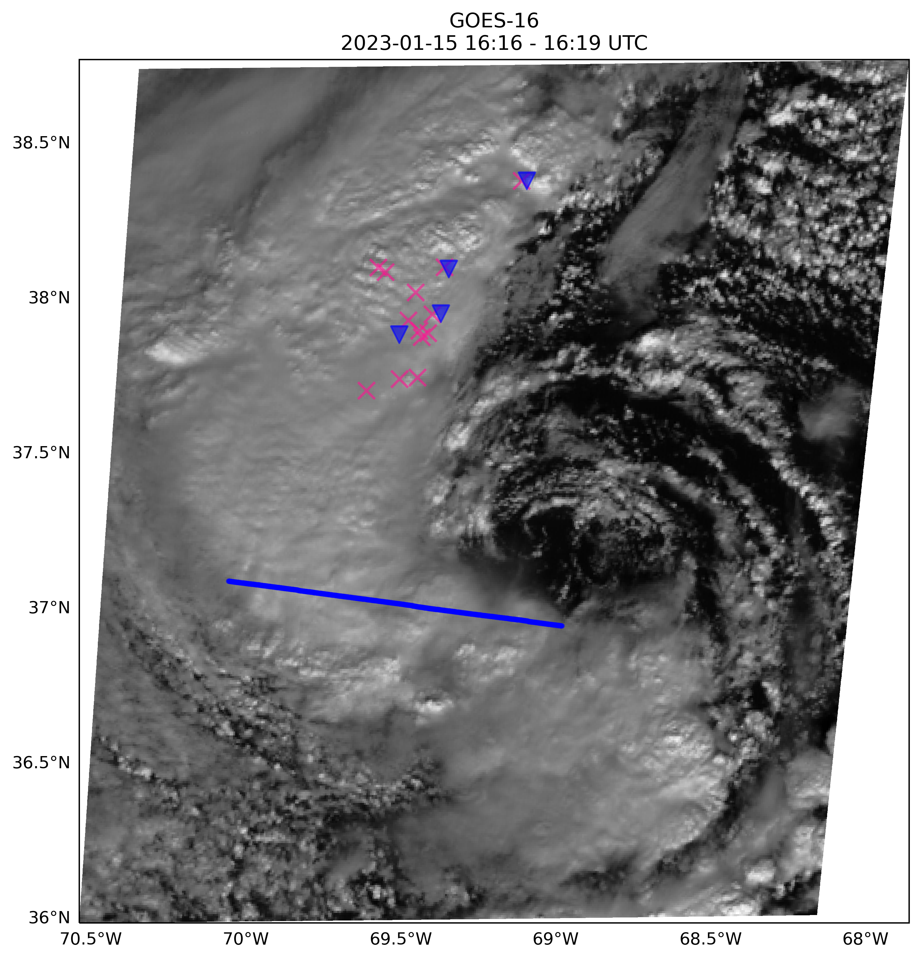
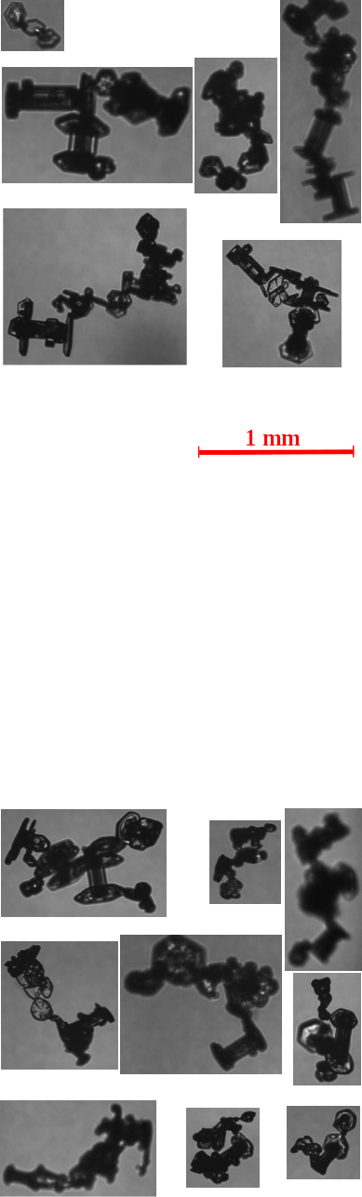


Recent Chain Aggregate Observations
IMPACTS - 15 January 2023 Research Flight
Chain Aggregates observed in-situ (P-3) during the 16:06:15–16:16:00 UTC flight leg through SW quadrant of an ET-cyclone off the Atlantic Coast.
NASA ER-2 Research Aircraft overpass also conducted during this time.
Hawkeye-CPI images of chain aggregates obtained during the IMPACTS 15 January 2023 16:06:15-16:16:00 UTC flight leg
104th AMS Annual Meeting – First Symposium on Cloud Physics: Cloud Properties in Winter Storms II
Notes:
Inconsistencies: Cloud chamber experiments have different environmental parameters than where the chain aggregates are observed in the real atmosphere.
Cirrus clouds have global and regions climatological influences
To accurately measure their impacts on the climate, we must figure out and analyze the particle types found in these clouds. This is because it is known that cirrus cloud radiative impacts are based on many different parameters, but more importantly the particle sizes found in the cirrus, and their asymmetry factor.
The relative change in asymmetry factor is about 5% when going from the initial monomer to the three- and six-component hexagonal column aggregate. This decrease in asymmetry factor would imply an instantaneous local flux shortwave error of about 15 W m⁻² and the difference in reflected incident solar radiation could be as much as 20%.

Slide 5
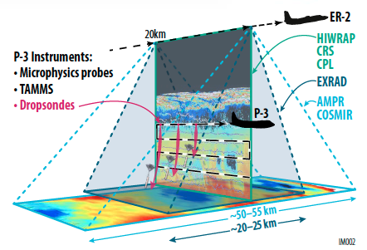
Dataset/Instrumentation
Investigation of Microphysics and Precipitation for Atlantic Coast-Threatening Snowstorms (IMPACTS).
NASA P-3b Orion
Hawkeye-Cloud Particle Imaging (CPI) and 2D-Stereo
Turbulent Air Motion Measurement System (TAMMS)
NASA ER-2
CRS (W-band) - Reflectivity (dBZ), Vertical Velocity, & Linear Depolarization Ratio (LDR)
Adapted from the NASA IMPACTS executive summary (https://espo.nasa.gov/impacts/).
104th AMS Annual Meeting – First Symposium on Cloud Physics: Cloud Properties in Winter Storms II
Notes:
Inconsistencies: Cloud chamber experiments have different environmental parameters than where the chain aggregates are observed in the real atmosphere.
Cirrus clouds have global and regions climatological influences
To accurately measure their impacts on the climate, we must figure out and analyze the particle types found in these clouds. This is because it is known that cirrus cloud radiative impacts are based on many different parameters, but more importantly the particle sizes found in the cirrus, and their asymmetry factor.
The relative change in asymmetry factor is about 5% when going from the initial monomer to the three- and six-component hexagonal column aggregate. This decrease in asymmetry factor would imply an instantaneous local flux shortwave error of about 15 W m⁻² and the difference in reflected incident solar radiation could be as much as 20%.

Slide 6
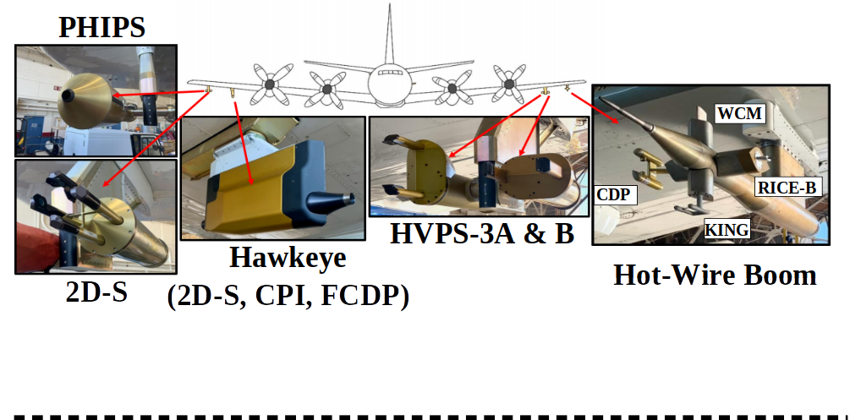
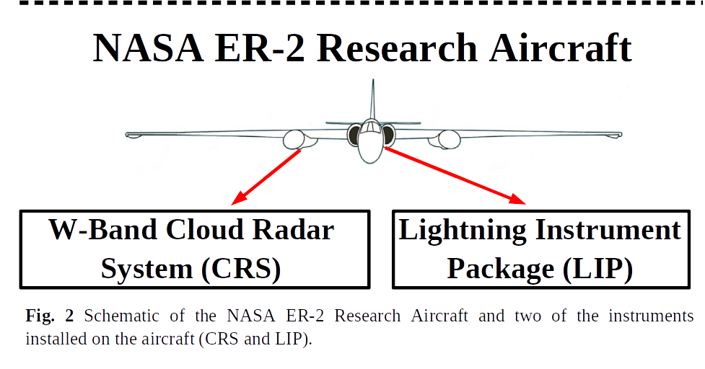
Objectives
Where are the chain aggregates observed.
Manually classify particles using Hawkeye-CPI for the 16:06:15-16:16:00 flight leg.
Relate chain aggregates to the ER-2 Cloud Radar System (CRS) observations.
Relate where they are observed (Hawkeye-CPI) to the 2D-S probe.
NASA P-3b Orion Research Aircraft
NASA ER-2 Research Aircraft
2D-S
W-band -- Cloud Radar System (CRS)
Hawkeye-CPI
104th AMS Annual Meeting – First Symposium on Cloud Physics: Cloud Properties in Winter Storms II
Notes:
The TAMMS is composed of several subsystems including: (1) distributed pressure ports coupled with absolute and differential pressure transducers and temperature sensors, (2) aircraft inertial and satellite navigation systems, (3) a central data acquisition/processing system, and (4) water vapor instruments and potentially other trace gas or aerosol sensors.

Slide 7
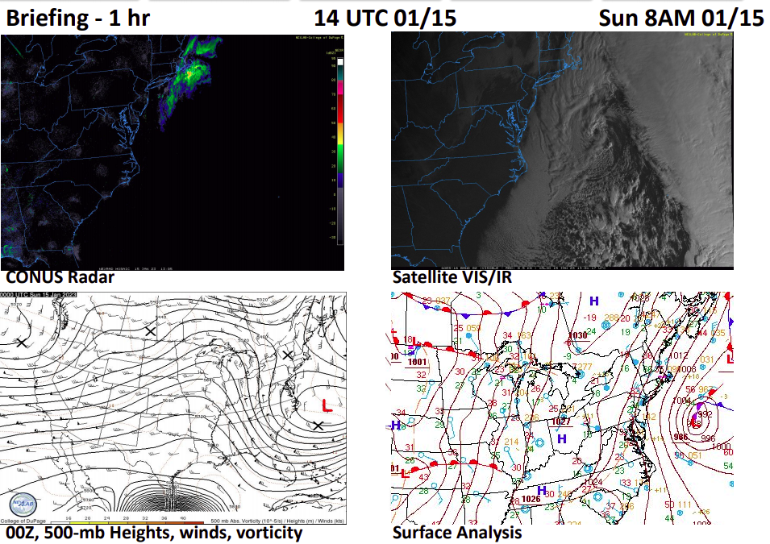
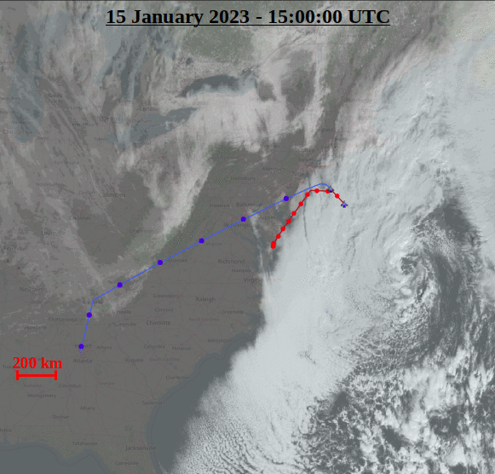
15 January 2023 Case Study - Background
13 UTC 01/15
L
No Ground Radar Coverage
Animated loop showing GOES-16 (VIS CH01) in 30-minute intervals (15:00-20:30 UTC) over eastern CONUS and western Atlantic. Overlayed are flight tracks from the P-3 aircraft (red) and the ER-2 aircraft (blue).
4-panel plot showing composite reflectivity (top-left), VIS/IR GOES-16 satellite imagery (top-right), 00 UTC upper-air analysis (bottom-left), and 12 UTC surface analysis (bottom-right).
7

Slide 8
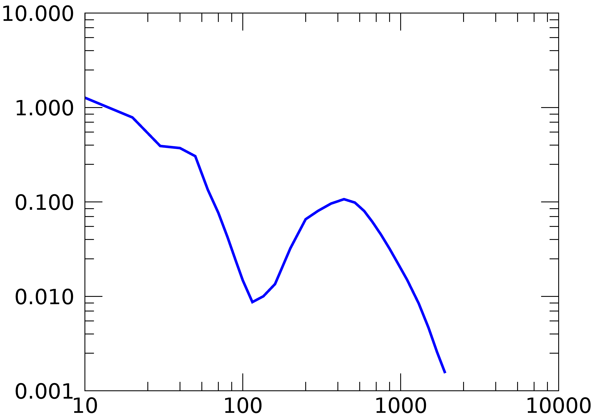
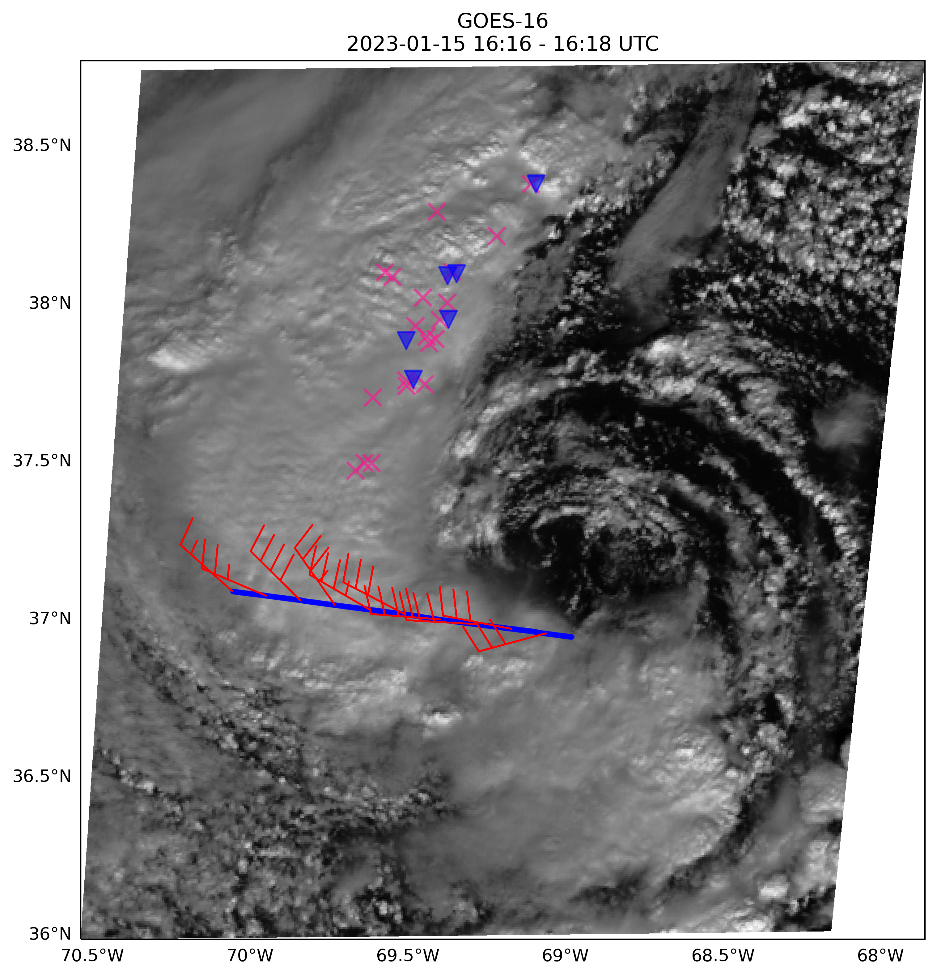
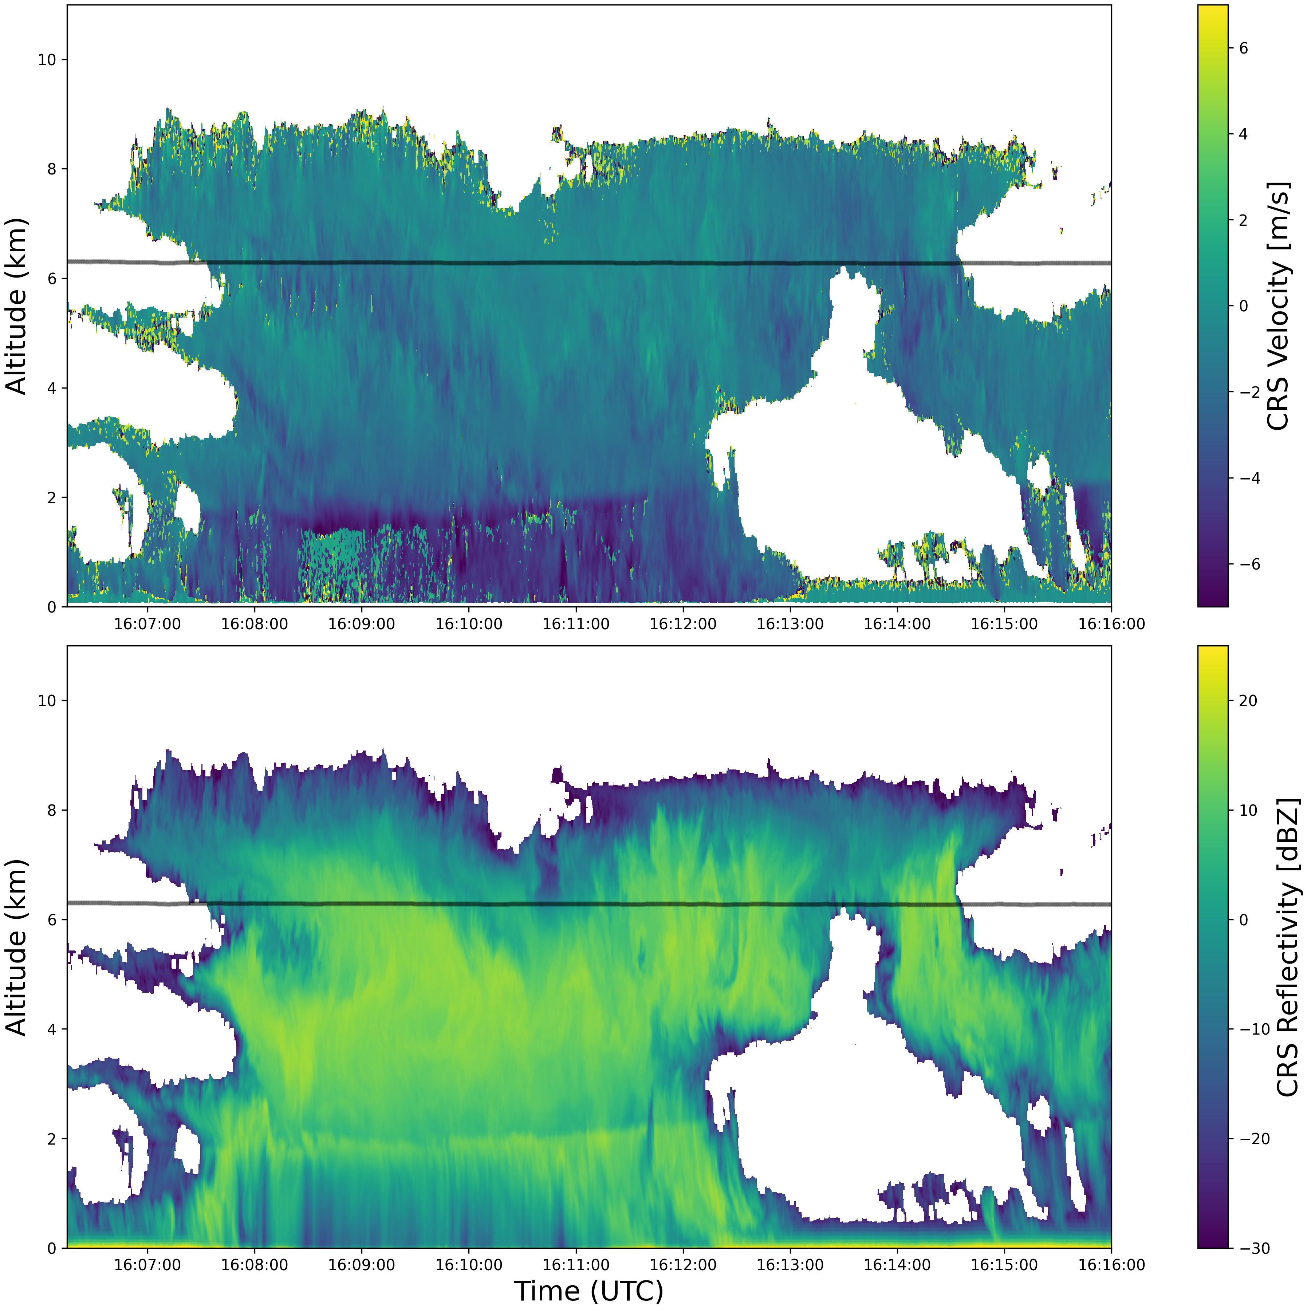
15 January 2023 Flight Leg: 16:06:15 – 16:16:00 UTC
2D-S Normalized Particle Concentration
16:06:15 – 16:16:00 UTC
Pink ‘X’ – Cloud/Intra-Cloud Lightning Strokes
Blue ‘ ’ – Cloud-to-Ground Lightning Strokes
dN/d(LOG(D)) [#/(cm³)
Cloud Particle Diameter [µm]
W-band Cloud Radar System (CRS)
P-3 Flight Track
10 km
50 km
- P-3 Altitude = 6,284 ± 7.6 m AGL
- T_{sample (P3)} = -24.5 ± 0.6 °C
- ER-2 Altitude ~ 20,000 m AGL
- ER-2 directly above P-3 at ~16:12:00 UTC
8

Slide 9
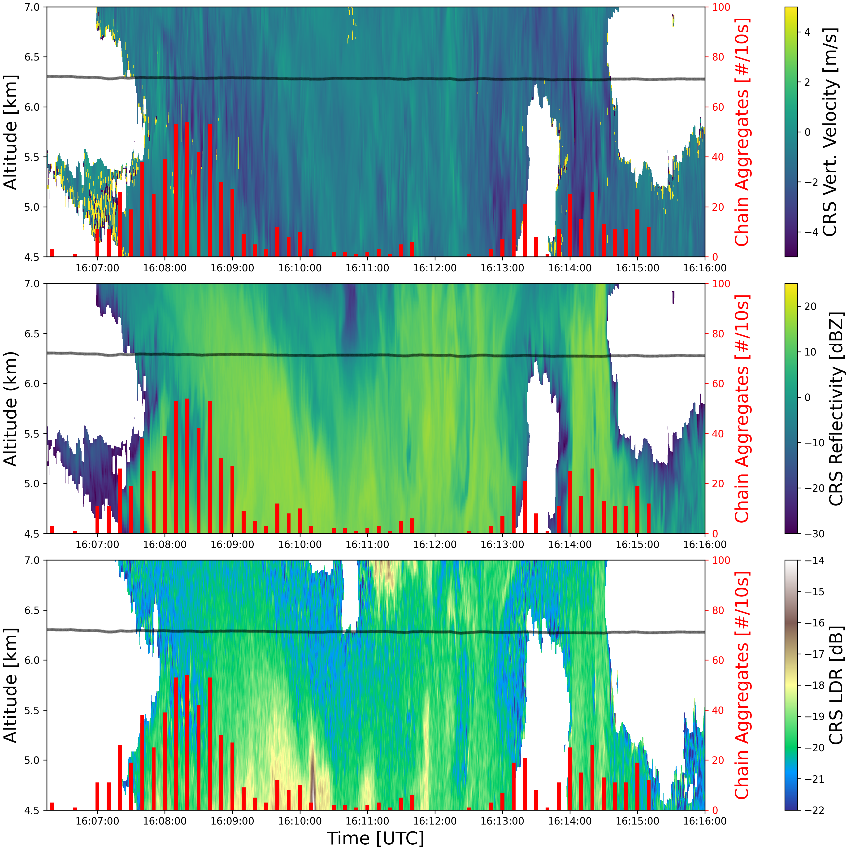
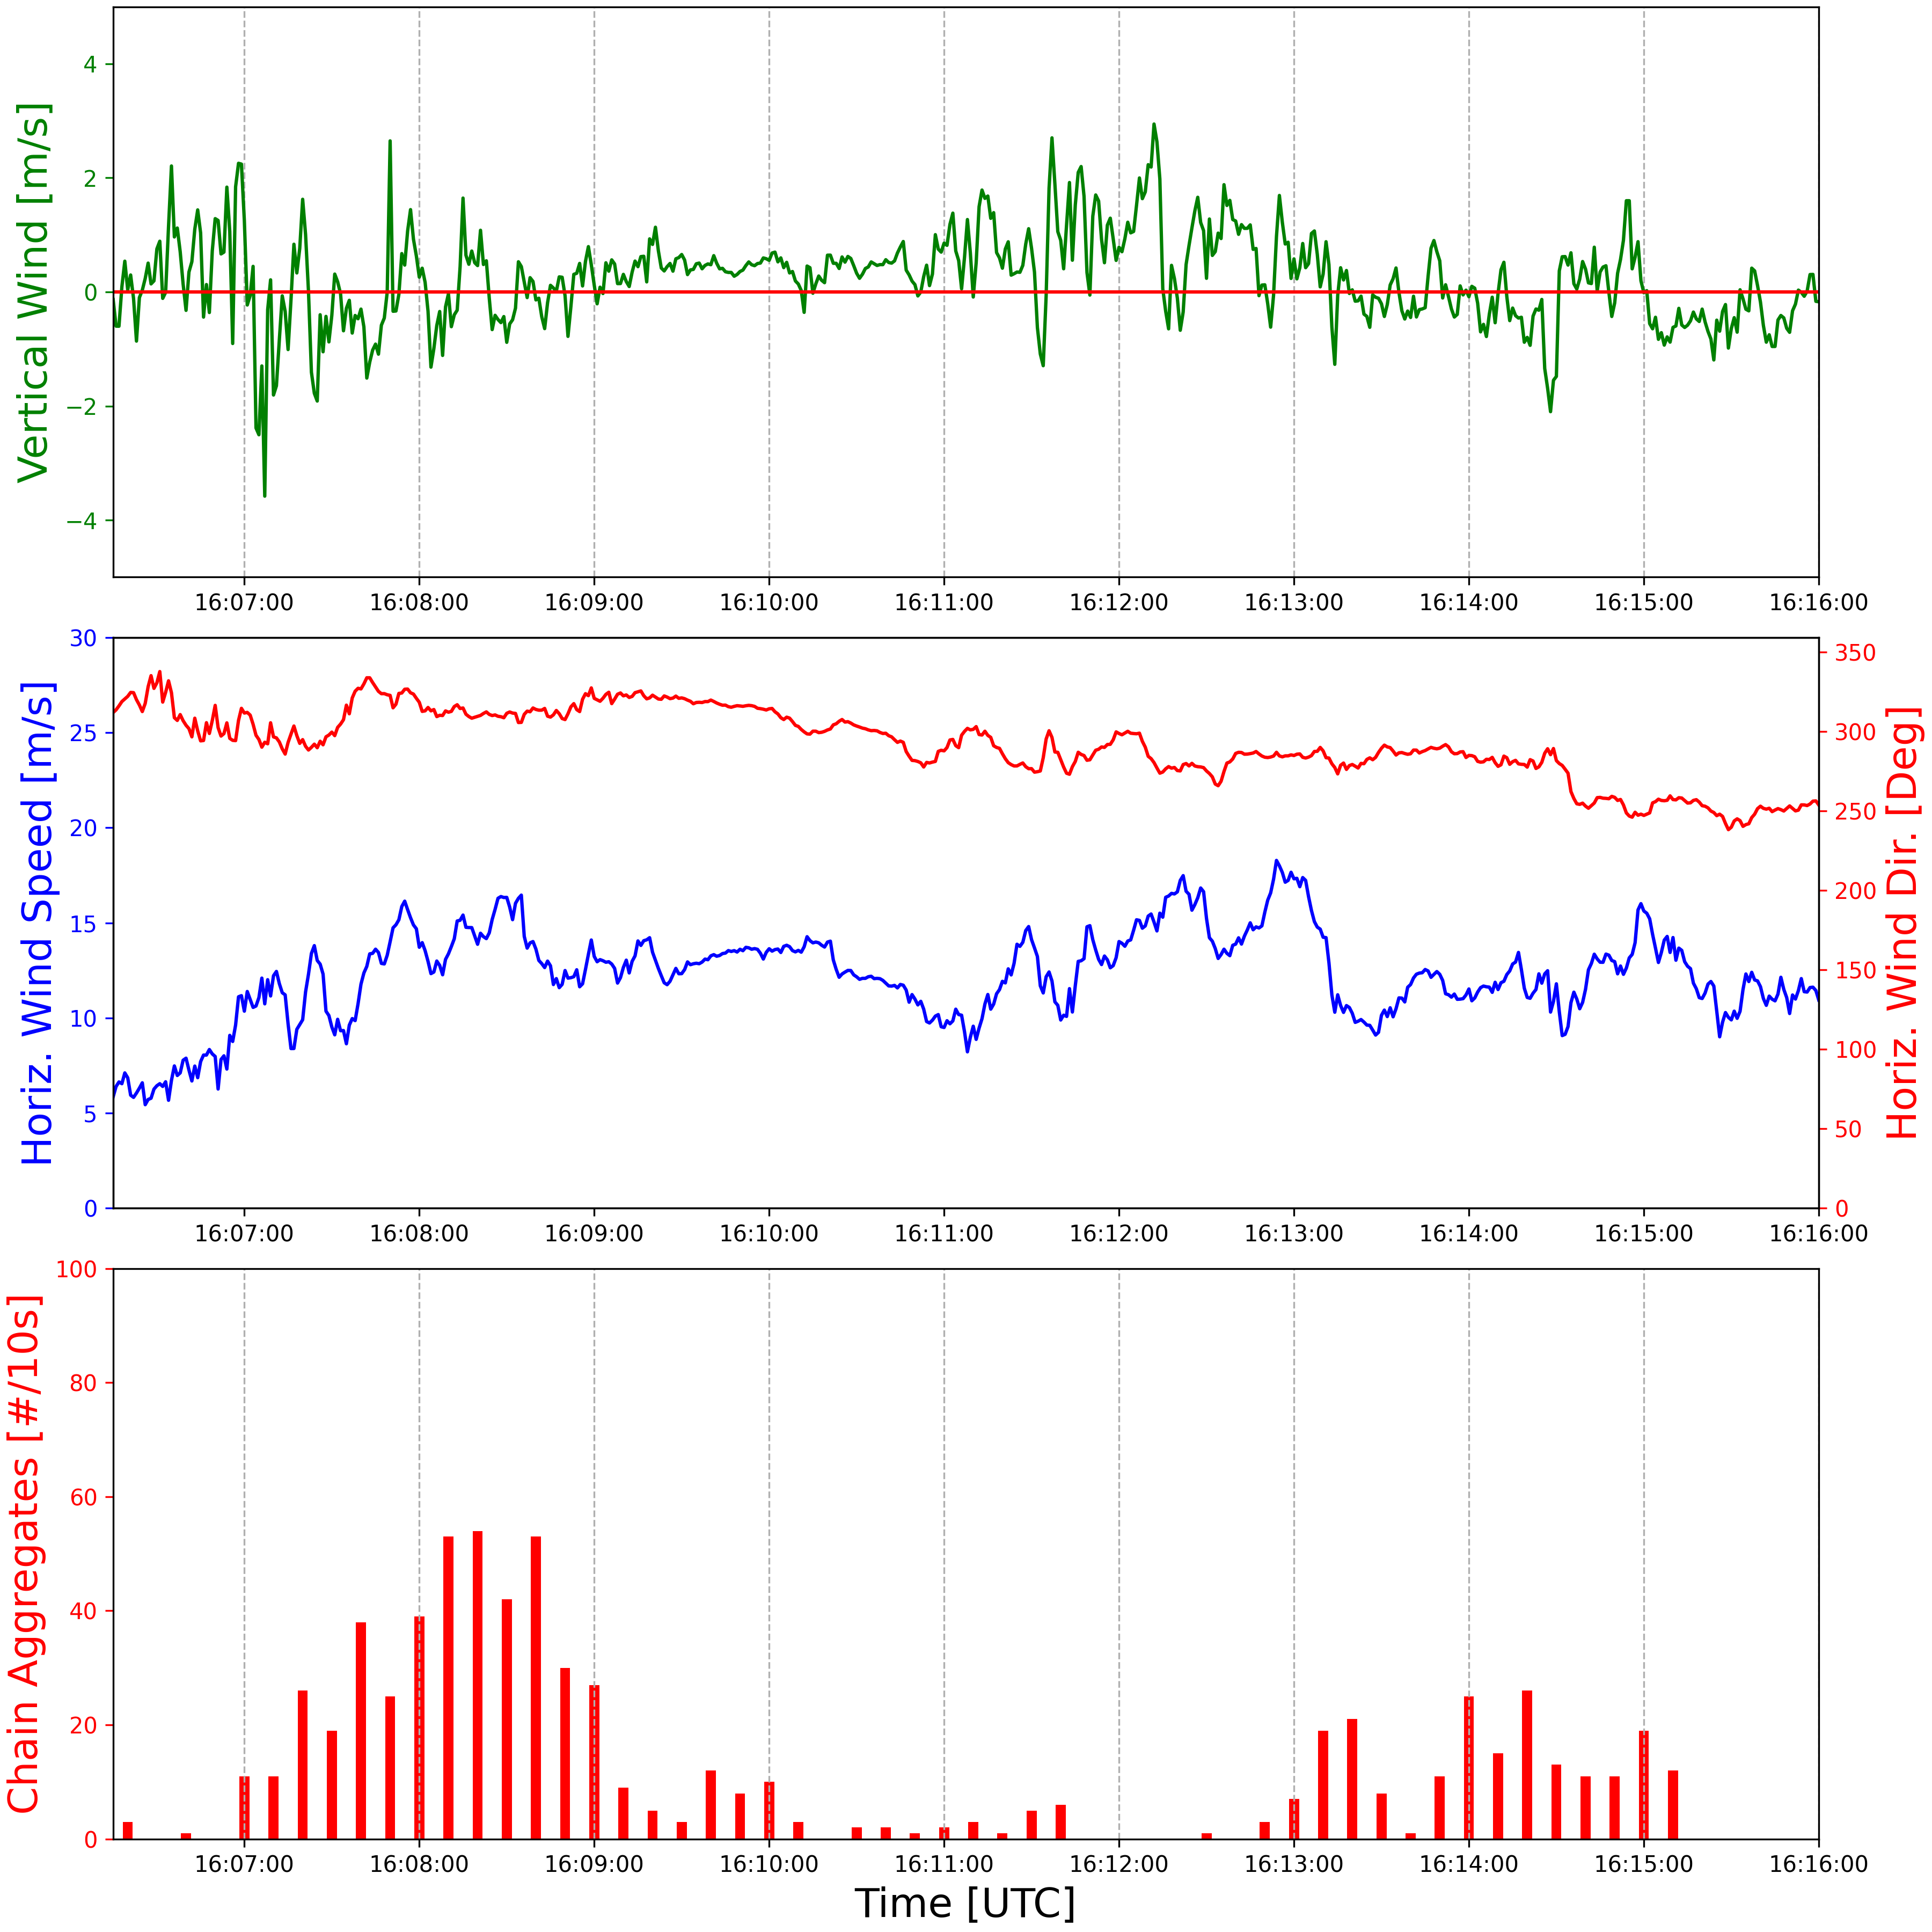
W-band Cloud Radar System (CRS)
P-3 Flight Track
P-3 Wind (TAMMS) Data
10 km
10 km
16:07
16:09
16:11
16:13
16:15
Time [UTC]
10 km
Where are the chain aggregates observed?
- Downstream of TROWAL where electrification is occurring.
- Small scale convective areas.
- Mixed vertical motion.
- LDR values between -18.5 to -21.5 dB.
16:07
16:09
16:11
16:13
16:15
9
Time [UTC]
104th AMS Annual Meeting – First Symposium on Cloud Physics: Cloud Properties in Winter Storms II

Slide 10
W-band Cloud Radar System (CRS)
P-3 Flight Track
P-3 Wind (TAMMS) Data
10 km
10 km
16:07
16:09
16:11
16:13
16:15
Time [UTC]
10 km
Where are the chain aggregates observed?
- Downstream of TROWAL where electrification is occurring.
- Small scale convective areas.
- Mixed vertical motion.
- LDR values between -18.5 to -21.5 dB.
16:07
16:09
16:11
16:13
16:15
10
Time [UTC]
104th AMS Annual Meeting – First Symposium on Cloud Physics: Cloud Properties in Winter Storms II

Slide 11
Need to Analyze More Cases…
…to relate chain aggregates to radar/lidar observations.
Chain aggregates observed during 17 research flights in 2022 & 2023.
Observed on almost every science flight in 2023!
However, more cases → more CPI images to classify → very time consuming!
Only interested where chain aggregates are located → need an automated chain aggregate detection method.
Utilize common chain aggregate properties to segregate them from the overall particle population
Apply Method to other in-situ probes (e.g. 2D-S) with larger sample volumes to establish a less uncertain chain aggregate detection scheme.
104th AMS Annual Meeting – First Symposium on Cloud Physics: Cloud Properties in Winter Storms II
Notes:
The TAMMS is composed of several subsystems including: (1) distributed pressure ports coupled with absolute and differential pressure transducers and temperature sensors, (2) aircraft inertial and satellite navigation systems, (3) a central data acquisition/processing system, and (4) water vapor instruments and potentially other trace gas or aerosol sensors.

Slide 12
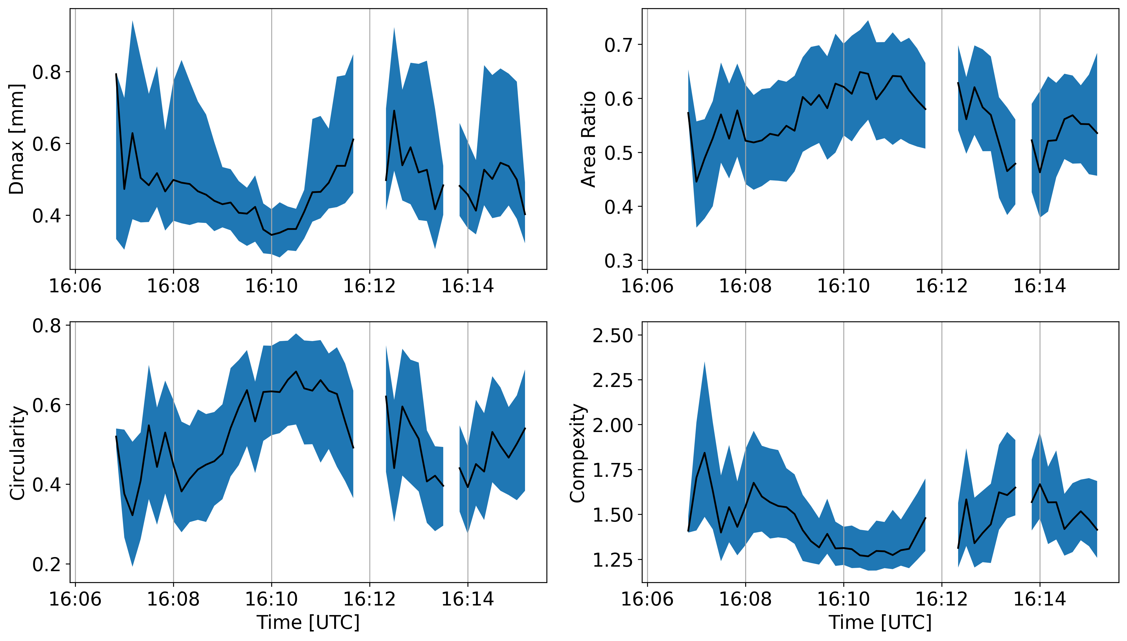
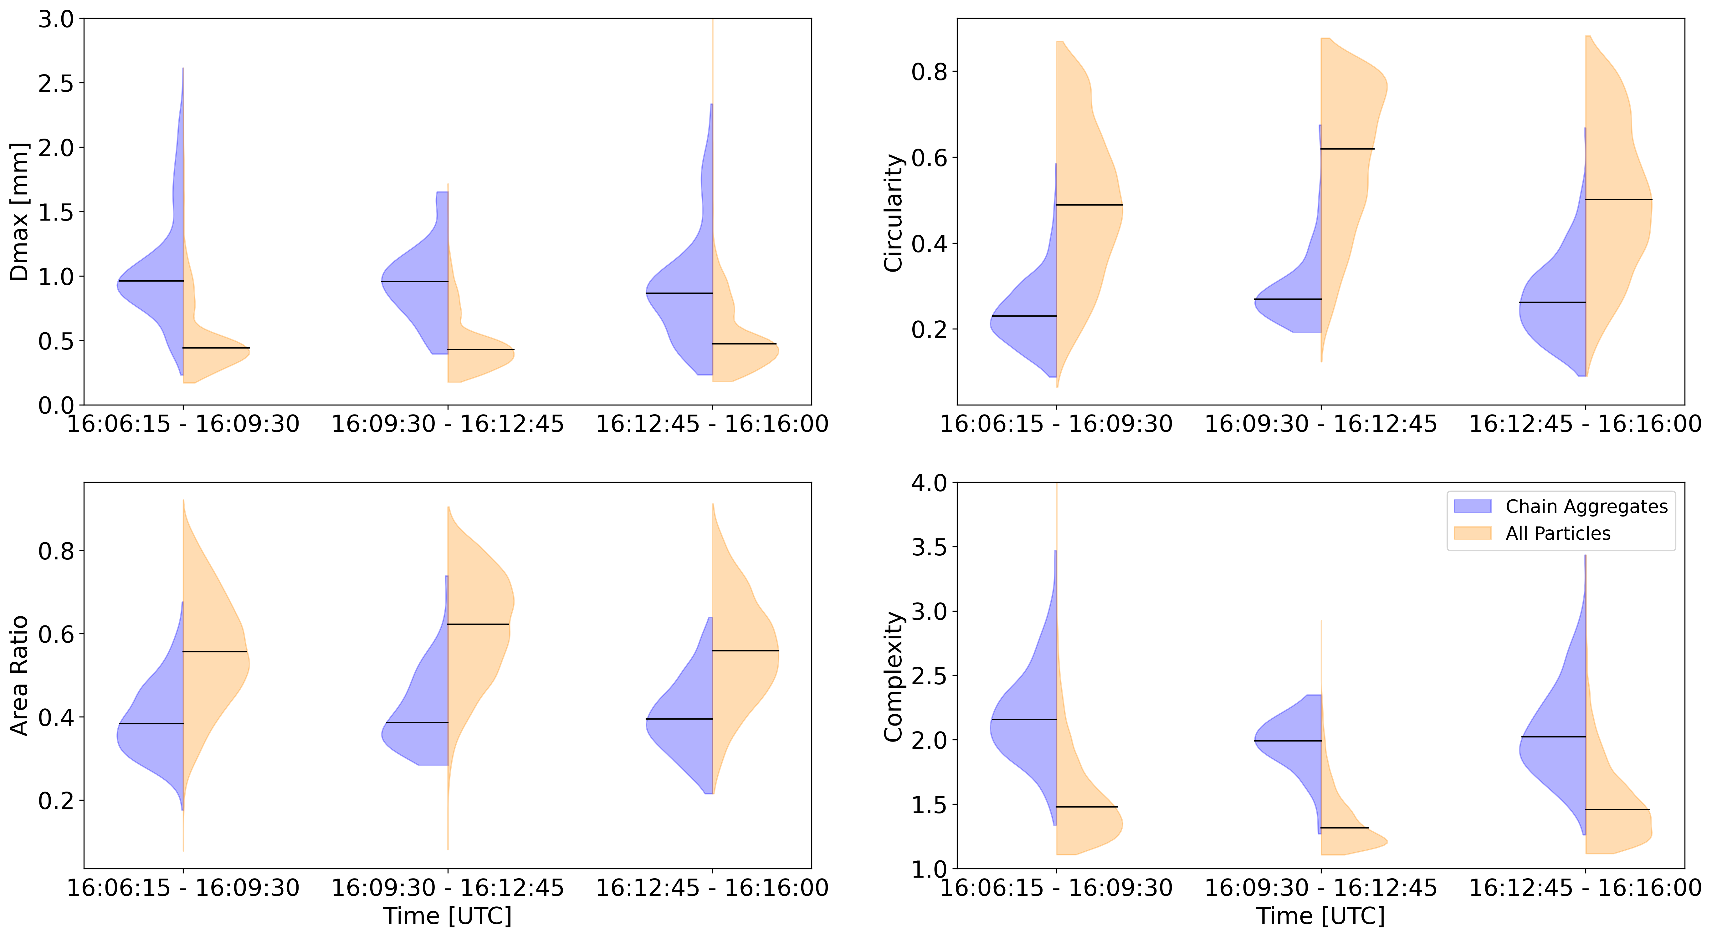
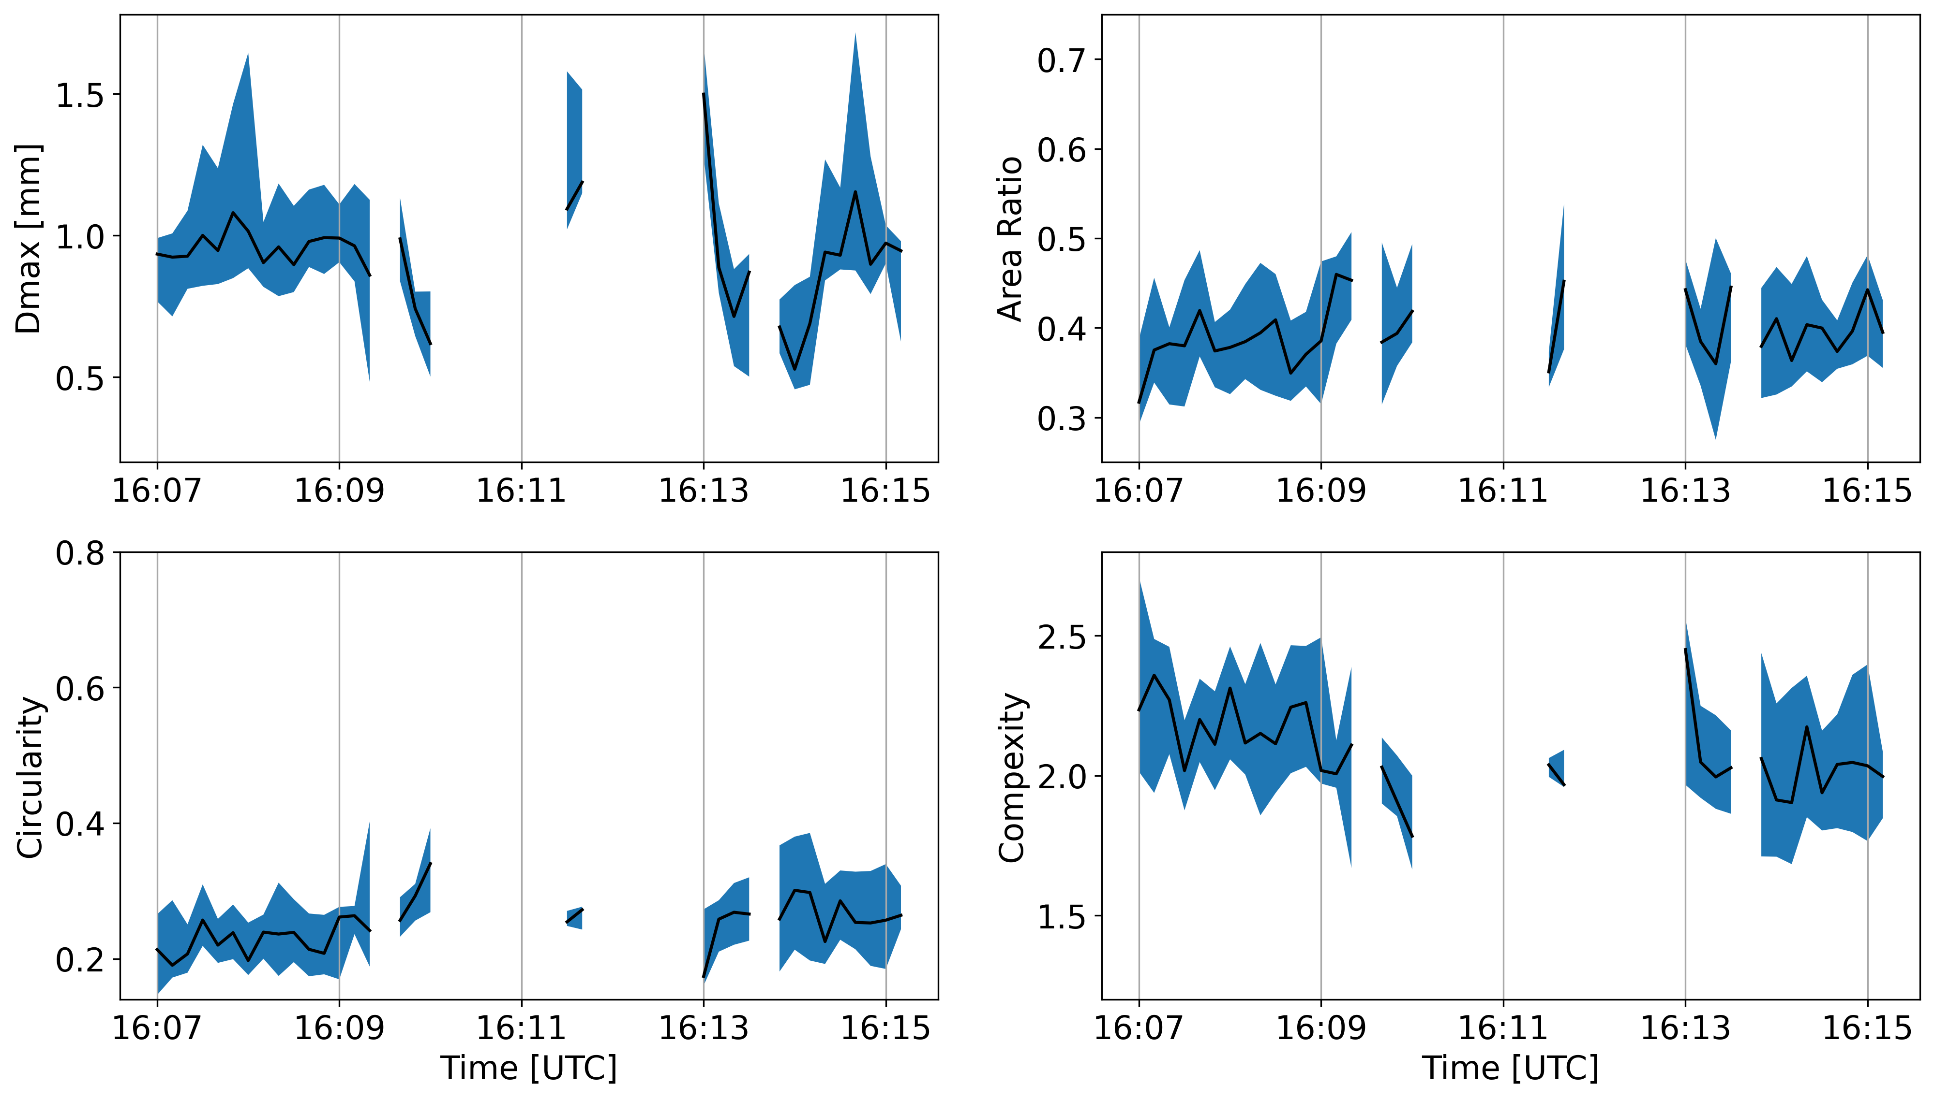
CPI
All Particle
Properties
≥ 150 µm
D_{max}
D_{max}:{
µ_{chains}, σ_{chains} = 0.99, 0.41 mm
µ_{total}, σ_{total} = 0.52, 0.27 mm
}
CPI
Classified Chain Aggregate
Properties
Area Ratio
Area Ratio:{
µ_{chains}, σ_{chains} = 0.4, 0.09
µ_{total}, σ_{total} 0.58, 0.13
}
Chain aggregates have a higher D_{max}, area ratio, circularity, and complexity compared to all particles observed.
12

Slide 13
CPI
All Particle
Properties
≥ 150 µm
D_{max}
D_{max}:{
µ_{chains}, σ_{chains} = 0.99, 0.41 mm
µ_{total}, σ_{total} = 0.52, 0.27 mm
}
CPI
Classified Chain Aggregate
Properties
Area Ratio
Area Ratio:{
µ_{chains}, σ_{chains} = 0.4, 0.09
µ_{total}, σ_{total} 0.58, 0.13
}
Chain aggregates have a higher D_{max}, area ratio, circularity, and complexity compared to all particles observed. Mainly focused on D_{max} and area ratio.
13

Slide 14
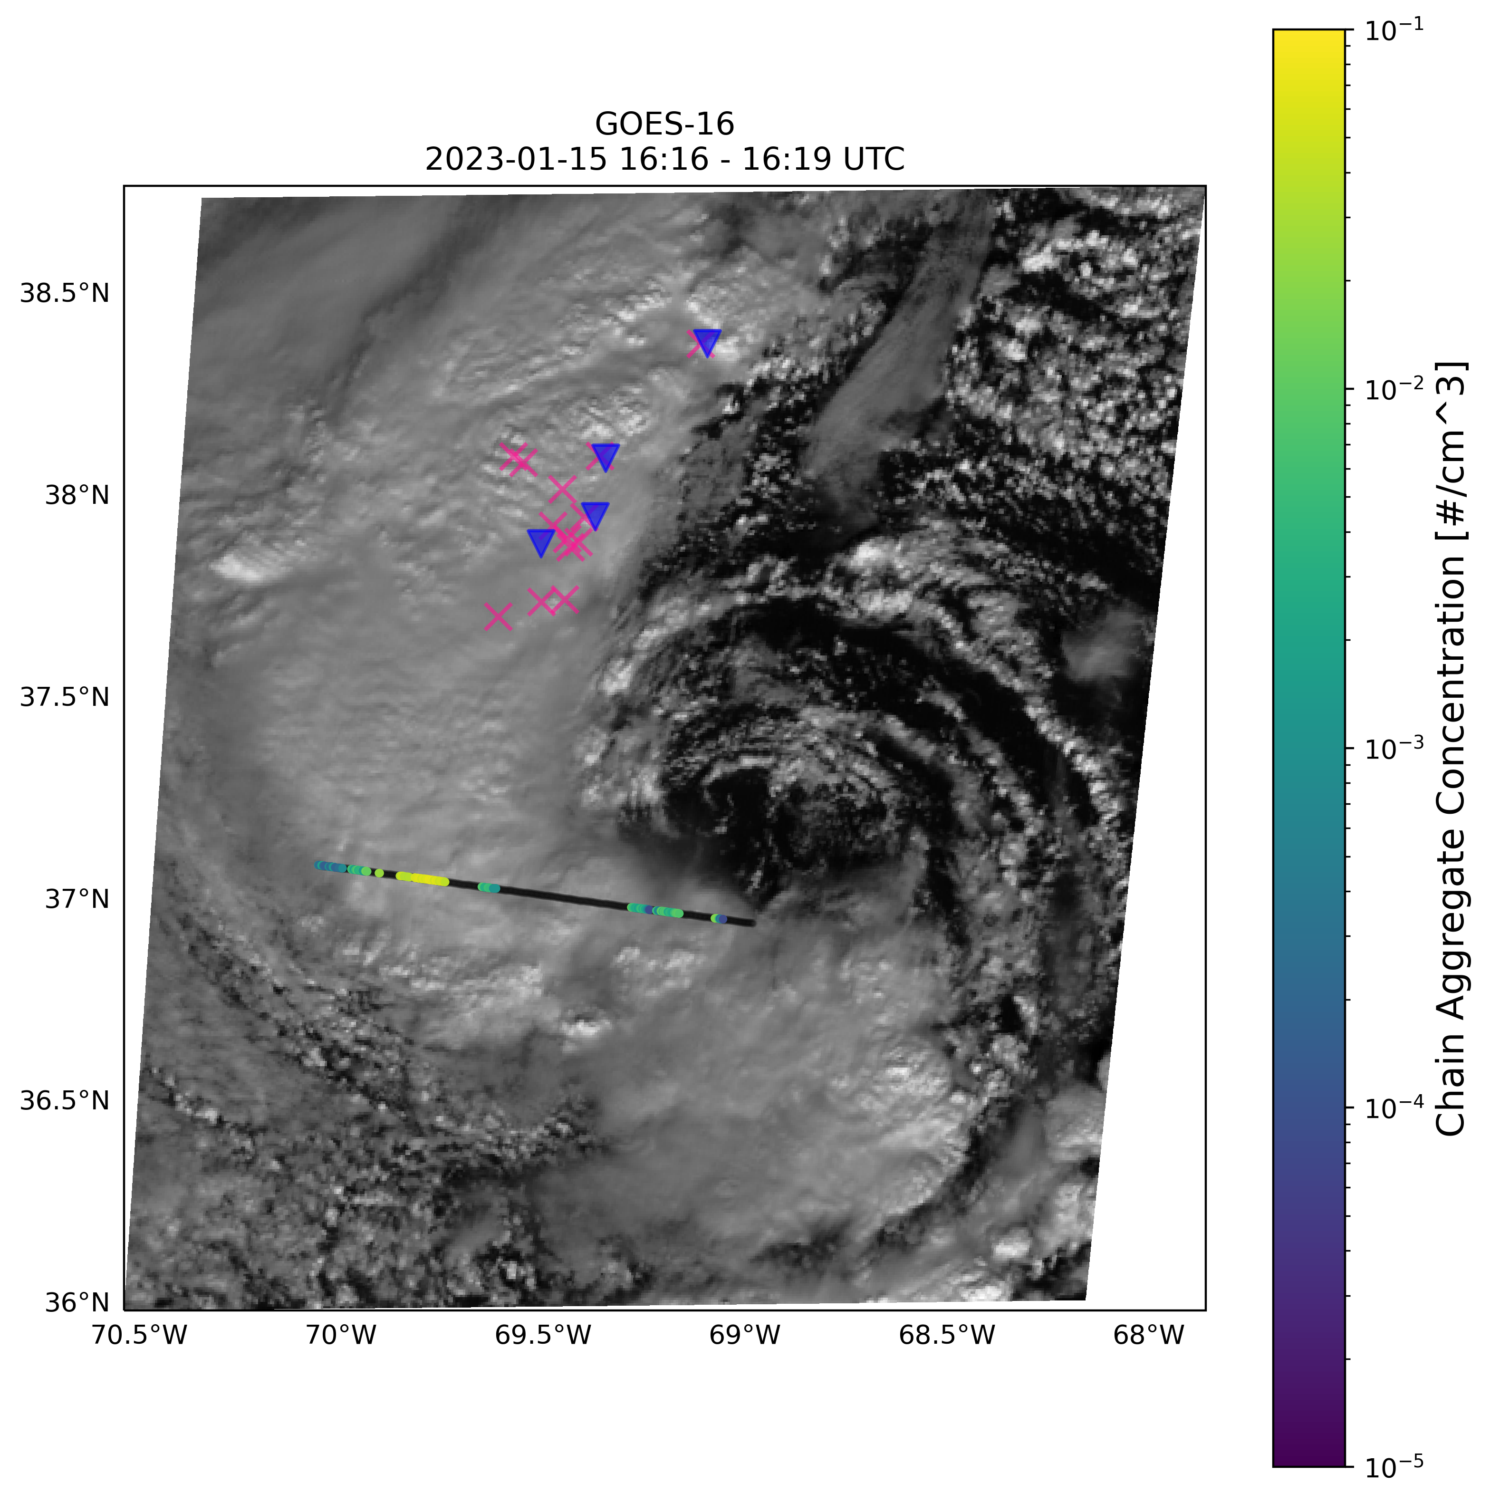
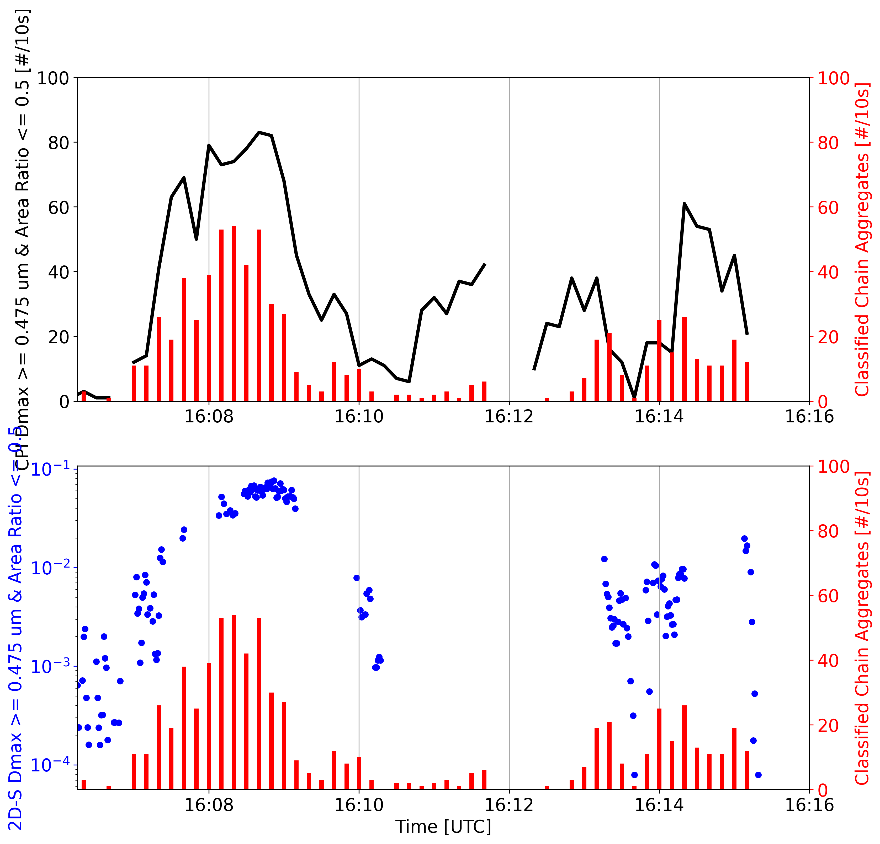
Applying CPI D_{max} & Area Ratio Thresholds on CPI & 2D-S particles
Cloud Particle Imager (CPI) Particles [#/10s]
D_{max} ≥ 475 µm & Area Ratio ≤ 0.5
Classified (CPI) Chain Aggs. [#/10s]
2D-S Particle Concentration [[#/cm³]
D_{max} ≥ 475 µm, Area Ratio ≤ 0.5
2D-Stereo (2D-S) Particle Concentration [#/cm³]
D_{max} ≥ 475 µm & Area Ratio ≤ 0.5
50 km
Classified (CPI) Chain Aggs. [#/10s]
Pink ‘X’ – Cloud/Intra-Cloud Lightning Strokes
Blue ‘ ’ – Cloud-to-Ground Lightning Strokes
Applying D_{max} and area ratio thresholds to the CPI and 2D-S particles does a good job in segregating chain aggregates from the total particle population.
14
104th AMS Annual Meeting – First Symposium on Cloud Physics: Cloud Properties in Winter Storms II

Slide 15
Summary
Cloud Particle Imager (CPI) Particles [#/10s]
Approximately 800 Chain Aggregates (8%) classified during the 16:06:15-16:16:00 flight leg on 15 January 2023.
Chains are similar to those observed in cloud chamber experiments and previous field campaigns.
Downstream of TROWAL where electrification is occurring.
Mixed vertical motion.
Small scale convective areas.
Using D_{max} and area ratio thresholds does a good job segregating chain aggregates from the total particle population.
D_{max} ≥ 475 µm & Area Ratio ≤ 0.5
Classified Chain Aggregates [#/10s]
2D-Stereo (2D-S) Particle Concentration [#/cm³]
D_{max} ≥ 475 µm & Area Ratio ≤ 0.5
Classified Chain Aggregates [#/10s]
15
104th AMS Annual Meeting – First Symposium on Cloud Physics: Cloud Properties in Winter Storms II

Slide 16
Future Work
17 number of flights from 2022 & 2023 observed chain aggregates.
Assessment across multiple IMPACTS flights.
Enable relating chain aggregate concentrations to ER-2 radar/lidar measurements.
Apply circularity measurement to 2D-S for a more robust chain aggregate concentration.
2D-S: D_{max} ≥ 475 µm, Area Ratio ≤ 0.5
16
104th AMS Annual Meeting – First Symposium on Cloud Physics: Cloud Properties in Winter Storms II

Slide 17
References & Acknowledgements
Baran, A. J. (2009). A review of the light scattering properties of cirrus. Journal of Quantitative Spectroscopy and Radiative Transfer, 110(14), 1239–1260. https://doi.org/10.1016/j.jqsrt.2009.02.026
Liou, K. N. (1973). Transfer of Solar Irradiance through Cirrus Cloud Layers., J. Geophys. Res., 78, 1409–1418.
Nairy, C. M. (2022). Observations of Chain Aggregates in Florida Cirrus Cloud Anvils on 3 August 2019 during CAPEEX19 (Master’s thesis), Dept. of Atmospheric Sciences, University of North Dakota, Grand Forks, North Dakota. Retrieved from https://commons.und.edu/theses/4363/
Saunders, C. P. R., & Wahab, N. M. A. (1975). The Influence of Electric Fields on the Aggregation of Ice Crystals. Journal of the Meteorological Society of Japan. Ser. II, 53(2), 121–126. https://doi.org/10.2151/jmsj1965.53.2_121
Schmitt, C. G., and A. J. Heymsfield (2014), Observational quantification of the separation of simple and complex atmospheric ice particles, Geophys. Res. Lett., 41, 1301–1307, doi:10.1002/2013GL058781.
Stephens, G. L., Tsay, S.-C., Stackhouse, P. W., & Flatau, P. J. (1990). The Relevance of the Microphysical and Radiative Properties of Cirrus Clouds to Climate and Climatic Feedback. Journal of the Atmospheric Sciences, 47(14), 1742–1754. https://doi.org/10.1175/1520-0469(1990)047<1742:TROTMA>2.0.CO;2
Stith, J. L., Avallone, L. M., Bansemer, A., Basarab, B., Dorsi, S. W., Fuchs, B., et al. (2014). Ice particles in the upper anvil regions of midlatitude continental thunderstorms: the case for frozen-drop aggregates. Atmospheric Chemistry and Physics, 14(4), 1973–1985. https://doi.org/10.5194/acp-14-1973-2014
This research was supported by a NASA research grant to the University of North Dakota. Grant #: 80NSSC19K0328. The IMPACTS dataset is publicly available at the NASA GHRC http://dx.doi.org/10.5067/IMPACTS/DATA101. We would also like to thank Andrew Heymsfield, Stephen Nicholls, & Mircea Grecu for their added expertise in this work.
Thank you.
17
104th AMS Annual Meeting – First Symposium on Cloud Physics: Cloud Properties in Winter Storms II

Slide 18
EXTRA SLIDES

Slide 19
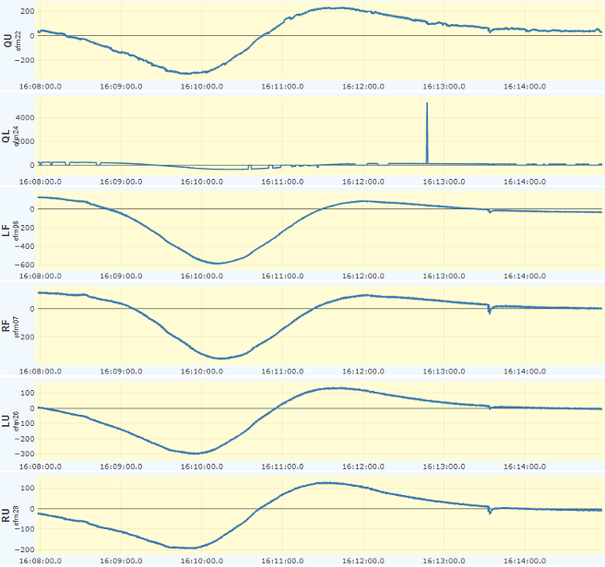

Slide 20
