Slide 1
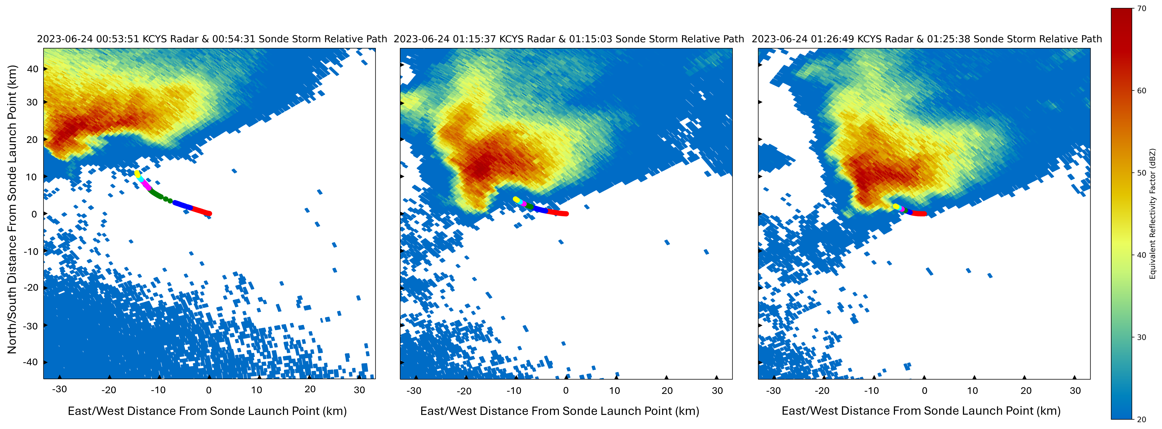
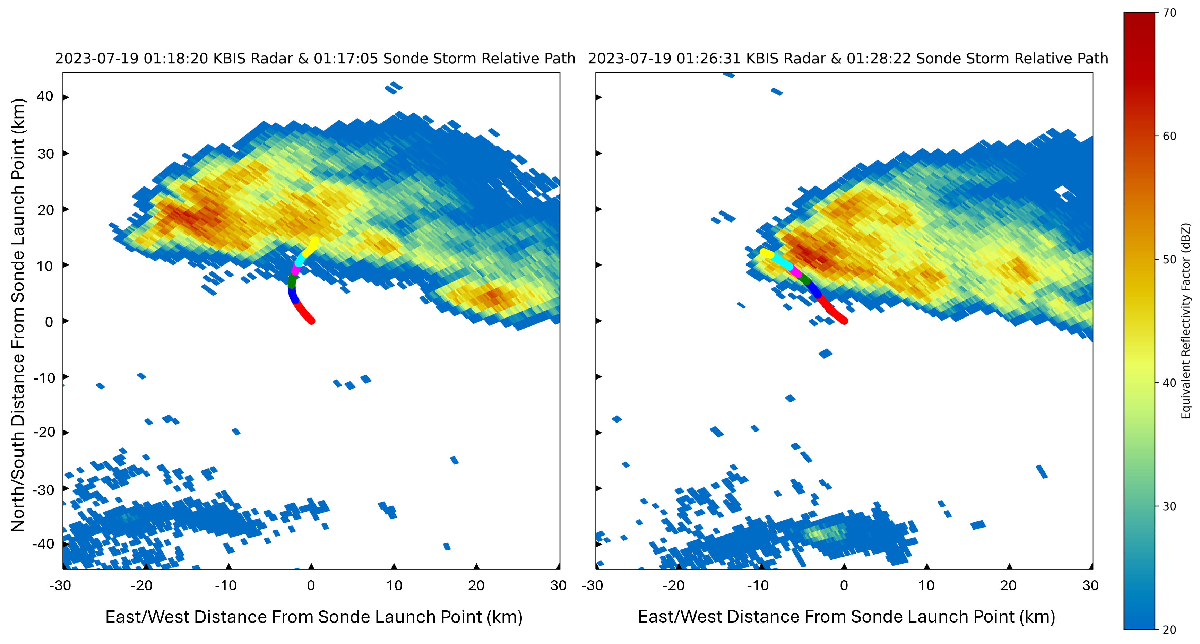
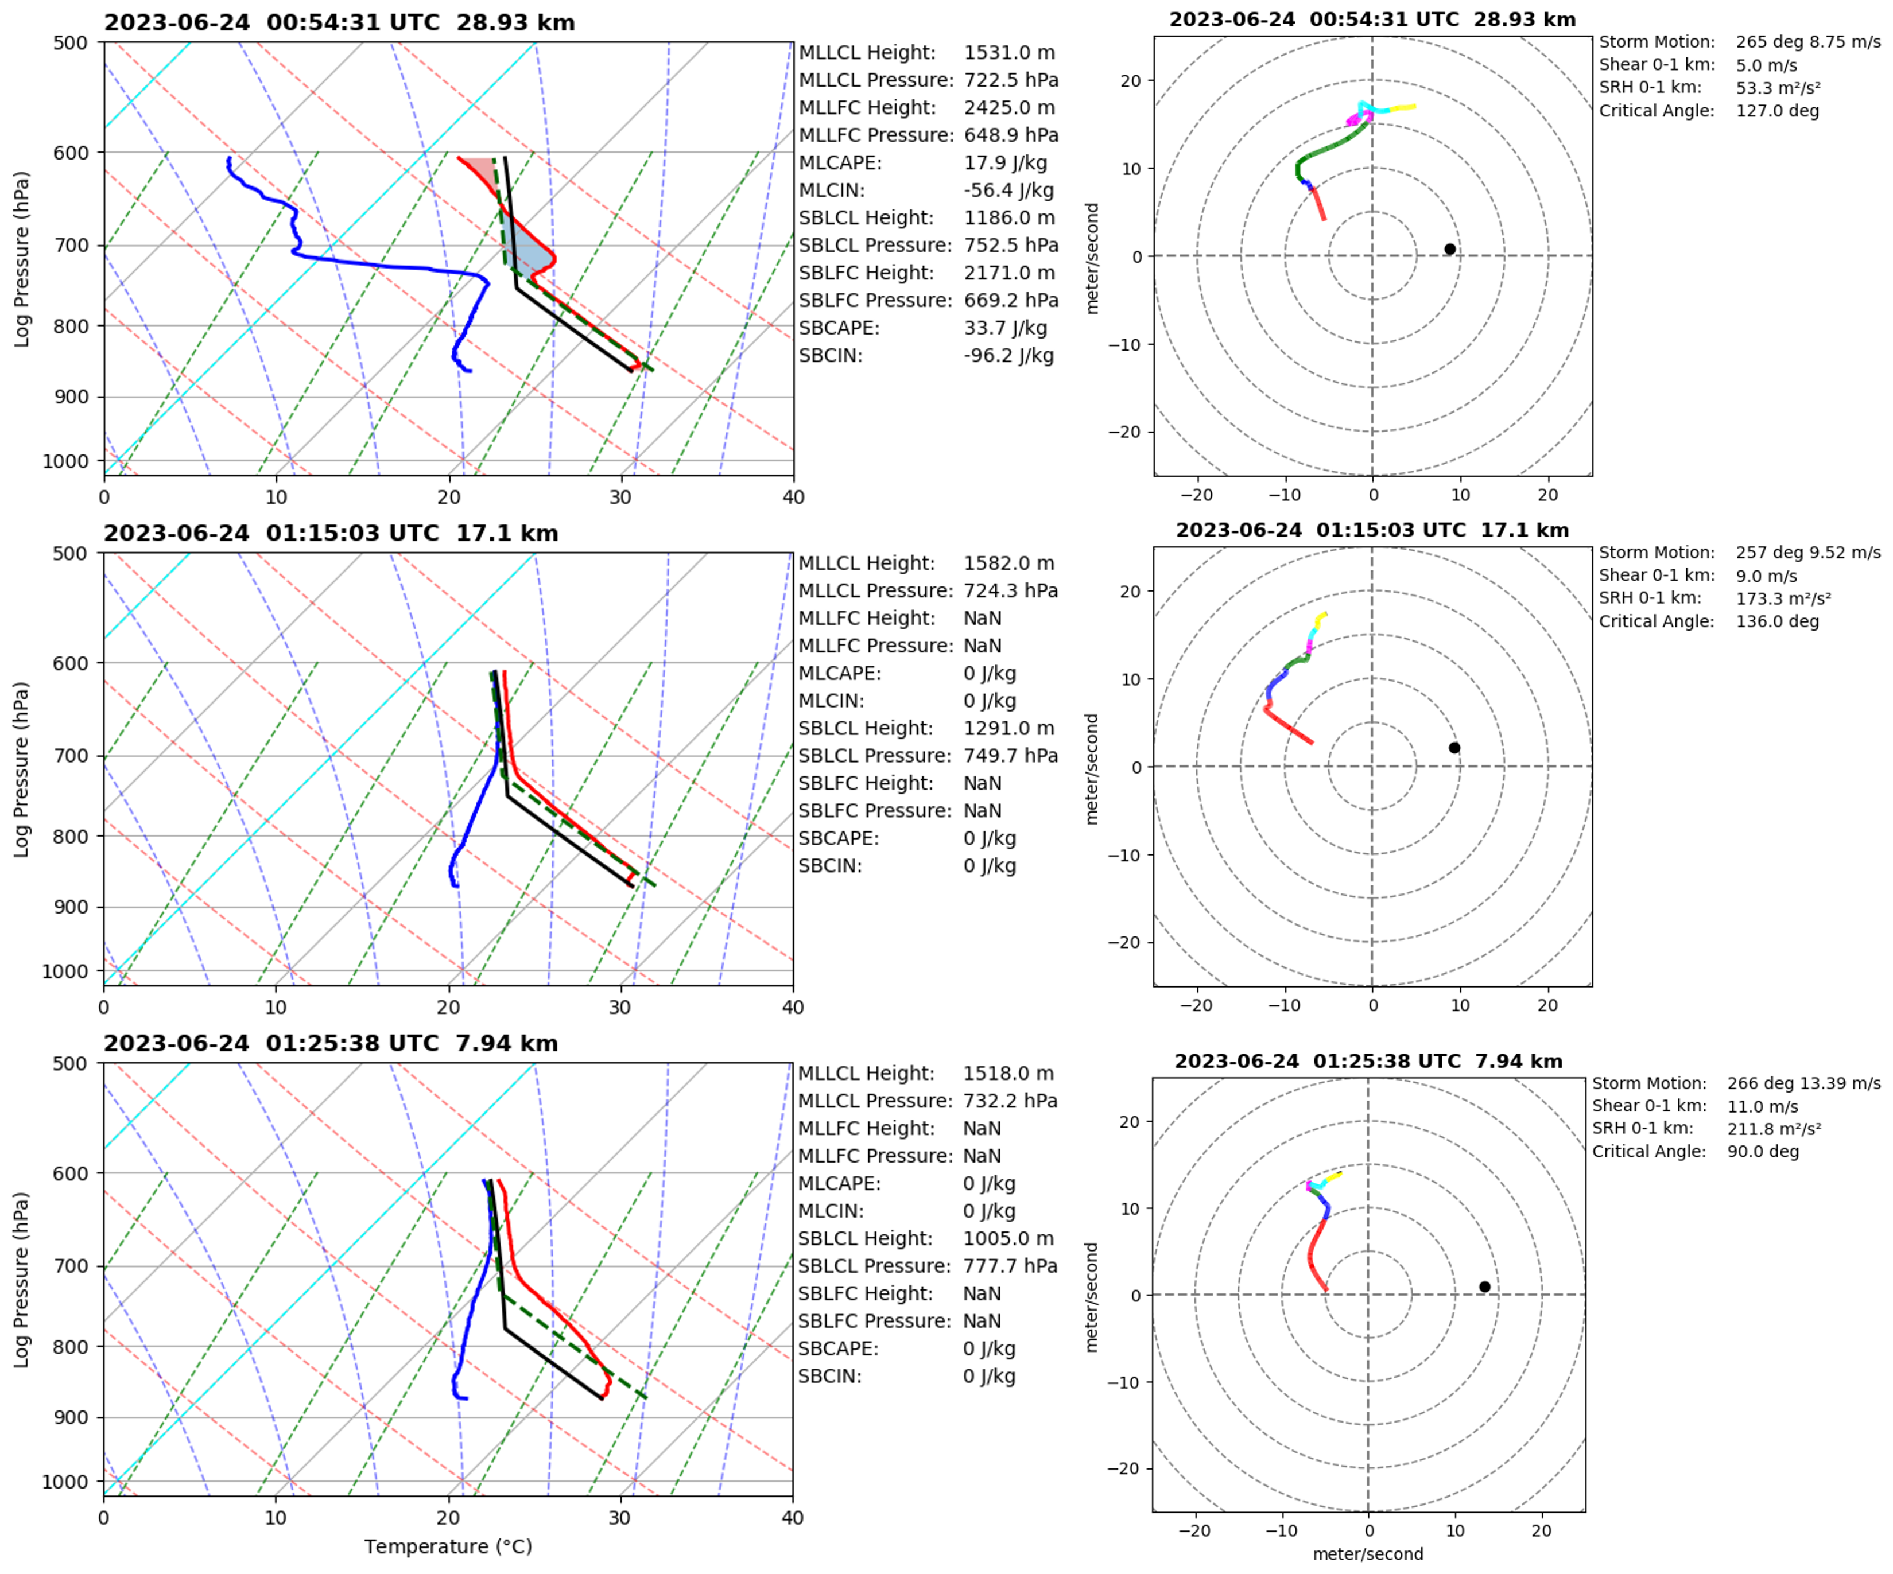
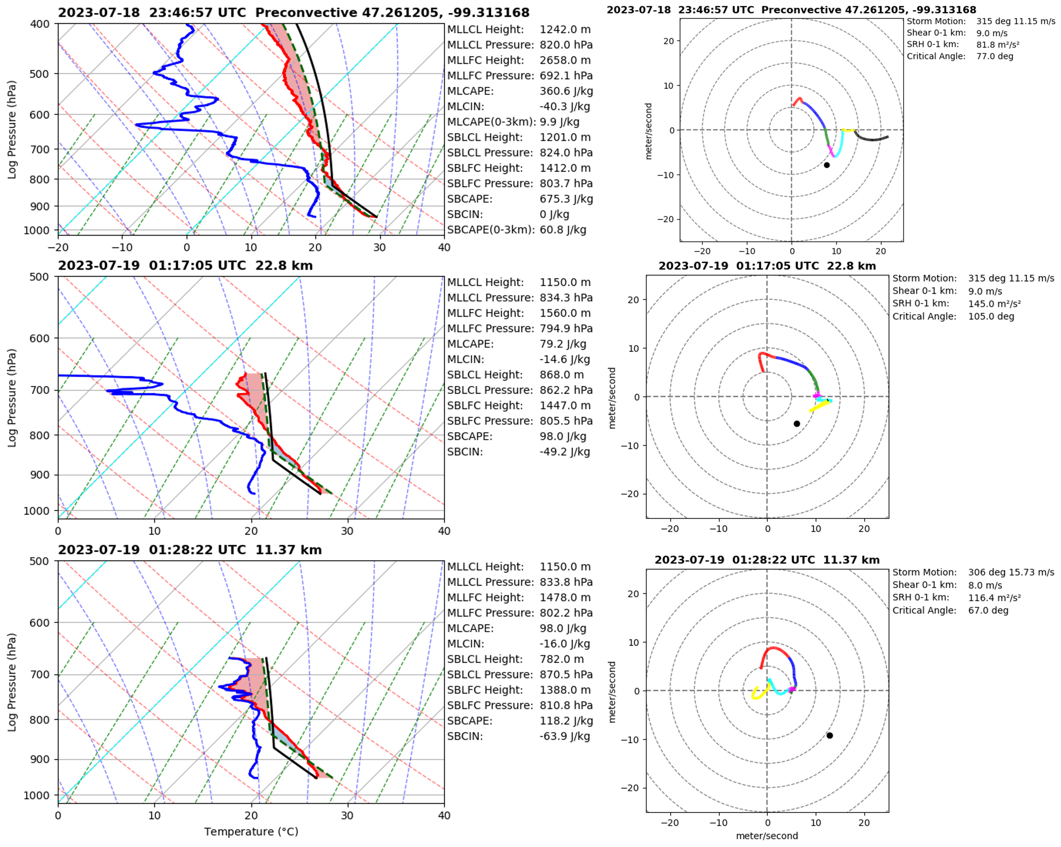
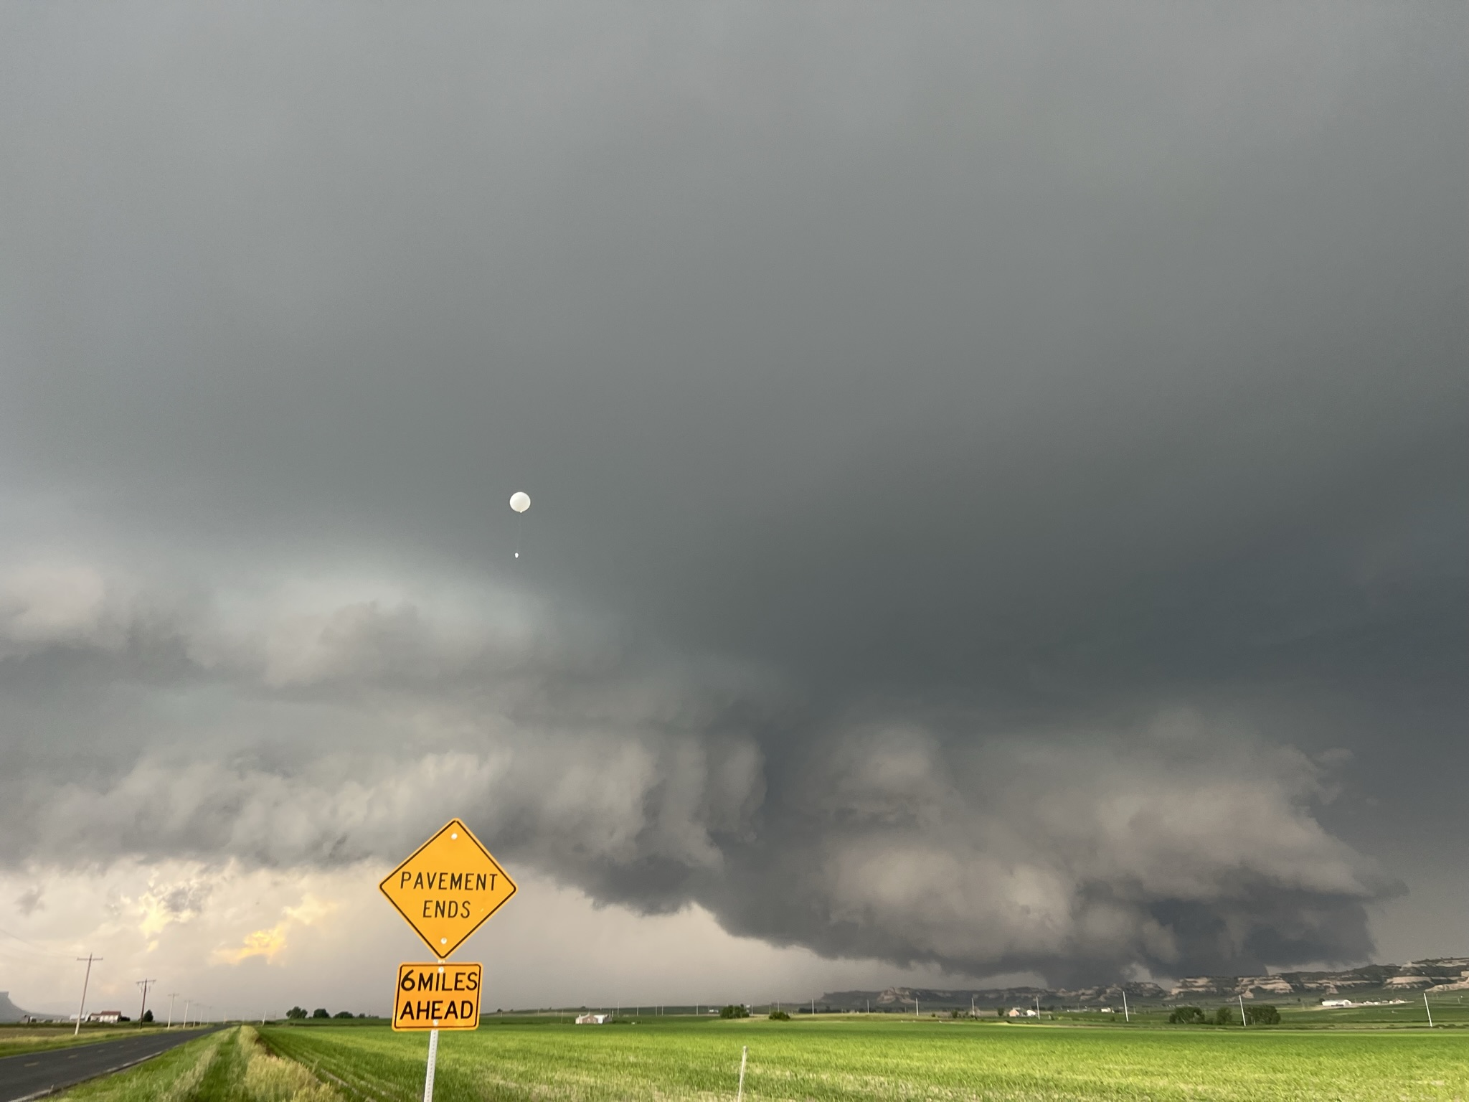
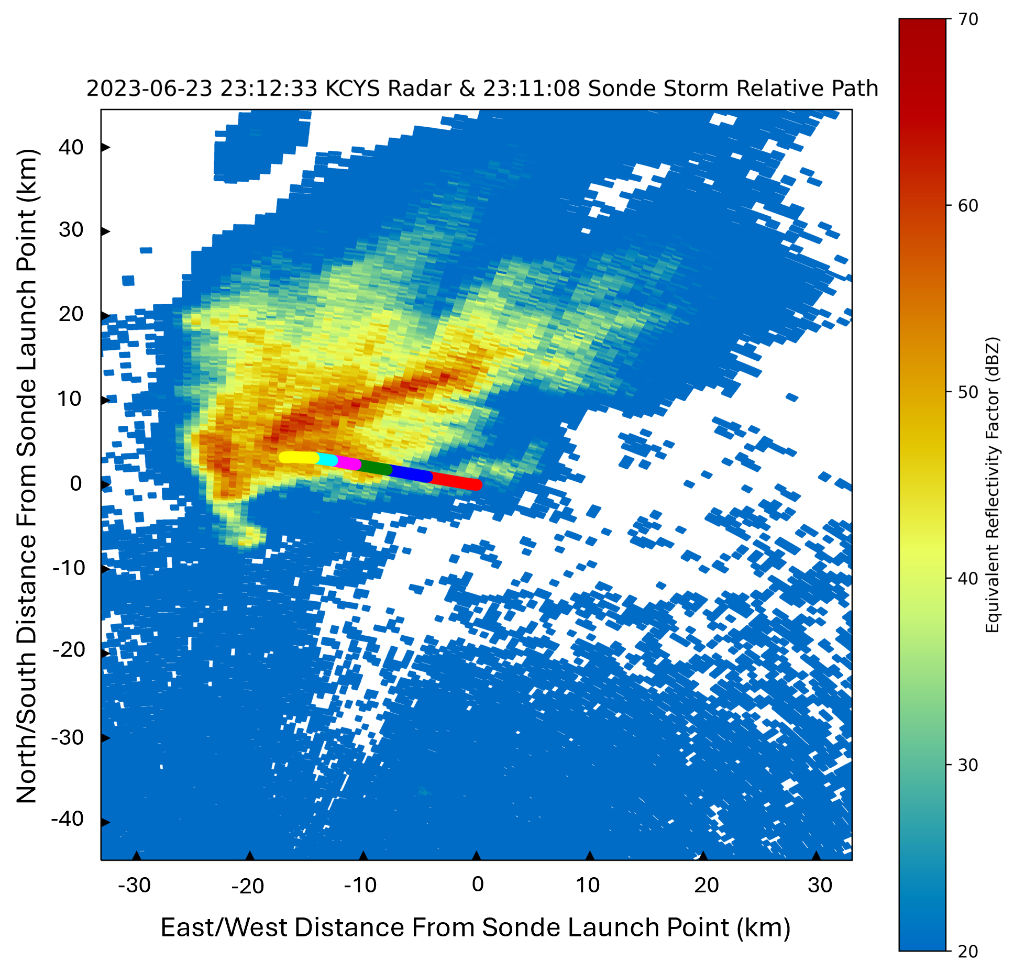
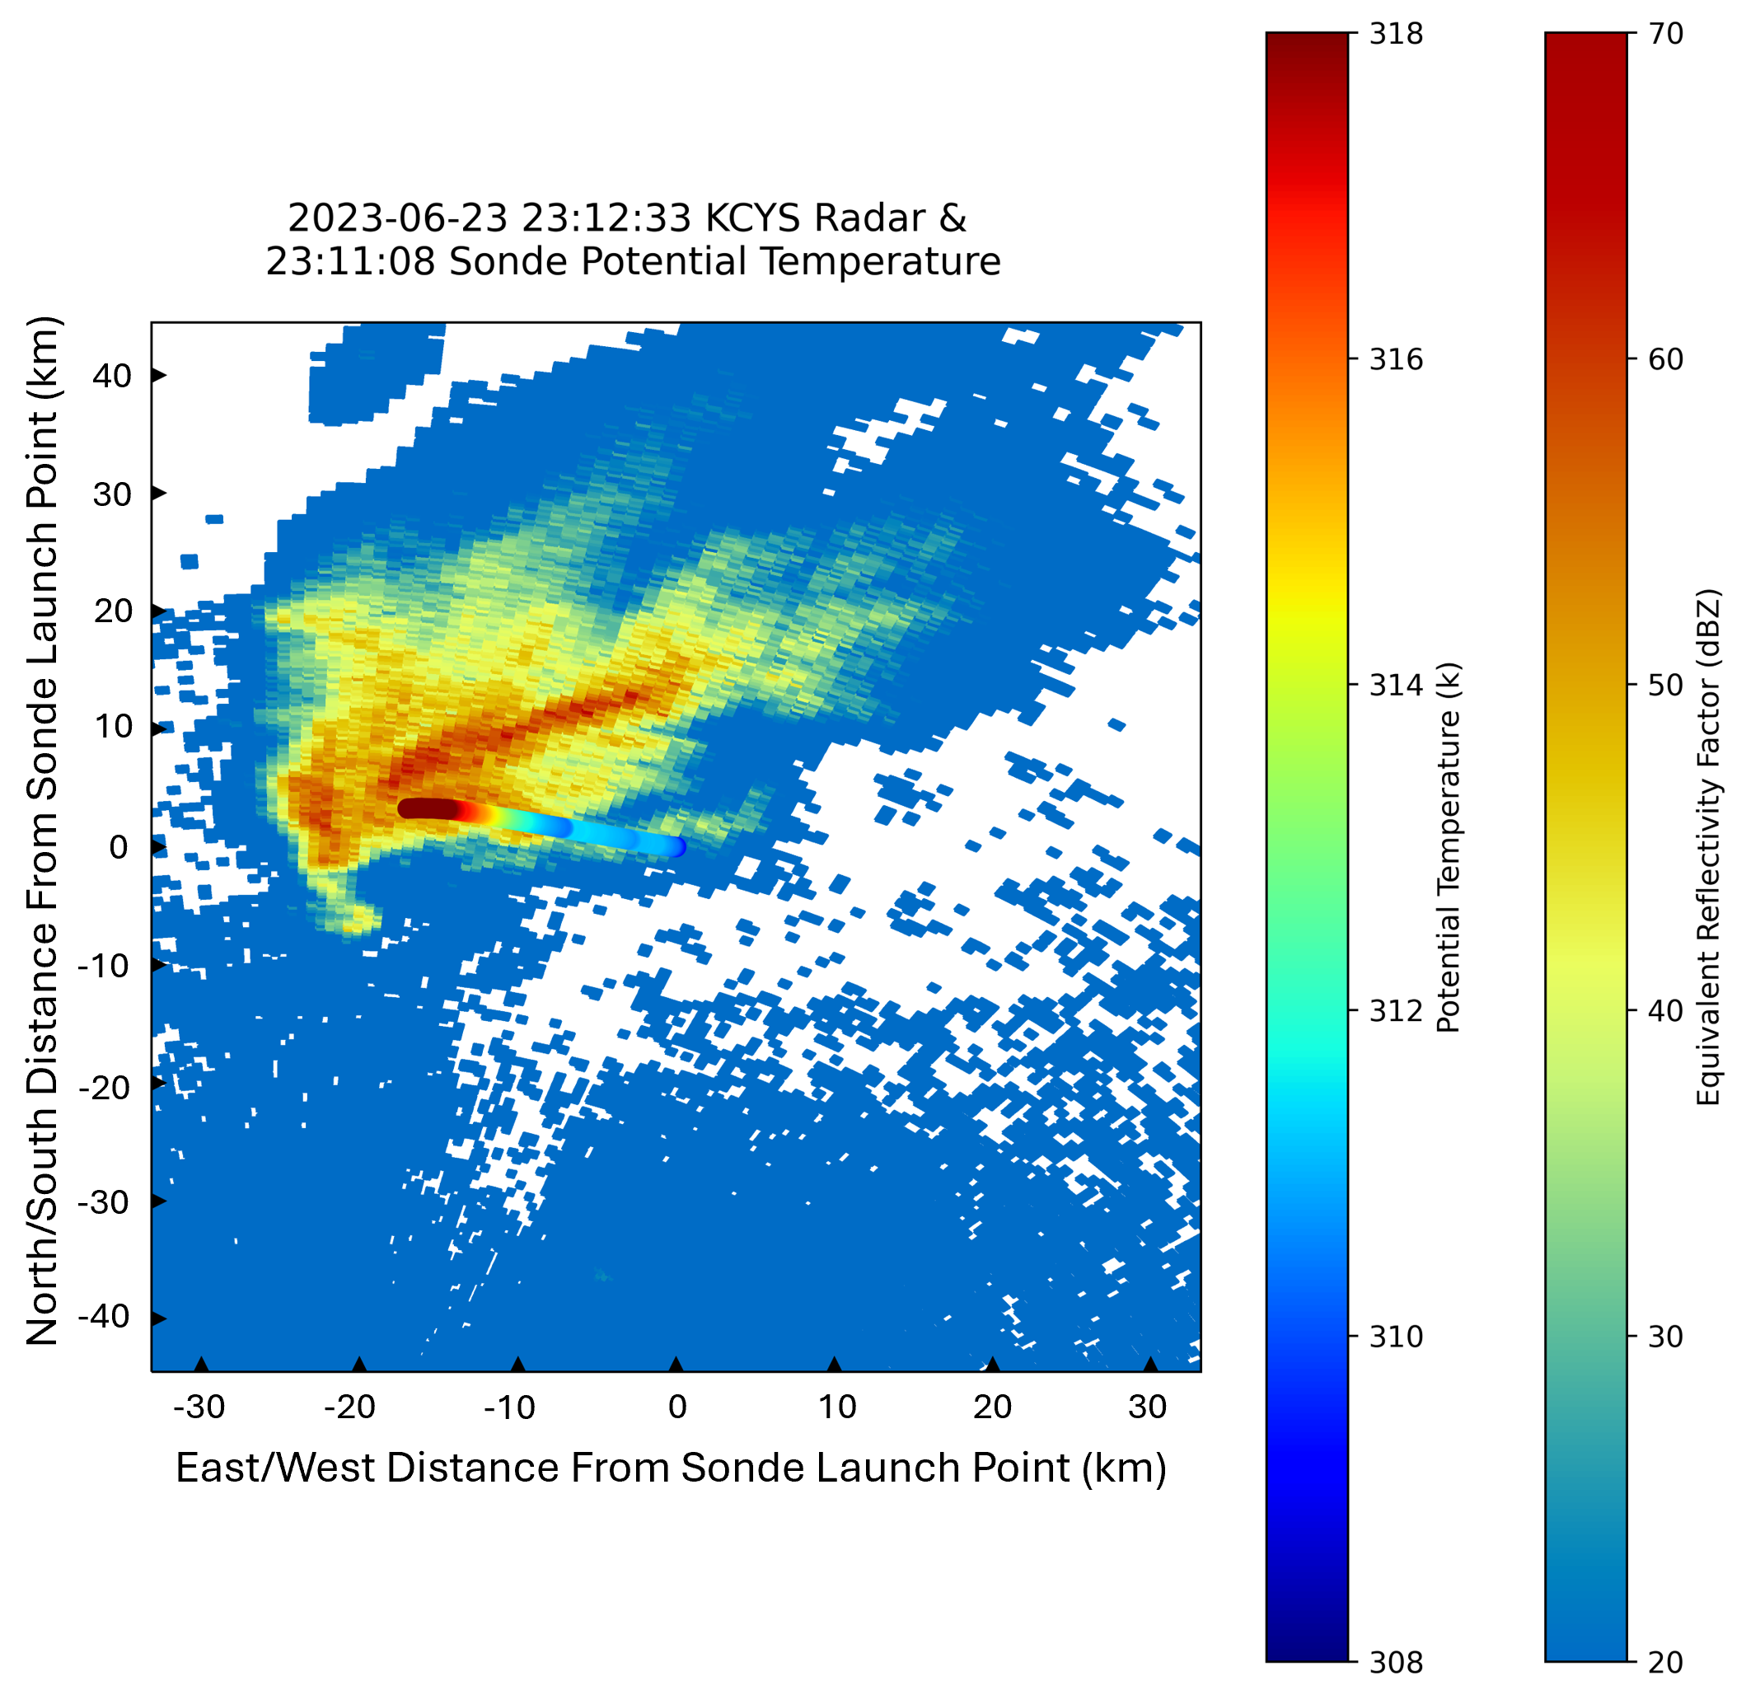
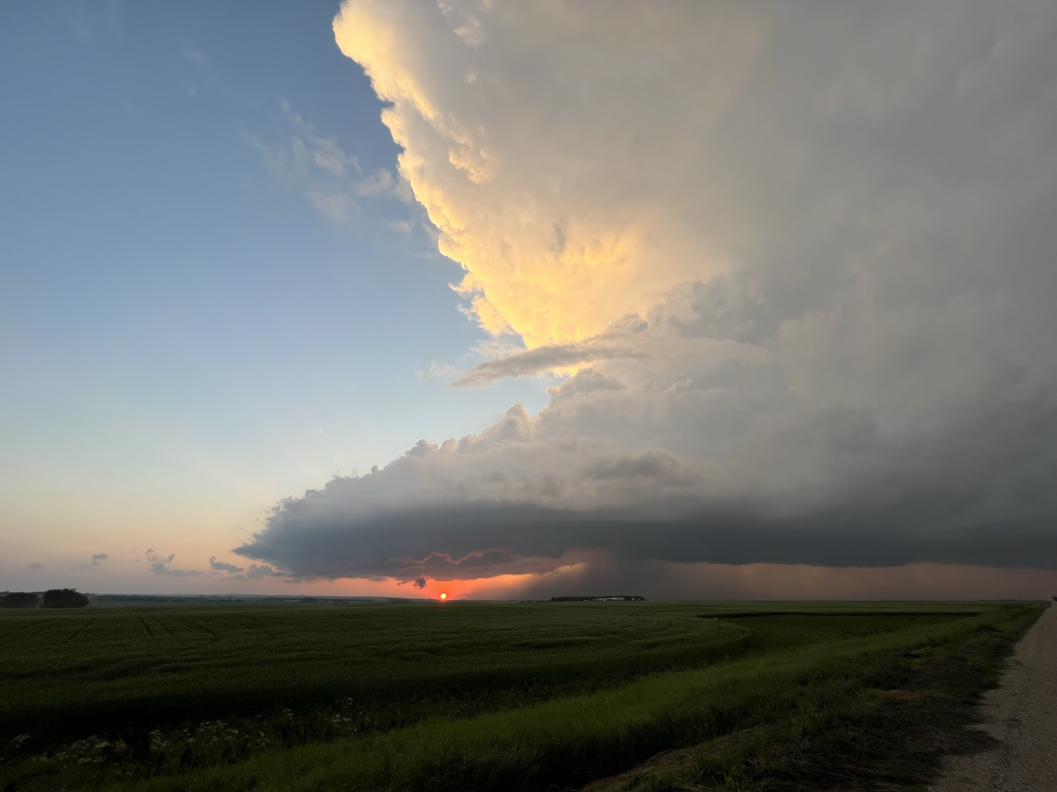
Analysis of Variation in Thermodynamic and Kinematic Properties within Supercell Inflow using Balloon-Borne Radiosondes
Nicholas Camp, Catherine Finley, Bruce Lee, Jake Mulholland, David Delene
University of North Dakota
Purpose
A large amount of research has been devoted to analysis of pre-storm environments in relation to severe hazards. However, much less work has been done investigating how supercells modify their environmental inflow. The recent studies that investigated tornadic versus non-tornadic supercell inflow environments showed conflicting results over changes in storm relative helicity (SRH) and anvil shading effects (Parker 2014; Wade et al 2018).
In the summer of 2023, a prototype project employing miniature radiosondes was undertaken to measure inflow at varying distances from the updrafts of a tornadic and non-tornadic supercell. This study aims to analyze how these two supercells modified their inflow environments as distance from the updraft decreased.
3. Tornadic Case Inflow Soundings
4. Non-Tornadic Case Preconvective and Inflow Soundings
2. Cases/Deployments
The goal for each case was to obtain a preconvective sounding followed by three soundings in the inflow of the supercell at 30 km, 20 km, and 10 km from the updraft.
Tornadic Case: Chugwater, WY – Scottsbluff, NE Supercell 06/23/23
No preconvective sounding
Obtained soundings at 28.93 km, 17.1 km, and 7.94 km from updraft
Additional sonde drifted into forward flank
2. Non-Tornadic Case: Sykeston, ND Supercell 07/18/23
Obtained preconvective sounding
Obtained soundings at 22.8 km and 11.37 km from updraft
Facing NW
5. Tornadic Case Forward Flank Sounding
7. Future Work
Facing NW
With field and analysis procedures established, a next step would be to markedly expand the number of cases to achieve statistical significance of the kinematic/thermodynamic changes if present.
References
Frame, J., and P. Markowski, 2010: Numerical Simulations of Radiative Cooling beneath the Anvils of Supercell Thunderstorms. Mon. Wea. Rev., 138, 3024–3047, https://doi.org/10.1175/2010MWR3177.1.
Helmus, J.J. and Collis, S.M., 2016: The Python ARM Radar Toolkit (Py-ART), a Library for Working with Weather Radar Data in the Python Programming Language. Journal of Open Research Software, 4, e25. DOI: http://doi.org/10.5334/jors.119
May, R. M., Goebbert, K. H., Thielen, J. E., Leeman, J. R., Camron, M. D., Bruick, Z., Bruning, E. C., Manser, R. P., Arms, S. C., and Marsh, P. T., 2022: MetPy: A Meteorological Python Library for Data Analysis and Visualization. Bull. Amer. Meteor. Soc., 103, E2273-E2284, https://doi.org/10.1175/BAMS-D-21-0125.1.
Parker, M. D., 2014: Composite VORTEX2 Supercell Environments from Near-Storm Soundings. Mon. Wea. Rev., 142, 508–529, https://doi.org/10.1175/MWR-D-13-00167.1
Wade, A. R., M. C. Coniglio, and C. L. Ziegler, 2018: Comparison of Near- and Far-Field Supercell Inflow Environments Using Radiosonde Observations. Mon. Wea. Rev., 146, 2403–2415, https://doi.org/10.1175/MWR-D-17-0276.1.
6. Conclusions
Tornadic case inflow features large elongation and reorientation of both the 0-500 m and 0-1 km shear vectors resulting in an increase in SRH (non-tornadic doesn’t).
Tornadic case inflow soundings show noticeable near-surface inversion, potentially a sign of radiative cooling due to anvil shading (Frame and Markowski 2010).
Tornadic case inflow thermodynamics profiles begin to follow adiabats in final two soundings, likely linked to updraft width/strength.
Acknowledgements
Funding for field operations was provided by a North Dakota Space Grant Consortium NASA mini-grant.

