Slide 1




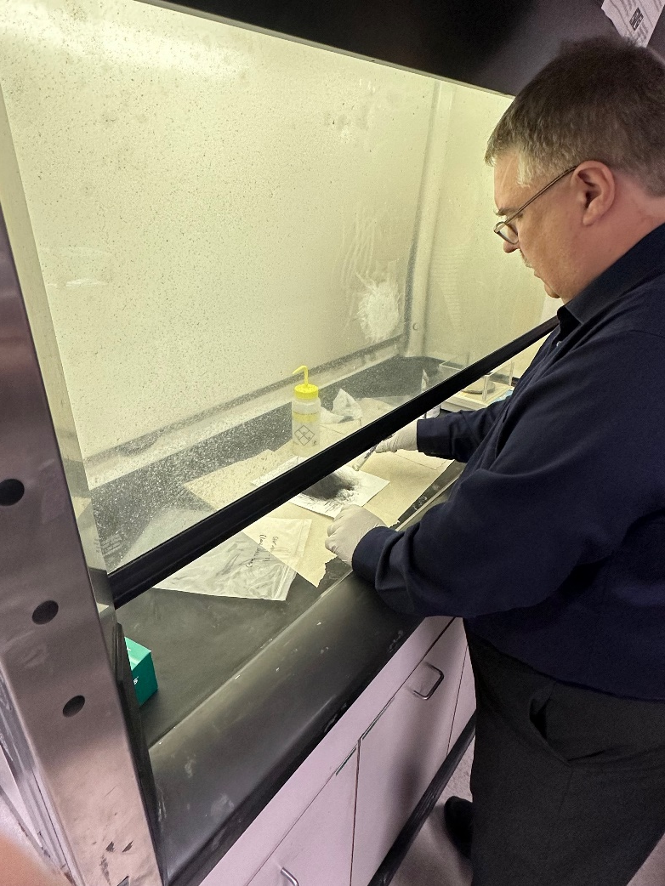
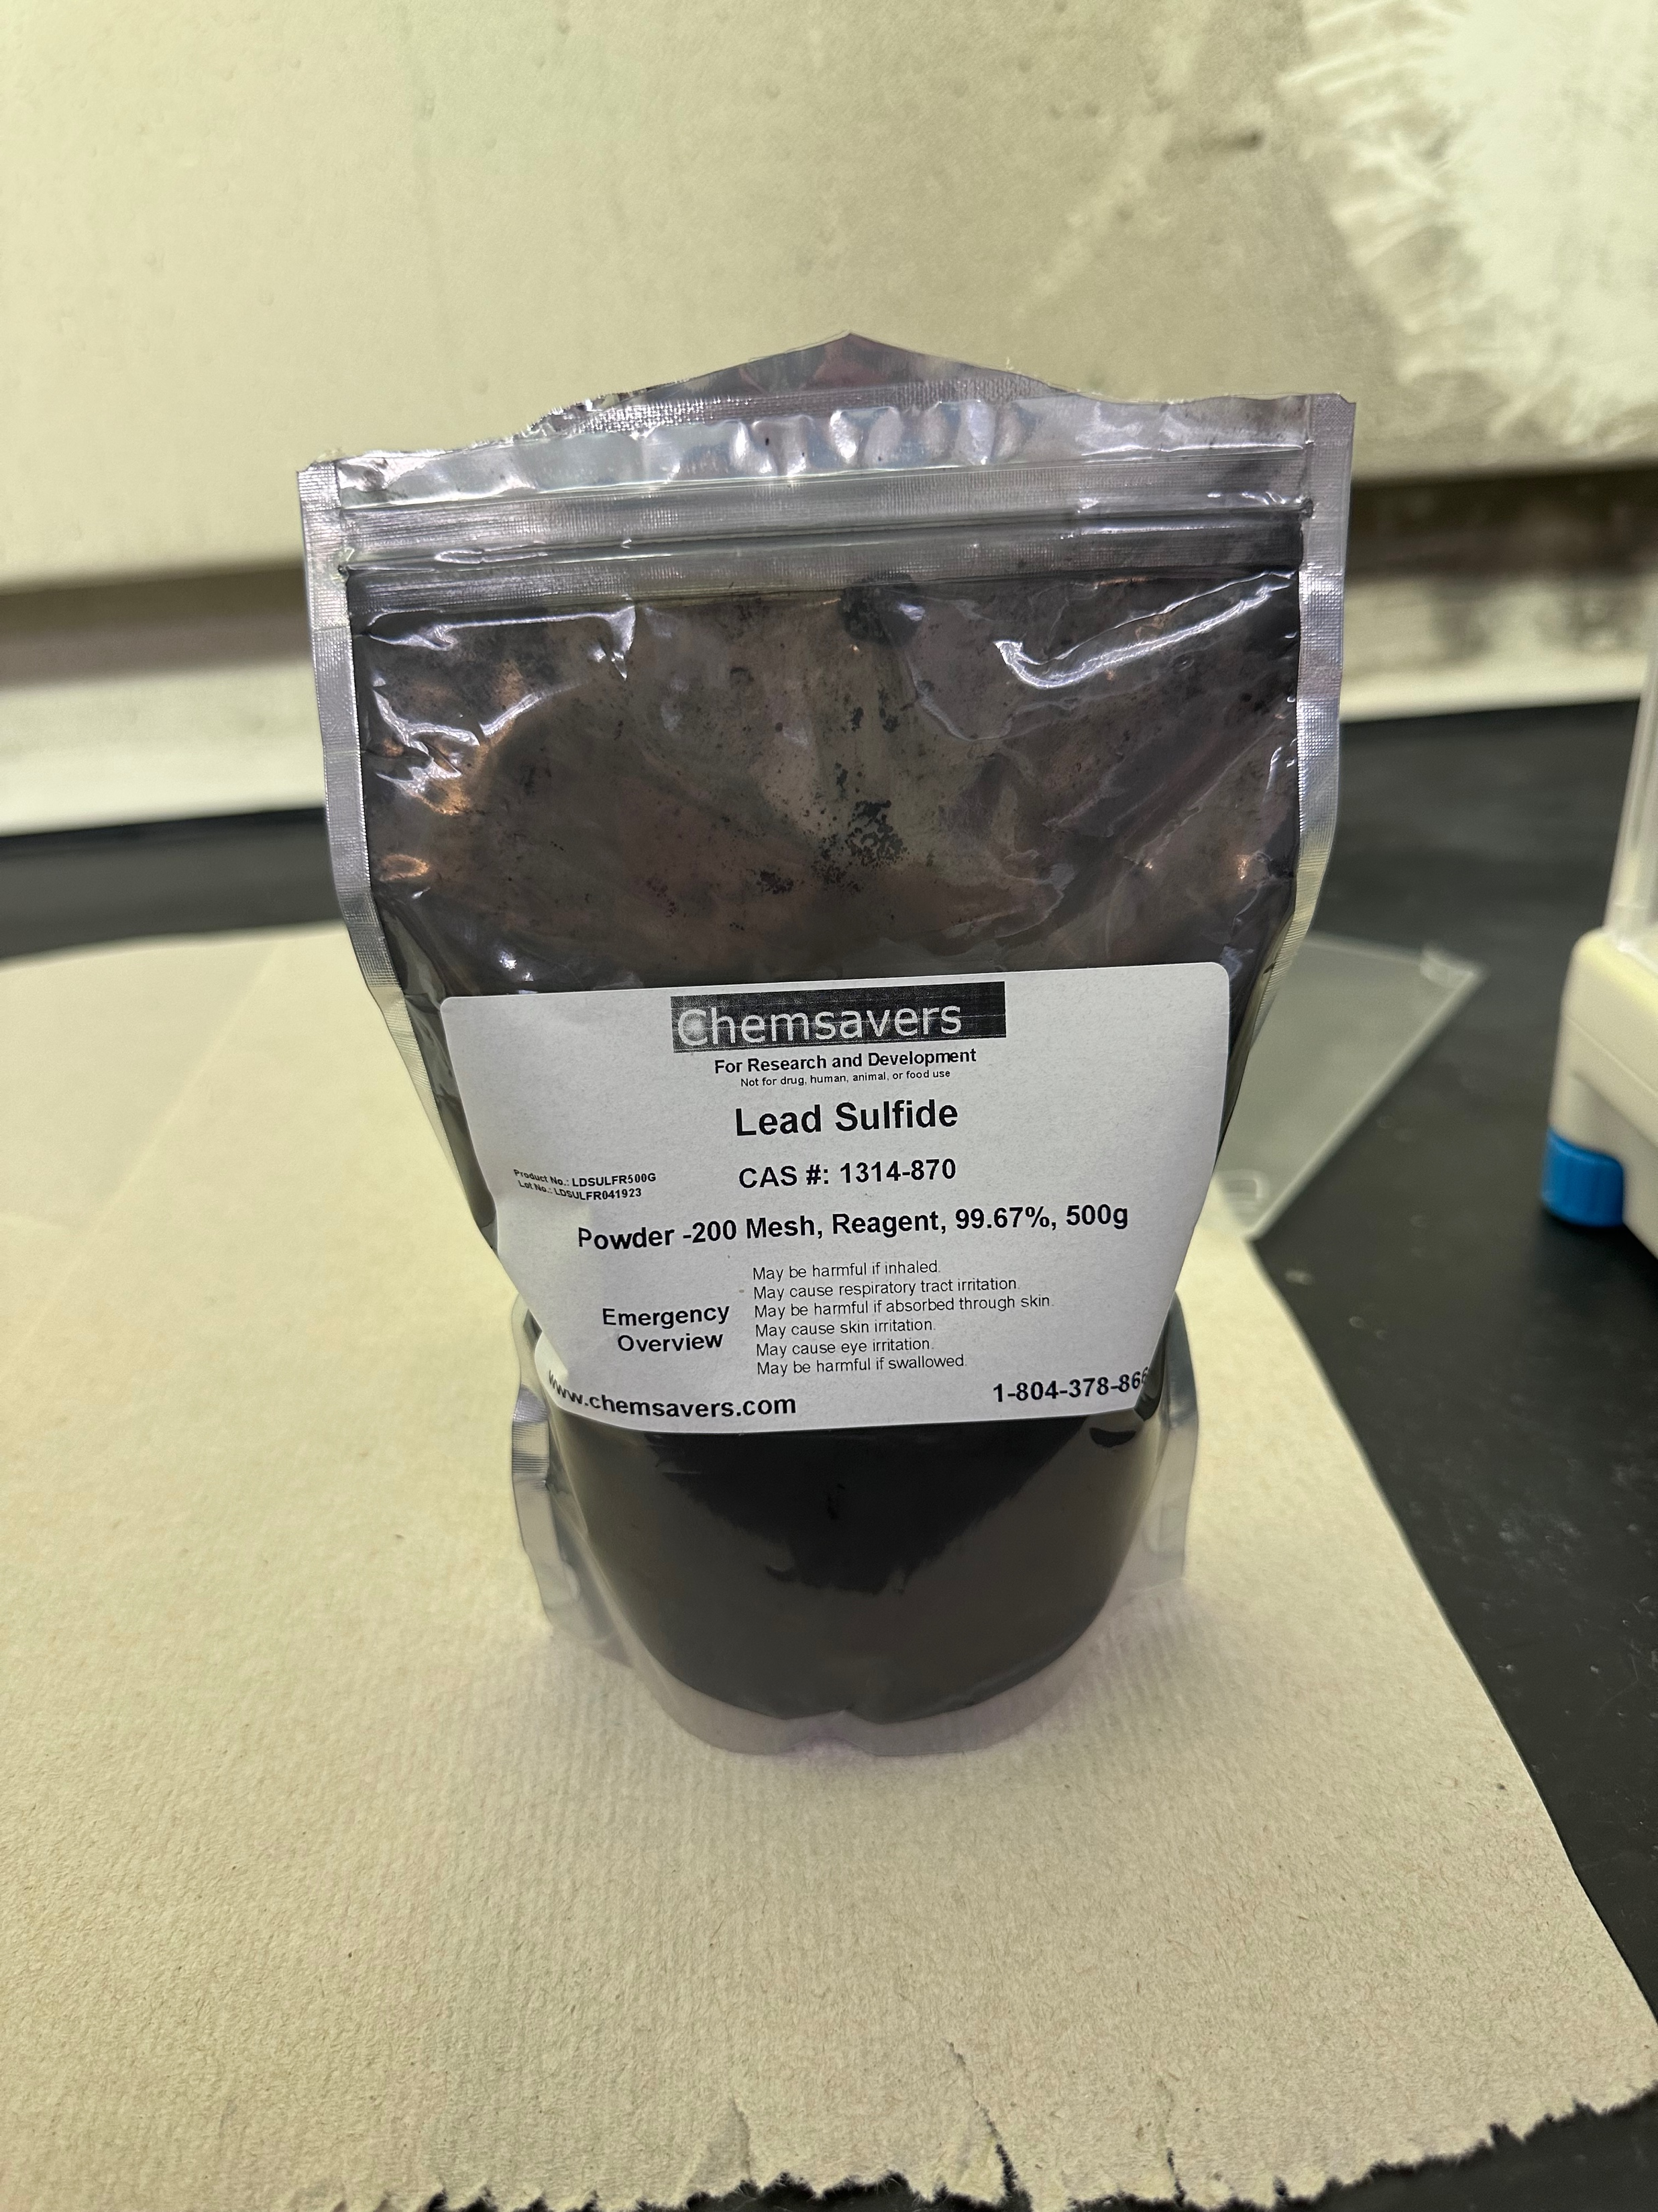
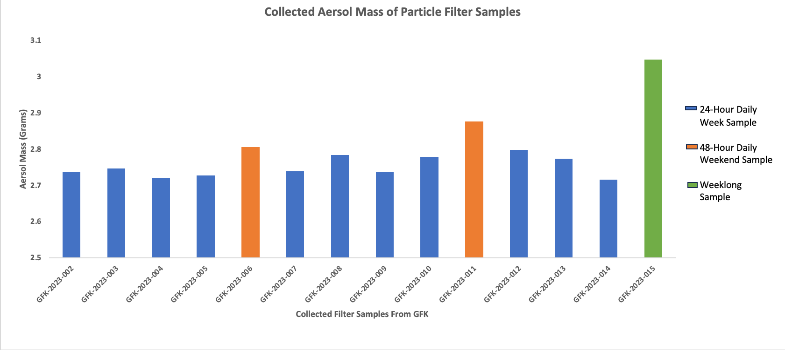
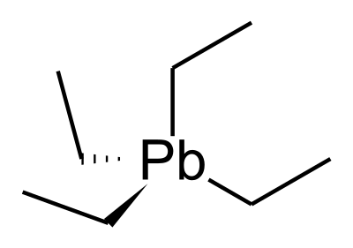
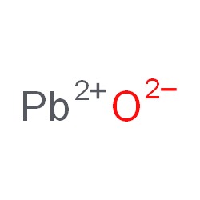
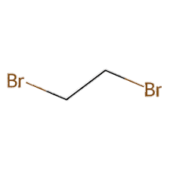
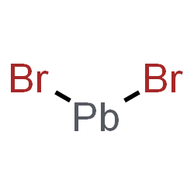
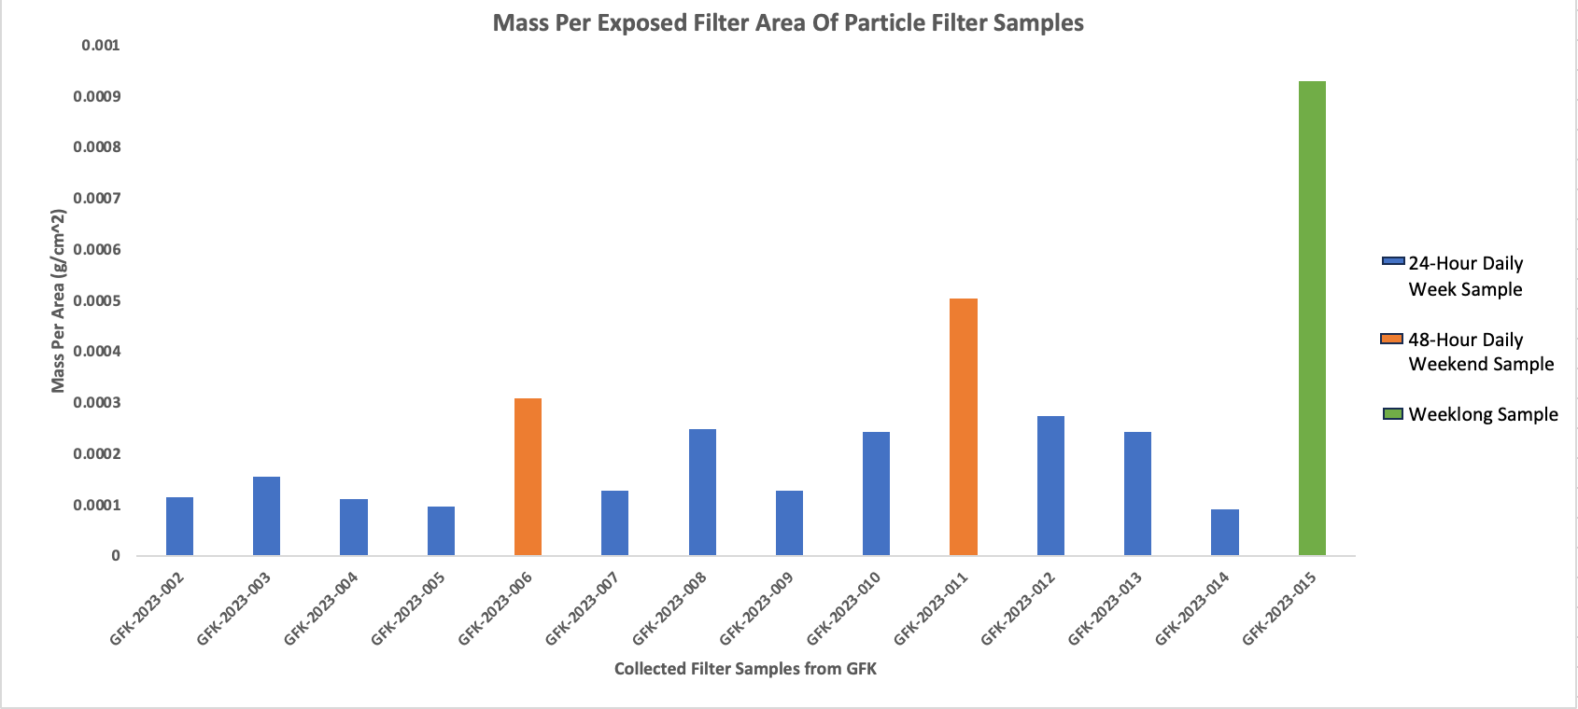
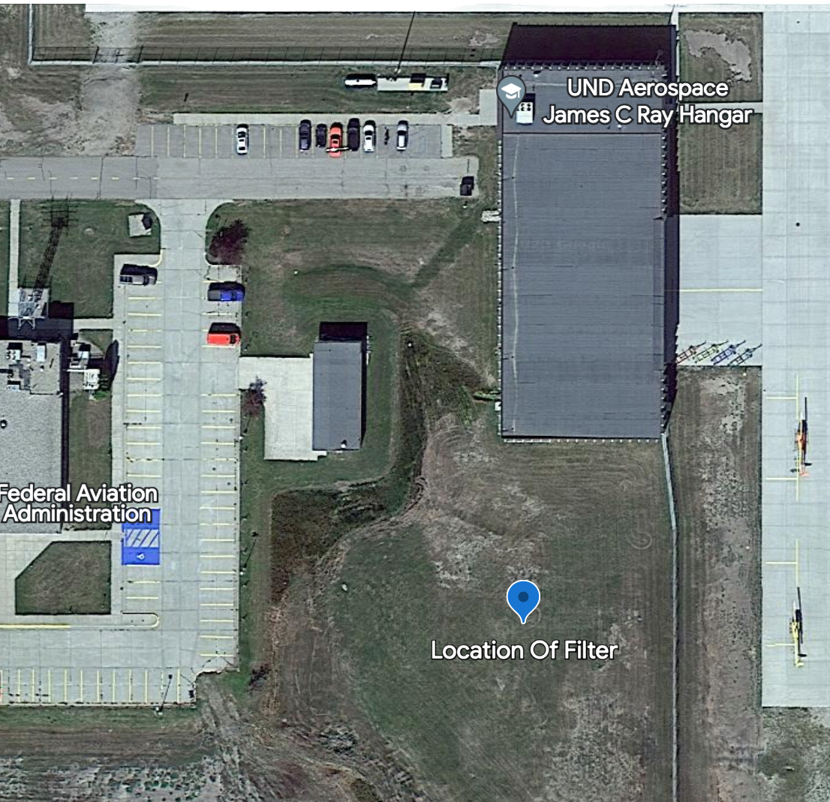
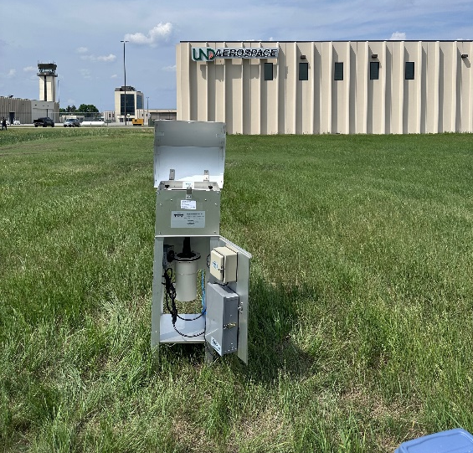
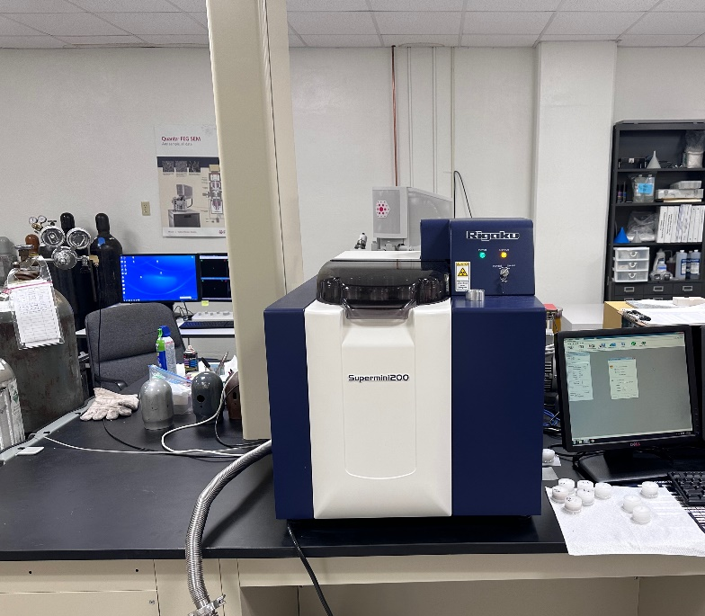
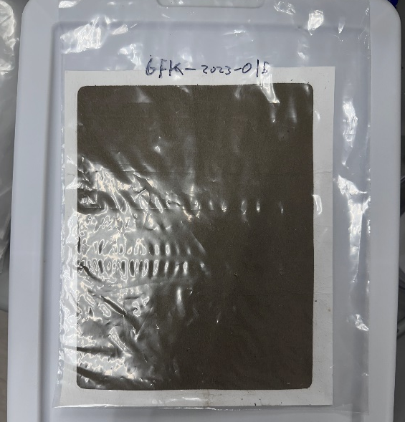
Measured Atmospheric Change In Lead Particulate Matter From UL94 Fuel Switch by Major Aerospace College
Alex Mendez and David Delene
Abstract
General aviation commonly uses 100 Low Leaded Octane Rated Fuel (LL100) to power piston-powered engine aircrafts. LL100 contains the additive tetra-ethyl lead to increase the fuel’s octane rating and prevents spontaneous combustion. Burning tetra-ethyl lead containing fuels releases lead (Pb) that is a toxic metal which accumulates in the blood and impacts human health. New aircraft can safely operate using unleaded fuel with 94 and 100 octane ratings (UL94 and UL100). The Aerospace College at the University of North Dakota switch their entire aircraft fleet to UL94 during June of 2023. The research objective is to obtain lead particulate matter measurements before and after the switch from LL100 to UL94. A high-volume filter sampler is deployed to collect daily and weekly samples on 8x10 inch filters at the Grand Forks airport . Daily and weekly filter samples were post and pre weighed using a high precision scale. X-Ray Fluorescence (XRF) is used to analysis the elemental composition of each filter sample. XRF sample analysis detected zero, or very small, amount of lead compared to the filter material. A filter loaded with a large amount of lead sulfide (Pb-S) confirmed XRF’s detection of lead on filters. Discussion with the XRF manufacturer indicated that there is not enough particular matter mass on the collected filters for elemental qualification using the energy dispersion XRF detector method employed and suggested testing the collected filter samples using a wavelength dispersion XRF. Additionally, a high and low mass filter are being analyzed using Inductively Coupled Plasma Mass Spectrometer ICP-MS to determine if the method can be used to quality lead amount on the 2023 collect filters.
Objective
Observe lead particulate matter measurements before and after the switch from Low Lead 100 Octane Rated Aviation Fuel (LL100) to Unleaded 94 Octane Rated Aviation Fuel (UL94).
Gain quantification of the amount of lead pollutants within local, airport environment in order to begin discussion on unleaded fuel adaption in general aviation.
Lead Sulfide Experiment
.
Results
Background
As LL100 fuel burns, TEL naturally degrades to lead oxide which increases the octane rating.
Deposits are formed due to lead oxides high melting point; these deposits are electrically conductive and is corrosive.
To prevent deposits forming, ethylene dibromide is used to react with lead oxide to form lead bromide which is a more volatile and a gas around a lower temperature to ensure that lead will be fully exhausted from the engine. (Refer to the figure below).
Exhausted gas cools to the solid phase in the atmosphere where the lead exists/evolves into different leaded compounds and ions.
Leaded compounds travel long distances in the air before going into the soil and possibly groundwater.
Exposure to these lead sources will lead to disruptions of tightly regulated processes due to lead stronger a binding affinity compared to these metal ions (Ca2+, Mg, Zn, Fe, et…) which are known to be involved within functions in biological systems.
Experiment with filter loaded with a large amount of lead sulfide (Pb-S). 3.14 grams of lead sulfide (Pb-S) was used. XRF confirmed detection of high amount of lead on filter.
Conclusion
Detected lead on daily samples, but at a very low amount to none.
Based off results and discussion with XRF manufacture. Lead sulfide experiment was performed to determine if XRF was effective in detecting lead. Test was successful.
Based off low concentrations of lead in daily airport samples and lead sulfide experiment. Decided to start running week-long samples beginning on the transition period (June 23rd).
Future Work:
Perform analysis on high and low mass filter using Inductively Coupled Plasma Mass Spectrometer (ICP-MS) to determine if the method can be used to quality lead amount on the 2023 collect filters.
Perform XRF for upcoming week-long samples.
Tetra-ethyl-Lead (TEL)
Lead oxide
Ethylene Dibromide
Lead (ll) Bromide
Methods
Collected daily and week-long samples.
Average aerosol mass for each daily sample was 2.78 grams.
Weights of each sample are affected by factors such as the day of the week, the weather on that day. Which is why weather data was tracked for each day throughout the summer. Recorded data compromised of temperature, winds, visibility, weather for each day.
XRF sample analysis detected lead on June 13th at a very small amount, 1/10 lower than expected from the literature.
Discussion with XRF manufacture indicated that there is not enough particulate matter mass on collected daily filter samples.
Decided to start running week-long samples beginning on the transition period (June 23rd).
Acknowledgments
We would like to acknowledge support form the National Science Foundation (NSF) under the IREC REU program CHE-2244530. Any opinions, findings, and conclusions or recommendations expressed in this material are those of the author(s) and do not necessarily reflect the views of the NSF.
UND Aerospace general aviation airport was chosen for the location of high-volume sampler. Daily and weekly samples were collected.
8” x 10” glass fiber filter daily and weekly samples were collected. Glass fiber samples were pre and post weighed. X-Ray Fluorescence (XRF) was used to analyze the elemental composition of each filter sample.
References
U.S. EPA. Integrated Science Assessment (ISA) for Lead (Final Report, Jul 2013). U.S. Environmental Protection Agency, Washington, DC, EPA/600/R-10/075F, 2013
U.S. EPA. Air Quality Criteria For Lead (Final Report, 2006). U.S. Environmental Protection Agency, Washington, DC, EPA/600/R-05/144aF-bF, 2006.
=

